Slide 1
The Presidency
Homophones and Subject Verb Agreement
Notes:
Today we will be reviewing homophones, subject verb agreement, and vocabulary. We will end by discussing details from this week's passage.

Slide 2

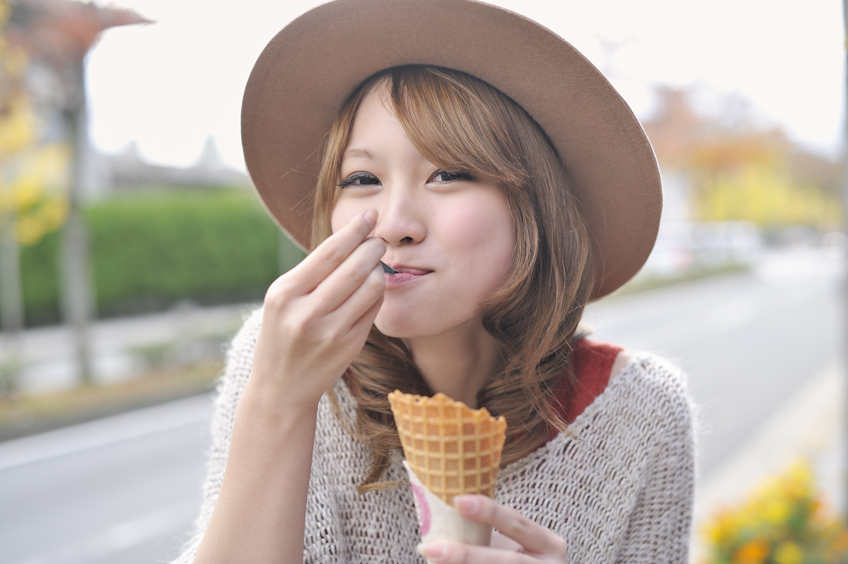
What Is a Homophone?
eight ate
Homophones sound alike but are spelled differently.
Notes:
Say: This week our Spelling words include some homophones. What exactly is a homophone? (Allow a student to answer and click to show definition.)
A homophone is a set of words that sound alike but are spelled differently. The words also have different meanings. Let’s look at an example. (Click to show the words eight and ate and have a student read them.)
These words sound the same, however they are spelled differently and have different meanings. (Click to show 8 and ate pictures.)
The first one is the number 8, and the second one is the past tense of eat, like you just ate dinner.

Slide 3

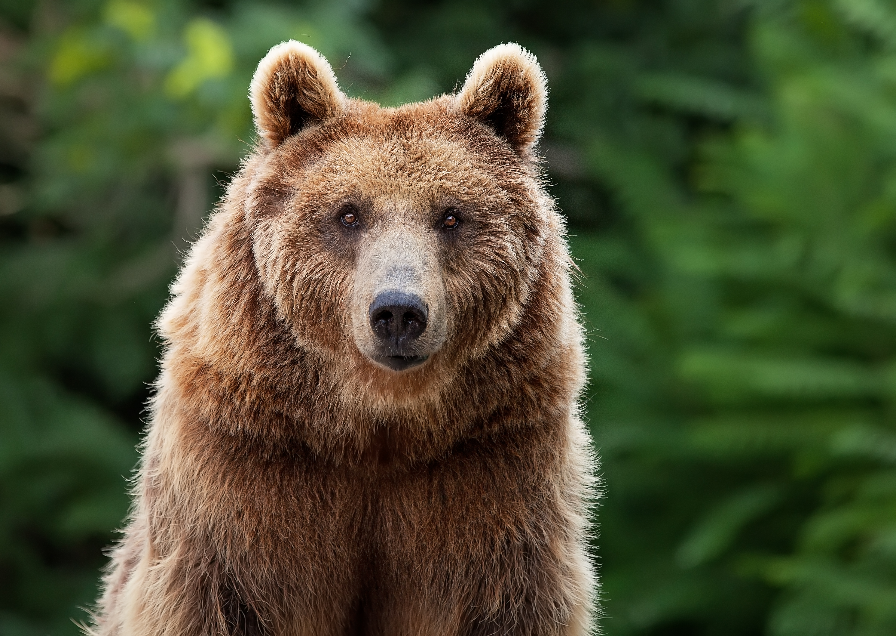
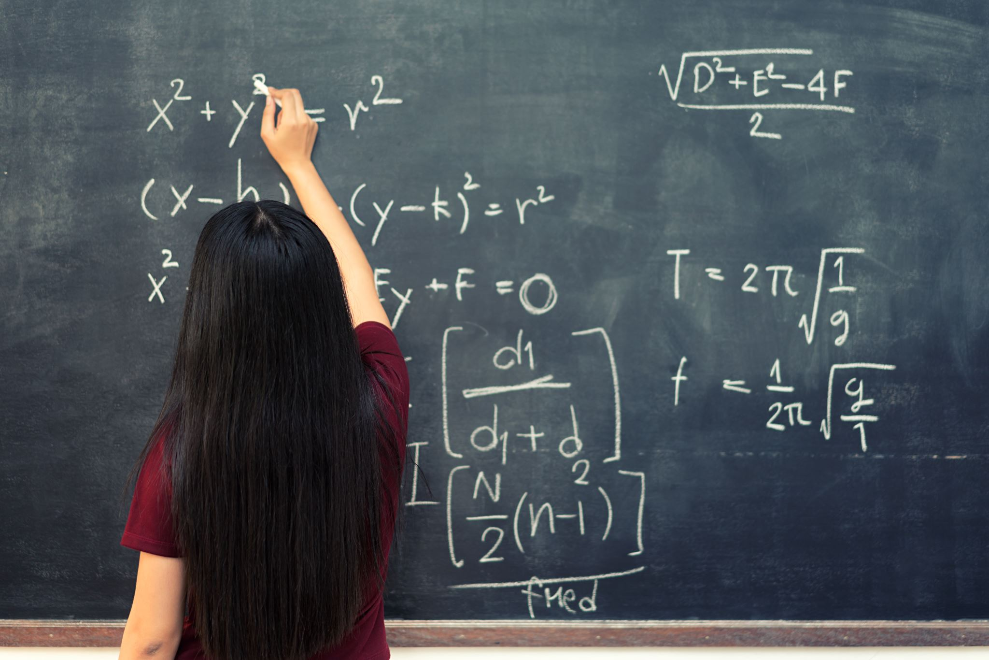
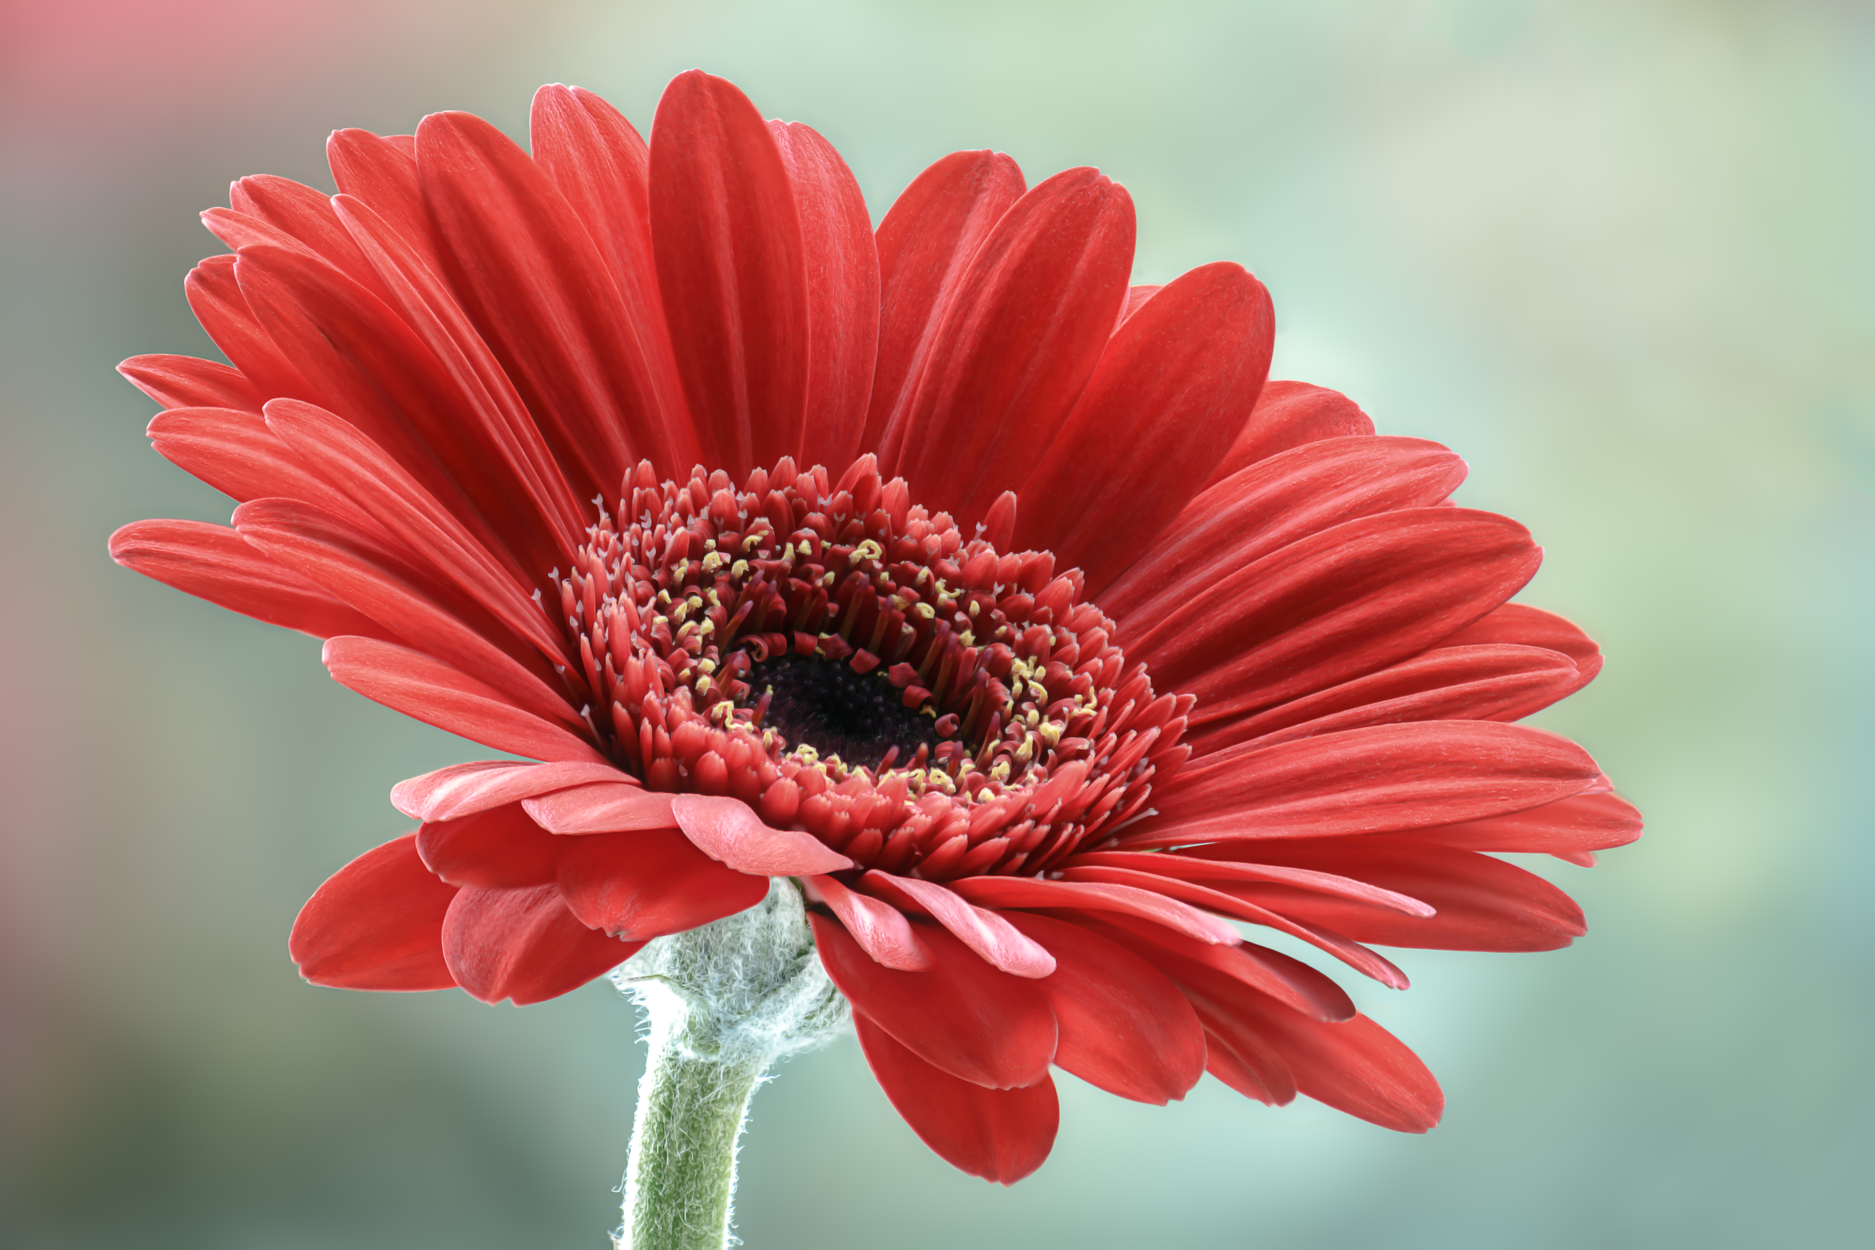

Help Find the Correct Homophone
bear bare
flower flour
be bee
bored board
plain plane
Notes:
Say: I will show you a picture and a set of words. Please tell me the correct homophone that matches the picture. Here is the first one (click to show the picture of the bee and the words be, bee).
Which word is correct? (Give the students a moment to answer, then click to show the word bee circled. Repeat with remaining words.
2. plain, plane
3. bored, board
4. bear, bare
5. flower, flour

Slide 4
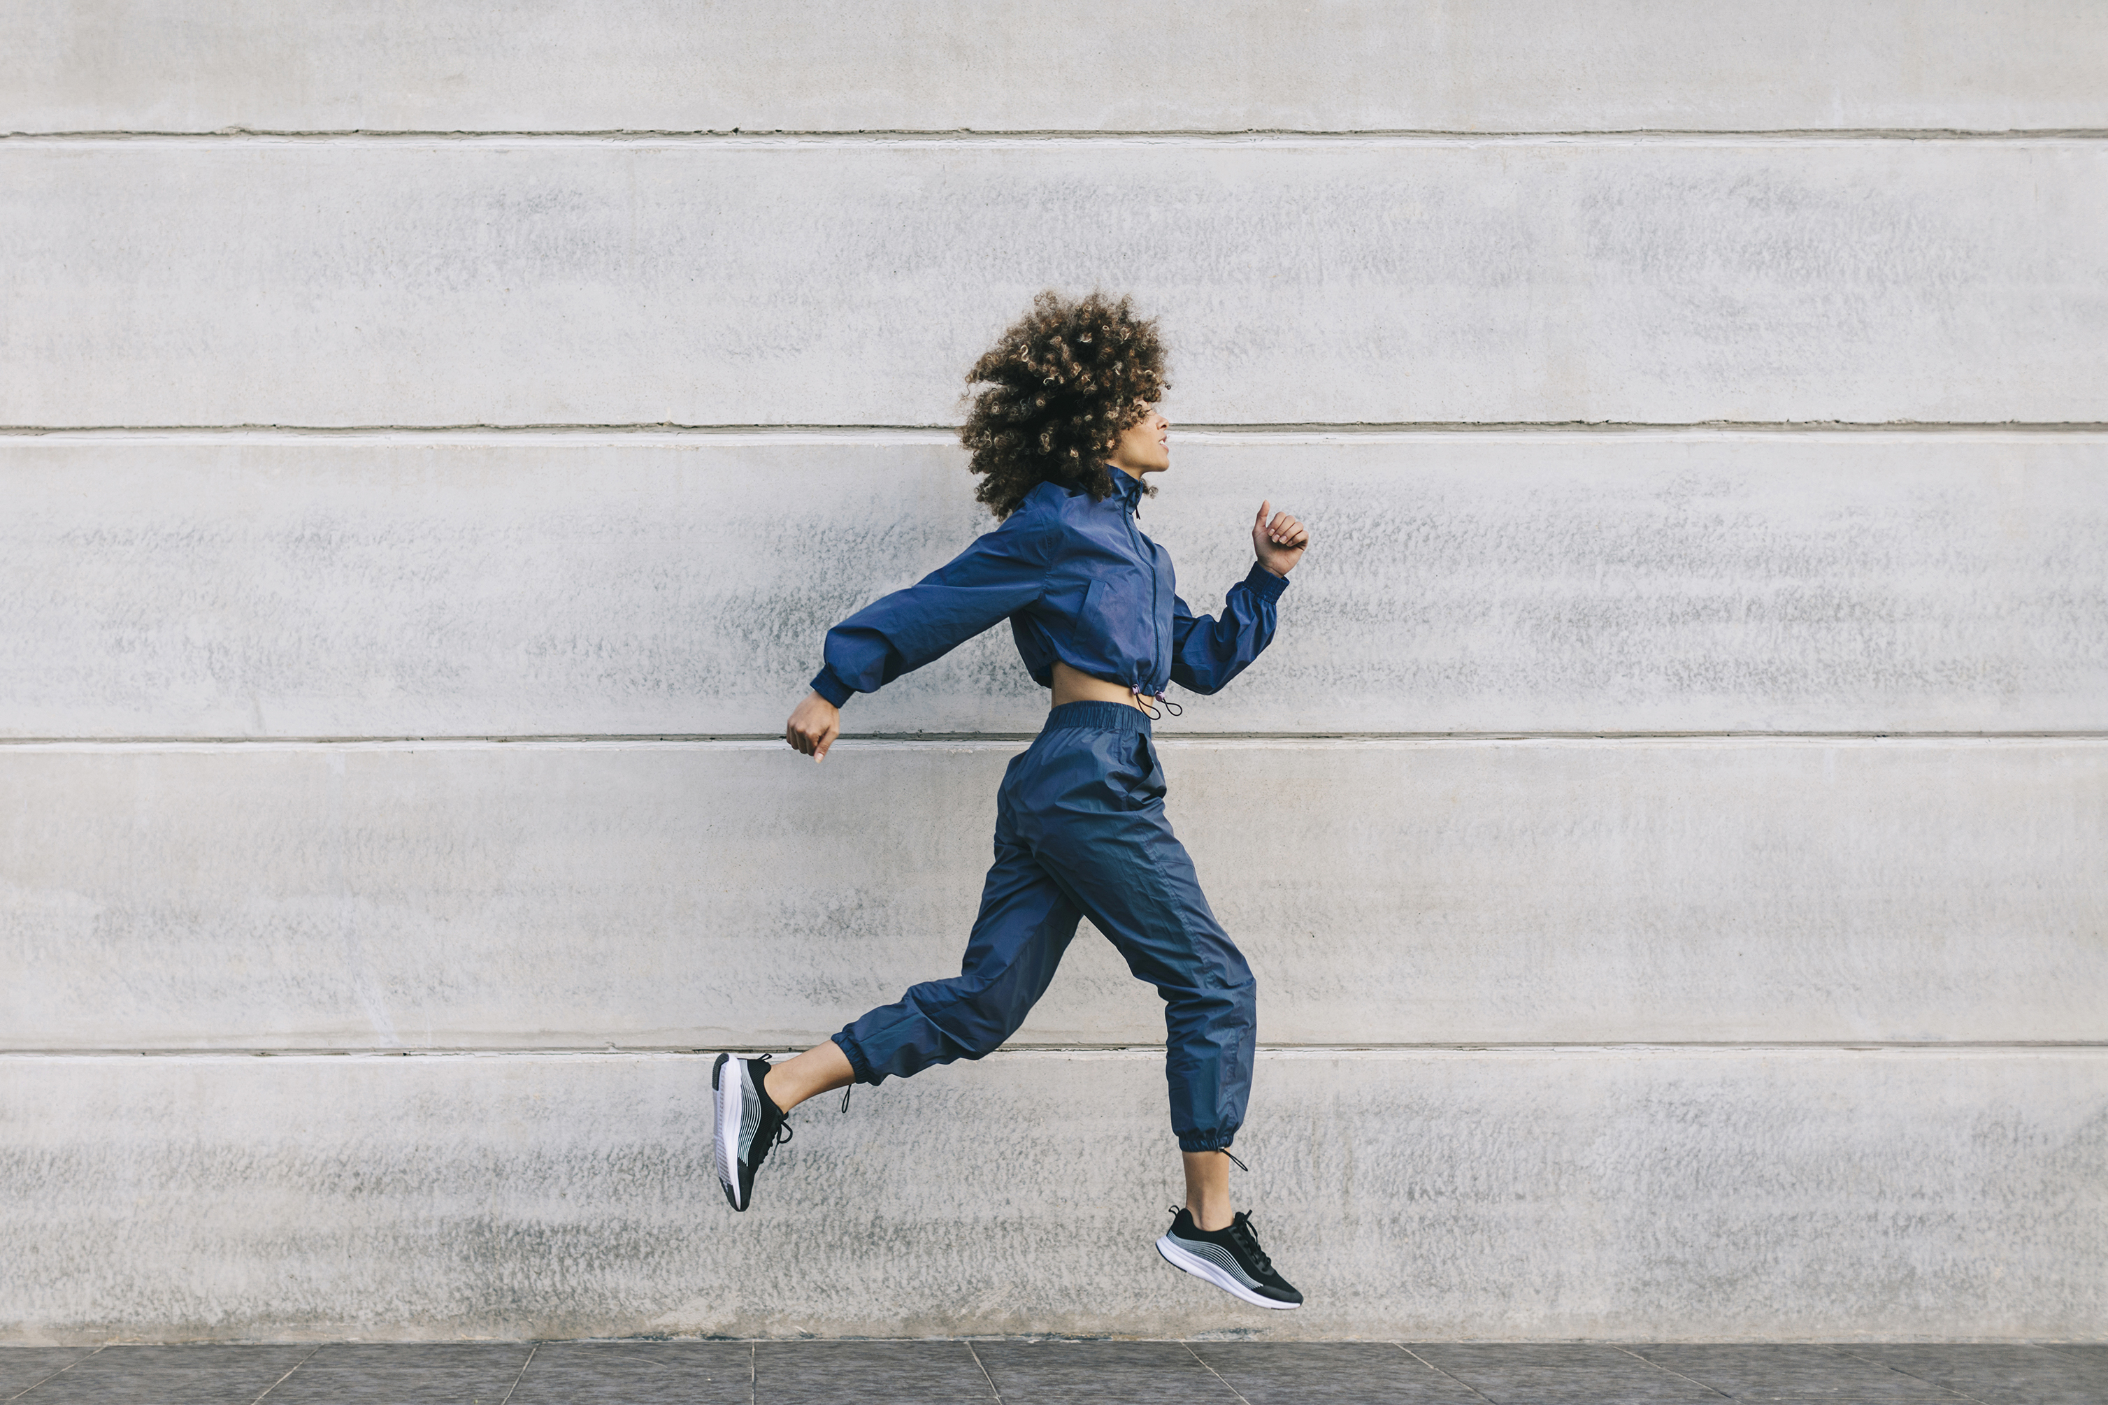
Subject and Verb Agreement
The girl run fast.
The girl runs fast.
The girls runs fast.
The girls run fast.
Notes:
Say: This week we are learning about subject verb agreement. In a sentence, the subject and verb must agree, or the sentence won’t be correct. For example, let’s look at this sentence (click to show the sentence).
“The girl run fast.” Is this sentence correct? (Allow the students to answer-no.)
The subject and verb don’t match in this sentence. We would need to write “The girl runs fast.” (Click to show corrected sentence.)
Now let’s make the subject plural. (Click to show sentence.)
“The girls runs fast.” Is this sentence correct? (Allow the students to answer-no.)
The subject and verb don’t match in this sentence. We would need to write “The girls run fast.” (Click to show corrected sentence.)
Let’s practice on the next slide!

Slide 5
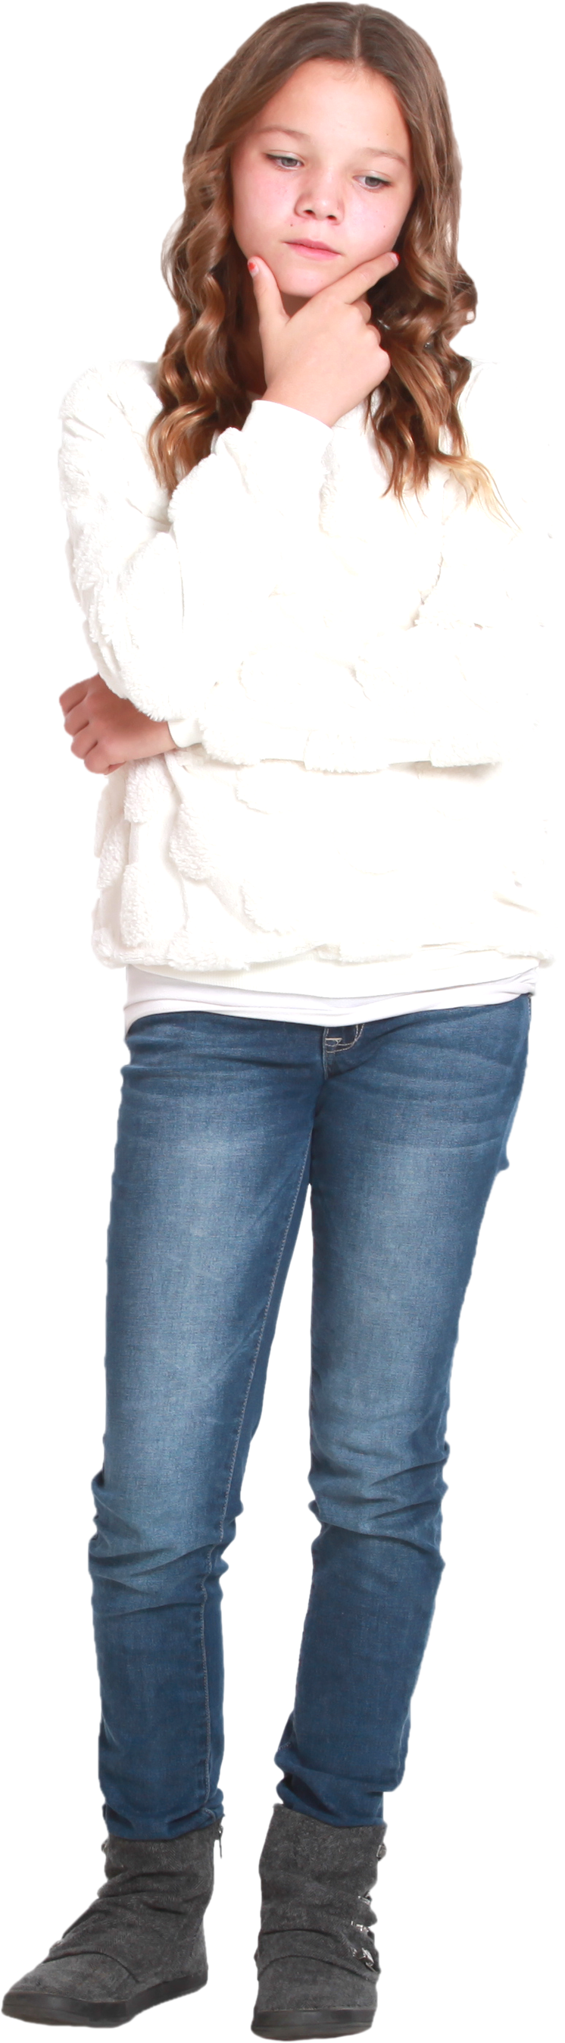
Do We Agree?
He sing in the chorus.
They clean the park.
My friends likes pizza.
The dog spin in excitement.
She swims very well.
The dog spins in excitement.
The dogs spin in excitement.
He sings in the chorus.
They sing in the chorus.
My friends like pizza.
My friend likes pizza.
Notes:
Say: Help Marissa decide if the subject and verb agree. If they don’t agree, please say how to correct the sentence. Here is the first one. (Click to show the first sentence. Give the students a moment to answer. If the sentence is incorrect, they can either change the subject or the verb to make it correct. Click to show the corrections. Repeat for the remaining sentences.
1. The dog spin in excitement- incorrect, change to “the dog spins” or “the dogs spin”
2. My friends likes pizza.-incorrect, change to “My friends like” or “My friend likes”
3. She swims very well!- correct
4. They clean the park.-correct
5. He sing in the chorus. –incorrect, change to “He sings” or “They sing”)

Slide 6
Presidential Vocabulary
word bank
unite
nation
leadership
globe
wisdom
symbol
to put or come together to form a single unit
a large area of land controlled by its own government
A round object as a model of the earth.
a wise attitude, belief, or course of action
the ability to be in charge or in control
something that stands for something else
Notes:
Say: Let’s review our vocabulary words for the week. When I show you the definition, please tell me the word on the slide that matches. Here is an example. (Click to show- the ability to be in charge or in control. Read it to the student.)
Which word matches this definition? (Student should say “leadership”. Click to show the answer disappear. Repeat the process with the remaining words.
2. unite- to put or come together to form a single unit
3. nation- a large area of land controlled by its own government
4. globe- a round object as a model of the Earth
5. wisdom- a wise attitude, belief, or course of action
6. symbol- something that stands for something else)

Slide 7
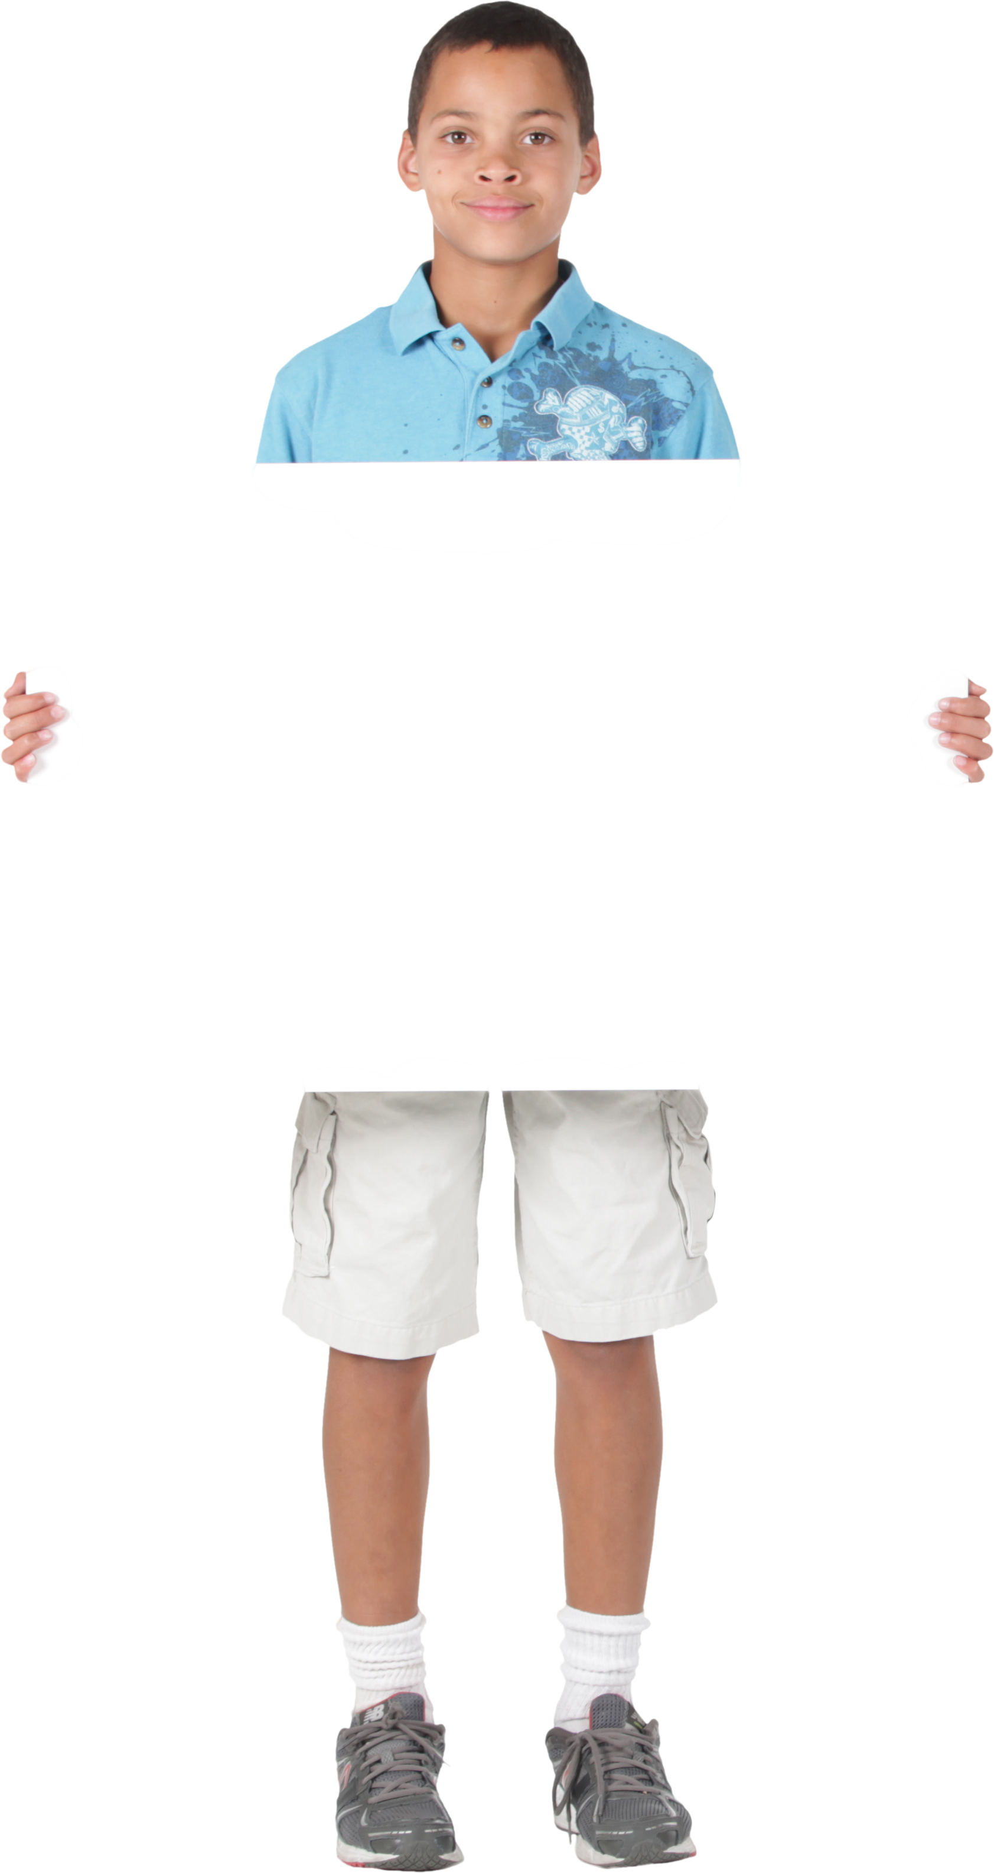
Making Sentences
nation
leadership
wisdom
symbol
unite
globe
Notes:
Say: Let’s practice using our vocabulary words in a sentence. Ethan will hold the word up for you, please use it in a sentence for me. Here is an example. (Click to show the word globe.)
Globe. Sarah found Bolivia on the globe in school. Can you please give me a sentence for the word leadership? (Click to show the word.)
(Repeat process for remaining words- click to show each one. If a student struggles, review the meaning of the word on the previous slide.
3. nation
4. symbol
5. unite
6. wisdom)

Slide 8




The President’s Many Hats
The President has many different roles to carry out.
Notes:
Say: Do you remember the main idea from our story this week? (Give the students a moment to answer then click to show “The President has many different jobs”)
Good! The main idea of this story is that the President has many different jobs, or roles to carry out. Please give me three details from the story that support the main idea. (Click to show three hats appear. Answers will vary. Students can talk about the different roles the president has. Ex: Chief Executive, choosing members of the cabinet, Chief of State, giving out the Medal of Honor, Commander in Chief, in charge of the military, Chief Diplomat, legislative leader and party leader)

Slide 9
Q & A
Any Questions?

