Slide 1
Jobs in the Community
Constructing Words and Subject/Predicate
Notes:
Say: Today we will be learning about oi and oy spellings, subject and predicate, review vocabulary, and discuss the main idea and details from the story we read this week about community helpers.

Slide 2
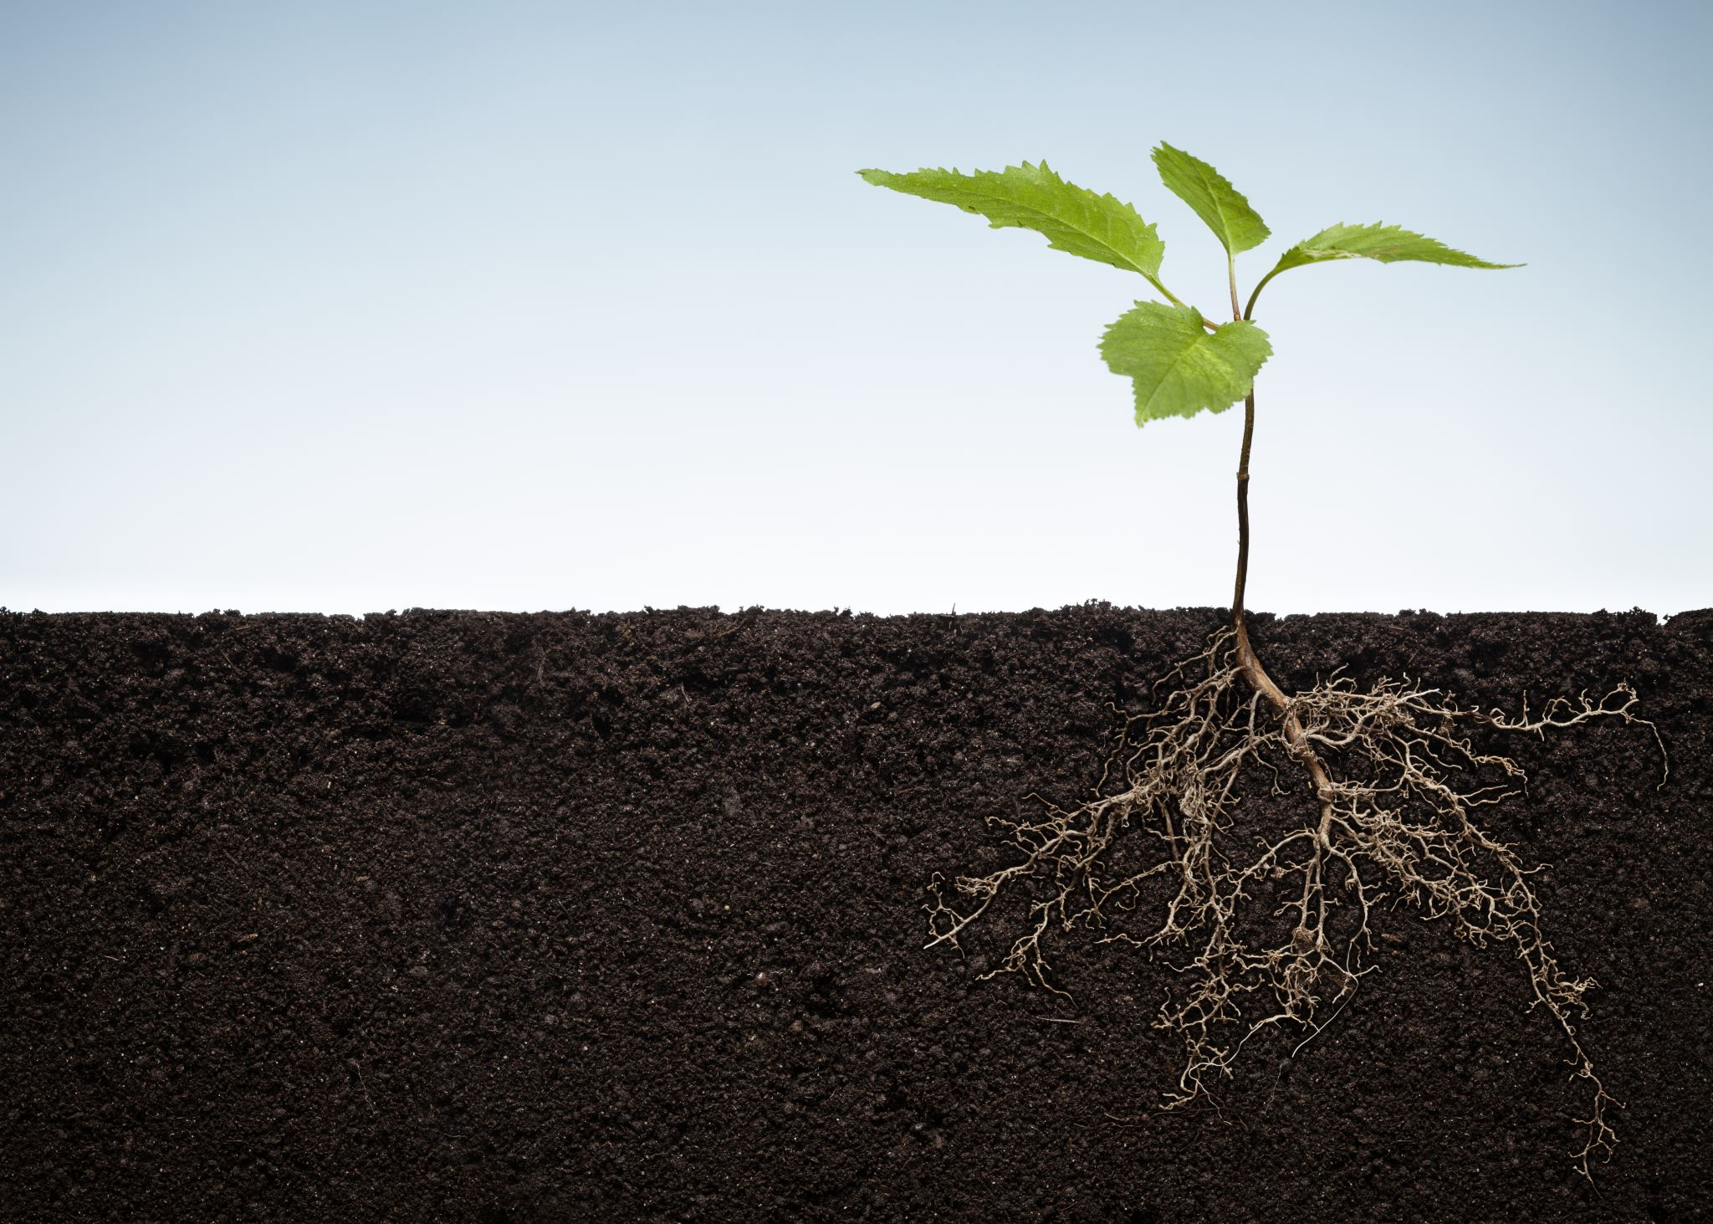
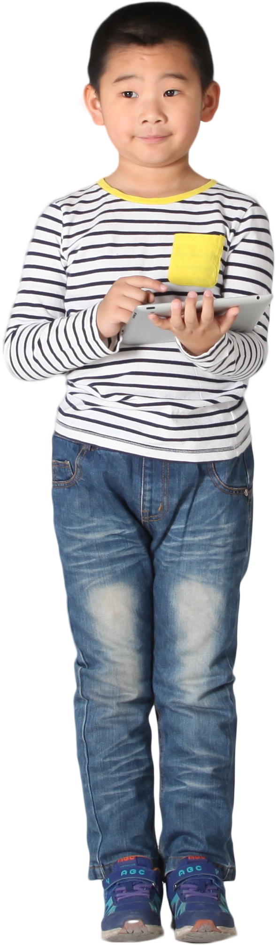
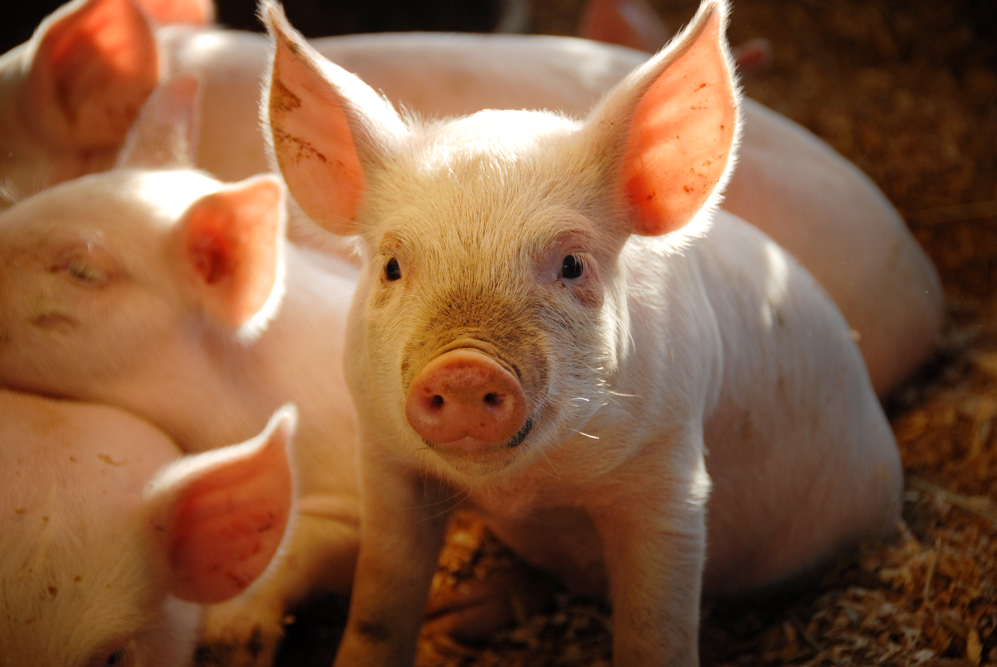
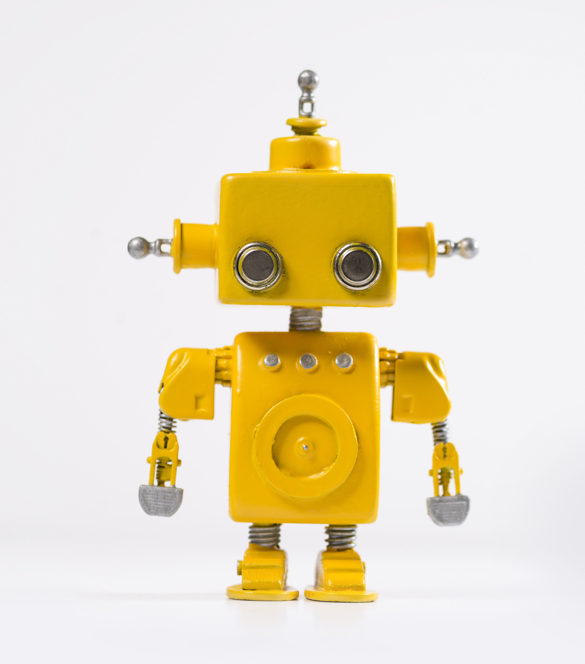
Working with Words
oi
oy
soil
boy
oink
toy
Notes:
Say to the students: We have been learning about words spelled with oi and oy. Today we are going to practice our oi and oy words. I will show you a picture. Please tell me if the word would be spelled with oy or oi.
(click to show a picture of a boy) Our first word is boy. Is boy spelled with oy or oi? (Give the students a moment to answer) Correct! It’s spelled with oy! (Click to show the word in the oy box)
Let’s move on to the next one, (click to show the soil picture). Which letters do we use to spell soil? (Give students a moment to answer) Correct! It’s spelled with oi! (Click to show the word in the oi box. Repeat with remaining pictures and words.
words: toy, oink)

Slide 3
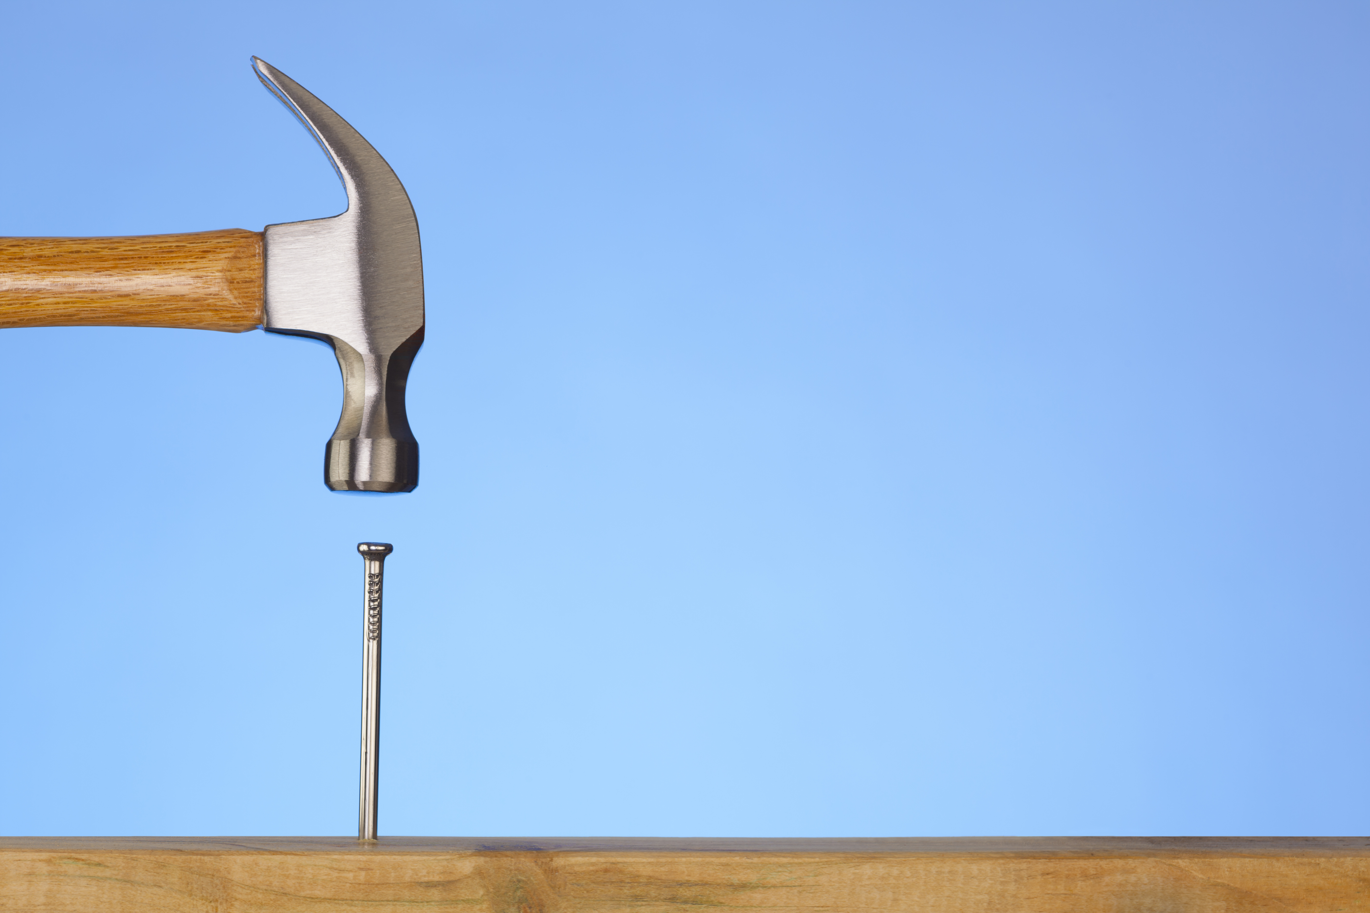
Constructing Words
sp_ _l
spoil
r_ _al
royal
f_ _l
foil
c_ _n
coin
j_ _
joy
Notes:
Say to the students:
Let’s build some oi and oy words! I will show you a word that is missing some letters, please tell me if it’s spelled with oi or oy. Here is the first one- spoil (click to show sp__l).
Which letters are used to spell spoil? (Give the students a moment to answer) Correct! It’s spelled with oi! (Click to show the correct spelling appear.)
Let’s move on to the next one, royal (click to show r__al).
Which letters do we use to spell royal? (Give the students a moment to answer.)
Correct! It’s spelled with oy! (Click to show the correct spelling appear. Repeat with the remaining words: foil, coin, joy.)

Slide 4
The Job of a Subject and Predicate
My uncle is a fire fighter.
subject | predicate
who or what the sentence is about | tells something about the subject
Notes:
Say to the students: This week we learned about subjects and predicates, and how they each have a special job in a sentence. Do you remember what the subject of a sentence is? (Give the students a moment to answer- then click to show the definition.)
That’s right, the subject is who or what the sentence is about. Can you tell me what the predicate is? (Give the students a moment to answer- then click to show the definition.)
The predicate tells something about the subject. Let’s take a look at this sentence. (Click to show “My uncle is a fire fighter”)
Which part is the subject? (Give the students a moment to answer- then click to underline - my uncle.)
Which part is the predicate? (Give the students a moment to answer- then click to circle - is a fire fighter.)

Slide 5

Identifying Subject and Predicate
The house was built very well.
The city council is meeting tonight.
The policeman helped the lost child.
The doctor is busy with his patients.
subject
predicate
Notes:
Say to the students: Can you help Jasmine find the subject or predicate in each sentence? I’ll show you a sentence, please tell me if the underlined part is the subject or the predicate. Here is the first one: (click to show the first sentence).
The doctor is busy with his patients. Is the underlined part the subject or the predicate? (Give the students a chance to answer-predicate. Then, click to show the predicate word spin.)
Well done! (Continue process with the remaining sentences.
2. The city council is meeting tonight.- subject
3. The house was built very well.-subject
4. The policeman helped the lost child.- predicate)

Slide 6
Community Jobs Vocabulary
the value found by adding all numbers in a set together and dividing them by the amount of numbers in the set
being the one who must answer or account for something
to carry out or do
the quality or state of being able
to keep from happening
one who lives in a place
word bank
responsible
ability
prevent
average
resident
perform
Notes:
Say to the students: Let’s review our vocabulary words for the week. We will match the definition to the word. The first definition is carry out or do. (Click to show–carry out or do.)
Which word matches this definition? (Students should say perform. Click to make the word disappear. Repeat with the remaining definitions.
being the one who must answer or account for something - responsible
the value found by adding all numbers in a set together and dividing them by the amount of numbers in the set - average
the quality or state of being able – ability
one who lives in a place - resident
to keep from happening - prevent)

Slide 7
Fill in the Blanks!
The dance teacher was excited to watch her students____.
Police officers are _____for keeping the community safe.
The excavator had the _____ to dig large holes.
Mr. Morris taught us how to find the ____of two numbers.
Firefighters teach us how to ____forest fires.
She was a _____of Pennsylvania.
word bank
responsible
ability
prevent
average
resident
perform
Notes:
Say to the students: Let’s practice using the words in sentences. I’ll show you a sentence, please tell me the word that fits best. Here is the first one. Police officers are _____for keeping the community safe. (Give the students a chance to answer- then click to put a line through responsible.)
Fantastic!
(Repeat the process for each sentence.
2. Firefighters teach us how to ____forest fires- prevent
3. Mr. Morris taught us how to find the ____of two numbers. -average
4. The dance teacher was excited to watch her students____. -perform
5. She was a _____of Pennsylvania.-resident
6. The excavator had the _____ to dig large holes. -ability)

Slide 8
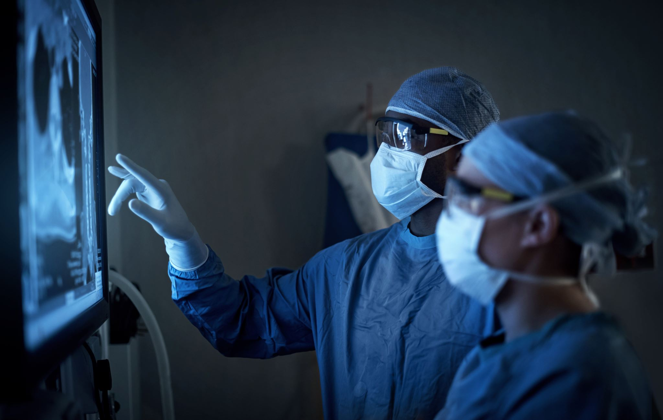

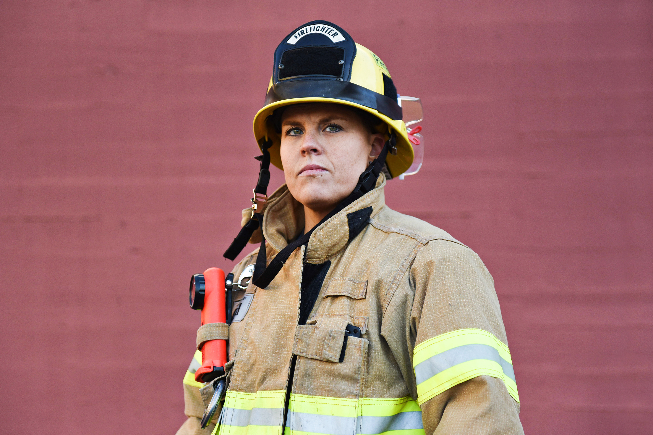
Jobs-The Main Idea
main idea
detail
detail
detail
Notes:
This week you read the story Jobs in the Community. This story is a non-fiction story. Do you remember what the main idea and details are of a story? (Wait for a student to answer.)
Correct, the main idea is what the story is mostly about, and the details support the main idea. What is the main idea of this story? ( Click to show "main idea". The main idea of the story is we are learning about different jobs in a community.)
Can you tell me three details that explain more about the main idea?
(Click to show three arrows that say detail. Answers will vary- students can talk about the various jobs in the community and why the different jobs are important.)

Slide 9
Q & A
Any Questions?

