Slide 1
Rural and City Living
Silent Letters, Articles, and Commas
Notes:
Say to the students:
Today we are going to review words with a silent b or k, commas and articles, vocabulary, and then we will end with the five finger retell.

Slide 2



Shhhh! These Letters are Silent!
knight
knife
knew
tomb
doubt
thumb
Notes:
Say to the students: We’re going to review some of our Spelling words. Each of these words has a special trait. (Click to make the words appear.) Does anyone know what is special about them? (Give the students a chance to respond.)
That’s right! Each one of the words listed has a silent letter! There are times when a word has a letter in it that we can’t hear. The letter can be in the beginning, middle, or end of a word. What makes these words special is that the letters are only silent in some words. For example, this week we are learning about the silent letters b and k. These letters aren’t always silent. We hear them in words like bear and kite (click to show a picture of a bear and a kite).
Let’s look at our some of our Spelling words and how they are spelled with a silent b or k. (Click to make the picture of the bear and kite disappear)
In the first column, we have words with a silent k (click to highlight the silent k in each word). Can you read each one of these words for me? (Assist the students if necessary, reminding them that the k is silent.)
Good work!
In the second column, we have words with a silent b (click to highlight the silent b in each word).
Can you read each one of these words for me? (Assist the students if necessary, reminding them that the b is silent.) Super job! Let’s practice some more words on the next slide!

Slide 3

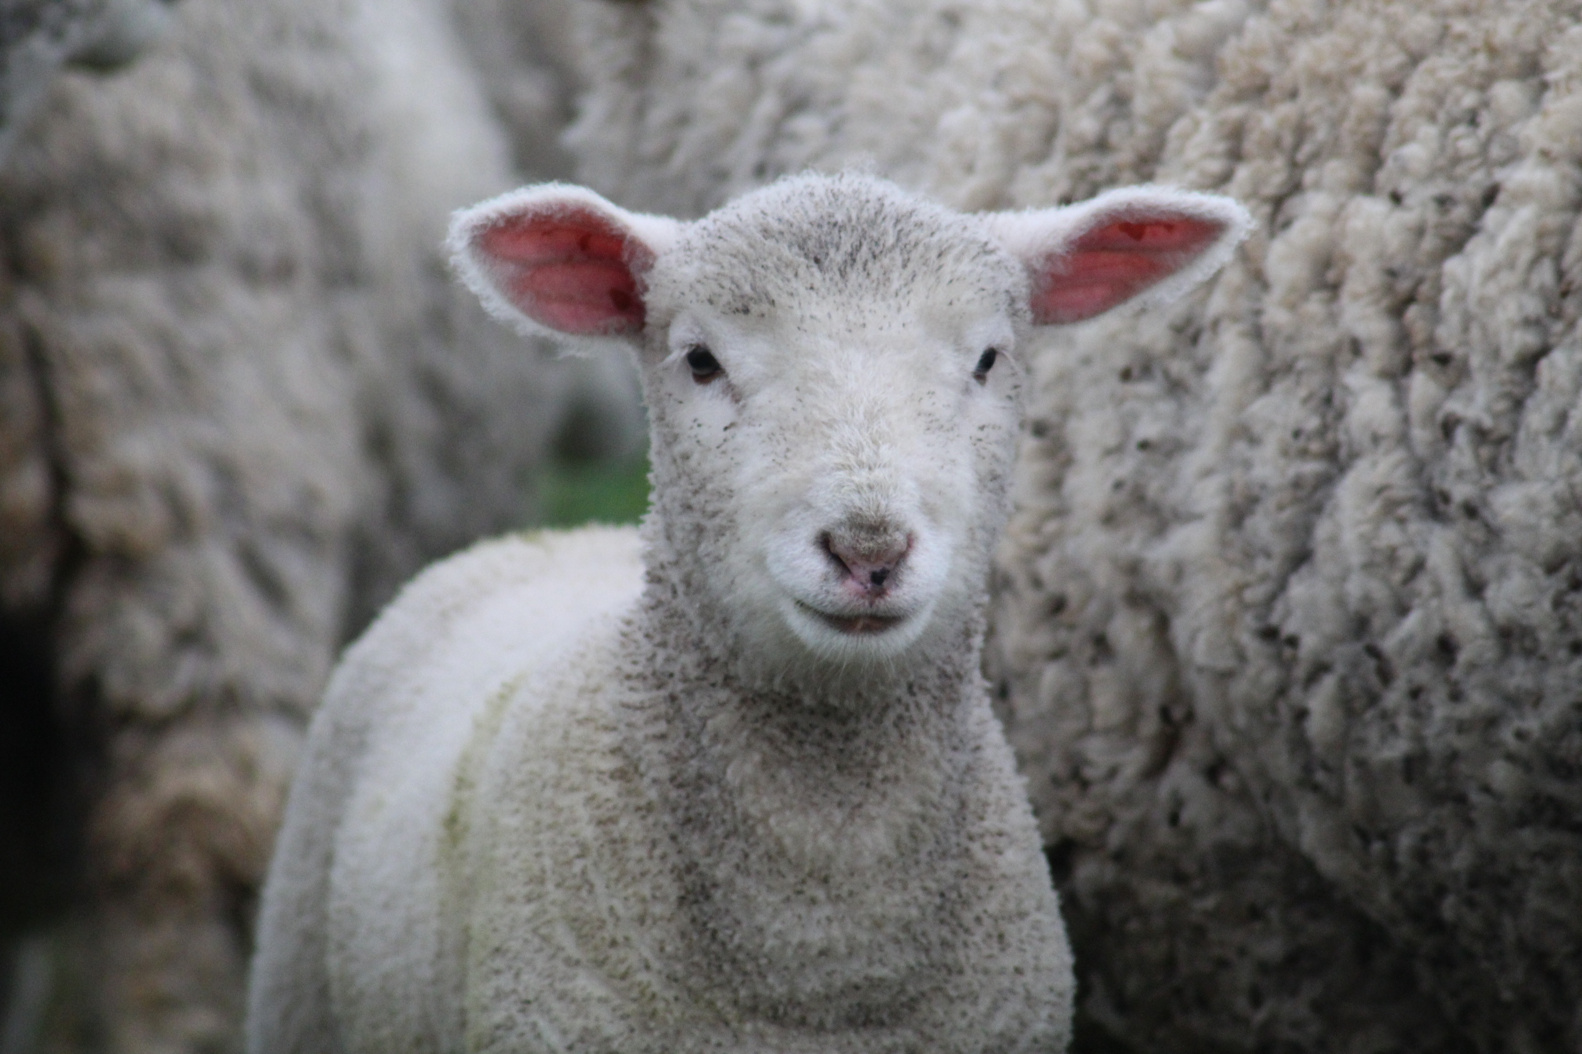
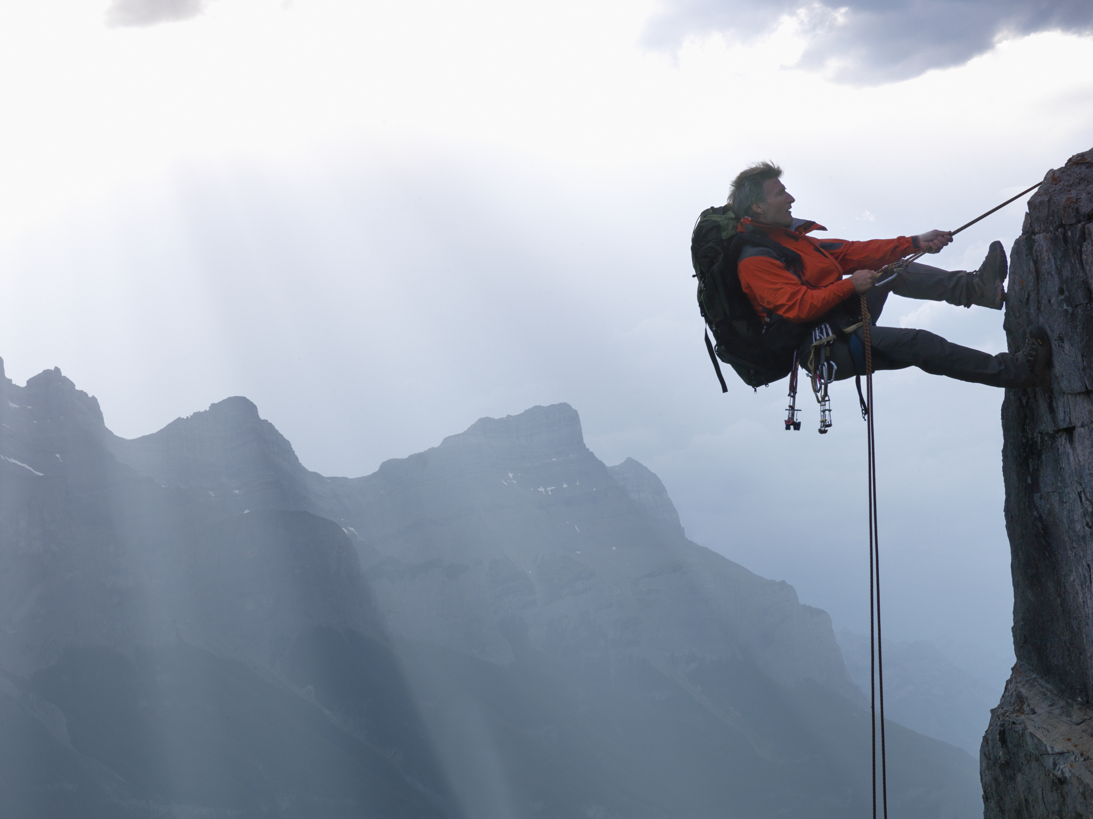
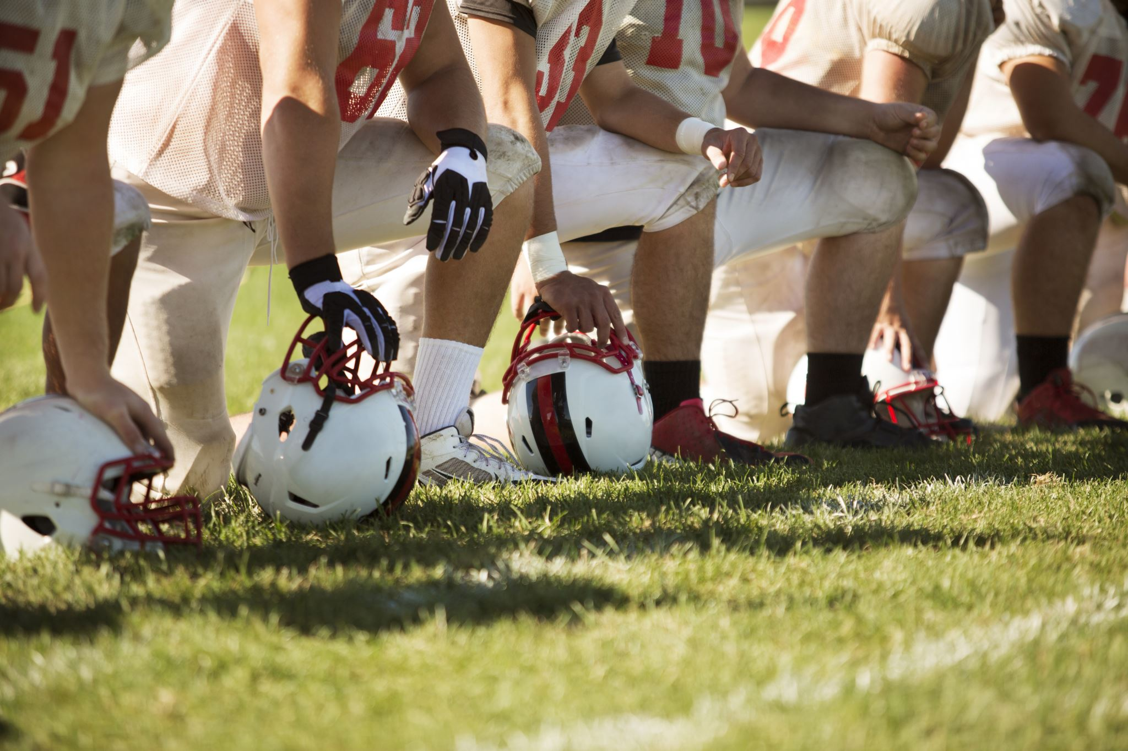

Silent Letter Practice
k
__neel
k
b
_not
clim__
lam__
b
b
com__
Notes:
Say to the students: Let's take a look at some pictures. Each picture goes with a word that has a silent letter in it. I will show you a word, and you tell me what silent letter is missing. Here is the first one (click to show lam_ next to the picture of a lamb).
Which letter is missing? (Students should say b. Click to show the b. If a student struggles, remind them that they are learning about silent k and silent b, and ask which one fits better in the word.)
That’s great! Let’s move on to the next one.
(Click to show the next word, and repeat the process for the remaining words
2. clim_ = climb
3. _neel=kneel
4. com_= comb
5. _not=knot)

Slide 4
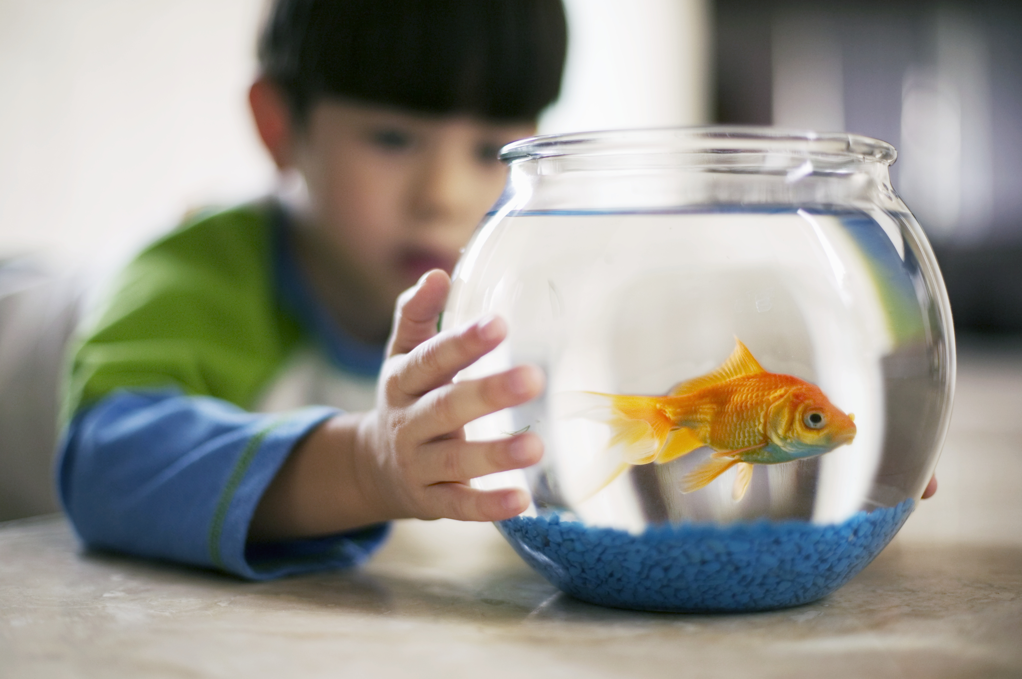
Grammar City
a
the
an
I see a fish.
The fish is small.
He lives in an oval tank.
Notes:
Say to the students: Now, we’re going to review the articles we learned about in the module. Articles are actually adjectives that we use before nouns. In this lesson, we’re learning about the articles a, an, and the (click to show the words).
We use “a” with singular general nouns. For example, we might write this. Can you read this sentence for me? (Click to show “I see a fish”).
We use “the” with specific nouns. For example, can you read this sentence for me? (Click to show “The fish is small”).
We use “an” for singular nouns that begin with a vowel. For example, can you read this sentence for me? (Click to show “He lives in an oval tank”).
Let’s practice more on the next slide.

Slide 5
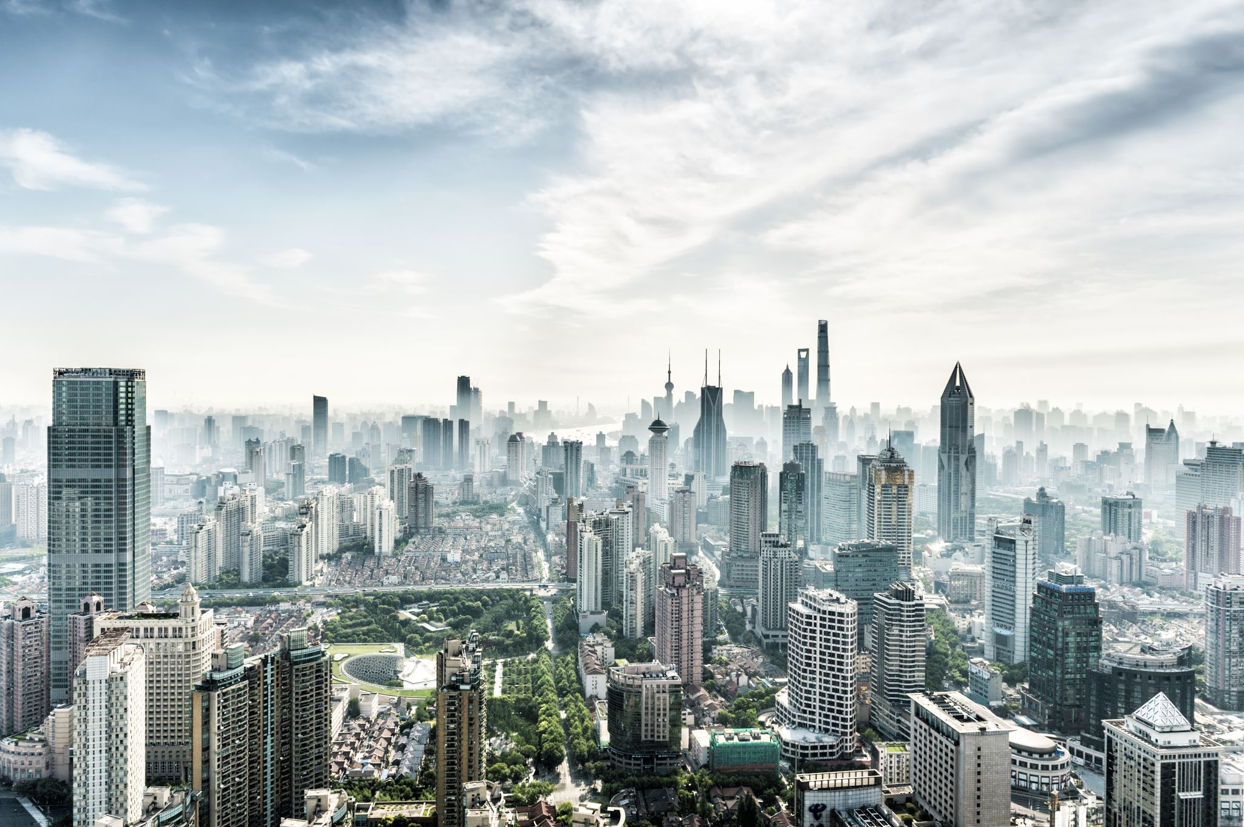
Grammar City Practice
It is ____ small apartment.
I like to visit ____ city.
My aunt lives in ___ apartment.
I live in ____country.
a the an
a
the
an
the
Notes:
Say to the students:
I will show you a sentence, please tell me the correct article that goes in the sentence. Here is the first one (click to show “I live in _ country”).
Which article would go here? (Give students a moment to answer, when they do, click to fill in the word “the”)
Nice work! Let’s try some more! (Repeat the process for each sentence, clicking to show the sentence, then clicking to show the answer after a student replies.)
(2. I like to visit __ city.- the
3. My aunt lives in __ apartment.-an
4. It is _ small apartment. -a)

Slide 6
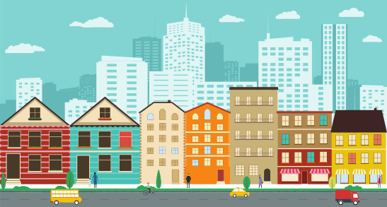
Commas in the City
There are two toy stores a grocery store and a fire station on my block.
I saw three red cars four big trucks and a taxi while walking to school.
There are two toy stores, a grocery store, and a fire station on my block.
I saw three red cars, four big trucks,
and a taxi while walking to school.
Notes:
Say to the students: We often use commas in our writing, and we can use them in many ways. Today we’re going to review using commas in a series. Let's look at this sentence (click to show “I saw three red cars four big trucks and a taxi while walking to school.” Read the sentence to the students.)
We use commas when we’re writing items in a series of three or more. In this sentence, we would put commas after the word cars, and the word trucks (click to show the sentence with commas.)
Let’s try another one!
Where do the commas go in this sentence? (Click to show “There are two toy stores a grocery store and a fire station on my block” answer- “There are two toy stores, a grocery store, and a fire station on my block”.)
(Click to show the corrected sentence after a student answers.)
Great work! Let’s practice some more on the next slide!

Slide 7
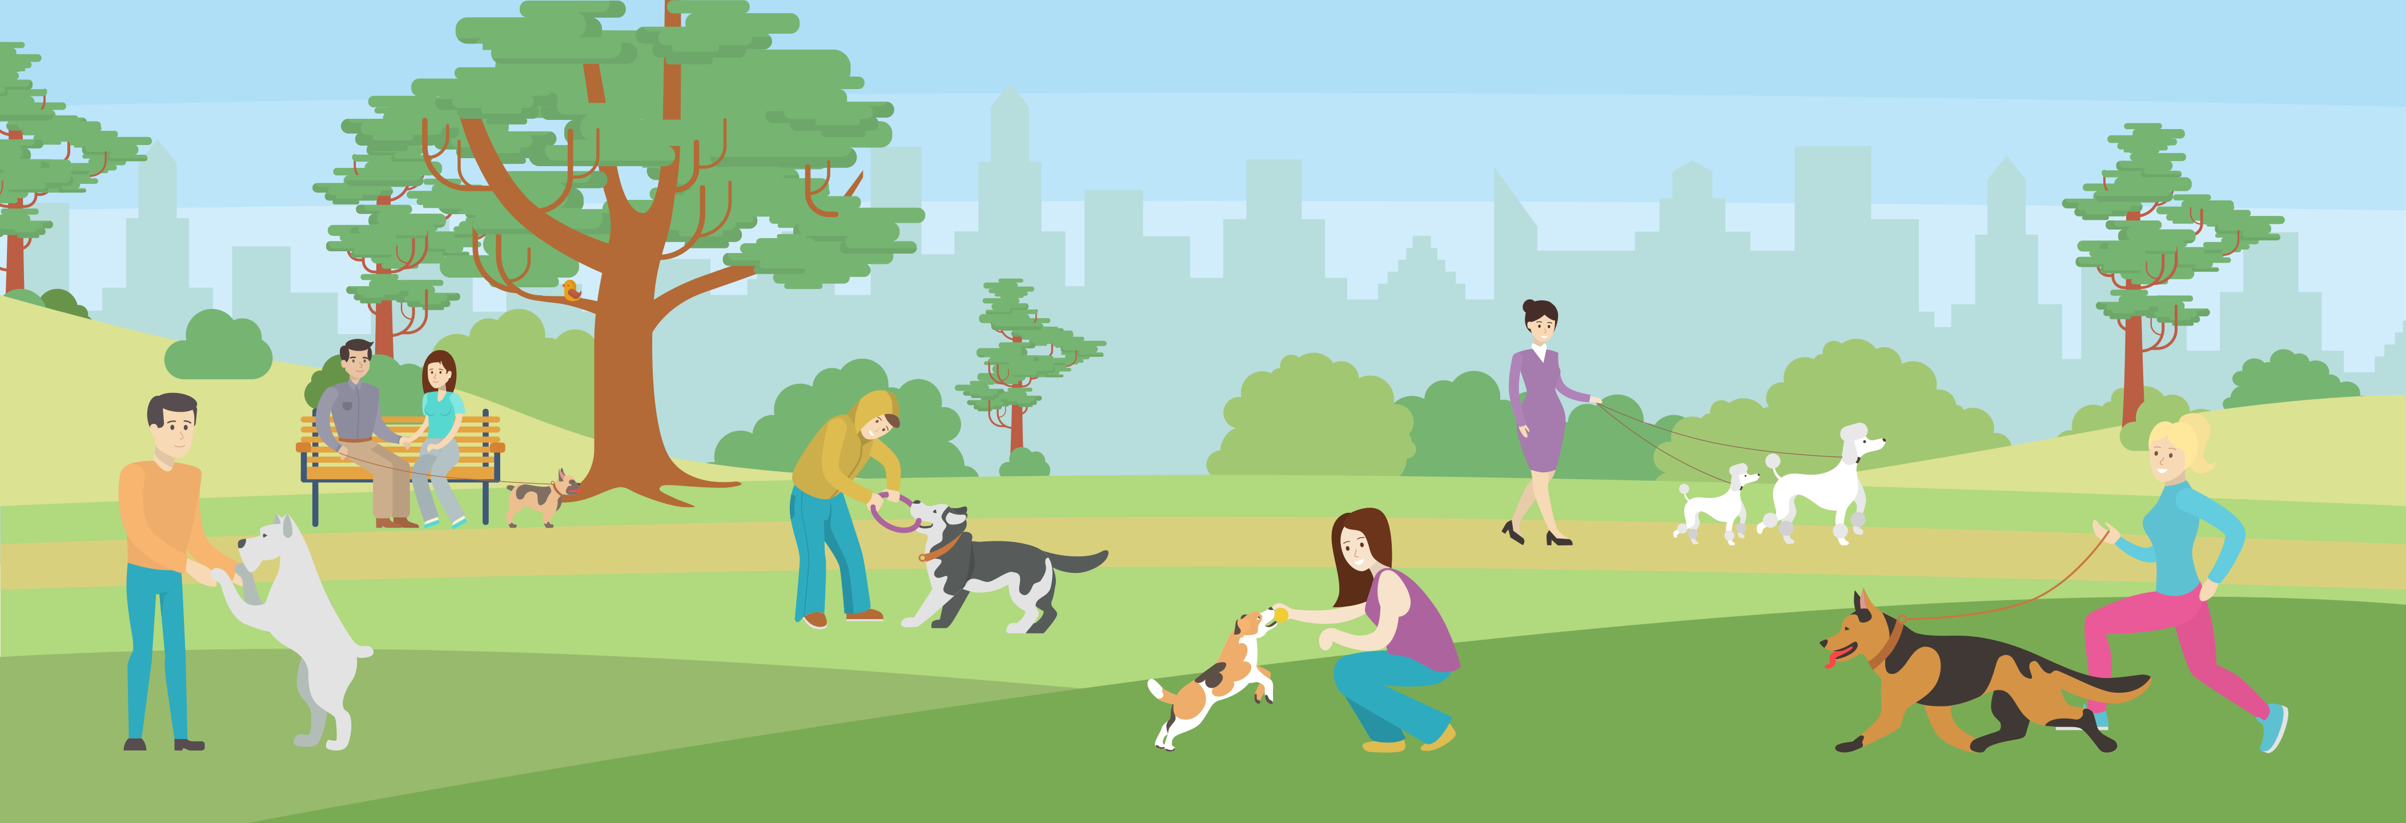
City Comma Practice
The dog park had four, small dogs three, large dogs and one, medium dog.
My desk contains three pencils, two notebooks, and one glue stick.
The dog park had four small dogs, three large dogs, and one medium dog.
Notes:
[Insert Shutterstock image ID:598462562]
Say to the students: I'm going to show you some sentences. In each one, please tell me if the commas are in the correct place. If they aren’t, please tell me where they belong.
Here is the first one:
(Click to show “My desk contains three pencils, two notebooks, and one glue stick.”)
Are the commas in the correct spot in this sentence? (Give the students a moment to answer) Yes! They are in the correct spot. Let’s try another one! (Click to show “The dog park had four, small dogs three, large dogs and one, medium dog.”)
Are the commas in the correct place here? (Let a student answer)
No! They are incorrect. Where should the commas go? (Give the students a moment to answer and then click to show the sentence with commas in the correct places.)

Slide 8
City and Country Story Vocabulary
to keep from happening
the state of being in self-control and calm
A place in which people live that is larger than a town.
slow in action, uninteresting
to have in mind as a purpose or aim
of or relating to the country
patience city dull
rural avoid intend
Notes:
Say to the students: Let’s review our vocabulary words for the week. When I show you the definition, tell me the word on the slide that it matches. Here is an example. (Click to show-"to have in mind as a purpose or aim" and read it to the student.)
Which word matches this definition? (Students should say “intend”. Click to show the answer circled. Repeat the process with the remaining words.
2. rural--of or relating to the country
3. city--A place in which people live that is larger than a town.
4. dull--slow in action, uninteresting
5. avoid--to keep from happening
6. patience--the state of being in self-control and calm

Slide 9
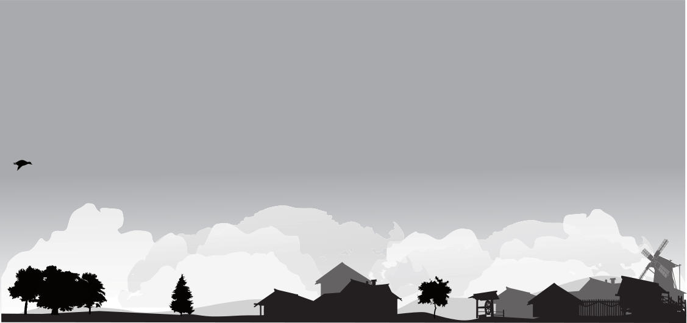
Can You Use These Words in a Sentence?
dull
avoid
rural
city
patience
intend
Notes:
Say to the students: Let’s practice using our vocabulary words in a sentence. When I show you the word, please use it in a sentence for me. Here is an example. (Click to show the word city)
City. I like to visit the city. Can you please give me a sentence for the word patience? (Click to show the word.)
(Repeat the process for the remaining words- click to show each one. If a student struggles, review the meaning of the word on the previous slide.
3. rural
4. avoid
5. intend
6. dull)

Slide 10

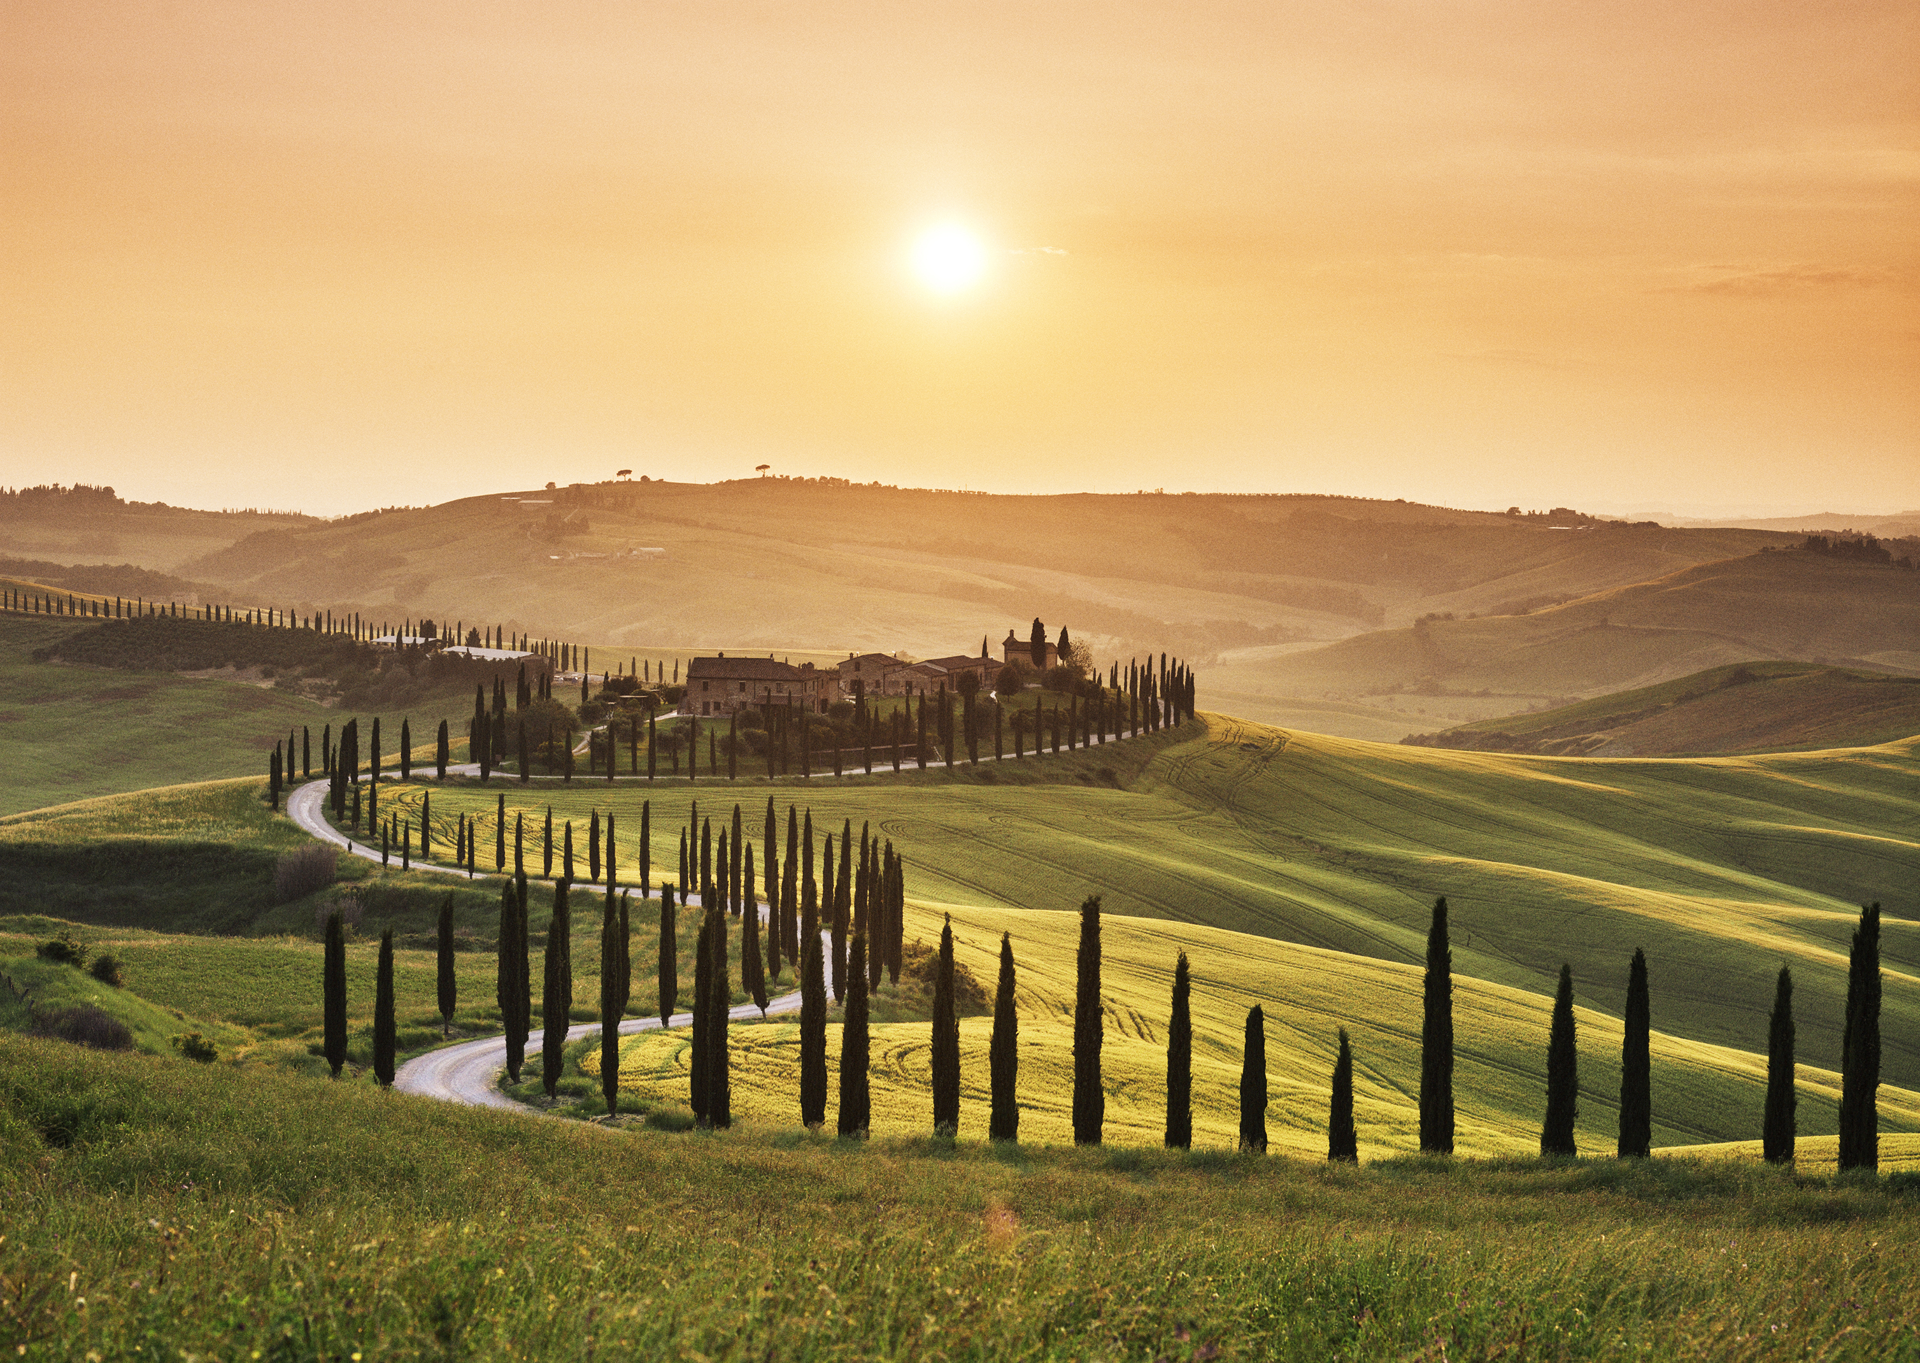
Give me Five!
Notes:
Say to the students: It’s time for the five finger retell! (Click to show the hand.)
Show me your fingers! (Have students hold up a hand and point to each finger as they go through the retell.
Characters- Aiden and his mom
Setting- Aidens city house, school, his car, his new country home
Problem- Aiden and his parents were moving from the city to the country.
Events- Aidens mom tells him they are moving to the country.
Aiden learns about the country in social studies the next day.
He doesn’t want to move, he likes the hustle and bustle of the city.
Moving day comes and he says goodbye to his friends.
He sees kids playing near his new home.
Neighbors come to welcome them.
Solution- Aiden decides to give the country a try.)
Text connection- Say to the students: Do you live in the city or the country? What do you like best about living there? What do you like least?

Slide 11
Q & A
Any Questions?

