Slide 1
Night Animals
Let’s Review!
Notes:
Notes to Teacher:
Tell the student that we are going to review our skills from this week.
We are going to talk about -au and -aw words, pronouns and antecedents, vocabulary and our story titled, Benjamin Bat.
Teacher clicks to bring up the next slide.

Slide 2

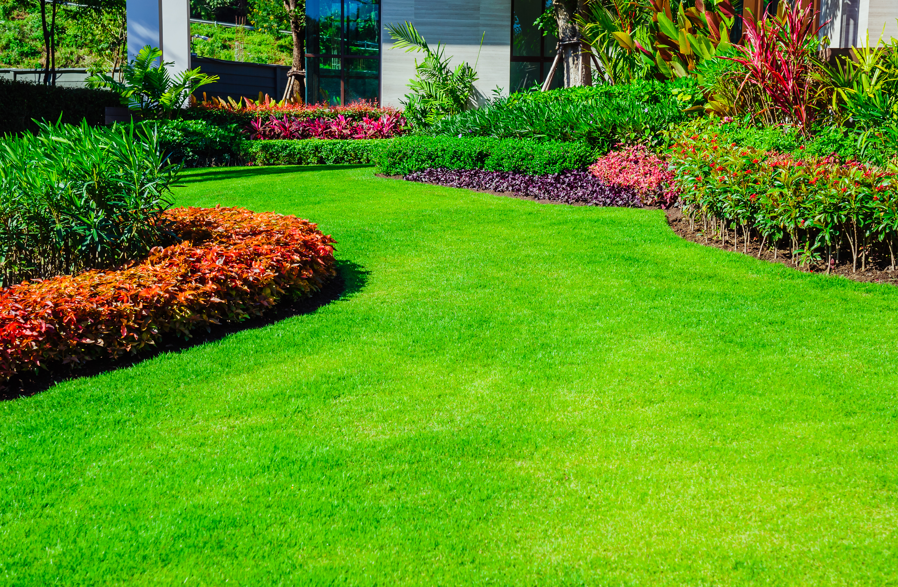
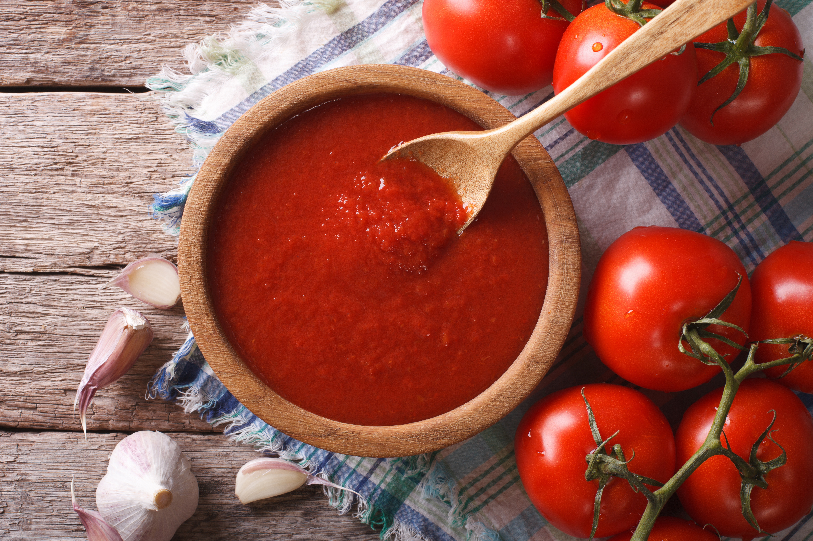
Reviewing Our Skills!
-au
-aw
sauce
lawn
a w
a u
l _ _ n
s _ _ c e
Notes:
Notes to Teacher:
Teacher will introduce the slide by telling the student that we are going to work on -au and -aw words.
Remind the student that these word parts sound the same.
Click to show the two ‘word parts’ in a chart. Tell the student that we are going to look at a picture and decide if the word is spelled with -au or -aw.
Click to show a lawn and the word: l__n.
Ask: “What is this?” (Lawn.)
Ask: “How do we spell lawn?” Allow time for the student to tell you how the word is spelled. (l aw n)
Ask: “Does it belong in the -au or -aw column?” (-aw.)
Click to add -aw to the word.
Click to move the word ‘lawn’ to the -aw column.
Click to show the sauce and the word s__ce.
Ask: “What is this?” (Sauce.) If the student does not know that this is the sauce, take a moment to talk about sauce.
Ask: “How do you spell sauce?” Allow time for the student to tell you how the word is spelled. (S au c e.)
Ask: “Does it belong in the -au or -aw column?” (-au.)
Click to add -au to the word.
Click to move the word ‘sauce’ to the -au column.
Teacher: “Awesome! Let’s take a look at some words and see if we can spell the words correctly.”
Click to go to the next slide.

Slide 3

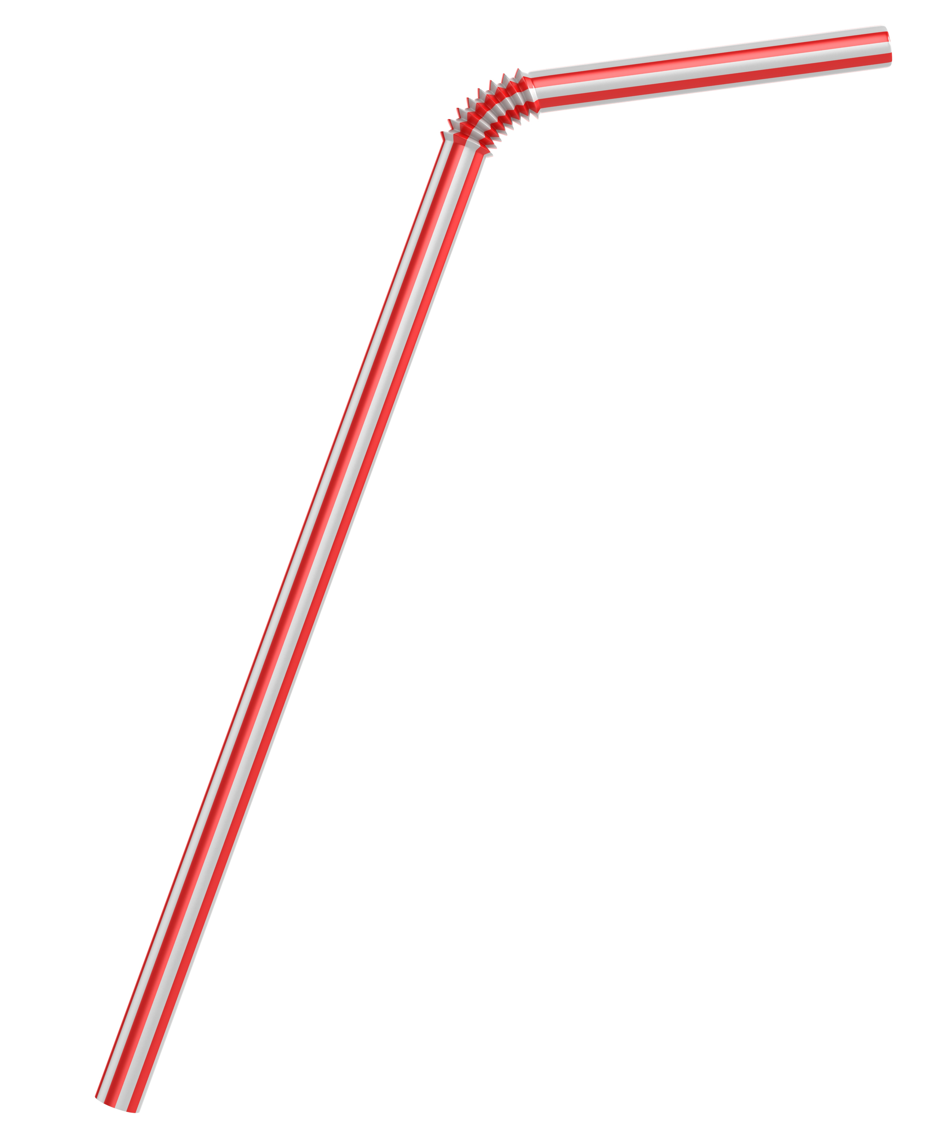



Let’s Practice!
autumn
straw
laundry
paw
-au
-aw
a w
p _ _
str_ _
a w
l _ _ ndry
a u
a u
_ _ tumn
Notes:
Visual Element: straw - 106906925, paw -1038732115, autumn - 1802809684, laundry – 1172480659 and laundry basket 318234968 (motion path)
Notes to Teacher:
Teacher will introduce the slide by telling the student that we are going to sort au- and aw- words.
Click to show the two laundry baskets: one basket labeled ‘au-‘ and the other labeled ‘-aw.’
Click to show a straw and the word str__.
Ask: “What is this?” (Straw.)
Ask: “How do we spell straw?” Allow time for the student to tell you how the word is spelled (s t r aw.)
Ask: “Does it belong in the -au or -aw column?” (-aw.)
Click to add -aw to the word.
Click to move the word ‘straw’ to the -aw basket.
Click to show a picture of autumn and the word __tumn.
Ask: “What is this?” (Autumn.) If the student says “fall ,” explain that autumn is another name for fall.
Ask: “How do we spell autumn?” Allow time for the student to tell you how the word is spelled. (au t u m n.)
Ask: “Does it belong in the -au or -aw column?” (-au.)
Click to add -au to the word.
Click to move the word ‘autumn’ to the -au basket.
Click to show the laundry and the word l__ndry.
Ask: “What is this?” (Laundry.)
Ask: “How do we spell laundry?” Allow time for the student to tell you how the word is spelled. (L au n d r y.)
Ask: “Does it belong in the -au or -aw column?” (-au.)
Click to add -au to the word.
Click to move the word ‘laundry’ to the -au basket.
Click to show a paw and the word p__.
Ask: “What is this?” (paw.)
Ask: “How do we spell paw?” Allow time for the student to tell you how the word is spelled. (p aw.)
Ask: “Does it belong in the -au or -aw column?” (-aw.)
Click to add -aw to the word.
Click to move the word ‘paw’ to the -aw basket.
Applaud student’s effort and click to go to the next slide.

Slide 4
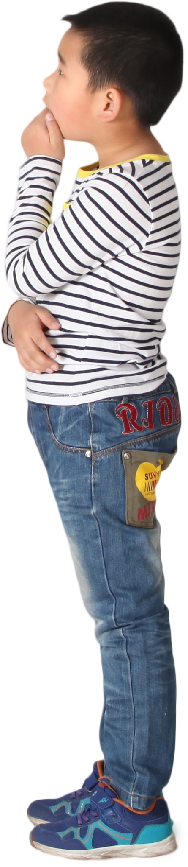
Pronouns and Antecedents
I me he their
The children cheered for their classmates.
When Rob walked outside, he saw the bus.
Notes:
Notes to Teacher:
Ask: “What is a pronoun?” (A pronoun is a word that takes the place of a noun.)
Click to show examples: I me he their
Ask: “What is an antecedent?”
Allow the student the opportunity to tell you that an antecedent is the noun it refers to.
Teacher: “Let’s look at a sentence.”
Click to show the sentence: When Rob walked outside, he saw the bus.
Ask: “What is the pronoun in the sentence?” (he)
Click to underline he.
Ask: What is the antecedent?” (Rob.)
Click to circle Rob.
Teacher: “Let’s try one more.”
Click to show the sentence: The children cheered for their classmates.
Ask: “What is the pronoun in the sentence?” (their.)
Click to underline their.
Ask” What is the antecedent?” (children.)
Click to circle children.
Applaud the student’s effort and click to go to the next slide.

Slide 5

Sorting Pronouns and Antecedents
Bob
pencil
tree
children
Nouns
he
it
they
us
Pronouns
Bob
he
pencil
it
they
tree
children
us
Notes:
Notes to Teacher:
Tell the student that today, he/she will decide if a word is a noun or a pronoun.
Have the student read each word. As he/she reads a word, have him/her identify it as a noun or a pronoun.
After the student identifies the word as a noun or pronoun, click the word and send it to the correct shelf (noun or pronoun.)
Complete this procedure for each word.
Bob – noun
he – pronoun
pencil – noun
it – pronoun
they – pronoun
tree – noun
children – noun
us - pronoun
Applaud the student’s effort and click to move to the next slide.

Slide 6
Pond Animals - Vocabulary Review
dispute
morsel
dismal
-a small piece of food.
-an argument or debate.
-very dreary and depressing.
Notes:
Notes to Teacher:
Teacher: “Let’s review some of our vocabulary words.”
Click to show the first word, morsel, and two definitions.
Teacher: “Our first word is morsel. (Have the student repeat the word – morsel.) What is the definition of morsel?”
Allow time for the student to tell you which definition matches morsel. If the student is correct, applaud his/her answer. If the student is incorrect, review the definition with him/her.
As the student gives you the correct definition, click to make the incorrect definition fade away.
Click to show the next word, dismal, and two definitions.
Teacher: “Our next word is dismal. (Have the student repeat the word – dismal.) What is the definition of dismal?”
Allow time for the student to tell you which definition matches dismal. If the student is correct, applaud his/her answer. If the student is incorrect, review the definition with him/her.
As the student gives you the correct answer, click to make the incorrect definition fade away.
Click to show the last word, dispute, and two definitions.
Teacher: “Our last word is dispute. (Have the student repeat the word – dispute.) What is the definition of dispute?”
Allow time for the student to tell you which definition matches dispute. If the student is correct, applaud his/her answer. If the student is incorrect, review the definition with him/her.
As the student gives you the correct answer, click to make the incorrect definition fade away.
Vocabulary:
morsel – a small piece of food.
dismal– very dreary and depressing.
dispute – an argument or debate.
Applaud the student’s effort and click to go to the next slide.

Slide 7
Vocabulary Review Take Two!
roam
gloom
nook
-partial or total darkness.
-a sheltered or hidden place.
-to go from place to place without a plan.
Notes:
Notes to Teacher:
Teacher: “Let’s review the rest of our vocabulary words.”
Click to show the first word, roam, and two definitions.
Teacher: “Our first word is roam. (Have the student repeat the word – roam.) What is the definition of roam?”
Allow time for the student to tell you which definition matches roam. If the student is correct, applaud his/her answer. If the student is incorrect, review the definition with him/her.
As the student gives you the correct definition, click to make the incorrect definition fade away.
Click to show the next word, gloom, and two definitions.
Teacher: “Our next word is gloom. (Have the student repeat the word – gloom.) What is the definition of gloom?”
Allow time for the student to tell you which definition matches gloom. If the student is correct, applaud his/her answer. If the student is incorrect, review the definition with him/her.
As the student gives you the correct answer, click to make the incorrect definition fade away.
Click to show the last word, nook, and two definitions.
Teacher: “Our last word is nook. (Have the student repeat the word – nook.) What is the definition of nook?”
Allow time for the student to tell you which definition matches nook. If the student is correct, applaud his/her answer. If the student is incorrect, review the definition with him/her.
As the student gives you the correct answer, click to make the incorrect definition fade away.
Vocabulary:
roam – to go from place to place without a plan.
gloom – partial or total darkness.
nook – a sheltered or hidden place.
Before clicking to the next slide, applaud the student’s effort.
Click to go to the next slide.

Slide 8
Our Vocabulary Adventure Continues!
dispute
The children had a _______.
nook
I found a quiet ____ to read in.
roam
Do not _____ away from the group.
dismal
The dark clouds made it look very ______.
morsel
The mouse ate every ______ of the cookie.
Word Bank
nook
morsel
gloom
roam
dismal
dispute
Notes:
Notes to Teacher:
Teacher: “Let’s practice our vocabulary words by filling in the blanks. Use the word bank to help you out.”
[There are six words but only five sentences.]
Click to show the first sentence.
The children had a _______ (dispute.)
Pause and allow the student to tell you which word completes this sentence.
Click to place the word in the sentence and cross off the word in the word bank.
Click to show the next sentence.
I found a quiet ____ to read in (nook.)
Pause and allow the student to tell you which word completes this sentence.
Click to place the word in the sentence and cross off the word in the word bank.
Click to show next sentence.
Do not ____ away from the group (roam.)
Pause and allow the student to tell you which word completes this sentence.
Click to place the word in the sentence and cross off the word in the word bank.
Click to show the next sentence.
The dark clouds made it look very ______ (dismal.)
Pause and allow the student to tell you which word completes this sentence.
Click to place the word in the sentence and cross off the word in the word bank.
Click to show the last sentence.
The mouse ate every ____ of cookie (morsel.)
Pause and allow the student to tell you which word completes this sentence.
Click to place the word in the sentence and cross off the word in the word bank.
Extension activity:
Teacher: “There is one word left in the word bank.”
Click to circle the word gloom.
Ask: “What is this word?” (gloom.)
Teacher: “Gloom is partial or total darkness. Can you use that word in a sentence ?”
Allow time for the student to create a sentence using the word gloom.
Vocabulary:
morsel – a small piece of food.
dismal – very dreary and depressing.
dispute – an argument or debate.
roam – to go from place to place without a plan.
gloom – partial or total darkness.
nook – a sheltered or hidden place.
Applaud the student’s effort and click to go to the next slide.

Slide 9
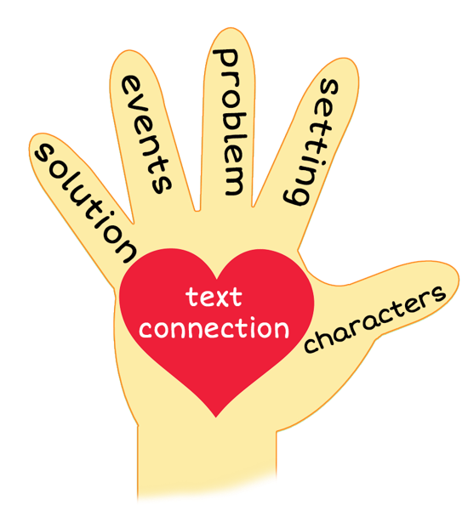
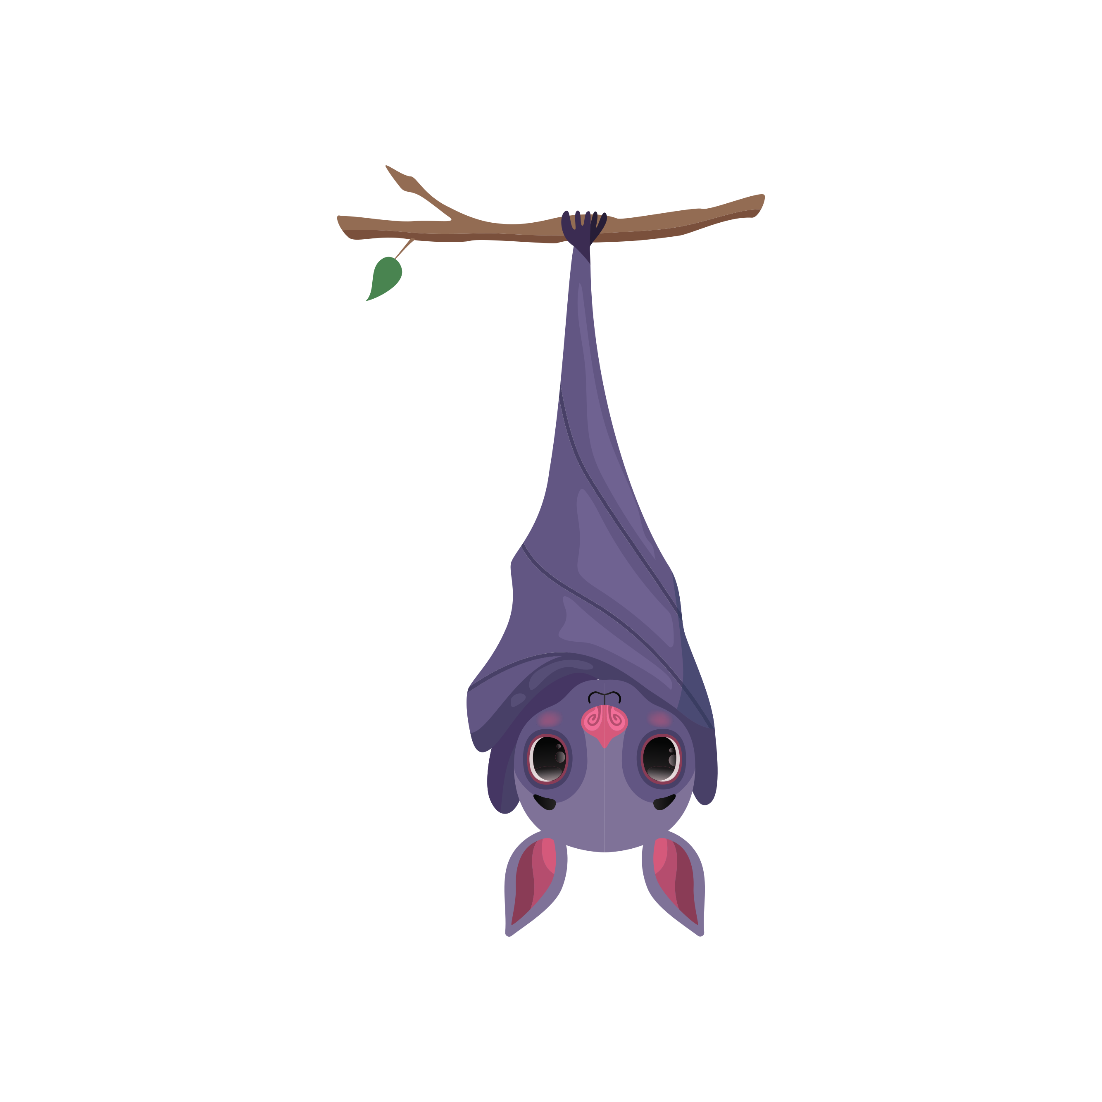
Benjamin Bat
Notes:
Notes to Teacher:
Remind the student that we read a story called, Benjamin Bat.
Thumb (Click to circle the thumb.) Who were the characters in the story – Benjamin Bat and Solomon Owl.
Pointer Finger (Click to circle the pointer finger.) - Where did the story take place? The story took place in Pleasant Valley. Most of the story took place outside but some of the story took place in Solomon Owl’s home.
Middle Finger (Click to circle the middle finger) – What was the problem in the story? There was a storm and Benjamin Bat wanted a safe place to take a nap.
Ring Finger (Click to circle the ring finger.) What happened in the story? We learned a lot about Benjamin Bat and Solomon Owl. Benjamin Bat’s friends thought he was crazy, as he always flew around in a zigzag. This flying made Solomon Owl dizzy.
One night, Benjamin Bat stopped to ask Solomon Owl for advice, as Benjamin Bat believed Solomon Owl was the wisest creature around.
Benjamin Bat wanted to find a safe place to take a nap.
Solomon Owl offered for Benjamin Bat to stay at his place. Benjamin Bat did not think this was a good idea but decided to stay there.
When they made it to Solomon Owl’s house, Solomon Owl gave Benjamin Bat a bed of leaves in the corner.
Pinky (Click to circle the pinky finger.) Solution – Was the problem solved? Yes. Both creatures napped and were kept safe from the stormy weather.
Palm of Hand (Click to circle the palm of the hand.) Text Connection –Did you ever need to rely on someone to help you out? How did this make you feel? Did that person help you out? If so, how did that make you feel?
How did you feel about Solomon Owl offering for Benjamin Bat to stay at his place? Why was Benjamin Bat so worried about staying at Solomon Owl’s place?
What was your favorite part of the story?
Applaud the student’s effort and click to go to the next slide.

Slide 10
Q & A
Any Questions?
Notes:
Thank the student for his/her effort.
Ask the student if he/she has any questions.

