Slide 1
Animal Friends
Let’s Review!
Notes:
Notes to Teacher:
Tell the student that we are going to review our skills from this week.
We are going to talk about words with -oo, pronouns, vocabulary and our story titled, The Hunting Party.
Teacher clicks to bring up the next slide.

Slide 2
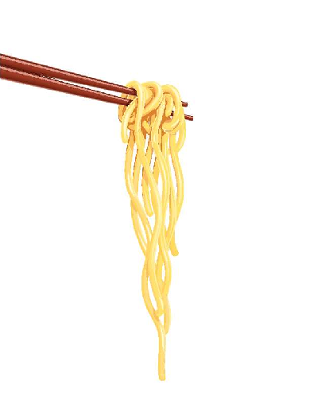

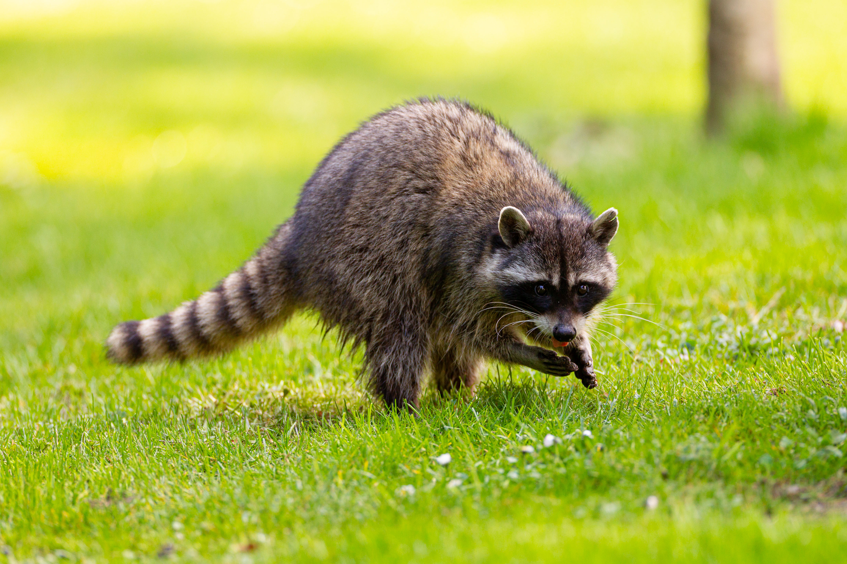
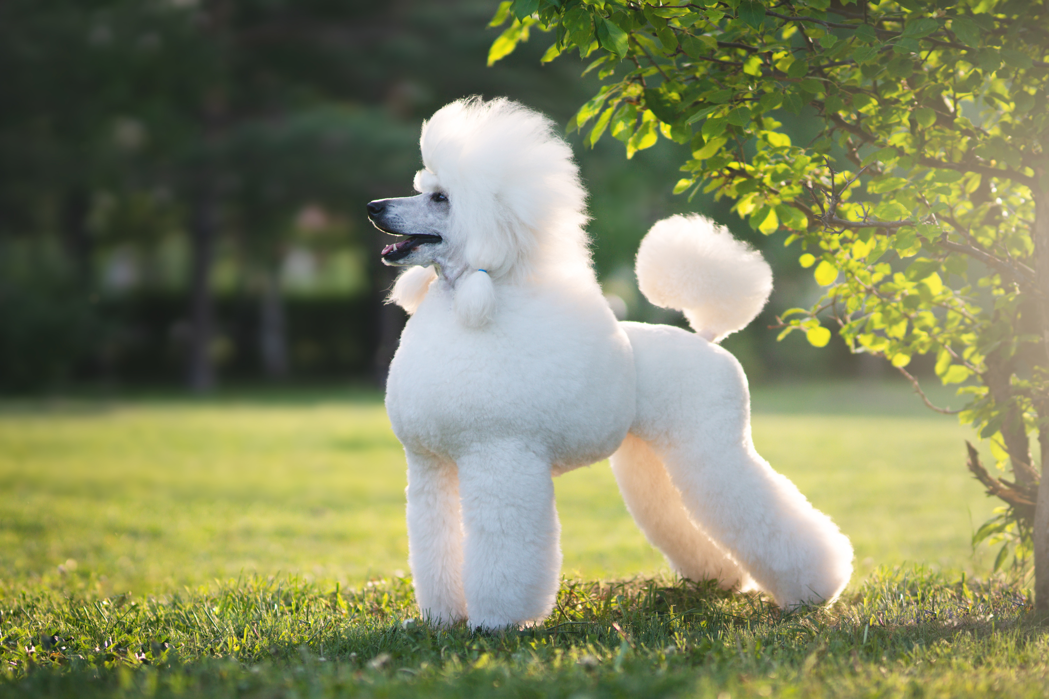
Reviewing Our Skills!
poodle
noodle
raccoon
moon
Notes:
Notes to Teacher:
Click to show a picture of a poodle with the word poodle next to it.
Teacher will introduce the slide by telling the student that we are going to work on words with -oo, sound, as in poodle.
Teacher: “Let’s take a look at some of our spelling words.”
Click to show the word noodle with a picture of a noodle. Say the word and have the student repeat the word.
Click to show the word moon with a picture of a moon. Say the word and have the student repeat the word.
Click to show the word raccoon with a picture of a raccoon. Say the word and have the student repeat the word.
Teacher: “Let’s take a look at some more words.”
Click to go to the next slide.

Slide 3

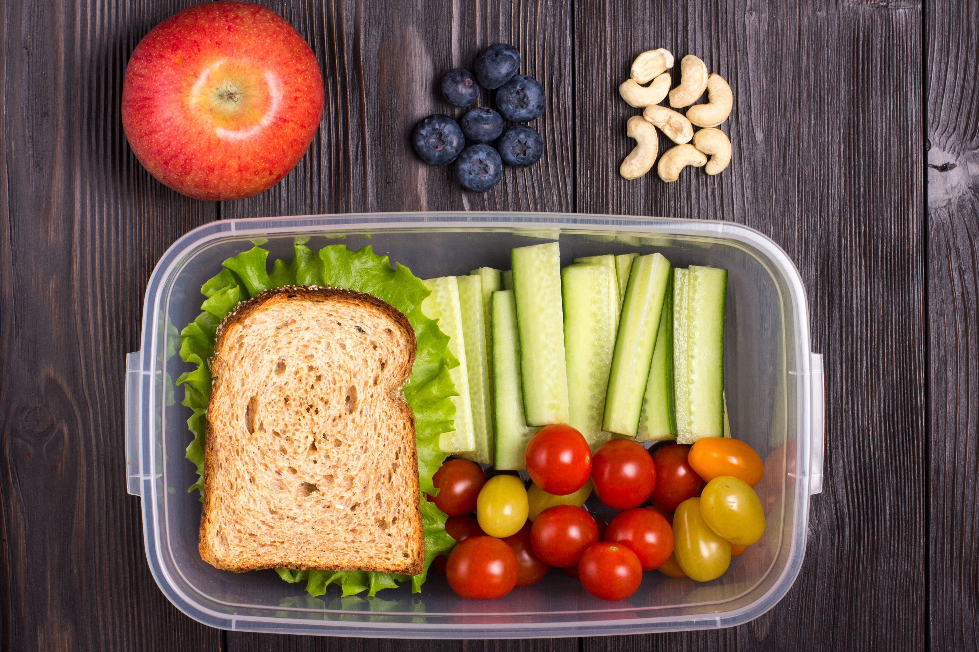
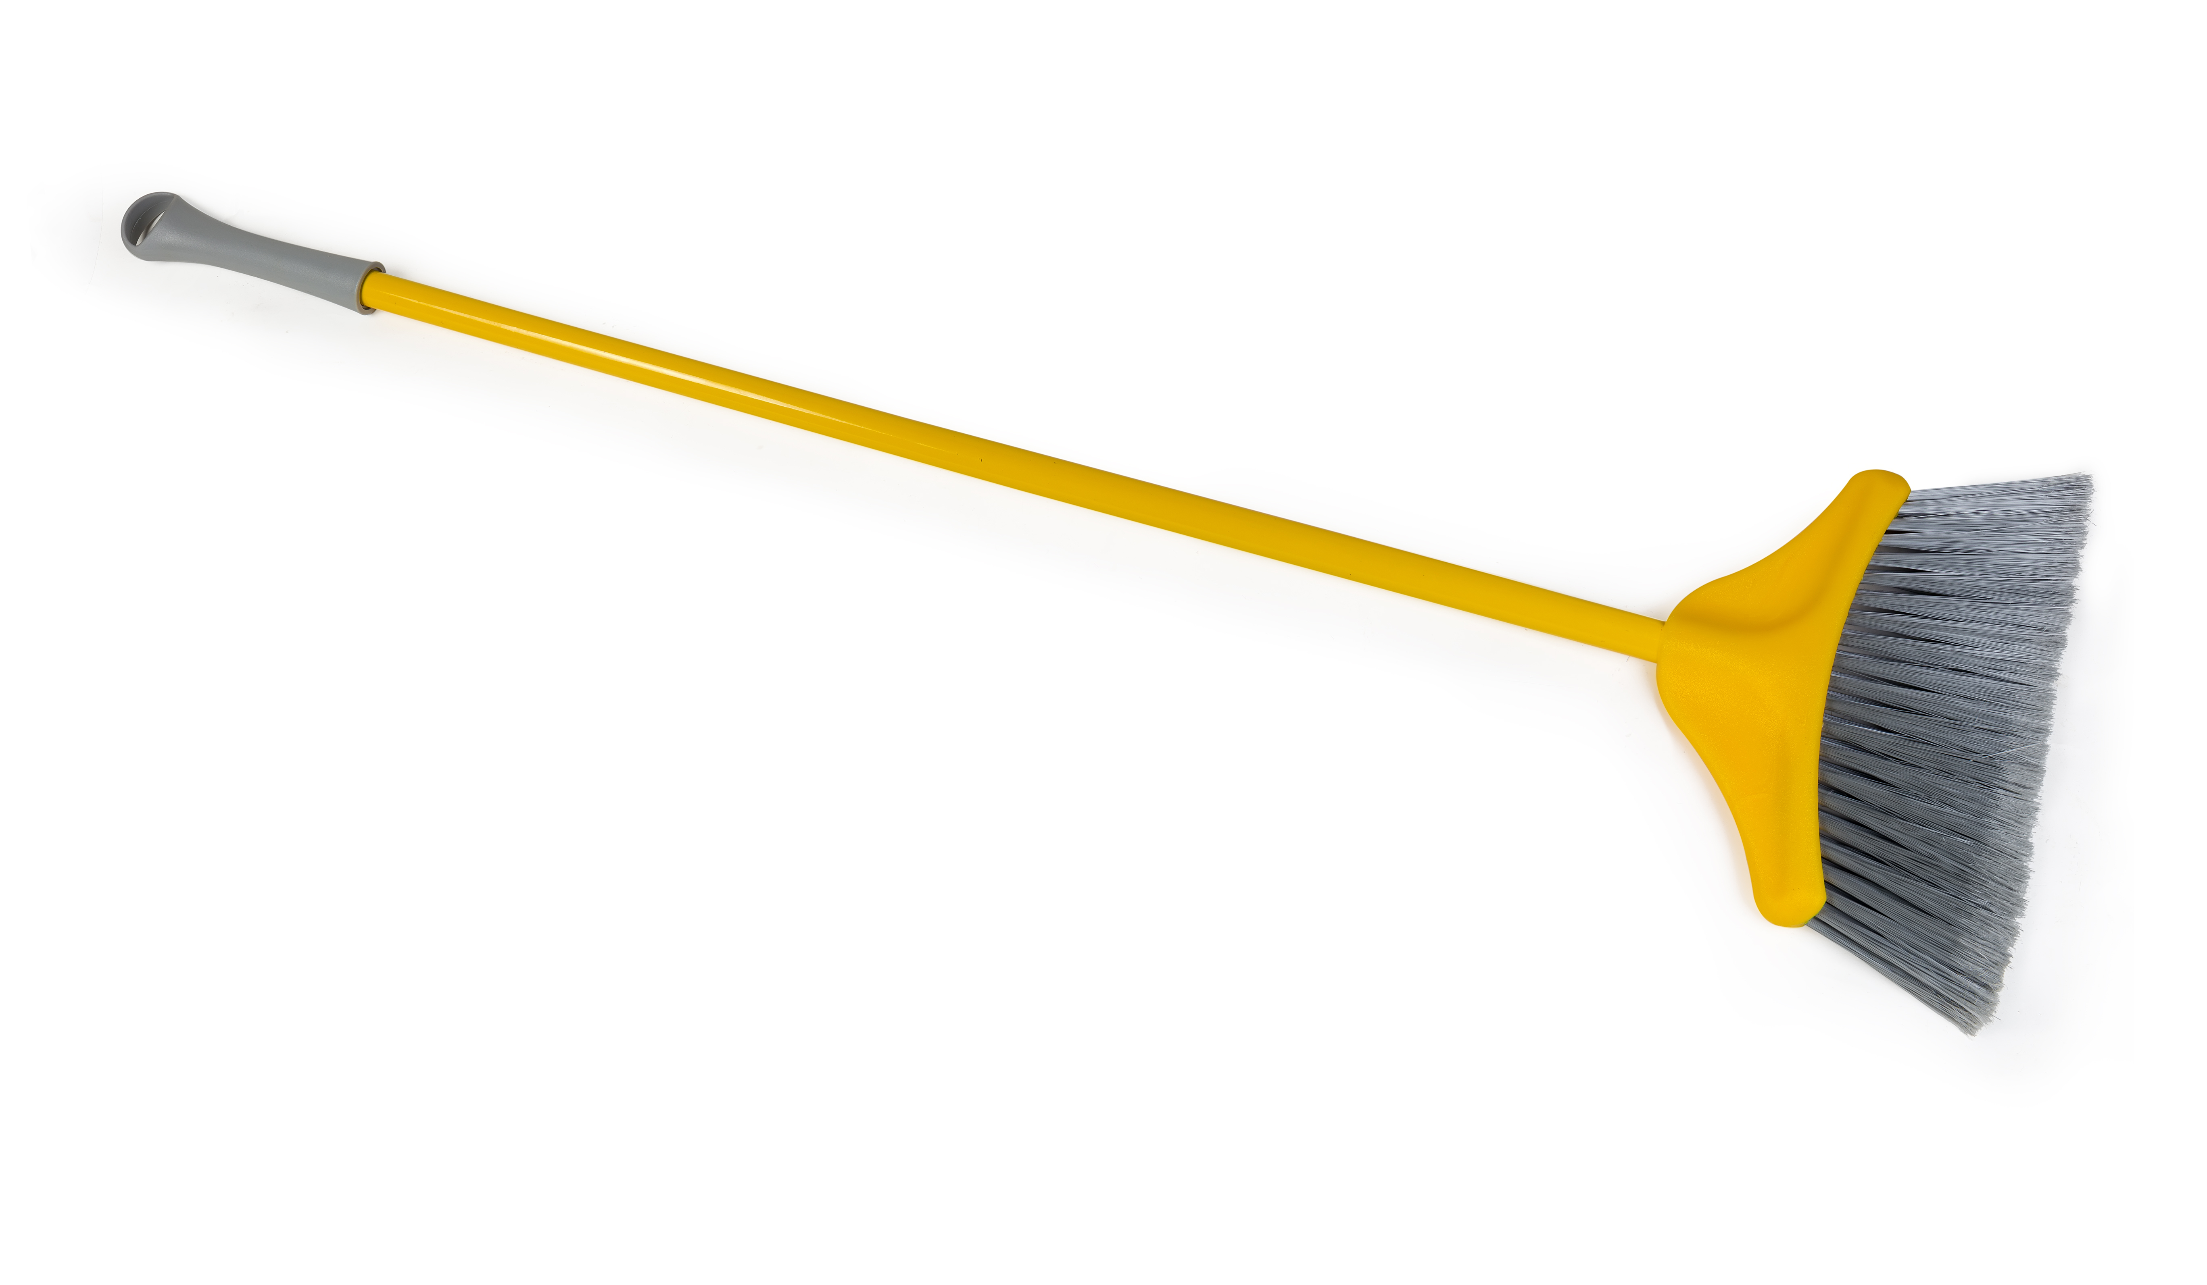
Let’s Practice!
food
broom
snooze
Notes:
Notes to Teacher:
Teacher will introduce the slide by telling the student that we are going to continue to work on words with the –oo sound.
Have the student read a word to you. After he/she reads it, click on the word to match it to the correct picture. Repeat this procedure for each of the words.
Applaud the student’s effort and click to go to the next slide.

Slide 4

Pronouns
Mom and Dad went to the store.
Look at Bob run with the dog.
The pig rolled in the mud.
I
you
he
she
him
her
they
them
it
we
us
Notes:
Notes to Teacher:
Ask: “What is a pronoun?” (A pronoun is a word that takes the place of a noun.)
Click to show some examples of pronouns to create a word bank.
Click to show I. Click to show you.
Click to show he. Click to show she.
Click to show him. Click to show her.
Click to show they. Click to show them.
Click to show it. Click to show we.
Click to show us.
Teacher: “Look at the following sentences and tell me what pronoun can replace the underlined noun.
Click to show the first sentence: Look at Bob run with the dog.
Ask: “What pronoun can replace Bob?” (him.)
Click to place a box around the correct pronoun.
Click to show the next sentence: Mom and Dad went to the store.
Ask: “What pronoun can replace Mom and Dad? (they.)
Click to place a box around the correct pronoun.
Click to show one more sentence: The pig rolled in the mud.
Ask: What pronoun can replace the pig? (It, he or she.)
Click to place a box around the correct pronouns. Remind student that we can use he or she, as well as it.
Applaud the student’s effort and click to go to the next slide.

Slide 5
Pronouns Take 2
The dog is eating his bone.
Her pencil fell on the floor.
We
are going to the park.
(Mark and I)
They
(The boys)
are playing baseball.
Notes:
Notes to Teacher:
Teacher: “Read each sentence and identify the pronoun in the sentence.”
Click to show the first sentence: The dog is eating his bone.
Ask: What is the pronoun in this sentence? (his.)
Click to underline his.
Click to show the next sentence: Her pencil fell on the floor.
Ask: What is the pronoun in the sentence? (her.)
Click to underline her.
Teacher: “Now, replace the noun in parentheses with the correct pronoun.”
Click to show the first sentence: (Mark and I) are going to the park.
Ask: What pronoun would replace Mark and I? (We.)
Click to show we.
Click to show the next sentence: (The boys) are playing baseball.
Ask: What pronoun would replace the boys? (They.)
Click to show they.
Applaud the student’s effort and click to move to the next slide.

Slide 6
Animal Friends- Vocabulary Review
-having a liking or love.
-ate up greedily or hungrily.
-failed to see or missed.
overlooked
fond
fond
devoured
overlooked
devoured
Notes:
Notes to Teacher:
Teacher: “Let’s review some of our vocabulary words.”
Click to show a definition and two words:
-ate up greedily or hungrily (overlooked or devoured)
Teacher: “Read the definition. Which word matches the definition?”
After the student tells you which word matches the definition, click to remove the incorrect word on the slide.
If the student is correct, applaud his/her answer. If the student is incorrect, review the definition and word with him/her.
Click to show the next definition and two words:
-failed to see or missed (fond or overlooked)
Teacher: “Read the definition. Which word matches the definition?”
After the student tells you which word matches the definition, click to remove the incorrect word on the slide.
If the student is correct, applaud his/her answer. If the student is incorrect, review the definition and word with him/her.
Click to show the last definition and two words:
-having a liking or love (fond or devoured)
Teacher: “Read the definition. Which word matches the definition?”
After the student tells you which word matches the definition, click to remove the incorrect word on the slide.
If the student is correct, applaud his/her answer. If the student is incorrect, review the definition and word with him/her.
Vocabulary:
devoured – ate up greedily or hungrily
overlooked– failed to see or missed
fond – having a liking or love
Before clicking to the next slide, applaud the student’s effort.
Click to go to the next slide.

Slide 7
Vocabulary Review Take Two!
-bent, twisted or turned unusually to one side.
-gloomily or resentfully silent.
-showing no self-control.
sullen
sullen
wry
wry
impatient
impatient
Notes:
Notes to Teacher:
Teacher: “Let’s review the rest of our vocabulary words.”
Click to show a definition and two words:
-gloomily or resentfully silent (sullen or wry)
Teacher: “Read the definition. Which word matches the definition?”
After the student tells you which word matches the definition, click to remove the incorrect word on the slide.
If the student is correct, applaud his/her answer. If the student is incorrect, review the definition and word with him/her.
Click to show the next definition and two words:
-bent, twisted or turned unusually to one side (wry or impatient)
Teacher: “Read the definition. Which word matches the definition?”
After the student tells you which word matches the definition, click to remove the incorrect word on the slide.
If the student is correct, applaud his/her answer. If the student is incorrect, review the definition and word with him/her.
Click to show the last definition and two words:
-showing no self-control (sullen or impatient)
Teacher: “Read the definition. Which word matches the definition?”
After the student tells you which word matches the definition, click to remove the incorrect word on the slide.
If the student is correct, applaud his/her answer. If the student is incorrect, review the definition and word with him/her.
Vocabulary:
sullen – gloomily or resentfully silent.
wry– bent, twisted or turned unusually to one side.
impatient – showing no self-control.
Applaud the student’s effort and click to move to the next slide.

Slide 8
Our Vocabulary Adventure Continues!
impatient
wry
fond
overlooked
devoured
sullen
Notes:
Notes to Teacher:
Teacher: “Let’s practice our vocabulary words by using each word in a sentence.”
Click to bring up one word onto the screen. As the word appears on the screen, the teacher or the student will read the word aloud.
*Give the student the opportunity to use it in a sentence.
*If the student uses the word correctly in a sentence, applaud his/her answer.
*If the student is having trouble using the word in a sentence, you may assist the student by reviewing the definition with him/her.
*Follow the same procedure for each of the six words.
Vocabulary:
devoured – ate up greedily or hungrily.
overlooked – failed to see or missed.
fond – having a liking or love.
sullen – gloomily or resentfully silent.
wry – bent, twisted or turned unusually to one side.
impatient – showing no self-control.
Applaud the student’s effort and then click to move to the next slide.

Slide 9
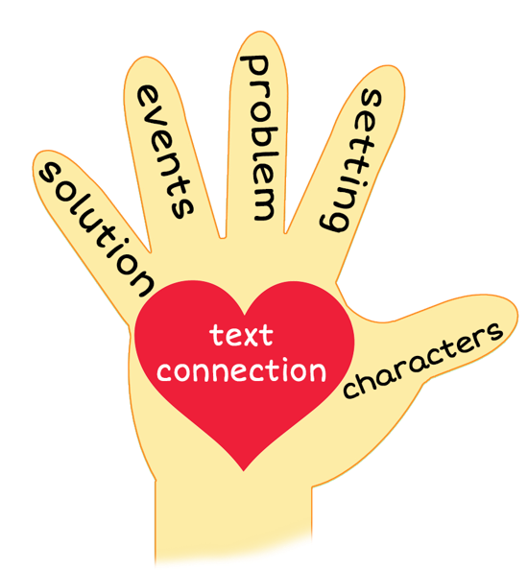
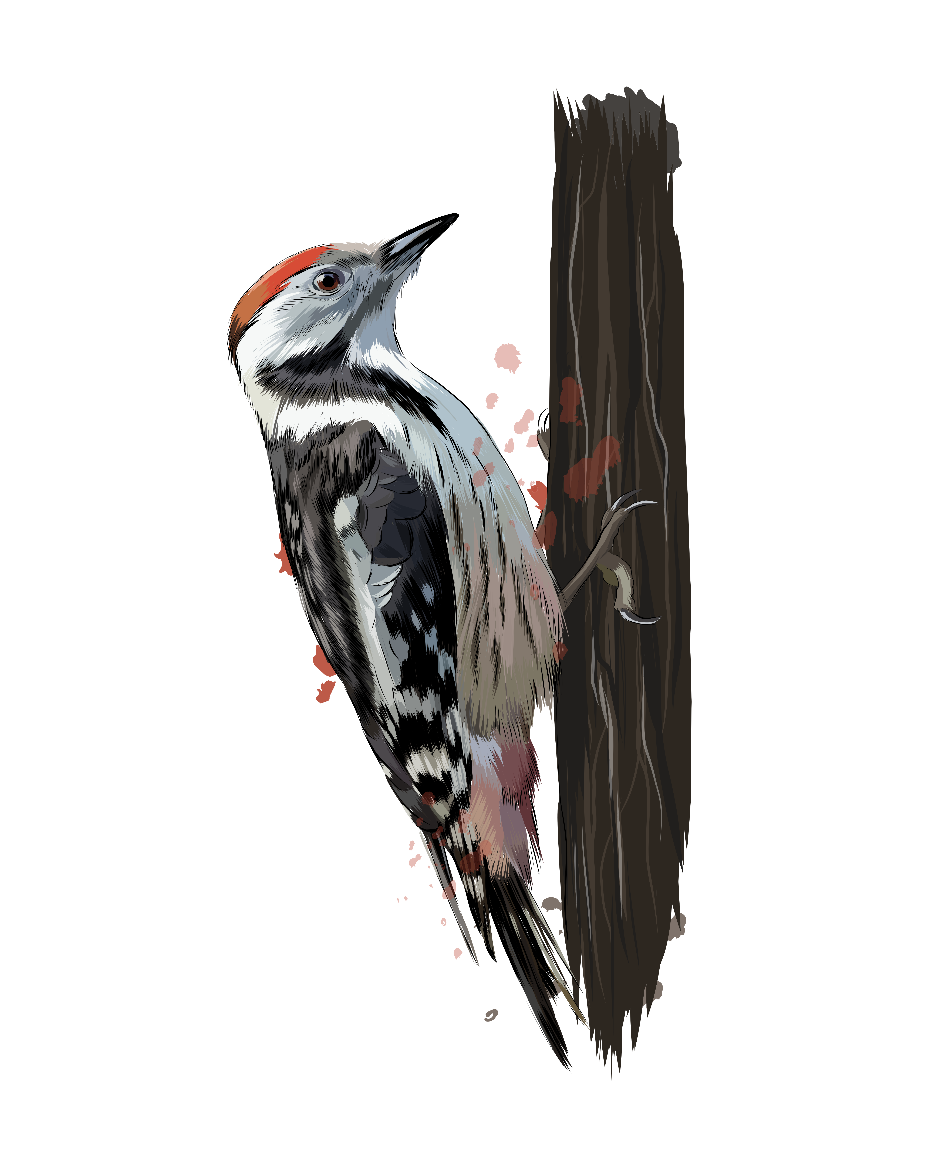
The Hunting Party
Notes:
Notes to Teacher:
Remind the student that we read a story called, The Hunting Party.
Thumb (Click to circle the thumb.) Who were the characters in the story – Cuffy Bear and Reddy Woodpecker
Pointer Finger (Click to circle the pointer finger.) - Where did the story take place? The story took place in the woods.
Middle Finger (Click to circle the middle finger) – What was the problem in the story? As the animals were hunting, they felt that the other animal was not being fair.
Ring Finger (Click to circle the ring finger.) What happened in the story? Cuffy Bear asked Reddy Woodpecker to go hunting for grubs.
Cuffy Bear wanted Reddy Woodpecker to wait to eat until he got there.
Reddy Woodpecker found trees full of grubs but Cuffy Bear would always eat most of the grubs.
Reddy Woodpecker barely had anything to eat.
Reddy Woodpecker felt that they should spilt the grubs evenly, while Cuffy Beat felt he should get most of the grubs because he was bigger.
Throughout the story they went through the woods, searching and eating grubs.
Pinky (Click to circle the pinky finger.) Solution – Was the problem solved? The problem was not necessarily solved. At the end of the story, they decided to go their separate ways. Each decided the other was selfish and not a good hunting partner.
Palm of Hand (Click to circle the palm of the hand.) Text Connection –Tell me about a time when you worked together with someone else. How did you split the workload? Was this easy or difficult? What made it easy? What made it more challenging?
How did you feel while reading this story?
Which character do you relate to – Reddy Woodpecker or Cuffy Bear?
Applaud the student’s effort.
Click to the next slide.

Slide 10
Q & A
Any Questions?
Notes:
Thank the student for his/her effort.
Ask the student if he/she has any questions.

