Slide 1
Pond Animals
Let’s Review!
Notes:
Notes to Teacher:
Tell the student that we are going to review our skills from this week.
We are going to talk about words with the thr- blend, verbs, vocabulary and our story titled, Paddy’s New Hat.
Teacher clicks to bring up the next slide.

Slide 2
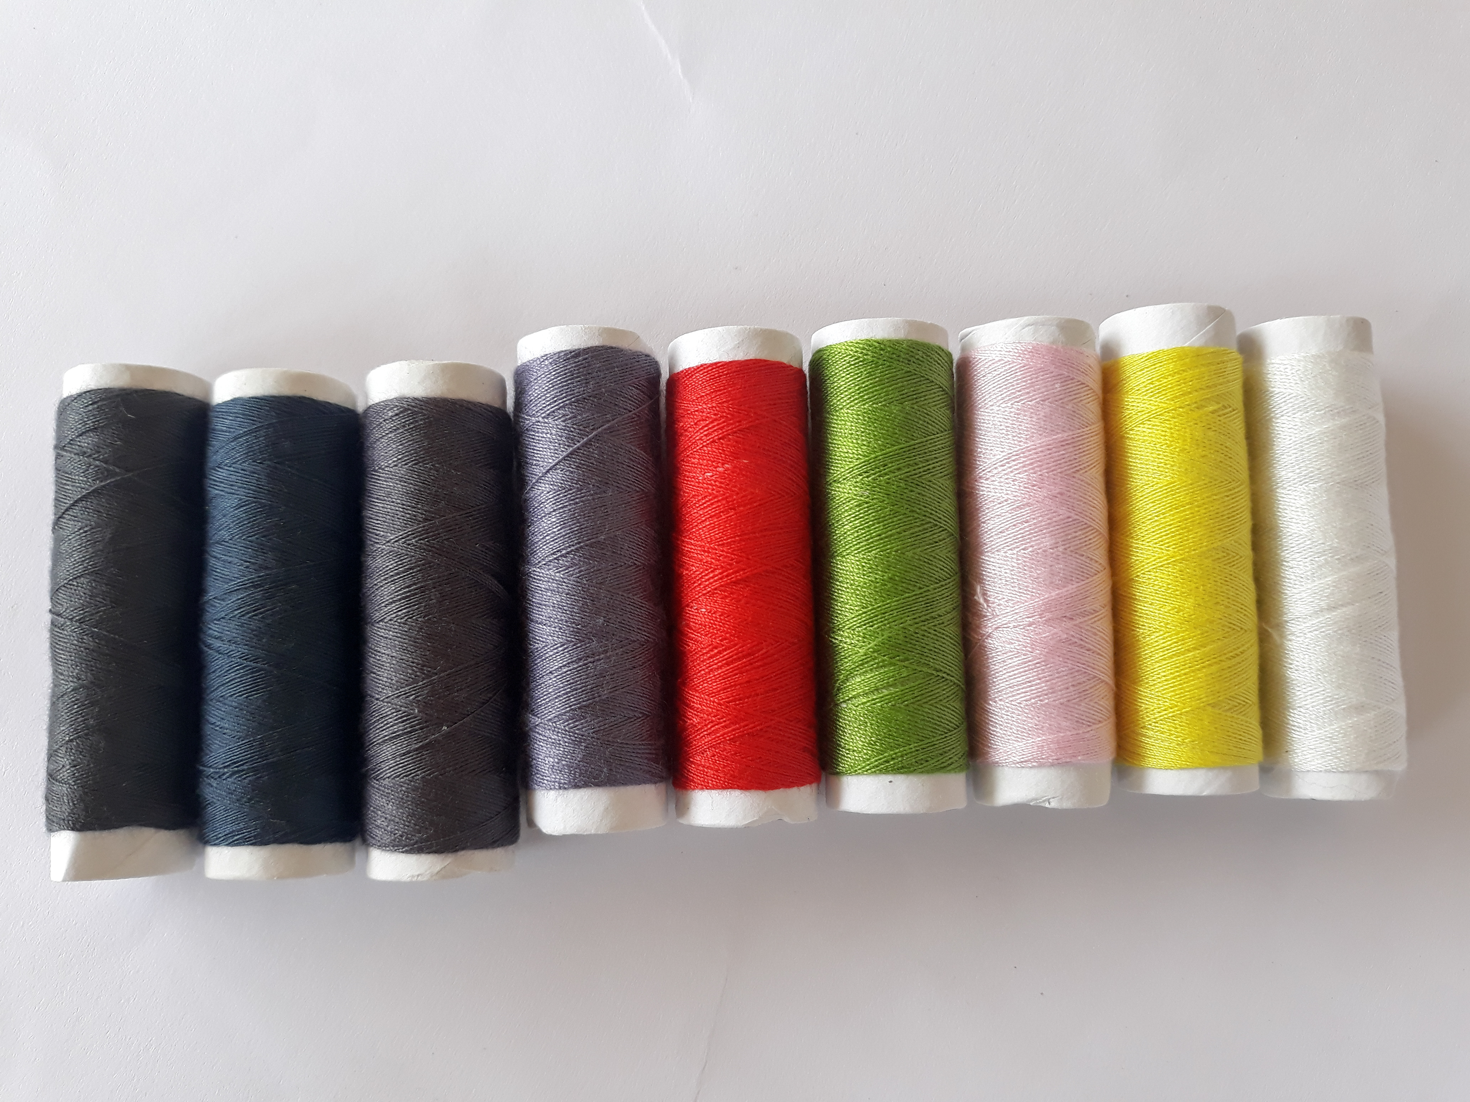
Reviewing Our Skills!
thr-
3
three
thread
Notes:
Notes to Teacher:
Teacher will introduce the slide by telling the student that we are going to work on words that have the thr- blend.
Click to show the blend: thr-.
Ask: “What sound do you hear when you blend ‘thr’ together?
Allow the student the opportunity to make the /thr/ sound, like /thr/ as in through.
Teacher: “Let’s read some more words with the /thr/ blend.”
Click to show the word, three. Ask: “What word is this?” The student will read the word to you.
Click to show the picture of the number three.
Click to show the word, thread. “What word is this?” The student will read the word to you.
Click to show the picture of thread.
Tell the student that we will look at some more words that have the thr- blend.
Applaud the student’s effort and click to go to the next slide.

Slide 3
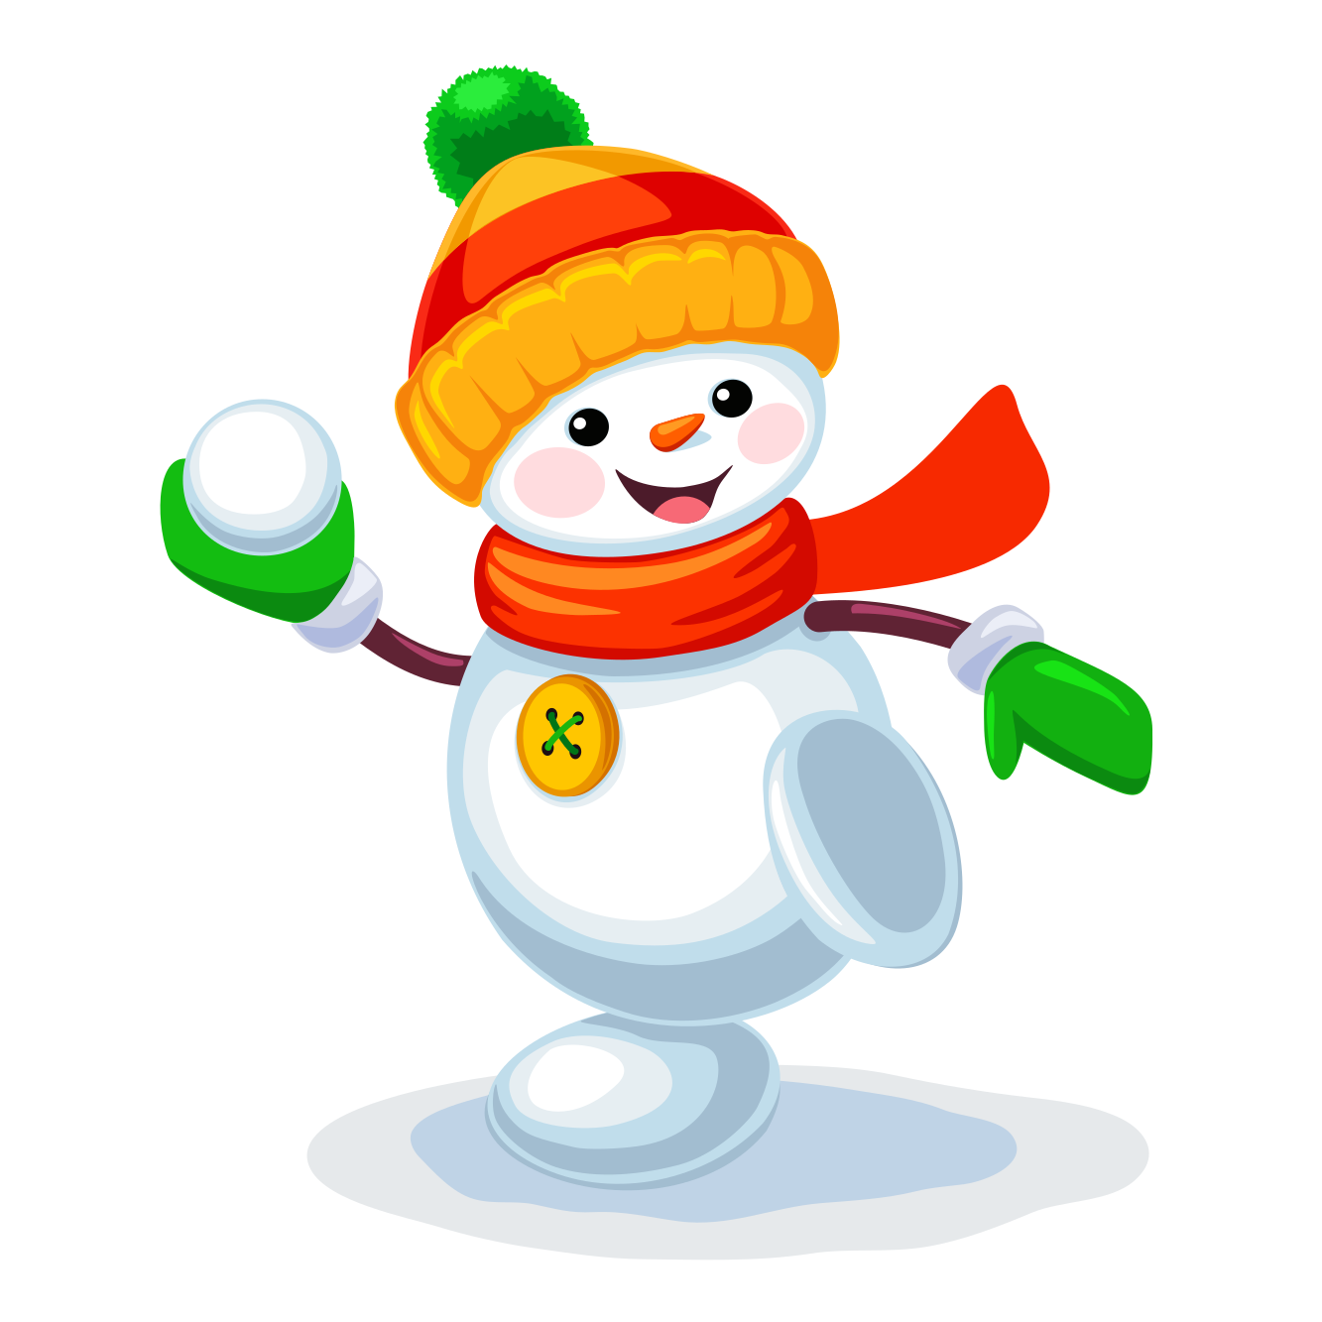

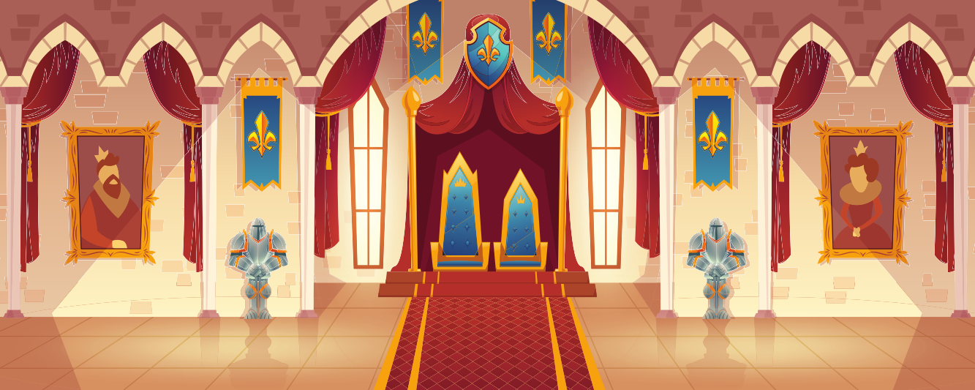
Let’s Practice!
thr-
threat
throw
throne
Notes:
Notes to Teacher:
Teacher will introduce the slide by telling the student that we are going to continue to work on thr- words.
Click to show the thr-blend.
Tell the student that we are going to read three words and match the word to the correct picture.
Click to show three pictures: throne, throw and threat.
Click to show the first word: throw. Ask the student to read the word to you, assisting if needed.
Once the student reads the word to you, have him/her tell you which picture goes with the word throw. Student should tell you the snowman is throwing the snowball.
Click the snowman to match the word with the snowman.
Click to show the next word: threat. Ask the student to read the word to you, assisting if needed.
Once the student reads the word to you, have him/her tell you which picture goes with the word threat. Student should tell you that the exclamation mark inside the triangle with the word danger alerts me that there might be a threat.
Click the triangle to match the word with the picture.
Click to show the last word: throne. Ask the student to read the word to you, assisting if needed.
Once the student reads the word to you, have him/her tell you which picture goes with the word throne. Student should tell you about the picture of a throne for the king and queen.
Click the picture to match the word with the picture.
Applaud student’s effort and click to go to the next slide.

Slide 4
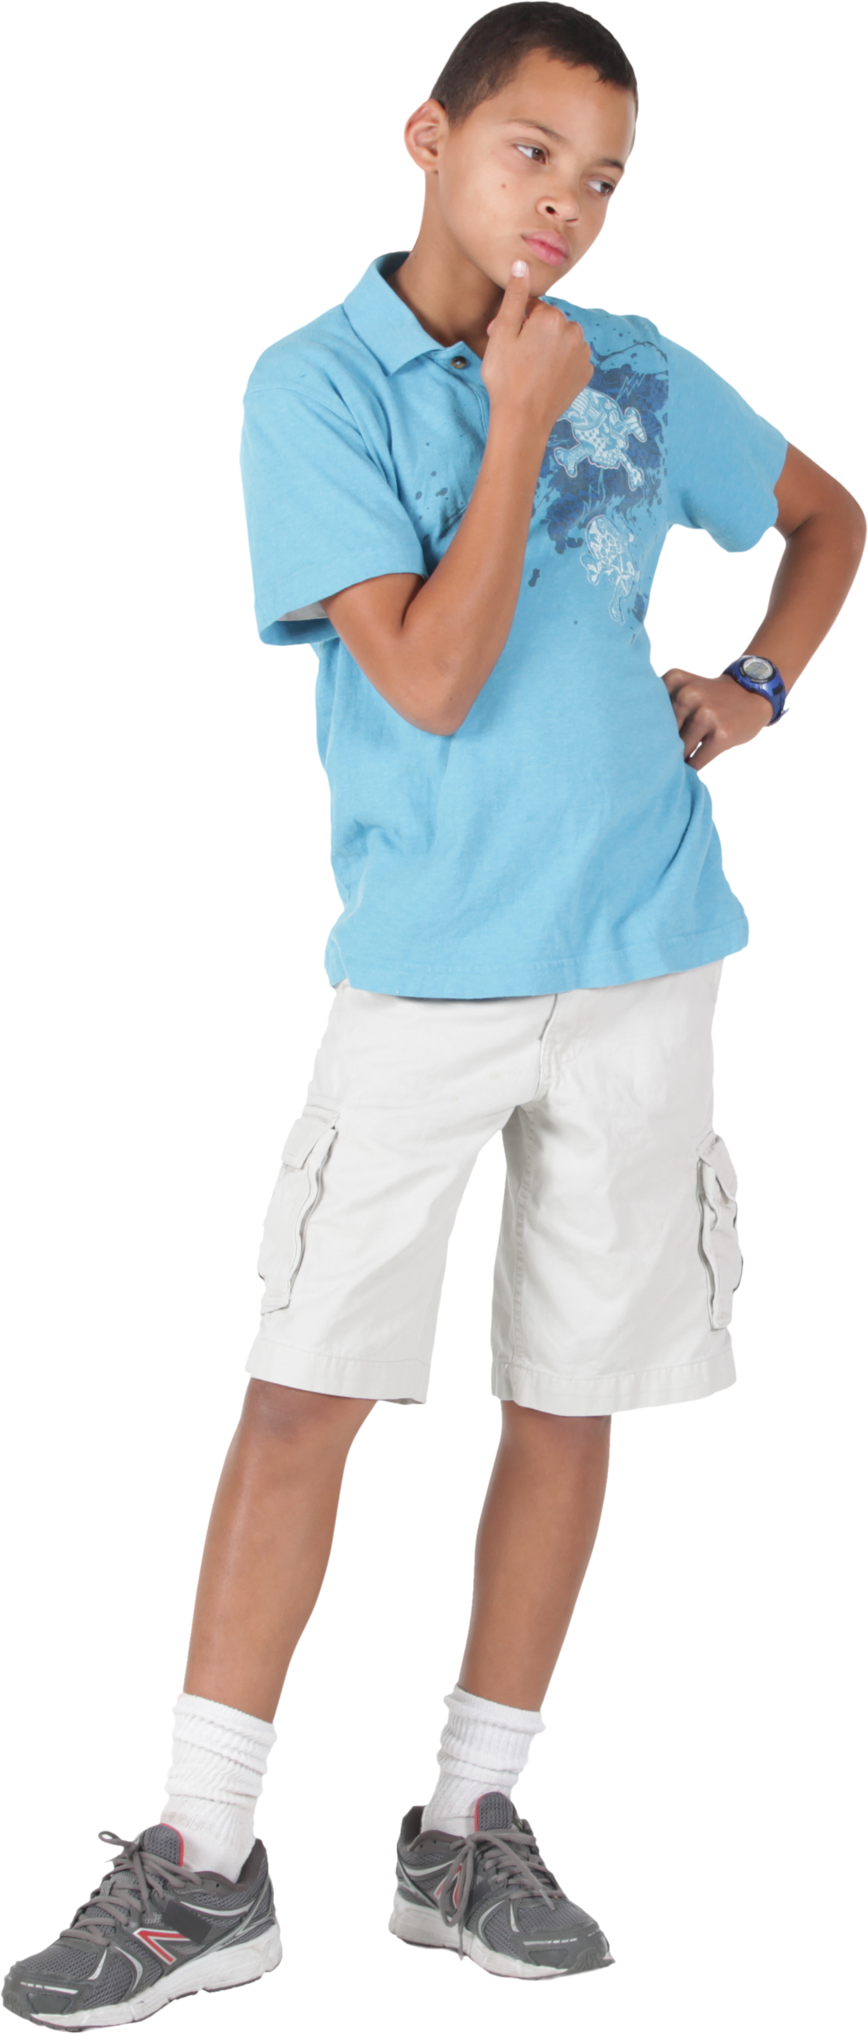
Future Tense Verbs
?
Future tense verbs talk about an action that will take place at a later time, in the future.
I will read the story tonight.
Bob will call John on Wednesday.
Notes:
Notes to Teacher:
Teacher: “We have been talking about verbs. Verbs tell us what the subject is doing.”
Tell the student that today we will look at future tense verbs.
Click to show the picture of the question mark.
Ask: “What is a future tense verb?”
Allow the student the opportunity to tell you that a future tense verb talks about an action that will take place at a later time, in the future. As students answer it correctly, click to display the definition on the screen.
Click to show an example (the question mark and definition will disappear):
I will read the story tonight.
Ask: “What will I do?” (Read.)
Ask: “When will I read?” (Tonight.)
Click to underline ‘will read’.
Tell the student that ‘will read’ is the future tense verb. It tells me what I will do tonight.
Teacher: “Let’s try another one.”
Click to show another example: Bob will call John on Wednesday.
Ask: “What will Bob do?” (Call John.)
Ask: “When will he call John?” (Wednesday.)
Click to underline ‘will call.’
Tell the student that ‘will call’ is the future tense verb. It tells me when Bob will call John.
Teacher: “Let’s look at some more verbs in sentences.”
Applaud student’s effort and click to go to the next slide.

Slide 5
Identifying Future Tense Verbs
Your Turn!
win
(win)
Do you think we ____ the
football game?
will
run
will
We ___ on Tuesday morning.
shop
(shop)
Notes:
Notes to Teacher:
Teacher: “Let’s work on future tense verbs in sentences.”
Click to show the first sentence: Do you think we _____ (win) the football game?
Have the student read the sentence aloud.
Teacher: “Fill in the correct future tense verb using the verb in the parenthesis.”
Allow time for the student to add ‘will win’ the game.
Click to show ‘will win’ in the sentence.
Click to show the next sentence: We ____ (shop) on Tuesday morning.
Have the student read the sentence aloud.
Teacher: “Fill in the correct future tense verb using the verb in the parenthesis.”
Allow time for the student to add ‘will shop’ on Tuesday morning.
Click to show ‘will shop’ in the sentence.
Applaud the student’s effort.
Click to show Your Turn! and the verb ‘run.’
Teacher: “It’s your turn. Create a sentence using the future tense for the verb run. You may tell me the sentence or write it down on a piece of paper or white board and show it to me.”
Allow time for the student to create and share a sentence with you. (Example: I will run in the relay race tomorrow.)
After the student creates and shares the sentence, ask him/her to identify/underline the future tense verb. (Example: I will run in the relay race tomorrow.)
Applaud the student’s effort and move on to the next slide.

Slide 6
Pond Animals - Vocabulary Review
distressed
assortment
urged
-a variety or collection of different things.
-worried or troubled.
-tried to persuade.
Notes:
Notes to Teacher:
Teacher: “Let’s review some of our vocabulary words.”
Click to show the first word, assortment, and two definitions.
Teacher: “Our first word is assortment. (Have the student repeat the word – assortment.) What is the definition of assortment?”
Allow time for the student to tell you which definition matches assortment. If the student is correct, applaud his/her answer. If the student is incorrect, review the definition with him/her.
As the student gives you the correct definition, click to make the incorrect definition fade away.
Click to show the next word, distressed, and two definitions.
Teacher: “Our next word is distressed. (Have the student repeat the word – distressed.) What is the definition of distressed?”
Allow time for the student to tell you which definition matches distressed. If the student is correct, applaud his/her answer. If the student is incorrect, review the definition with him/her.
As the student gives you the correct answer, click to make the incorrect definition fade away.
Click to show the last word, urged and two definitions.
Teacher: “Our last word is urged. (Have the student repeat the word – urged.) What is the definition of urged?”
Allow time for the student to tell you which definition matches urged. If the student is correct, applaud his/her answer. If the student is incorrect, review the definition with him/her.
As the student gives you the correct answer, click to make the incorrect definition fade away.
Vocabulary:
assortment – a variety or collection of different things.
distressed– worried or troubled.
urged– tried to persuade.
Before clicking to the next slide, applaud the student’s effort.
Click to go to the next slide.

Slide 7
Vocabulary Review Take Two!
satisfied
inquired
stylish
-asked about.
-made happy.
-having style, fashionable.
Notes:
Notes to Teacher:
Teacher: “Let’s review the rest of our vocabulary words.”
Click to show the first word, satisfied, and two definitions.
Teacher: “Our first word is satisfied. (Have the student repeat the word – satisfied.) What is the definition of satisfied?”
Allow time for the student to tell you which definition matches satisfied. If the student is correct, applaud his/her answer. If the student is incorrect, review the definition with him/her.
As the student gives you the correct definition, click to make the incorrect definition fade away.
Click to show the next word, inquired, and two definitions.
Teacher: “Our next word is inquired. (Have the student repeat the word – inquired.) What is the definition of inquired?”
Allow time for the student to tell you which definition matches inquired. If the student is correct, applaud his/her answer. If the student is incorrect, review the definition with him/her.
As the student gives you the correct answer, click to make the incorrect definition fade away.
Click to show the last word, stylish, and two definitions.
Teacher: “Our last word is stylish. (Have the student repeat the word – stylish.) What is the definition of stylish?”
Allow time for the student to tell you which definition matches stylish. If the student is correct, applaud his/her answer. If the student is incorrect, review the definition with him/her.
As the student gives you the correct answer, click to make the incorrect definition fade away.
Vocabulary:
satisfied – made happy.
inquired– asked about.
stylish – having style, fashionable.
Before clicking to the next slide, applaud the student’s effort.
Click to go to the next slide.

Slide 8
Our Vocabulary Adventure Continues!
word bank
assortment
distressed
urged
satisfied
inquired
stylish
urged
distressed
inquired
Your Turn!
The boy _______ his mom to take him to the carnival.
The child appeared __________ because he was lost.
The girl __________ about the candy on the table.
Notes:
Say: Let’s review our vocabulary words for the week. When I show you a sentence, please tell me the word on the slide that works best in the blank. Here is first sentence. (Click to show The boy _____ his mom to take him to the carnival. –urged)
Say: Which word fits best in the sentence? (Student should say “urged”. Click to show the answer disappear and appear in the sentence. Repeat the process for the next two sentences.
2. The child appeared __________ because he was lost. -distressed
3. The girl ______ about the candy on the table. – inquired)
(Click to show Your Turn! Ask the students to write a sentence for each word remaining on the screen: assortment, satisfied, stylish. They may say their sentence or show you their sentence on their whiteboard.)
Applaud the student’s effort and then click to move to the next slide.

Slide 9
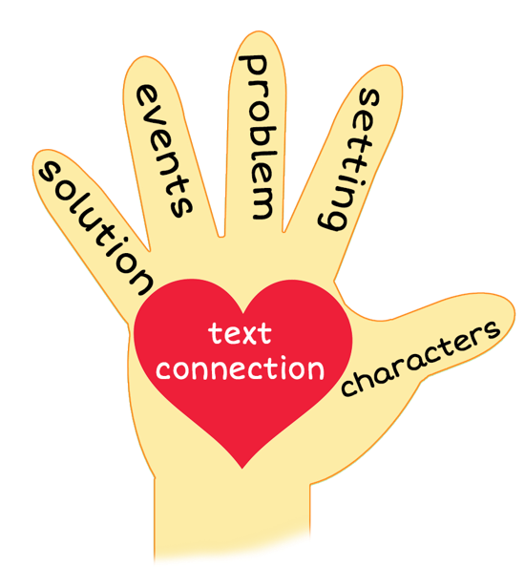
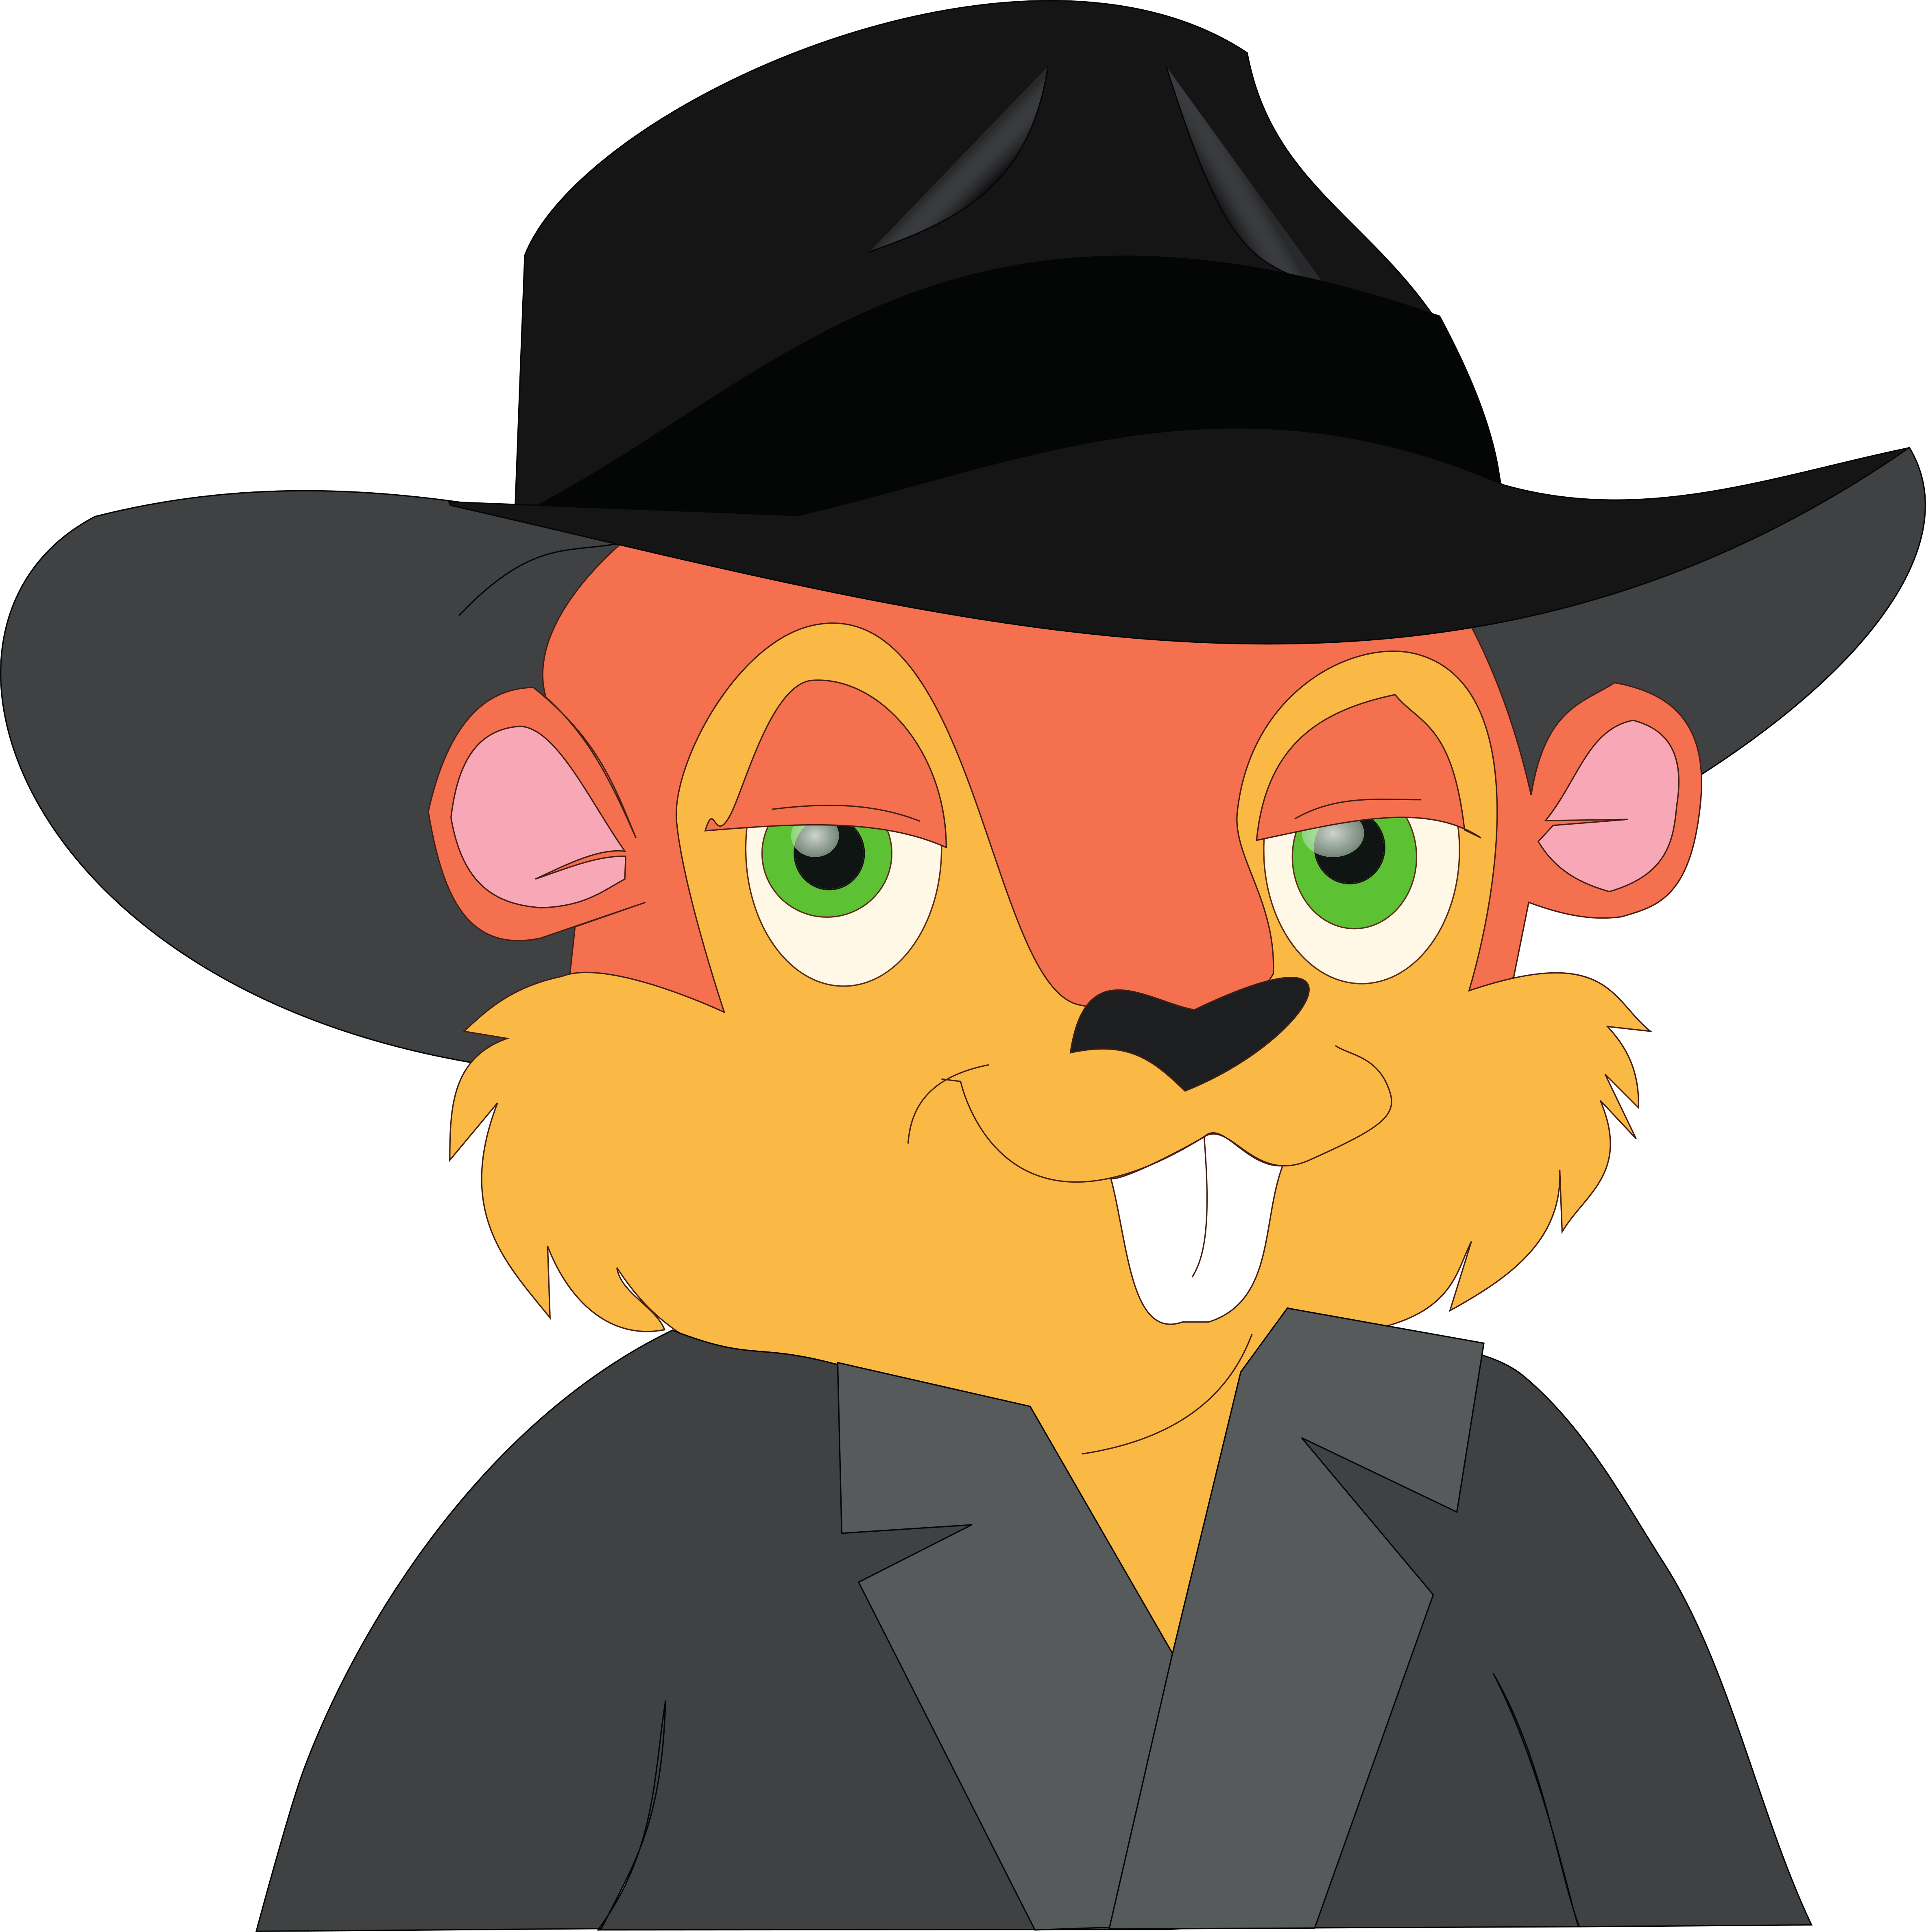
Paddy’s New Hat
Notes:
Notes to Teacher:
Remind the student that we read a story called, Paddy’s New Hat.
Thumb (Click to circle the thumb.) Who were the characters in the story – Paddy (the muskrat,) Paddy’s wife, Jimmy Rabbit and Mr. Crow.
Pointer Finger (Click to circle the pointer finger.) - Where did the story take place? The story took place near the pond and at the hat store.
Middle Finger (Click to circle the middle finger) – What was the problem in the story? Paddy lost his hat in the water. This is the fourth hat he lost this summer.
Ring Finger (Click to circle the ring finger.) What happened in the story?
Paddy, the muskrat, came home and told his wife that as he was swimming near the milldam, he lost his hat.
They were both upset by this, as it was the fourth hat he lost this summer. His wife, Mrs. Paddy, wanted to add a strap to his hat so that he would not lose it, but Paddy did not like her idea.
After losing his hat, he told his wife that he was going to go see Jimmy Rabbit at the hat store. Mr. Crow told Paddy that Jimmy Rabbit opened up a new hat store and has a wonderful selection.
Paddy went to the hat store, told Jimmy Rabbit his problem and began looking for the perfect hat for him.
Jimmy Rabbit helped him find a hat and worked with him on a solution to keep his hat on his head.
Pinky (Click to circle the pinky finger.) Solution – Was the problem solved? At of the end of the story, Paddy still had his new hat.
Palm of Hand (Click to circle the palm of the hand.) Text Connection –Did you ever lose something you loved? How did that make you feel? Were you able to get a replacement? If so, how did you make sure that you did not lose it again?
Do you think Paddy will lose his hat again?
What was your favorite part of the story?
Applaud the student’s effort.
Click to the next slide.

Slide 10
Q & A
Any Questions?
Notes:
Thank the student for his/her effort.
Ask the student if he/she has any questions.

