Slide 1
My Adventures
Sailing through our Skills
Notes:
Welcome the student. Tell him/her that we will be sailing through CCVC words, Sentences, Vocabulary and Finding Agent Barkley, one skill at a time!
Teacher clicks to bring up the next slide.

Slide 2

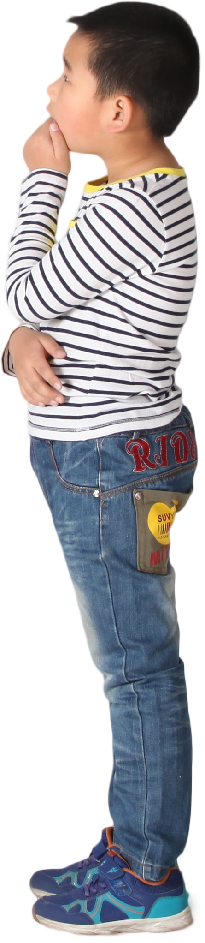


Let’s Talk about Words!
flag
frog
__ab
cr
Notes:
Notes to Teacher:
Teacher should introduce the slide by telling the student that we are going to work on CCVC (consonant-consonant-vowel-consonant) words.
Teacher clicks to bring up the word, ‘flag’ with an image of a flag.
Ask: “What word do you see?” (flag.)
Teacher: “This word begins with two consonant letters: fl. When we put the f and the l together, they make the /fl/ sound.”
Click to show another word: frog (with an image of a frog.)
Ask: “What word do you see?” (frog.)
When we put the f and the r together, they make the /fr/ sound.”
Click to show the picture of the crab with the following text: __ab. Ask student to identify the picture (crab.)
Ask: “What two consonants go together to make the /cr/ sound?” (Allow student to respond ‘cr.’)
Teacher should click to show the “cr” at the beginning of -ab.
Applaud student’s effort.
Teacher: “Let’s try some more CCVC (consonant-consonant-vowel-consonant) words!”
Click to go to the next slide.

Slide 3
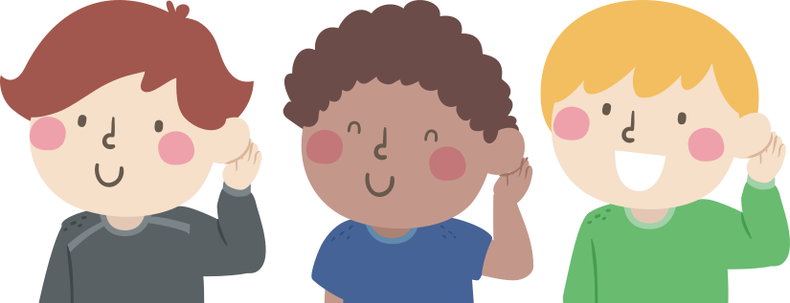

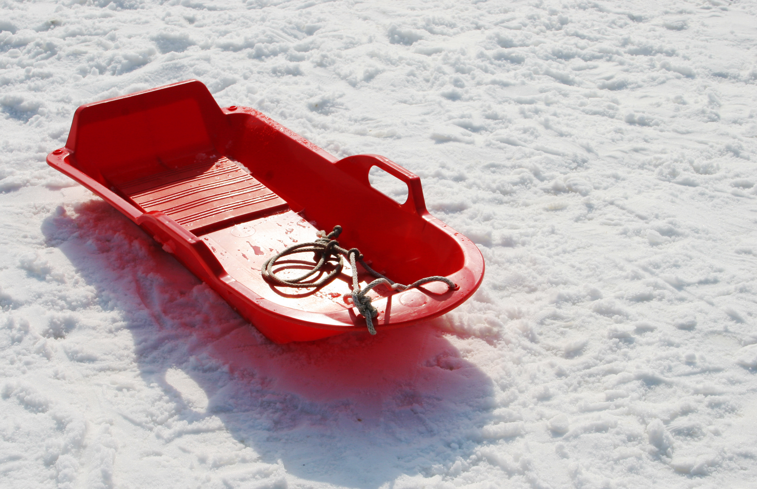
Let’s Practice!
sl
__ed
__ap
cl
Notes:
Notes to Teacher:
Click to bring up the image of the children listening.
Tell the student that we are going to practice filling in the missing part of each word. Each word will begin with two consonants.
Click to bring up a picture of a sled.
Ask: “What is this?” (sled.)
Ask: “What letters are missing in sled?” (s l.)
Click to add “sl” to sled.
Click to bring up the picture of people clapping.
Ask: “What are these people doing?” (clapping.)
Ask: “What letters are missing in clap?” (c l.)
Click to add “cl” to clap.
Applaud the student’s effort and then click to go to the next slide.

Slide 4
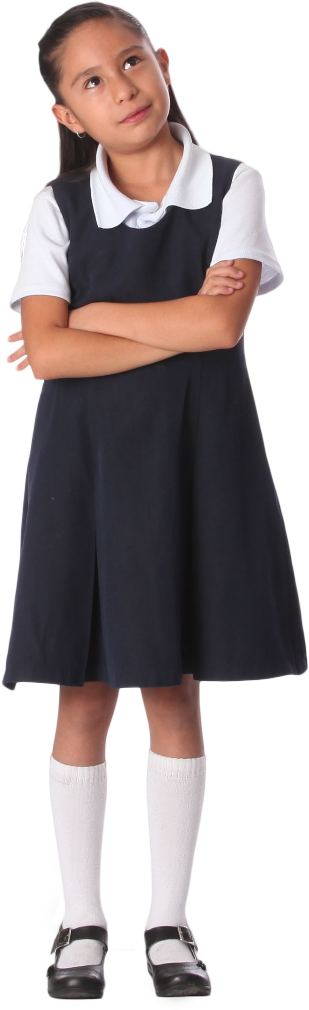
Sentence Parts
What does a sentence need?
Subject + Predicate
The dog ran fast..
I can draw a flower.
Alex.
rolled down the hill.
Notes:
Notes to Teacher:
Click to bring the child to the screen with a question.
Have the student read the question: “What does a sentence need?”
Allow the student time to answer the question.
If he/she can tell you a sentence is a complete thought that includes a subject and predicate, applaud his/her answer and click to show the answer.
(The child and question will disappear from the slide.)
If the student is having a difficult time answering the question, click and explain the parts of a sentence. A subject is who or what the sentence is about. A predicate is a verb or verb phrase that tells about the subject.
Remind the student that a sentence needs a subject and a predicate.
Teacher: “Let’s take a look at a few sentences.”
The teacher will click to show a sentence and have the student identify the subject and predicate:
The dog ran fast. (Subject: The dog + Predicate: ran fast.)
The teacher will click to show the next sentence:
I can draw a flower. (Subject: I + Predicate: can draw a flower.)
After reading the two sentences (above) and identifying the subject and predicate, have the student read the incomplete sentences, identifying what part is missing and filling in the missing part.
Click to show the next line:
Alex. (We are missing the predicate.)
Ask: “What can Alex do or where can Alex go?” Possible answers – Alex can draw a dinosaur or Alex went to the dentist.)
Click to show the last line:
rolled down the hill. (We are missing the subject.)
Ask: “Who or what rolled down the hill?” Possible answer – The ball rolled down the hill.)
Applaud the student’s effort and then click to go to the next slide.

Slide 5

Searching for Sentences
The car is red.
I see the stuffed animal.
The squirrel
Notes:
Notes to Teacher:
Click to show the student looking through the magnifying glass.
Tell the student that today, he/she will search for complete sentences.
Teacher will click to show a sentence or part of a sentence. As a sentence is brought to the slide, have the student read the text (assist as needed.) After identifying if it is a sentence or not, the teacher may take it a step further: If it is a complete sentence, the teacher may have student identify the subject and/or predicate. If it is not a complete sentence, the teacher may ask the student to identify the missing part.
Click to show the first sentence: “The car is red.”
Ask: “Is this a sentence?” (Yes.) Click to show the green star. “Yes, this is a sentence.”
Click to take the previous sentence away and bring up the next one:
“I see the stuffed animal.”
Ask: “Is this a sentence?” (Yes.) Click to show the green star. “Yes, this is a sentence.”
Click to take the previous sentence away and bring up the last one:
“The squirrel” Ask: “Is this a sentence?” (No.) Click to show the red x. “No, this is not a complete sentence.”
Ask: “What is missing?” (We are missing the predicate.)
Ask: “How can we make this a complete sentence?” (We need to add a predicate.) The student should tell you more about the squirrel. Possible answers – The squirrel buried the acorn. The squirrel ran up the tree. The squirrel is brown.
Applaud the student’s effort and click to go to the next slide.

Slide 6
My Adventures –
Vocabulary Review
to wander from a group without a purpose
frighten
to make afraid
wander
to move about without a purpose
stray
Notes:
Notes to Teacher:
Teacher: “Let’s review our vocabulary words.”
Click to show frighten. Have the student read the word.
Click to show wander. Have the student read the word.
Click to show stray. Have the student read the word.
Click to show the first definition.
Ask: “Which word means to wander from a group without a purpose?”
Allow the student time to tell you that stray means to wander from a group without a purpose.
Click to draw an arrow from the definition to the matching word.
Click to show the next definition.
Ask: “Which word means to make afraid?”
Allow the student time to tell you that frighten means to make afraid.
Click to draw an arrow from the definition to the matching word.
Click to show the last definition.
Ask: “Which word means to move about without a purpose?”
Allow the student time to tell you that wander means to move about without a purpose.
Click to draw an arrow from the definition to the matching word.
Applaud the student’s effort and click to review the next set of words.

Slide 7
Vocabulary Review Take Two!
noisily rough
romp
rough and noisy play
boisterous
to put on straps by which an animal pulls a load
harness
Notes:
Notes to Teacher:
Teacher: “Let’s review the rest of our vocabulary words.”
Click to show romp. Have the student read the word.
Click to show boisterous. Have the student read the word.
Click to show harness. Have the student read the word.
Click to show the first definition.
Ask: “Which word means noisily rough?”
Allow the student time to tell you that boisterous means noisily rough.
Click to draw an arrow from the definition to the matching word.
Click to show the next definition.
Ask: “Which word means rough and noisy play?”
Allow the student time to tell you that romp means rough and noisy play.
Click to draw an arrow from the definition to the matching word.
Click to show the last definition.
Ask: “Which word means to put on straps by which an animal pulls a load?”
Allow the student time to tell you that a harness means to put on straps by which an animal pulls a load.
Click to draw an arrow from the definition to the matching word.
Applaud the student’s effort and click to go to the next slide.

Slide 8
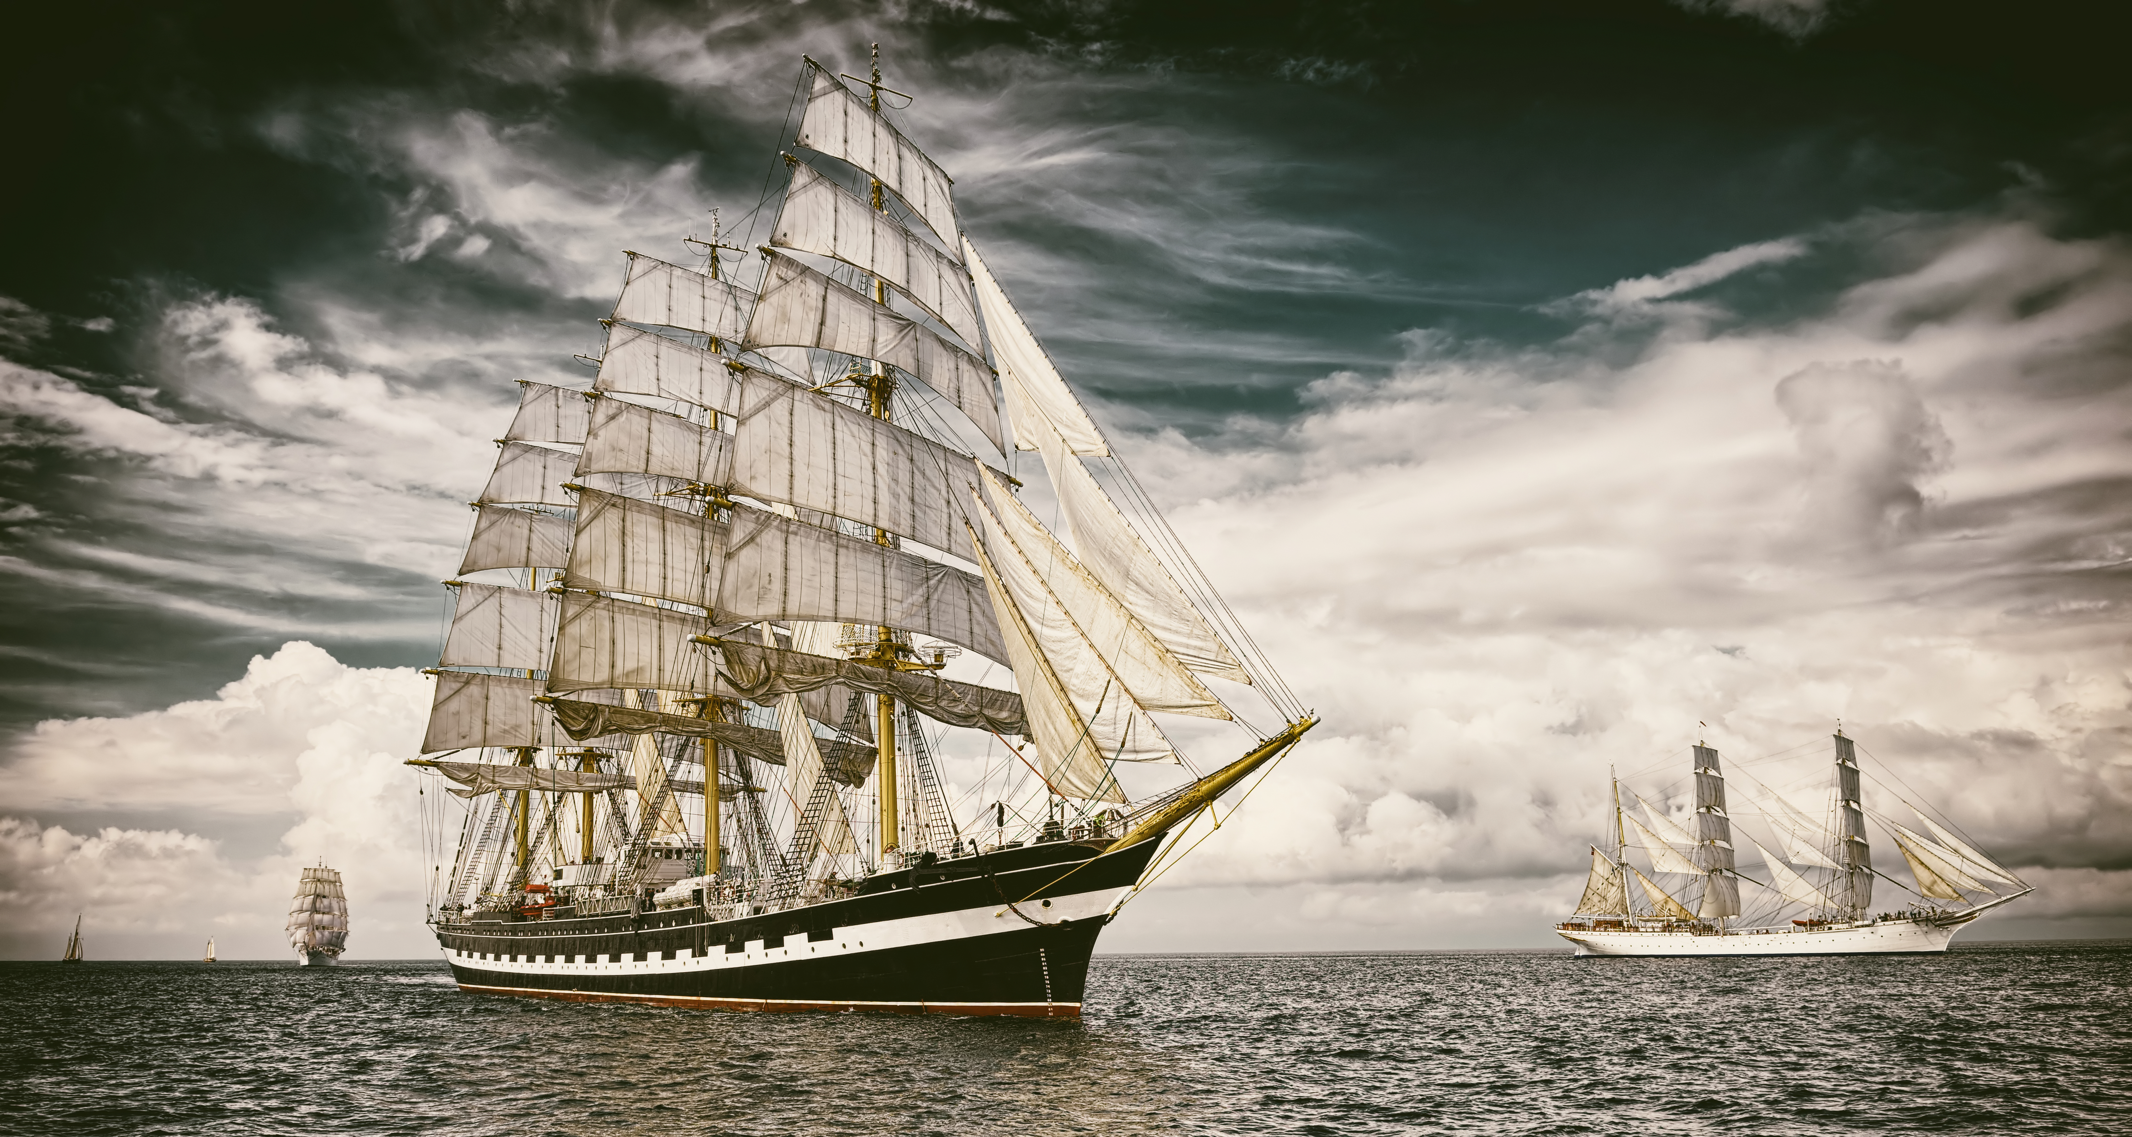
Our Vocabulary Adventure Continues!
The kittens love to _____ and play.
romp
boisterous
The ________ crowd cheered at
the game!
wander
Please do not _____ off.
frighten
The loud noise may ________
the cat.
Evan needs to get a
________ for Barkley.
harness
Please do not _____ from the group.
stray
frighten wander stray
romp boisterous harness
Notes:
Notes to Teacher:
Teacher: “Let’s practice our vocabulary by filling in the blanks.”
Click to bring up a word bank with six vocabulary words. (Review the vocabulary words in the word bank.)
Click to bring up the first sentence: The kittens love to ______ and play. (romp)
*Teacher or student should read the sentence aloud.
*Give the student the opportunity to fill in the missing word.
*If the student fills in the correct word, applaud his/her answer.
*If the answer is incorrect, assist the student in filling in the sentence with the correct word.
*Click to add word to the line in the sentence.
*Follow the same procedure for the rest of the sentences. The previous sentence will disappear.
Click to bring up the next sentence: Please do not ______ off. (wander)
Click to bring up the next sentence: The loud noise may _______the cat. (frighten)
Click to bring up the next sentence: Evan needs to get a _______ for Barkley. (harness)
Click to bring up the next sentence: Please do not _____ from the group. (stray)
Click to bring up the last sentence: The __________ crowd cheered at the game! (boisterous)
Applaud student’s effort and click to move to the next slide.

Slide 9
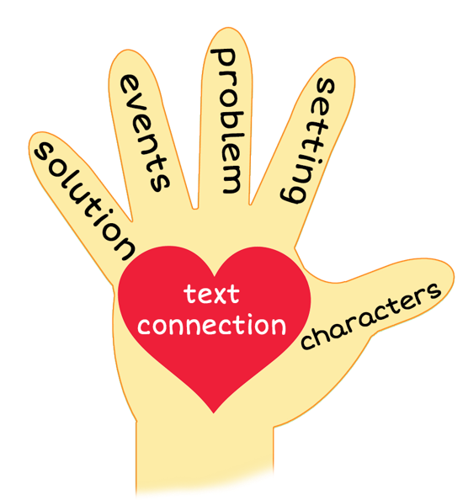
5 Finger Retell
Notes:
Notes to Teacher:
Remind the student how to use our hand to help retell a story, using the information below.
Click to bring the image of a hand.
Ask the student to hold up his/her hand and point to each finger as we go through the retell.
Teacher will click on the slide so each finger is circled as we work through this review. Ask the student to use his/her hand with you as you move through the slide.
Thumb (Click to circle the thumb.) “We will talk about the characters in the story. Who did we meet in the story? We may meet people and/or animals.”
Pointer Finger (Click to circle the pointer finger.) - “We will talk about the setting- Where and when did the story talk place?”
Middle Finger (Click to circle the middle finger) – “We will talk about the problem -Was there a problem in the story? If so, what was the problem?”
Ring Finger (Click to circle the ring finger.) “We will talk about the events in the story. What happened in the story?”
Pinky (Click to point to the pinky finger.) Solution – “Was the problem solved? If so, how did the characters solve the problem in the story?”
Palm of Hand (Click to point to the palm of the hand.) Text Connection – How does this story connect to your life?
Remind the student that we will use our hand to help us retell our story today.
Click to go to the next slide.

Slide 10
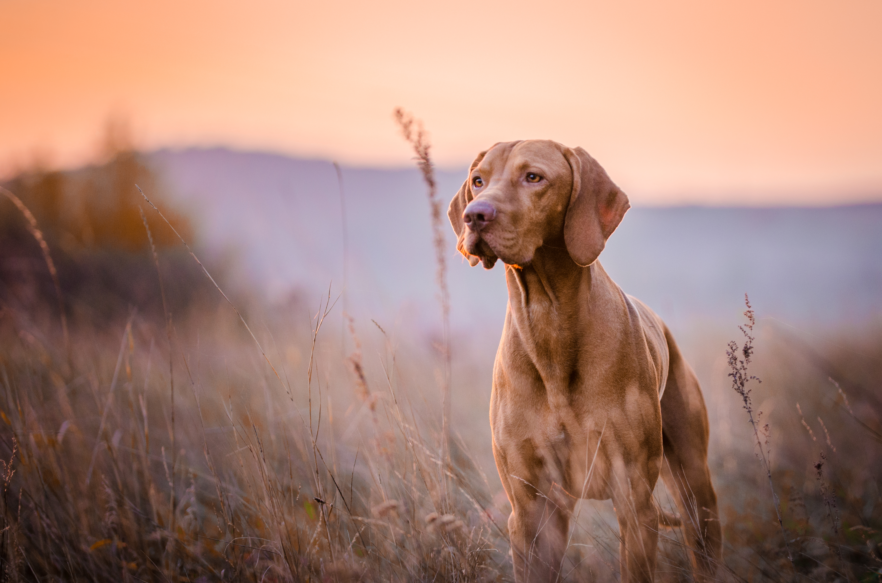
Finding Agent Barkley
Notes:
Notes to Teacher:
Remind the student that we read a story called, Finding Agent Barkley.
Click to bring up the image of the 5 finger retell and a dog.
Thumb (Click to circle the thumb.)
Ask: “Who were the characters in the story?” – Evan, Barkley, Aunt Laura, Lexi Stinson and her dog, Baxter.
Pointer Finger (Click to circle the pointer finger.)
Ask: “Where did the story take place?” - The story took place outside in the neighborhood. It took place after school.
Middle Finger (Click to circle the middle finger.)
Ask: “What was the problem in the story?” - Evan lost Barkley while they were on their walk.
Ring Finger (Click to circle the ring finger.)
Ask: “What happened in the story?” - Every day after school, Evan took Barkley for a walk in their neighborhood. Evan used his imagination, and they went on an adventure.
Today, as they were going on their walk, Barkley let out a loud bark and took off.
Evan did not know what to do so he went back home to get Aunt Laura.
Evan and Aunt Laura grabbed bicycles from the garage and went searching for Barkley.
At the end of the story, they found Barkley and made a new friend.
Pinky (Click to circle the pinky finger.)
Ask: “Was the problem solved? Did they find Barkley?” - Yes. Evan and Aunt Laura met a neighbor (Lexi Stinson) while they were searching for Barkley. She heard them calling out. Barkley was playing in a yard with her dog, Baxter.
Palm of Hand (Click to circle the palm of the hand.)
Ask: “Can you relate to this story? Did you ever lose something or someone? How did that make you feel? Did you find it or him/her? How did you find what you lost? How did you feel at the end?” – Answers will vary.
Applaud the student’s effort and click to go to the next slide.

Slide 11
Q & A
Any Questions?
Notes:
Ask the student if he/she has any questions. Thank the student for sailing through these skills today!

