Slide 1
Letter Combinations
-old and -ost

Slide 2
-old and –ost Letter Combinations
mold
cost
host
fold
Notes:
Say, “This week we reviewed the -old and the -ost endings. Sometimes these words can have a long (o) and short (o) sounds. Let’s look at a few words. I would like for you to sound the words out. If you need help, I wil =l be here to help you!”
Click to show.
Student Response: mold
Click to show.
Student Response: cost
Click to show.
Student Response: host
Click to show.
Student Response: fold

Slide 3
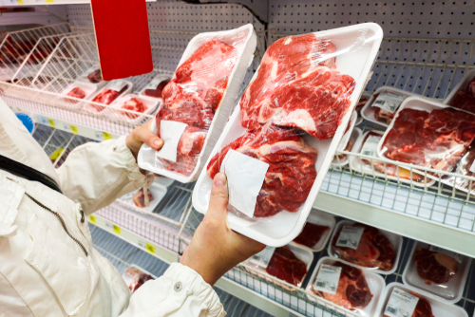

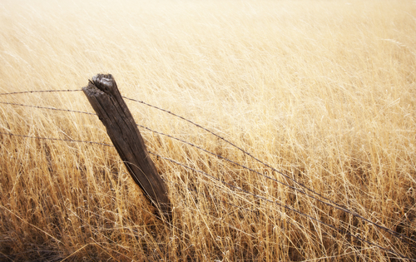
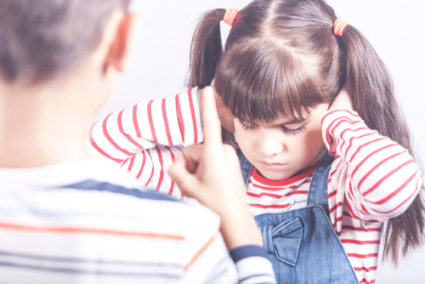
Listen and Spell
scold
cost
bold
post
Notes:
Say, “It’s time for more practice. Please go find yourself a white board or a piece of lined paper and something to write with.”
Allow students time to get these items.
Say, ”I will say a word, you will write that word on your white board or piece of paper.”
Click once for the picture.
Say, “Bold. She loves big bold colors. Bold.”
Allow students time to write their spelling.
Click once for the correct spelling to appear.
Say, “B O L D take the time to check your spelling. If you misspelled the word that is okay. Please correct your spelling now.”
Allow students time to correct their spelling.
Double click for the picture.
Say, “Scold. When she broke the TV she was scolded. Scold.”
Allow students time to write their spelling.
Click once for the correct spelling to appear.
Say, “S C O L D take the time to check your spelling. If you misspelled the word that is okay. Please correct your spelling now.”
Allow students time to correct their spelling.
Double click for the picture.
Say, “Cost. How much does that steak cost? Cost.”
Allow students time to write their spelling.
Click once for the correct spelling to appear.
Say, “C O S T take the time to check your spelling. If you misspelled the word that is okay. Please correct your spelling now.”
Allow students time to correct their spelling.
Double click for the picture.
Say, “Post. We must fix the broken fence post! Post.”
Allow students time to write their spelling.
Click once for the correct spelling to appear.
Say, “P O S T take the time to check your spelling. If you misspelled the word that is okay. Please correct your spelling now.”
Allow students time to correct their spelling.

Slide 4

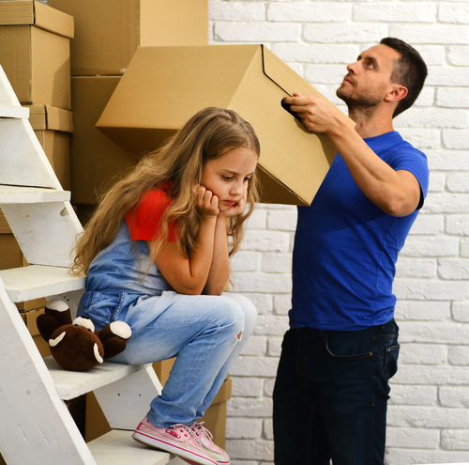
Story Retell
Notes:
Say, “Now it’s time to practice with our weekly reading of Maria’s Goodbye.”
Click once.
Say, “Who are the characters?”
Student Response: Maria, Principal Mills
Say, ”What is the setting of the story?”
Student Response: school stage
Say, “What was the problem in the story?”
Click once.
Student Response: Maria was moving over the summer to a different state. She was nervous about her new school teachers, classmates, and education.
Say, “How about the beginning middle and end of the story?”
Student Response: In the beginning of the story Maria was receiving an award at the end of the second grade. Maria was asked to stay on the front of the stage with Principal Mills. She was moving over the summer and would have to make new friends. After the awards ceremony everyone went outside to play. Maria took many pictures with her friends and teachers. After a while everyone went into the classroom to get their things. Maria’s teacher had the other students go to their desks to get something. They were cards. Each student made Maria a card with special notes inside to help Maria move onto her new school.
Say, “What was the solution to the problem in the story?
Student Response: Maria’s school made her last day very memorable.

Slide 5
Prepositions
They ran out the door.
He fell off his bike.
She jumped across the creek.
He fell off his bike.
She jumped across the creek.
They ran out the door.
Notes:
Say, “What is a preposition?”
Student Response: A preposition is a word that links a noun or pronoun to another word in a sentence. Prepositions show where and when.
Click to show.
Say, “He fell off his bike. What is the preposition in this sentence?”
Student Response: off
Click to show.
Click for next sentence.
Say, “They ran out the door. What is the preposition in this sentence?”
Student Response: out
Click to show.
Click for next sentence.
Say, “She jumped across the creek. What is the preposition in this sentence?”
Student Response: across
Click to show.

Slide 6
Conjunctions
for | a | because
he | and | she
they | nor | them
but | her | him
or | yet | so
for
and
nor
but
or
yet
so
Notes:
Say, “What is a conjunction?”
Student Response: A conjunction connects parts of a sentence.
Say, “Do we remember the list of words that we can use that are conjunctions?”
Student Response: for, and, nor, but, or, yet, so
Click to show.
Say, “Now can you locate these conjunctions in a group of words. Please find all seven in the chart.”
Click to show chart.
Student Response: for, and, nor, but, or, yet, so
Click after students find each one. There will be seven total clicks.

Slide 7
Connects the Parts of Speech to their Meaning
Describes a noun or pronoun.
Connects parts of sentences.
preposition
Tells about an action or what the subject is doing.
Connects a noun to another part of the sentence. It tell where and when.
Describes a verb, an adjective, or another verb.
adverb
verb
Notes:
Say, “This school year you have reviewed a lot of parts of speech. I want to see what you remember! I have the meanings of each part of speech here. It is your job to identify what part of speech I am talking about.”
Click to show.
Say, “Connects a noun to other parts of the sentence. It tells where and when. Is this describing a preposition, adverb, or verb?”
Student Response: Preposition
Click to show.
Click for next.
Say, “Tells about an action or what the subject is doing.
Click to connect.”
Student Response: Verb
Click to show.
Click for next.
Say, “Describes a verb, an adjective, or another adverb.”
Student Response: Adverb
Click to show.

Slide 8
Connects the Parts of Speech to their Meaning
adjective
Describes a noun or pronoun.
Connects parts of sentences.
Person, place, thing, or idea
conjunction
subject
Notes:
Say, “I still want to see what you remember! I have the meanings of each part of speech here. It is your job to identify what part of speech I am talking about.”
Click to show.
Say, “Describes a noun or pronoun. Is this describing an adjective, conjunction, or subject?”
Student Response: adjective
Click to show.
Click for next.
Say, “Connects parts of sentences.”
Click to connect.”
Student Response: conjunction
Click to show.
Say, “Person, place, thing, or idea.”
Click to connect.”
Student Response: subject
Click to show.

Slide 9
Q & A
Any Questions?

