Slide 1
Parts of Speech
Listen and Spell

Slide 2
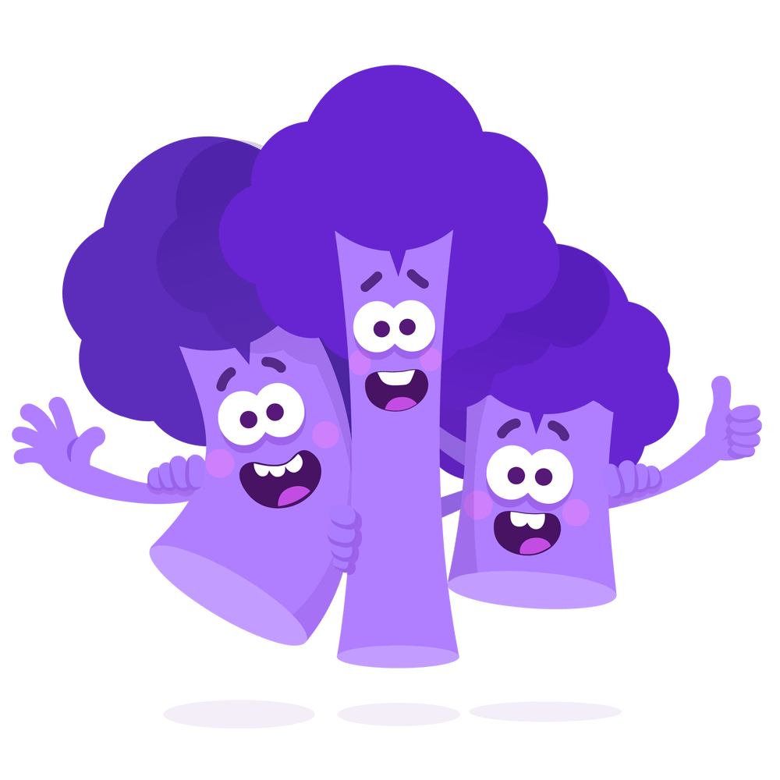
-le Word Endings
cable
shuffle
paddle
Notes:
Say, “What sound does -le make?”
Student Response: (l) sound
Say, “Very good job. Let’s look at a few words. I would like for you to read them to me. If you need help I am always here to help.”
Click once.
Student Response: cable
Click once.
Student Response: shuffle
Click once.
Student Response: paddle

Slide 3
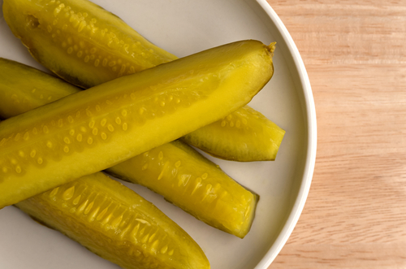
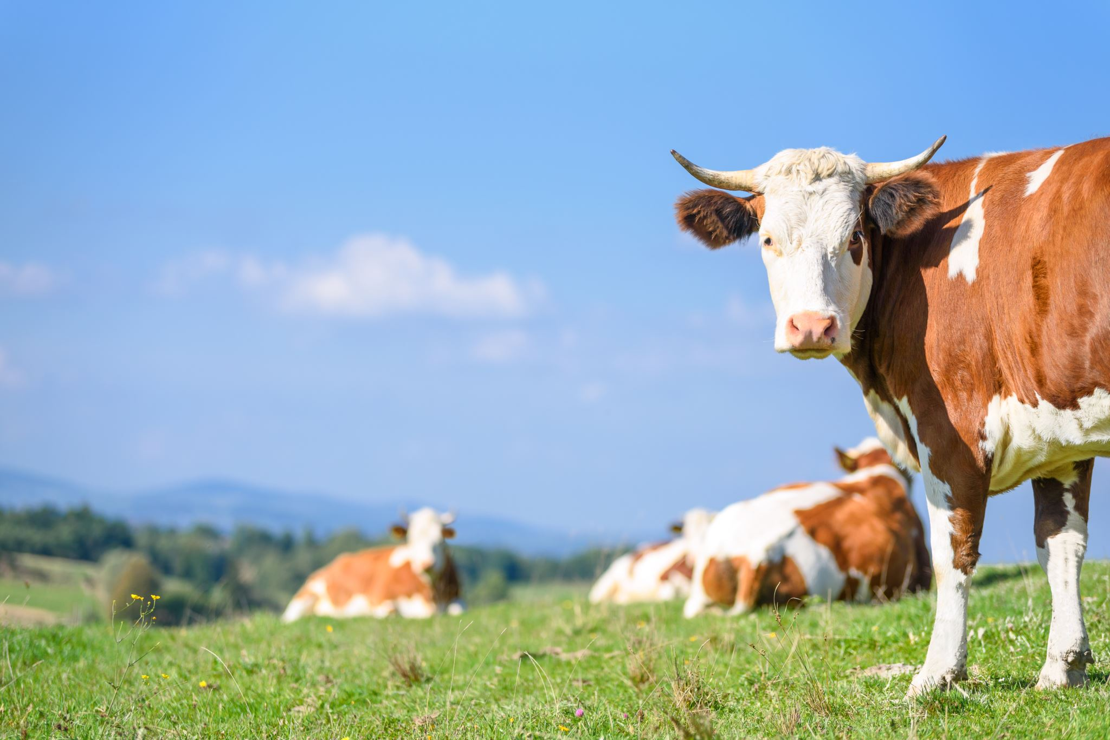
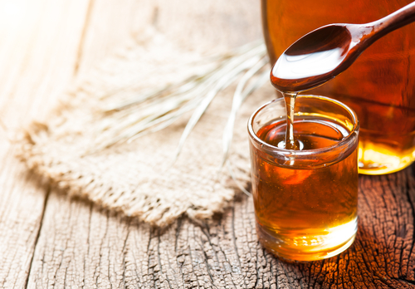
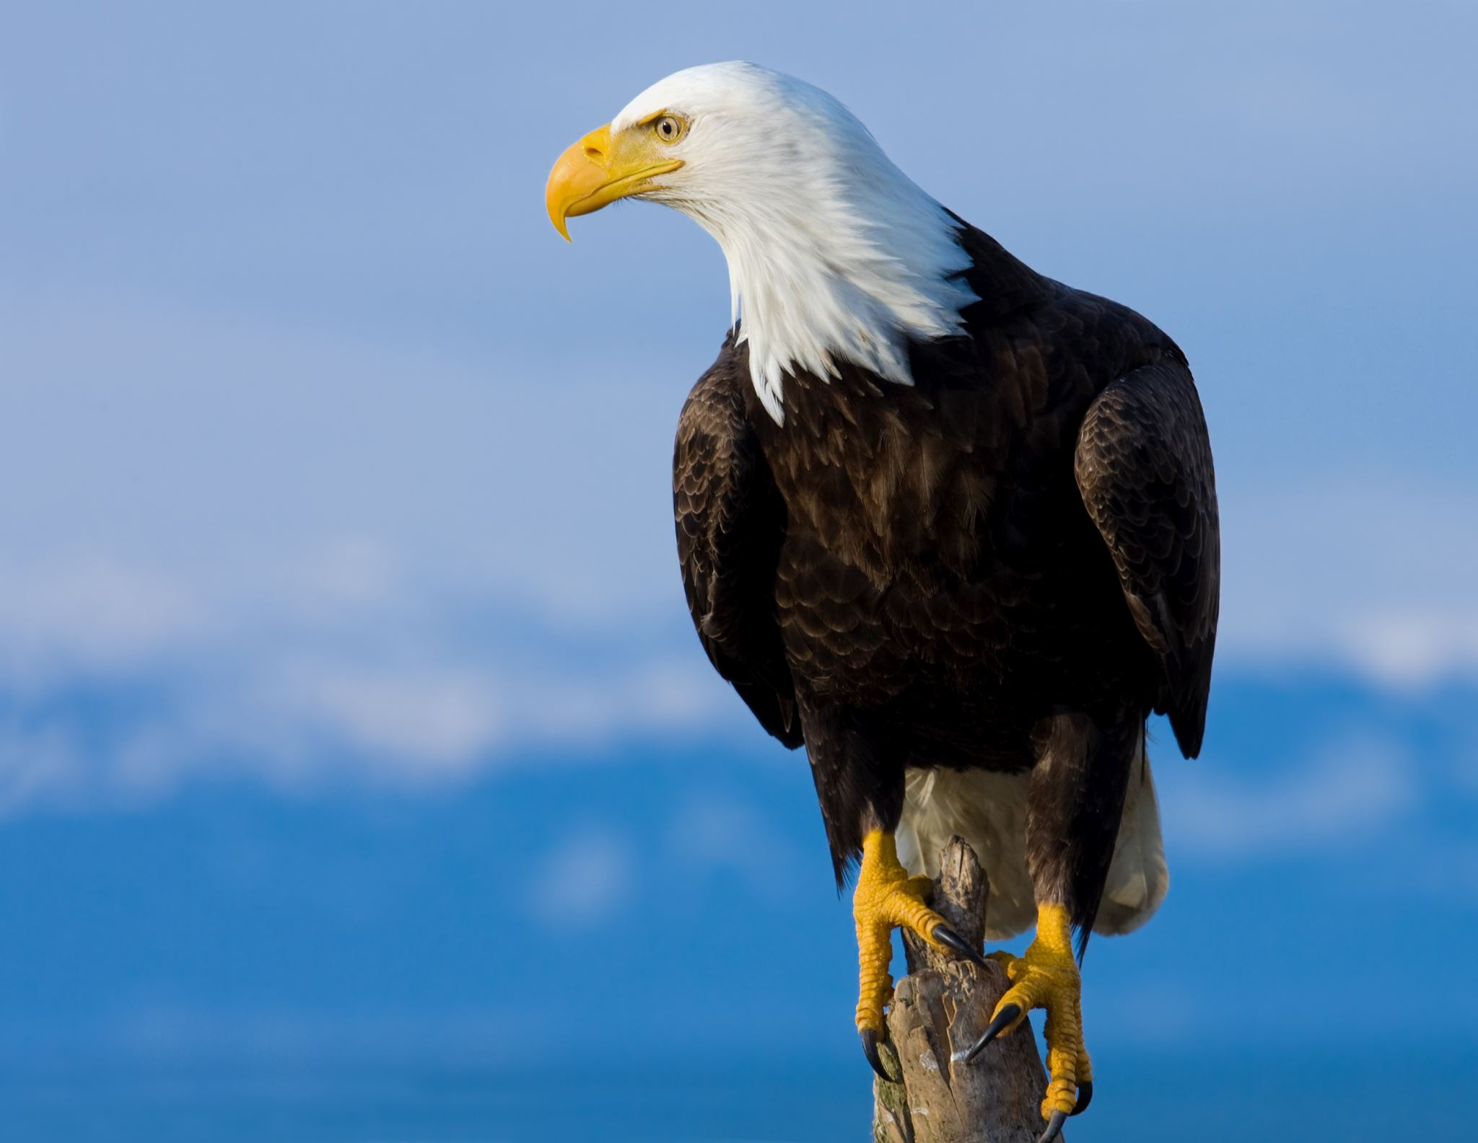
Listen and Spell
maple
cattle
eagle
pickle
Notes:
Say, “It’s time for more practice. Please go find yourself a white board or a piece of lined paper and something to write with.”
Allow students time to get these items.
Say, ”I will say a word, you will write that word on your white board or piece of paper.”
Click once for the picture.
Say, “Maple. Earlier this year we learned how maple syrup is made. Maple.”
Allow students time to write their spelling.
Click once for the correct spelling to appear.
Say, “M A P L E take the time to check your spelling. If you misspelled the word that is okay. Please correct your spelling now.”
Allow students time to correct their spelling.
Double click for the picture.
Say, “Cattle. Every morning you can see the cattle in the pasture. Cattle.”
Allow students time to write their spelling.
Click once for the correct spelling to appear.
Say, “C A T T L E take the time to check your spelling. If you misspelled the word that is okay. Please correct your spelling now.”
Allow students time to correct their spelling.
Double click for the picture.
Say, “Eagle. It is very rare to see an eagle in the wild. Eagle.”
Allow students time to write their spelling.
Click once for the correct spelling to appear.
Say, “E A G L E take the time to check your spelling. If you misspelled the word that is okay. Please correct your spelling now.”
Allow students time to correct their spelling.
Double click for the picture.
Say, “Pickle. You get a pickle with your cheeseburger. Pickle.”
Allow students time to write their spelling.
Click once for the correct spelling to appear.
Say, “P I C K L E take the time to check your spelling. If you misspelled the word that is okay. Please correct your spelling now.”
Allow students time to correct their spelling.

Slide 4
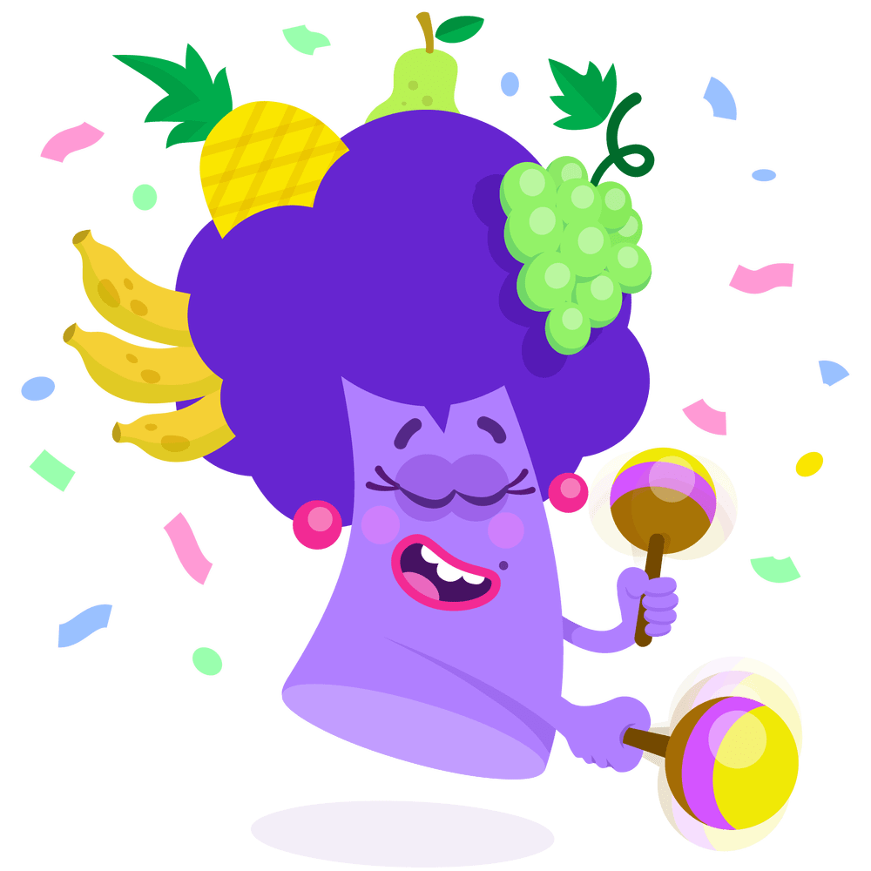
Common and Proper
Nouns are a person, place, thing, or an idea.
Common Nouns are not specific. They are general people, places, things, or ideas.
Proper Nouns name a specific person, place, thing, or idea.
Notes:
Say, “What is a noun?”
Student Response: Nouns are a person, place, thing, or an idea.
Click to show.
Say, “What is a common noun?”
Student Response: Common Nouns are not specific. They are general people, places, things, or ideas.
Click to show.
Say, “What is a proper noun?”
Student Response: Proper Nouns name a specific person, place, thing, or idea.
Click to show.

Slide 5
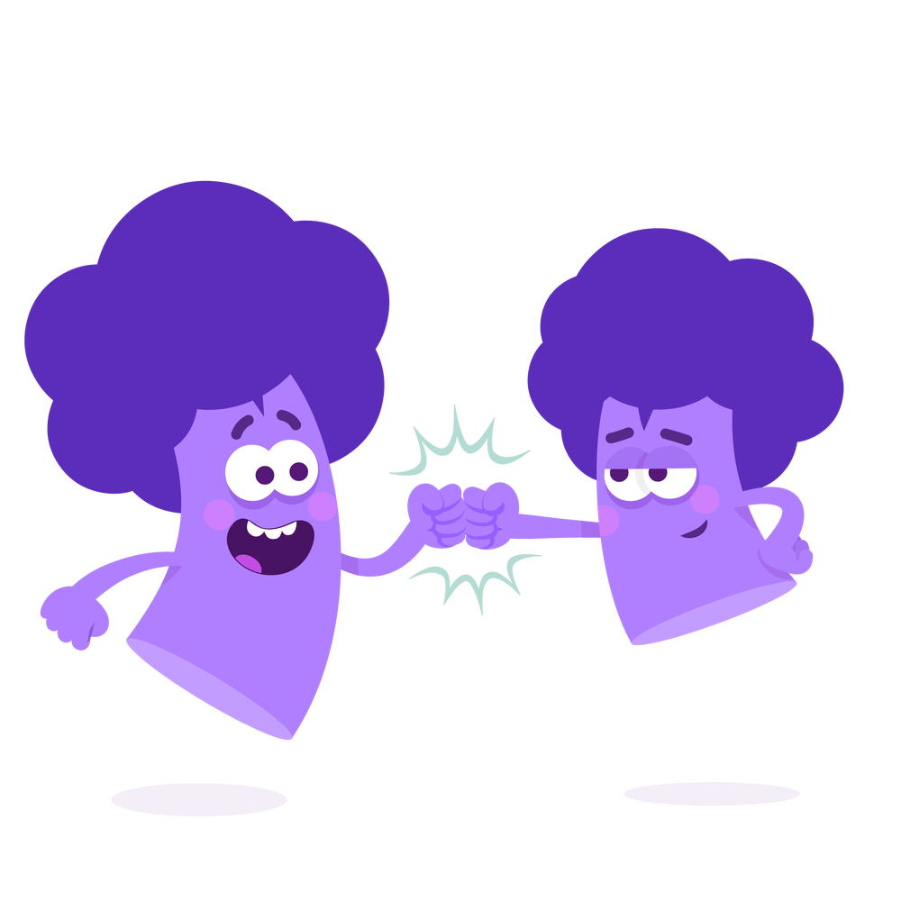
Common or Proper Noun
Maine
Proper Noun
Store
Ms. Taylor
Common Noun
Chips
Common Noun
Proper Noun
Notes:
Say, “I have a few nouns. It is your job to determine if the noun is common or proper.”
Click to show.
Say, “Ms. Taylor. Is this name a common noun or a proper noun?”
Student Response: Proper noun
Click to show.
Double click for next noun.
Say, “Store. Is this place a common noun or a proper noun?”
Student Response: Common noun
Click to show.
Double click for next noun.
Say, “Maine. Is this place a common noun or a proper noun?”
Student Response: Proper noun
Click to show.
Double Click for next noun.
Say, “Chips. Is this thing a common noun or proper noun?”
Student Response: Common noun
Click to show.

Slide 6
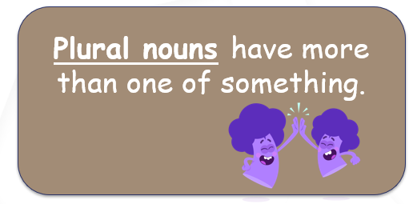
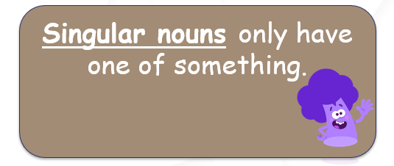
Singular and Plural Nouns
Notes:
Say, “What is a singular noun?”
Student Response: Singular nouns only have one of something.
Click to show.
Say, “What is a plural noun?”
Student Response: A plural noun has more than one of something.
Click to show.

Slide 7

Make It Plural
toy
horses
horse
family
class
families
classes
toys
Notes:
Say, “I have a few words that are already in singular form. I need you to make them plural.”
Click to show.
Say, “Toy. How do I make this plural? How do I spell it?”
Student Response: Toys
Click to show.
Say, “Family. How do I make this plural? How do I spell it?”
Student Response: Families
Click to show.
Say, “Horse. How do I make this plural? How do I spell it?”
Student Response: Horses
Click to show.
Say, “Class. How do I make this plural? How do I spell it?”
Student Response: Classes
Click to show.

Slide 8
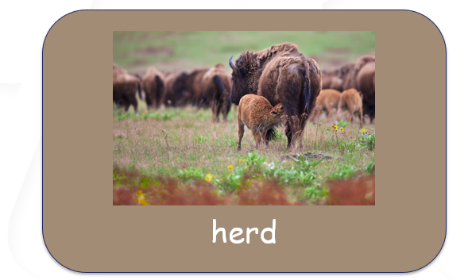
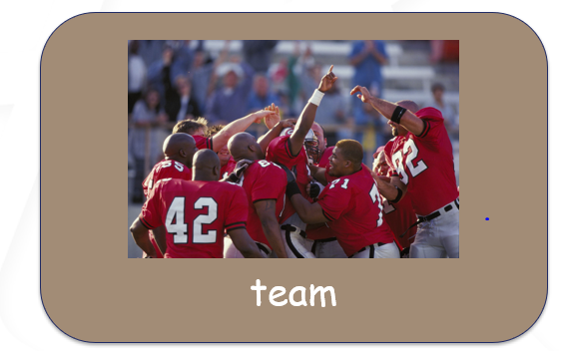
Collective Nouns
Collective nouns name groups.
Notes:
Say, “What is a collective noun?”
Student Response: Collective nouns name groups.
Click to show.
Say, “Let’s look at a few examples.”
Click once.
Say, “Team. Does the word team talk about a group of people? Would this be a collective noun?”
Student Response: YES
Click once.
Say, “What about a herd? Does this word talk about a group of animals?”
Student Response: YES

Slide 9
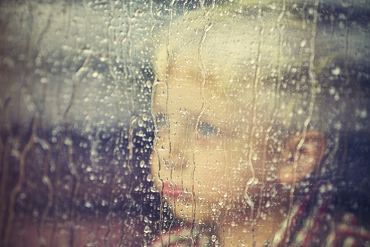
Story Retell
Notes:
Say, “Now it’s time to practice with our weekly reading of Scared in the Storm.”
Click once.
Say, “Who are the characters?”
Student Response: Author- Sam, Tim- big brother of author, six total kids, younger sister Sarah, brother Liam
Say, ”What is the setting of the story?”
Student Response: Boys outside on their bikes heading to their house.
Say, “What was the problem in the story?”
Student Response: Giant storm was happening outside, and Sam was afraid.
Say, “How about the beginning middle and end of the story?”
Student Response: In the beginning of the story, Sam, the author, and Tim were outside riding their bikes when the storm hit. The boy’s road their bikes back to the house. When inside the house, Sam was worried, Stormed scared him. Sam was worried there might be a hurricane, but the family did not live near water to worry about that. Then Sam was worried there might be a tornado. The light went out shortly after asking about the tornado. Sam was scared and he screamed. All the brothers and sisters began making shadow puppets with their flashlight. The light came on and the rain had stopped. Sam felt much better once the storm was over. The siblings continued to play with their shadow puppets. Sam played with them because the storm was finally over.
Say, “What was the solution to the problem in the story?
Student Response: The storm had finally passed and Sam could have fun with his brothers and sisters.

Slide 10
Q & A
Any Questions?

