Slide 1
Clap or Tap
Syllables

Slide 2
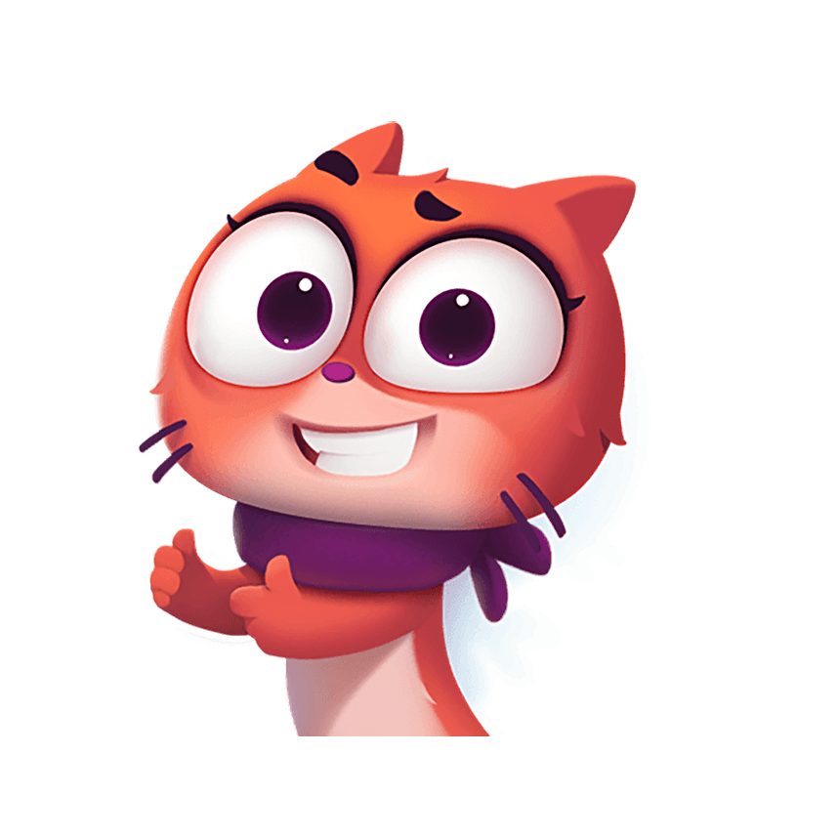
Syllables
cabin
dentist
paperback
Notes:
Say, “What is a syllable?”
Student Response: A syllable is the sound of a vowel when you say the word aloud.
Say, “What are some tools we can use to count syllables in a word?”
Student Response: clap, talk like a robot, tap your pencil, and you can put your hand under your chin and say the word.
Say, “Let’s look at a few words. Use the tool you would like and say these words.”
Click to show.
Say, Cabin. Ca/bin, how many syllables is in the word cabin?”
Student Response: 2
Say, “Perfect!”
Click to show.
Say, “Dentist. Den/tist, how many syllables is in the word dentist?”
Student Response: 2
Say, “Very good job!”
Click to show.
Say, “Paperback. Pa/per/back, how many syllable is in the word paperback?”
Student Response: 3
Say, “Perfect!”

Slide 3

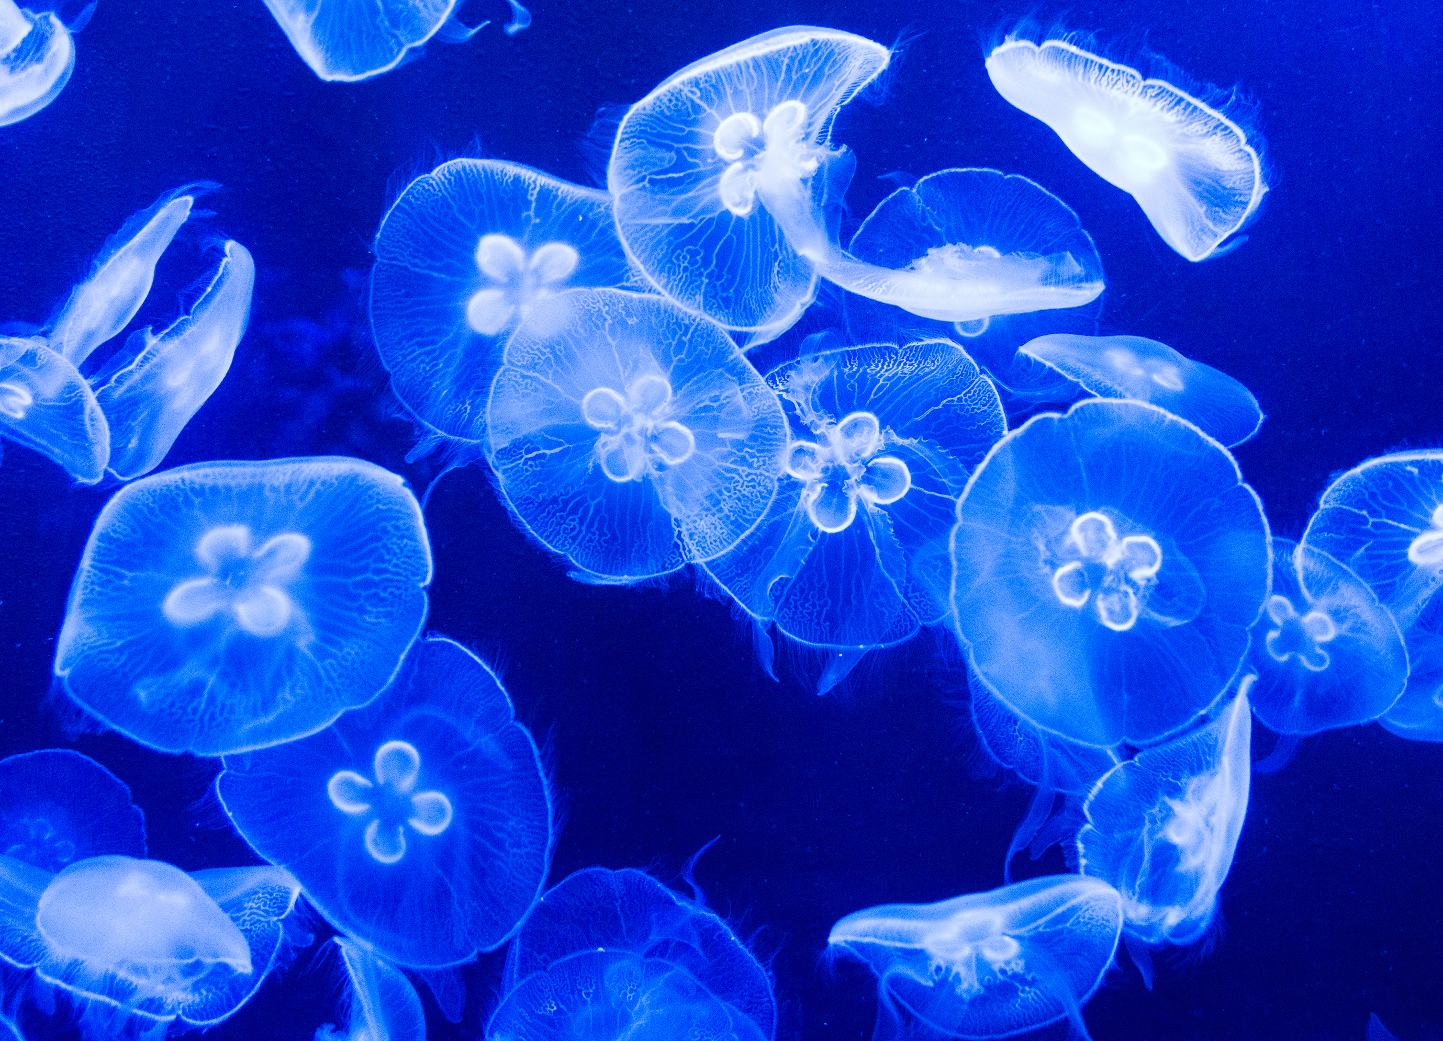
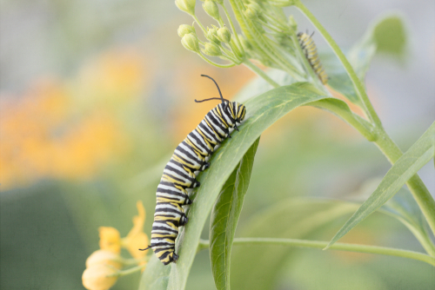

Listen and Spell
organization
crayon
jellyfish
caterpillar
Notes:
Say, “It’s time for more practice. Please go find yourself a white board or a piece of lined paper and something to write with.”
Allow students time to get these items.
Say, ”I will say a word, you will write that word on your white board or piece of paper.”
Click once for the picture.
Say, “Crayon. I can’t seem to find my favorite crayon. Crayon.”
Allow students time to write their spelling.
Click once for the correct spelling to appear.
Say, “C R A Y O N take the time to check your spelling. If you misspelled the word that is okay. Please correct your spelling now.”
Allow students time to correct their spelling.
Double click for the picture.
Say, “Jellyfish. Be careful, last summer there were a lot of jellyfish in the water. Jellyfish.”
Allow students time to write their spelling.
Click once for the correct spelling to appear.
Say, “J E L L Y F I S H take the time to check your spelling. If you misspelled the word that is okay. Please correct your spelling now.”
Allow students time to correct their spelling.
Double click for the picture.
Say, “Caterpillar. Did you see the giant caterpillar on that leaf? Caterpillar.”
Allow students time to write their spelling.
Click once for the correct spelling to appear.
Say, “C A T E R P I L L A R take the time to check your spelling. If you misspelled the word that is okay. Please correct your spelling now.”
Allow students time to correct their spelling.
Double click for the picture.
Say, “Organization. Look at the organization of those books. Organization.”
Allow students time to write their spelling.
Click once for the correct spelling to appear.
Say, “O R G A N I Z A T I O N take the time to check your spelling. If you misspelled the word that is okay. Please correct your spelling now.”
Allow students time to correct their spelling.

Slide 4
Prepositions
Prepositions come before a noun or pronoun and provide information about the direction, time, or location of something.
Notes:
Say, “What is a preposition?”
Student Response: Prepositions come before a noun or pronoun and provide information about the direction, time, or location of something.
Click to show.
Say, “What are a few words that we would use as a preposition.”
Student Response: May vary. (Examples: in, on, under, across, etc)

Slide 5

Identify Prepositions
She threw the ball across the room.
He is hiding under the bed.
He is hiding under the bed.
The sugar is in the jar.
The sugar is in the jar.
She threw the ball across the room.
Notes:
Say, “I have a few sentences. Your job is to identify the preposition in each.”
Click to show.
Say, “He is hiding under the bed. What is the preposition in this sentence?”
Student Response: under
Click to show.
Click for next sentence.
Say, “The sugar is in the jar. What is the preposition in this sentence?”
Student Response: in
Click to show.
Click for next sentence.
Say, “She threw the ball across the room. What is the preposition in this sentence?”
Student Response: across
Click to show.

Slide 6
Fill in the Prepositions
The dog is sleeping ______ the bed.
on
hat
running
The teddy bear is _____ the toy box.
by
drive
hat
He went __ the park.
roll
to
run
to
on
by
Notes:
Say, “Now we have sentences that have missing prepositions. You will be given three prepositions per sentence.”
Click to show.
Say, “The teddy bear is ____ the toy box.”
Student Response: by
Click to show.
Click for next sentence.
Say, “The dog is sleeping ____ the bed.”
Student Response: on
Click to show.
Click for next sentence.
Say, “He went _____ the park.”
Student Response: went
Click to show.

Slide 7
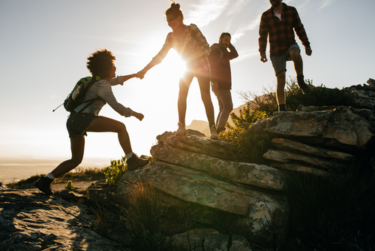
Story Retell
Notes:
Say, “This week you read Planning a Hike. Can you give me five details that help support what the main idea of the passage is?”
Click once.
Student Response: The main idea is the hiking dos and don’ts. (The details will vary.) A few examples listed.
Never go on a hike by yourself.
Work together with your hiking partner/group.
Have an idea of the path you are taking.
Have your supplies ready for your hike.
Always check the weather.

Slide 8
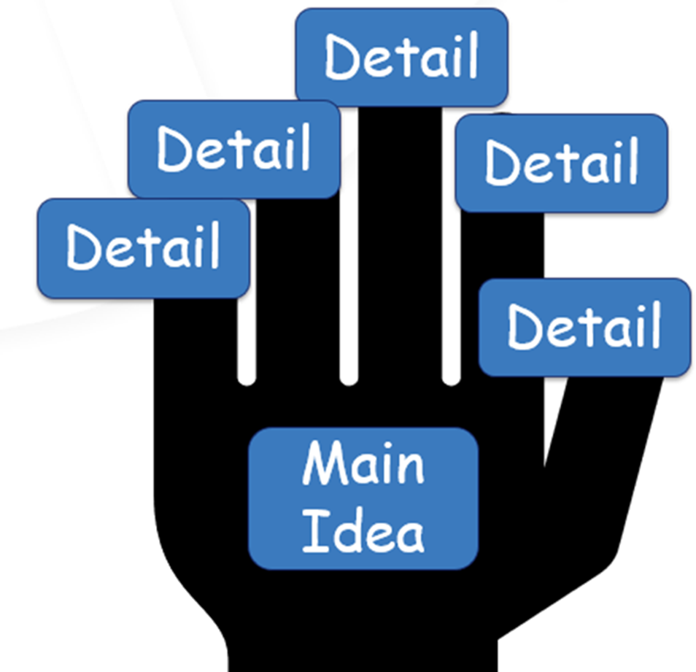
National Parks
Notes:
Say, “This week you also read about National Parks. Can you give me the main idea of the story and at least five details about the passage?”
Click once.
Student Response: The main idea is about President George Washington. (Detail may vary)
National Parks are called conservations. Meaning the government is trying to save land.
National Parks are used for a lot of outdoor activities and nature education.
National Parks are across the nation.
Every National Park are located in a different habitat, and they have different experiences.
National Parks do cost money for entrance.

Slide 9
Q & A
Any Questions?

