Slide 1
Syllables
Tools To Use

Slide 2

Syllables
A syllable is the sound of a vowel when you say the word aloud.
1. A vowel sound can be the last sound heard.
2. Sometimes a syllable ends with a vowel sound followed by a consonant.
3. A group of letters can make one vowel sound. This counts as one syllable.
Notes:
Say, “What is a syllable?”
Student Response: A syllable is the sound of a vowel when you say the word aloud.
Click to show.
Say, “What were the three tips that we learned about this week?”
Student Response:
A vowel sound can be the last sound heard.
Sometimes a syllable ends with a vowel sound followed by a consonant.
A group of letters can make one vowel sound. This counts as one syllable.
Click to show.

Slide 3

Identify Multi Syllable Words
timeline | dog
pen | technology
computer | tree
top | hat
development | cat
timeline
technology
computer
development
Notes:
Say, “I have a chart of words. It is your job to identify the multi syllable words. When you say the multi syllable word, that word will appear in a box. We will begin by looking at the word timeline and then the word dog.”
Click to show chart.
Student Response: timeline
Click to show.
Student Response: technology
Click to show.
Student Response: computer
Click to show.
Student Response: development
Click to show.

Slide 4
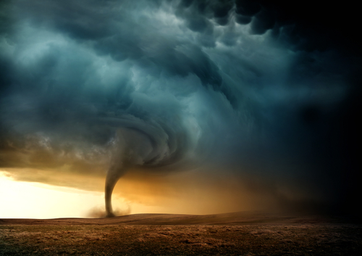
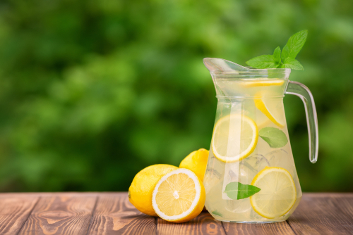
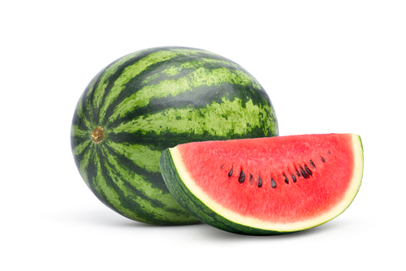
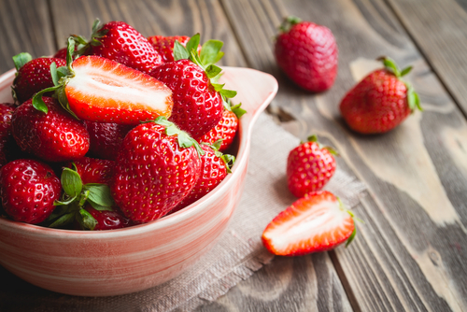
Listen and Spell
strawberry
watermelon
tornado
lemonade
Notes:
Say, “It’s time for more practice. Please go find yourself a white board or a piece of lined paper and something to write with.”
Allow students time to get these items.
Say, ”I will say a word, you will write that word on your white board or piece of paper.”
Click once for the picture.
Say, “Lemonade. Lemonade is a must at any picnic. Lemonade.”
Allow students time to write their spelling.
Click once for the correct spelling to appear.
Say, “L E M O N A D E take the time to check your spelling. If you misspelled the word that is okay. Please correct your spelling now.”
Allow students time to correct their spelling.
Double click for the picture.
Say, “Tornado. Pennsylvania, does not see many tornados. Tornado.”
Allow students time to write their spelling.
Click once for the correct spelling to appear.
Say, “T O R N A D O take the time to check your spelling. If you misspelled the word that is okay. Please correct your spelling now.”
Allow students time to correct their spelling.
Double click for the picture.
Say, “Watermelon. Watermelon is a great summertime treat. Watermelon.”
Allow students time to write their spelling.
Click once for the correct spelling to appear.
Say, “W A T E R M E L O N take the time to check your spelling. If you misspelled the word that is okay. Please correct your spelling now.”
Allow students time to correct their spelling.
Double click for the picture.
Say, “Strawberry. She likes to dip her strawberry in sugar. Strawberry.”
Allow students time to write their spelling.
Click once for the correct spelling to appear.
Say, “S T R A W B E R R Y take the time to check your spelling. If you misspelled the word that is okay. Please correct your spelling now.”
Allow students time to correct their spelling.

Slide 5
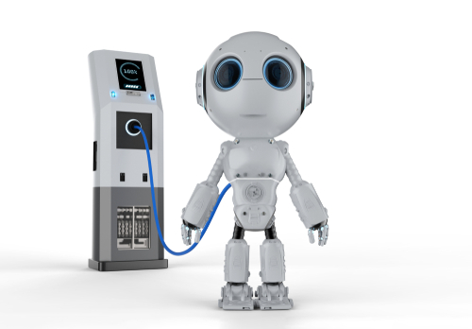
Story Retell
Notes:
Say, “Now it’s time to practice with our weekly reading of Jeff Needs an Update.”
Say, “Who are the characters?”
Student Response: Zane, Jeff, Dad, Ava
Say, ”What is the setting of the story?”
Student Response: Zane waking up late in his home.
Say, “What was the problem in the story?”
Click once.
Student Response: Jeff needs an update. Everyone was running late because he didn’t wake them up.
Say, “How about the beginning middle and end of the story?”
Student Response: In the beginning of the story Zane, Dad, and Ava were all running late because Jeff did not wake them up in time. Jeff is their family robot. He needed an update. As the family rushed to get ready for the day they seemed to have missed that Jeff was smoking a little bit. When the family was heading home in their flying car, they called Jeff but no answer. When they got home, Jeff was on the floor. Dad could not get Jeff up. Zane was sad he wasn’t working. Dad plugged Jeff into the charger and began his update. Zane was worried about Jeff. While Jeff was on the charger, the family went out to eat. Zane was too worried to eat. While the family ate they talked about all of the things they didn’t notice about Jeff leading up to this event. When the family got home they all went to Jeff to see if the charging and update worked. It did! Jeff was back!
Say, “What was the solution to the problem in the story?
Student Response: Jeff needs an update.

Slide 6
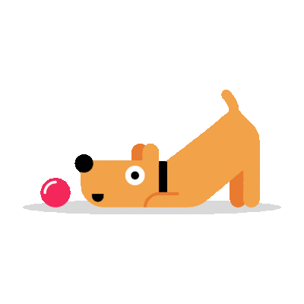
Adjectives
Adjective Endings | Examples
-er, -est | harder, hardest
-able/ -ible | capable
-al | logical
-ful | wonderful
-ic | terrific
-ive | massive
-less | clueless
-ous | stupendous
Notes:
Say, “What is an adjective?”
Student Response: Adjectives are words that describe or modify nouns or pronouns.
Say, “Let’s take a look at a few adjective endings.”
Click to show.
Say, “Remember not all adjective have these endings. You must make sure that the word is describing a noun or pronoun.”

Slide 7
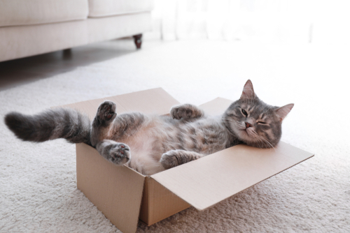
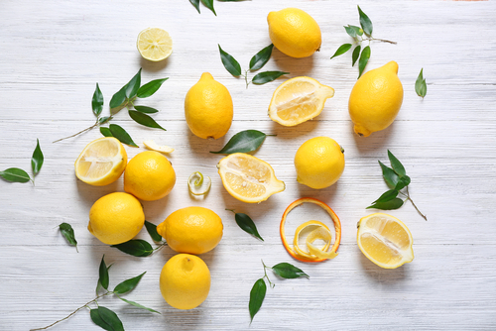

Make Your Own
Notes:
Say, “ I have a pictures. I will give you the noun or pronoun. It is your job to come up with your own adjective. A describing word for the noun or pronoun. Everyone will most likely have different ones and that’s fine! I want to hear what everyone has to say.”
Click to show.
Say, “This is Kim. How would you describe Kim?”
Student Response: Answers will vary.
Click to show.
Say, “A lemon. How would you describe a lemon?”
Student Response: Answers will vary.
Click to show.
Say, “This is a cat. How would you describe the cat?”
Student Response: Answers will vary.

Slide 8
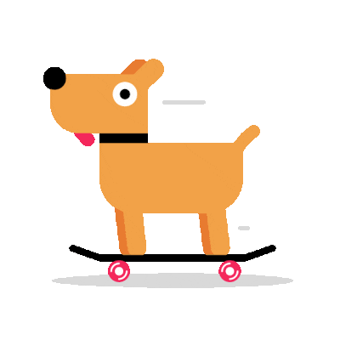
Adverbs
easy
easily
Notes:
Say, “What is an adverb?”
Student Response: An adverb describes or modifies a verb, an adjective, or another adverb.
Say, “If adverbs end in ily and I have a word that ends in y; what do I have to do?”
Student Response: The y is changed to an i and the -ly ending is added.
Say, “Perfect. Let’s look at an example.”
Click to show.
Say, “Easy. I want to use this word as an adverb. So it needs to be changed. How would I do that?”
Student Response: Change the y to an i and add ly.
Click to show.

Slide 9
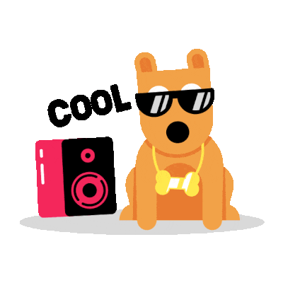
Identify the Adverbs
quietly
closely
sunny
badly
pretty
quiet
truck
Notes:
Say,” I have seven words here. It is your job to identify the adverbs.”
Student Response: quietly
Click to show.
Student Response: closely
Click to show.
Student Response: badly
Click to show.
Click for a cool dog.

Slide 10
Q & A
Any Questions?

