Slide 1
Long /u/ Sounds
Spelling

Slide 2
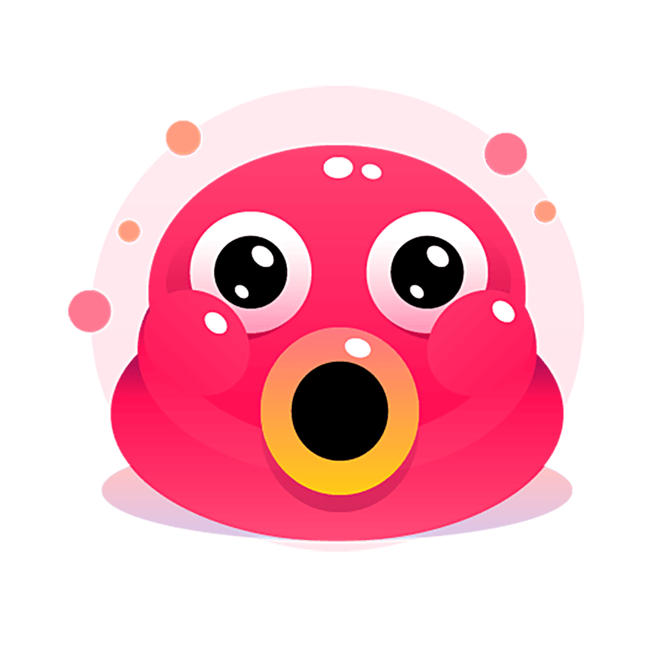
-oo-
broom
smoothie
Notes:
Say, “What does the long /oo/ sound, sound like?”
Student Response: The /oo/ sounds like a long u.
Say, “Correct. So the /oo/ can say it’s name. Let’s look over a few words that have the long /oo/ sound.”
Click to show.
Say, “Broom. Does this word have the long /oo/ sound?”
Student Response: YES
Click to show next.
Say, “Smoothie. Does this word have the long /oo/ sound?”
Student Response: YES

Slide 3

-ew-
blew
crew
new
Notes:
Say, “What sound does the -ew- sound make?”
Student Response: It has the same long /oo/ sound that represents a long /u/.
Say, “Correct. Now, let’s look at a few examples. I will say the firs word. You will read me the last two words.”
Click to show.
Say, “Blew. Do you hear the long /u/ sound?”
Student Response: Yes
Click to show.
Student Response: crew
Click to show.
Student Response: new

Slide 4
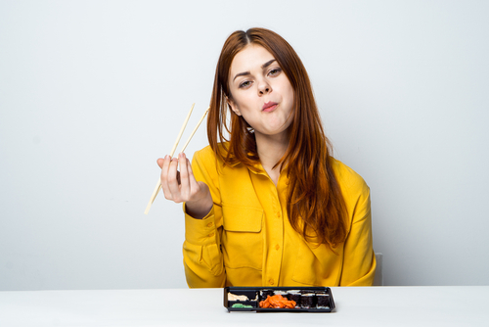
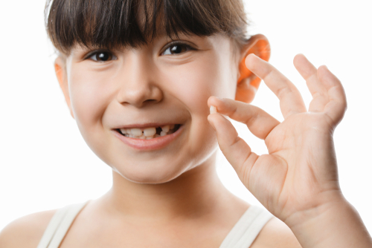

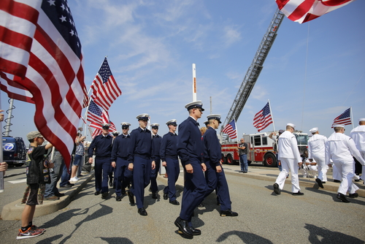
Listen and Spell
crew
chew
scoot
tooth
Notes:
Say, “It’s time for more practice. Please go find yourself a white board or a piece of lined paper and something to write with.”
Allow students time to get these items.
Say, ”I will say a word, you will write that word on your white board or piece of paper.”
Click once for the picture.
Say, “Scoot. Can you scoot over so my friend can sit here? Scoot.”
Allow students time to write their spelling.
Click once for the correct spelling to appear.
Say, “S C O O T take the time to check your spelling. If you misspelled the word that is okay. Please correct your spelling now.”
Allow students time to correct their spelling.
Double click for the picture.
Say, “Tooth. She lost a tooth today at school. Tooth.”
Allow students time to write their spelling.
Click once for the correct spelling to appear.
Say, “T O O T H take the time to check your spelling. If you misspelled the word that is okay. Please correct your spelling now.”
Allow students time to correct their spelling.
Double click for the picture.
Say, “Crew. This is my Navy crew. Crew.”
Allow students time to write their spelling.
Click once for the correct spelling to appear.
Say, “C R E W take the time to check your spelling. If you misspelled the word that is okay. Please correct your spelling now.”
Allow students time to correct their spelling.
Double click for the picture.
Say, “Chew. Chew and swallow before talking. Chew.”
Allow students time to write their spelling.
Click once for the correct spelling to appear.
Say, “C H E W take the time to check your spelling. If you misspelled the word that is okay. Please correct your spelling now.”
Allow students time to correct their spelling.

Slide 5
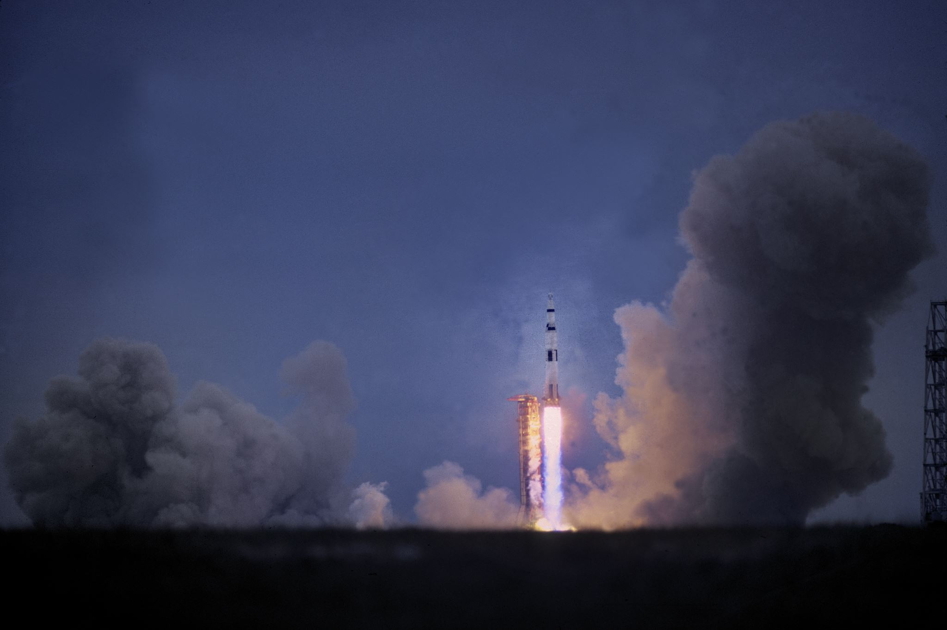
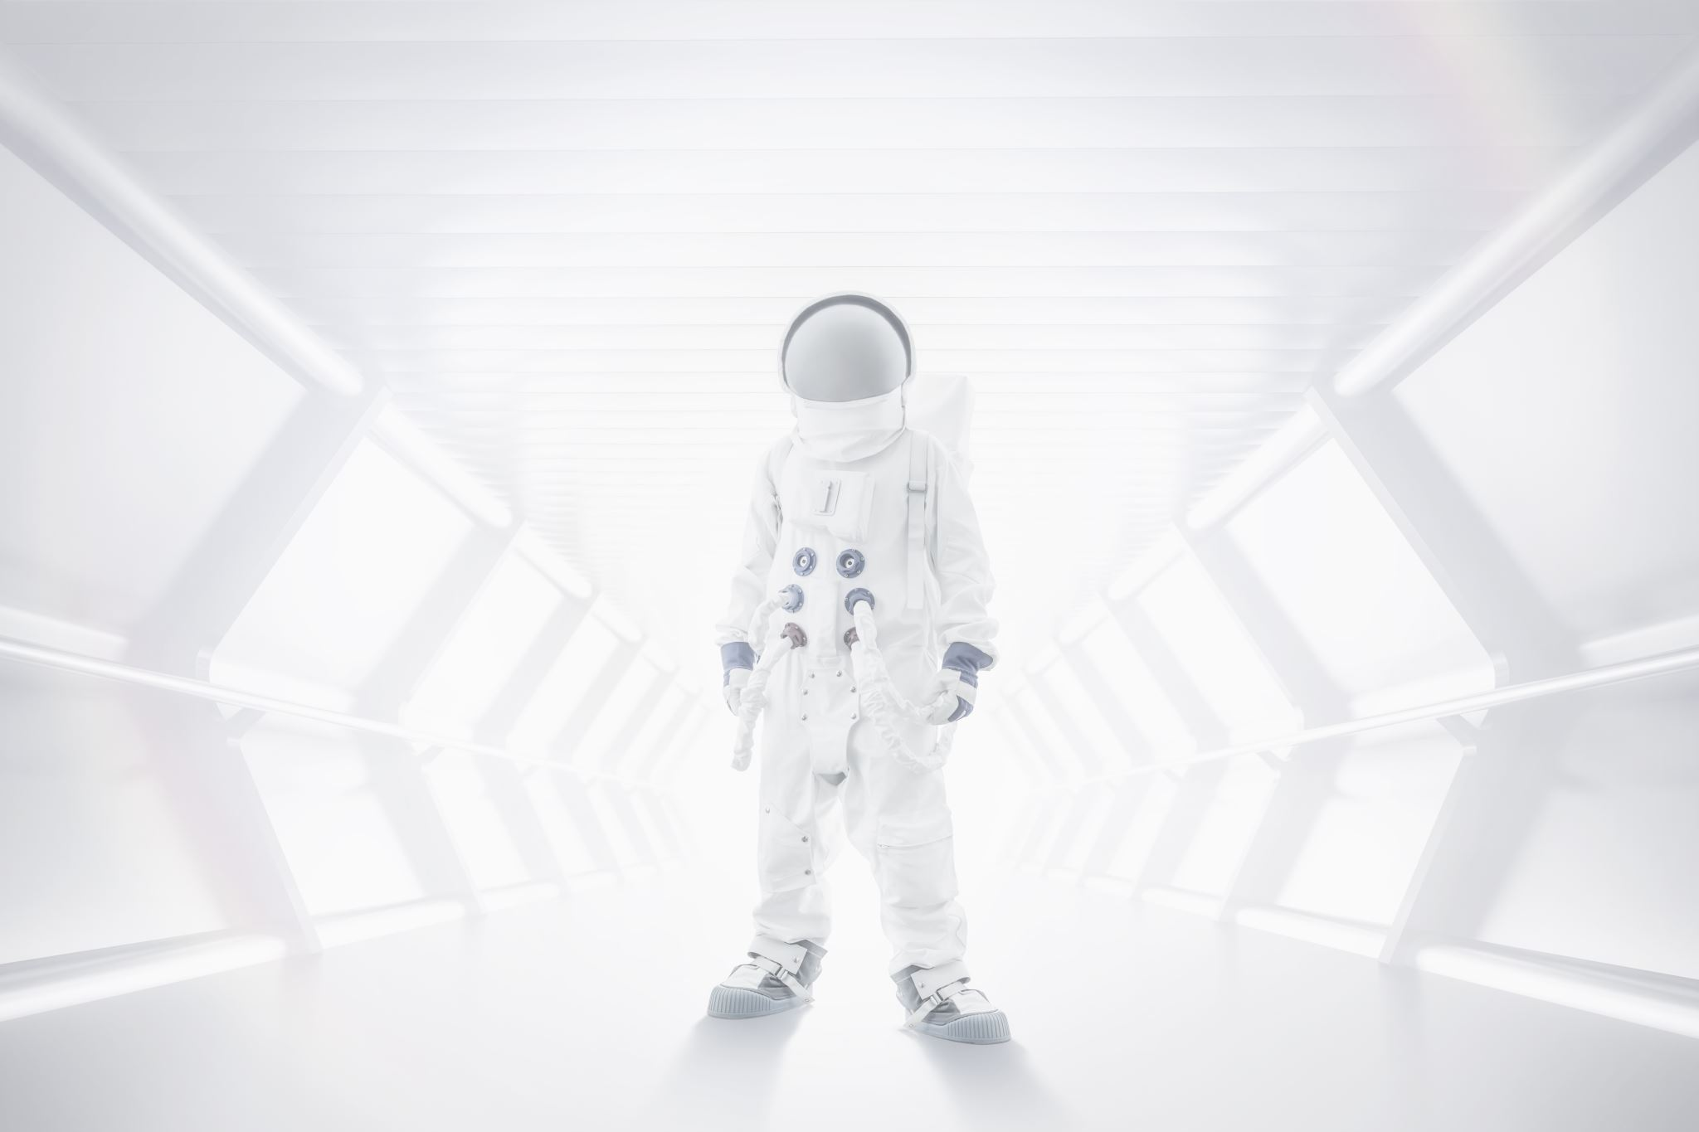
Story Retell
Notes:
Say, “Now it’s time to practice with our weekly reading of Field Trip to the Moon.”
Say, “Who are the characters?”
Student Response: Mrs. Johnston, classroom students, one is named Samantha
Say, ”What is the setting of the story?”
Click.
Student Response: Mrs. Johnston’s classroom and then the spaceship.
Say, “What was the problem in the story?”
Student Response: Samantha is nervous and does not want to go into space.
Say, “How about the beginning middle and end of the story?”
Student Response: In the beginning of the story a classroom of students are getting ready to fly to the moon. A student named Samantha, is very nervous. She did not want to fly into space. Once the class was in space, Mrs. Johnston points out planet Earth from space. Samantha finds it beautiful. Once in space, the captain allows the students the opportunity to float in the gravity free area. The kids begin to play in the air. The captains needed a help in the flight deck. Samantha was chosen. There was a problem. One of the legs was stuck. The captain needs someone small to climb down through a small doorway to fix the broken leg. Samantha went down through the small doorway and fixed the leg. Samantha felt strong and brave.
Click once.
Say, “What was the solution to the problem in the story?
Student Response: Samantha went up into space. She was needed for an important task, and she completed it! She felt strong and brave after saving the landing of the spaceship.

Slide 6

“not” Contractions
don’t
can’t
do not
aren’t
cannot
are not
Notes:
Say, “What is a contraction?”
Student Response: A contraction is the combining of some letters of an original word or words to make a shorter word.
Say, “To create a “not” contraction, we need a few things. We need the original word, remove some letters, place letters in specific order, remember irregular contractions, and where to place the apostrophe. Why don’t we practice this?”
Student Response: YES
Say, “Okay, I have the original words. I need you to help me make this into a “not” contraction.”
Click to show.
Say, “ are not”
Student Response: aren’t
Click to show.
Click for next.
Say, “cannot”
Student Response: Can’t
Click to show. Click for next.
Say, “do not”
Student Response: don’t
Click to show.

Slide 7
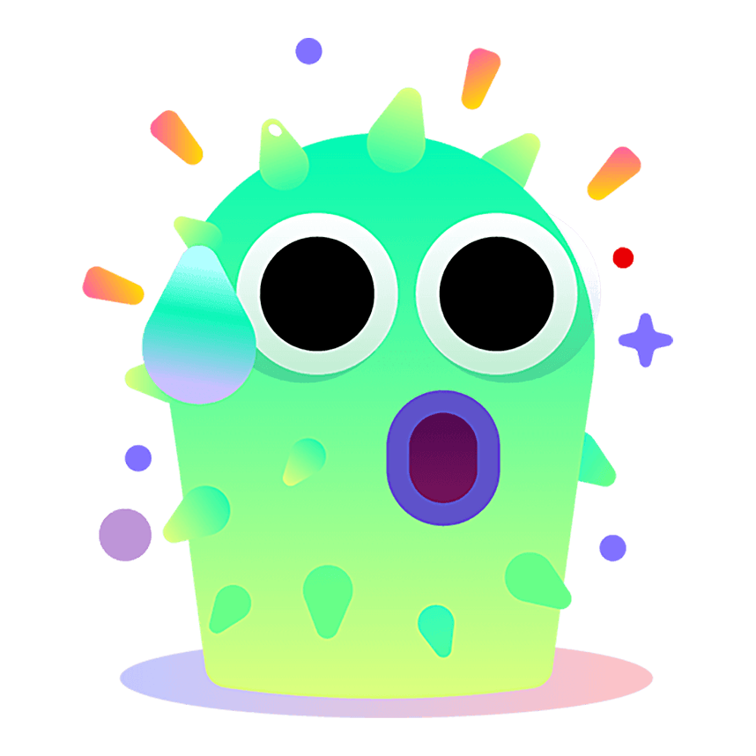
Contraction Check
wasnot
shouldn’t
shouldn’t
doesn’t
doesnt
wasn’t
Notes:
Say, “ I have a few contractions I want you all to look at for me. I will show you one at a time. Can you please proof read my work?”
Student Response: YES
Click to show.
Say, “Doesnt”
Student Response: You are missing the apostrophe! It must go between the n and the t.
Click to show answer.
Say, “Very good job! What about this one?”
Click once.
Say, “Shouldn’t”
Student Response: That one is good.
Click to show.
Say, “wasnot”
Student Response: Wasn’t is what you should have.
Click to show.

Slide 8
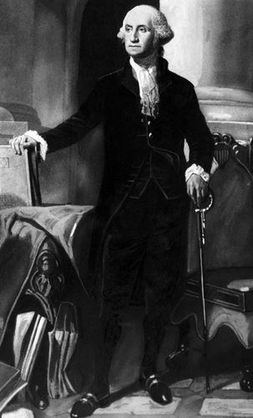
Short Story
Notes:
Say, “This week you read about George Washington. Can you give me the main idea of the story and at least five details about the passage?”
Click once.
Student Response: The main idea is about President George Washington. (Detail may vary)
He was the first president of the Untied States.
He was born in Virginia.
He led the Continental army in the American Revolution.
George Washington helped create the job of the President of the United States.
He has a monument in Washington DC.

Slide 9
Q & A
Any Questions?

