Slide 1
-al and –au- Patterns
Spelling

Slide 2

-al Sound
talk
tall
Notes:
Say, “The -al pattern has two different sounds. Do we remember what those sounds are?”
Student Response: It can have a soft /o/ sound and it could have the /l/ sound in it too.
Click to show examples.

Slide 3

-au- Pattern
clause
because
audio
Notes:
Say, “Let’s look at a few words what have the -au- pattern. Help me sound them out.”
Click to show.
Student Response: clause
Click to show.
Student Response: because
Click to show.
Student Response: audio

Slide 4



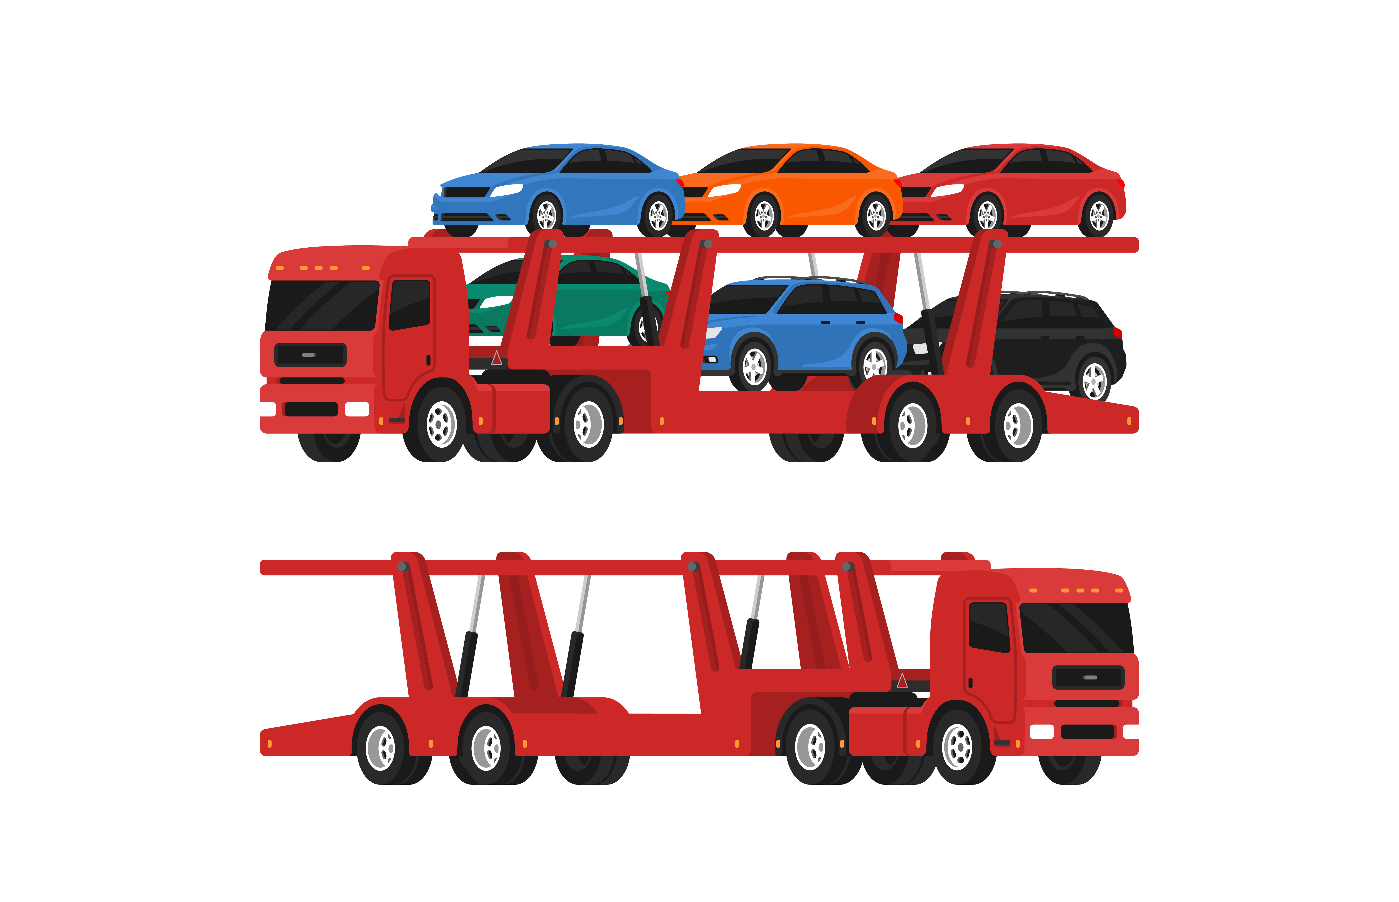
Listen and Spell
exhaust
tall
talk
haul
Notes:
Say, “It’s time for more practice. Please go find yourself a white board or a piece of lined paper and something to write with.”
Allow students time to get these items.
Say, ”I will say a word, you will write that word on your white board or piece of paper.”
Click once for the picture.
Say, “Talk. The announcer really likes to talk. Talk.”
Allow students time to write their spelling.
Click once for the correct spelling to appear.
Say, “T A L K take the time to check your spelling. If you misspelled the word that is okay. Please correct your spelling now.”
Allow students time to correct their spelling.
Double click for the picture.
Say, “Tall. The building is really tall. Tall.”
Allow students time to write their spelling.
Click once for the correct spelling to appear.
Say, “T A L L take the time to check your spelling. If you misspelled the word that is okay. Please correct your spelling now.”
Allow students time to correct their spelling.
Double click for the picture.
Say, “Haul. I had to haul my truck to the truck show. Haul.”
Allow students time to write their spelling.
Click once for the correct spelling to appear.
Say, “H A U L take the time to check your spelling. If you misspelled the word that is okay. Please correct your spelling now.”
Allow students time to correct their spelling.
Double click for the picture.
Say, “Exhaust. The exhaust might need changed. Exhaust.”
Allow students time to write their spelling.
Click once for the correct spelling to appear.
Say, “E X H A U S T take the time to check your spelling. If you misspelled the word that is okay. Please correct your spelling now.”
Allow students time to correct their spelling.

Slide 5

Story Retell
Notes:
Say, “Now it’s time to practice with our weekly reading of Water Needs.”
Click once.
Say, “I would like for you to provide me with at least five key details from the passage. “
Student Response: (Answers may vary)
All living things need water to survive.
We use water for cooking, baking, and to play.
In Africa it is hard to get clean water. They have to search for clean water to help their loved ones and livestock survive.
People in Africa have the job of searching for water. They have to carry the water on top of their heads.
Water must be clean for people to consume. You would get sick if it was dirty!
Say, “Now, what is the Main idea of this passage?”
Student Response: How living things need water, and it must be clean.

Slide 6

Abbreviations
August
July
December
September
March
June
October
January
Nov.
Oct.
Dec.
Jan.
Feb.
Mar.
Apr.
May
Jun.
Jul.
Aug.
November
Sep.
May
April
February
Notes:
Say, “What is an abbreviation?”
Student Response: An abbreviation is a shortened form of a word or phrase.
Say, “Let’s practice with abbreviating the months of the year.”
Click once.
Say, “I have the months of the year here, one at a time. What would we do to abbreviate each?”
Student Response: Jan.
Click to show.
Click for next.
Student Response: Feb.
Click to show.
Click for next.
Student Response: Mar.
Click to show.
Click for next.
Student Response: Apr.
Click to show.
Click for next.
Student Response: May
Click to show.
Click for next.
Student Response: Jun.
Click to show.
Click for next.
Student Response: Jul.
Click to show.
Click for next.
Student Response: Aug.
Click to show.
Click for next.
Student Response: Sep.
Click to show.
Click for next.
Student Response: Oct.
Click to show.
Click for next.
Student Response: Nov.
Click to show.
Click for next.
Student Response: Dec.

Slide 7

Contractions
Would not
She is
Cannot
She’s
Wouldn’t
Can’t
Notes:
Say, “What is a contraction?”
Student Response: A contraction is one word made by combining parts of two words. Letters are taken out of a word, and an apostrophe is used (').
Say, “Let’s practice this. I have some words that I need changed to contractions.”
Click once.
Say, “The words she is. What would the contraction be here?”
Student Response: she’s
Click to show.
Click once.
Say, “The word cannot. What would the contraction be here?”
Student Response: can’t
Click to show.
Click once.
Say, “The words would not. What would the contraction be here?”
Student Response: wouldn’t
Click to show.

Slide 8

Formal and Informal Language
It’s raining cats and dogs.
Notes:
Say, “Cliches are used in informal language. They are also known as popular phrases that have a specific meaning.”
Say, ”Let’s look at an example.”
Click to show examples.
Say, “It’s raining cats and dogs. What does this mean?”
Student Response: It’s raining really hard.
Say, “What is slang? When do we use it?”
Student Response: Slang is used in informal text. We use these words or phrases with friends. Sometimes, slang is only understood between friends.
Say, “When you are writing formally, you should use specific words. If I wanted to write about a chainsaw. Would I use the specific phrase chainsaw, or would I say tool or thing?”
Student Response: Chainsaw
Say, “When should I use shortened words? In formal or informal writing?”
Student Response: Informal writing

Slide 9
Q & A
Any Questions?

