Slide 1
Prefixes
mis- and over-

Slide 2
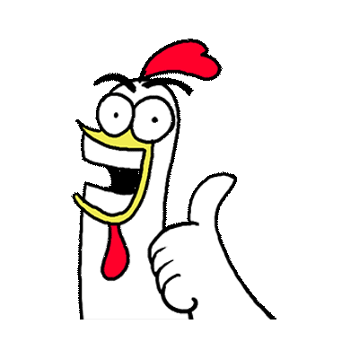
Prefix mis-
misread
mismatch
mistreat
Notes:
Say, “What is a prefix?”
Student Response: A prefix is a group of letters added to the front of a root word that can change the meaning.
Say, “Perfect. Today, we are going to review the prefix mis-. Let’s take a look at a few words that have that prefix. I would like for you to also explain the meaning of the word.”
Click to show.
Say, “Misread. What does this word mean?”
Student Response: Someone read something wrong.
Click to show.
Say, “What is this word and it’s meaning?”
Student Response: Mismatch, and it means something does not match.
Click to show.
Say, “Perfect, what about this last word? How do I say it and what does it mean?”
Student Response: Mistreat. When you or someone else does not treat someone the right way.
Click for a thumbs up.

Slide 3
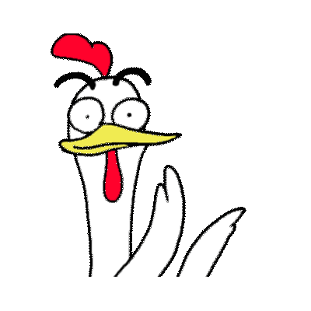
Prefix over-
overwork
overeat
overdue
Notes:
Say, “Now, let’s look at another prefix. This time we will look at the prefix over-. Let’s take a look at a few words and their meanings.”
Click to show word.
Say, “What is this word and it’s meaning?”
Student Response: Overwork and it means working too much.
Click to show.
Say, “What is this word and it’s meaning?”
Student Response: Overeat, and it means to eat too much.
Click to show.
Say, “What is this word and it’s meaning?”
Student Response: Overdue, and it means something is late.
Click for a thumbs up.

Slide 4


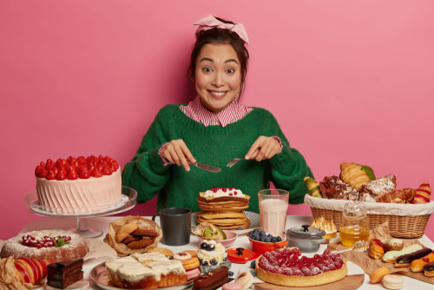

Listen and Spell
overeat
misplace
mistrust
overwork
Notes:
Say, “It’s time for more practice. Please go find yourself a white board or a piece of lined paper and something to write with.”
Allow students time to get these items.
Say, ”I will say a word, you will write that word on your white board or piece of paper.”
Click once for the picture.
Say, “Misplace. I have seemed to misplace my pencil. Misplace.”
Allow students time to write their spelling.
Click once for the correct spelling to appear.
Say, “M I S P L A C E take the time to check your spelling. If you misspelled the word that is okay. Please correct your spelling now.”
Allow students time to correct their spelling.
Double click for the picture.
Say, “Mistrust. She seems to mistrust her neighbor. Mistrust.”
Allow students time to write their spelling.
Click once for the correct spelling to appear.
Say, “M I S T R U S T take the time to check your spelling. If you misspelled the word that is okay. Please correct your spelling now.”
Allow students time to correct their spelling.
Double click for the picture.
Say, “Overwork. They are beyond overworked. Overwork.”
Allow students time to write their spelling.
Click once for the correct spelling to appear.
Say, “O V E R W O R K take the time to check your spelling. If you misspelled the word that is okay. Please correct your spelling now.”
Allow students time to correct their spelling.
Double click for the picture.
Say, “Overeat. Make sure you do not overeat at the buffet. Overeat.”
Allow students time to write their spelling.
Click once for the correct spelling to appear.
Say, “O V E R E A T take the time to check your spelling. If you misspelled the word that is okay. Please correct your spelling now.”
Allow students time to correct their spelling.

Slide 5

Main Idea and Details
Detail
Detail
Detail
Detail
Detail
Main Idea
Notes:
Say, “What is the main idea of a nonfiction story?”
Student Response: What the passage is mostly about.
Click to show.
Say, “Now, you might be looking at this hand and thinking of our retelling hand. We are using our hand for something similar. The fingers this time are used to give the details in the story. What are details?”
Student Response: Facts that support the main idea.
Click.

Slide 6
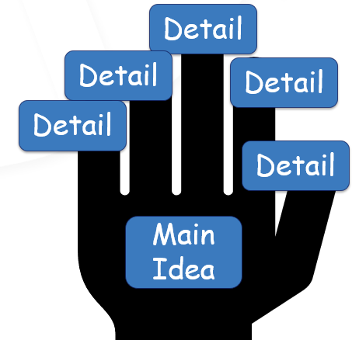
Practice Time
Wakeup
Shower
Brush teeth
Breakfast
Clothes
Shoes
Bookbag
Lunchbox
School bus
Notes:
Say, “I have a few things I need to do.”
Click to show list.
Say, “This is my list of things I must do before I do something. Wakeup, shower, brush teeth, eat breakfast, get dressed, put on shoes, get bookbag, carry lunch box, go to bus stop. What do you think the main idea of my story is?”
Student Response: Getting ready for school or going to school. (Answers may vary)
Say, “Very good job. I gave you a list of details and you were able to figure out the main idea of my story.”
Click to show this on the main idea hand.
Say, “You can see the main idea was getting ready for school. Then I provided you with details.”

Slide 7
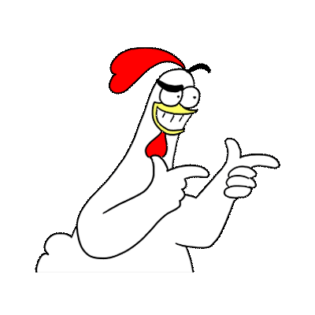
Past Tense Verbs
Adding Double Consonant
shopped
Past Tense Regular Action Verb
cooked
Regular Action Verb
cook
Base Word
cook
Notes:
Say, “What is a base word?”
Student Response: The base word is the original form of a word.
Click to show example.
Say, “Our base word example is the word cook.”
Say, “ What is a regular action verb?”
Student Response: A regular action verb follows a pattern when we make it past tense.
Click to show example.
Say, “We have an example of a regular action verb, the word cook.”
Say, “How do we make a regular action verb past tense?”
Student Response: Add -ed to the end of it.
Click to show example.
Say, “Like in the word cooked. We added an –ed to the regular action verb.”
Say, “What do we have to do when we add an -ed to the end of a word but it would change the vowel sound of the word?”
Student Response: To prevent this, we must add the double consonant before adding -ed.
Click to show example.
Say, “Very good job like in the word shopped.”

Slide 8
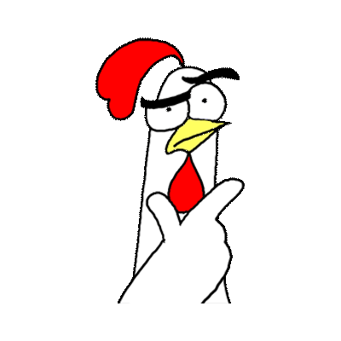
Match
bug
wanted
past
bugged
race
raced
want
pasted
Notes:
Say, “You have already practiced this once this week. I would like for you to go through and match the base word to it’s correct past tense form.
Say, “Bug. What would the past tense word be based off this base word?”
Student Response: Bugged
Click to show answer.
Say, “Past. What would the past tense word be based off this base word?”
Student Response: Pasted
Click to show answer.
Say, “Race. What would the past tense word be based off this base word?”
Student Response: Raced
Click to show answer.
Say, “Want. What would the past tense word be based off this base word?”
Student Response: Wanted
Click to show answer.

Slide 9

Story Retell
Notes:
Say, “Now it’s time to practice with our weekly reading of Planet Earth.”
Click once.
Say, “I would like for you to provide me with at least five key details from the passage. “
Student Response: (Answers may vary)
We live on planet earth.
Earth is part of something called the solar system.
In our solar system we have 8 total planets and 146 moons! Only one sun though.
Our solar system is part of the Milky Way Galaxy.
Planet Earth is made of layers. Each layer has it’s own name.
Say, “Now, what is the Main idea of this passage?”
Student Response: Planet Earth

Slide 10
Q & A
Any Questions?

