Slide 1
Suffix -tion
Spelling

Slide 2
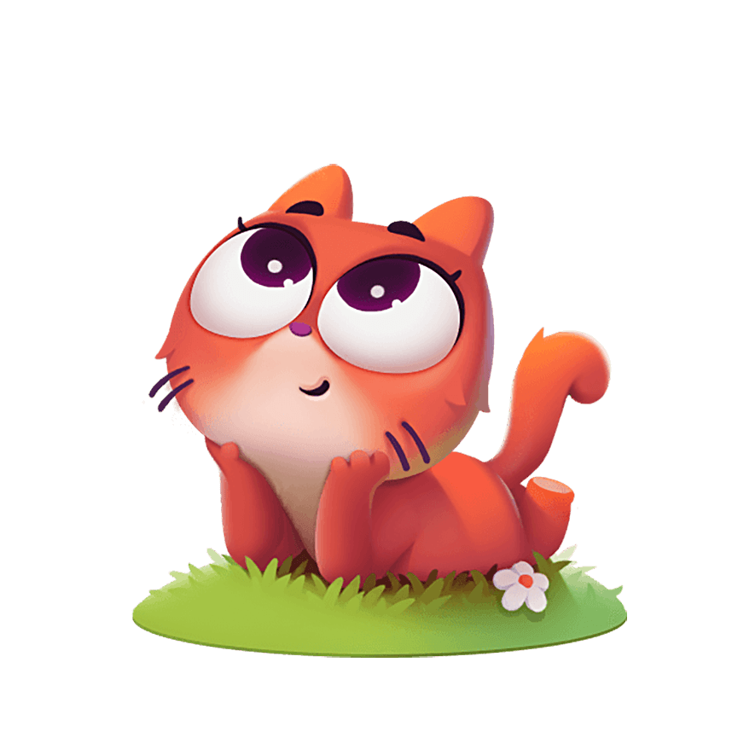
Suffix -tion
Motion
Education
Notes:
Say, “What is a suffix?”
Student Response: A suffix is a group of letters added to a root word that can change the meaning.
Say, “What does the suffix -tion sound like?”
Student Response: /shun/
Say, “Very good job. Let’s look a at a couple words and say them together.”
Click once.
Everyone: motion
Click once.
Everyone: education

Slide 3

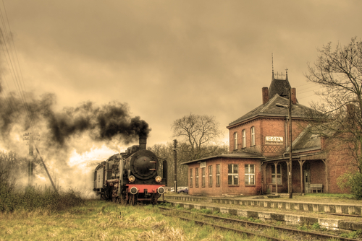


Listen and Spell
addition
location
direction
station
Notes:
Say, “It’s time for more practice. Please go find yourself a white board or a piece of lined paper and something to write with.”
Allow students time to get these items.
Say, ”I will say a word, you will write that word on your white board or piece of paper.”
Click once for the picture.
Say, “Addition. Later today we will be practicing our addition facts. Addition.”
Allow students time to write their spelling.
Click once for the correct spelling to appear.
Say, “A D D I T I O N take the time to check your spelling. If you misspelled the word that is okay. Please correct your spelling now.”
Allow students time to correct their spelling.
Double click for the picture.
Say, “Direction. Excuse me, could you tell me which direction the library is in? Direction.”
Allow students time to write their spelling.
Click once for the correct spelling to appear.
Say, “D I R E C T I O N take the time to check your spelling. If you misspelled the word that is okay. Please correct your spelling now.”
Allow students time to correct their spelling.
Double click for the picture.
Say, “Location. This house is in a great location. Location.”
Allow students time to write their spelling.
Click once for the correct spelling to appear.
Say, “L O C A T I O N take the time to check your spelling. If you misspelled the word that is okay. Please correct your spelling now.”
Allow students time to correct their spelling.
Double click for the picture.
Say, “Station. I cannot wait to see the old station. Station.”
Allow students time to write their spelling.
Click once for the correct spelling to appear.
Say, “S T A T I O N take the time to check your spelling. If you misspelled the word that is okay. Please correct your spelling now.”
Allow students time to correct their spelling.

Slide 4
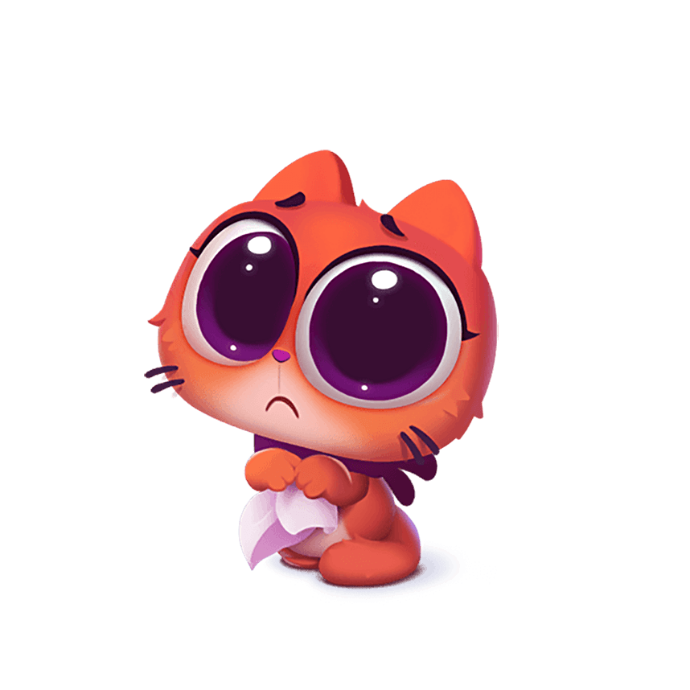
Fiction or Nonfiction
This text shows facts.
This text is not a real story.
This text has make-believe characters.
This text informs someone.
Fiction
Nonfiction
Fiction
Nonfiction
Notes:
Say, “What is fiction and nonfiction?
Student Response: Fiction includes characters and events that are made-up. Fiction is not true. Nonfiction includes real people, events, and animals. Nonfiction is true.
Say, “Lets talk more about fiction and nonfiction. I have a few phrases that you have already reviewed. I want to see how much you remember.”
Click once.
Say, “This text informs someone. Is this fiction or nonfiction?”
Student Response: Nonfiction
Click to show answer.
Click for next.
Say, “This text is not a real story. Is this fiction or nonfiction?”
Student Response: Fiction
Click to show answer.
Click for next.
Say, “This text has make-believe characters. Is this fiction or nonfiction?”
Student Response: Fiction
Click to show answer.
Click for next.
Say, “This text shows facts. Is this fiction or nonfiction?”
Student Response: Nonfiction
Click to show answer.

Slide 5

Main Idea & Details
Details are facts that support the main idea.
The main idea is what the passage is mostly about.
Notes:
Say, “What is a main idea?”
Student Response: The main idea is what the passage is mostly about.
Click to show.
Say, “For the main idea to make sense it needs what to support it?”
Student Response: Details!
Click to show.
Say, “How do we find out what the main idea of the passage is? Where are some places to look?”
Student Response: The title, headings, sentences, pictures, the ending, and any questions that might be asked.

Slide 6

Phrases and Sentences
Can you please move the chair to the basement?
move
Notes:
Say, “Words that do not make up a complete thought are what?”
Student Responses: Phrases
Click to show.
Say, “Move, is just a phrase. This is not a complete sentence.
Say, “What am I missing for this to be a complete sentence?”
Student Response: A capital letter, the “who”, the “what we are moving, and the correct ending to the sentence.
Click to show.
Say, “What about this then. Is this considered a complete sentence? Can you please move the chair to the basement?”
Student Response: YES

Slide 7
Noun Phrase or Verb Phrase
The lake
Noun Phrase
A dog
Noun Phrase
Am studying
Verb Phrase
Notes:
Say, “There are three phrases that need to be identified as a noun phrase or a verb phrase. Let’s read them together and identify.
Click to show.
Say, “The lake. What is this phrase?”
Student Response: noun phrase
Click to show.
Click to show.
Say, “. What is this phrase?”
Student Response: noun phrase
Click to show.
Click to show.
Say, “Am studying. What is this phrase?”
Student Response: verb phrase
Click to show.

Slide 8


Story Retell
Notes:
Say, “Now it’s time to practice with our weekly reading of Everyday Patterns”
Click.
Say, “Who are the characters?”
Student Response: Not really a character this is an informative passage. Nonfiction.
Say, ”What is the setting of the story?”
Student Response: Looking around the reader.
Say, “What was the problem in the story?”
Student Response: Having the reader notice the number of patterns around them.
Say, “How about the beginning middle and end of the story?”
Student Response: The story begins by talking about different patterns. Patterns all around us. Games can have patterns, in music, on buildings, fences, etc. Not only are patterns on physical items but there are patterns in the thing we do each day. Like our classroom routine. That is a pattern.
Say, “What was the solution to the problem in the story?
Student Response: There are patterns everywhere. On buildings, in games, in our morning routines, and in nature.

Slide 9
Q & A
Any Questions?

