Slide 1
V/CV Words
Spelling

Slide 2
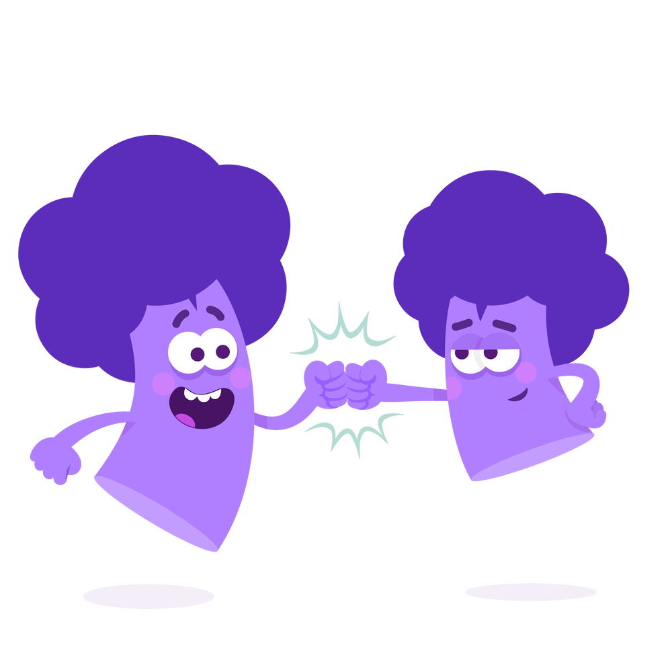
V/CV Words
Melon
V/CV
Melon
Remaining letters in the alphabet.
Vowels are the letters a, e, i, o, u and sometimes y.
Notes:
Say, “When I say the word vowel. What does that mean?”
Student Response: Vowels are the letters a, e, i, o, u and sometimes y.
Click to show.
Say, “Very good job. That is what the V in the title of this slide stands for. What about the word consonant? What is a consonant?”
Student Response: Remaining letters in the alphabet.
Click to show.
Say, “Awesome job. That is what the C in the title of this slide stands for.”
Click to show the word.
Say, “Let’s look at this example. Here is the word melon. The e is the vowel, the l, is the consonant and the o being the second vowel.”
Click to show VCV under word.

Slide 3
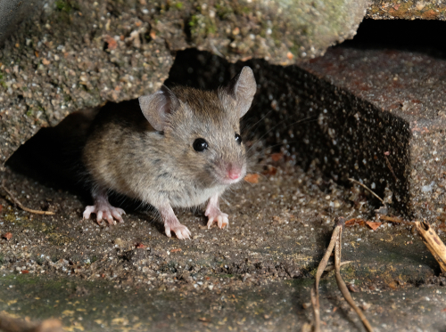
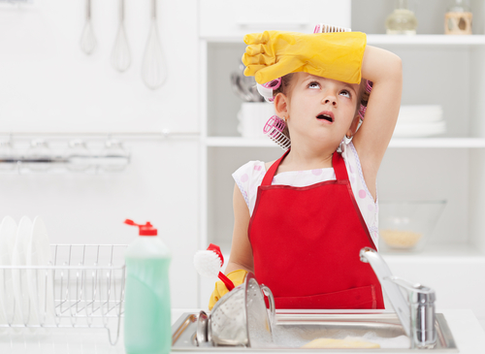


Listen and Spell
super
paper
later
tiny
Notes:
Say, “It’s time for more practice. Please go find yourself a white board or a piece of lined paper and something to write with.”
Allow students time to get these items.
Say, ”I will say a word, you will write that word on your white board or piece of paper.”
Click once for the picture.
Say, “Paper. Did you read the paper this morning? Paper.”
Allow students time to write their spelling.
Click once for the correct spelling to appear.
Say, “P A P E R take the time to check your spelling. If you misspelled the word that is okay. Please correct your spelling now.”
Allow students time to correct their spelling.
Double click for the picture.
Say, “Super. He looks super strong. Super.”
Allow students time to write their spelling.
Click once for the correct spelling to appear.
Say, “S U P E R take the time to check your spelling. If you misspelled the word that is okay. Please correct your spelling now.”
Allow students time to correct their spelling.
Double click for the picture.
Say, “Later. I will do the dishes later. Later.”
Allow students time to write their spelling.
Click once for the correct spelling to appear.
Say, “L A T E R take the time to check your spelling. If you misspelled the word that is okay. Please correct your spelling now.”
Allow students time to correct their spelling.
Double click for the picture.
Say, “Tiny. Look at the tiny mouse. Tiny.”
Allow students time to write their spelling.
Click once for the correct spelling to appear.
Say, “T I N Y take the time to check your spelling. If you misspelled the word that is okay. Please correct your spelling now.”
Allow students time to correct their spelling.

Slide 4

Label the VCV Letters
even
even
VCV
tiny
tiny
VCV
later
later
VCV
paper
super
paper
VCV
super
VCV
Notes:
Say, “Using you’re the words you just wrote down, we will underline the VCV letters and label them.”
Click to show example.
Say, “Let’s look at the example. The word even. What three letters are we underlining?”
Student Response: eve
Click to show.
Say, “Very good job. Now, what letters are our vowels in the word even?”
Student Response: The es.
Click to show.
Say, “Now let’s go over our words from the Listen and Spell. Please use your marker, pencil, whatever writing utensil you are using to label with me.”
Click to show.
Say, “What are we underlining here? What are our vowels? What are our consonants?”
Student Response: ape, a and e are the vowels, p is the consonant
Click to show answer.
Click to show.
Say, “What are we underlining here? What are our vowels? What are our consonants?”
Student Response: upe, u and e are vowels, p is the consonant
Click to show answer.
Click to show.
Say, “What are we underlining here? What are our vowels? What are our consonants?”
Student Response: ate, a and e are vowels, t is the consonant
Click to show answer.
Click to show.
Say, “What are we underlining here? What are our vowels? What are our consonants?”
Student Response: iny, i and y are vowels, n is the consonant
Click to show answer.

Slide 5

Characterization
The girl jumped and screamed when she saw an old friend.
The girl was shy as she quietly walked to the back of the room.
Direct
Indirect
Notes:
Say, “We learned about two ways an author can characterize. Does anyone remember them?
Student Response:
An author can directly tell us the trait of a character.
An author can indirectly tell us the trait by leaving clues to show us the character.
Say, “Let’s take a look at an example of each!”
Click to show sentences.
Say, “The girl was shy as she quietly walked to the back of the room. Is this sentence direct or indirect?”
Student Response: Direct
Click to show.
Click for next sentence.
Say, “The girl jumped and screamed when she saw an old friend. Is this sentence direct or indirect?”
Student Response: Indirect
Click to show.

Slide 6
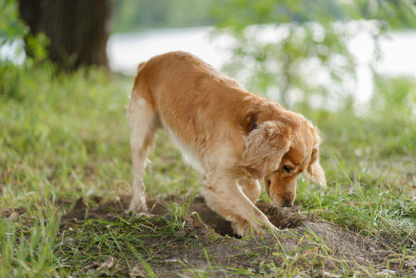
Story Retell
Notes:
Say, “Now it’s time to practice with our weekly reading of Pixie’s Surprise.”
Click once.
Say, “Who are the characters?”
Student Response: Mom, Dad, Pixie, Bobby
Say, ”What is the setting of the story?”
Student Response: Carter Family Yard
Say, “What was the problem in the story?”
Student Response: Pixie and the gophers are digging holes!
Say, “How about the beginning middle and end of the story?”
Student Response: In the beginning the author explains again how Pixie loves to dig holes all throughout the sandbox, yard, and garden. Mom and Dad fill them in as much as they can. Pixie wasn’t the only animal digging holes in the garden. There were gophers digging too! Later Pixie was out in the yard and saw a butterfly. She wanted to catch it and when she went to try, she fell in one of her holes. She hurt her leg but that didn’t stop Pixie from digging holes. At the end of the story, Pixie had seen something in the yard. She began digging until something bit her right on the nose! Mom an Dad felt bad that Pixie’s nose hurt but they hoped that she would stop digging holes. She did for a little bit at least.
Say, “What was the solution to the problem in the story?
Student Response: Pixie dug until she was bit in the nose by something. She stopped digging for a while after that.

Slide 7
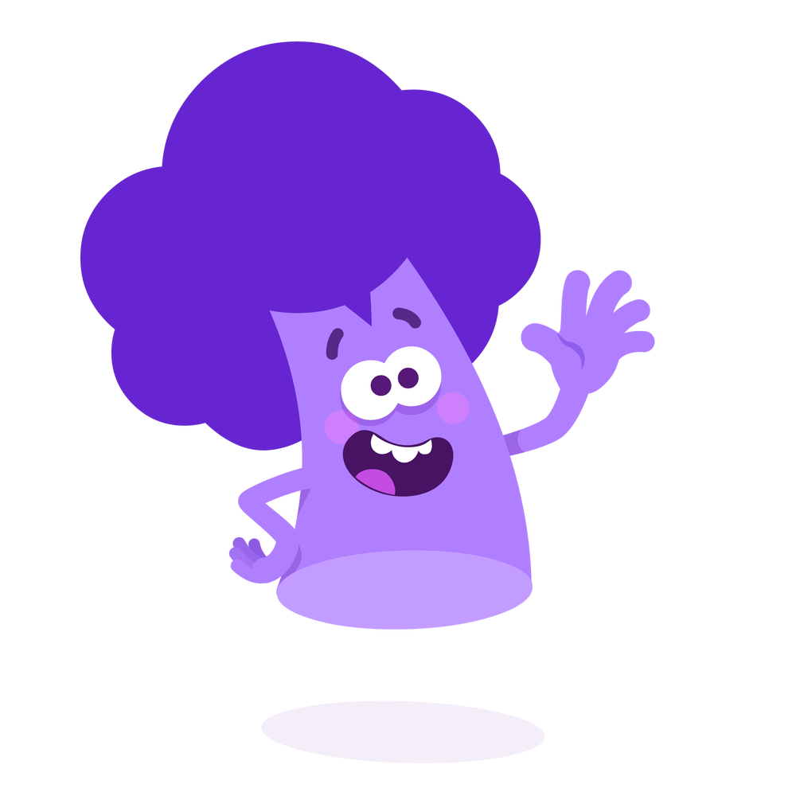
Commas
Commas are used when
Letters
Dates
Places
Lists before and after quotations
After introductory words connect independent clauses.
Notes:
Say, “When do we use commas?”
Student Response: Commas are used in letters, dates, places, lists, before and after quotations, after introductory words, and connect independent clauses.
Click to show.

Slide 8
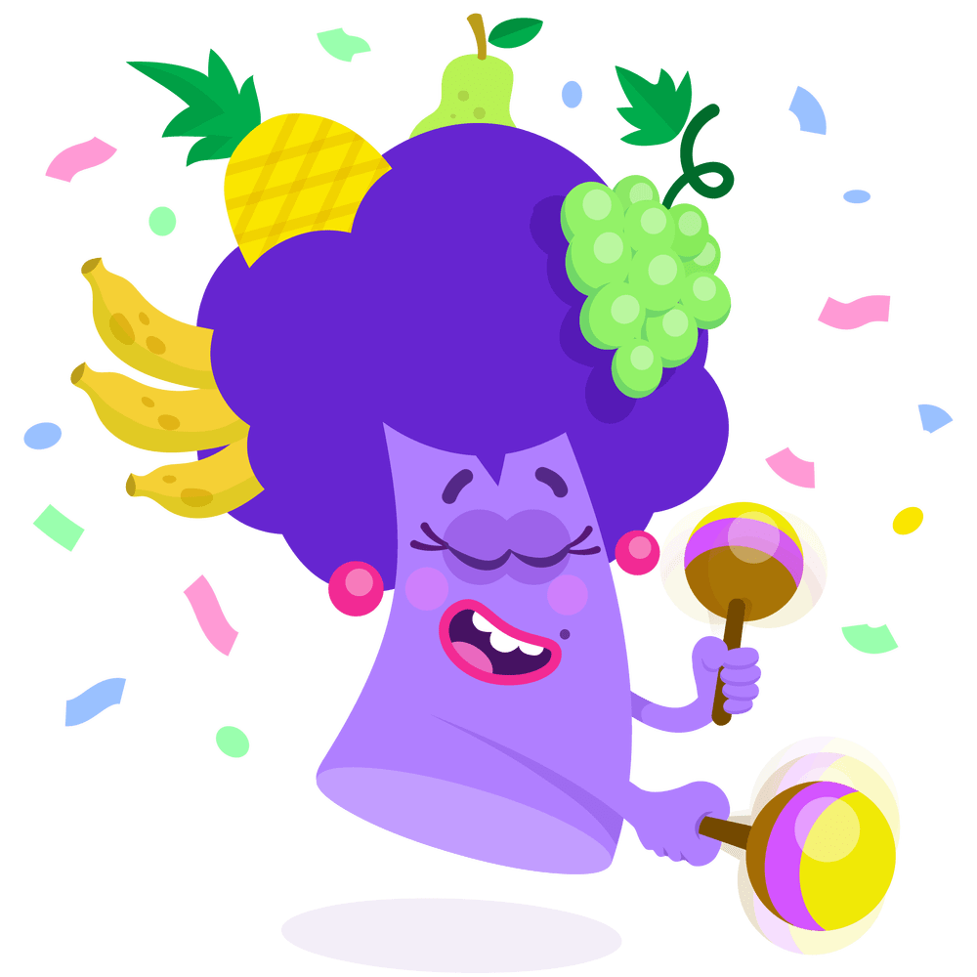
Where do the Commas Go?
Dear Mr. Robertson,
jeans shirt socks shoes
jeans, shirt, socks, shoes
Dear Mr. Robertson
Charleston,
South Carolina
Charleston
South Carolina
However I do love the water.
However, I do love the water.
August 5 2021
August 5, 2021
Notes:
Say, “I have a few phrases that are missing commas. It is your job to help me put them in the correct place. Are we ready?”
Student Response: Yes!
Click to show phrase.
Say, “August 5 2021. Where should we put a comma?”
Student Response: After the day of the month.
Click to show.
Double click for next phrase.
Say, “Charleston South Carolina. Where should we put a comma?”
Student Response: After Charleston.
Click to show.
Double click for next phrase.
Say, “jeans shirt socks shoes. Where should we put a comma?”
Student Response: This is a list. Jeans, shirt, socks, shoes.
Click to show.
Double click for next phrase.
Say, “However I do love the water. Where should we put a comma?”
Student Response: After the introductory word, however.
Click to show.
Double click for next phrase.
Say, “Dear Mr. Robertson. Where should we put a comma?”
Student Response: After Mr. Robertson.
Click to show.

Slide 9
Q & A
Any Questions?

