Slide 1
Diphthongs
Formal and Informal Language

Slide 2
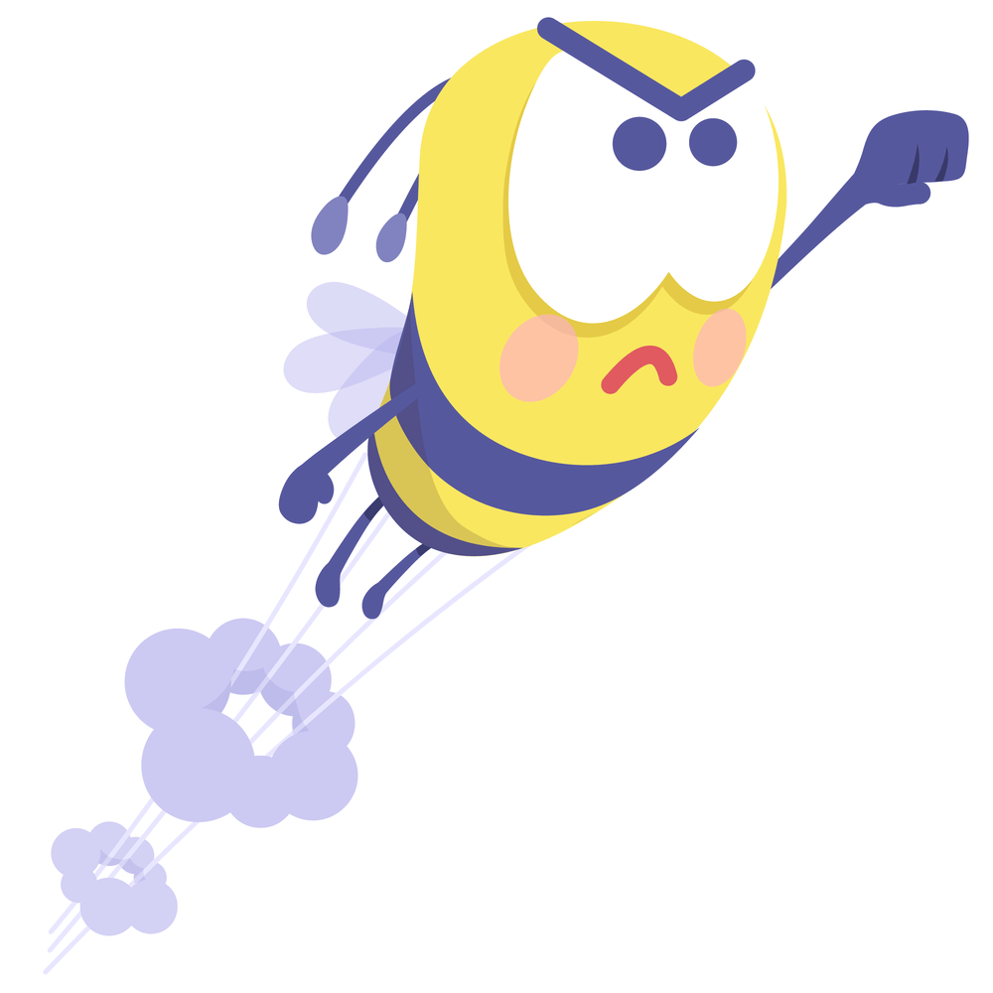
Diphthongs
A diphthong is a sound created by two vowels in a single syllable. The sound starts with the first vowel and travels to the second vowel.
oil
soil
loyal
enjoy
Notes:
Say, “What is a diphthong?”
Student Response: A diphthong is a sound created by two vowels in a single syllable. The sound starts with the first vowel and travels to the second vowel.
Click to show meaning.
Say, “Very good job! Now, let’s look at the diphthongs oi and oy. What sound do they make?”
Student Response: They make the same sound /oi/.
Say, “Perfect! Let’s read a few words aloud.”
Click to show one word.
Student Response: oil
Click to show word.
Student Response: soil
Click to show word.
Student Response: loyal
Click to show word.
Student Response: enjoy

Slide 3
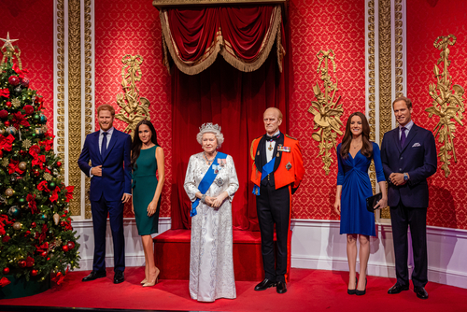


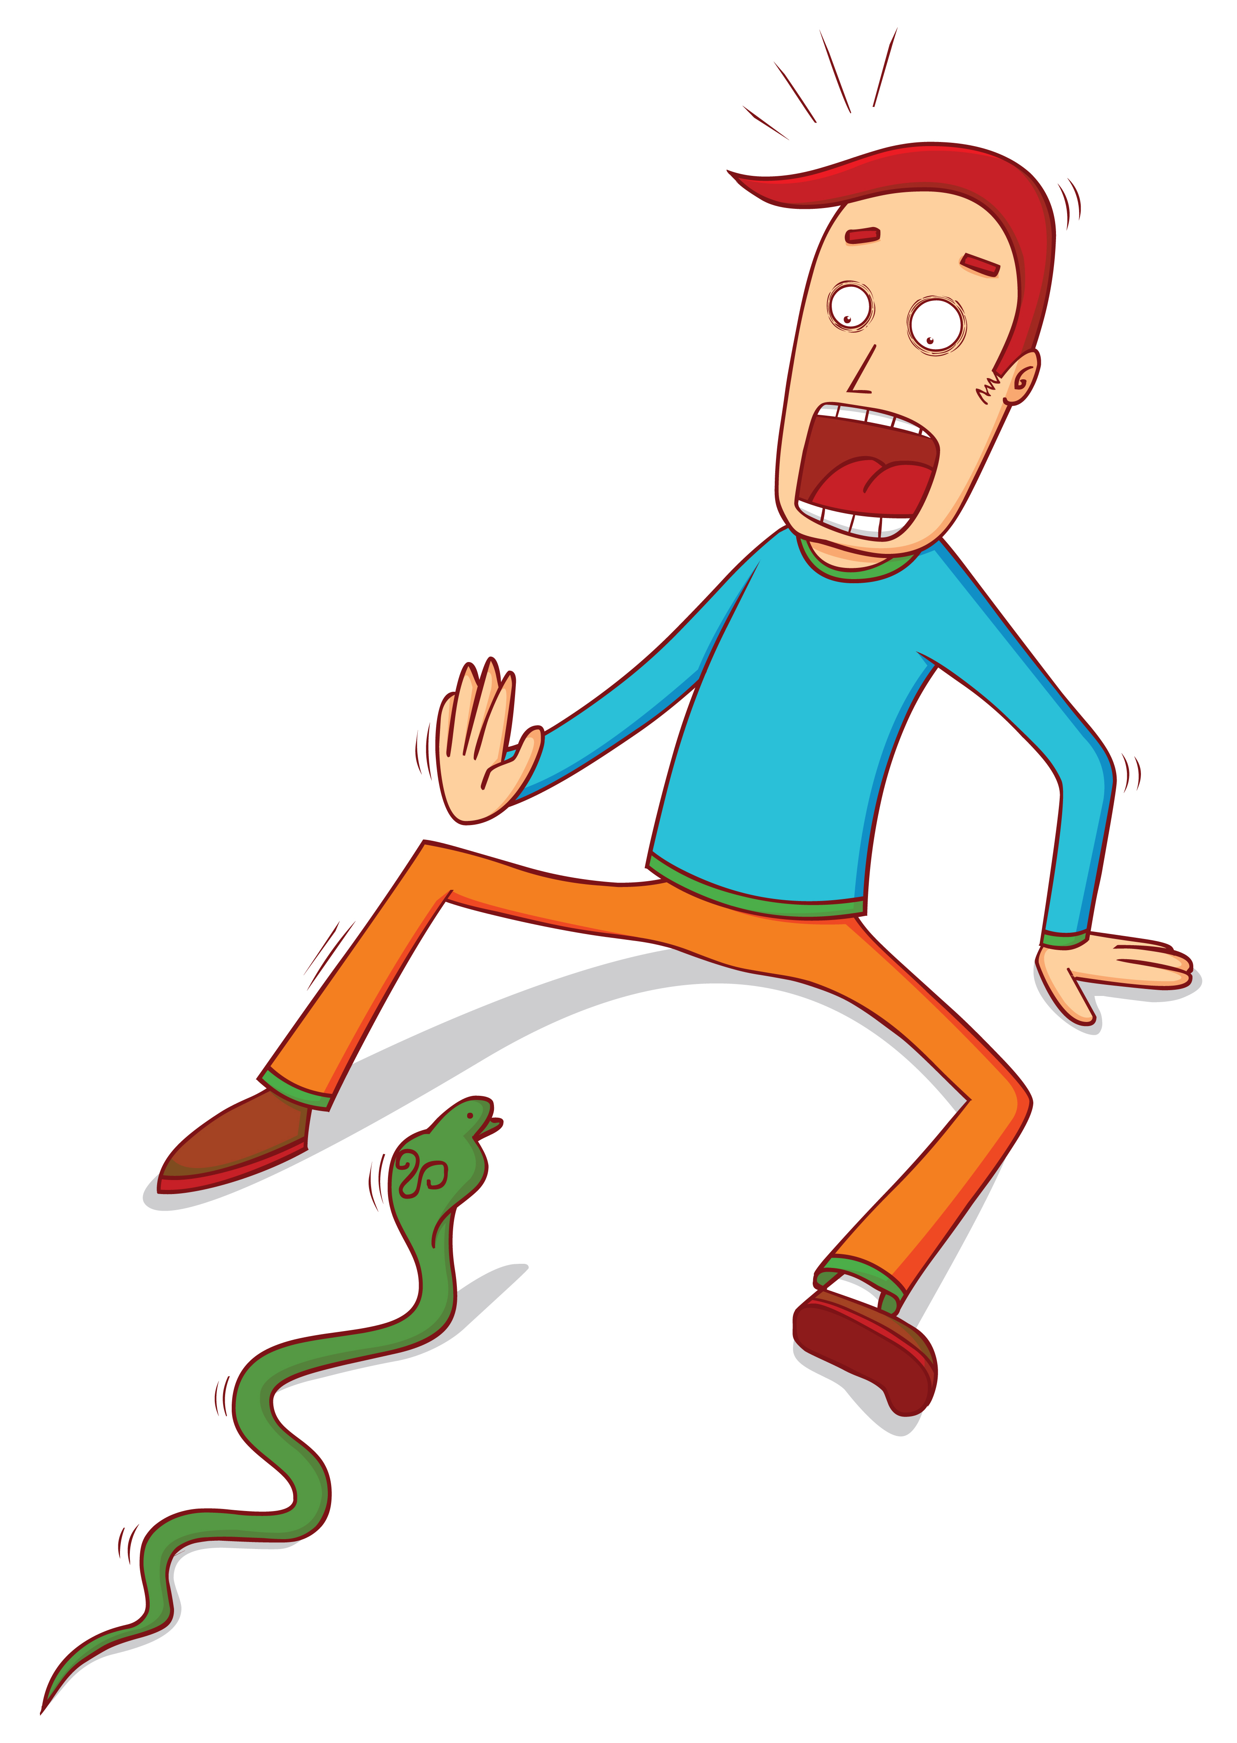
Listen and Spell
voyage
toilet
royal
avoid
Notes:
Say, “It’s time for more practice. Please go find yourself a white board or a piece of lined paper and something to write with.”
Allow students time to get these items.
Say, ”I will say a word, you will write that word on your white board or piece of paper.”
Click once for the picture.
Say, “Avoid. On our hike we came across a snake, went around it to avoid getting bit. Avoid.”
Allow students time to write their spelling.
Click once for the correct spelling to appear.
Say, “A V O I D take the time to check your spelling. If you misspelled the word that is okay. Please correct your spelling now.”
Allow students time to correct their spelling.
Double click for the picture.
Say, “Toilet. Make sure to put the toilet seat down. Toilet.”
Allow students time to write their spelling.
Click once for the correct spelling to appear.
Say, “T O I L E T take the time to check your spelling. If you misspelled the word that is okay. Please correct your spelling now.”
Allow students time to correct their spelling.
Double click for the picture.
Say, “Voyage. I want to go on a voyage to Egypt. Voyage.”
Allow students time to write their spelling.
Click once for the correct spelling to appear.
Say, “V O Y A G E take the time to check your spelling. If you misspelled the word that is okay. Please correct your spelling now.”
Allow students time to correct their spelling.
Double click for the picture.
Say, “Royal. The royal family always dresses so professionally. Royal.”
Allow students time to write their spelling.
Click once for the correct spelling to appear.
Say, “R O Y A L take the time to check your spelling. If you misspelled the word that is okay. Please correct your spelling now.”
Allow students time to correct their spelling.
Double click for the picture.

Slide 4
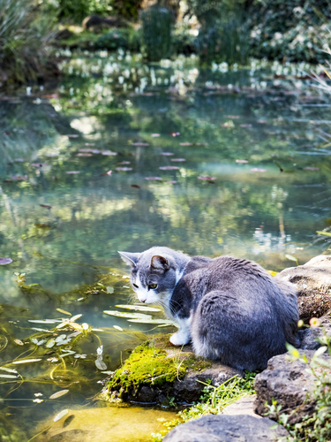
Story Retell
Notes:
Say, “Now it’s time to practice with our weekly reading of Franky Goes Fishing.”
Click once.
Say, “Who are the characters?”
Student Response: Franky and Pippi
Say, ”What is the setting of the story?”
Student Response: Meadow near the pond.
Say, “What was the problem in the story?”
Student Response: Franky thought he could catch a fish himself.
Say, “How about the beginning middle and end of the story?”
Student Response: In the beginning of the story, Franky and Pippi were playing in the meadow near the pond. When Franky went near the pond, he saw something that was the same size as him! Pippi came over and they figured out that it was a catfish. Franky told Pippi that he could catch the fish. So Franky tried to hide where the fish could not see him. He pounced! When he came out of the water, he yelled “run” the fish bit him and took him under water. Franky though that fish was going to chase him and Pippi so the two of them ran back home and into the house.
Say, “What was the solution to the problem in the story?
Student Response: When he tried Franky was bit and he learned that he shouldn’t go fishing anymore.

Slide 5

Formal Language
When you write or speak to a teacher or another adult in public.
Notes:
Say, “When should you use formal language?”
Student Response: When you write or speak to a teacher or another adult in public.
Click once.
Say, “Very good job, this is a professional language. Something you should always use when writing for class. Please remember that!”

Slide 6
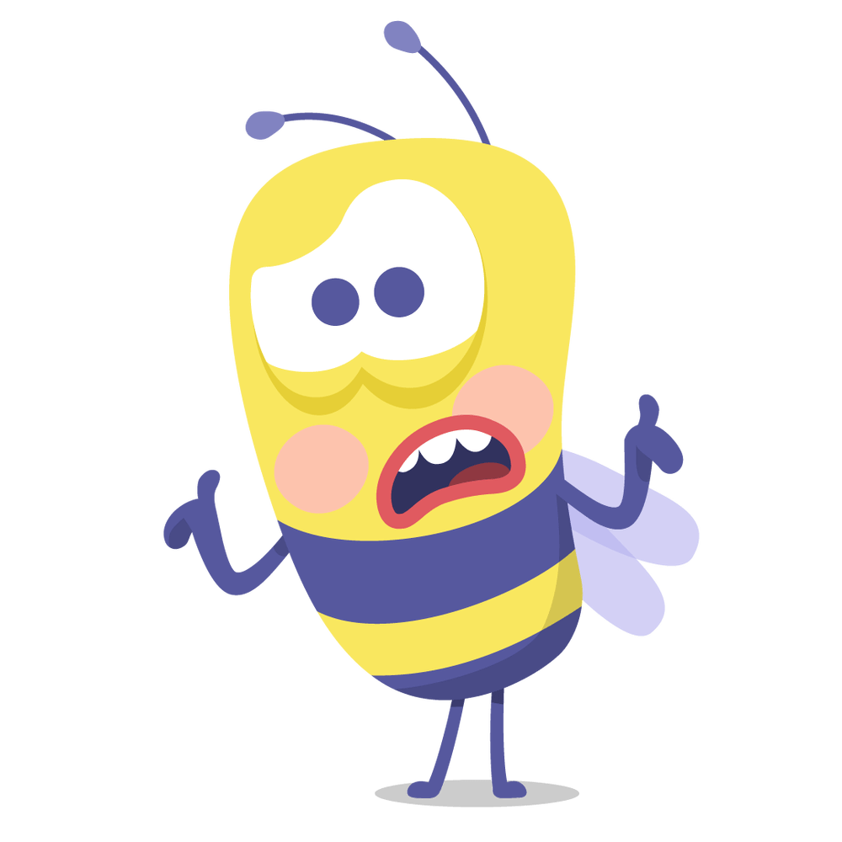
Informal Language
This is when we are talking to a friend.
Notes:
Say, “When should you use informal language?”
Student Response: This is when we are talking to a friend.
Click once.
Say, “Very good job. You might use this “street talk’ or “casual language” with friends on the phone, in person, or texting.”

Slide 7
Formal or Informal Language
Formal | Informal
Dear Sue
Hey Sue
Very nice
Cool
Because
Cause
Cause
Because
Cool
Hey Sue
Very nice
Dear Sue
Notes:
Say, “Let’s see if you can spot the difference between formal and informal language. I have a few words and word phrases. It is your job to determine if it is formal or informal.
Click once.
Say, “Hey Sue, is this formal or informal language?”
Student Response: Informal
Double click to show answer.
Click for next.
Say, “Dear Sue, is this formal or informal language?”
Student Response: Formal
Double click to show answer.
Click for next.
Say, “Cool, is this formal or informal language?”
Student Response: Informal
Double click to show answer.
Click for next.
Say, “Very nice, is this formal or informal language?”
Student Response: Formal
Double click to show answer.
Click for next.
Say, “Cause, is this formal or informal language?”
Student Response: Informal
Double click to show answer.
Click for next.
Say, “Because, is this formal or informal language?”
Student Response: Formal
Double Click to show answer.

Slide 8
Edit Writing
Dear Grandmother,
How are you feeling today? I have been tired recently. I think it is cause the dogs have been taking over the bed. When do you plan on getting a dog? I know you would <3 having one! When you do get 1, please call me so we can set up a puppy play date. I have to get going grandmother. I love you so much.
Love,
Samantha
I think it is because the dogs have been
love having one!
When you do get one
Notes:
Say, “I have a letter to someone’s grandma. I would like for you to go through the writing to check for only formal language in the letter. If you find any informal language let me know so we can edit the letter.”
Read the letter
Say, “Now, that we have read the letter once, let’s go through the letter line by line. Dear Grandmother. Does this letter begin correctly?”
Student Response: Yes
Say, “How are you feeling today? I have been tired Is everything written in formal language?”
Student Response: YES
Say, “recently. I think it is cause the dogs have been How about this line? Is everything written in formal language?”
Student Response: NO cause must be changed to because.
Click to show fix.
Say, “taking over the bed. When do you plan on Is everything written in formal language?”
Student Response: YES
Say, “getting a dog? I know you would <3 having one! Is everything written in formal language?”
Student Response: NO There is a heart picture instead of the word love.
Click to fix.
Say, “When you do get 1, please call me so we can set Is everything written in formal language here?”
Student Response: NO, The number one should be written out, one.
Click to fix.
Say, “Great job. up a puppy play date. I have to get going How about this line? Is everything written in formal language?”
Student Response: Yes
Say, “grandmother. I love you so much. How about this line? Is everything written in formal language?”
Student Response: Yes
Say, “What about the ending of the letter? Love, Samantha. Is everything written in formal language?”
Student Response: Yes

Slide 9
Q & A
Any Questions?

