Slide 1
G Sounds
Listen and Spell Them

Slide 2
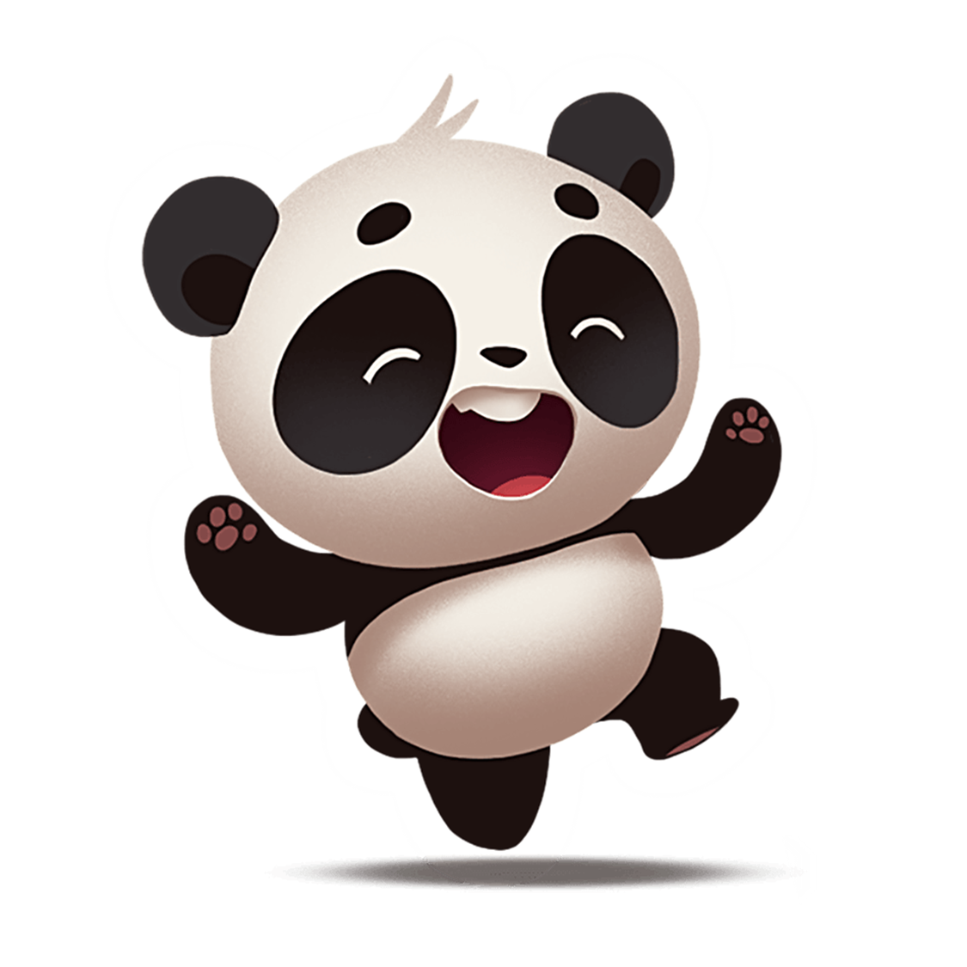
G Sounds like /j/
gym
Notes:
Say, “ This week we learned that the letter g sometimes sounds like /j/, Do we remember the rule for this? “
Student Response: Yes, whenever the g is followed by a e. i. or y it will make the /j/ sound.
Say, “Very good job! Let’s take a look. Listen carefully to the /j/ sound.”
Click to show word.
Say, “ Gym, do we hear the /j/ sound?”
Student Response: Yes!
Say, “We hear the /j/ sound because of the letter y following after the g.

Slide 3
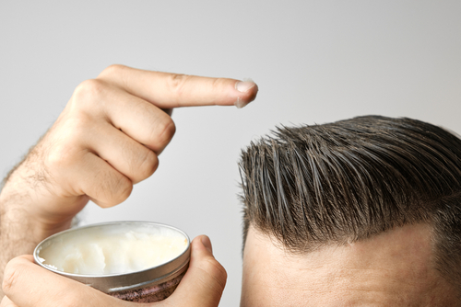
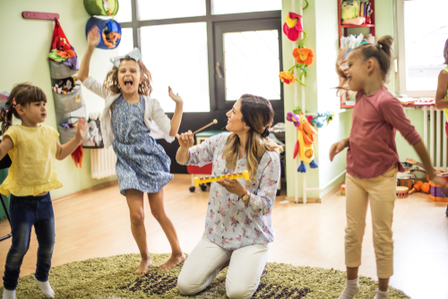
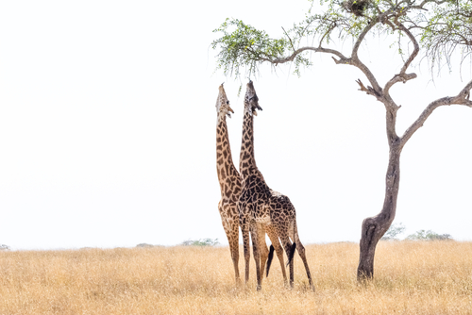
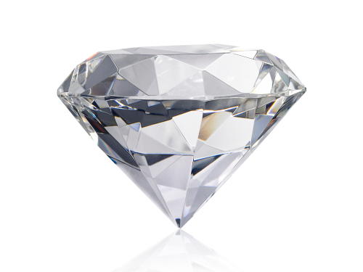
Listen and Spell
gel
gem
giraffe
gym
Notes:
Say, “It’s time for more practice. Please go find yourself a white board or a piece of lined paper and something to write with.”
Allow students time to get these items.
Say, ”I will say a word, you will write that word on your white board or piece of paper.”
Click once for the picture.
Say, “Gym. There will be a dance in the gym this afternoon. Gym.”
Allow students time to write their spelling.
Click once for the correct spelling to appear.
Say, “G Y M take the time to check your spelling. If you misspelled the word that is okay. Please correct your spelling now.”
Allow students time to correct their spelling.
Double click for the picture.
Say, “Gel. Do you use hair gel? Gel.”
Allow students time to write their spelling.
Click once for the correct spelling to appear.
Say, “G E L take the time to check your spelling. If you misspelled the word that is okay. Please correct your spelling now.”
Allow students time to correct their spelling.
Double click for the picture.
Say, “Gem. That gem looks so vibrant. Gem.”
Allow students time to write their spelling.
Click once for the correct spelling to appear.
Say, “G E M take the time to check your spelling. If you misspelled the word that is okay. Please correct your spelling now.”
Allow students time to correct their spelling.
Double click for the picture.
Say, “Giraffe. The giraffe can reach so high in the tree. Giraffe.”
Allow students time to write their spelling.
Click once for the correct spelling to appear.
Say, “G I R A F F E take the time to check your spelling. If you misspelled the word that is okay. Please correct your spelling now.”
Allow students time to correct their spelling.

Slide 4

G Sounds like a /j/ at the End
cage
bridge
Notes:
Say, “We know that the letter g makes the /j/ sound when an i, e, or y follow the letter g. What about at the end of a word? How do we make the /j/ sound at the end of a word?”
Student Response: The letter combinations -ge and -dge make the /j/ sound.
Say, “Let’s take a look at a couple examples.”
Click once.
Say, “In the word cage, do you hear the /j/ sound at the end?”
Student Response: Yes
Say, “Does this word end with either of our two letter combinations?”
Student Response: Yes, -ge.
Click once
Say, “Now the word bridge, does the g sound like a /j/?”
Student Response: Yes!
Say, “What letter combination did we use here?
Student Response: -dge

Slide 5

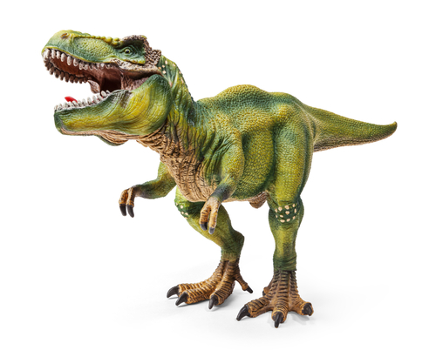
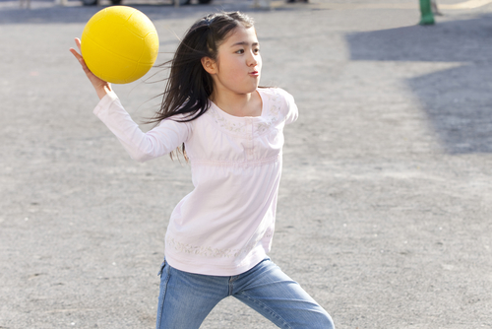
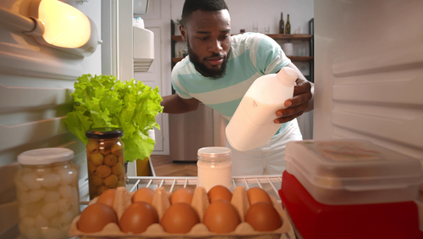
Listen and Spell
fridge
dodge
huge
page
Notes:
Say, “It’s time for more practice. Please go find yourself a white board or a piece of lined paper and something to write with.”
Allow students time to get these items.
Say, ”I will say a word, you will write that word on your white board or piece of paper.”
Click once for the picture.
Say, “Dodge. Can you dodge the ball in dodgeball? Dodge.”
Allow students time to write their spelling.
Click once for the correct spelling to appear.
Say, “D O D G E take the time to check your spelling. If you misspelled the word that is okay. Please correct your spelling now.”
Allow students time to correct their spelling.
Double click for the picture.
Say, “Huge. The dinosaurs were huge! Huge.”
Allow students time to write their spelling.
Click once for the correct spelling to appear.
Say, “H U G E take the time to check your spelling. If you misspelled the word that is okay. Please correct your spelling now.”
Allow students time to correct their spelling.
Double click for the picture.
Say, “Page. Turn to the next page. Page.”
Allow students time to write their spelling.
Click once for the correct spelling to appear.
Say, “P A G E take the time to check your spelling. If you misspelled the word that is okay. Please correct your spelling now.”
Allow students time to correct their spelling.
Double click for the picture.
Say, “Fridge. Make sure to put the milk in the fridge. Fridge.”
Allow students time to write their spelling.
Click once for the correct spelling to appear.
Say, “F R I D G E take the time to check your spelling. If you misspelled the word that is okay. Please correct your spelling now.”
Allow students time to correct their spelling.

Slide 6
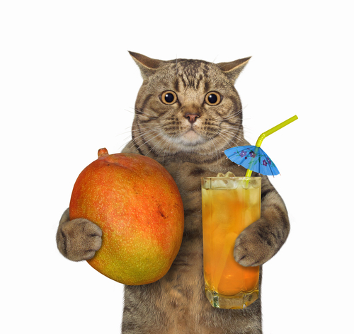
Story Retell
Notes:
Say, “Now it’s time to practice with our weekly reading of Mangoes for Pixie.”
Click once.
Say, “Who are the characters?”
Student Response: Carter Family, Uncle Nick, Aunt Julie
Say, ”What is the setting of the story?”
Student Response: Carter house
Say, “What was the problem in the story?”
Student Response: Pixie was worried mom would be mad because she got a hold of the mangoes.
Say, “How about the beginning middle and end of the story?”
Student Response: In the beginning of the story, the Carter family had visitors. It was Uncle Nick and Aunt Julie. They brought mangoes for mom. Pixie sniffed the mangoes and she wanted to try them. Mom said no. While family was visiting Pixie fell asleep. When she woke up no one was home. Pixie saw the bag with the mangoes in it. Pixie reached on the table to get the mangoes. Once Pixie reached them, she began to eat the juicy mango. When mom got home, mom saw that Pixie ate some of the mangoes. Pixie was worried mom would be mad. Mom was not made. She cleaned up Pixie’s mess and hid the mangoes from Pixie.
Say, “What was the solution to the problem in the story?
Student Response: Pixie got a hold of the mangoes and ate some. When mom came home Pixie was worried mom would be upset. She was not. Mom simply hid the rest of the mangoes from her.

Slide 7
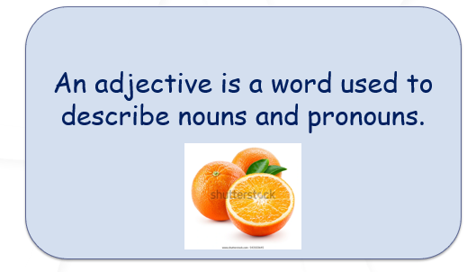
Adjectives or Adverbs
An adverb is a word used to describe verbs, adjectives, and other adverbs.
My friend bravely rode a bull!
Notes:
Royalty-free stock photo ID: 543103645
Say, “What is an adjective?”
Student Response: An adjective is a word used to describe nouns and pronouns.
Click once.
Say, “What are some adjectives to describe an orange?”
Student Response Answers will vary.
Say, “Very good job! Now, what is an adverb?”
Student Response: An adverb is a word used to describe verbs, adjectives, and other adverbs.
Click once.
Click once.
Say, “What would the adverb be in this sentence? My friend bravely rode a bull!”
Student Response: bravely!
Say, “Very good job.”

Slide 8
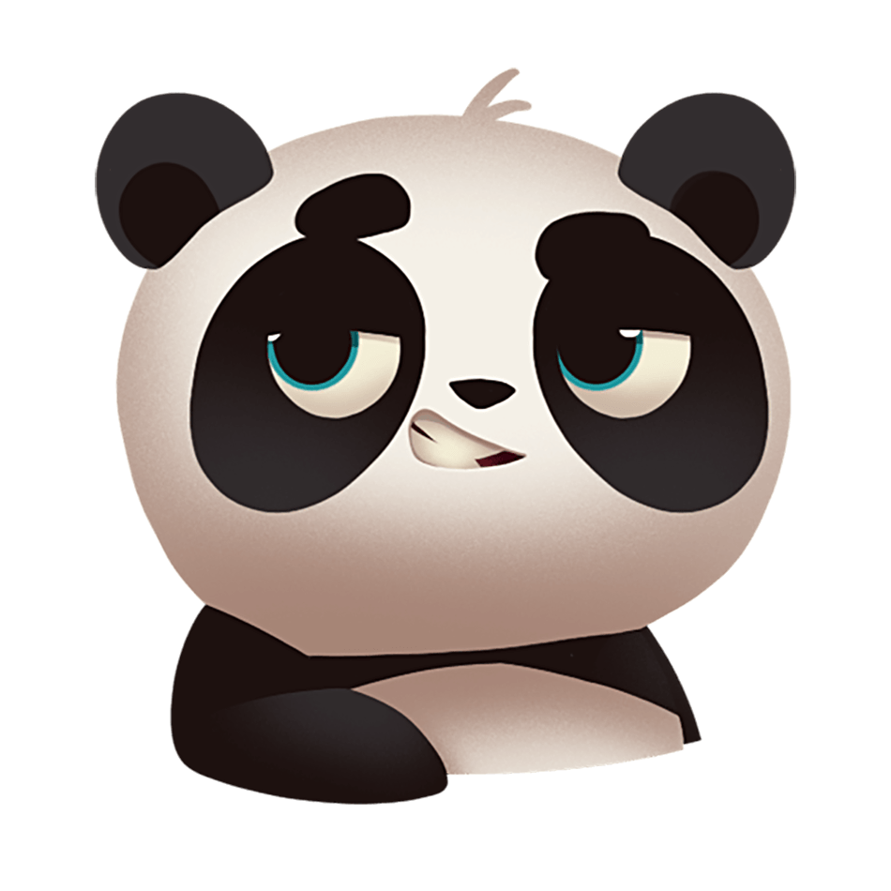
Find the Adverbs
cage
calmly
shame
actually
smile
freely
true
fairly
honest
Notes:
Say, “I have a few words here. Your job is to locate the adverbs. Let’s go from left to right beginning with the word, “calmly”. Is the word calmly an adverb?”
Student Response: YES!
Click once for the word to move.
(Do this for all of the words. The adverbs are the only time you will click. Those words are: calmly, actually, freely, fairly.)

Slide 9
Q & A
Any Questions?

