Slide 1
Suffix –ly
Abverbs

Slide 2
Prefix and Suffix
A prefix is a letter or group of letter added before a base word.
A suffix is a letter or group of letters added after a base word.
Notes:
Say,” What is a prefix and where can you find one?”
Student Response: A prefix is a letter or group of letter added before a base word.
Click to show.
Say,” What is a suffix then? Where can I find that?”
Student Response: A suffix is a letter or group of letters added after a base word.
Click to show.

Slide 3
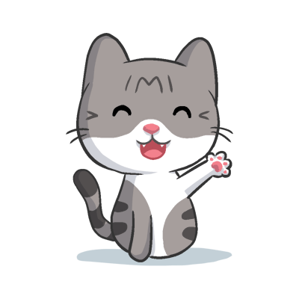
The Suffix –ly
quietly
bravely
Notes:
Say,” The suffix -ly usually tells us how or how often something is done.
Click to show a word.
Say,” Quietly. Does the suffix -ly say how or how often something is done?”
Student Response: Yes, it tells us how quiet someone or something .
Click to show next word.
Say, “What about the word bravely? Does the suffix -ly say how or how often something is done?”
Student Response: Yes, it tell us how brave someone is.

Slide 4
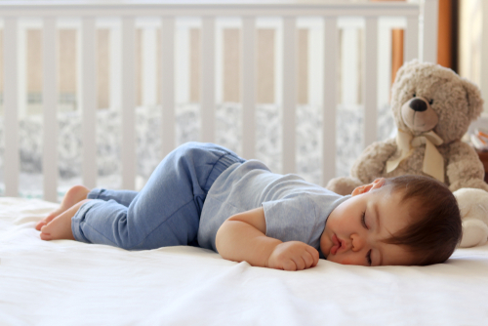
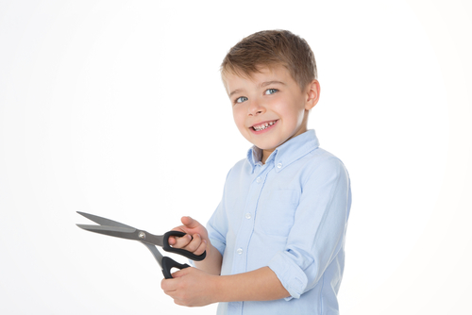
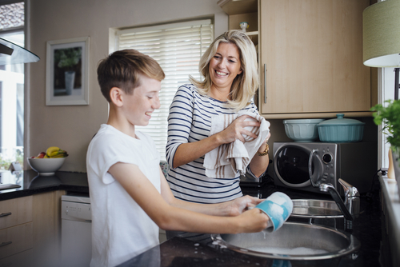

Listen and Spell
gladly
badly
slowly
softly
Notes:
Say, “It’s time for more practice. Please go find yourself a white board or a piece of lined paper and something to write with.”
Allow students time to get these items.
Say, ”I will say a word, you will write that word on your white board or piece of paper.”
Click once for the picture.
Say, “Slowly. Walk slowly when holding scissors. Slowly.”
Allow students time to write their spelling.
Click once for the correct spelling to appear.
Say, “S L O W L Y take the time to check your spelling. If you misspelled the word that is okay. Please correct your spelling now.”
Allow students time to correct their spelling.
Double click for the picture.
Say, “Badly. I want that video game so badly. Badly.”
Allow students time to write their spelling.
Click once for the correct spelling to appear.
Say, “B A D L Y take the time to check your spelling. If you misspelled the word that is okay. Please correct your spelling now.”
Allow students time to correct their spelling.
Double click for the picture.
Say, “Glady. I would gladly help you with the dishes. Gladly.”
Allow students time to write their spelling.
Click once for the correct spelling to appear.
Say, “G L A D L Y take the time to check your spelling. If you misspelled the word that is okay. Please correct your spelling now.”
Allow students time to correct their spelling.
Double click for the picture.
Say, “Softly. Make sure to lay the baby down softly. Softly.”
Allow students time to write their spelling.
Click once for the correct spelling to appear.
Say, “S O F T L Y take the time to check your spelling. If you misspelled the word that is okay. Please correct your spelling now.”
Allow students time to correct their spelling.

Slide 5

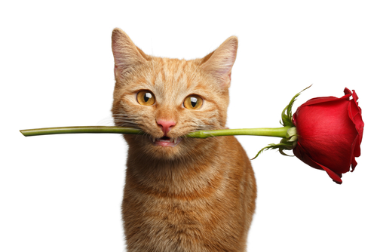
Story Retell
Notes:
Say, “Now it’s time to practice with our weekly reading of Franky and the Flowers.”
Click once.
Say, “Who are the characters?”
Student Response: Susan, Franky, Abby, Tom, Tara
Say, ”What is the setting of the story?”
Student Response: Carter Family House
Say, “What was the problem in the story?”
Student Response: Some of the flowers looked like they were cut and the family we finding buds all over the house.
Say, “How about the beginning middle and end of the story?”
Student Response: Susan found a bouquet of flowers from someone, but she didn’t know who. Then the family noticed that some of the flowers looked like they had been cut off at the stem. Tom found a rose bud on the floor the next day, Tara found puffy flowers by her bed, Abby found some yellow petals by the door, and Susan found rose buds on the floor. Before the family left, they decided to hide the bouquet. They hid the flowers in Tara’s room, but her door was broken so it didn’t close. When the family got home they found flowers all over the floor. When they went to look in Tara’s room they found Franky playing with the flowers. The family finally figured out the Franky had been picking the flowers and playing with them.
Click once.
Say, “What was the solution to the problem in the story?
Student Response: Franky had been cutting off the buds and playing with the flowers.

Slide 6

What is an adverb?
An adverb is a word that gives details or modifies a verb, an adjective, or another adverb.
Notes:
Say, “ What is an adverb?”
Student Response: An adverb is a word that gives details or modifies a verb, an adjective, or another adverb.
Click to show meaning.
Say, “Usually adverbs end with the suffix -ly. BUT not all of them do! Let’s look at some examples of both..”

Slide 7
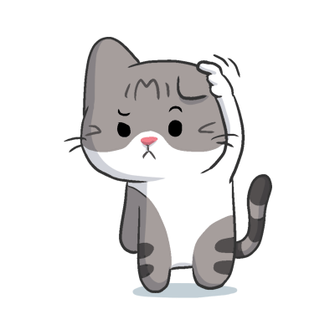
Adverbs
early
cheerfully
there
only
randomly
almost
here
later
Notes:
Say, “Lets take a look at some adverbs. I will show you one word at a time and I would like for you to read the words to me. “
Click once.
Student Response: early
Click once.
Student Response: cheerfully
Click once.
Student Response: here
Click once.
Student Response: only
Click once.
Student Response: randomly
Click once.
Student Response: almost
Click once.
Student Response: there
Click once.
Student Response: later
Say, “Very good job! Do you see that not all adverbs end with the suffix -ly but some do?”
Student Response: YES
Say, “Which ones? Answer: here, there, almost, later
Student Response: there
Click
Student Response: almost
Click
Student Response: here
Click
Student Response: later
Click

Slide 8
Adverbs in a Sentence
He ______ helped his dad in the garage.
She _____ did not make the team this year.
Wash your hands _____ you are done using the restroom.
When we are in the library, make sure to talk _______.
happily
once
quietly
sadly
Notes:
Say, “I have four sentences that require the correct adverb in them. It is your job to listen to me read the sentence and then pick the correct adverb for that sentence. Are we ready?”
Student Response: YES
Click once.
Say, “When we are in the library make sure to talk _______ to one another.”
Student Response: quietly
Click to show answer.
Click for next sentence.
Say, “Wash your hands ______ you are done using the restroom.”
Student Response: once
Click to show answer.
Click for next sentence.
Say, “She _______ did not make the team this year.”
Student Response: sadly
Click to show answer.
Click for next sentence.
Say, “He _________ helped his dad in the garage.”
Student Response: happily
Click to show answer.

Slide 9
Q & A
Any Questions?

