Slide 1
Check for Completion
Phrases

Slide 2
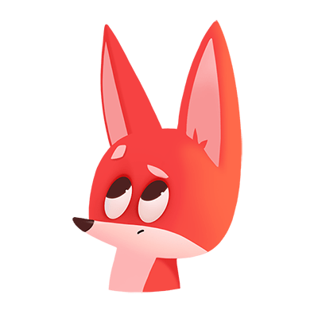
Words Ending in -ore
wore
score
store
Notes:
Say, “We learned this week that when words end in -ore they make a different sound. What sound was that?”
Student Response: or
Click to show a word.
Say, “How do I say this word if we know that words ending with -ore make the or sound?”
Student Response: score
Say, “Very good job. Let’s look at a few more.”
Click once.
Say, “What is this word?”
Student Response: wore
Click once.
Say, “What about this word?”
Student Response: store

Slide 3

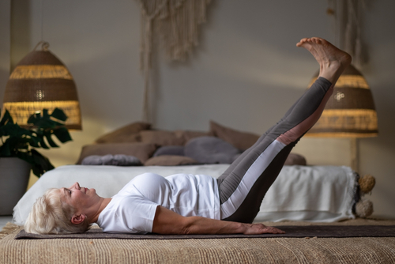

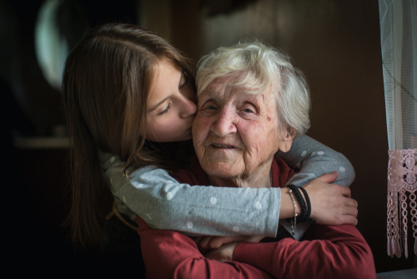
Listen and Spell
more
core
adore
shore
Notes:
“It’s time for more practice. Please go find yourself a white board or a piece of lined paper and something to write with.”
Allow students time to get these items.
Say, ”I will say a word, you will write that word on your white board or piece of paper.”
Click once for the picture.
Say, “Core. Anytime I go to the gym I save core for last. Core.”
Allow students time to write their spelling.
Click once for the correct spelling to appear.
Say, “C O R E, take the time to check your spelling. If you misspelled the word that is okay. Please correct your spelling now.”
Allow students time to correct their spelling.
Double click for the picture.
Say, “More. May I please have more soup? More.”
Allow students time to write their spelling.
Click once for the correct spelling to appear.
Say, “M O R E, take the time to check your spelling. If you misspelled the word that is okay. Please correct your spelling now.”
Allow students time to correct their spelling.
Double click for the picture.
Say, “Adore. She adores her grandmother. Adore.”
Allow students time to write their spelling.
Click once for the correct spelling to appear.
Say, “A D O R E, take the time to check your spelling. If you misspelled the word that is okay. Please correct your spelling now.”
Allow students time to correct their spelling.
Double click for the picture.
Say, “Shore. I stand on the shore and look for boats. Shore.”
Allow students time to write their spelling.
Click once for the correct spelling to appear.
Say, “S H O R E, take the time to check your spelling. If you misspelled the word that is okay. Please correct your spelling now.”
Allow students time to correct their spelling.

Slide 4
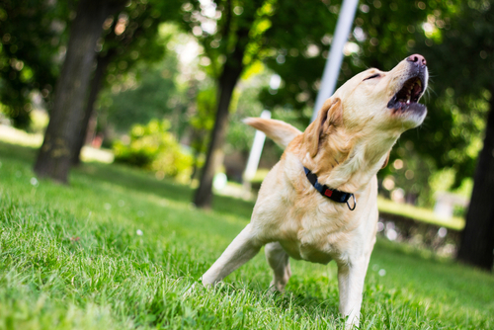
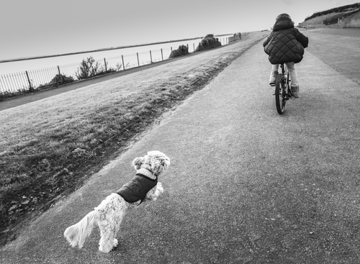
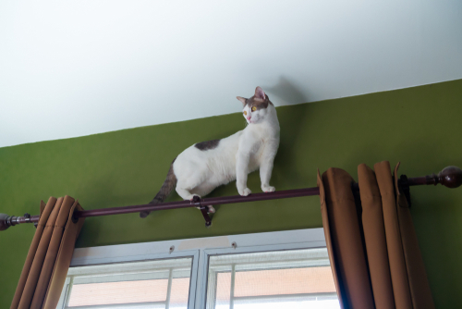
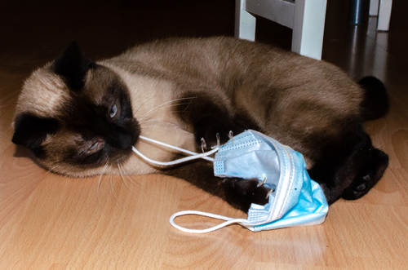
Story Retell
Notes:
Say, “Now it’s time to practice with our weekly reading of Habits.”
Say, “Who are the characters?”
Student Response: Pippi, Franky, Susan, Tom, Bobby, Pixie
Say, ”What is the setting of the story?”
Student Response: Carter Family House
Say, “What was the problem in the story?”
Student Response: Franky, Pippi, Bobby, and Pixie all have habits that are different.
Say, “How about the beginning middle and end of the story?”
Click 4 times.
Student Response: When Pippi and Franky were kittens they stayed in Susan and Tom’s rooms. Their rooms were connected with a bathroom that held the kitten’s food, water, and liter boxes. When the kittens grew into cats, Susan moved the food and water into the kitchen and the liter box somewhere safe. When this first happened Pippi and Franky would go to the kid’s bathroom to get a drink of water when the water wasn’t there they would cry. Susan began keeping a bowl of fresh water in the bathroom for them. Once the cat’s food was moved to the kitchen Bobby would try to eat it knowing the cat food wasn’t good for him. Bobby also has a habit of barking, a lot. The Carters don’t really like it. Pixie is a very thirsty dog, and she would always get a drink of water when she would go by the cat’s water bowl or her own. Pixie even chases motorcycles that go back the Carter’s home. Franky likes to balance on things, the Carters are always worried he’s going to fall too. Pippi like to dig in the recycle bin to pull out papers, candy wrappers, and other things that catch her attention.
Say, “What was the solution to the problem in the story?
Student Response: The Carter Family has learned to adjust to the habits of all of their pets and works with them on some of them.

Slide 5
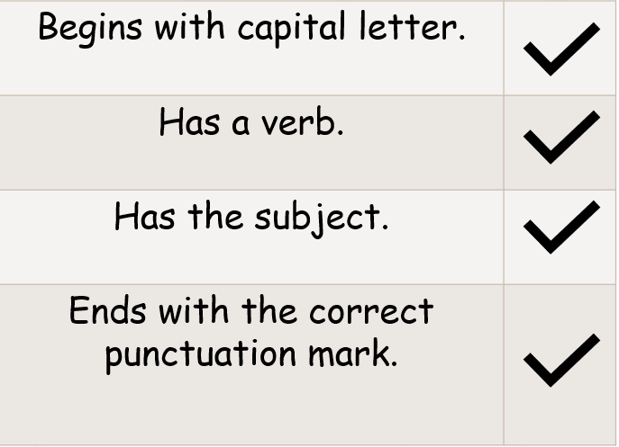
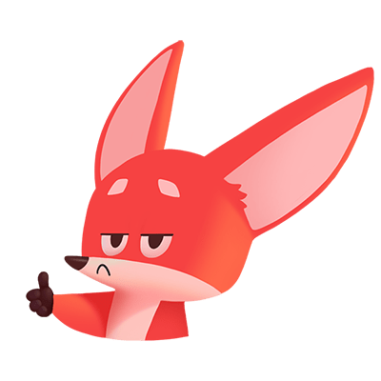
Checking for Completion
Notes:
Say, “ This week we learned what exactly needs to be in a sentence for the sentence to be considered a complete sentence. What are those four things?”
Student Response: Begins with a capital letter, has a verb, has the subject, and ends with the correct punctuation mark.
Click to show those four things.

Slide 6


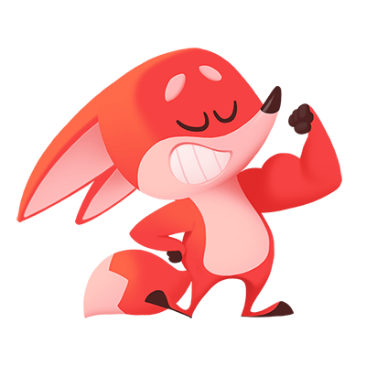
You Check
I went to the gym.
got a pet goat
He got a pet goat.
Notes:
Say, I have two sentences that need to be checked for completion. Are we ready to see that is begins with a capital letter, has a verb, has the subject, and ends with the correct punctuation mark?”
Student Response: YES
Click once.
Say, “ I went to the gym. Look at the check list we have. Is this sentence complete?”
Student Response: YES
Click to show check mark.
Click for next sentence.
Say, “got a pet goat” “Is this a complete sentence?”
Student Response: NO
Say, “What is missing?”
Student Response: There is no subject just the verb, the sentence does not begin with a capital letter, and there is no punctuation at the end.
Say, “Okay, so let’s try this one.”
Click to show correct completed sentence.
Say, “He got a pet goat. Is this a complete sentence?”
Student Response: YES
Click to show a check mark.

Slide 7
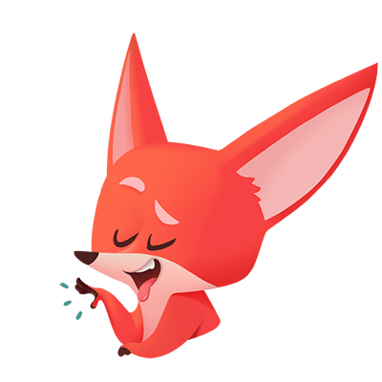
Phrases
A phrase is not a sentence. It is a group of words that make sense together, but it does not say "who does it" and "what happens." Phrases may contain a noun or a verb. But phrases do not have nouns and verbs together.
ate lunch
He ate lunch.
Notes:
Say, “We learned that a phrase is not a complete sentence, correct?”
Student Response: Yes! Because it is a group of words that make sense together but does not have the “who or what”.
Click to show meaning.
Say, “A phrase is not a sentence. It is a group of words that make sense together, but it does not say "who does it" and "what happens." Phrases may contain a noun or a verb. But phrases do not have nouns and verbs together.”
Click to show phrase.
Say, “ate lunch would be a phrase.”
Click once to show complete sentence.
Say, “If we were to add the subject, the “who”, “he” to this phrase. He ate lunch. Now, we have a complete sentence.”

Slide 8
Predicates
Sent a text message.
We know that predicates tells us what the ______ is or is doing.
The dog slept.
You can clean your room.
sentence
sentence
phrase
subject
Notes:
Say, “We know that predicates tells us what the ______ is or is doing.”
Student Response: Subject.
Click to fill blank.
Say, “Very good job. Let’s take a look at a few sentences. I would like for you to tell me what are sentences and what are phrases.”
Click once.
Say, “Sent a text message. Is this a sentence or a phrase?”
Student Response: Phrase
Click to show answer.
Click for next sentence.
Say, “The dog slept. Is this a sentence or phrase?”
Student Response: Sentence.
Click to show answer.
Click for next sentence.
Say, “You can clean your room. Is this a sentence pr phrase?”
Student Response: Sentence
Click to show answer.

Slide 9
Q & A
Any Questions?

