Slide 1
Compound Words
“to be” Verbs

Slide 2
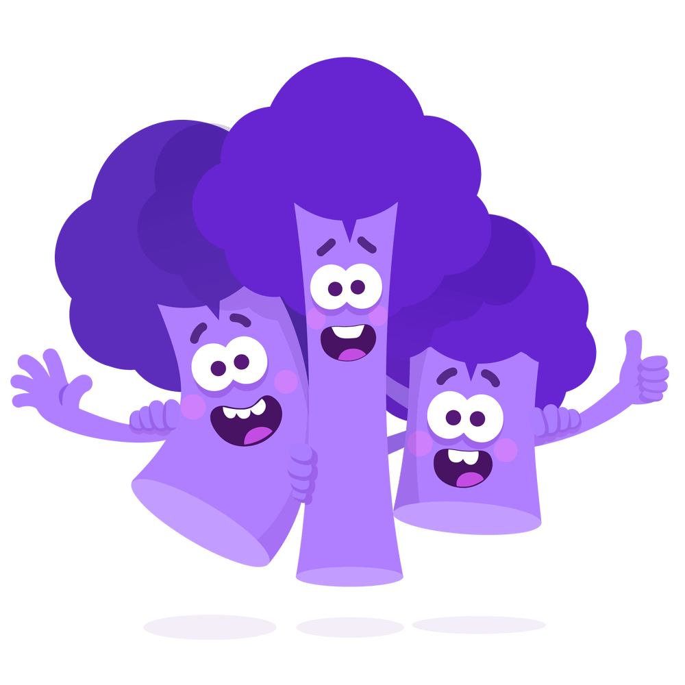
-ar
bark
farm
dark
card
Notes:
Say, “This week we learned about the sound -ar makes when they are together. Does anyone remember that sound?
Student Response: -ar
Say, “Very good job! Let’s look at some words that had the -ar sound in them.”
Click once.
Say, “What is this word?”
Student Response: card.
Click once.
Say, “What is this word?”
Student Response: farm
Click once.
Say, “What is this word?”
Student Response: bark
Click once.
Say, “What is this word?”
Student Response: dark

Slide 3
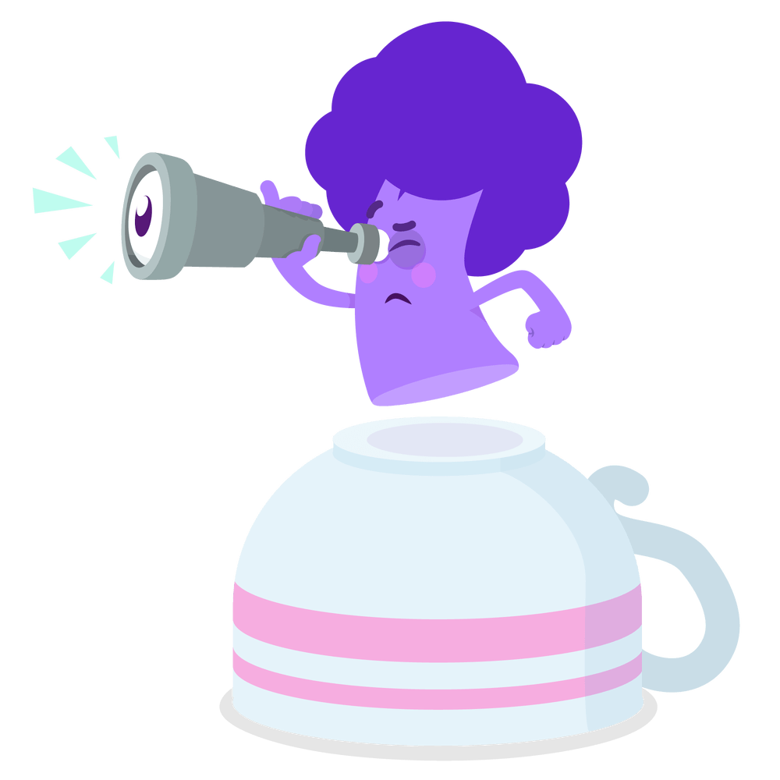
Compound Words
any | + | where | = | anywhere
hair | + | cut | = | haircut
star | + | fish | = | starfish
book | + | mark | = | bookmark
Notes:
Say, “What is a compound word?”
Student Response: Two words that come together to make one word.
Say, “Very good job! Let’s take a look at a few.”
Click once.
Say, “What is this word?”
Student Response: anywhere
Click once.
Say, “What is this word?”
Student Response: haircut
Click once.
Say, “What is this word?”
Student Response: starfish
Click once.
Say, “What is this word?”
Student Response: bookmark

Slide 4
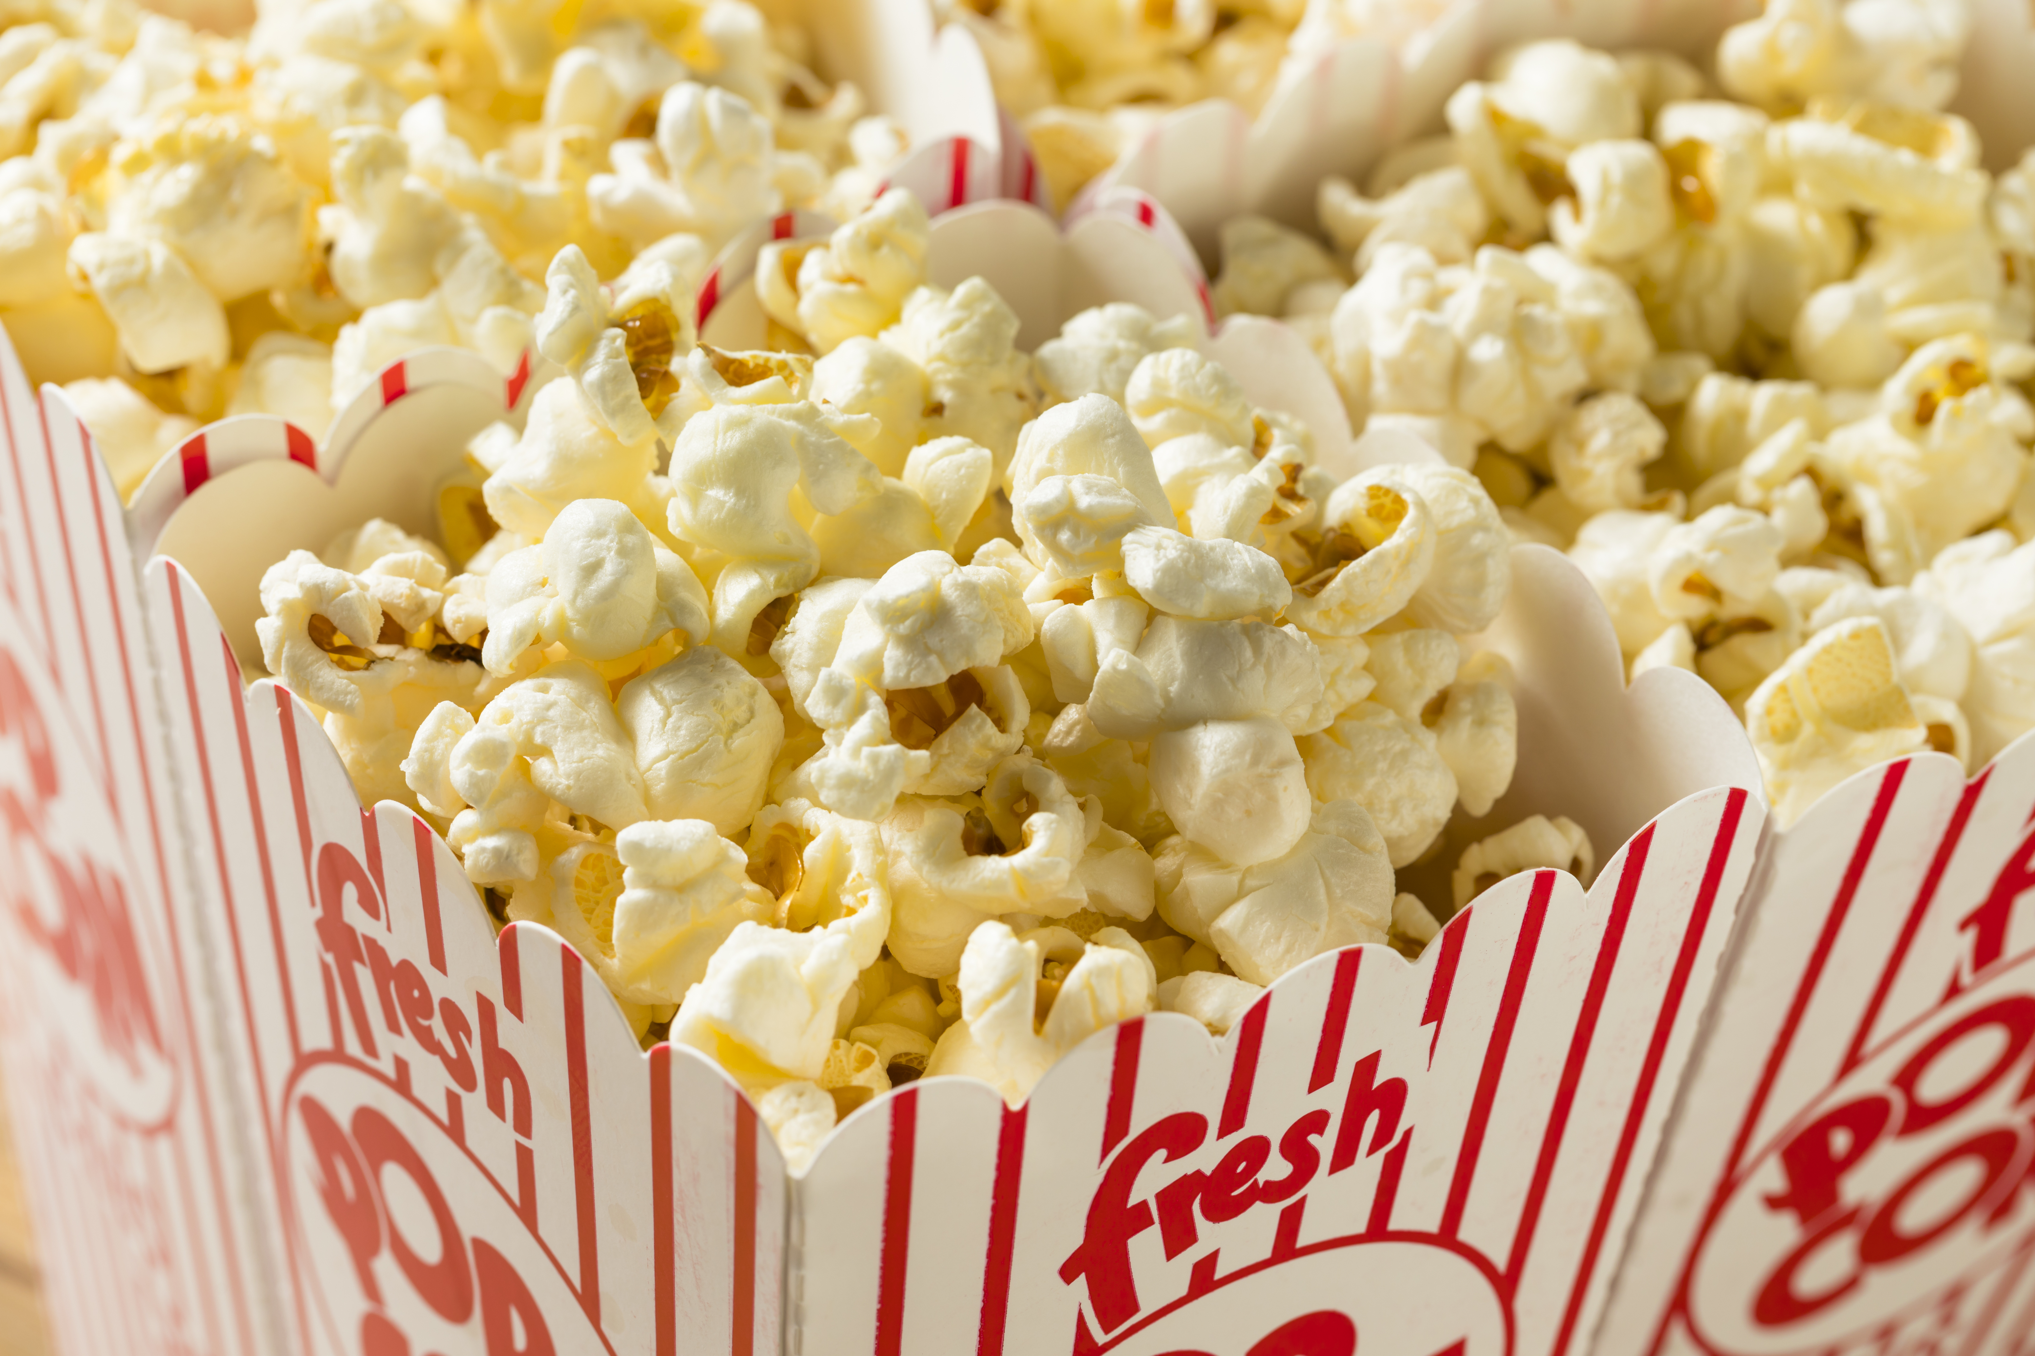
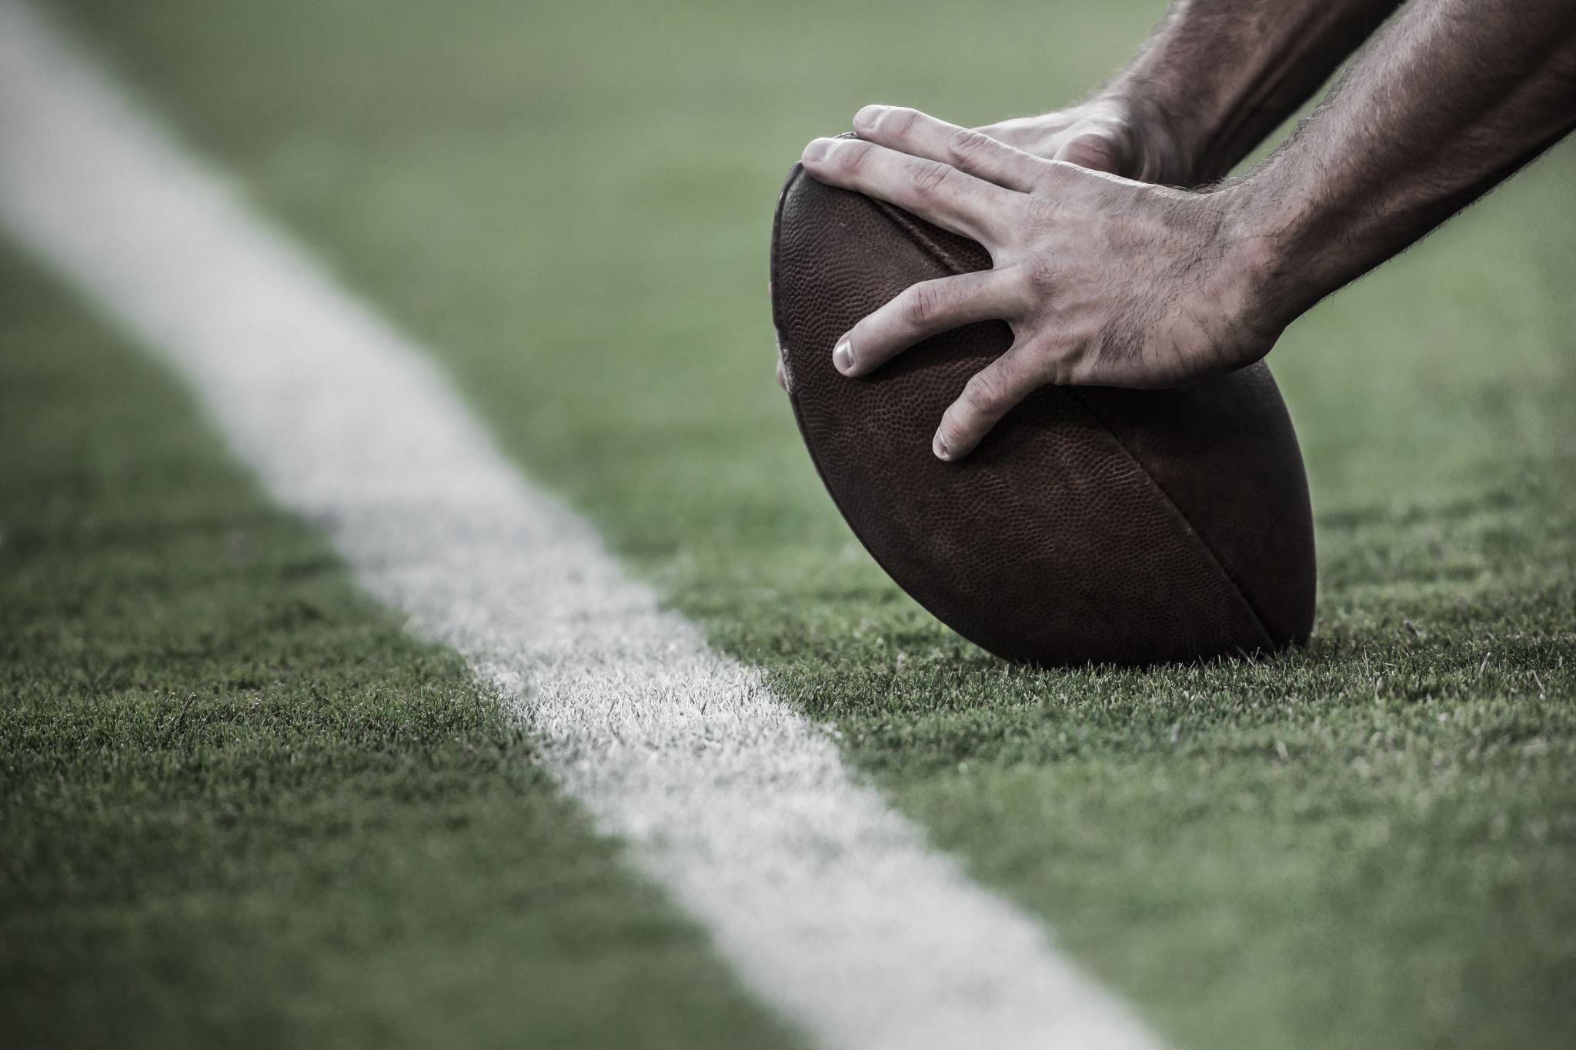
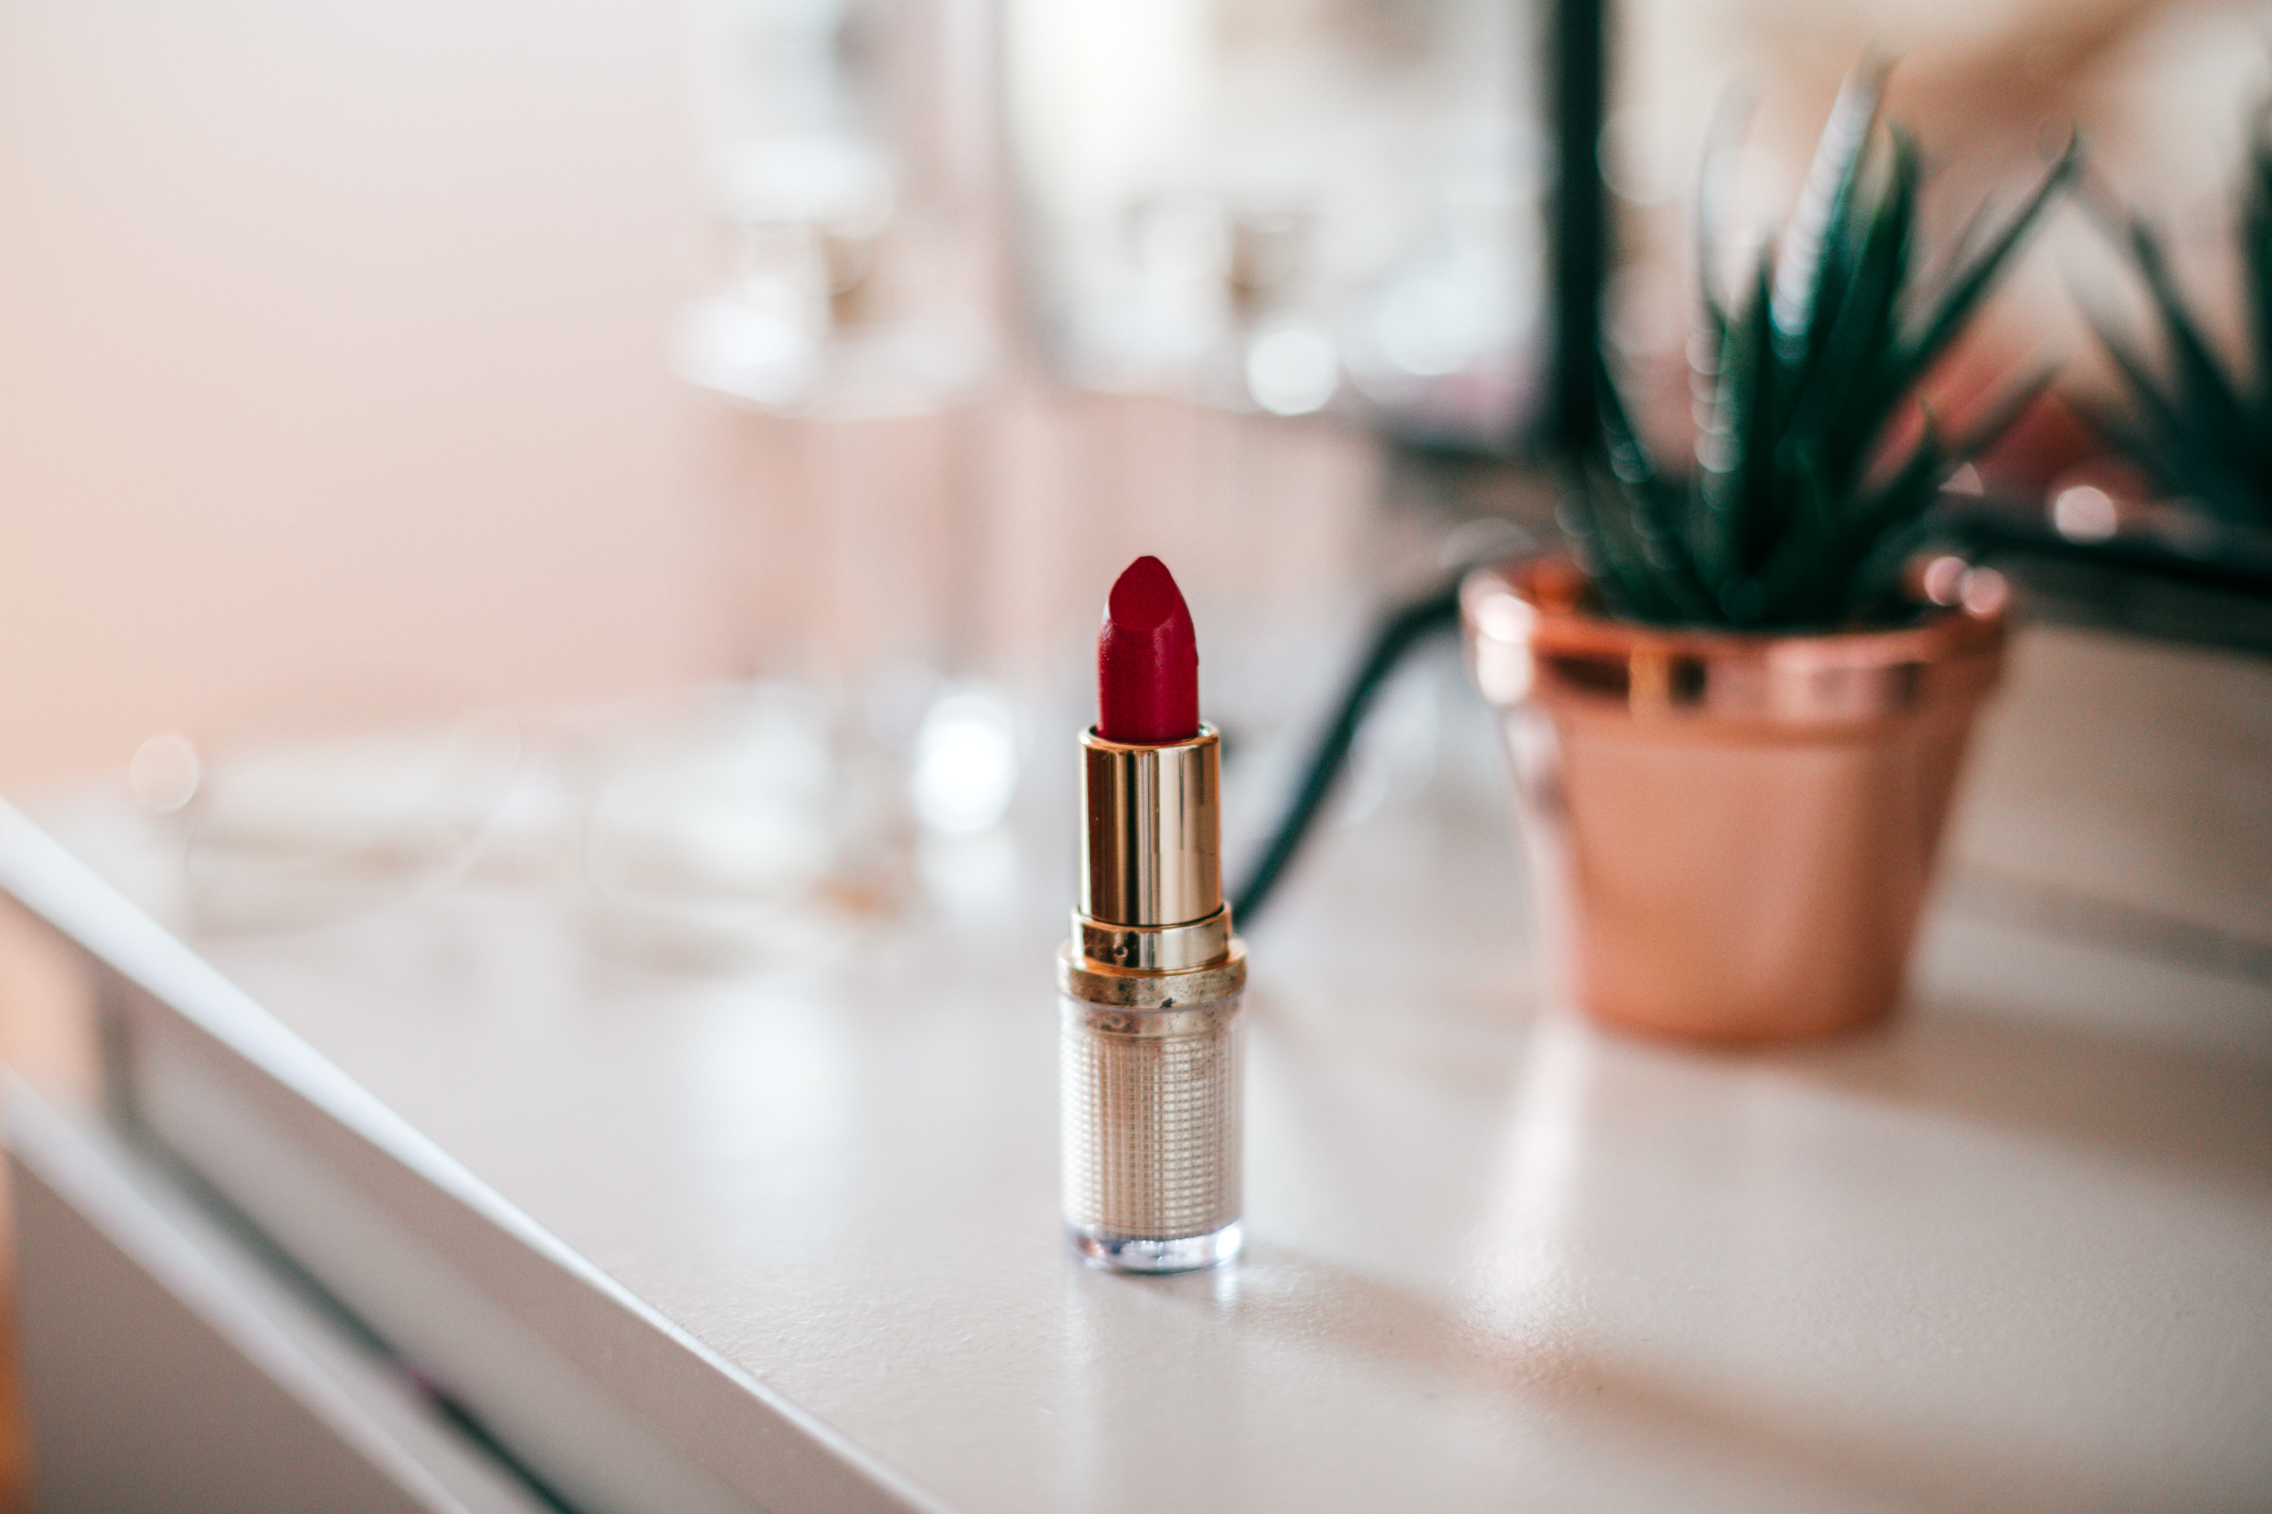
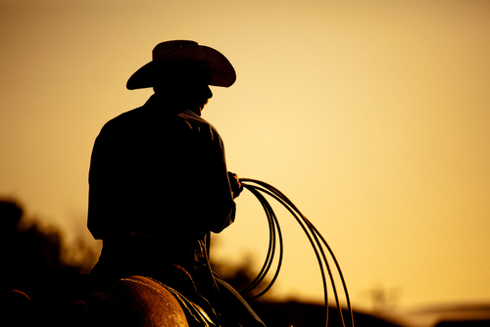
Listen and Spell
lipstick
football
popcorn
cowboy
Notes:
Say, “It’s time for more practice. Please go find yourself a white board or a piece of lined paper and something to write with.”
Allow students time to get these items.
Say, ”I will say a word, you will write that word on your white board or piece of paper.”
Click once for the picture.
Say, “Football. Sunday afternoons are for football games. Football.”
Allow students time to write their spelling.
Click once for the correct spelling to appear.
Say, “F O O T B A L L, take the time to check your spelling. If you misspelled the word that is okay. Please correct your spelling now.”
Allow students time to correct their spelling.
Double click for the picture.
Say, “Lipstick. She is wearing red lipstick. Lipstick.”
Allow students time to write their spelling.
Click once for the correct spelling to appear.
Say, “L I P S T I C K, take the time to check your spelling. If you misspelled the word that is okay. Please correct your spelling now.”
Allow students time to correct their spelling.
Double click for the picture.
Say, “Popcorn. You can’t have a movie night without popcorn. Popcorn.”
Allow students time to write their spelling.
Click once for the correct spelling to appear.
Say, “P O P C O R N, take the time to check your spelling. If you misspelled the word that is okay. Please correct your spelling now.”
Allow students time to correct their spelling.
Double click for the picture.
Say, “Cowboy. The cowboy road away on a horse. Cowboy.”
Allow students time to write their spelling.
Click once for the correct spelling to appear.
Say, “C O W B O Y, take the time to check your spelling. If you misspelled the word that is okay. Please correct your spelling now.”
Allow students time to correct their spelling.
Double click for the picture.

Slide 5
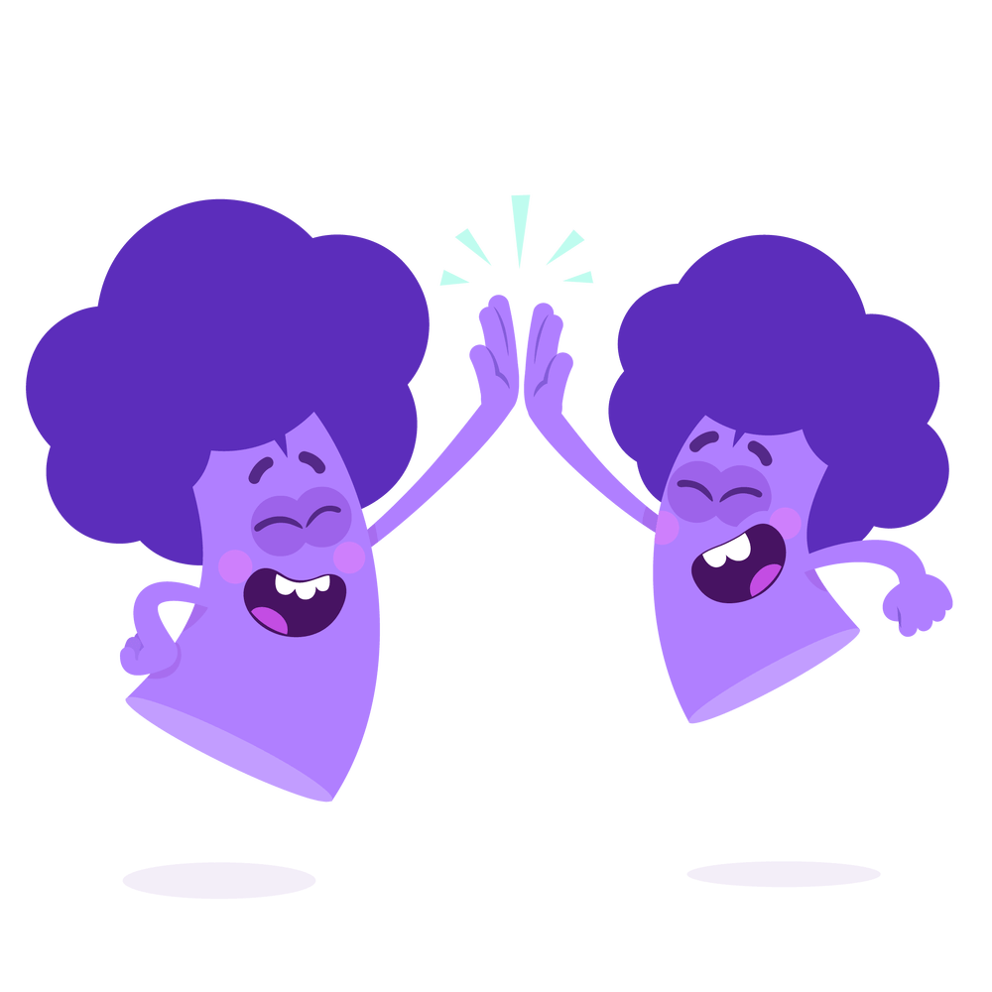
“to be” Verb
am is are were was will be
She _____ at the park yesterday.
was
Notes:
Say, “am, is, are, were, was, will be. What do we call these words?”
Student Response: “to be” verbs
Click once.
Say, “She ____ at the park yesterday. Which “to be” verb should we use in this sentence?”
Student Response: was
Click once.
Say, “Very good job! Now, what tense is the word was? Past, Present, or Future tense?”
Student Response: Past tense

Slide 6
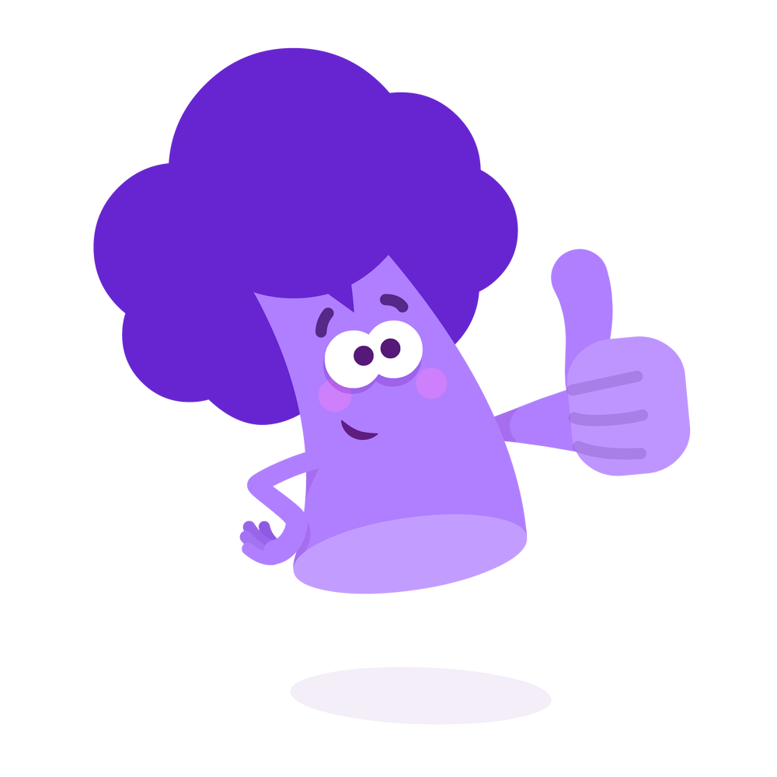
“to be” Verbs in Sentences
am is are were was will be
I _____ going to get my haircut.
What ______ you doing for dinner?
Where ______ the dogs at?
am
are
will be
Tomorrow _________ so much fun!
are
Notes:
Say, “Let’s try to find the correct “to be” verb for each sentence. There is a word bank but not all of the “to be” verbs will be used.”
Click once.
Say, “I _____ going to get my haircut. What “to be” verb works in this sentence?”
Student Response: am
Click to show answer.
Click to show next sentence.
Say, “Where ____ the dogs at? What “to be” verb works in this sentence?”
Student Response: were
Click to show answer.
Click to show next sentence.
Say, “Tomorrow ________ so much fun! What “to be” verb works in this sentence?”
Student Response: will be
Click to show answer.
Click to show next sentence.
Say, “What ____ you doing for dinner? What “to be” verb works in this sentence?”
Student Response: are
Click to show answer.
Click for a thumbs up.

Slide 7
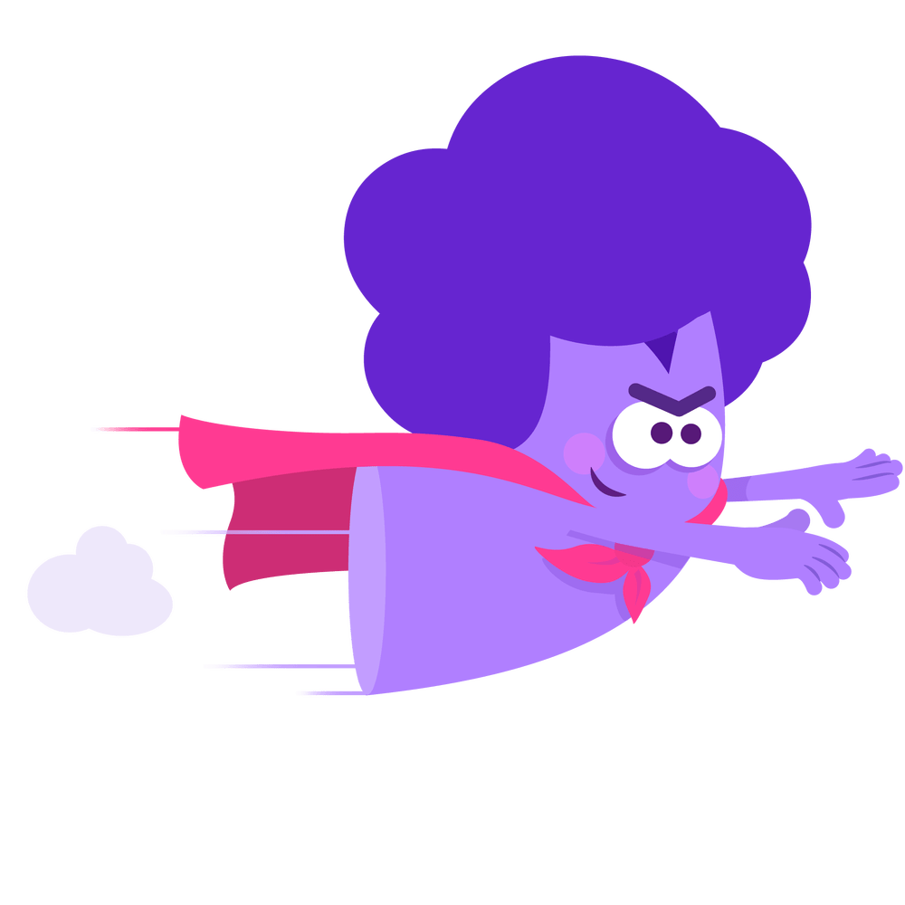
“to be” Verb Tense
I will be at the arcade.
They are doing each other’s makeup.
There was a firework show!
Past
Tense
Future Tense
Present Tense
Notes:
Say, “I have three sentences above. Your job is to identify the “to be verb in the sentence and if the sentence is past, present, or future tense.”
Click once.
Say, “They are doing each other’s makeup.”
Student Response: The “to be” verb is are and it is present tense.
Click to show answer.
Click for next sentence.
Say, “I will be at the arcade.”
Student Response: The “to be” verb is will be and it is future tense.
Click to show answer.
Click for next sentence.
Say, “There was a firework show!”
Student Response: The “to be” verb is was an it is past tense.
Click to show answer.

Slide 8
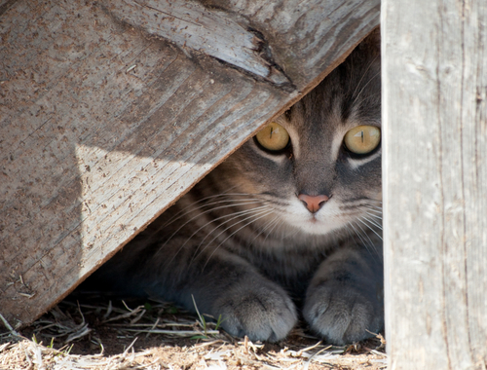
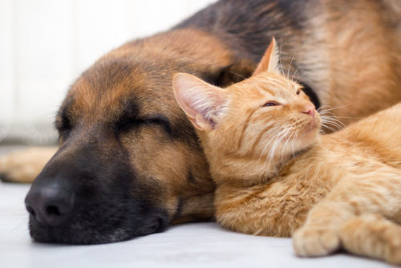
Story Retell
Notes:
Say, “Now it’s time to practice with our weekly reading of The Rescue.”
Say, “Who are the characters?”
Student Response: Pixie, Bobby, Pippi, Franky, Abby, mom, dad
Say, ”What is the setting of the story?”
Student Response: Carter Family Home
Say, “What was the problem in the story?”
Student Response: Franky had been missing!
Double Click
Say, “How about the beginning middle and end of the story?”
Student Response: At the beginning of the story, all of the Carter family were wondering where Franky had been. No one had seen him for an entire day. It was raining outside, and they were worried that Franky was outside. The next day, it was not raining. Bobby and Pixie went outside to play in the mud. Pippi went outside to look for Franky. Then Pixie found a crawl space under the house. She began barking and Pippi ran over to the crawl space. In the crawl was Franky! He was trapped though there was water all around him. Bobby, Pixie, and Pippi worked out a plan to get Franky out. Pippi went into the crawl space on a float. Franky was able to get onto the raft too. The only way for them to get back to the crawl space was to use their paws to row them back. Pixie and Bobby waited for them to come back. They made it back safely. Bobby, Pixie, Franky, and Pippi were safe at home in front of a nice warm fire.
Say, “What was the solution to the problem in the story?
Student Response: Pixie, Bobby, and Pippi worked together to save Franky from under the house.

Slide 9
Q & A
Any Questions?

