Slide 1
Ending in y
Story Retell

Slide 2
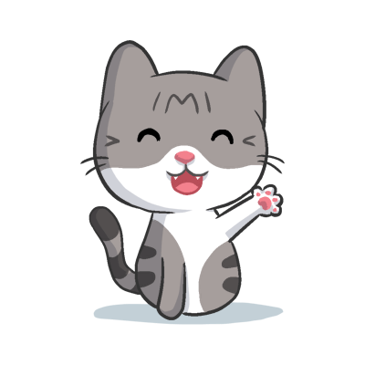
Ending in y
Ending in y Rules
1. When y is at the end of a word and there are no other vowels in that word.
2. When y is at the end of the word and there is more than one syllable.
3. When y follows another vowel.
a, e, i, o, u, and sometimes y
Notes:
Say, “What are our vowels?”
Student Response: a, e, i, o, u
Say, “Very good job! Sometimes we can have one more vowel and we learned about it this week what vowel is that?”
Student Response: sometimes y
Click to show the vowels.
Say, “There are three patterns to look for when you know there is a y as a vowel. Do we remember those three patterns?”
Student Response:
When y is at the end of a word and there are no other vowels in that word.
When y is at the end of the word and there is more than one syllable.
When y follows another vowel.
Click to show these rules.

Slide 3
y Making the long i or e Sound
fly
sky
happy
bunny
Notes:
Say, “This week some of your spelling words have the letter y in them. But the letter y makes a different sound. Do we remember the long sound the letter y makes when it is at the end of a word?”
Student Response: long i or e sound
Say, “Good job! Let’s take a look at a few words before we practice spelling them.”
Click to show a word.
Say, “Can anyone sound this word out for me? Remember the letter y is at the end of the word so it’s a long i or e sound.”
Student Response: fly
Click to show a word.
Say, “Can anyone sound this word out for me? Remember the letter y is at the end of the word so it’s a long i or e sound.”
Student Response: happy
Click to show a word.
Say, “Can anyone sound this word out for me? Remember the letter y is at the end of the word so it’s a long i or e sound.”
Student Response: sky
Click to show a word.
Say, “Can anyone sound this word out for me? Remember the letter y is at the end of the word so it’s a long i or e sound.”
Student Response: bunny

Slide 4
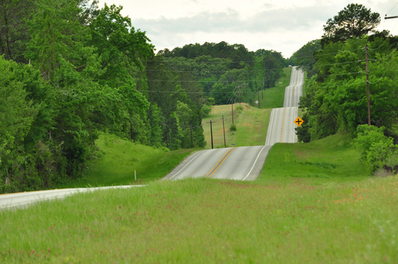
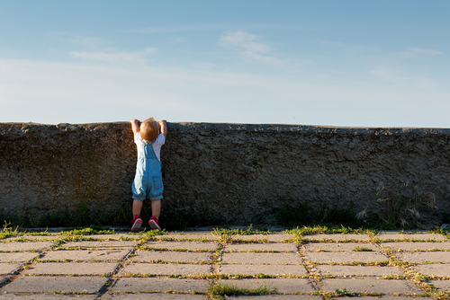
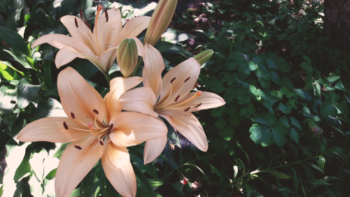
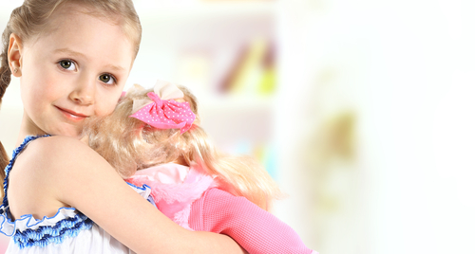
Listen and Spell
hilly
my
try
lily
Notes:
Say, “It’s time for more practice. Please go find yourself a white board or a piece of lined paper and something to write with.”
Allow students time to get these items.
Say, ”I will say a word, you will write that word on your white board or piece of paper.”
Click once for the picture.
Say, “My. That is my American Girl Doll. My.”
Allow students time to write their spelling.
Click once for the correct spelling to appear.
Say, “M Y, take the time to check your spelling. If you misspelled the word that is okay. Please correct your spelling now.”
Allow students time to correct their spelling.
Double click for the picture.
Say, “Try. If you don’t try you won’t know if you can do it. Try.”
Allow students time to write their spelling.
Click once for the correct spelling to appear.
Say, “T R Y, take the time to check your spelling. If you misspelled the word that is okay. Please correct your spelling now.”
Allow students time to correct their spelling.
Double click for the picture.
Say, “Lily. This lily smells so good! Lily.”
Allow students time to write their spelling.
Click once for the correct spelling to appear.
Say, “L I L Y, take the time to check your spelling. If you misspelled the word that is okay. Please correct your spelling now.”
Allow students time to correct their spelling.
Double click for the picture.
Say, “Hilly. This route is very hilly. Hilly.”
Allow students time to write their spelling.
Click once for the correct spelling to appear.
Say, “H I L L Y, take the time to check your spelling. If you misspelled the word that is okay. Please correct your spelling now.”
Allow students time to correct their spelling.

Slide 5

Reflexive Pronouns
We use a reflective pronoun when a noun or pronoun does something to itself.
Myself, himself, itself, themselves, yourself, herself, ourselves
Notes:
Say, “Reflexive Pronoun. What does that mean?”
Student Response: This is when a noun does something to itself.
Click once.
Say, “Good job! Some examples of a reflexive pronouns would be.”
Click once.
Teacher: Read the reflexive pronouns on the screen.

Slide 6
Reflexive Pronouns in Sentences
1. She was able to figure it out _________.
2. Please help _______ to some candy.
3. He can get it ________.
himself
herself
yourself
Notes:
Say, “We have three sentences that are missing reflexive pronouns. We will read one sentence at a time and choose the answer that we feel is the correct one.”
Click once.
Say, “She was able to figure it out ________.”
Student Response: herself
Click once for answer.
Click once.
Say, “Please help _______ to some candy.”
Student Response: yourself
Click once for answer.
Click once.
Say, “He can get it _______.”
Student Response: himself
Click once for answer.

Slide 7
Sight Word Wall
lay
by
ball
lullaby
all
buy
bully
lab
Notes:
Say, “I will show you a word. We will say the word as a class and spell the word.”
Click once for each word to appear on its own.

Slide 8
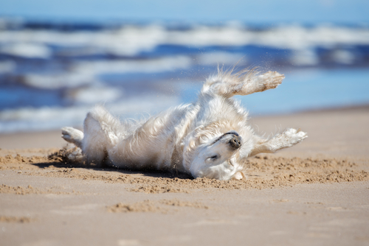
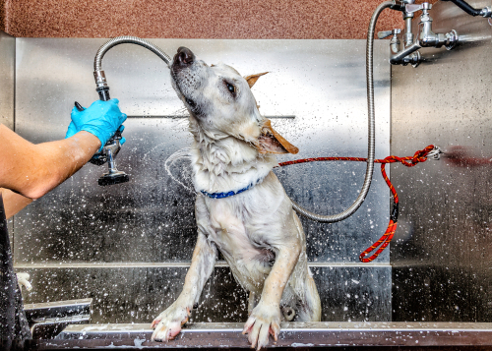
Story Retell
Notes:
Say, “Now it’s time to practice with our weekly reading of Bobby and Pixie Have a Bath.”
Say, “Who are the characters?”
Click.
Student Response: Bobby, Pixie, Susan, Jenny
Say, ”What is the setting of the story?”
Student Response: Critter Cuts- dog groomers
Say, “What was the problem in the story?”
Student Response: Bobby and Pixie were very dirty.
Click
Say, “How about the beginning middle and end of the story?”
Student Response: In the beginning of the story, Bobby and Pixie were playing in the sandpit. They were very dirty! Susan took them for a ride to the dog groomers called Critter Cuts. Bobby and Pixie both were about to get a bath and a trim. They both had to get brushed before getting a haircut. Bobby did not like getting brushed, but he stayed still. Pixie moved around a lot, but she loved getting brushed. Bobby didn’t like the bath, but Pixie loved it! When Susan brought them back home Bobby and Pixie went right back to the sandpit and began rolling in it. They didn’t stay clean for very long.
Say, “What was the solution to the problem in the story?
Student Response: Bobby and Pixie went to the dog groomers to get a bath and a haircut. They looked so clean until they got home and went back into the sandpit!

Slide 9
Q & A
Any Questions?

