Slide 1
Irregular Sounds
Possession

Slide 2
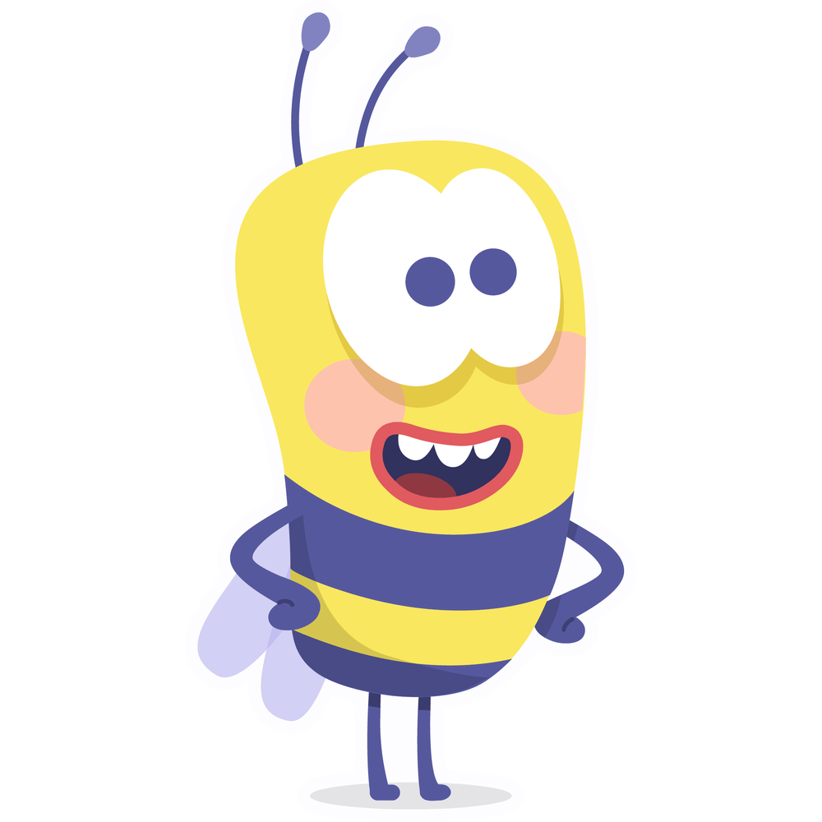
The Irregular Sound “uh”
bacon
bacon
camel
camel
rascal
rascal
Notes:
Say, “This week we learned that sometimes words do not follow the rules. Sometimes when one or two vowels come together, they can make the “schwa”. This sounds like a short u. Listen to the following words do you hear the short u sound in them?”
Click to show bacon.
Say, “Bacon. Do you hear the short u sound?”
Student Response: Yes, where the o is.
Click to show the o highlighted.
Click once to show the word camel.
Say, “Camel. Do you hear the short u sound?”
Student Response: Yes, where the e is.
Click to show the e highlighted.
Click once to show the word rascal.
Say, “Husband. Do you hear the short u sound?”
Student Response: Yes, where the a is.
Click to show the a highlighted.

Slide 3
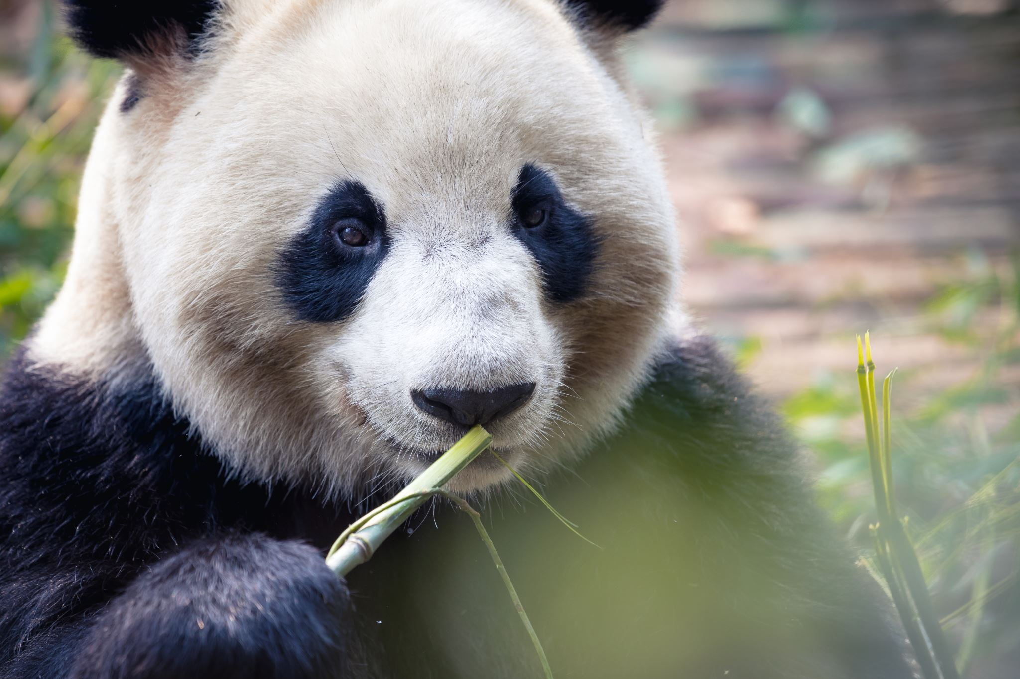
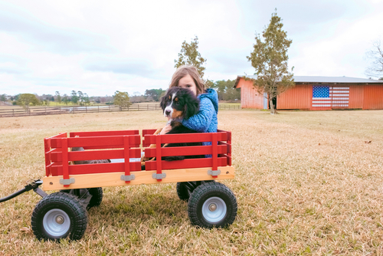
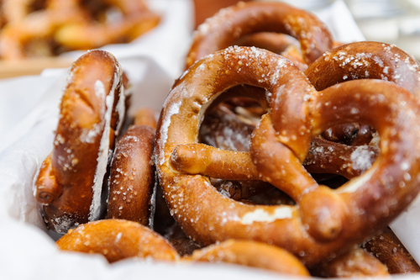
Listen and Spell
panda
pretzel
wagon
Notes:
Say, “It’s time for more practice. Please go find yourself a white board or a piece of lined paper and something to write with.”
Allow students time to get these items.
Say, ”I will say a word, you will write that word on your white board or piece of paper.”
Click once for the picture.
Say, “Panda. The panda hung from a piece of bamboo. Panda.”
Allow students time to write their spelling.
Click once for the correct spelling to appear.
Say, “P A N D A, take the time to check your spelling. If you misspelled the word that is okay. Please correct your spelling now.”
Allow students time to correct their spelling.
Double click for the picture.
Say, “Pretzel. This pretzel has too much salt on it. Pretzel.”
Allow students time to write their spelling.
Click once for the correct spelling to appear.
Say, “P R E T Z E L, take the time to check your spelling. If you misspelled the word that is okay. Please correct your spelling now.”
Allow students time to correct their spelling.
Double click for the picture.
Say, “Wagon. She used to have a little red wagon. Wagon.”
Allow students time to write their spelling.
Click once for the correct spelling to appear.
Say, “W A G O N, take the time to check your spelling. If you misspelled the word that is okay. Please correct your spelling now.”
Allow students time to correct their spelling.

Slide 4
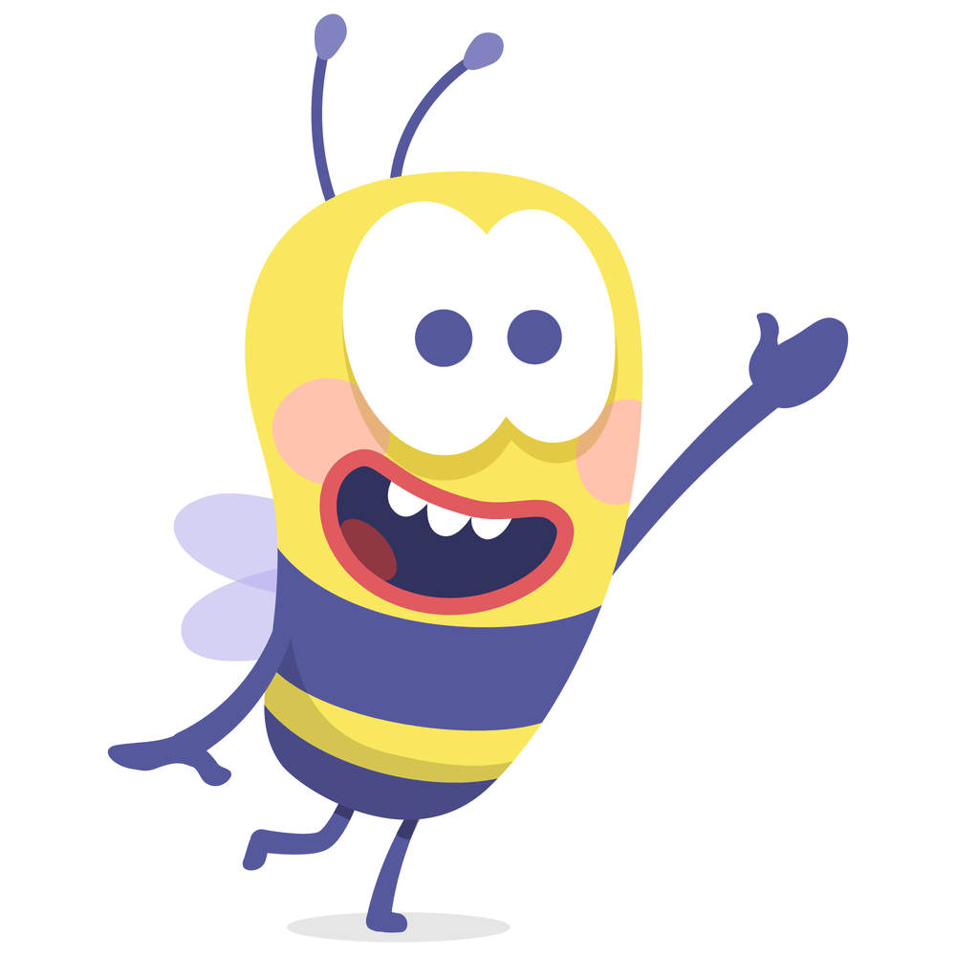
Possessive Pronouns
His, her, our, their, its, your
Notes:
Say, “We use pronouns to relace a noun. Sometimes they even show possession. These are called possessive pronouns. Can you think of any examples? “
Student Response: his, her, our, their, its, your
Click to show some examples of possessive pronouns.

Slide 5
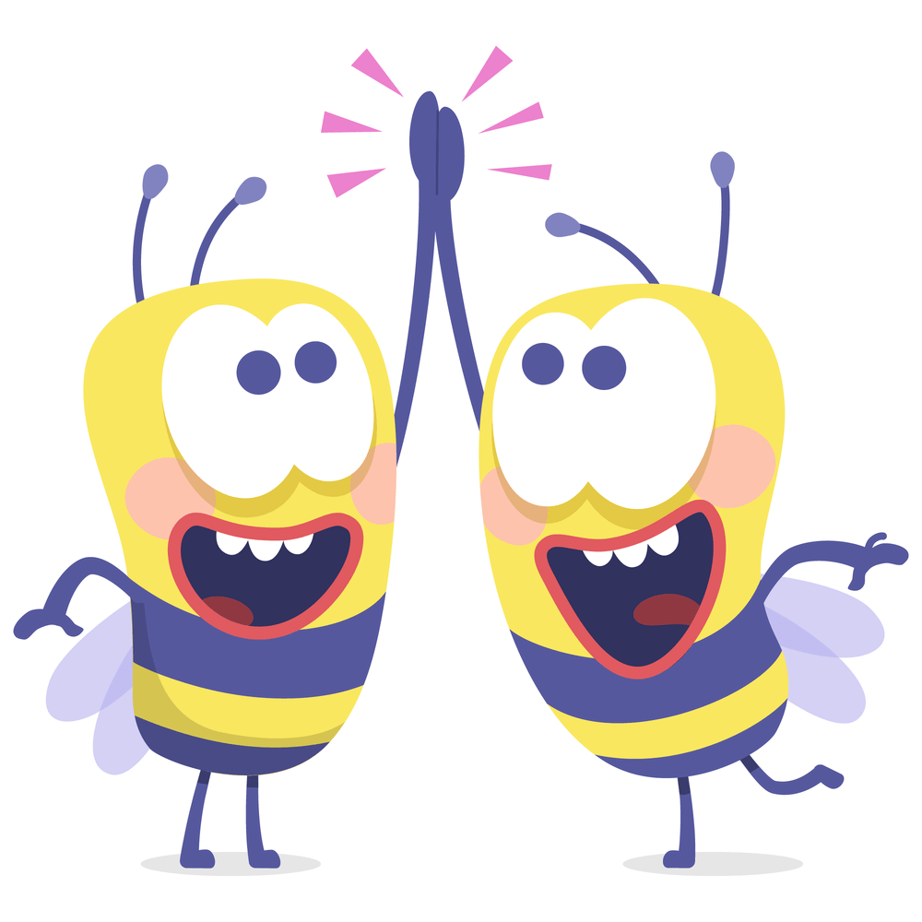
Pronoun Fill Ins
The house that belongs to Branon and Samantha.
The boat that belongs to my brother and I.
I want you to go next.
It is your turn.
Our boat.
Their house. .
Notes:
Say, “ I have a sentence that only has nouns in it. We are going to replace those nouns with pronouns in the next sentence.”
Click to show first group.
Say, “The boat that belongs to my brother and I. If I wanted to use a possessive pronoun what would this sentence look like?”
Student Response: Our boat.
Click to show answer.
Click for next sentence.
Say, “The house that belongs to Brandon and Samantha. If I wanted to use a possessive pronoun what would this sentence look like?”
Student Response: Their house.
Click to show answer.
Click for next sentence.
Say, “I want you to go next. If I wanted to use a possessive pronoun what would this sentence look like?”
Student Response: It is your turn.
Click to show answer.

Slide 6
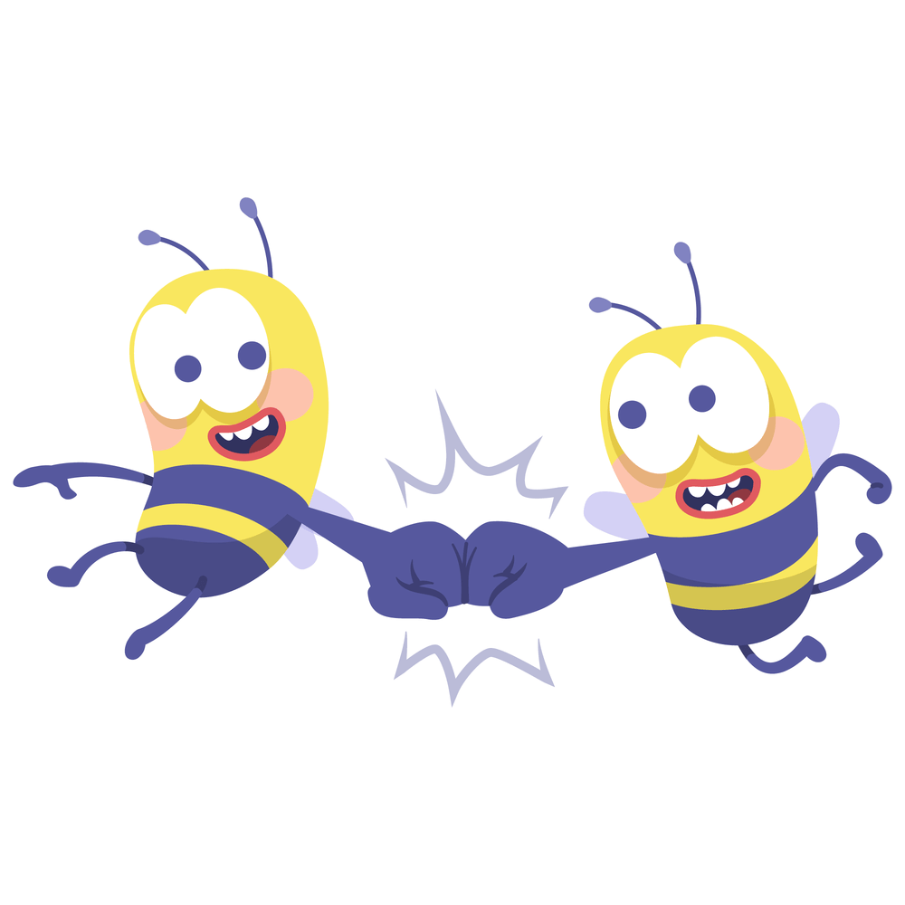
Complete the Sentence
Carl is Sam and Cole’s dad. Linda pointed to him and said, “He is _____ dad.”
Sarah was next to go in the bounce house. The adult said, “It is ______ turn to go in.”
The horses belong to Tim and Jeff. They are _______ horses.
their
your
their
Notes:
Say, “We are going to complete a few sentences with the correct pronoun.”
Click to show sentence.
Say, “The horses belong to Tim and Jeff. They are _______ horses.”
Student Response: their
Click to show answer.
Click to show next sentence.
Say, “Sarah was next to go in the bounce house. The adult said, “It is ______ turn to go in.”
Student Response: your
Click to show answer.
Click to show next sentence.
Say, “Carl is Sam and Cole’s dad. Linda pointed to him and said, “He is _____ dad.”
Student Response: their
Click to show answer.
Click for a YEAH!

Slide 7
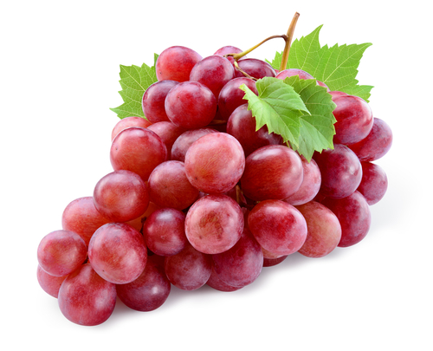
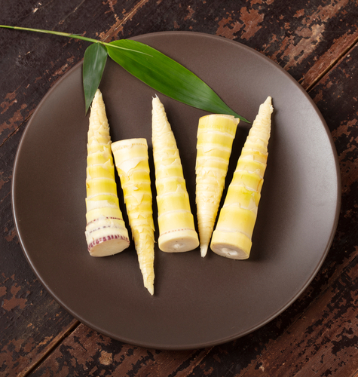
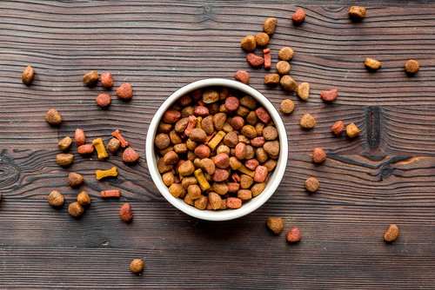
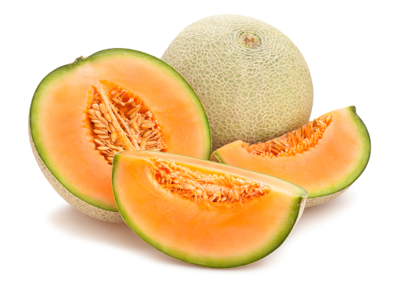
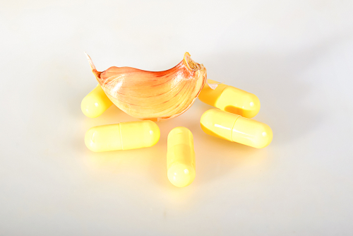
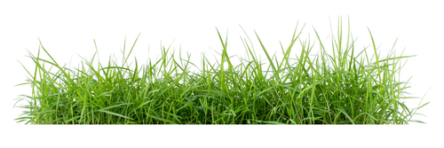
Story Retell
Notes:
Say, “Now it’s time to practice with our weekly reading of Favorite Foods.”
Say, “Who are the characters?”
Click 6 times naming each item. Grapes, dog chow, tender shoots, cantaloupe, garlic tablets, and grass
Student Response: Pixie, Tom, Bobby, Susan, Pippi
Say, ”What is the setting of the story?”
Student Response: Carter Family’s Backyard Garden
Say, “What was the problem in the story?”
Student Response: Every pet in the house likes specific treats. Some can make them sick!
Say, “How about the beginning middle and end of the story?”
Student Response: In the beginning of the story, we learned that the Carter’s have grapes in their garden. Pixie loves the grapes, but grapes are not good for dogs. We learned that she doesn’t get sick from them, and her favorites are the red ones. Then we learned that Bobby likes to eat grass in the yard especially in this one spot they go to on their evening walks. Pippi loves cantaloupe, she meows even louder wen she can smell it. She also loves the dogs dog chow! Bobby does not seem to mind when Pippi is eating his chow but sometimes he will chase Pippi away. Franky likes tender shoots from the Farmers Market. Franky will meow super loud before his bedtime snack. He loves his garlic tablets. Sometimes he even gets one for breakfast.
Say, “What was the solution to the problem in the story?
Student Response: We learned what treats each pet in the Carter family like and we even learned that these treats do make others sick; but they don’t make these pets sick.

Slide 8
Q & A
Any Questions?

