Slide 1
Vowels Saying their Names with Silent es
Parts of a Sentence

Slide 2

Long Vowel and Silent e
A long vowel says its name.
A silent e means that you do not hear the /e/ sound.
fade
Notes:
Say, “We have a great friend I call him the silent e. This e does what to vowels in words?”
Student Response: Makes the vowel a long vowel.
Say, “Very good job!”
Click once to show the meaning.
Say, “A long vowel says its name. A silent e means that you do not hear the e sound at all. Let’s take a look at an example.”
Click once.
Say, “Who can use the skill we just learned to say this word. Remember, there is a silent e so the vowel will say its name.”
Student Response: Fade.
Say, “Yes! Do you hear the i say its name?”
Student Response: YES

Slide 3
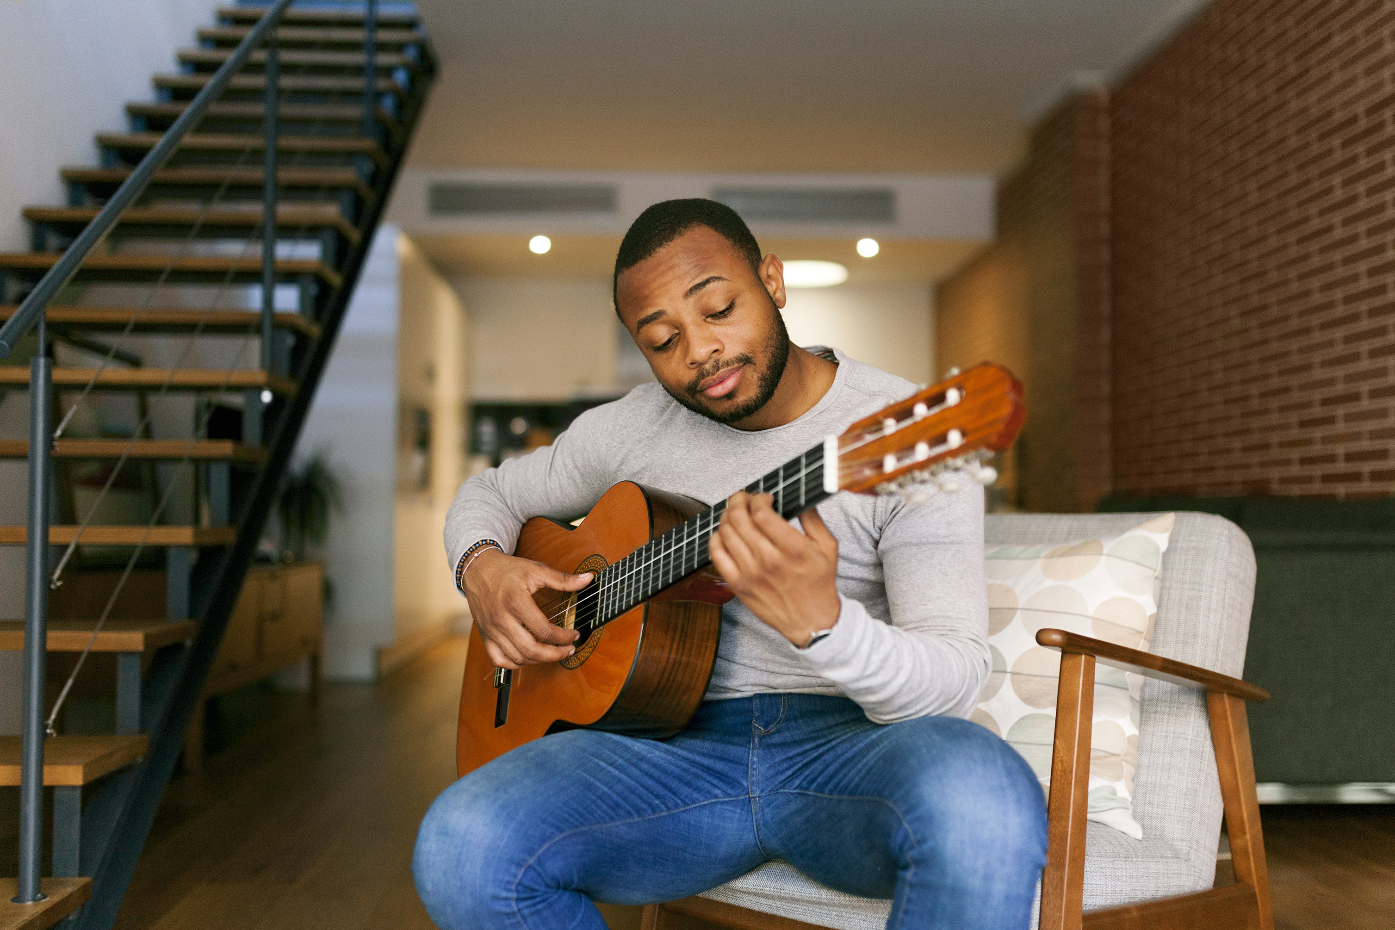
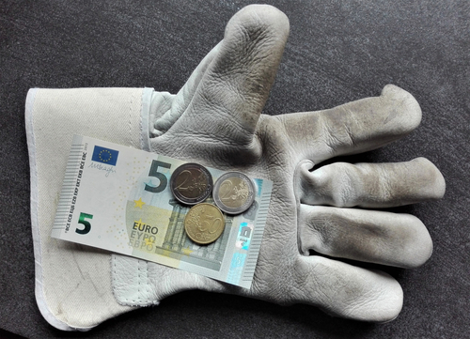
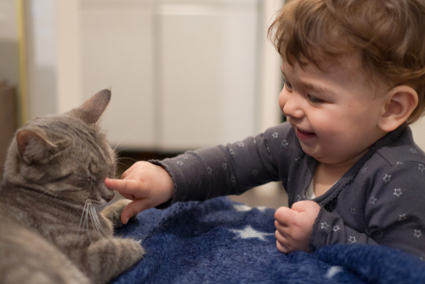

Listen and Spell
pipe
tune
wage
poke
Notes:
Say, “It’s time for more practice. Please go find yourself a white board or a piece of lined paper and something to write with.”
Allow students time to get these items.
Say, ”I will say a word, you will write that word on your white board or piece of paper.”
Click once for the picture.
Say, “Pipe. There is a leak in the pipe. Pipe.”
Allow students time to write their spelling.
Click once for the correct spelling to appear.
Say, “P I P E, take the time to check your spelling. If you misspelled the word that is okay. Please correct your spelling now.”
Allow students time to correct their spelling.
Double click for the picture.
Say, “Tune. He will have to tune his guitar. Tune.”
Allow students time to write their spelling.
Click once for the correct spelling to appear.
Say, “T U N E, take the time to check your spelling. If you misspelled the word that is okay. Please correct your spelling now.”
Allow students time to correct their spelling.
Double click for the picture.
Say, “Wage. What you see on your paycheck is your hourly wage. Wage.”
Allow students time to write their spelling.
Click once for the correct spelling to appear.
Say, “W A G E, take the time to check your spelling. If you misspelled the word that is okay. Please correct your spelling now.”
Allow students time to correct their spelling.
Double click for the picture.
Say, “Poke. Do not poke the cat. Poke.”
Allow students time to write their spelling.
Click once for the correct spelling to appear.
Say, “P O K E, take the time to check your spelling. If you misspelled the word that is okay. Please correct your spelling now.”
Allow students time to correct their spelling.
Double click for the picture.

Slide 4
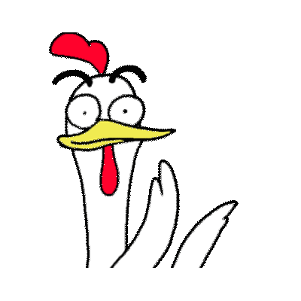
Sight Word Wall
so
well
on
ran
this
Notes:
Say, “I will show you a word. We will say the word as a class and spell the word.”
Click once for each word to appear on its own.

Slide 5
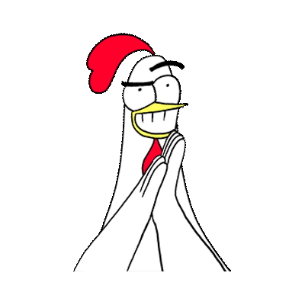
Sight Word Locator
this
ran
so
well
on
Notes:
Say,” I have all of this week’s sight words on the board here. I am going to say a sight word and you will have to identify the word. If you are correct, the word will move. Are we ready?”
Student Response: YES
Say, “On, where is the word on?”
Students Identify
Click once.
Say, “Ran, where is the word ran?”
Students Identify
Click once.
Say, “So, where is the word so?”
Students Identify
Click once.
Say, “This, where is the word this?”
Students Identify
Click once.
Say, “Well, where is the word well?”
Students Identify
Click once.

Slide 6
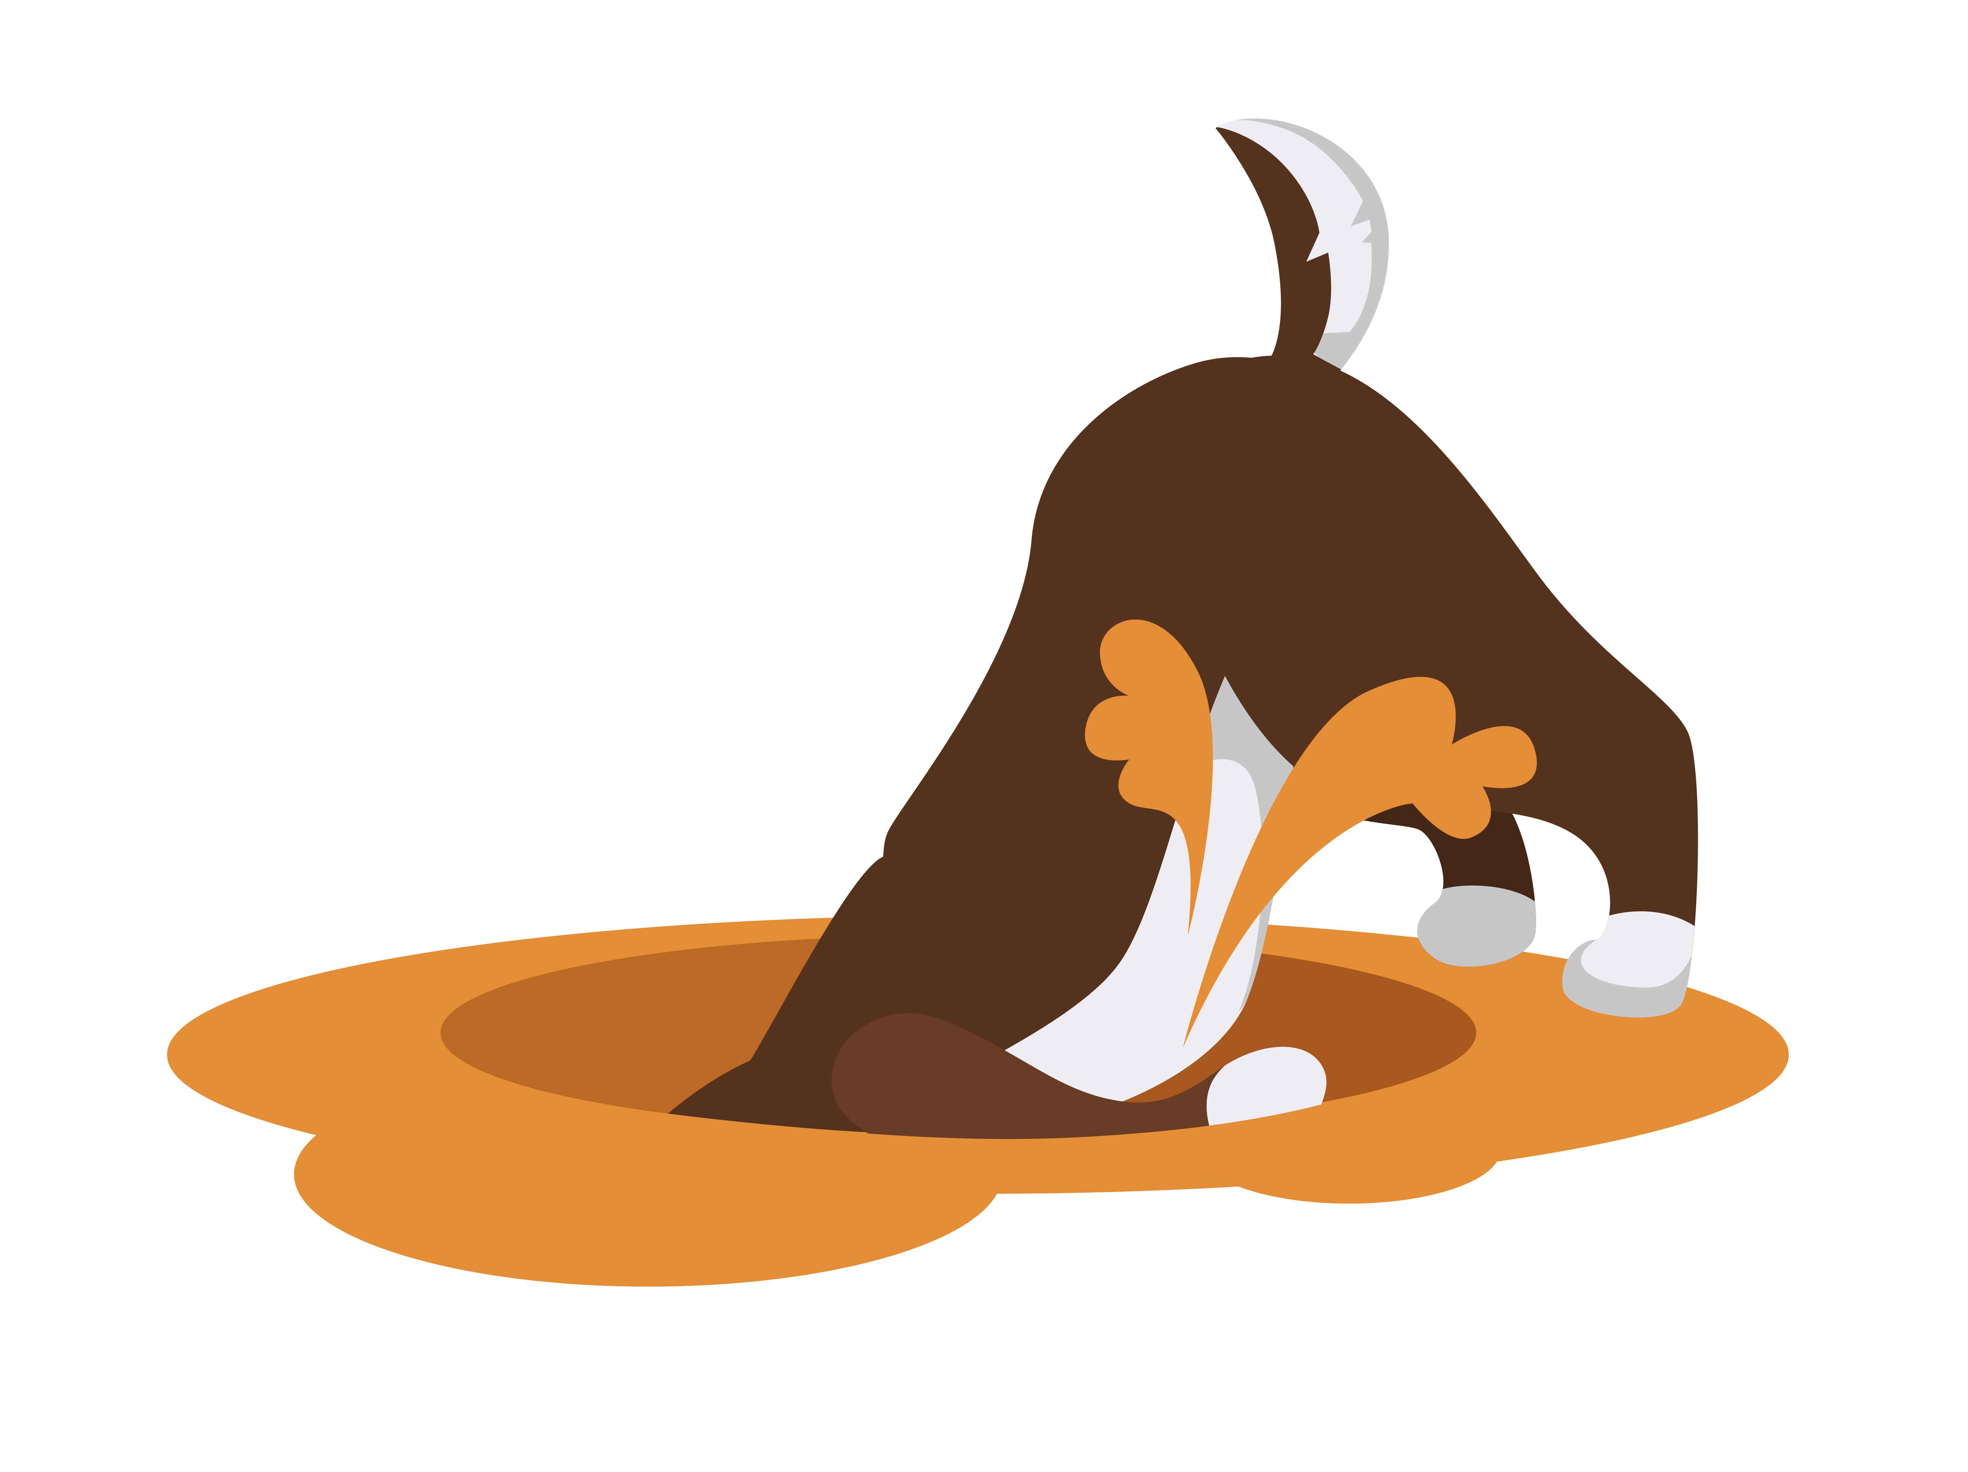
Story Retelling
Notes:
Say, “Now it’s time to practice with our weekly reading of Pixie’s Surprise.”
Say, “Who are the characters?”
Click once.
Student Response: Pixie, Dad, Mom
Say, ”What is the setting of the story?”
Student Response: Carter Family’s backyard.
Say, “What was the problem in the story?”
Student Response: Pixie keeps digging holes!
Say, “How about the beginning middle and end of the story?”
Student Response: In the beginning of the story, Pixie was digging holes all throughout the yard. Dad would go back and fill the holes in but Pixies would dig another hole! Mom and Dad didn’t know what to do to have Pixies stop digging holes. One day Pixie was chasing a butterfly in the backyard and fell into one of her holes. Hurting yourself. Mom and Dad tough that maybe that would get her to stop digging but it didn’t. Then another day, Pixie saw something in one of her holes, so she dug and dug until she was bit by a gopher in the hole. After that Pixie stopped digging holes. She didn’t want to get bit again.
Say, “What was the solution to the problem in the story?
Student Response: Pixie saw something in one of her holes, so she dug and dug until she was bit by a gopher in the hole. After that Pixie stopped digging holes. She didn’t want to get bit again.

Slide 7

Pronouns
A noun is a person, place, or thing.
A verb is the action word or to be word.
A pronoun is a word we use to replace the noun.
like, he, she, they, their
Notes:
Say, “Sentences tell who or what and what happens. We know how to begin our sentences and end our sentences. What is a noun?”
Student Response: A noun is a person, place, or thing.
Click once.
Say, “What about a verb? What is a verb?”
Student Response: A verb is the action word or to be word.
Click once.
Say, “Now a pronoun. What is a pronoun?”
Student Response: A pronoun is a word we use to replace the noun. Like he, she, they, their, etc.
Double Click.

Slide 8

Identify the Parts of a Sentence
Nouns | Verbs | Pronouns
Macy
jumped
she
store
throw
they
store
jumped
they
Macy
she
throw
Notes:
Say, “ We have some words that are can be apart of sentences. Your job is to categorize them as nouns, verbs, or pronouns. Are we ready?”
Student Response: YES
Click once for word to appear.
Say, “ Macy, is the name Macy a noun, verb, or pronoun?”
Student Response: Noun
Click once to reveal answer.
Click once for word to appear.
Say, “Jumped. Is this word a noun, verb, or pronoun?”
Student Response: Verb
Click once to reveal answer.
Click once for word to appear.
Say, “She. Is this word a noun, verb, or pronoun?”
Student Response: Pronoun
Click once to reveal answer.
Click once for word to appear.
Say, “Store. Is this word a noun, verb, or pronoun?”
Student Response: Noun
Click once to reveal answer.
Click once for word to appear.
Say, Throw. Is this word a noun, verb, or pronoun?”
Student Response: Verb
Click once to reveal answer.
Click once for word to appear.
Say, “They. It this word a noun, verb, or pronoun?”
Student Response: Pronoun
Click once to reveal answer.
Click for a thumbs up.

Slide 9
Q & A
Any Questions?

