Slide 1
Prefixes and Pronouns
Identify the Sight Word

Slide 2

Prefixes re- and un-
Prefixes
Letters that come before a base word. The letters change the meaning of the work.
Safe unsafe.
Place and replace.
Notes:
Say, “This week we learned about the prefixes re- and un-. What is a prefix?”
Student Response: Letters that come before a base word. The letters change the meaning of the work.
Click once for prefix meaning.
Say, “Very good job! A great example would be, safe and unsafe or place or replace.
Click twice for examples to appear.
Say, “What is the meaning of the word safe and the prefix unsafe?”
Student Response: The word safe means it is okay to do and unsafe means that it is not safe. (Answers may vary.)
Say, “Yes! What about the word place and replace?”
Student Response: Place means something somewhere to replace means to put back or fill a missing spot. (Answers may vary.)
Click again for thumbs up picture.

Slide 3
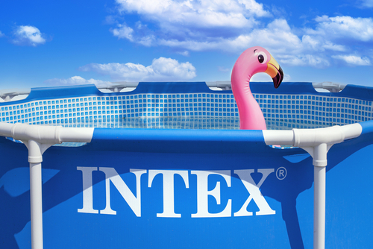
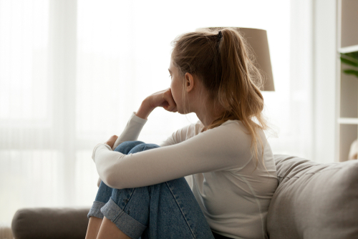

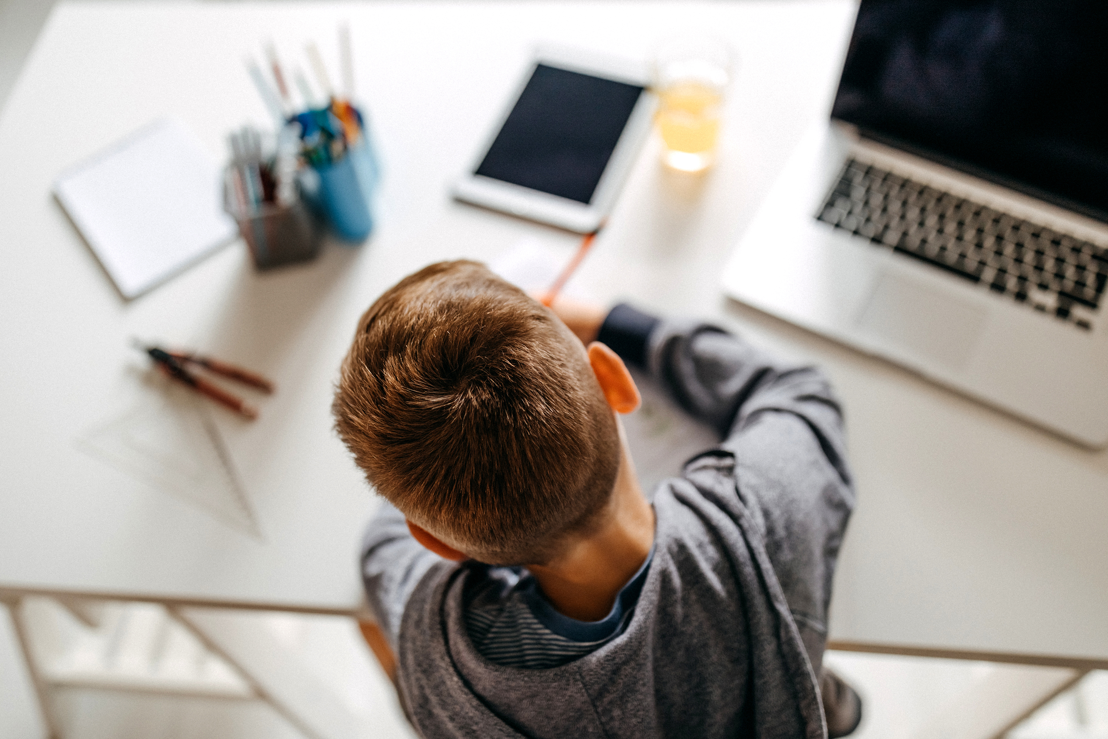
Listen and Spell
uncover
repaint
rewrite
unhappy
Notes:
Say, “It’s time for more practice. Please go find yourself a white board or a piece of lined paper and something to write with.”
Allow students time to get these items.
Say, ”I will say a word, you will write that word on your white board or piece of paper.”
Click once for the picture.
Say, “Repaint. Looks like we need to repaint this room. Repaint.”
Allow students time to write their spelling.
Click once for the correct spelling to appear.
Say, “R E P A I N T, take the time to check your spelling. If you misspelled the word that is okay. Please correct your spelling now.”
Allow students time to correct their spelling.
Double click for the picture.
Say, “Rewrite. I would like for you to go back and rewrite this story. Rewrite.”
Allow students time to write their spelling.
Click once for the correct spelling to appear.
Say, “R E W R I T E, take the time to check your spelling. If you misspelled the word that is okay. Please correct your spelling now.”
Allow students time to correct their spelling.
Double click for the picture.
Say, “Unhappy. She looks very unhappy. Unhappy.”
Allow students time to write their spelling.
Click once for the correct spelling to appear.
Say, “U N H A P P Y, take the time to check your spelling. If you misspelled the word that is okay. Please correct your spelling now.”
Allow students time to correct their spelling.
Double click for the picture.
Say, “Uncover. It’s that time of year, we need to uncover the pool. Uncover.”
Allow students time to write their spelling.
Click once for the correct spelling to appear.
Say, “U N C O V E R, take the time to check your spelling. If you misspelled the word that is okay. Please correct your spelling now.”
Allow students time to correct their spelling.

Slide 4
Sight Word Wall
buy
use
us
pull
those
fast
Notes:
Say, “I will show you a word. We will say the word as a class and spell the word.”
Click once for each word to appear on its own.
Click at the end for thumbs up picture.

Slide 5
Sight Word Locator
use
those
us
pull
fast
buy
Notes:
Say,” I have all of this week’s sight words on the board here. I am going to say a sight word and you will have to identify the word. If you are correct, the word will move. Are we ready?”
Student Response: YES
Say, “Those, where is the word those?”
Students Identify
Click once.
Say, “Fast, where is the word fast?”
Students Identify
Click once.
Say, “Pull, where is the word pull?”
Students Identify
Click once.
Say, “Us, where is the word us?”
Students Identify
Click once.
Say, “Buy, where is the word buy?”
Students Identify
Click once.
Say, “Use, where is the word use?”
Students Identify
Click once.

Slide 6
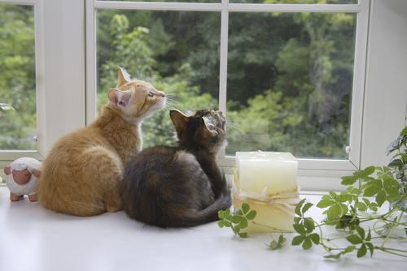
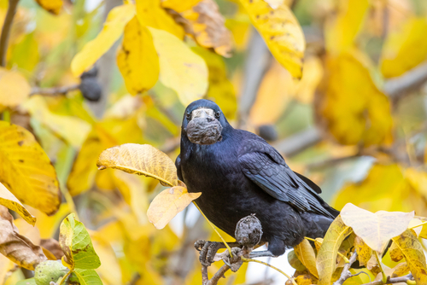
Story Retell
Notes:
Say, “Now it’s time to practice with our weekly reading of The Crow Has a Snack. Use your retelling hand!”
Say, “Let’s start with the thumb. Who are the characters?”
Double Click.
Student Response: Pippi and Franky (family cats), crow
Say,” Next, is the pointer finger. What is the setting of the story?”
Student Response: Window of the Carter family’s house and right outside of the window in the yard.
Say, “Then, the problem finger. What was the problem in the story?”
Student Response: Pippi and Franky wanted to play with the crow. The crow kept dropping his walnut on the road.
Say, “After, the ring finger asks you to explain the detail in the beginning middle and end of the story.”
Student Response: In the begging of the story, Pippi and Franky were watching a crow from outside the Carter’s Window. The crow had found a walnut on the ground right outside the window. The cats wanted to go outside and play with the crow but they couldn’t. Once the crow found the walnut he flew up into the air and dropped the walnut on the ground. He did this multiple times. Pippi thought the crow was being silly until the last drop. The walnut crated open and the crow flew down to eat the walnut. The crow wasn’t being silly but using his brain. Pippi said at the end of the story that she saw the crow wink at her as he flew off.
Say, “Finally, the pinky finger. What was the solution to the problem in the story?
Student Response: Pippi and Franky couldn’t go outside so they watched the clever crow. The crow was dropping the walnut in the road to crack it not because he was just dropping it.

Slide 7
Singular Nouns and Pronouns
Singular pronouns take the place of a singular noun.
Dad went to the store. Then dad got in the truck to head home. When dad got home, dad cleaned the garage and cut the grass.
Dad went to the store. Then he got in the truck to head home. When he got home, he cleaned the garage and cut the grass.
Notes:
Say, “What is a noun?”
Student Response: A noun is a person, place, thing, or idea.
Say, “Very good job, a singular (put up on finger) means one. We can use singular nouns for a person, a place, a thing, or an idea. One thing. Singular pronoun: takes the place of a singular noun.”
Click once for the meaning of a singular pronoun to appear.
Say, “A singular noun can be replaced with a singular pronoun.”
Click once.
Say, “Let’s read this mini writing, “Dad went to the store. Then dad got in the truck to head home. When dad got home, dad cleaned the garage and cut the grass.” Do we say dad a lot in this mini writing?”
Student Response: YES
Say, “Could we replace the name dad with something else? If so, what? “
Student Response: He
Say, “Very good job! Now would it be a good idea to leave the first dad to show who exactly we are talking about?”
Student Response: Yes
Click to show new version of mini writing.
Say, “Dad went to the store. Then he got in the truck to head home. When he got home, he cleaned the garage and cut the grass. This is a must better writing. We are able to take the singular noun and preplace it with a singular pronoun. Great job everyone!”
Click once for a thumbs up.

Slide 8
Plural Nouns and Pronouns
Plural pronouns takes the place of a plural noun.
Lindsey and Sam are going to the mall. They all want to stop and get a coffee first. After they stop to get their coffee, they go into the first store.
Lindsey and Sam are going to the mall. Lindsey and Sam want to stop and get a coffee first. After Lindsey and Sam stop to get Lindsey and Sam’s coffee, Lindsey and Sam go into the first store.
Notes:
Say, “If we know now that the word singular means one. What does the word plural mean?”
Student Response: More than one.
Say, “That is correct so can we have a plural noun and a plural pronoun?”
Student Response: YES
Click once for the meaning of plural pronoun to appear.
Say, “Plural pronouns take place of a plural noun.”
Double Click for mini writing.
Say, “Lindsey and Sam are going to the mall. Lindsey and Sam all want to stop and get a coffee first. After Lindsey and Sam stop to get Lindsey’s and Sam’s coffee Lindsey and Sam go into the first store.” Wow, there are a lot of Lindsey and Sam’s in this writing. Can we change that?”
Student Response: Yes!!!! With the plural pronoun they.
Say, “Yes, but what about when they are show possession? Could we use the word their?”
Student Response: YES!
Say, “Let’s check it out.”
Click to show edited mini writing.
Ask student (or if unable help them to read) next paragraph: “Lindsey and Sam are going to the mall. They all want to stop and get a coffee first. After they stop to get their coffee, they go into the first store.”
Click once for a thumbs up.

Slide 9
Singular or Plural
Singular Pronouns | Plural Pronouns
he
his
they
she
she
them
him
his
it
her
he
they
their
them
it
their
him
her
Notes:
Say, “Now it is time to identify the singular and plural pronouns. I will show you a pronoun and as a class tell me if that pronoun is a singular pronoun or a plural pronoun.
Click to show first word.
Say, “He, is a singular or a plural pronoun?”
Student Response: Singular
Click to show answer.
Click to show word.
Say, “She, is a singular or a plural pronoun?”
Student Response: Singular
Click to show answer.
Click to show word.
Say, “It, is a singular or a plural pronoun?”
Student Response: Singular
Click to show answer.
Click to show word.
Say, “They is a singular or a plural pronoun?”
Student Response: Plural
Click to show answer.
Click to show word.
Say, Him, is a singular or a plural pronoun?”
Student Response: Singular
Click to show answer.
Click to show word.
Say, “Her, is a singular or a plural pronoun?”
Student Response: Singular
Click to show answer.
Click to show word.
Say, “Them, is a singular or a plural pronoun?”
Student Response: Plural
Click to show answer.
Click to show word.
Say, “His, is a singular or a plural pronoun?”
Student Response: Singular
Click to show answer.
Click to show word.
Say, “Their, is a singular or a plural pronoun?”
Student Response: Plural
Click to show answer.
Click to show word.

Slide 10
Q & A
Any Questions?

