Slide 1
The “er” Sound
New Home

Slide 2

The “er” Sound
nurse
skirt
surf
perk
dirt
germ
Notes:
Say, “This week you learned about letter combinations that make the “er” sound. What were these three letter combinations?”
Student Response: “er”, “ur”, and “ir”
Click once.
Say, “Here are a few words that have that “er” sound in them. Let’s read them as a class.”
Student Response: Nurse, skirt, surf, perk, dirt, germ

Slide 3

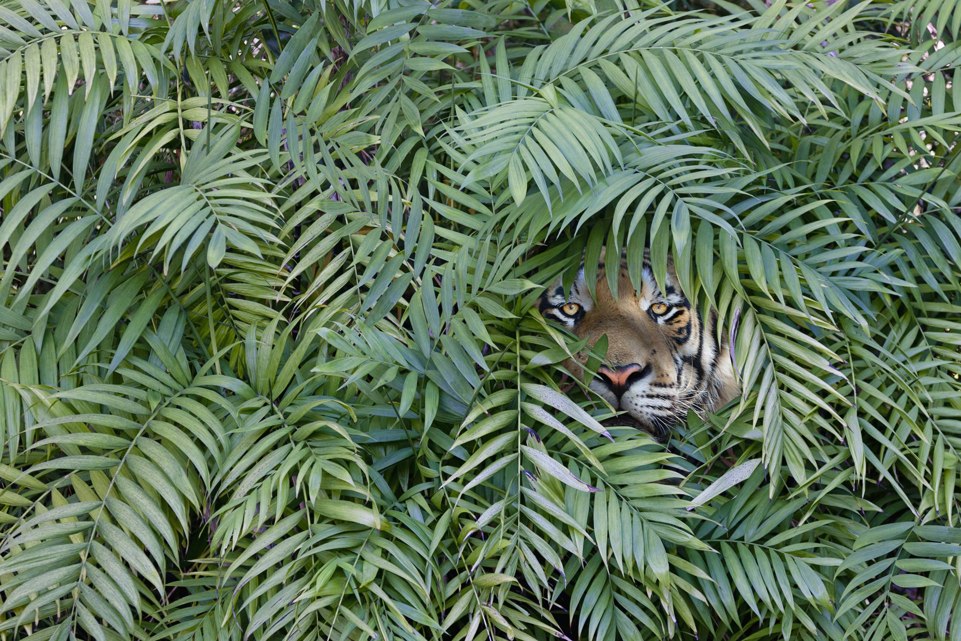
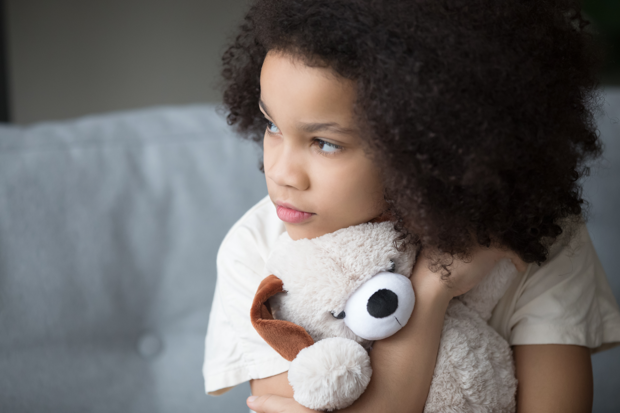
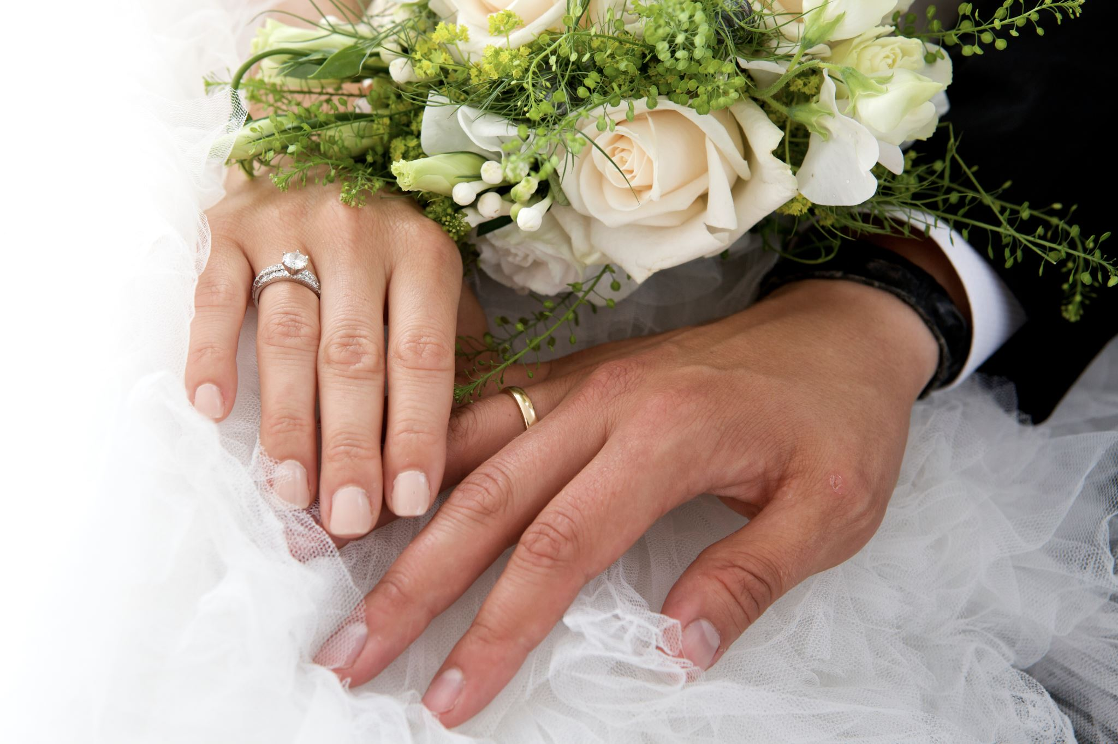

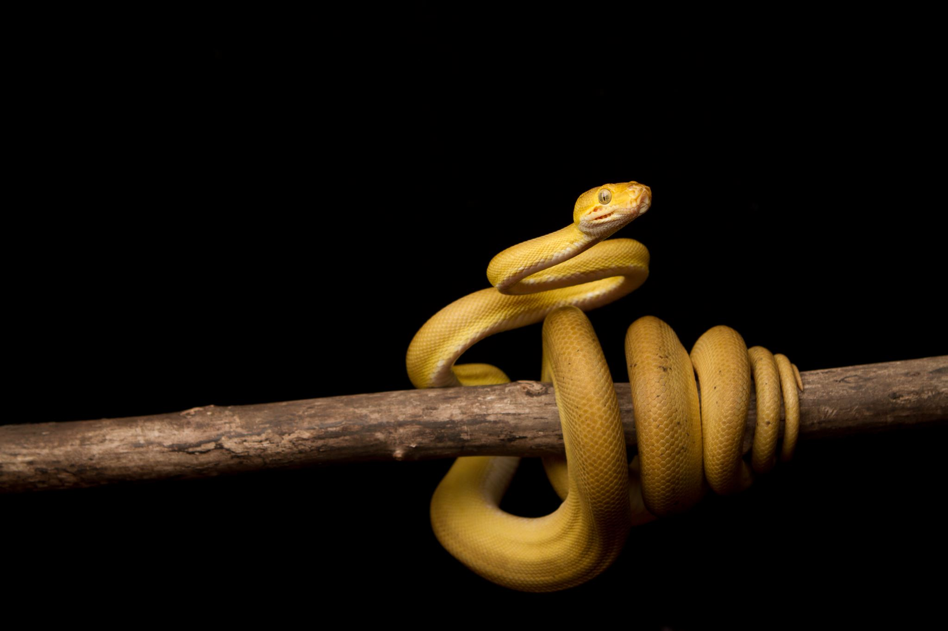
Listen and Spell
girl
stir
fern
blur
curl
perfect
Notes:
Say, “It’s time for more practice. Please go find yourself a white board or a piece of lined paper and something to write with.”
Allow students time to get these items.
Say, ”I will say a word, you will write that word on your white board or piece of paper.”
Click once for the picture.
Say, “Blur. After I hit my head, everything was a blur. Blur.”
Allow students time to write their spelling.
Click once for the correct spelling to appear.
Say, “B L U R, take the time to check your spelling. If you misspelled the word that is okay. Please correct your spelling now.”
Allow students time to correct their spelling.
Double click for the picture.
Say, “Curl. Look at that snake curl up in a ball. Curl.”
Allow students time to write their spelling.
Click once for the correct spelling to appear.
Say, “C U R L, take the time to check your spelling. If you misspelled the word that is okay. Please correct your spelling now.”
Allow students time to correct their spelling.
Double click for the picture.
Say, “Perfect. The wedding was perfect. Perfect.”
Allow students time to write their spelling.
Click once for the correct spelling to appear.
Say, “P E R F E C T, take the time to check your spelling. If you misspelled the word that is okay. Please correct your spelling now.”
Allow students time to correct their spelling.
Double click for the picture.
Say, “Fern. That plant is called a fern. Fern.”
Allow students time to write their spelling.
Click once for the correct spelling to appear.
Say, “F E R N, take the time to check your spelling. If you misspelled the word that is okay. Please correct your spelling now.”
Allow students time to correct their spelling.
Double click for the picture.
Say, “Stir. Make sure that you stir the hot cocoa mix in well. Stir.”
Allow students time to write their spelling.
Click once for the correct spelling to appear.
Say, “S T I R, take the time to check your spelling. If you misspelled the word that is okay. Please correct your spelling now.”
Allow students time to correct their spelling.
Double click for the picture.
Say, “Girl. She had a little girl. Girl.”
Allow students time to write their spelling.
Click once for the correct spelling to appear.
Say, “G I R L, take the time to check your spelling. If you misspelled the word that is okay. Please correct your spelling now.”
Allow students time to correct their spelling.

Slide 4

Sight Word Wall
after
ask
from
give
him
form
her
Notes:
Say, “I will show you a word. We will say the word as a class and spell the word.”
Click once for each word to appear on its own.

Slide 5

Sight Word Locator
him
her
give
ask
from
form
after
Notes:
Say,” I have all of this week’s sight words on the board here. I am going to say a sight word and you will have to identify the word. If you are correct, the word will move. Are we ready?”
Student Response: YES
Say, “Ask, where is the word ask?”
Students Identify
Click once.
Say, “Form, where is the word form?”
Students Identify
Click once.
Say, “Her, where is the word her?”
Students Identify
Click once.
Say, “Give, where is the word give?”
Students Identify
Click once.
Say, “After, where is the word after?”
Students Identify
Click once.
Say, “From, where is the word from?”
Students Identify
Click once.
Say, “Him, where is the word him?”
Students Identify
Click once.

Slide 6
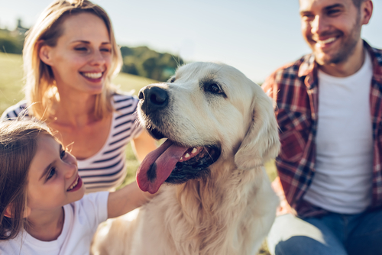
Story Retell
Notes:
Say, “Now it’s time to practice this week’s reading of Pixie’s New Home.”
Say, “Who are the characters?”
Click once.
Student Response: Tara, Bobby (dog), Mom, Abby, Dad, Sally, Pixie (dog)
Say,” What is the setting of the story?”
Student Response: The Carter family’s house and Sally’s house.
Say, “What was the problem in the story?”
Student Response: Pixie growled at dad.
Say, “What are some of the details in the beginning middle and end of the story?”
Student Response: In the beginning of the story, Tara is talking to mom about getting another dog. This was Bobby has someone to play with. They knew that they wanted to go meet Pixie, she was a dog at Sally’s house. All the family members agreed that they needed another dog. When they meet Pixie, they said that she is a puppy and need needs training, but she is very loving. The Carter family decided that they wanted to take Pixie home to meet Bobby. She was very happy to go on a car ride. When Bobby and Pixie met, they took a minute to get to know one another. After a little time, Pixie and Bobby were running around the yard playing. The family decided to keep Pixie and Bobby got a new sister.
Say, “What was the solution to the problem in the story?
Student Response: She was afraid of men but after their family walk and Dad scratching behind her ear she liked dad.

Slide 7

Grammar
Grocery List
Milk eggs bread strawberries blueberries ground meat steak chicken
Grocery List
milk, eggs, bread, strawberries, blueberries, ground meat, steak, chicken
Notes:
Say, “Do you remember that we use commas between items in a list?”
Student Response: YES! Like a grocery list (example)
Click once to show list without commas.
Say, “So here is my grocery list. Where should we put commas at?”
Student Response: milk, eggs, bread, strawberries, blueberries, ground meat, steak, chicken
Click once to show answer.

Slide 8

Commas
I have five pets. Their names are Ira Daisy Kane Cash and Clementine.
Please don’t forget to pick up cheese milk and eggs.
Don’t forget to pack your brush toothpaste and toothbrush.
I have five pets. Their names are Ira, Daisy, Kane, Cash, and Clementine.
Please don’t forget to pick up cheese, milk, and eggs.
Don’t forget to pack your brush, toothpaste, and toothbrush.
Notes:
Say, “I have three sentences that require commas in the lists. Can you help me place them?”
Student Response: YES
Click to show sentence one.
Say, “I have five pets their names are Ira Daisy Kane Cash and Clementine. Where do the commas go?”
Student Response: I have five pets their names are Ira, Daisy, Kane, Cash, and Clementine.
Click to show the commas in the sentence.
Double click to show sentence one.
Say, “Please don’t forget to pick up cheese milk and eggs. Where do the commas go?”
Student Response: Please don’t forget to pick up cheese, milk, and eggs.
Click to show the commas in the sentence.
Double click to show sentence one.
Say, “Don’t forget to pack your brush toothpaste and toothbrush. Where do the commas go?”
Student Response: Don’t forget to pack your brush, toothpaste, and toothbrush.
Click to show the commas in the sentence.

Slide 9
Q & A
Any Questions?

