Slide 1
Contractions and their Meanings
Back to the Future

Slide 2

Contractions
it + is = it’s
Notes:
Say, “This week we learned about contractions. A great example would be when we take the words it and is, we combine the two to create it’s.”
Click once to show addition problem.
Say, ”What changed when we turned it is into a contraction?
Student Response: We took the two words together using an apostrophe. The I in is was replaced with that apostrophe.

Slide 3

Contractions
are not
I’ve
did not
Don’t
I have
Didn’t
do not
He’ll
he will
Aren’t
Notes:
Say, “Let’s practice identifying contractions. I have two words you have to match them to the correct contraction.
Say, “The first one is are not, what is the correct contraction?”
Student Response: aren’t
Click to connect
Say, “Did not, what is the correct contraction?”
Student Response: didn’t
Click to connect
Say, “I have, what is the correct contraction?”
Student Response: I’ve
Click to connect
Say, “Do not, what is the correct contraction?”
Student Response: don’t
Click to connect
Say, “He will, what is the correct contraction?”
Student Response: he’ll
Click to connect
Click once for a thumbs up.

Slide 4
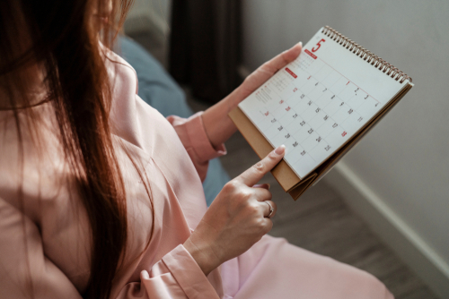

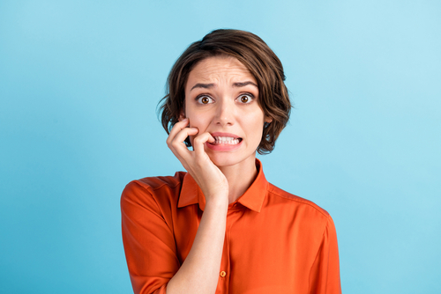

Listen and Spell
can’t
aren’t
I’m
it’s
Notes:
Say, “It’s time for more practice. Please go find yourself a white board or a piece of lined paper and something to write with.”
Allow students time to get these items.
Say, ”I will say a word, you will write that word on your white board or piece of paper.”
Click once for the picture.
Say, “Can’t. I can’t play tonight, I have homework. Can’t.”
Allow students time to write their spelling.
Click once for the correct spelling to appear.
Say, “C A N ‘ T, take the time to check your spelling. If you misspelled the word that is okay. Please correct your spelling now.”
Allow students time to correct their spelling.
Double Click for the picture.
Say, “It’s. Looks like it’s going to take one week. It’s. ”
Allow students time to write their spelling.
Click once for the correct spelling to appear.
Say, “I T ‘ S, take the time to check your spelling. If you misspelled the word that is okay. Please correct your spelling now.”
Allow students time to correct their spelling.
Double Click for the picture.
Say, “Aren’t. You aren’t supposed to know the secret. Aren’t.”
Allow students time to write their spelling.
Click once for the correct spelling to appear.
Say, “A R E N ‘ T, take the time to check your spelling. If you misspelled the word that is okay. Please correct your spelling now.”
Allow students time to correct their spelling.
Double Click for the picture.
Say, “I’m. I’m going to the store today. I’m.”
Allow students time to write their spelling.
Click once for the correct spelling to appear.
Say, “I ‘ M, take the time to check your spelling. If you misspelled the word that is okay. Please correct your spelling now.”
Allow students time to correct their spelling.

Slide 5

Sight Word Wall
tea
get
eat
came
for
please
mace
but
tub
ate
Notes:
Say, “I will show you a word. We will say the word as a class and spell the word.”
Click once for each word to appear on its own.

Slide 6

Let’s Locate Them
mace
for
ate
tea
get
please
but
tub
eat
came
Notes:
Say,” I have all of this week’s sight words on the board here. I am going to say a sight word and you will have to identify the word. If you are correct, the word will move. Are we ready?”
Student Response: YES
Say, “But, where is the word but?”
Students Identify
Click once.
Say, “Mace, where is the word mace?”
Students Identify
Click once.
Say, “Eat, where is the word eat?”
Students Identify
Click once.
Say, “Please, where is the word please?”
Students Identify
Click once.
Say, “For, where is the word for?”
Students Identify
Click once.
Say, “Tub, where is the word tub?”
Students Identify
Click once.
Say, “Came, where is the word came?”
Students Identify
Click once.
Say, “Ate, where is the word ate?”
Students Identify
Click once.
Say, “Get, where is the word get?”
Students Identify
Click once.
Say, “Tea, where is the word tea?”
Students Identify
Click once.

Slide 7
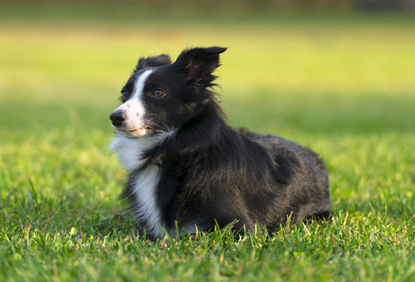
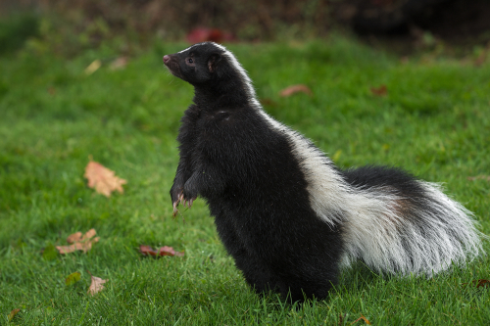
Story Retell
Notes:
Say, “Now it’s time to practice with our weekly reading of Bobby’s Stinky Adventure.”
Say, “Who are the characters?”
Double Click.
Student Response: The Carter Family: Bobby- dog, Tara, Abby, Dad,
Say,”What is the setting of the story?”
Student Response: Car and Picnic with a lake
Say, “What was the problem in the story?”
Student Response: Bobby smelled really bad.
Say, “How about the beginning middle and end of the story?”
Student Response: In the beginning of the story, Bobby wanted to go spend time with his family at the picnic, but he did not want to go for a car ride. Bobby doesn’t like cars after his had been hit by one as a puppy breaking his leg and he lost his tail. Once, they got there Bobby was very excited about the smells, lake, and the bone he was getting at the picnic. After lunch Bobby and the Carter family went for a walk. On the walk Bobby saw a black an white animal an chased it. Bobby was sprayed by a skunk. He didn’t smell too good. Bobby jumped in the lake after to try and get rid of the smell, it didn’t work. When the family brought Bobby home they bathed him in tomato juice it helped a little but he will need more tomato juice baths.
Say, “What was the solution to the problem in the story?
Student Response: Bobby was sprayed by a skunk and needed many tomato baths.

Slide 8
Grammar
Future Tense is something that has not happened yet but will.
She will have her party Saturday.
Notes:
Say, “Let us go back to talking about tense. We have learned about past tense and present tense a couple weeks ago. This week we learned about future tense. Can anyone explain to me what future tense is?”
Student Response: Something that has not happened yet but will.
Click to show meaning.
Say, “When we are writing a sentence, we have to add something to it to make the tense future tense. What sight word is that?”
Student Response: Will
Say, “Correct! Let’s take a look at an example.”
Click once for sentence to appear.
Say, “She will have her party Saturday. The sight word will tells us that this has not happened yet but it will be happening. Future tense.”

Slide 9
Future and Past Tense
I will be wearing a red dress to the wedding.
They got married 50 years ago.
Shannon and Jake will get married at 2:30 on Saturday.
Future Tense
Past Tense
Future Tense
Notes:
Say, “I have three sentences, you must identify the ones that are future tense.”
Click for sentence one.
Say, “Shannon and Jake will get married at 2:30 on Saturday. Is this sentence future tense?”
Student Response: YES
Click to show answer.
Double click for sentence two.
Say, “They got married for 50 years. It this sentence future tense?”
Student Response: NO
Say, “What tense is it then?”
Student Response: Past Tense
Click to show answer.
Double click for sentence three.
Say, “I will be wearing a red dress to the wedding. Is this sentence future tense?”
Student Response: YES
Click for a thumbs up.

Slide 10
Q & A
Any Questions?

