Slide 1
Listen and Spell

Slide 2
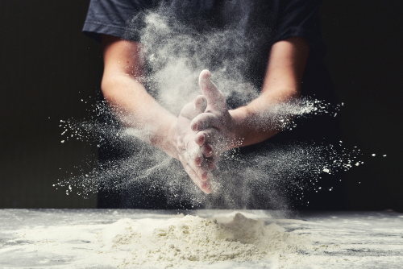

The Vowel Sounds “ow” and “ou”
flour
flower
Notes:
Say, “If I say flour and mow, do you hear a sound that is the same in both words?” ​
Student Response: Yes, the ow sound. ​
Click once for the words to appear. ​
Say, “The word flour is spelled F L O U R and the word flower is spelled​
F L O W E R. The ow sound can be made by an ou and an ow combination. ​

Slide 3

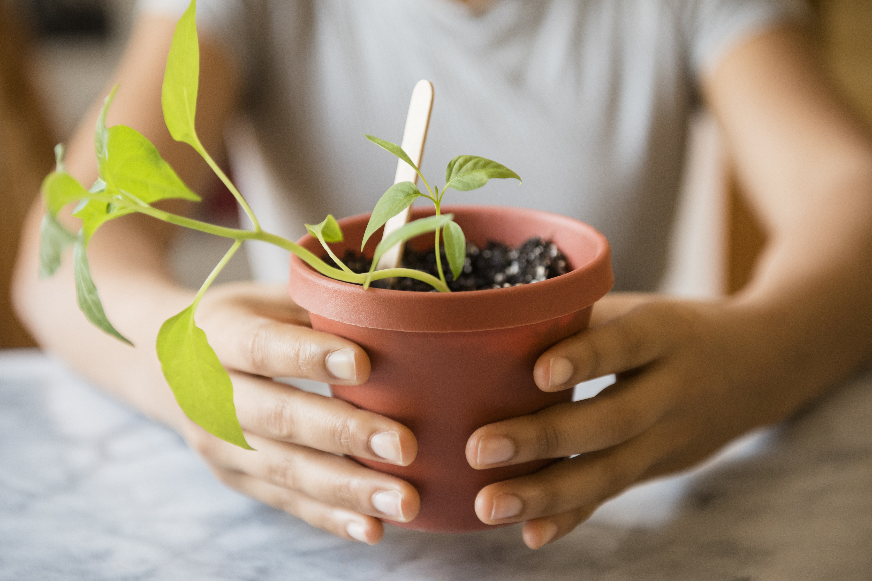
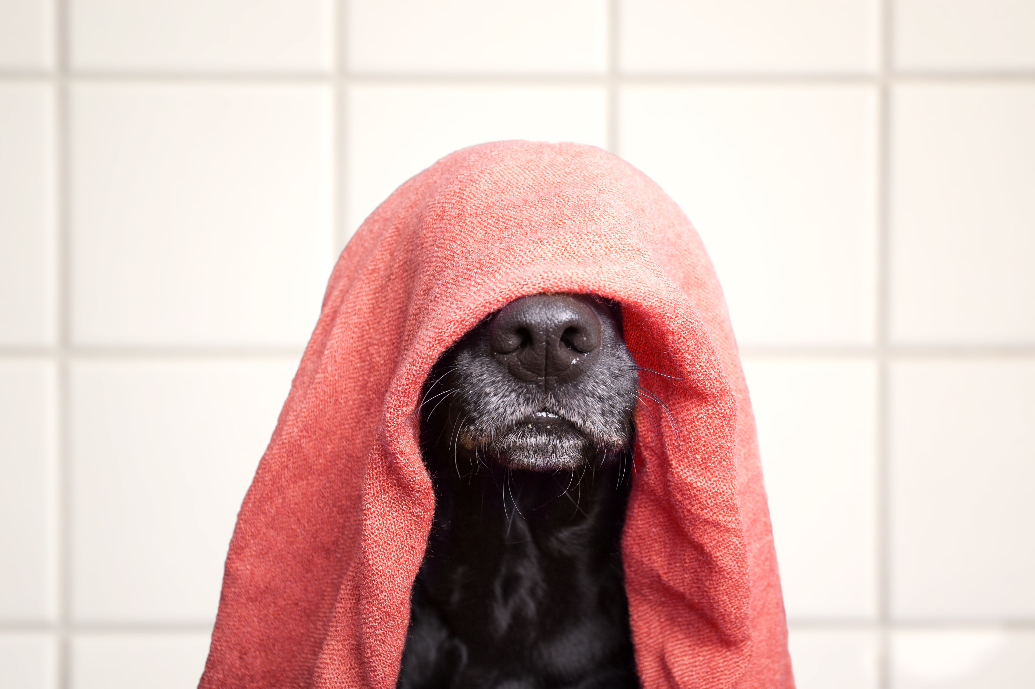
Listen and Spell
ouch
flour
towel
grow
Notes:
Say, “It’s time for more practice. Please go find yourself a white board or a piece of lined paper and something to write with.”
Allow students time to get these items.
Say, ”I will say a word, you will write that word on your white board or piece of paper.”
Click once for the picture.
Say, “Flour. There is flour in the kitchen. Flour.”
Allow students time to write their spelling.
Click once for the correct spelling to appear.
Say, “F L O U R, take the time to check your spelling. If you misspelled the word that is okay. Please correct your spelling now.”
Allow students time to correct their spelling.
Double Click.
Say, “Towel. Make sure to pack a towel for your pool day. Towel.”
Allow students time to write their spelling.
Click once for the correct spelling to appear.
Say, “T O W E L, take the time to check your spelling. If you misspelled the word that is okay. Please correct your spelling now.”
Allow students time to correct their spelling.
Double Click.
Say, “Grow. Let’s watch the plants grow. Grow.”
Allow students time to write their spelling.
Click once for the correct spelling to appear.
Say, “G R O W, take the time to check your spelling. If you misspelled the word that is okay. Please correct your spelling now.”
Allow students time to correct their spelling.
Double Click.
Say, “Ouch. OUCH that really hurt! Ouch.”
Allow students time to write their spelling.
Click once for the correct spelling to appear.
Say, “O U C H, take the time to check your spelling. If you misspelled the word that is okay. Please correct your spelling now.”
Allow students time to correct their spelling.

Slide 4
Sight Word Wall
find
look
see
said
yellow
where
Notes:
Say, “I will show you a word. We will say the word as a class and spell the word.”
Click once for each word to appear on its own.

Slide 5
Sight Word Locating
said
look
find
yellow
where
see
Notes:
Say,” I have all of this week’s sight words on the board here. I am going to say a sight word and you will have to identify the word. If you are correct, the word will move. Are we ready?”
Student Response: YES
Say, “find, where is the word find?”
Students Identify
Click once.
Say, “Said, where is the word said?”
Students Identify
Click once.
Say, “Look, where is the word look?”
Students Identify
Click once.
Say, “Yellow, where is the word yellow?”
Students Identify
Click once.
Say, “See, where is the word see?”
Students Identify
Click once.
Say, “Where, where is the word Where?”
Students Identify
Click once.

Slide 6
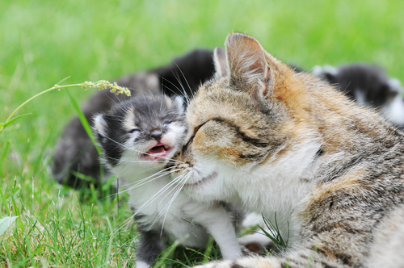
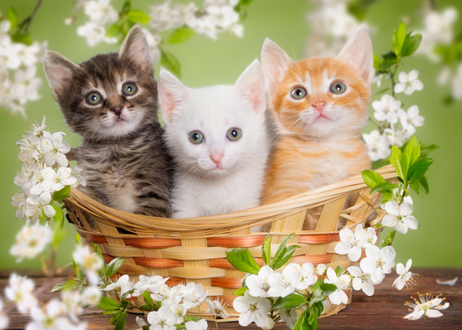
Lets Retell A Story
Notes:
Click once for first picture to appear.
Say, “Now it’s time to practice with our weekly reading of The Family. Use your retelling hand!”
Say, “Let’s start with the thumb. Who are the characters?”
Student Response: Franky and Pippi the cats and Bobby the dog. The Carters family: Tom and Susan and their daughter Abby.
Say,” Next, is the pointer finger. What is the setting of the story?”
Student Response: California
Click once for last picture to appear.
Say, “Then, the problem finger. What was the problem in the story?”
Student Response: 6 kittens were scared and jumped out of a basket running away!
Say, “After, the ring finger asks you to explain the detail in the beginning middle and end of the story.”
Student Response: The beginning of the story introduced the members of the Carter family human and fur. Then we went into detail about Franky and Pippi as kittens. They have 4 other brothers and sisters. When they lived with their mother, they had a different owner. When the kittens were old enough, they were going to their new homes. Their adopted homes. When the kittens reached the first home, they all got frightened and ran off. Everyone was looking for them. All the kittens were found, and the kittens were all dropped off at their new homes. At the end Franky and Pippi were given their names.
Say, “Finally, the pinky finger. What was the solution to the problem in the story?
Student Response: All the kittens were found and adopted!

Slide 7

Grammar
Tom and Jesse were done with work for the day. I would love to go to the park, said Jesse.
Tom shook his head no. What if we we go down to the pond? asked Tom.
Oh, we could go fishing and maybe swim afterwards! replied Jesse.
Both boys got their fishing gear, swimsuits, and towels and headed down to the pond.
''
”
"
"
"
"
Notes:
Say, “Do we remember the word dialogue?”
Student Response: Yes, it is the conversation between you and someone else.
Say, “Very good job! Now, when we are writing a dialogue, we must use quotation marks and commas. Quotation marks are used when a character in the story says something. They hug the words. Commas help to separate the dialogue from the rest of the sentence. Let’s take a look at an example.”
Click once for mini story to appear.
Read the story.
Say, “We can hear when Tom is speaking and when Jesse is speaking. Let’s go ahead and put some quotation marks in this writing. Remember they hug what someone is saying. The first group of quotations would hug, I would love to go to the park, need quotation marks.”
Click to have them appear.
Say, “What other sentences should we hug with our quotation marks?”
Student Response: What about we go down to the pond? AND Oh we could go fishing and maybe swim after! both need quotation marks.
Click twice to have them appear.
Say, “Very good job now lets go back and add in those commas. Remember a comma should be added to help separate the dialogue from the rest of the sentence.
Student Response: In the first sentence after park.
Click once to show.
Say, “Very good job! Anywhere else?”
Student Response: Before asked Tom, AND before replied Jesse
Click twice to show commas.
Click once for the thumbs up to appear.

Slide 8
Q & A
Any Questions?

