Slide 1
Subject-Verb Agreement
Five Finger Retelling

Slide 2

Grammar
Plural
If the subject is plural, then the verb should also be plural.
Subject-Verb Agreement
This is when the subject and the verb have the same tense. They must agree for the sentence to make sense.
Singular
If the subject is singular, then the verb should also be singular.
Notes:
Say, “This week in our grammar lessons we have learned about verbs. There are three different kinds of verbs do we remember what they are called?”
Student Response: Singular, plural, and subject-verb agreements.
Say, “Very good job! When we have a singular subject the verb should also be singular.
Click.
Say,” If we have a plural subject the verb should be what?”
Student Response: plural
Click.
Say,” Very good, what about a subject verb agreement? What is that?”
Student Response: This is when the subject and the verb have the same tense. They must agree for the sentence to make sense.

Slide 3

Let’s Practice
The salad tastes good.
My dog loves to play.
The children is running to the park.
The children are running to the park.
The salad taste good.
Notes:
Say,” I need someone to rea the sentence on the board out loud. It is our job to see if the sentence makes sense. Look closely at those subjects and the verbs.”
Click for first sentence to appear.
Student Response: (Reading Sentence) The children is running to the park. The “to be” verb should be are.
Click for the “to be” verb to change.
Say, “Very good job! We are talking about more than one child so the “to be” verb should match! Next sentence!”
Click for the second sentence to appear.
Student Response: (Reading Sentence) My dog loves to play. This one is perfect!
Click once for next sentence to appear.
Student Response: (Reading Sentence) The salad taste good. NO the word taste should be tastes.
Click once for the word taste to change.

Slide 4
Adding an -s or an -es
-s | -es
tastes
foxes
The salad tastes good.
bakes
run
churches
taste
bake
fox
igloo
shrub
church
bush
runs
bushes
shrubs
igloos
Notes:
Say, “We add an -s to many nouns when we want to make them plural. We even add an -s to many verbs to make it singular form. A great example was in our last sentence. The word taste. We needed to add an -s to the end”
Click once to show that sentence. ( The salad tastes good.) Click again to remove it.
Click once to show chart.
Say, “Now, sometimes we have to add an -es to the end of words. Can anyone recall the rules to that? When do we add an -es?”
Student Response: One words that end with: -s, -ch, -sh, -o, -x, or -z. Also if a word ends in -y and a consonant comes before it then the -y is replaced with -ie before adding the -s.
Click to show one word at a time.
Say, “We need to determine what words go under the -s and the -es columns.
Click once to have word disappear and click again to have them appear in the correct category.

Slide 5
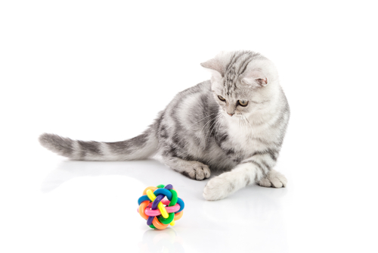
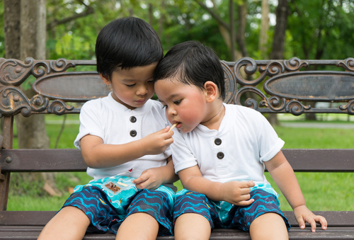
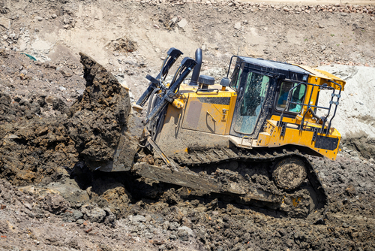
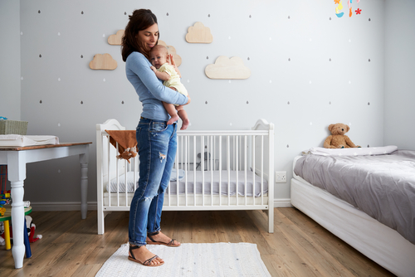
Listen and Spell
carries
shares
pushes
plays
Notes:
Say, “It’s time for more practice. Please go find yourself a white board or a piece of lined paper and something to write with.”
Allow students time to get these items.
Say, ”I will say a word, you will write that word on your white board or piece of paper.”
Click once for the picture.
Say, “Pushes. The machine pushes the dirt up the hill. Pushes.”
Allow students time to write their spelling.
Click once for the correct spelling to appear.
Say, “P U S H E S, take the time to check your spelling. If you misspelled the word that is okay. Please correct your spelling now.”
Allow students time to correct their spelling.
Click to have word disappear.
Click once for the picture.
Say, “Play. The cat plays with the ball. Plays.”
Allow students time to write their spelling.
Click once for the correct spelling to appear.
Say, “P L A Y S, take the time to check your spelling. If you misspelled the word that is okay. Please correct your spelling now.”
Allow students time to correct their spelling.
Click to have word disappear.
Click once for the picture.
Say, “Carries. The mother carries her baby to its room. Carries.”
Allow students time to write their spelling.
Click once for the correct spelling to appear.
Say, “C A R R I E S, take the time to check your spelling. If you misspelled the word that is okay. Please correct your spelling now.”
Allow students time to correct their spelling.
Click to have word disappear.
Click once for the picture.
Say, “Shares.”
Allow students time to write their spelling.
Click once for the correct spelling to appear.
Say, “P L A Y S, take the time to check your spelling. If you misspelled the word that is okay. Please correct your spelling now.”
Allow students time to correct their spelling.

Slide 6
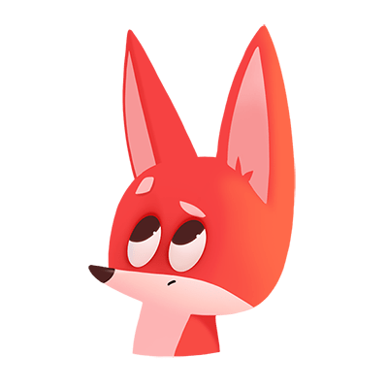
Sight Word Wall
upon
sleep
cold
before
five
its
pull
which
write
Notes:
Say, “I will show you a word. We will say the word as a class and spell the word.”
Click once for each word to appear on its own.

Slide 7
Sight Word Locating
write
pull
five
sleep
its
cold
upon
which
before
Notes:
Say,” I have all of this week’s sight words on the board here. I am going to say a sight word and you will have to identify the word. If you are correct, the word will move. Are we ready?”
Student Response: YES
Say, “Before, where is the word before?”
Students Identify
Click once.
Say, “Cold, where is the word cold?”
Students Identify
Click once.
Say, “Five where is the word five?”
Students Identify
Click once.
Say, “Its, where is the word its?”
Students Identify
Click once.
Say, “Pull, where is the word pull?”
Students Identify
Click once.
Say, “Sleep, where is the word sleep?”
Students Identify
Click once.
Say, “Upon, where is the word upon?”
Students Identify
Click once.
Say, “Which, where is the word which?”
Students Identify
Click once.
Say, “Write, where is the word write?”
Students Identify
Click once.

Slide 8

The Retelling Hand
Problem
Setting
BME
Solution
Characters
Notes:
Say, “Let’s go over how to use our retelling hand.”
Say, “Get that retelling hand out and ready! We are going to begin with your thumb. This is the characters.”
Click Once.
Say, “What do we need to say about the characters?”
Student Response: The people, animals, or creatures in the story.
Click Once.
Say, “Your pointer finger is the setting finger. What is the setting?
Student Response: This is when you will talk about the when and where the story took place.
Click Once.
Say, “This next finger, is the problem finger. What do we explain here?”
Student Response: Here you are going to tell what went wrong in the story.
Click Once.
Say, “Your ring finger is where you talk about what happened. Can you explain more in detailed what you should do here?”
Student Response: You should explain in detail the beginning, middle, and end of the story.
Click Once.
Say, “Lastly, your pinky is the solution. Who can explain what the solution is?”
Student Response: This is where your explain how the problem in the story was fixed.

Slide 9

Let’s Practice
Notes:
Say, “Now it’s time to practice with our weekly reading of Sharing. Use your retelling hand!”
Click Once.
Say, “Let’s start with the thumb. Who are the characters?”
Student Response: Meg, Ben
Say,” Next, is the pointer finger. What is the setting of the story?”
Student Response: Talking about Vermont
Say, “Then, the problem finger. What was the problem in the story?”
Student Response: Ben and Meg are saying goodbye.
Say, “After, the ring finger asks you to explain the detail in the beginning middle and end of the story.”
Student Response: Ben and Meg enjoyed sharing their life with us. They want us to write a book about our lives be detailed. They would like for you to visit Vermont see the bakery, bookstore, and the general store. Check out the seasons, etc. Ben and Meg want to say goodbye for now.
Say, “Finally, the pinky finger. What was the solution to the problem in the story?
Student Response: They want you to visit Vermont and write about it to your school.

Slide 10
Q & A
Any Questions?

