Slide 1
-ed and –ing Endings
Five Finger Retelling

Slide 2
Possessive Nouns
Past Tense
Tyler worked hard on his math test yesterday.
Present Tense
Tyler is working hard on his math test.
Notes:
Say, “This week we learned that verbs can change tense. Like something that happened yesterday or something that is happening right now! I just gave you an example of past tense, yesterday and present tense, happening now. Can you give me the word ending examples we reviewed this week?”
Student Response: -ed for past tense and -ing for present tense.
Click twice for past and present tense sentences to appear.
Say, “Very good job. Let’s take a look at an example. Past Tense: Tyler worked hard on his math test yesterday. What is the past tense verb here?”
Student Response: worked because of the -ed ending.
Click to have the answer circled.
Say,” Very good job! Present tense: Tyler is working hard on his math test. What is the same verb that just changes the tense of the sentence?”
Student Response: working, meaning it is happening right now.
Click once for answer to be circled.

Slide 3
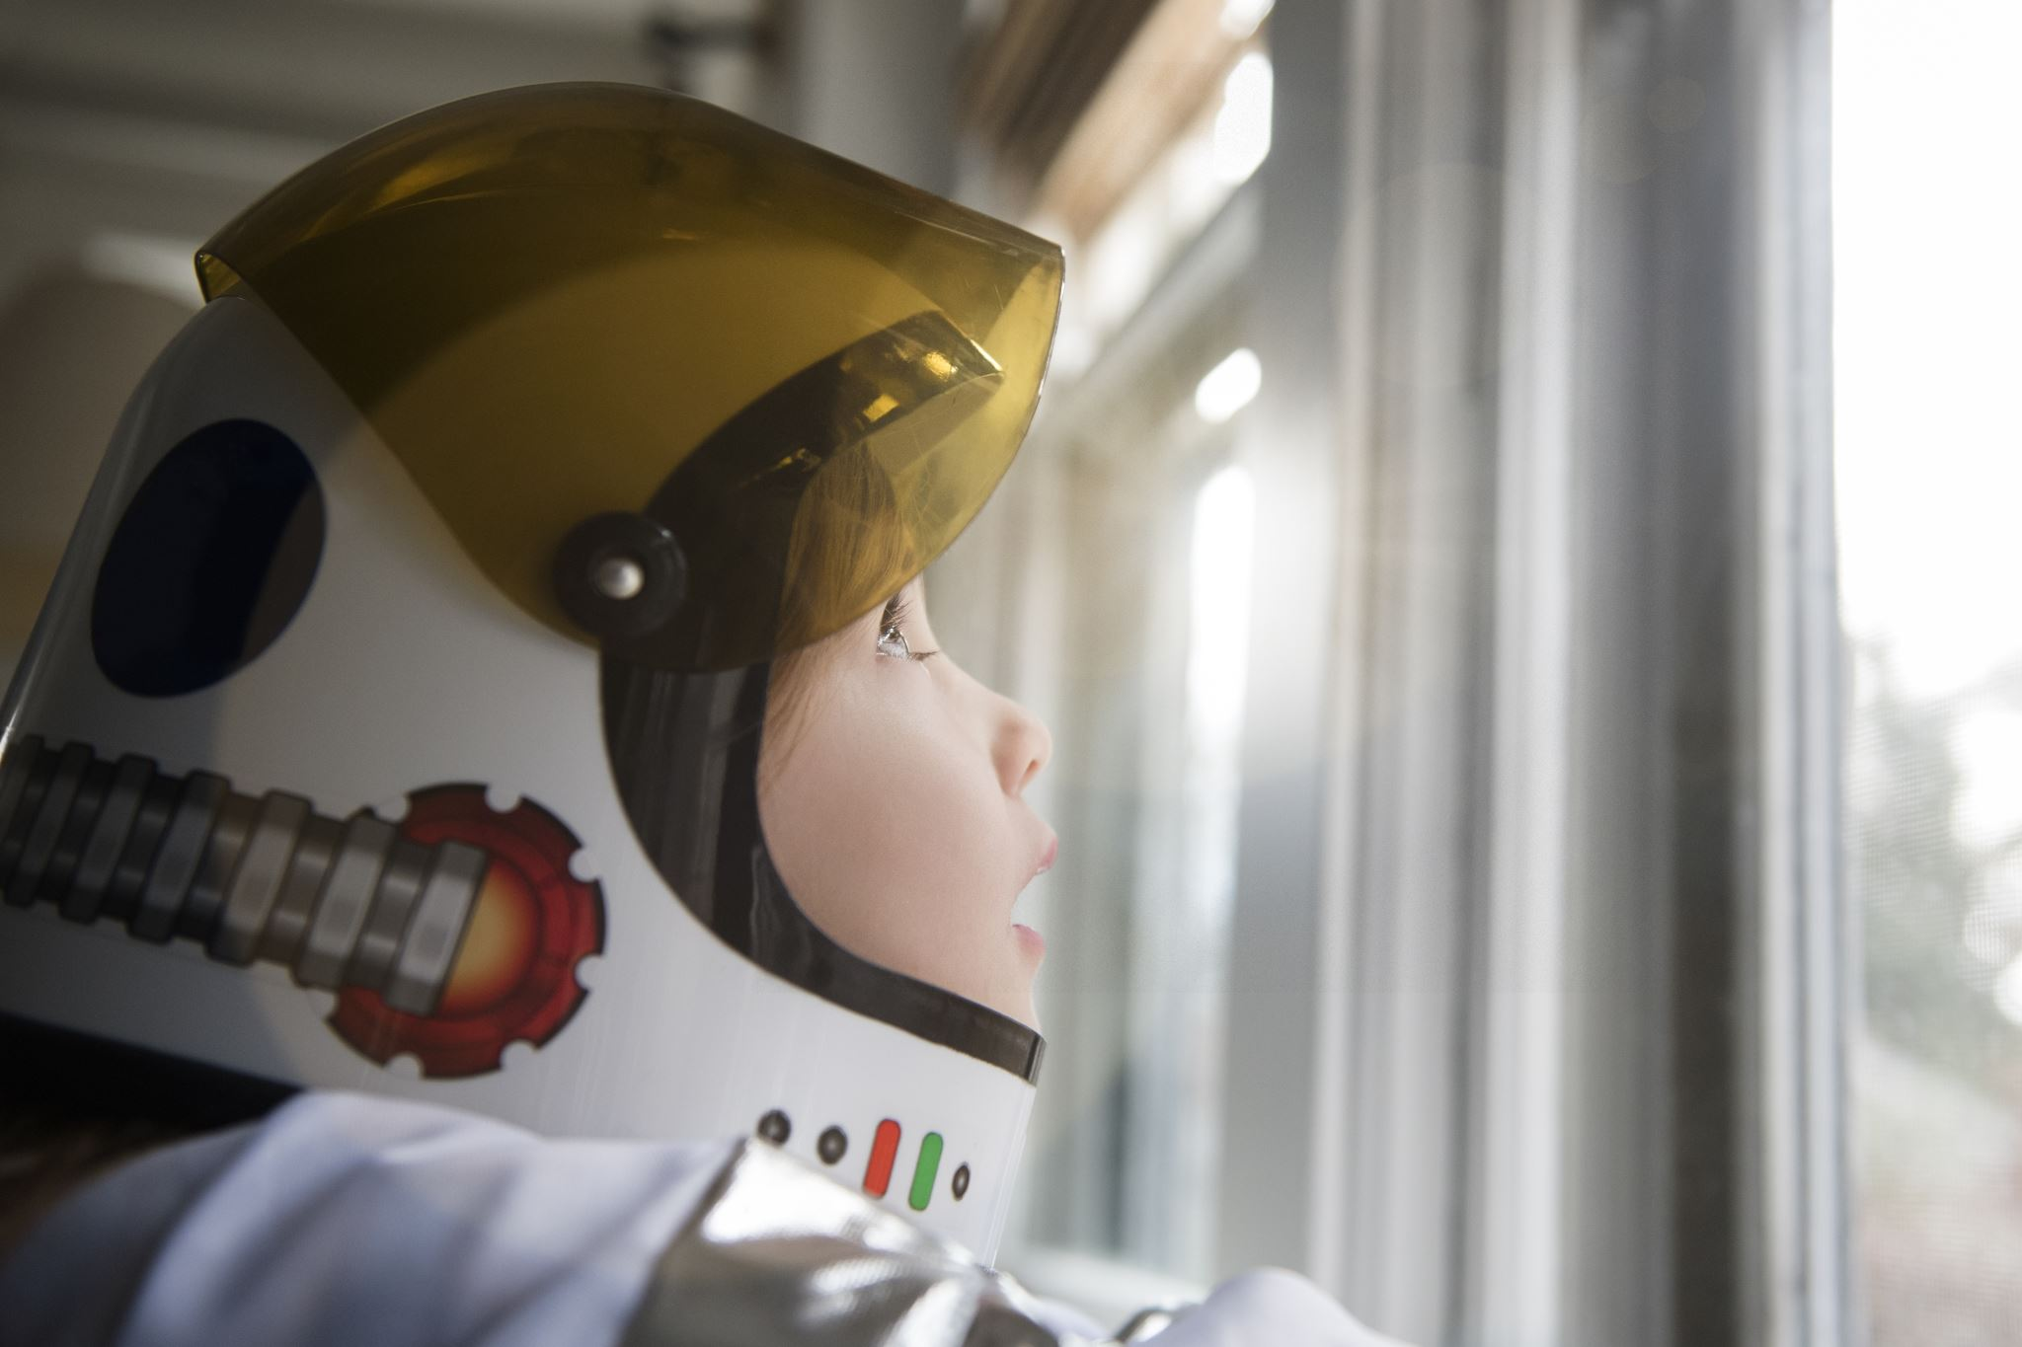


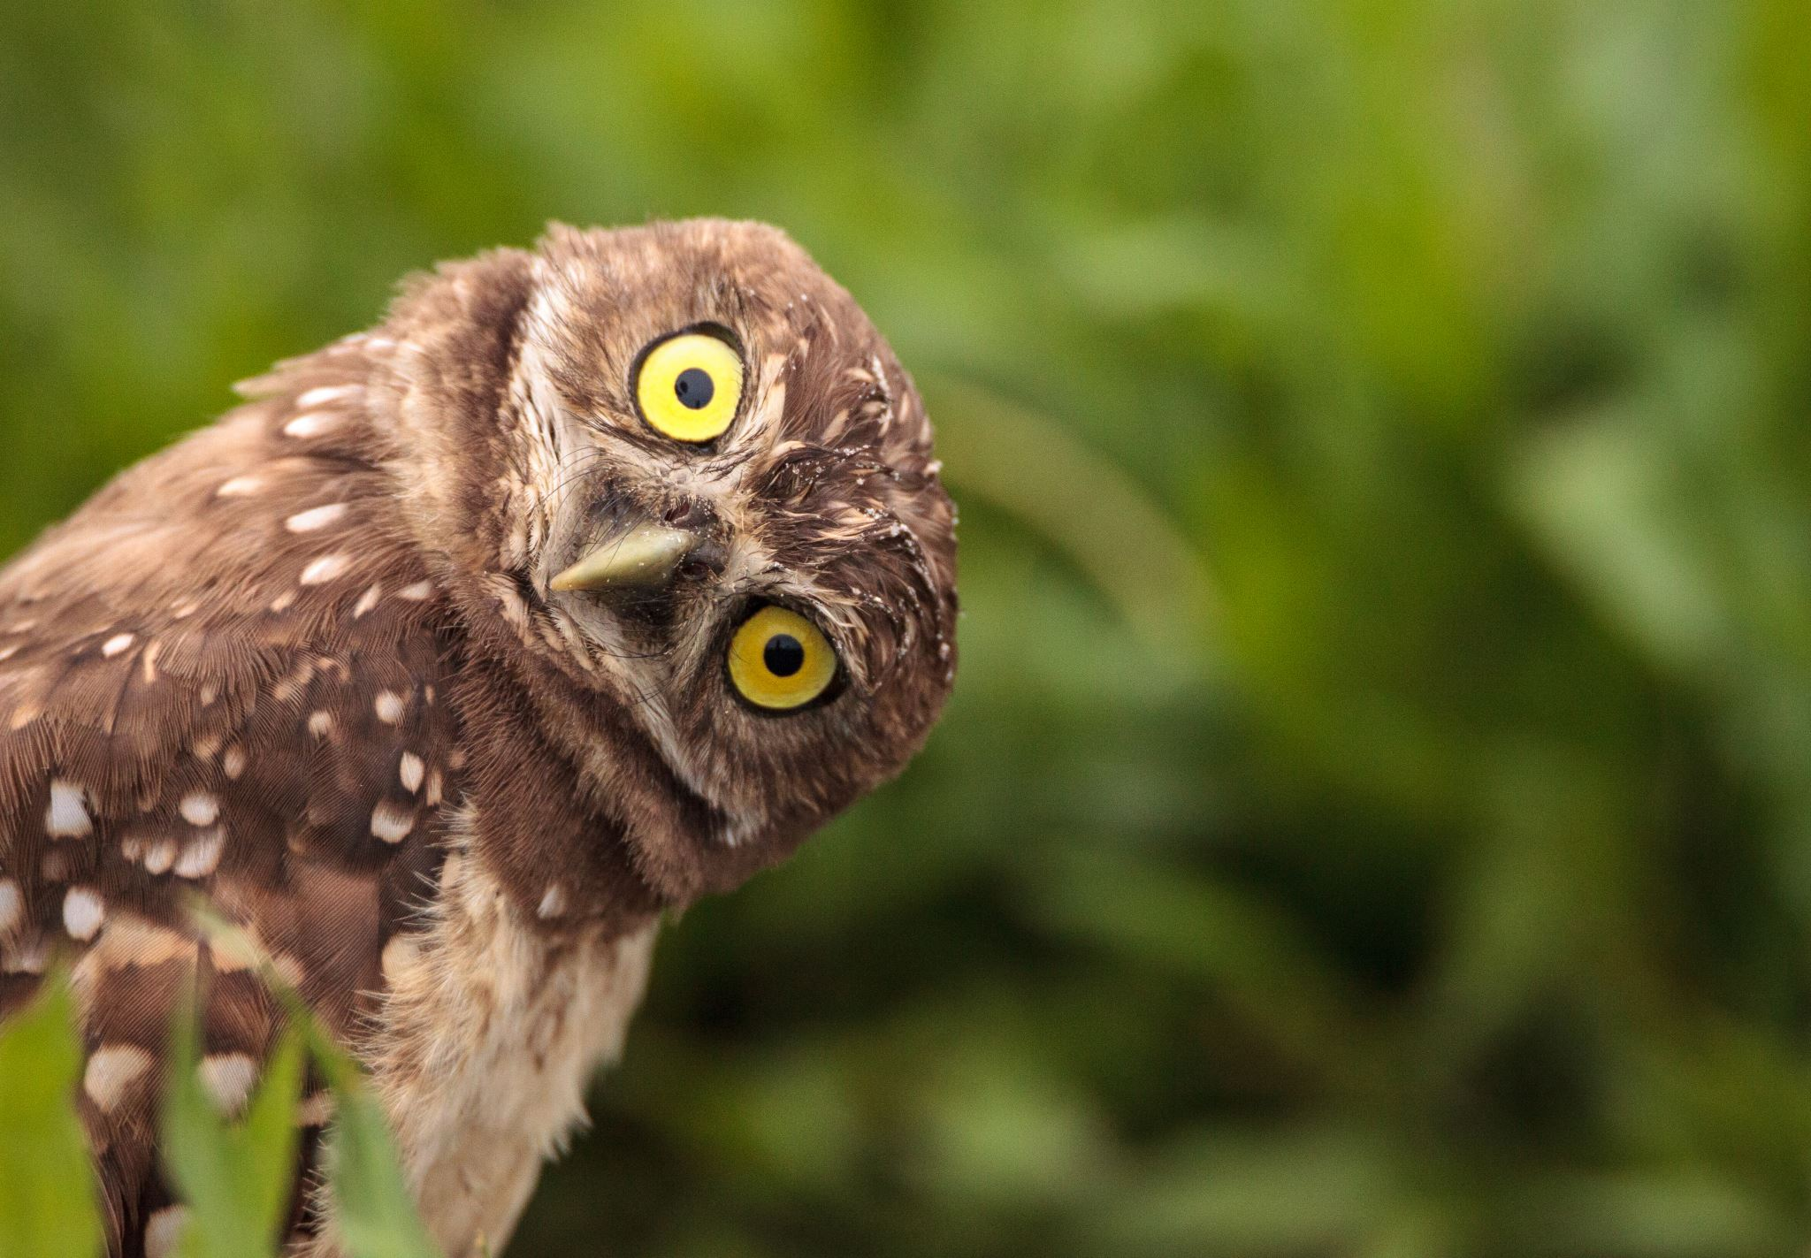
Listen and Spell
stayed
talking
wished
going
Notes:
Say, “It’s time for more practice. Please go find yourself a white board or a piece of lined paper and something to write with.”
Allow students time to get these items.
Say, ”I will say a word, you will write that word on your white board or piece of paper.”
Click once for the picture.
Say, “Talking. He was talking. Talking.”
Allow students time to write their spelling.
Click once for the correct spelling to appear.
Say, “T A L K I N G, take the time to check your spelling. If you misspelled the word that is okay. Please correct your spelling now.”
Allow students time to correct their spelling.
Click once for picture to appear.
Say, “Stayed. She stayed with her cousins this weekend. Stayed.”
Allow students time to write their spelling.
Click once for the correct spelling to appear.
Say, “S T A Y E D, take the time to check your spelling. If you misspelled the word that is okay. Please correct your spelling now.”
Allow students time to correct their spelling.
Click once for picture to appear.
Say, “Going. Where are you going for the weekend? Going.”
Allow students time to write their spelling.
Click once for the correct spelling to appear.
Say, “G O I N G, take the time to check your spelling. If you misspelled the word that is okay. Please correct your spelling now.”
Allow students time to correct their spelling.
Click once for picture to appear.
Say, “Wished. The little girl wished on a shooting star. Wished.”
Allow students time to write their spelling.
Click once for the correct spelling to appear.
Say, “W I S H E D, take the time to check your spelling. If you misspelled the word that is okay. Please correct your spelling now.”
Allow students time to correct their spelling.

Slide 4
Sight Word Wall
wash
those
or
call
would
green
first
been
sit
Notes:
Say, “I will show you a word. We will say the word as a class and spell the word.”
Click after each word to reveal the next.

Slide 5
Sight Word Locating
would
been
call
sit
first
or
wash
green
those
Notes:
Say,” I have all of this week’s sight words on the board here. I am going to say a sight word and you will have to identify the word. If you are correct, the word will move. Are we ready?”
Student Response: YES
Say, “Been, where is the word been?”
Students Identify
Click once.
Say, “Call, where is the word because?”
Students Identify
Click once.
Say, “First, where is the word because?”
Students Identify
Click once.
Say, “Green, where is the word because?”
Students Identify
Click once.
Say, “Or, where is the word because?”
Students Identify
Click once.
Say, “Sit, where is the word because?”
Students Identify
Click once.
Say, “Those, where is the word because?”
Students Identify
Click once.
Say, “Wash, where is the word because?”
Students Identify
Click once.
Say, “Would, where is the word because?”
Students Identify
Click once.

Slide 6

The Retelling Hand
Problem
Setting
BME
Solution
Characters
Notes:
Say, “Let’s go over how to use our retelling hand.”
Say, “Get that retelling hand out and ready! We are going to begin with your thumb. This is the characters.”
Say, “What do we need to say about the characters?”
Student Response: The people, animals, or creatures in the story.
Say, “Your pointer finger is the setting finger. What is the setting?
Student Response: This is when you will talk about the when and where the story took place.
Say, “This next finger, is the problem finger. What do we explain here?”
Student Response: Here you are going to tell what went wrong in the story.
Say, “Your ring finger is where you talk about what happened. Can you explain more in detailed what you should do here?”
Student Response: You should explain in detail the beginning, middle, and end of the story.
Say, “Lastly, your pinky is the solution. Who can explain what the solution is?”
Student Response: This is where your explain how the problem in the story was fixed.

Slide 7
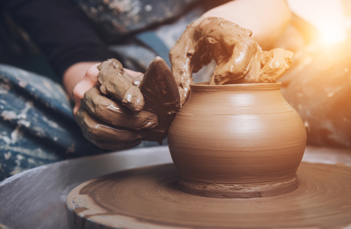
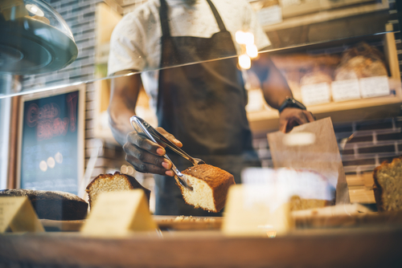

Let’s Practice
Notes:
Say, “Now it’s time to practice with our weekly reading of Afternoon Treat. Use your retelling hand!”
Say, “Let’s start with the thumb. Who are the characters?”
Student Response: Meg- sister, Ben- brother, Mother, Chip- pet, John- bookstore owner
Say,” Next, is the pointer finger. What is the setting of the story?”
Student Response: Began at their home in Vermont. Then they went out for an afternoon treat at Putney Bakery. They made a stop at the bookstore and the general store.
Say, “Then, the problem finger. What was the problem in the story?”
Student Response: The first mini problem was when Chip took Ben’s pinch pot project!
Second was when Ben and Meg wanted to go play in the school but mom had work to do at home.
Say, “After, the ring finger asks you to explain the detail in the beginning middle and end of the story.”
Student Response: The beginning the kids got to make something out of clay. After lunch Meg, Ben, and Mother went to the bakery for a treat, then the library where they each got a book, and finally they went to the town general store. In the end of the story they went home Mother had to get work done so Meg and Ben played store.
Say, “Finally, the pinky finger. What was the solution to the problem in the story?
Student Response: For the first problem, when Chip took Ben’s clay project, he was upset but then made a new one.
The second problem when the kids wanted to go play in the school they had to go home. They decided to play school with each other instead.

Slide 8
Grammar
liked
jumped
eat
happening
holding
look
turned
tied
clap
Notes:
Say, “Let’s identify a few past tense verbs. Remember a past tense verb is one that is talking about something that has already happened. I have a few words on this slide. Which ones are past tense?”
Student Response: liked, turned, jumped, tied (These can be given in different order.)
Click to show all answers after student has responded with all 4.

Slide 9
Grammar
The dog is _____ up and down the stairs.
run
running
ran
Yesterday we ______ to the park.
walk
walks
walked
Tomorrow we will _____ our bikes.
ride
rides
road
running
walked
ride
Notes:
Say, “Now we are going to choose the correct word to complete the sentence.”
Click once.
Say, “Yesterday we ______ to the park.”
Student Response: walked
Click once to show answer.
Click once for next sentence.
Say, “Tomorrow we will ______ our bikes.”
Student Response: ride
Click once to show answer.
Click once for next sentence.
Say,” The dog is _____ up and down the stairs.”
Student Response: running
Click once to show answer.

Slide 10
Q & A
Any Questions?

