Slide 1
Two- Consonant Endings
Linking Verbs

Slide 2
Two- Consonant Endings
-ft
gift
-xt
text
-mp
hump
-ck
check
Notes:
Say,” This week we are really focusing on two- consonant endings. Can anyone remind me and the rest of the class of the four ends we have looked at?”
Student Response: -ft, -xt, -mp, -ck
Say, “Very good job! Now, lets look at these two-consonant endings individually.”
Click once.
Say, “The -ft ending, like in the word gift. Could everyone as a class say this word?”
Student Response: gift
Click once.
Say, “The -xt ending, like in the word text. Could everyone as a class say this word?”
Student Response: text
Click once.
Say, “The -mp ending, like in the word hump. Could everyone as a class say this word?”
Student Response: hump
Click once.
Say, “The -ck ending, like in the word check. Could everyone as a class say this word?”
Student Response: check
Click once.

Slide 3

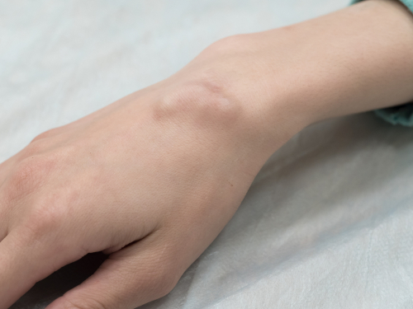


Listen and Spell
kick
gift
stamp
lump
Notes:
Say, “It’s time for more practice. Please go find yourself a white board or a piece of lined paper and something to write with.”
Allow students time to get these items.
Say, ”I will say a word, you will write that word on your white board or piece of paper.”
Click once for the picture.
Say, “Gift. I wonder what that big gift is. Gift.”
Allow students time to write their spelling.
Click once for the correct spelling to appear.
Say, “G I F T, take the time to check your spelling. If you misspelled the word that is okay. Please correct your spelling now.”
Allow students time to correct their spelling.
Click once for picture to appear.
Say, “Stamp. Make sure to put a stamp on your letter before mailing it. Stamp”
Allow students time to write their spelling.
Click once for the correct spelling to appear.
Say, “S T A M P, take the time to check your spelling and correct any mistakes you might have made.”
Allow students time to correct their spelling.
Click once for picture to appear.
Say, “Kick. You must kick the ball into the goal. Kick.”
Allow students time to write their spelling.
Click once for the correct spelling to appear.
Say, “K I C K, take the time to check your spelling and correct any mistakes you might have made.”
Allow students time to correct their spelling.
Click once for picture to appear.
Say, “Lump. I have a lump on my leg. Lump”
Allow students time to write their spelling.
Click once for the correct spelling to appear.
Say, “L U M P, take the time to check your spelling and correct any mistakes you might have made.”
Allow students time to correct their spelling.

Slide 4
Sight Word Wall
because
sing
off
very
these
work
but
fast
goes
Notes:
Say, “I will show you a word. We will say the word as a class and spell the word.”
Click for each word to appear.

Slide 5
Sight Word Practice
work
sing
off
goes
these
but
because
very
fast
Notes:
Say,” I have all of this week’s sight words on the board here. I am going to say a sight word and you will have to identify the word. Are we ready?”
Student Response: YES
Say, “Because, where is the word because?”
Students Identify
Say, “but, where is the word but?”
Students Identify
Say, “fast where is the word fast?”
Students Identify
Say, “Goes, where is the word goes?”
Students Identify
Say, “off, where is the word off?”
Students Identify
Say, “sing, where is the word sing?”
Students Identify
Say, “These, where is the word these?”
Students Identify
Say, “Very, where is the word very?”
Students Identify
Say, “Work, where is the word work?”
Students Identify

Slide 6

The Retelling Hand
Problem
Setting
BME
Solution
Characters
Notes:
Say, “Let’s go over how to use our retelling hand.”
Say, “Get that retelling hand out and ready! We are going to begin with your thumb. This is the characters.”
Say, “What do we need to say about the characters?”
Student Response: The people, animals, or creatures in the story.
Say, “Your pointer finger is the setting finger. What is the setting?
Student Response: This is when you will talk about the when and where the story took place.
Say, “This next finger, is the problem finger. What do we explain here?”
Student Response: Here you are going to tell what went wrong in the story.
Say, “Your ring finger is where you talk about what happened. Can you explain more in detailed what you should do here?”
Student Response: You should explain in detail the beginning, middle, and end of the story.
Say, “Lastly, your pinky is the solution. Who can explain what the solution is?”
Student Response: This is where your explain how the problem in the story was fixed.

Slide 7
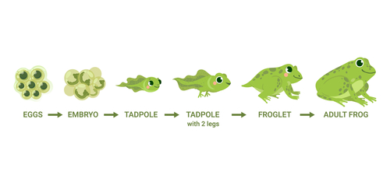
Let’s Practice
Notes:
Say, “Now it’s time to practice with our weekly reading of Tadpoles. Use your retelling hand!”
Say, “Let’s start with the thumb. Who are the characters?”
Student Response: Meg, Ben, Mother, Chip
Say,” Next, is the pointer finger. What is the setting of the story?”
Student Response: Pond near Meg and Ben’s house
Say, “Then, the problem finger. What was the problem in the story?”
Student Response: Meg fell into the pond while looking at the frog eggs.
Say, “After, the ring finger asks you to explain the detail in the beginning middle and end of the story.”
Student Response: In the beginning of the story, Meg, Ben, and Mother were going to the pond to see frog eggs. They were going to go to the pond once a week to watch the tadpoles grow into frogs. When they were there the first time Meg fell into the pond. They had to go home get cleaned up and do schoolwork. At the end of the story Meg and Ben drew pictures of what they had learned about tadpoles and frogs.
Say, “Finally, the pinky finger. What was the solution to the problem in the story?
Student Response: Everyone went home. Meg got a warm bath and began her school work.

Slide 8
Grammar
“to be” Verbs
is, am, are, was, were, will, be, being, been
Tommy will be the winner.
Notes:
Say, “We know that an action verb is the part of the sentence that shows movement or action. Linking verbs help us link word together in a sentence. The most common linking verb is “to be”. Can anyone recall some of our “to be” forms?”
Student Response: is, am, are, was, were, will be, being, been.
Click once to show some “to be” words.
Say, “Very good job. Let’s look at a sentence. We need to identify the action verb and the linking verb.”
Click once for sentence to appear.
Say,” Tommy will be the winner. What is the action verb in this sentence?”
Student Response: winner
Click once for the action verb to be underlined.
Say,” What is the linking verb in this sentence?”
Student Response: will be
Click once for the linking verb to be circled.

Slide 9
Grammar Practice
Suzy is working on an art project.
The horses have been running in the pasture.
Where are you going?
Notes:
Say, “I have this sentence and two more sentences we need to look at. In this sentence the action verb is already underlined. What is the linking verb in this sentence? Suzy is working on an art project.”
Student Response: Is
Click once for the linking verb to be circled.
Click once for next sentence to appear.
Say,” The horses have been running in the pasture. The action verb is running. What is the linking verb?”
Student Response: been
Click once for the linking verb to be circled.
Click once for next sentence to appear.
Say,” Where are you going? Going is the action verb. What the linking verb?”
Student Response: are
Click once for the linking verb to be circled.

Slide 10
Q & A
Any Questions?

