Slide 1
“n” Sound Endings and Action Verbs
Find the Action

Slide 2
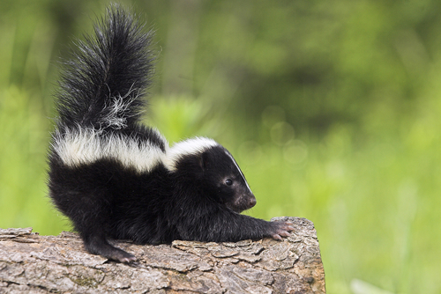
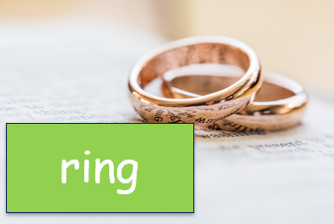
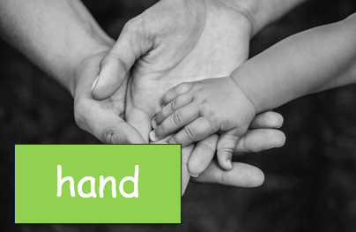
Ending Sounds with “n”
Notes:
Say, “ We are going to look at the letter “n” at the end of a word. We learned about blended letters. Do you remember this?”
Student Response: Yes! (Could give examples like: bend, tank, sent, wink, paint, etc.)
Say, “Very good job! Let’s go ahead and review a few of these blended “n” words. I will show one word with a picture at a time. As a class everyone say this word.”
Click once.
Student Response: Skunk
Click once.
Student Response: Ring
Click once.
Student Response: Hand

Slide 3
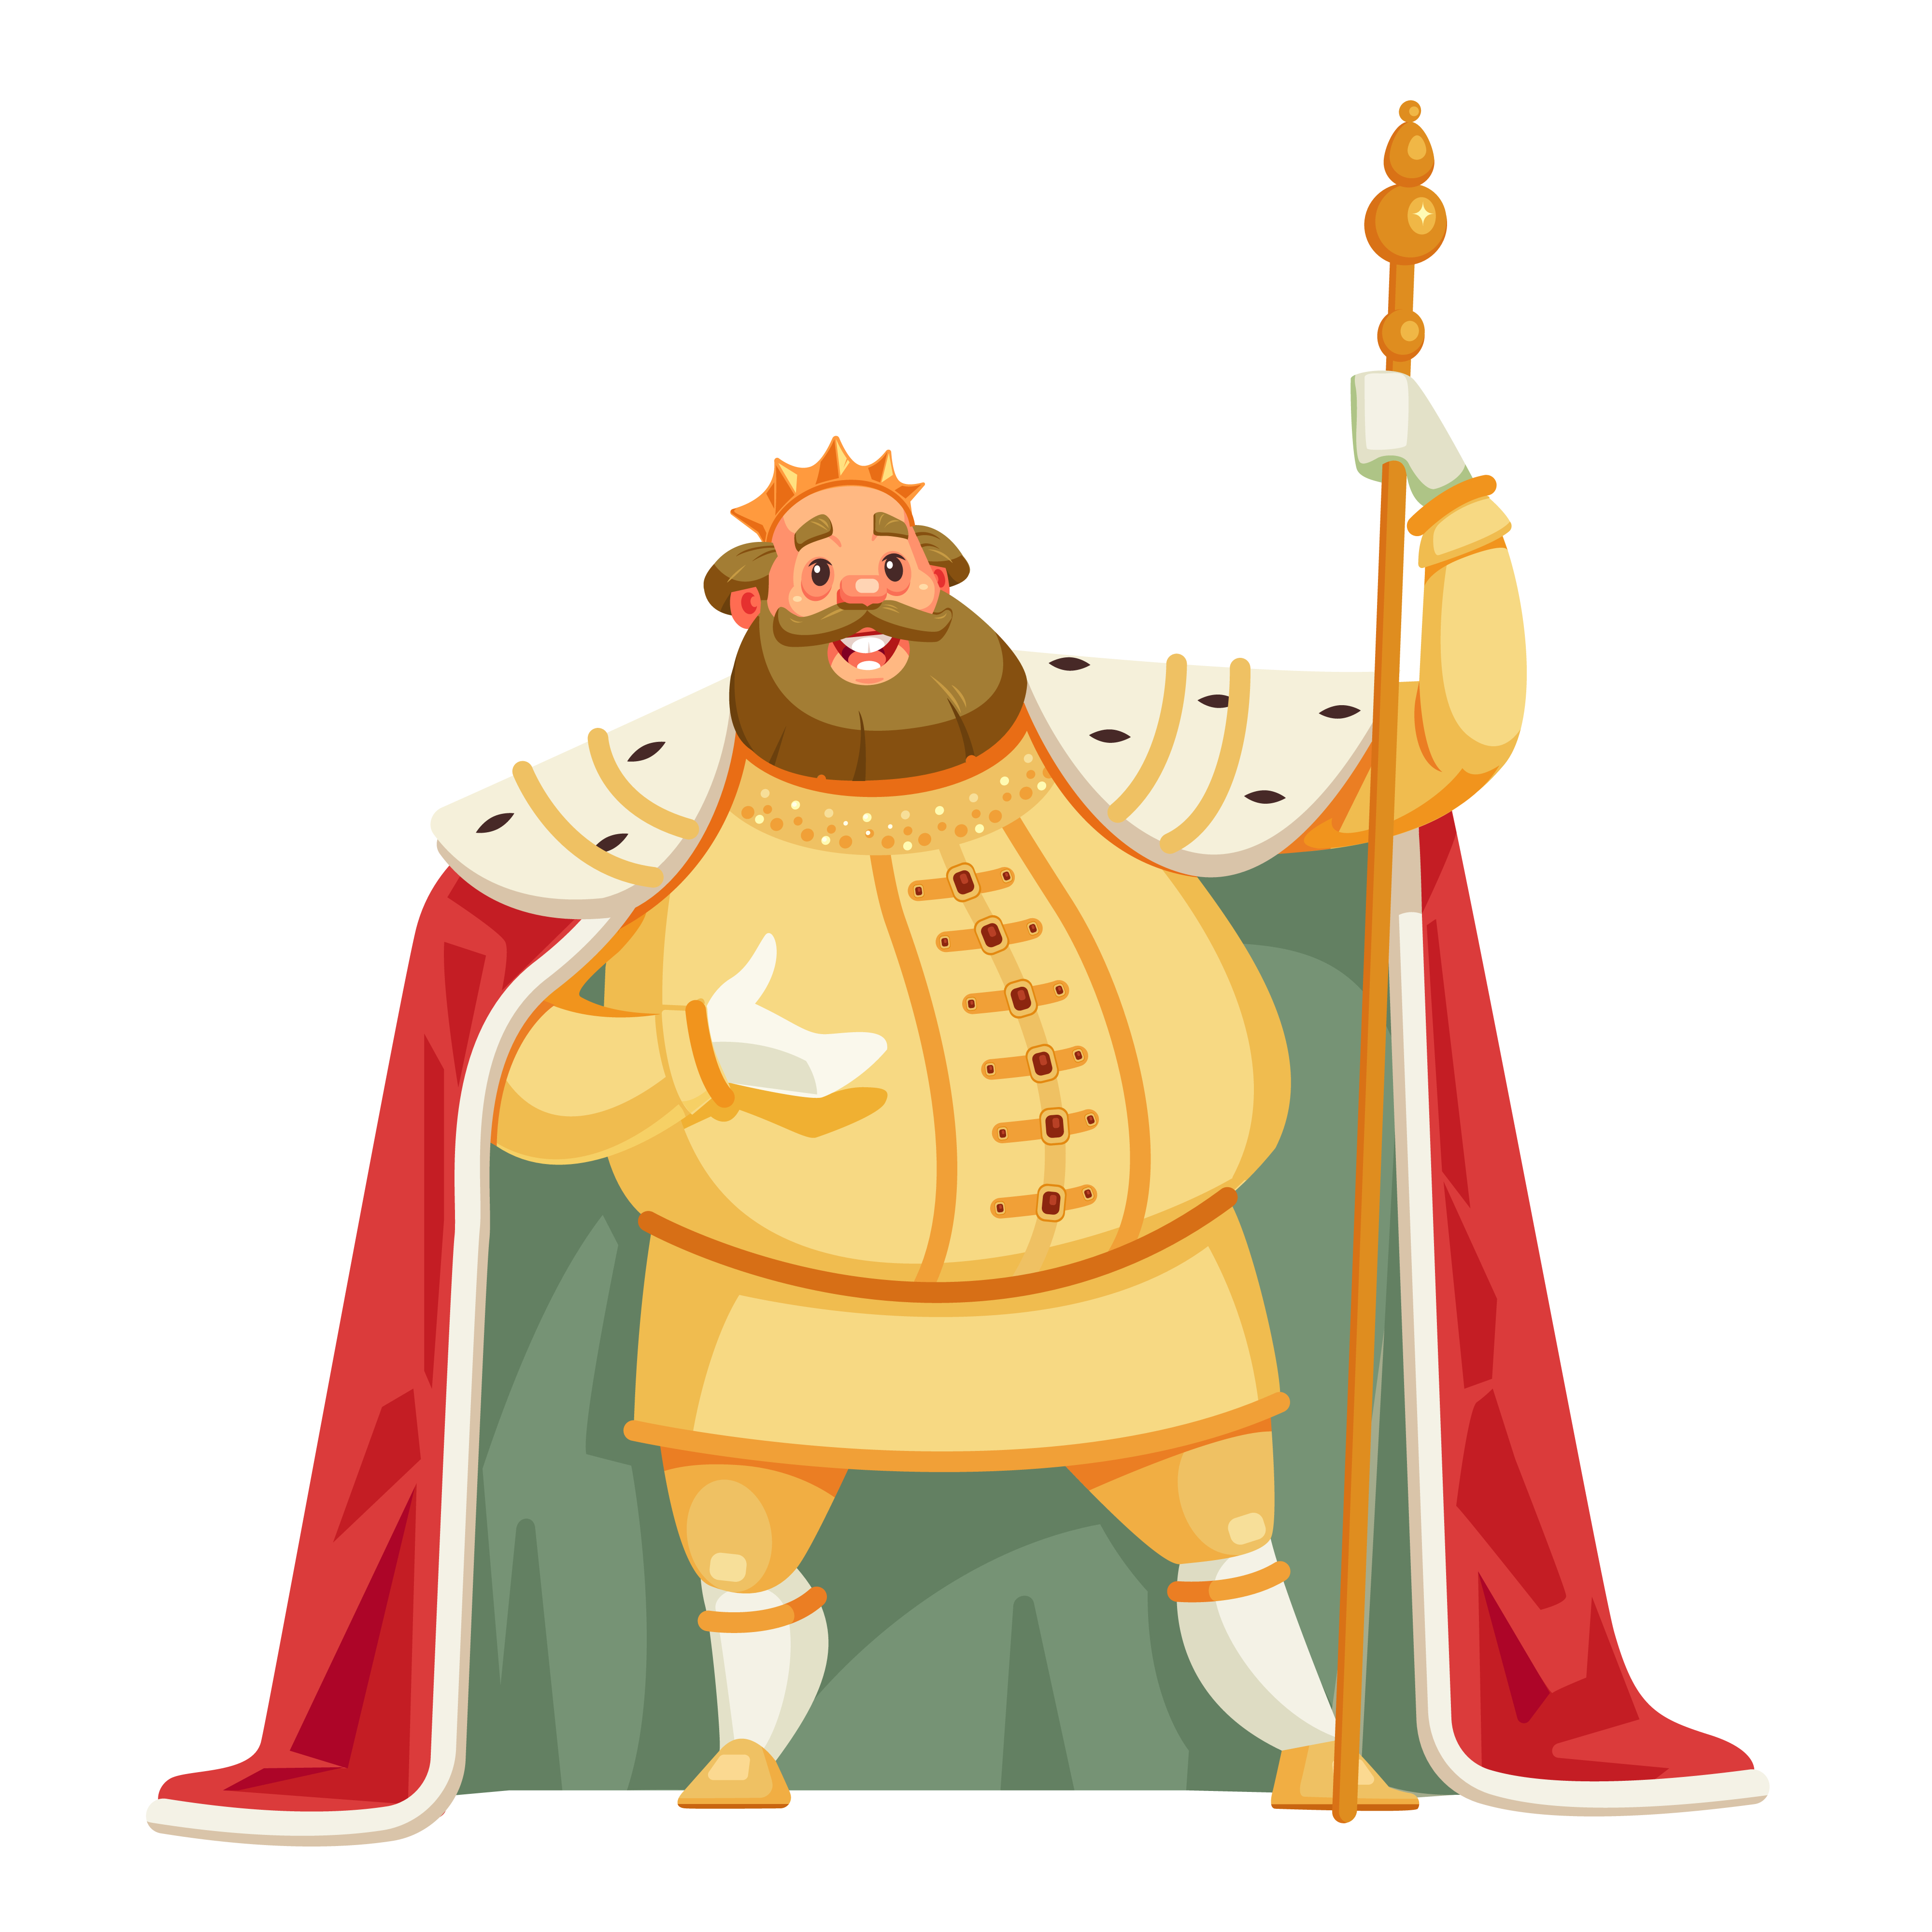
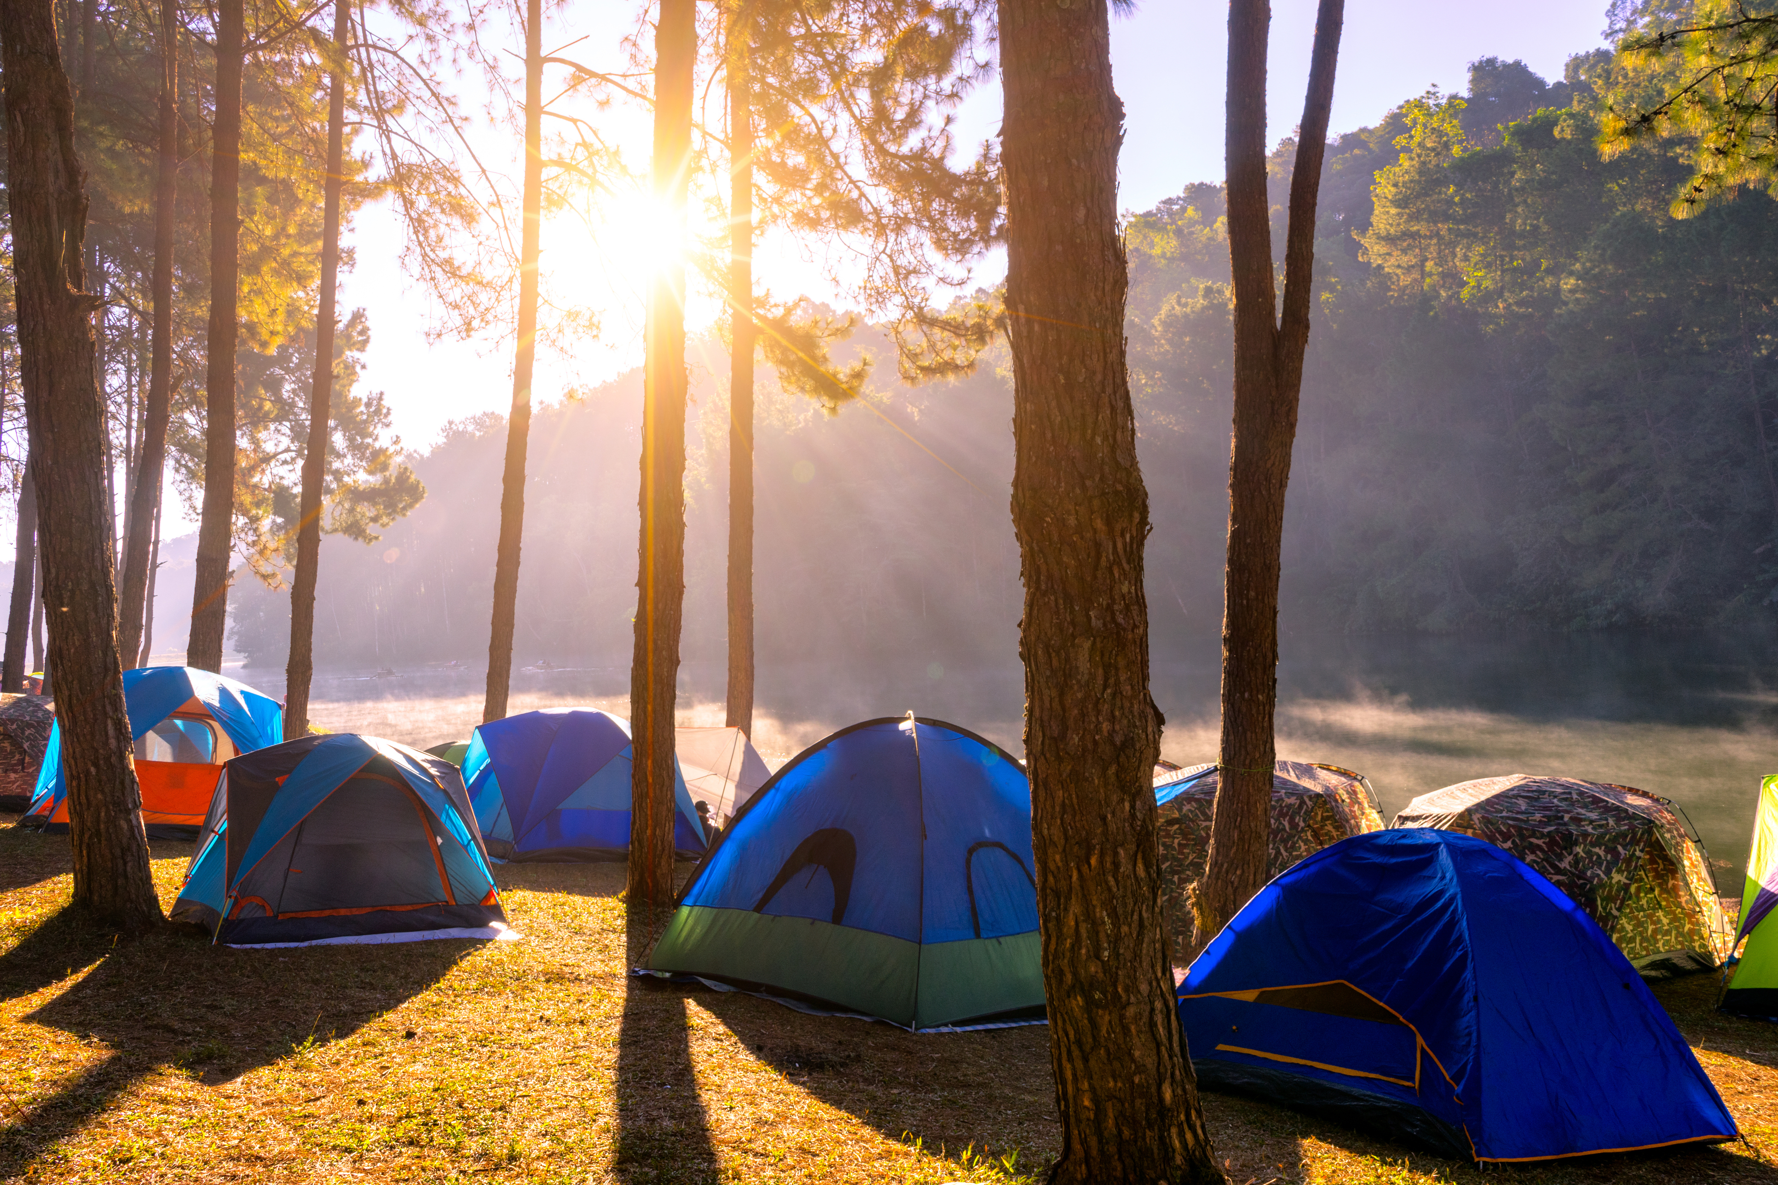
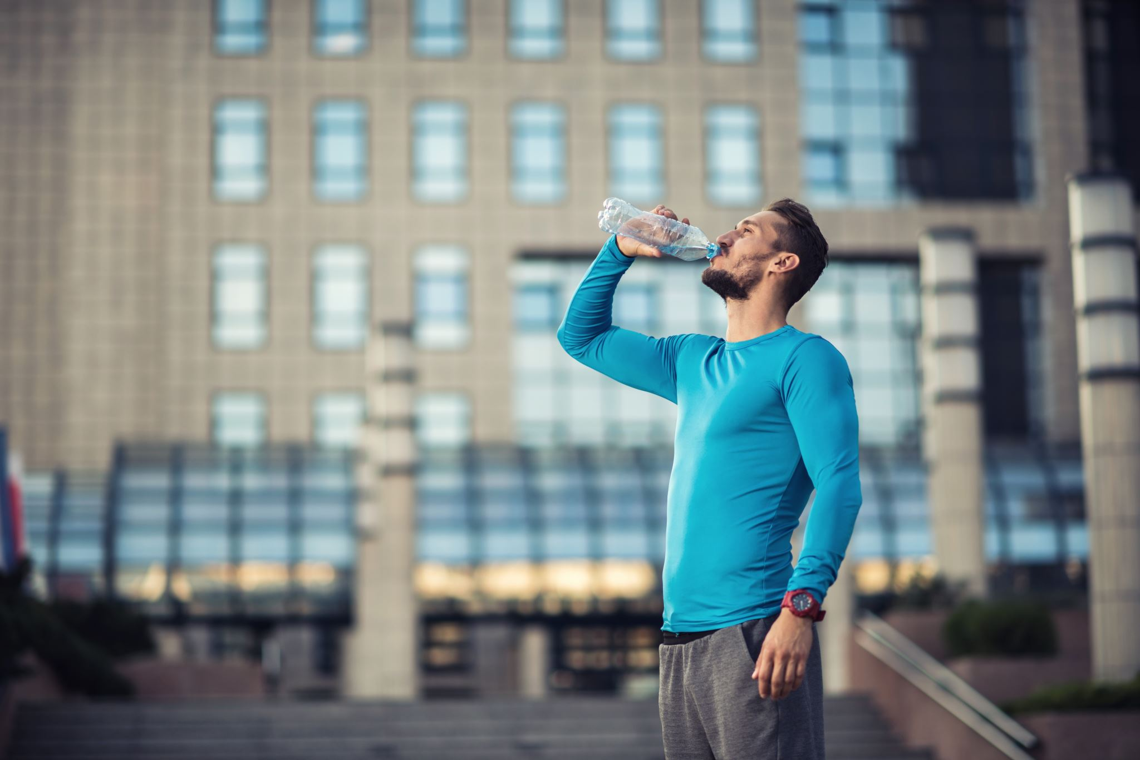
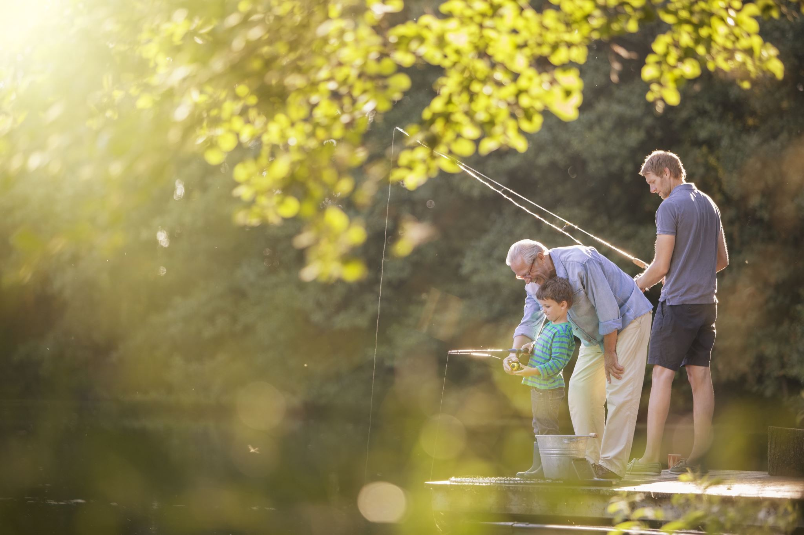
Listen and Spell
pond
king
drink
tent
Notes:
Say, “It’s time for more practice. Please go find yourself a white board or a piece of lined paper and something to write with.”
Allow students time to get these items.
Say, ”I will say a word, you will write that word on your white board or piece of paper.”
Click once for the picture.
Say, “Pond. There are many fish in the pond. Pond”
Allow students time to write their spelling.
Click once for the correct spelling to appear.
Say, “P O N D, take the time to check your spelling. If you misspelled the word that is okay. Please correct your spelling now.”
Allow students time to correct their spelling.
Click once for picture to appear.
Say, “King. Bow before the king. King”
Allow students time to write their spelling.
Click once for the correct spelling to appear.
Say, “K I N G, take the time to check your spelling and correct any mistakes you might have made.”
Allow students time to correct their spelling.
Click once for picture to appear.
Say, “Drink. Make sure to drink lots of water today, it is going to be hot. Drink.”
Allow students time to write their spelling.
Click once for the correct spelling to appear.
Say, “D R I N K, take the time to check your spelling and correct any mistakes you might have made.”
Allow students time to correct their spelling.
Click once for picture to appear.
Say, “Tent. Tonight, we are sleeping in a tent in the backyard! Tent.”
Allow students time to write their spelling.
Click once for the correct spelling to appear.
Say, “T E N T, take the time to check your spelling and correct any mistakes you might have made.”
Allow students time to correct their spelling.

Slide 4
Sight Word Wall
use
right
many
gave
around
both
don’t
their
with
Notes:
Say, “I will show you a word. We will say the word as a class and spell the word.”
Click for first word. (around)
Continue with this for all sight words.

Slide 5
Sight Word Practice
My mom ____ me specific instructions.
This must be ____ house.
I ____ think we should be here without permission.
their
gave
don’t
Notes:
Say, “We are going to complete three sentences with some of our sight words. Number one. This must be blank house. What word do you think with complete this sentence? Don’t, gave, or their.”
Students Response: their
Click once for answer to enlarge.
Click again for next sentence to appear.
Say, “I blank think we should be here without permission.”
Students Response: don’t
Click once for answer to enlarge.
Click again for next sentence to appear.
Say, “My mom blank me specific instructions.”
Student Response: gave
Click once for answer to enlarge.

Slide 6

The Retelling Hand
Problem: What went wrong in the story?
Setting: The when and where the story took place.
Characters: Who is in the story. List people, animals, or creatures.
BME: Recall details about the beginning, middle, and end of the story.
Solution: Explain about how the problem in the story was resolved.
Notes:
Say, “Let’s go over how to use our retelling hand.”
Click to have a hand appear on the page.
Say, “Get that retelling hand out and ready! We are going to begin with your thumb. This is the characters.”
Say, “What do we need to say about the characters?”
Student Response: The people, animals, or creatures in the story.
Click once to reveal the word characters and its meaning.
Say, “Your pointer finger is the setting finger. What is the setting?
Student Response: This is when you will talk about the when and where the story took place.
Click once to reveal the word setting.
Say, “This next finger, is the problem finger. What do we explain here?”
Student Response: Here you are going to tell what went wrong in the story.
Click once to reveal the word problem.
Say, “Your ring finger is where you talk about what happened. Can you explain more in detailed what you should do here?”
Student Response: You should explain in detail the beginning, middle, and end of the story.
Click once to reveal the events in the story.
Say, “Lastly, your pinky is the solution. Who can explain what the solution is?”
Student Response: This is where your explain how the problem in the story was fixed.
Click once to reveal the solution.

Slide 7

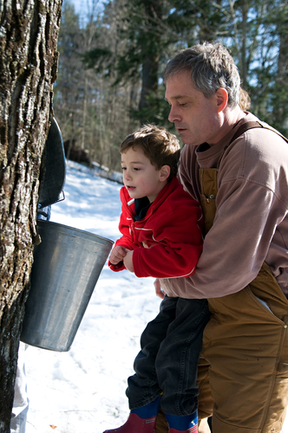
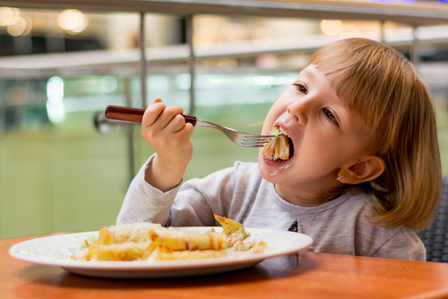
Let’s Practice
Notes:
Say, “Now it’s time to practice with our weekly reading of Maple Syrup. Use your retelling hand!”
Say, “Let’s start with the thumb. Who are the characters?”
Student Response: Meg, Ben, and Mother
Say,” Next, is the pointer finger. What is the setting of the story?”
Student Response: Vermont in their home.
Say, “Then, the problem finger. What was the problem in the story?”
Student Response: Ben was not paying attention and spilled maple syrup on his plate and the table.
Say, “After, the ring finger asks you to explain the detail in the beginning middle and end of the story.”
Student Response: The story begins with the kids eating breakfast and noticing the ground is starting to thaw. Meg and Ben do their main lesson at home and then head into town to learn how maple syrup is made. They painted and learned how to blend colors with water. Then then headed into town before that they had to find Chip their dog, he was playing with the neighbor dog. When they finally got the Harlow’s farm, they learned how maple syrup is made!
Say, “Finally, the pinky finger. What was the solution to the problem in the story?
Student Response: Ben learned that the making of maple syrup was hard and long. He learned that he needs to be more careful with his syrup in the mornings.

Slide 8
Action Verbs
Describes something that a person, place, or think can do.
They ate all the donuts.
Notes:
Say,” Can anyone tell me what an action verb is?”
Student Response: An action verb describes something that a person, place, or think can do.
Click once to show the meaning of an action verb.
Say, “Very good job! Here is an example of an action verb in a sentence.”
Click once to show a sentence.
Say, “They ate all of the donuts. Who are we talking about here?”
Student Response: They
Say, “Very good, now what are they doing?”
Student Response: They ate.
Say, “Perfect so the action verb is what?”
Student Response: Ate
Click to have the action verb circled on the sentence.

Slide 9
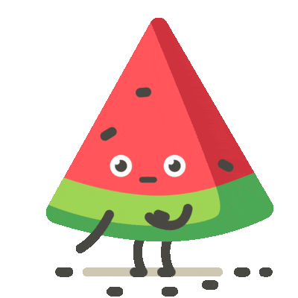
Let’s Find the Action Verbs
walk
him
ride
run
play
listen
her
Daisy
Notes:
Say,” It is time to find the action verbs. I have multiple ice cream cones here. Some have action verbs on them, and others do not. It is your job to identify the action verbs!”
Allow students to identify those actions verbs.
Click the screen show correct answers: walk, ride, run, play, listen

Slide 10
Q & A
Any Questions?

