Slide 1
Digraphs and Spelling
Winter Fun

Slide 2
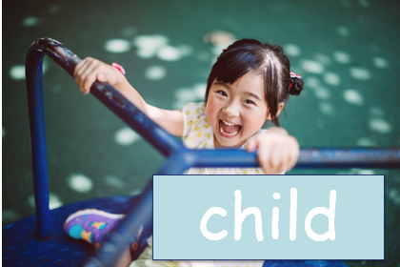
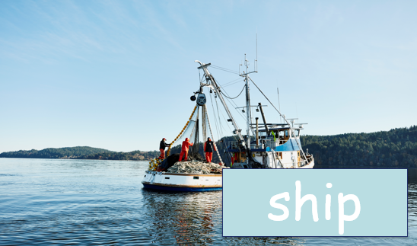

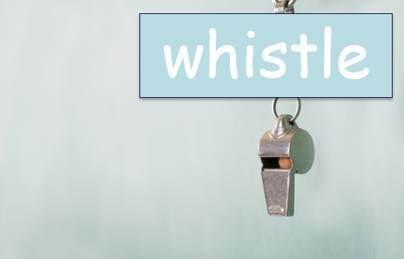
“Ch” “Sh” “Th” and “Wh”
Notes:
Say, “This week was talked about words that contain digraphs. Does anyone remember what a diagraph is?”
Student Response: ch, sh, th, and wh are all digraphs. The two letters come together to make a new sound.
Say,” Very good job! So “ch” make the what sound?”
Student Response: CH
Say, “What about the “sh” what sound does that make?”
Student Response: SHHHHH…
Say, “What about the “th” what sound does that make?”
Student Response: THHH…
Say, “The last one is the “wh” What sound does that make?”
Student Response: WH
Say,” Very good job! Now I am going to show you four pictures. It is your job to read the word out loud. You know the sounds of each digraph that is going to be used.”
Click once to show a child.
Student Response: Child
Click once to show a ship.
Student Response: Ship
Click once to show the number three.
Student Response: Three
Click once to show a whistle.
Student Response: Whistle

Slide 3
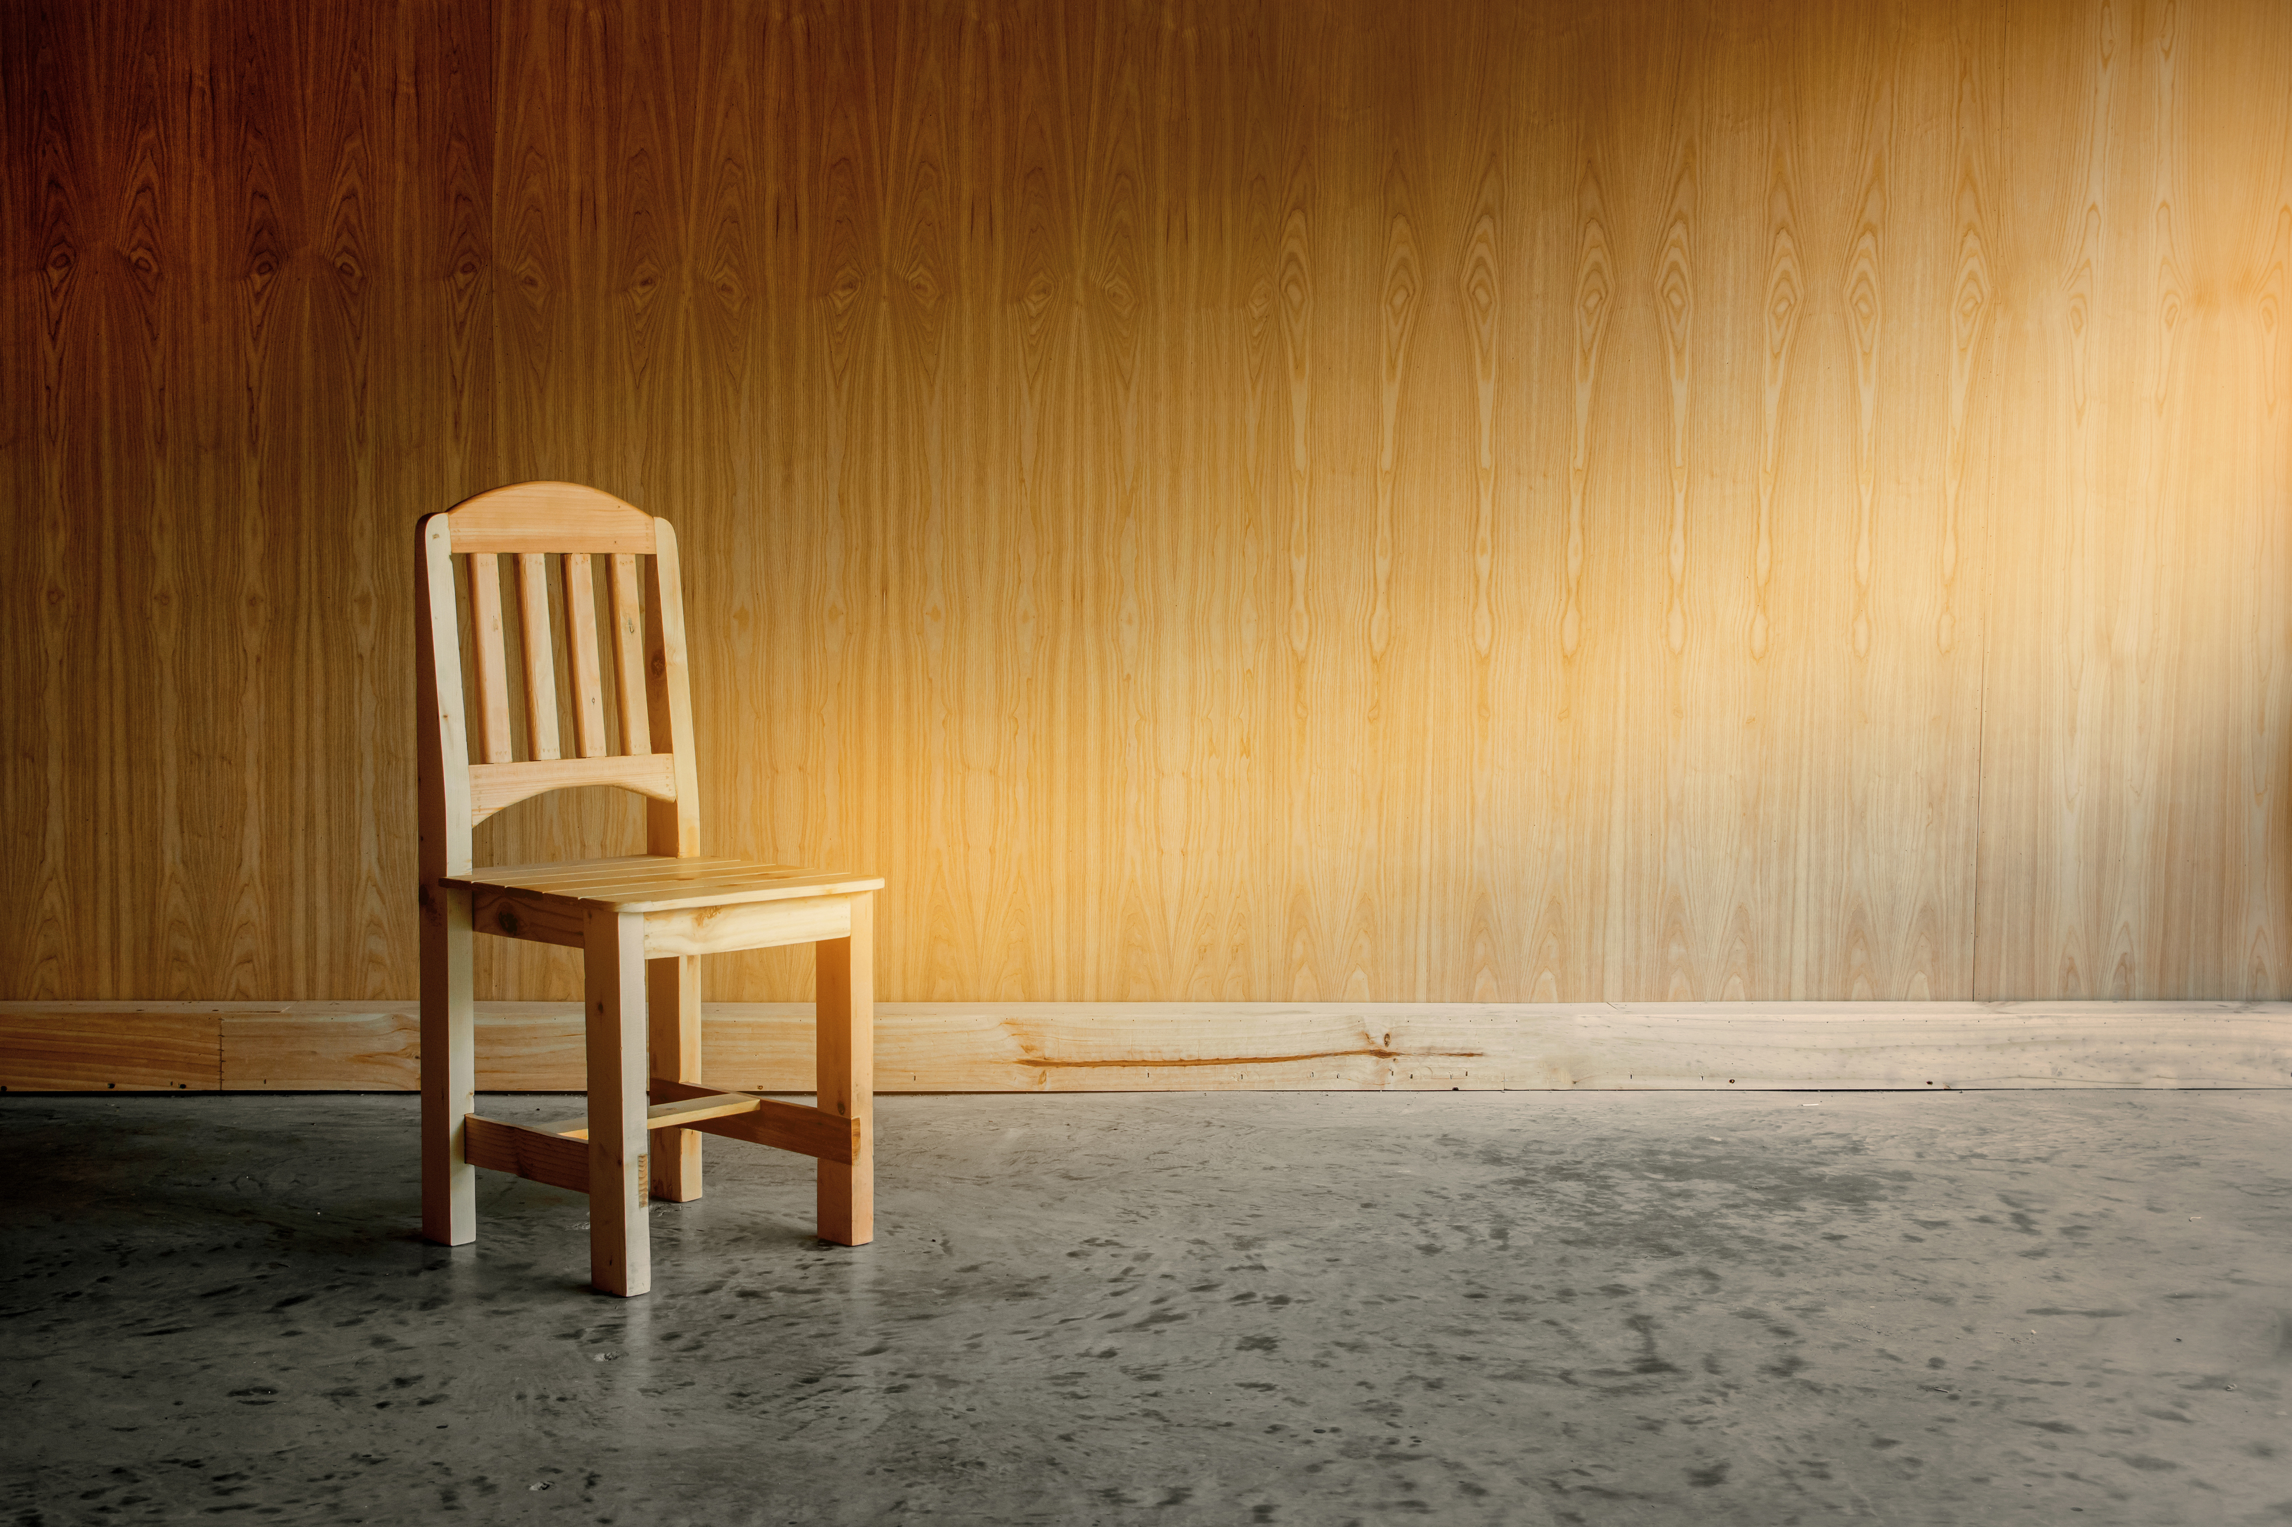
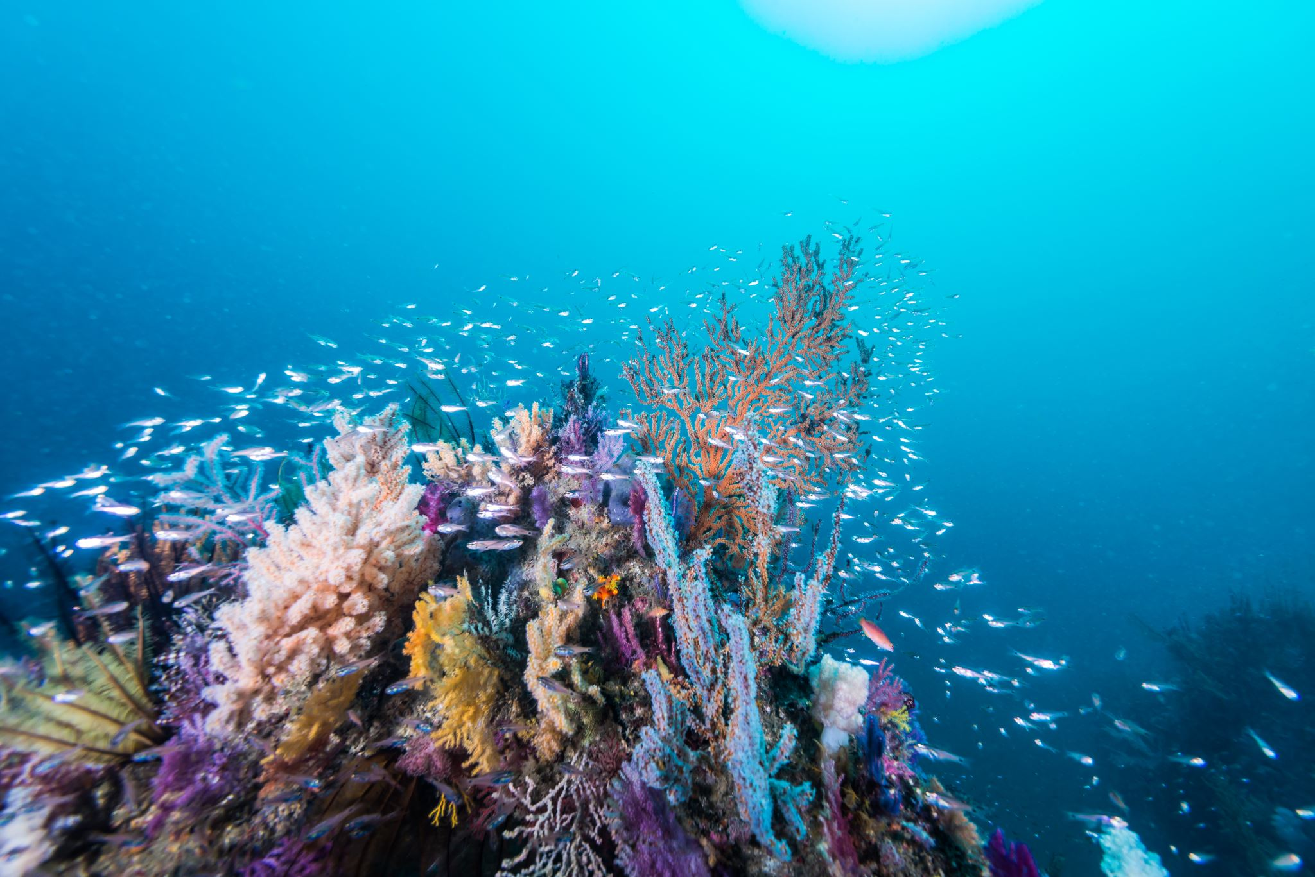
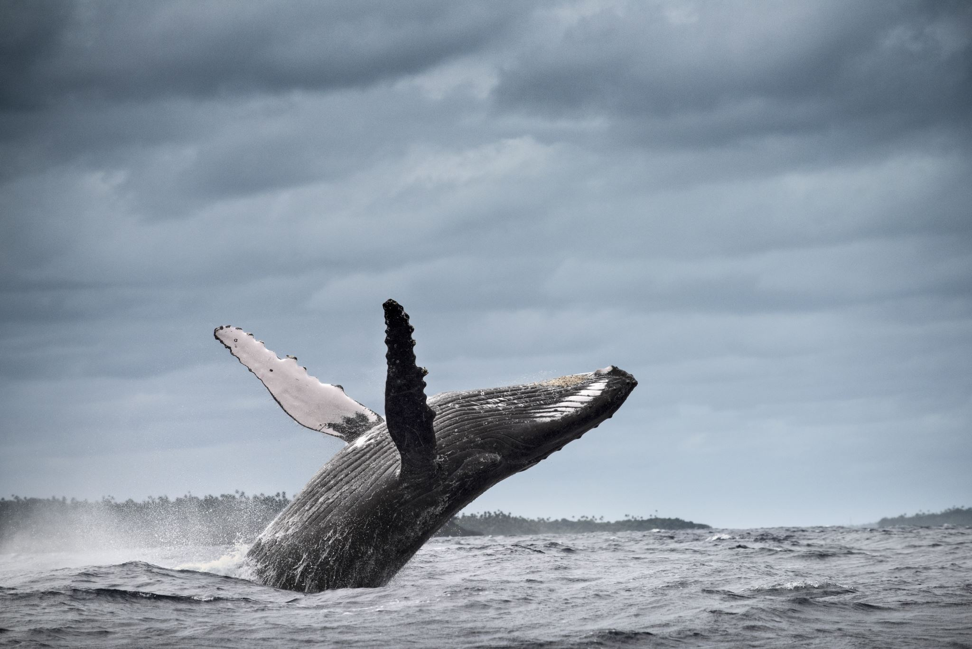
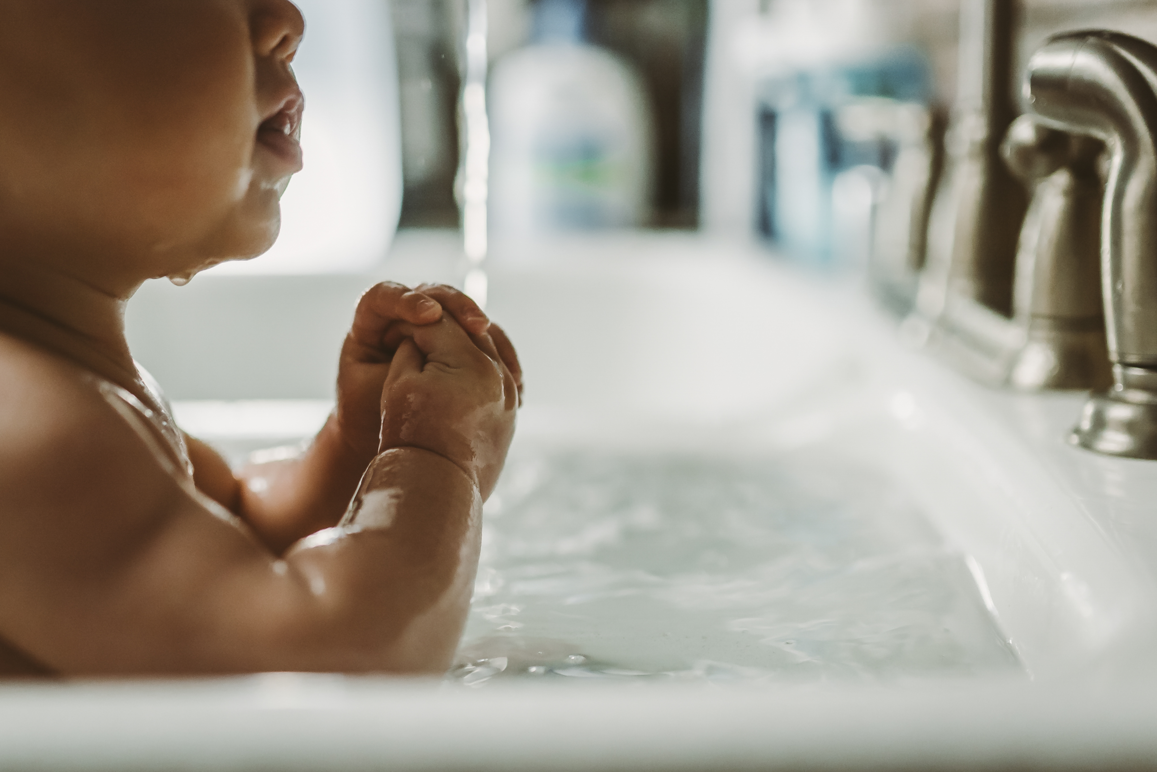
Listen and Spell
whale
bath
fish
chair
Notes:
Say, “It’s time for more practice. Please go find yourself a white board or a piece of lined paper and something to write with.”
Allow students time to get these items.
Say, ”I will say a word, you will write that word on your white board or piece of paper.”
Click once for the picture.
Say, “Whale. The whale’s tail made a big splash. Whale.”
Allow students time to write their spelling.
Click once for the correct spelling to appear.
Say, “W H A L E, take the time to check your spelling. If you misspelled the word that is okay. Please correct your spelling now.”
Allow students time to correct their spelling.
Click once for picture to appear.
Say, “Bath. My dog loves to take a bath. Bath”
Allow students time to write their spelling.
Click once for the correct spelling to appear.
Say, “B A T H , take the time to check your spelling. If you misspelled the word that is okay. Please correct your spelling now.”
Allow students time to correct their spelling.
Click once for picture to appear.
Say, “Fish. Do you see that school of fish? Fish.”
Allow students time to write their spelling.
Click once for the correct spelling to appear.
Say, “F I S H, take the time to check your spelling. If you misspelled the word that is okay. Please correct your spelling now.”
Allow students time to correct their spelling.
Click once for picture to appear.
Say, “Chair. Make sure to keep all four legs on your chair on the ground. Chair.”
Allow students time to write their spelling.
Click once for the correct spelling to appear.
Say, “C H A I R, take the time to check your spelling. If you misspelled the word that is okay. Please correct your spelling now.”
Allow students time to correct their spelling.

Slide 4
Sight Word Wall
your
us
read
does
always
made
found
best
tell
why
Notes:
Say, “We are going to do a speed review of your words. I will show the word. Everyone will say the word and then spell the word. We will do this for all of this week’s sight words.”
Click once.
Student Response: always
Click once.
Student Response: best
Click once.
Student Response: does
Click once.
Student Response: found
Click once.
Student Response: made
Click once.
Student Response: read
Click once.
Student Response: tell
Click once.
Student Response: us
Click once.
Student Response: why
Click once.
Student Response: your

Slide 5
Sight Word Practice
found
She ___ the hidden treasure.
You should _____ use soap when you wash your hands.
_____ do we review our sight words weekly?
why
always
Notes:
Say, “I have three sentences that are missing their sight words. It is your job to identify the correct sight word for each sentence.”
Click once for sentence one to appear.
Say, “She blank the hidden treasure. What is the missing sight word?
Student Response: found
Say, “You should blank use soap when you wash your hands. What is the missing sight word here?”
Student Response: always
Say, “Blank do we review our sight words weekly? And the last one would be?”
Student Response: Why

Slide 6

The Retelling Hand
Problem: What went wrong in the story?
Setting: The when and where the story took place.
Characters: Who is in the story. List people, animals, or creatures.
BME: Recall details about the beginning, middle, and end of the story.
Solution: Explain about how the problem in the story was resolved.
Notes:
Say, “Let’s go over how to use our retelling hand.”
Click to have a hand appear on the page.
Say, “Get that retelling hand out and ready! We are going to begin with your thumb. This is the characters.”
Say, “What do we need to say about the characters?”
Student Response: The people, animals, or creatures in the story.
Click once to reveal the word characters and its meaning.
Say, “Your pointer finger is the setting finger. What is the setting?
Student Response: This is when you will talk about the when and where the story took place.
Click once to reveal the word setting.
Say, “This next finger, is the problem finger. What do we explain here?”
Student Response: Here you are going to tell what went wrong in the story.
Click once to reveal the word problem.
Say, “Your ring finger is where you talk about what happened. Can you explain more in detailed what you should do here?”
Student Response: You should explain in detail the beginning, middle, and end of the story.
Click once to reveal the events in the story.
Say, “Lastly, your pinky is the solution. Who can explain what the solution is?”
Student Response: This is where your explain how the problem in the story was fixed.
Click once to reveal the solution.

Slide 7
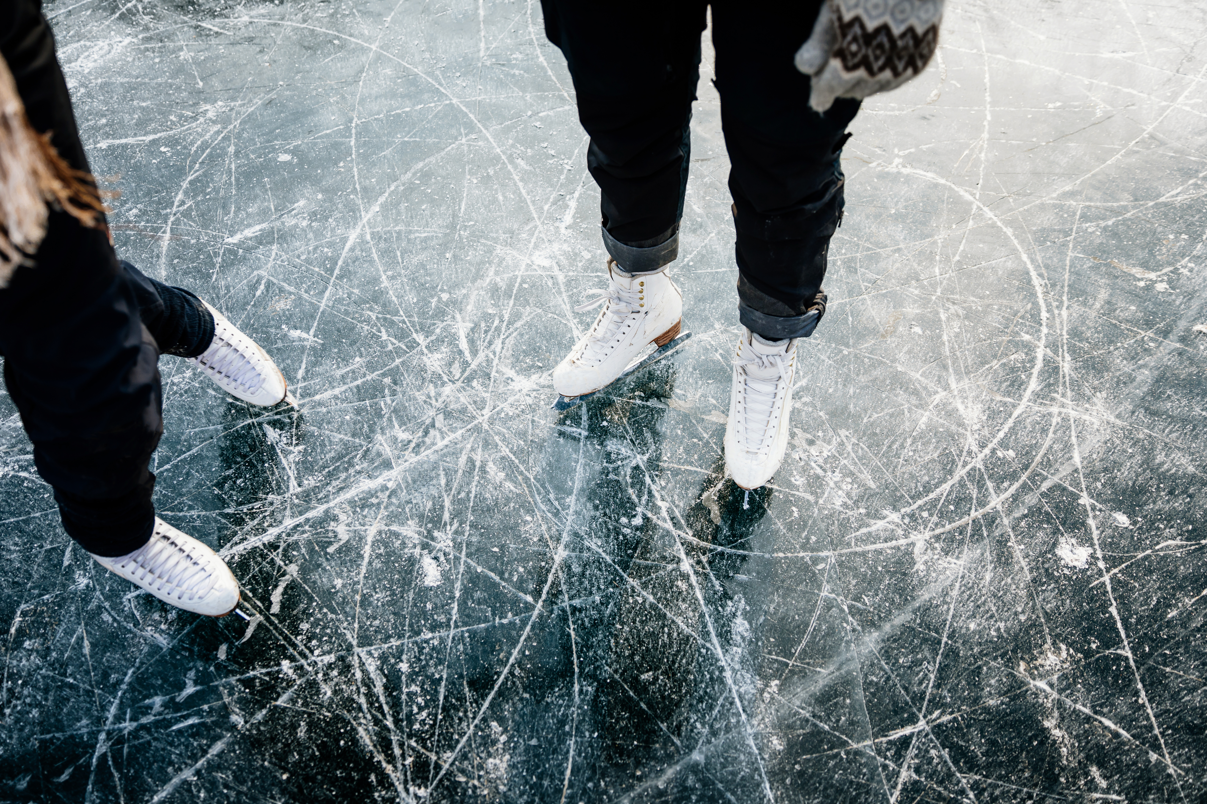
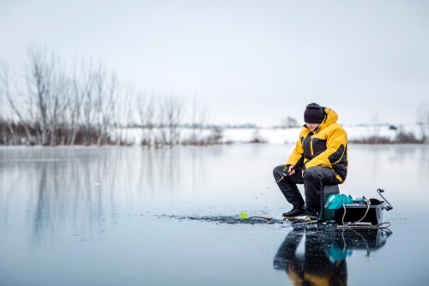
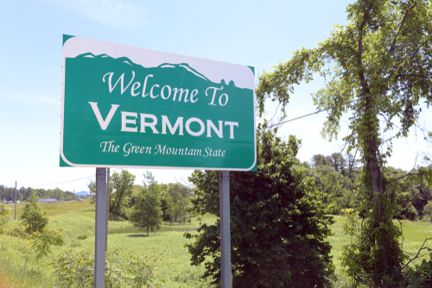
Let’s Practice
Notes:
Say, “Now it’s time to practice with our weekly reading of Winter Fun. Use your retelling hand!” ​
​
Say, “Let’s start with the thumb. Who are the characters?” ​
Student Response: Ben, Meg, Mother, and Chip​
​
Say,” Next, is the pointer finger. What is the setting of the story?” ​
Student Response: Vermont in the winter at a pond​
​
Say, “Then, the problem finger. What was the problem in the story?” ​
Student Response: Mother wants to make sure that the ice is thick enough for Ben and Meg to ice skate on it. ​
​
Say, “After, the ring finger asks you to explain the detail in the beginning middle and end of the story.” ​
Student Response: In the beginning Meg and Ben were explaining that they play outside a lot going sledding, ice skating, and skiing. That day they were going to the pond to ice skate. Both kids learned a lot that day. Once the kids got cold, they went the longer way home to see how ice fishing looked. At the end of the story, Ben wanted to write about his adventure at the outdoor center. Mother said it was a great idea to write about his new skill he learned. ​
​
Say, “Finally, the pinky finger. What was the solution to the problem in the story? ​
Student Response: The ice was thick enough for the kids to go ice skating and they both learned new things while ice skating. ​
​

Slide 8
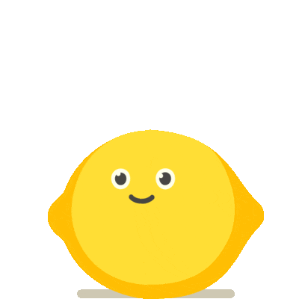
Can you Find the Nouns?
city
tree
mean
mall
baby
girl
doctor
gum
flower
sadly
caring
friendly
Notes:
Say, “We have to find the hidden nouns in this slide. Does anyone remember what a noun is?”
Student Response: A noun is a person, place, thing, or event.
Say,” Very good job! Now, let’s find them!”
Allow students to raise hand and identify the nouns. There are 8 nouns.

Slide 9
Q & A
Any Questions?

