Slide 1
Soft “c’ and “g” Sounds
Spelling with Spell Checking of Teacher

Slide 2
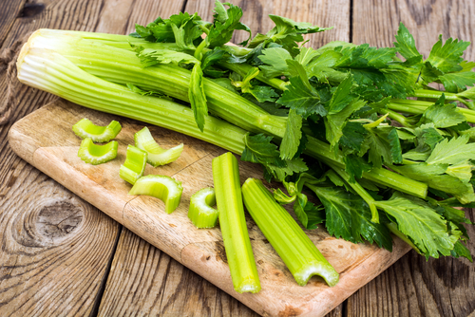
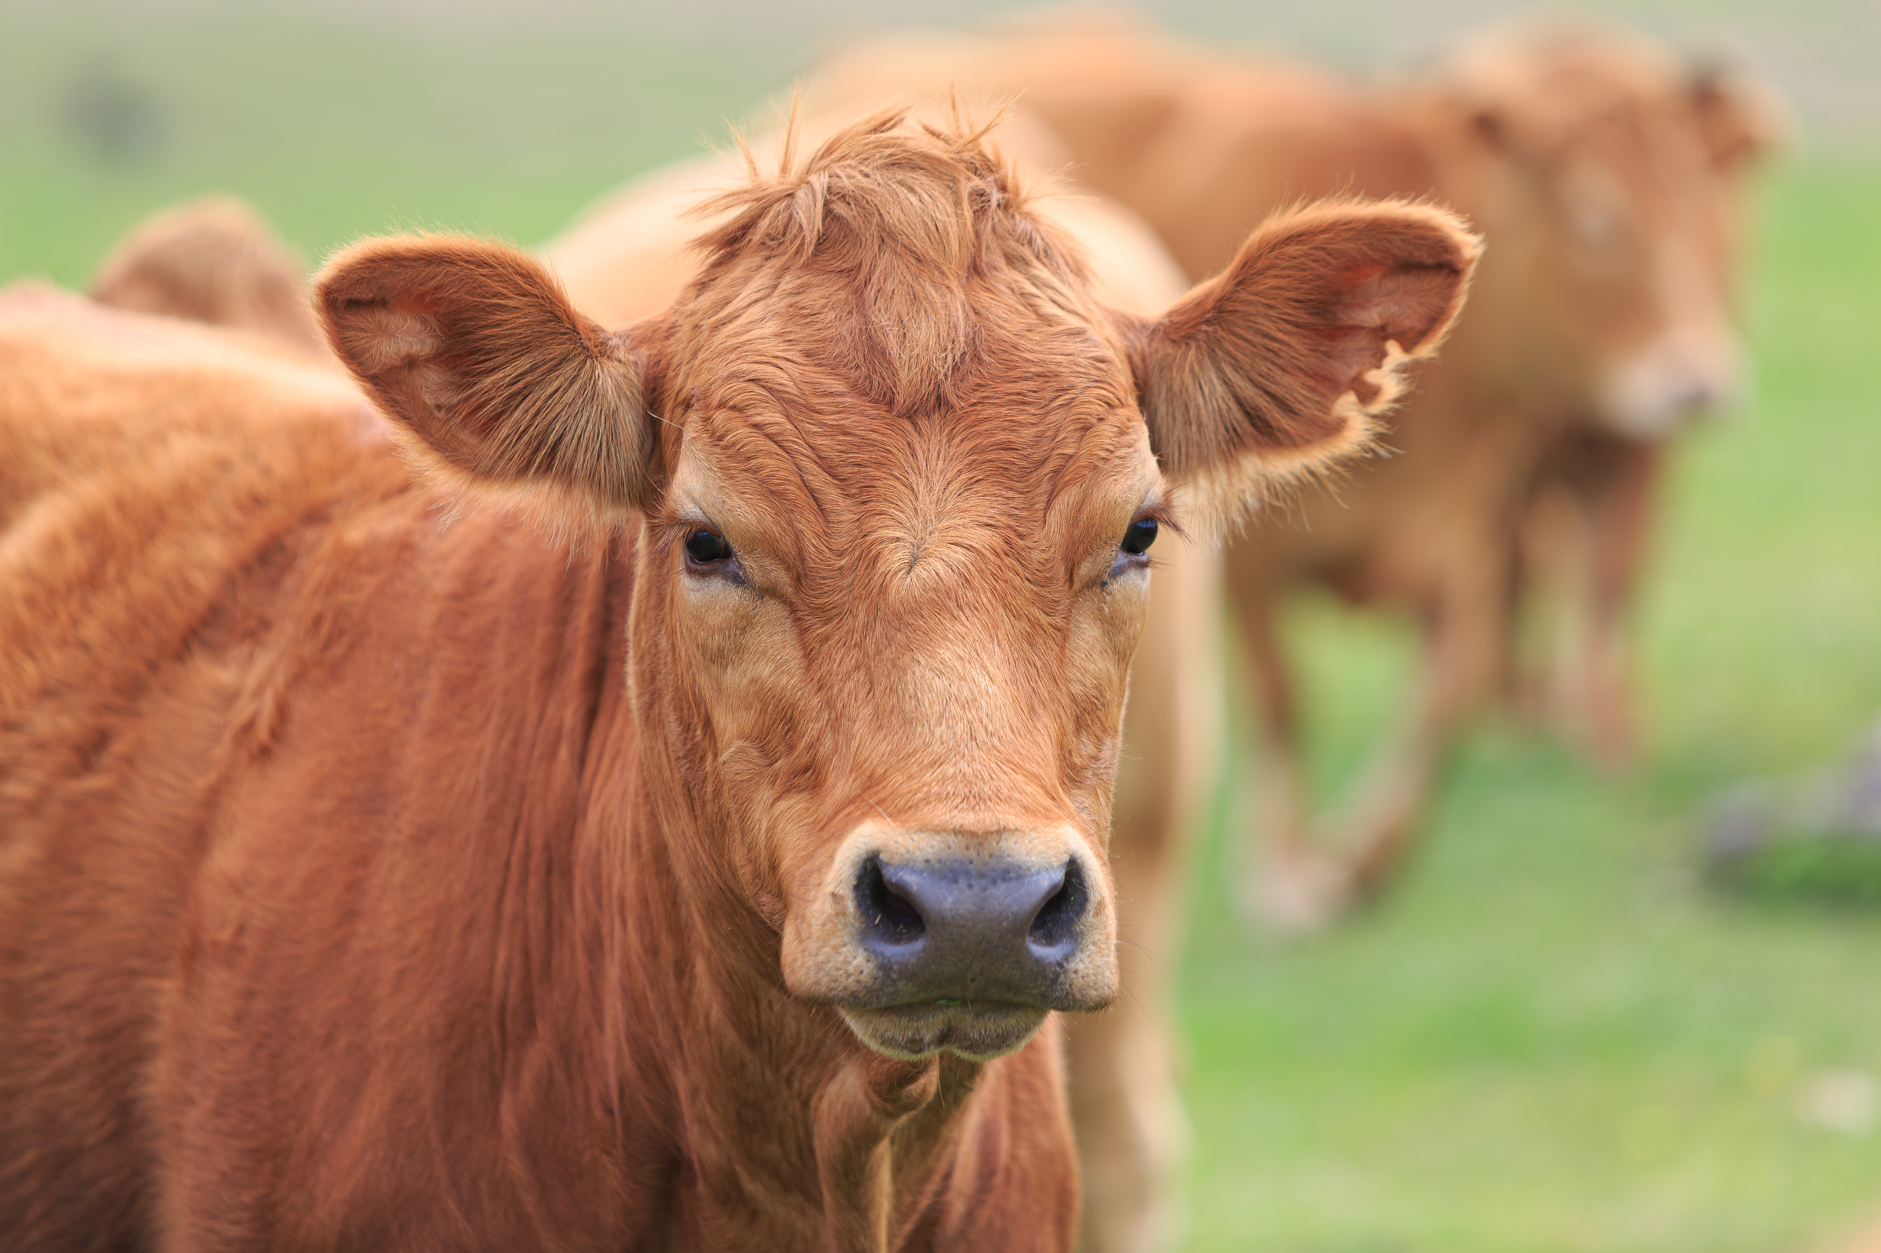
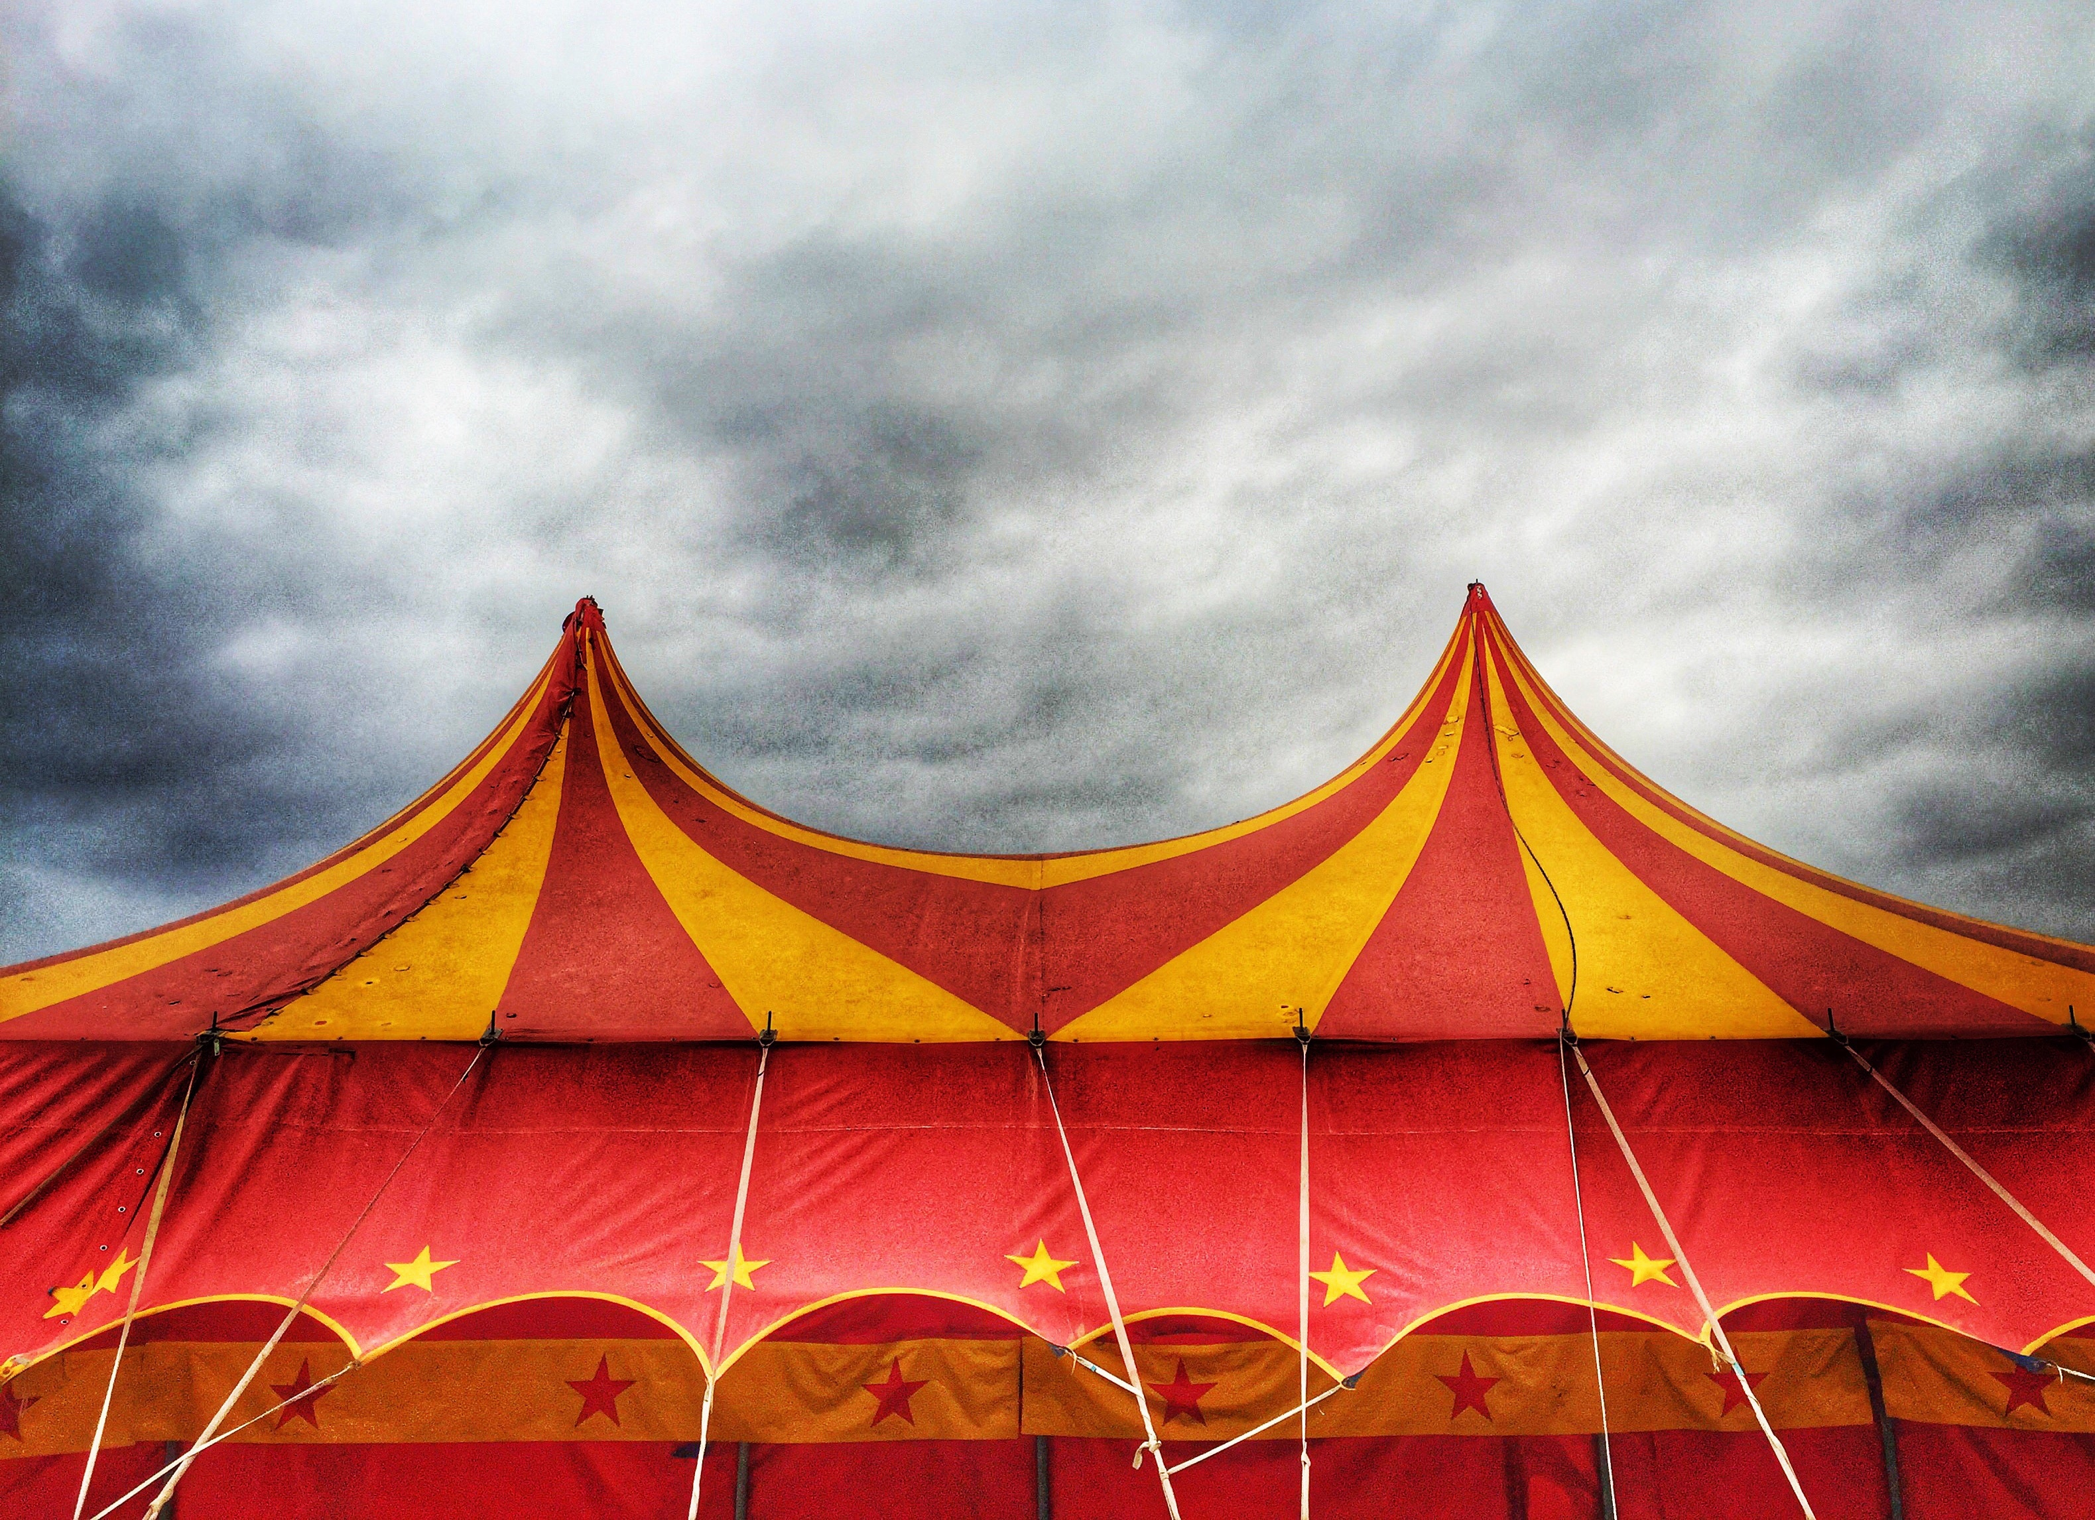
Soft “c” Sound
Notes:
Say, “Do you remember this week we learned that sometimes the letter “c” can make a soft sound?”
Student Response: Yes, like the word______. (Could be the word circle.) – Example
Say, “Very good job the soft “c” sounds like an “s”. Let’s Look at a few examples. You tell me if the word has a soft “c” or a hard “c”.”
Click once to see the picture of celery.
Say, “This is celery. Is this “c” a sort or a hard “c”?”
Student Response: Soft “c”
Click to show a picture of a cow.
Say, “Does this cow begin with a soft or a hard “c”?”
Student Response: Hard “c”
Click once to see a picture of a circus
Say, “What about the word circus? This one is tricky because there are two “c”s in it.”

Slide 3
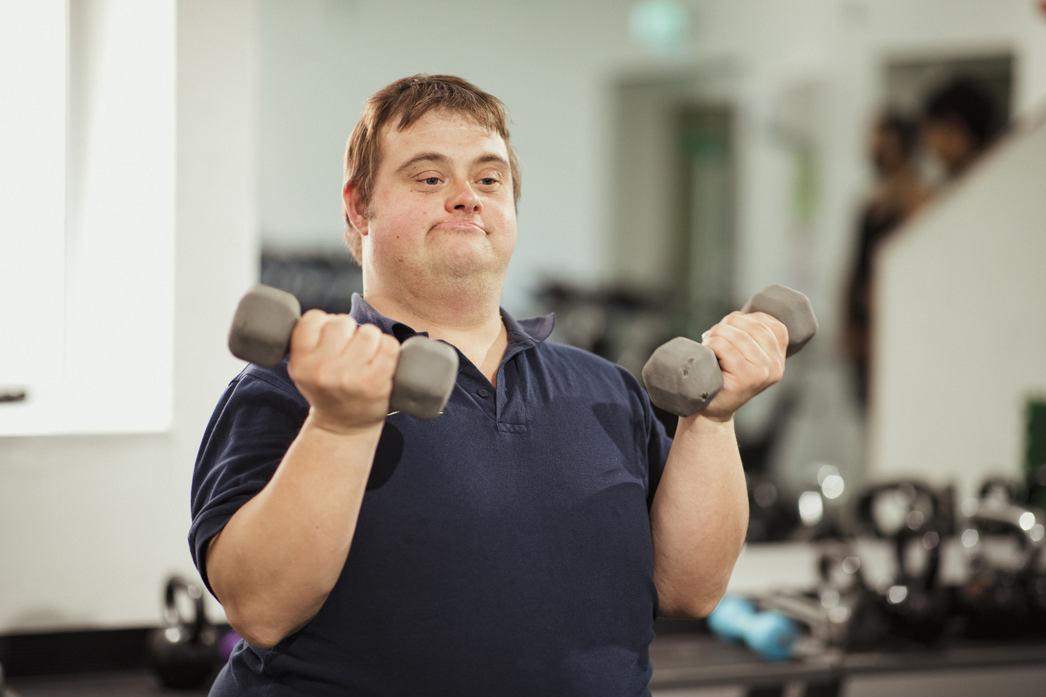
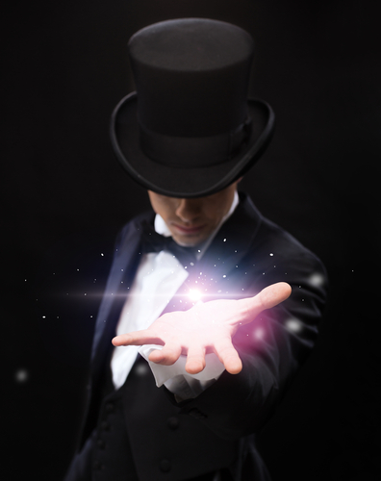
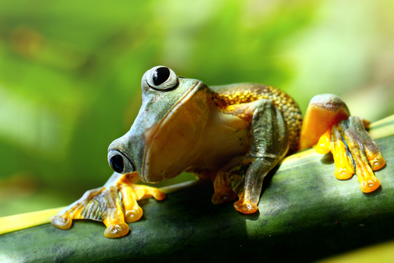
Soft “g” Sound
Notes:
Say, “Do you remember this week we learned that sometimes the letter “g” can make a soft sound?”
Student Response: Yes, like the word______. (Could be the word giraffe.) – Example
Say, “Very good job that does make a soft “g” sound. Let us Look at a few examples. You tell me if the word has a soft “g” or a hard “g”.”
Click once for a picture of a gym.
Say, “This is a gym. Do you hear a soft or a hard “g” sound in the word gym?”
Student Response: Soft “g”
Click once for a picture of a magician.
Say, “This is a magician, in this word do you hear a soft or a hard “g”?”
Student Response: Soft “g”
Click once for a picture of a frog to appear.
Say, “This is a frog. Does the “g” make a soft or a hard sound?
Student Response: Hard “g”

Slide 4
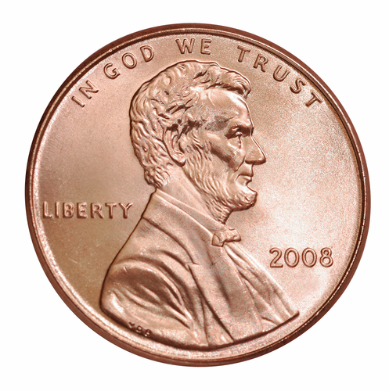
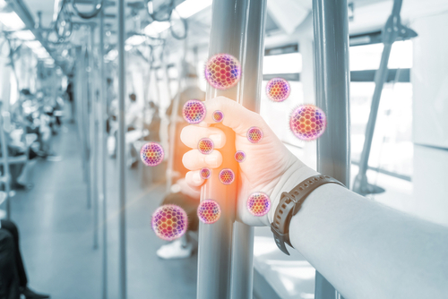
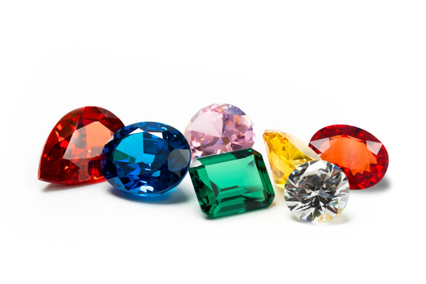
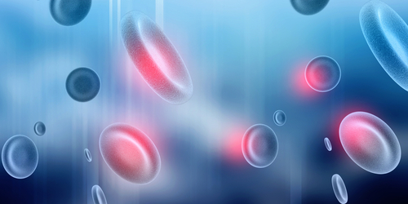
Listen and Spell
germ
cent
cell
gem
Notes:
Say, “It’s time for more practice. Please go find yourself a white board or a piece of lined paper and something to write with.”
Allow students time to get these items.
Say, ”I will say a word, you will write that word on your white board or piece of paper.”
Click once for the picture.
Say, “Cent. I have one cent in my pocket. Cent”
Allow students time to write their spelling.
Click once for the correct spelling to appear.
Say, “C E N T, take the time to check your spelling. If you misspelled the word that is okay. Please correct your spelling now.”
Click once for the picture.
Say, “Cell. That cell is very tiny. Cell.”
Allow students time to write their spelling.
Click once for the correct spelling to appear.
Say, “C E L L, take the time to check your spelling. If you misspelled the word that is okay. Please correct your spelling now.”
Click once for the picture.
Say, “Germ. Make sure to wash your hands so you get ride of all of the germs. Germ.”
Allow students time to write their spelling.
Click once for the correct spelling to appear.
Say, “G E R M, take the time to check your spelling. If you misspelled the word that is okay. Please correct your spelling now.”
Click once for the picture.
Say, “Gem. He found a rare gem. Gem.”
Allow students time to write their spelling.
Click once for the correct spelling to appear.
Say, “G E M, take the time to check your spelling. If you misspelled the word that is okay. Please correct your spelling now.”

Slide 5
Sight Word Wall
just
fly
may
had
every
of
walk
put
Notes:
Say, “Let’s go through our sight words for the week. You will as a whole class repeat after me and then spell the word out loud.
Say, ”every.”
Student Response: Repeat and spell.
Click once
Say, ”had.”
Student Response: Repeat and spell.
Click once.
Say, ”may.”
Student Response: Repeat and spell.
Say, ”put.”
Student Response: Repeat and spell.
Click once.
Say, ”fly.”
Student Response: Repeat and spell.
Click once.
Say, ”just.”
Student Response: Repeat and spell.
Click once.
Say, ”of.”
Student Response: Repeat and spell.
Click once.
Say, ”walk.”
Student Response: Repeat and spell.
Click once.

Slide 6

The Retelling Hand
Problem: What went wrong in the story?
Setting: The when and where the story took place.
Characters: Who is in the story. List people, animals, or creatures.
BME: Recall details about the beginning, middle, and end of the story.
Solution: Explain about how the problem in the story was resolved.
Notes:
Say, “Let’s go over how to use our retelling hand.”
Say, “Everyone put one hand in front of you. We are going to begin with your thumb. This is the characters.”
Click once to reveal the word characters.
Say, “Here you should talk about who was in the story. The people, animals, or creatures.”
Click once to reveal the word setting.
Say, “Your pointer finger is the setting finger. This is when you will talk about the when and where the story took place.”
Click once to reveal the word problem.
Say, “This next finger, is the problem finger. Here you are going to tell what went wrong in the story.”
Click once to reveal the events in the story.
Say, “Your ring finger is where you talk about what happened in the beginning, middle, and end of the story.”
Click once to reveal the solution.
Say, “Lastly, your pinky is the solution. This is where your explain how the problem in the story was fixed.”

Slide 7
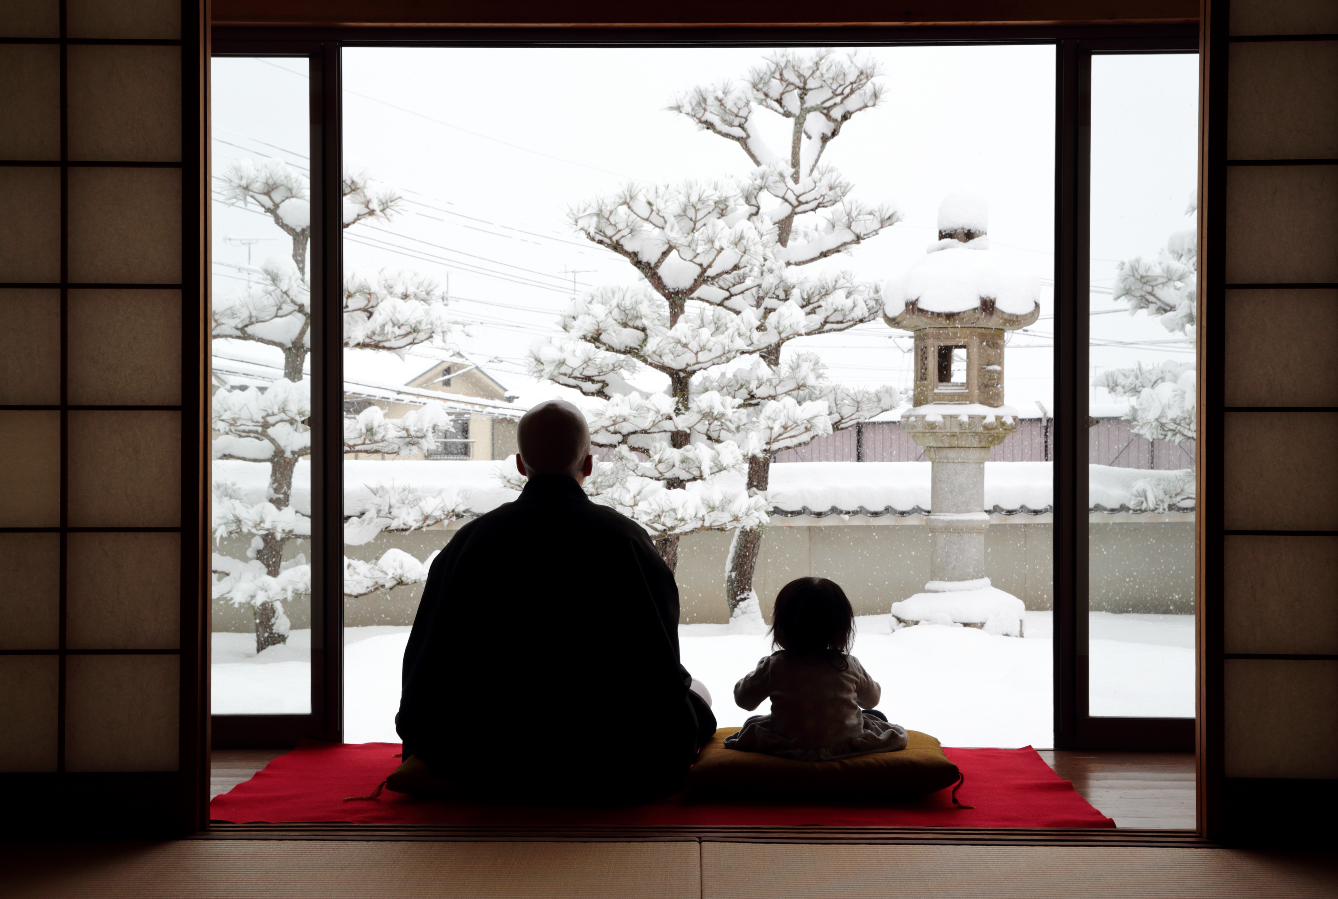
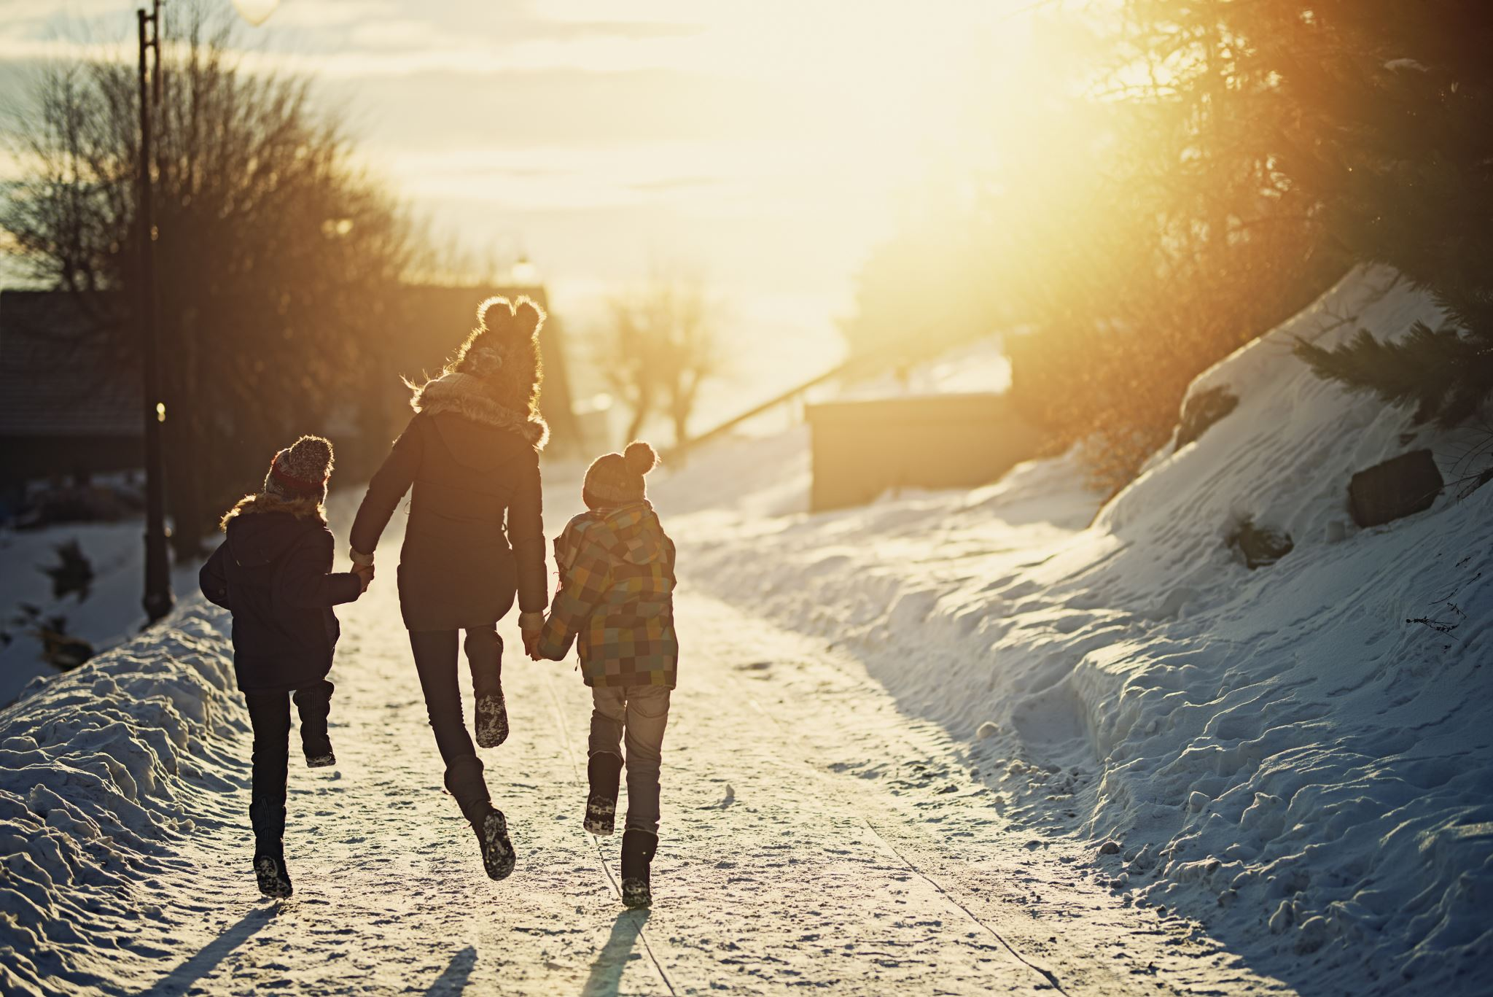
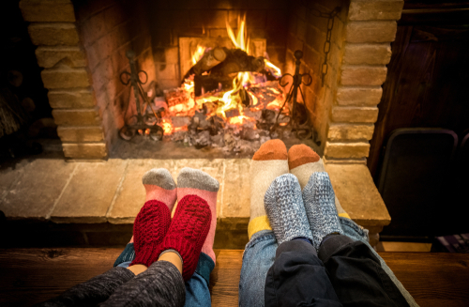
Let's Practice
Notes:
Say, “Now it’s time to practice with our weekly reading of Snow. Use your retelling hand!”
Say, “Let’s start with the thumb. Who are the characters?”
Student Response: Meg, Ben, Mother, Daddy
Say,” Next, is the pointer finger. What is the setting of the story?”
Student Response: Vermont and it was the first snow of the year.
Say, “Then, the problem finger. What was the problem in the story?”
Student Response: Ben and Meg could not go outside to sled until the snow stopped.
Say, “After, the ring finger asks you to explain the detail in the beginning middle and end of the story.”
Student Response: In the beginning of the story, Meg and Ben woke up to the first snow of the year. They wanted to go outside to sled. Mother said once the snow stopped, they could go sledding. In the meantime, Meg and Bend learned that every snowflake looks different. They then began to make paper snowflakes until the snow stopped. Once the snow stopped, they were able to go outside and sled. Daddy got home and saw the roof was sagging from the weight of the snow. Daddy took a shovel to get the snow off of the roof. The next day there was more snow and they wanted to make a snowman. Chip came outside and pulled the scarf off of their snowman. Ben was not happy with Chip. But he was happy that he had hot cocoa. When Ben began working on his lesson book he wrote about the snowman and Chip. Chip also mentioned that he saw footprints in the snow. Mother took Meg and Ben to the library to learn about animals in the winter.
Say, “Finally, the pinky finger. What was the solution to the problem in the story?
Student Response: The snow stopped, and the kids were able to go play outside.

Slide 8
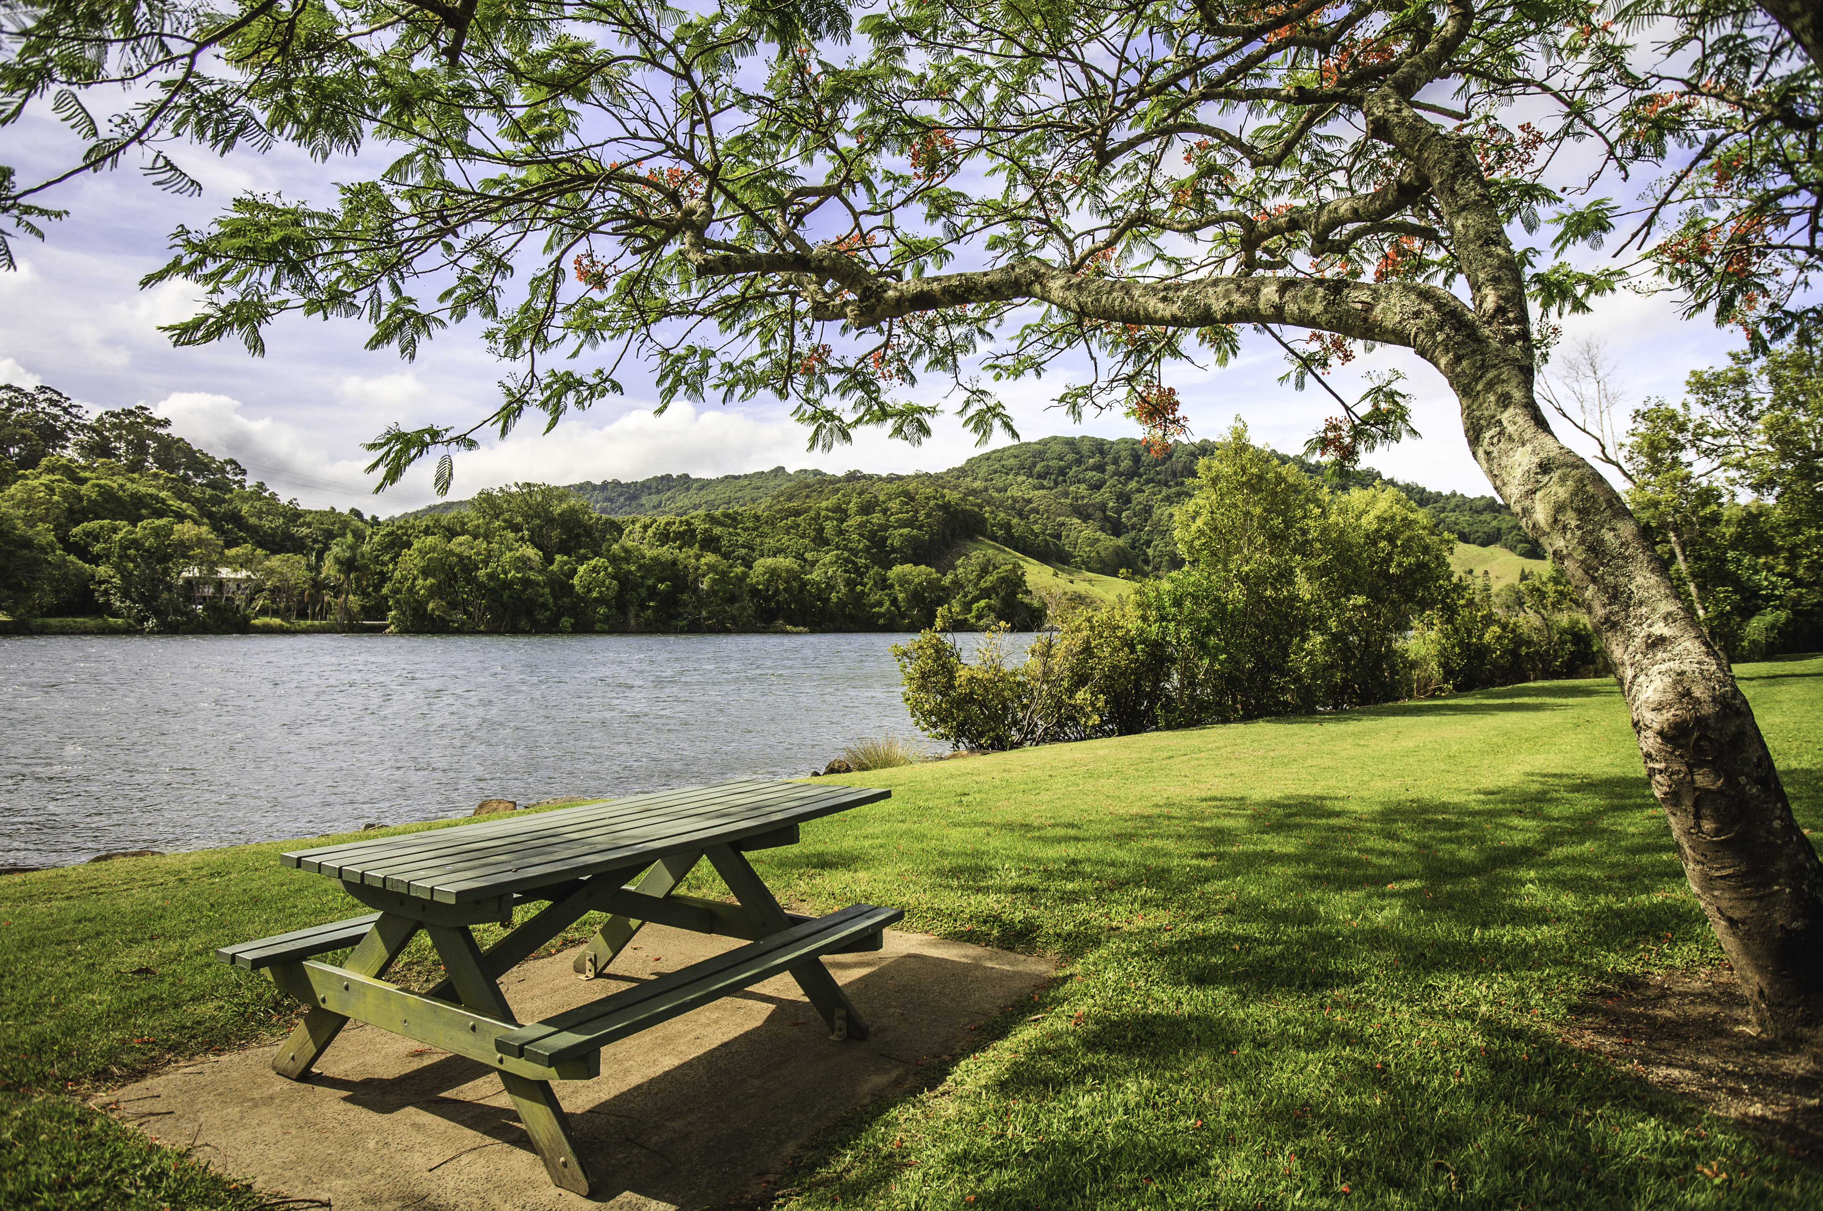
Grammar
Mingo Creek Park
Notes:
Say, “A proper noun is a specific person, place, or thing. That means the first letting in the noun deserves what?”
Student Response: A capital letter.
Click once to show picture of a park.
Say, “This is Mingo Creek Park. This is a proper noun because it is a specific park. What letters should be capitalized?”
Student Response: The M in Mingo the C in Creek and the P in park.
Click for the name to appear.

Slide 9
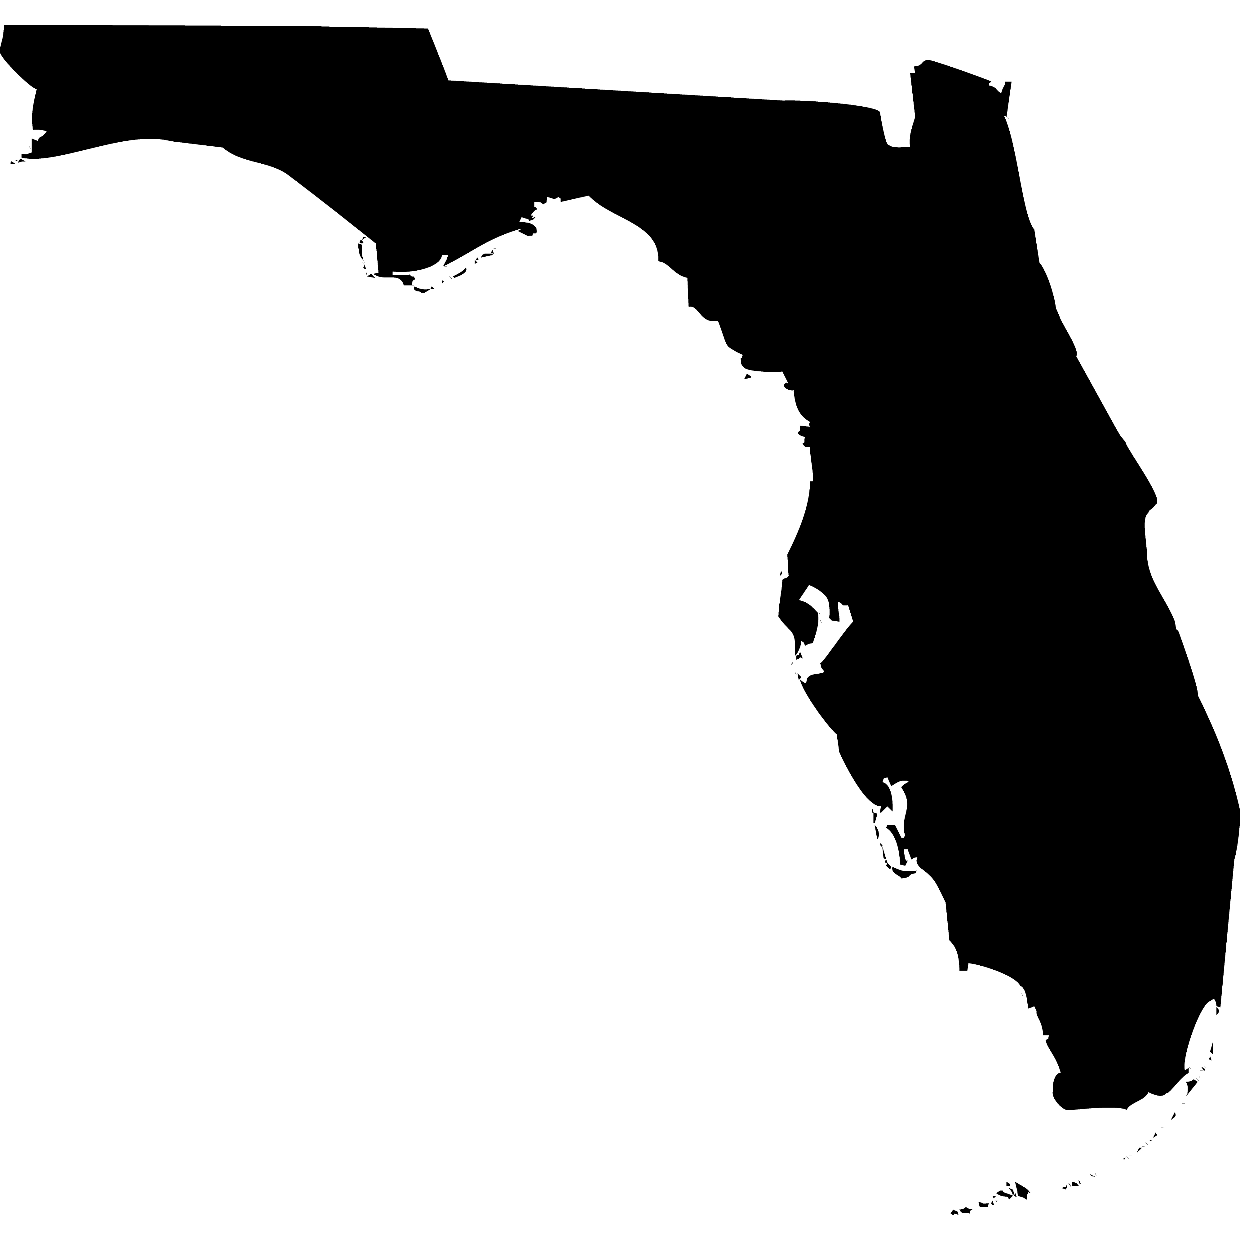


Proper Noun Corrections
aShley
Ashley
Florida
facebook
Facebook
Notes:
Say,” I have three pictures of specific people, places, and things. It is you job to check my work. Did I capitalize the correct letters in the proper nouns?”
Click once for a picture of Ashley to appear.
Say, “ This is Ashely. Is the name Ashley a proper noun?”
Student Response: Yes, because it is a specific person.
Click once.
Say,” Did I type her name correctly to be a proper noun?”
Student Response: NO! The A should be capitalized not the s.
Click once for correction.
Click once for a picture of Florida to appear.
Say, “This is the state of Florida. It is a proper noun because it is a specific place.”
Click once.
Say, “Did I type the state’s name correctly?”
Student Response: YES!
Click one for the Facebook logo to appear.
Say, “ Here is the Facebook page.”
Click once.
Say, “Did I type this specific thing correctly?”
Student Response: No! You need to capitalize the “f” because it is a specific thing.
Click once for correction.
Say, “Very good Job! “

Slide 10
Q & A
Any Questions?

