Slide 1
“EEE”
Retelling Hand

Slide 2
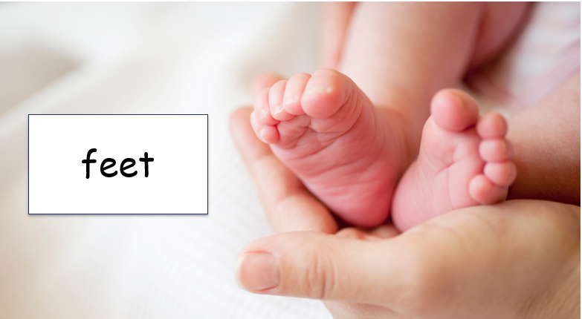
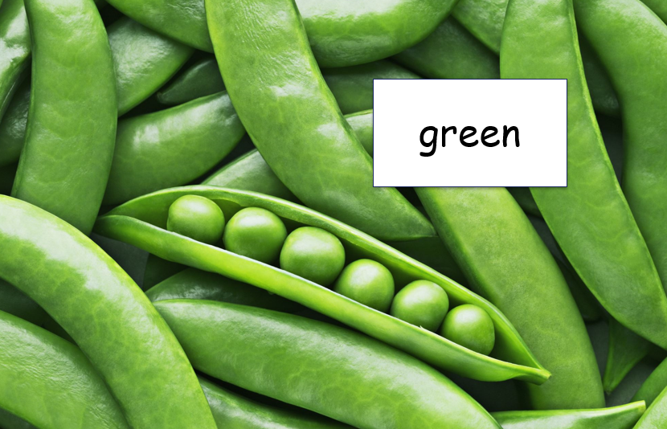
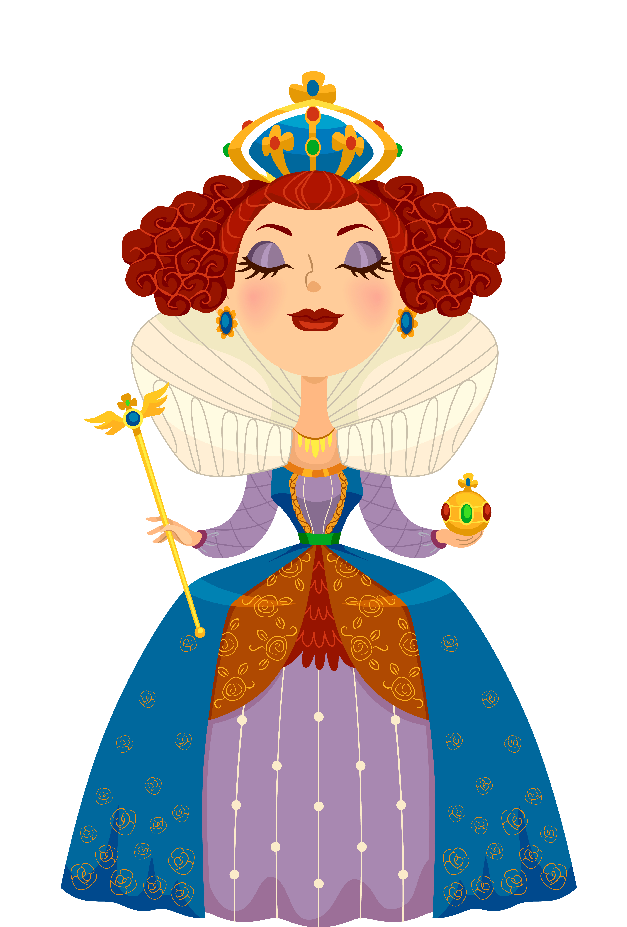
“EEE” Long –e- Sound
queen
Notes:
Royalty-free stock vector ID: 558917329
Click once for the picture of feet to appear.
Say,” These are feet. Do you hear in the word feet a long or a short vowel sound?”
Student Response: Long vowel or long -e- sound.
Say, “Very good job! The second e makes the first e say its name!”
Click once for the picture of green to appear.
Say, “This is green. Is the e in the word green a long or a short vowel sound?”
Student Response: Long vowel sound or Long -e- sound.
Say, “That is correct! The second e again makes the first e say its name.”
Click once for the picture of the queen to appear.
Say, “Queen. Short or long vowel sound?”
Student Response: Long vowel sound or long -e- sound.
Say, “Great job!”

Slide 3
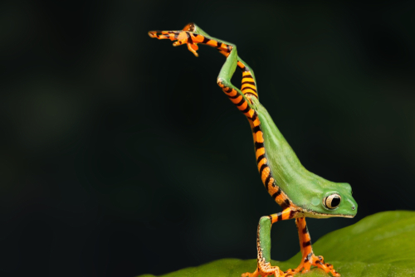

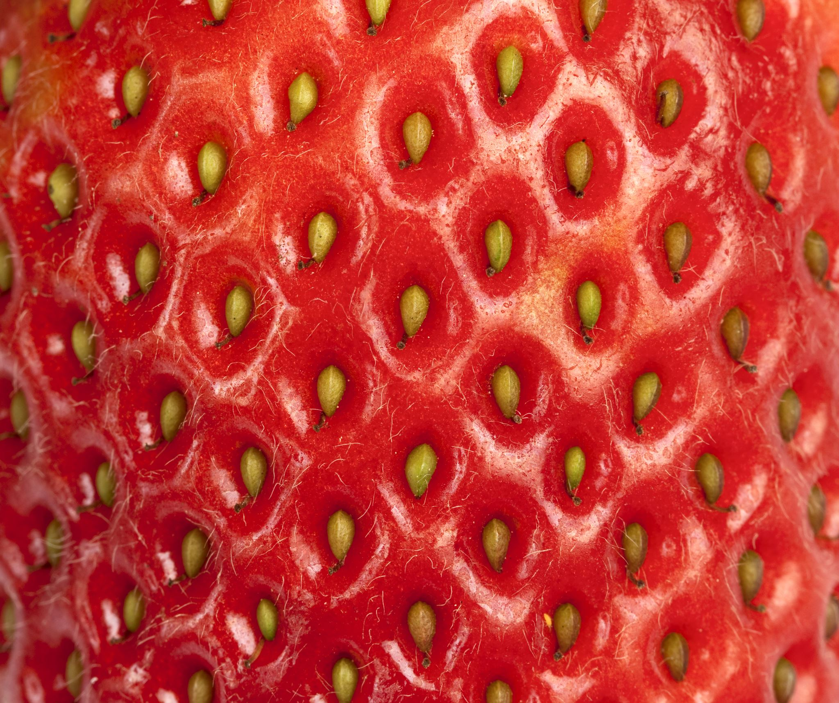
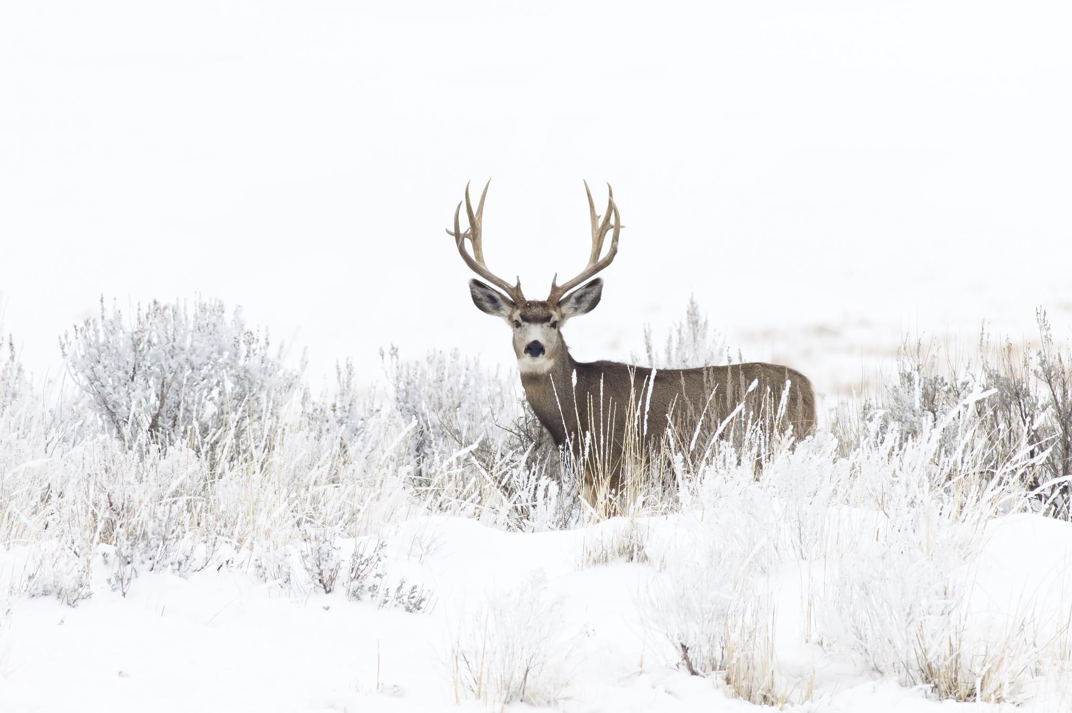
Listen and Spell
leap
hear
deer
seed
Notes:
Royalty-free stock photo ID: 1178562046
Say, “It’s time for more practice. Please go find yourself a white board or a piece of lined paper and something to write with.”
Allow students time to get these items.
Say, ”I will say a word, you will write that word on your white board or piece of paper.”
Click once for the picture.
Say, “Leap, the frog can leap far. Leap”
Allow students time to write their spelling.
Click once for the correct spelling to appear.
Say, “L E A P, take the time to check your spelling. If you misspelled the word that is okay. Please correct your spelling now.”
Allow students time to correct their spelling.
Click once for picture to appear.
Say, “ Hear. If I listen closely, I can hear the crickets. Hear”
Allow students time to write their spelling.
Click once for the correct spelling to appear.
Say, “H E A R, take the time to check your spelling and correct any mistakes you might have made.”
Allow students time to correct their spelling.
Click once for picture to appear.
Say, “deer. Every night there are at least three deer in my yard. Deer.”
Allow students time to write their spelling.
Click once for the correct spelling to appear.
Say, “D E E R, take the time to check your spelling and correct any mistakes you might have made.”
Allow students time to correct their spelling.
Click once for picture to appear.
Say, “Seed. We are going to plant a pumpkin seed this afternoon. Seed.”
Allow students time to write their spelling.
Click once for the correct spelling to appear.
Say, “S E E D, take the time to check your spelling and correct any mistakes you might have made.”
Allow students time to correct their spelling.

Slide 4

Sight Word Practice
What ____ you thinking?
Please ask before you _____.
Can you put the toys ____ there?
over
take
were
Notes:
Say, “We are going to complete three sentences with some of our sight words. Number one. Please ask before you blank. What word do you think with complete this sentence? Over, take, or were.”
Students Response: take
Click once for answer to enlarge.
Click again for next sentence to appear.
Say, “Can you put the toys blank there?”
Students Response: over
Click once for answer to enlarge.
Click again for next sentence to appear.
Say, “What blank you thinking?”
Student Response: were
Click once for answer to enlarge.

Slide 5

The Retelling Hand
Problem: What went wrong in the story?
Setting: The when and where the story took place.
Characters: Who is in the story. List people, animals, or creatures.
BME: Recall details about the beginning, middle, and end of the story.
Solution: Explain about how the problem in the story was resolved.
Notes:
Say, “Let’s go over how to use our retelling hand.”
Say, “Everyone put one hand in front of you. We are going to begin with your thumb. This is the characters.”
Click once to reveal the word characters.
Say, “Here you should talk about who was in the story. The people, animals, or creatures.”
Click once to reveal the word setting.
Say, “Your pointer finger is the setting finger. This is when you will talk about the when and where the story took place.”
Click once to reveal the word problem.
Say, “This next finger, is the problem finger. Here you are going to tell what went wrong in the story.”
Click once to reveal the events in the story.
Say, “Your ring finger is where you talk about what happened in the beginning, middle, and end of the story.”
Click once to reveal the solution.
Say, “Lastly, your pinky is the solution. This is where your explain how the problem in the story was fixed.”

Slide 6
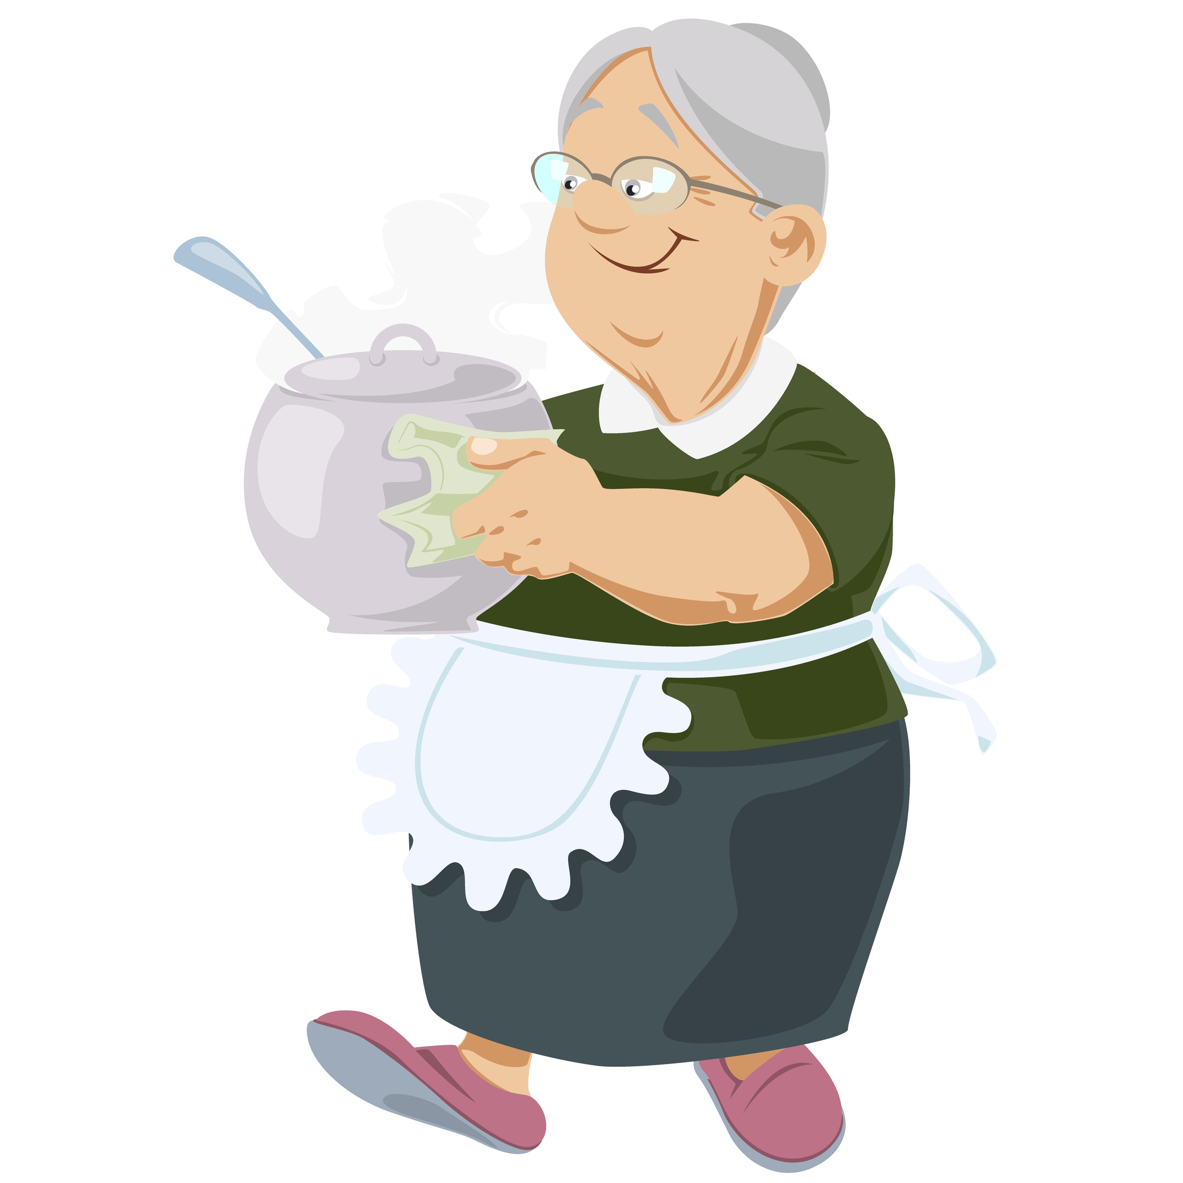
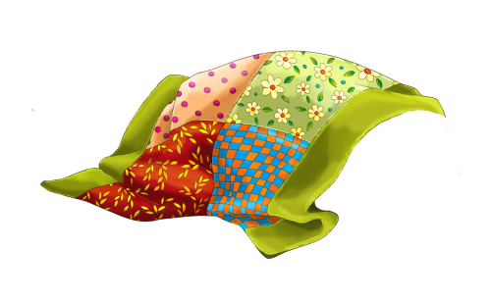
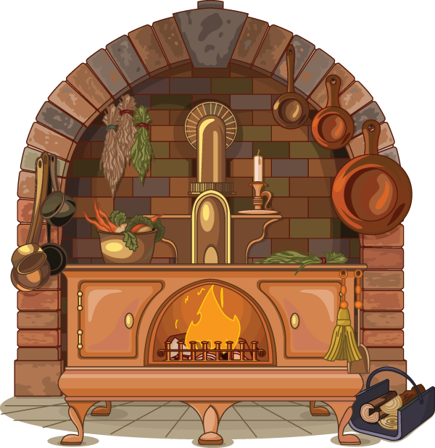
Let's Practice
Notes:
Royalty-free stock vector ID: 1784207603
Royalty-free stock illustration ID: 1193016403
Royalty-free stock vector ID: 741165589
Say, “Now it’s time to practice with our weekly reading of Grandmother’s House. Use your retelling hand!”
Say, “Let’s start with the thumb. Who are the characters?”
Say,” Next, is the pointer finger. What is the setting of the story?”
Say, “Then, the problem finger. What was the problem in the story?”
Say, “After, the ring finger asks you to explain the detail in the beginning middle and end of the story.”
Say, “Finally, the pinky finger. What was the solution to the problem in the story?

Slide 7
Grammar
Collective Noun: When one word is used to talk about a groups of nouns.
Example:
Bouquet of flowers
Notes:
Royalty-free stock vector ID: 1028705566
Say, “We know that a noun is a what?”
Student Response: Person, place, or thing.
Say, “Very good job! Sometimes in a sentence you can use a one word to talk about a group of nouns. This is called a collective noun.
Click for the word and its meaning to appear.
Click again for an example to appear.
Say, “A bouquet is multiple flowers together. The collective noun would be bouquet.”

Slide 8
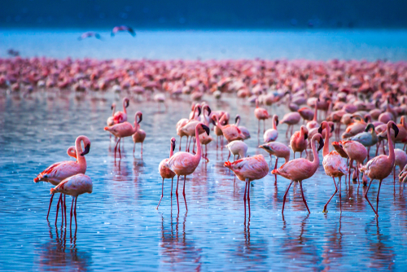
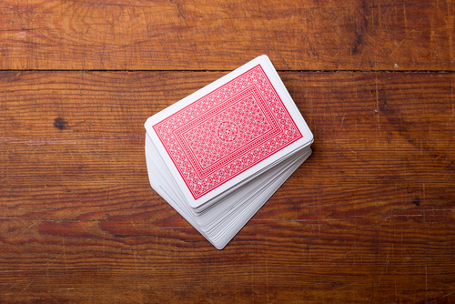
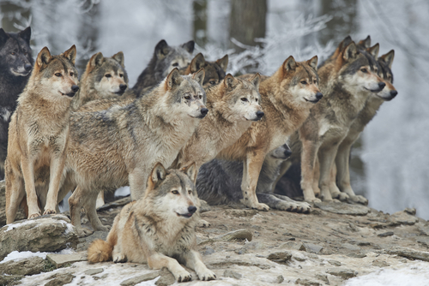
Connect the Collective Nouns
cards
birds
wolves
Notes:
Royalty-free stock photo ID: 262696916
Royalty-free stock photo ID: 370730354
Royalty-free stock photo ID: 1098181742
Say,” There will be three words that are collective nouns. You must connect them to the noun that it relates to.”
Click once for collective noun to appear, deck.
Student Response: cards
Click once for collective noun to appear, pack.
Students Response: wolves
Click once for collective noun to appear, flock.
Students Response: birds

Slide 9
Q & A
Any Questions?

