Slide 1
Long -a- Sounds and Nouns
Common and Proper Nouns

Slide 2
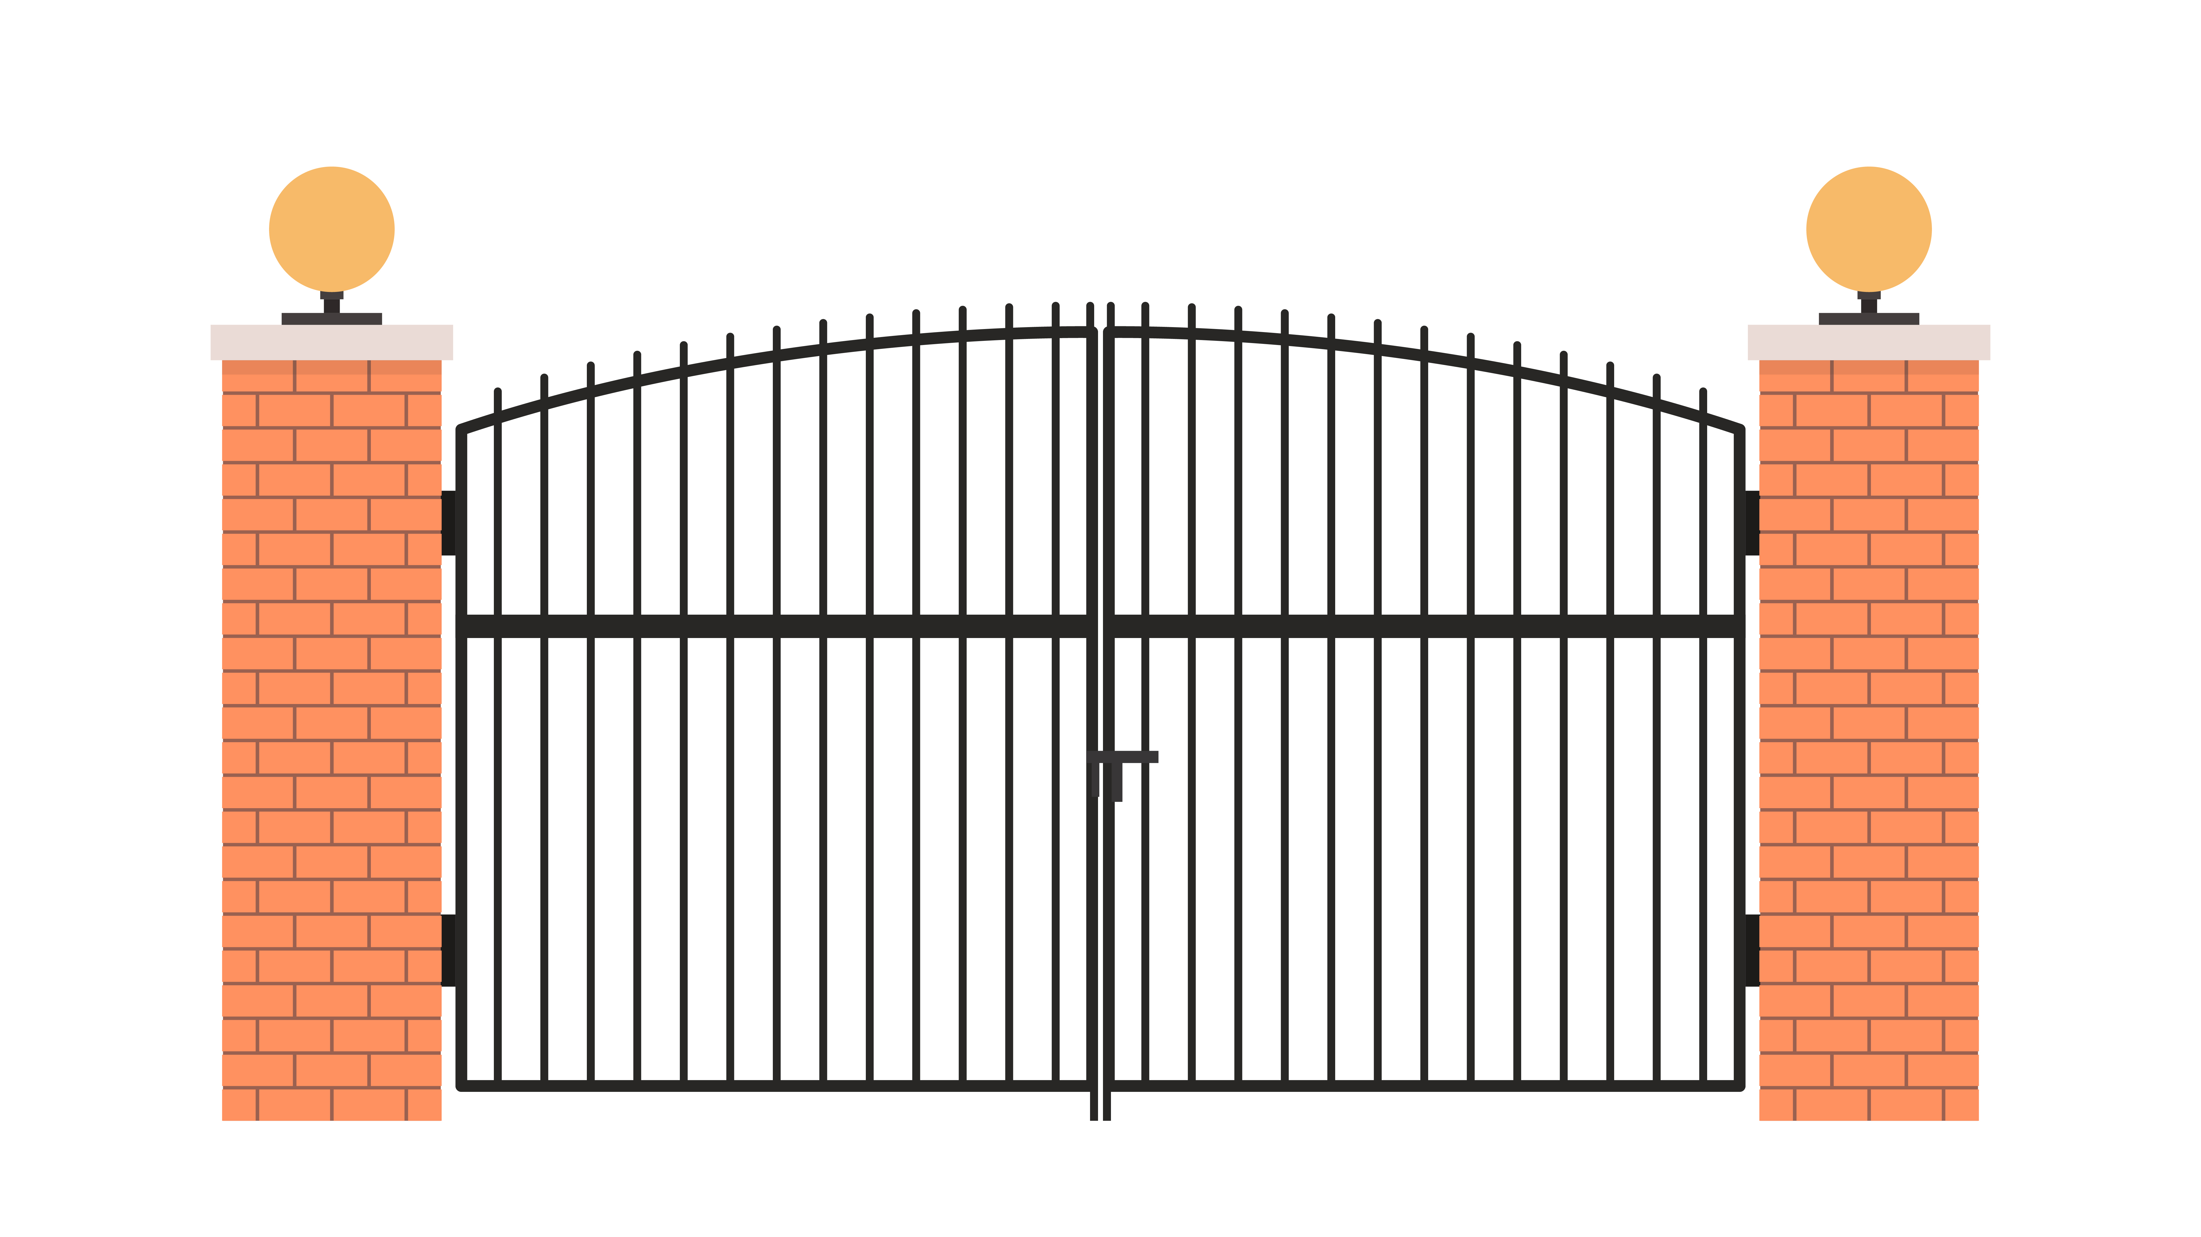
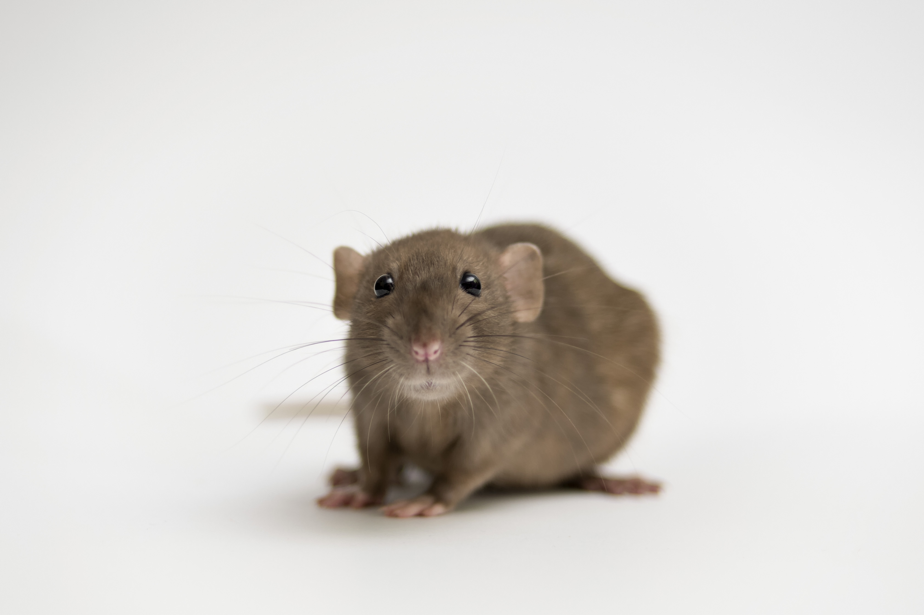

Long –a- Sounds
gate
rat
paint
Notes:
Say, “As a whole group, please make the sound of a short letter -a-.”
Student Response: Everyone would verbally make the short -a- sound like in the word bag.
Say, “This week we learned that the letter A can make a long -a- sound. That sounds like what?”
Students Response: They should sound like “A”.
Say, “Do you remember the rules to make the long “A” sound?” Students Response:
Rule 1: Sometimes you hear the long "a" sound when the word has an "e" at the end. You do not hear the "e."
Example: fake
Rule 2: Sometimes you hear the long "a" sound when it is next to another vowel. When you see two vowels, you only hear the first one. Vowels are a,e,i,o,u
Example: pail
Say, “It is time to practice the long -a- sound. There will be three pictures, it is your job as a class to determine which two have the long -a- sound.”
The words that have the long -a- sound are gate and paint.
Click, for the first picture to appear.
Click once more for the spelling of the word to appear.
Say, “gate”
Click, for the first picture to appear, click once more for the spelling of the word to appear.
Say, “Rat. Does that -a- make the long -a- sound?”
Student response: NO! That is a short -a- sound.
Click, for the first picture to appear.
Click once more for the spelling of the word to appear.
Say, “paint”

Slide 3

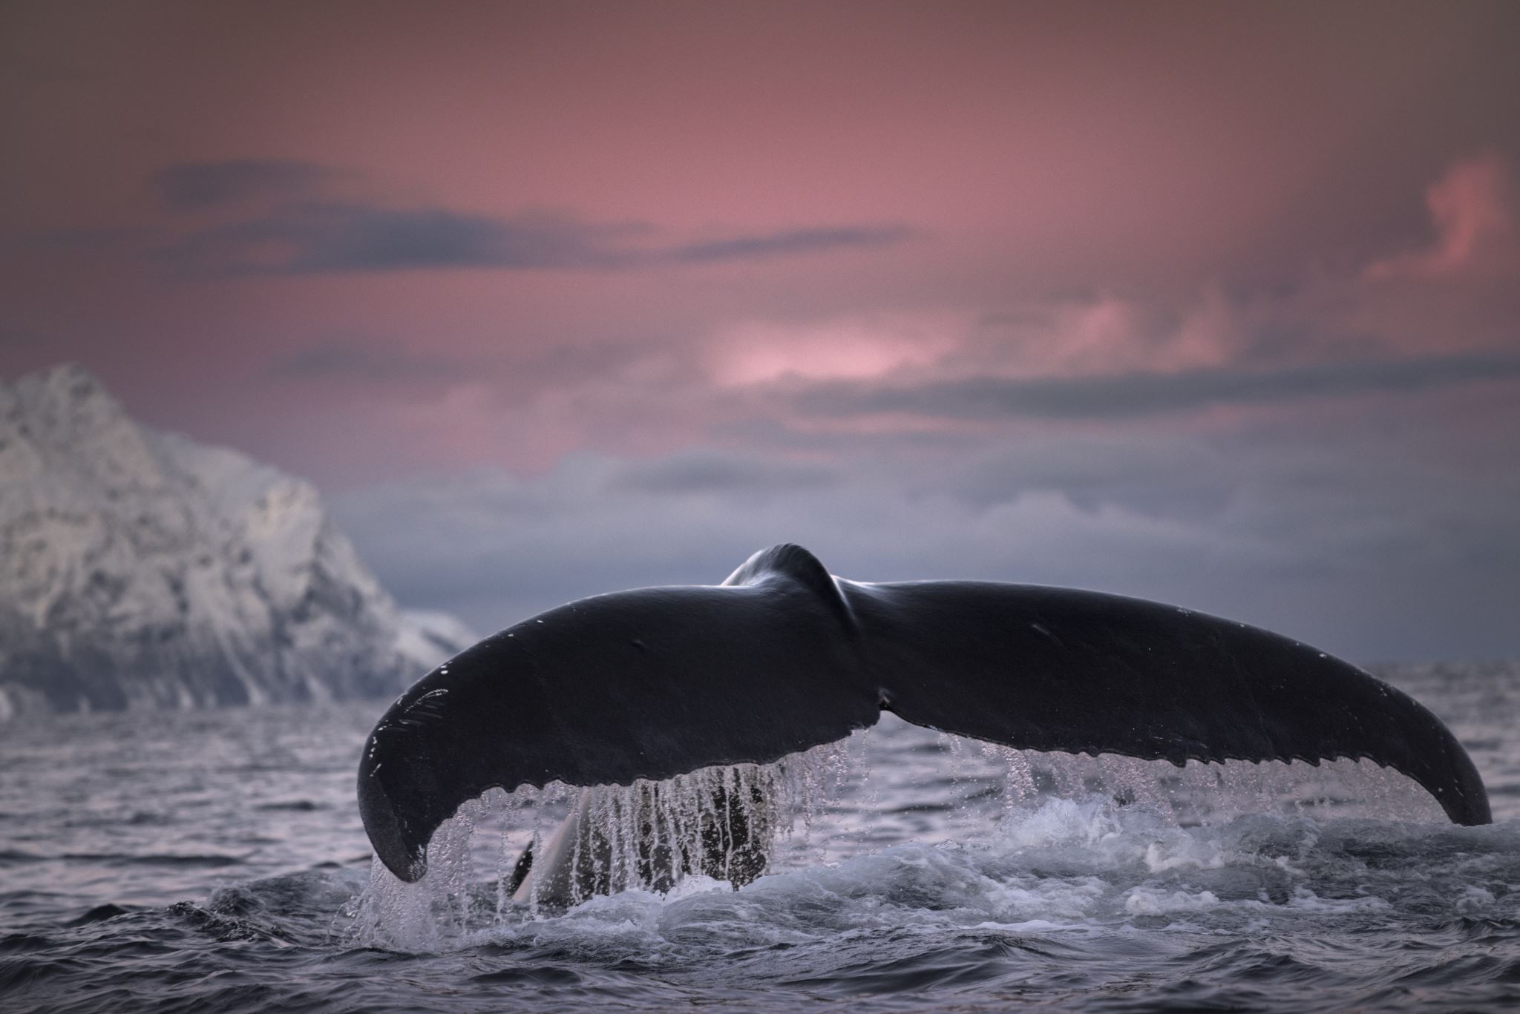
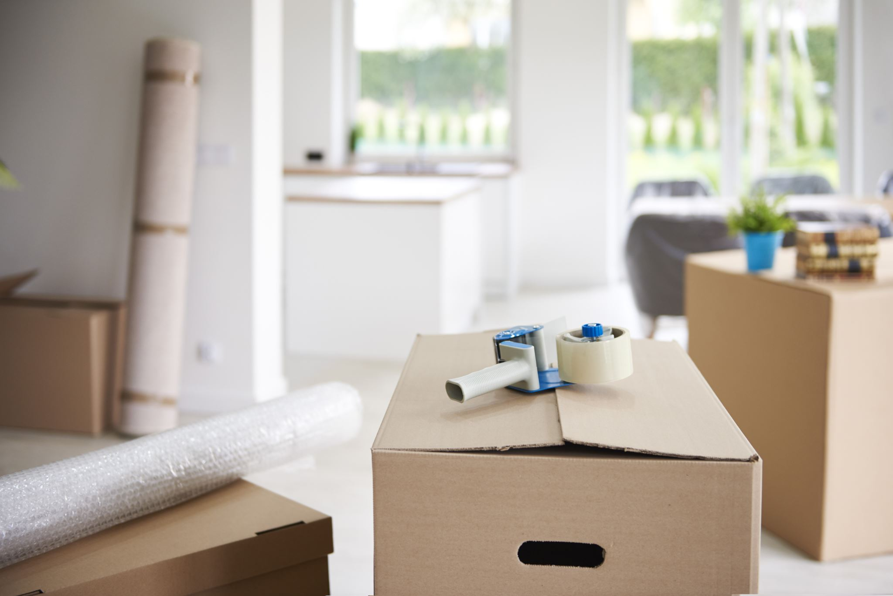

Listen and Spell
pail
tape
tail
bake
Notes:
Say,” It is time to practice spelling the long -a- sound. Please go find a white board and marker or a piece of lined paper and pencil.”
Allow students time to get materials.
Click once for picture to appear.
Say, “Bake. He loves to bake with his dad. Bake.”
Allow students time to write their response down.
Click once to have the word appear.
Say, “If you have misspelled this word, please make your corrections now.
Allow time for students to make changes if needed.
Click once for picture to appear.
Say, Tape. Make sure you tape your project together. Tape.”
Allow students time to write their response down.
Click once to have the word appear.
Say, “If you have misspelled this word, please make your corrections now.
Allow time for students to make changes if needed.
Click once for picture to appear.
Say, Tail. The whale’s tail came out of the water. Tail.”
Allow students time to write their response down.
Click once to have the word appear.
Say, “If you have misspelled this word, please make your corrections now.
Allow time for students to make changes if needed.
Click once for picture to appear.
Say, “Pail. I use a pail to move sand. Pail.”
Allow students time to write their response down.
Click once to have the word appear.
Say, “If you have misspelled this word, please make your corrections now.
Allow time for students to make changes if needed.

Slide 4
Sight Word Review
same
again
when
once
by
them
round
old
give
let
know
Notes:
Say,” I will say the word. As a class you will spell the word.
Click once for first word to appear.
Say, “know”
Students Spell
Click
Say,” old”
Students Spell
Click
Say, “round”
Students Spell
Click
Say, “them”
Students Spell
Click
Say, ”when”
Students Spell
Click
Say, “again”
Students Spell
Click
Say, “by”
Students Spell
Click
Say, “give”
Students Spell
Click
Say, “let”
Students Spell
Click
Say, ”once”
Students Spell
Click
Say, “same”
Students Spell

Slide 5


Sight Word Practice
Look at them running up the hill!
A square is a round object.
The old lady needed help crossing the street.
When I grow up, I want to be a police officer.
Do I have to remind you again?
Notes:
These sentences will contain a sight word. Students are to determine if the sentence makes sense. If the sentence does not make sense, then the student will have to edit the sentence verbally.
The old lady needed help crossing the street.
A square is a round object. – This is incorrect. Should say, “A circle is a round object.”
Look at them running up the hill!
When I grow up I want to be a police officer.
Do I have to remind you again?

Slide 6

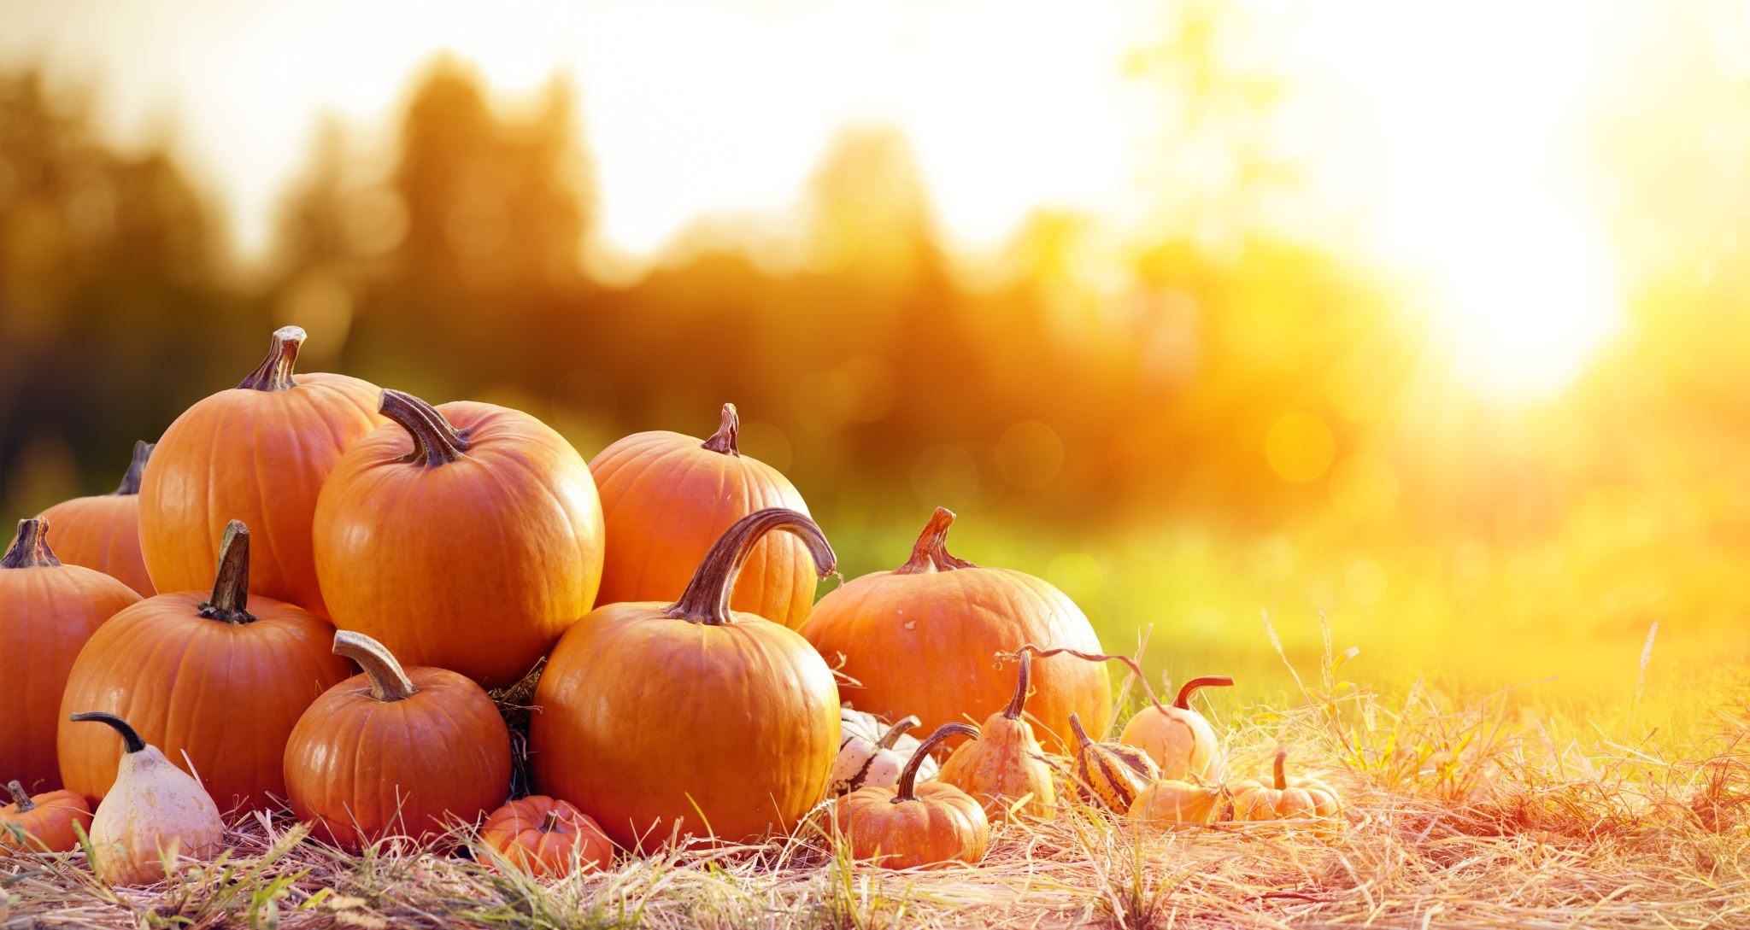
The Retelling Hand
Problem: What went wrong in the story?
Setting: The when and where the story took place.
Characters: Who is in the story. List people, animals, or creatures.
BME: Recall details about the beginning, middle, and end of the story.
Solution: Explain about how the problem in the story was resolved.
Notes:
Say, “Let’s go over how to use our retelling hand.”
Say, “Everyone put one hand in front of you. We are going to begin with your thumb. This is the characters.”
Click once to reveal the word characters.
Say, “Here you should talk about who was in the story. The people, animals, or creatures.”
Click once to reveal the word setting.
Say, “Your pointer finger is the setting finger. This is when you will talk about the when and where the story took place.”
Click once to reveal the word problem.
Say, “This next finger, is the problem finger. Here you are going to tell what went wrong in the story.”
Click once to reveal the events in the story.
Say, “Your ring finger is where you talk about what happened in the beginning, middle, and end of the story.”
Click once to reveal the solution.
Say, “Lastly, your pinky is the solution. This is where your explain how the problem in the story was fixed.”
Click once to show a pumpkin picture.
Say, “Now it’s time to practice with our weekly reading of Pumpkin Patch. Use your retelling hand!”
Say, “Let’s start with the thumb. Who are the characters?”
Student Response: Meg, Ben, Mother, Daddy
Say,” Next, is the pointer finger. What is the setting of the story?”
Student Response: Home and then pumpkin farm
Say, “Then, the problem finger. What was the problem in the story?”
Student Response: Ben wanted the biggest pumpkin, but he couldn’t pick it up.
Say, “After, the ring finger asks you to explain the detail in the beginning middle and end of the story.”
Student Response: The kids were very excited to go to the pumpkin patch. Ben wanted to get the biggest pumpkin he could find. They found one and needed help loading it into the car. They name the pumpkin Mr. Happy Face after they carved a smile into the pumpkin. The kids wanted to surprise Daddy with their big pumpkin. They hid behind the pumpkin an waited for their Daddy to come home. They had one more surprise inside the house too. Meg, Ben, and Mother made pumpkin pie for dessert.
Say, “Finally, the pinky finger. What was the solution to the problem in the story?
Student Response: They were able to get help at the farm from Mr. Smith to get the big pumpkin into the car. It was a team effort to get the big pumpkin out of the car.

Slide 7

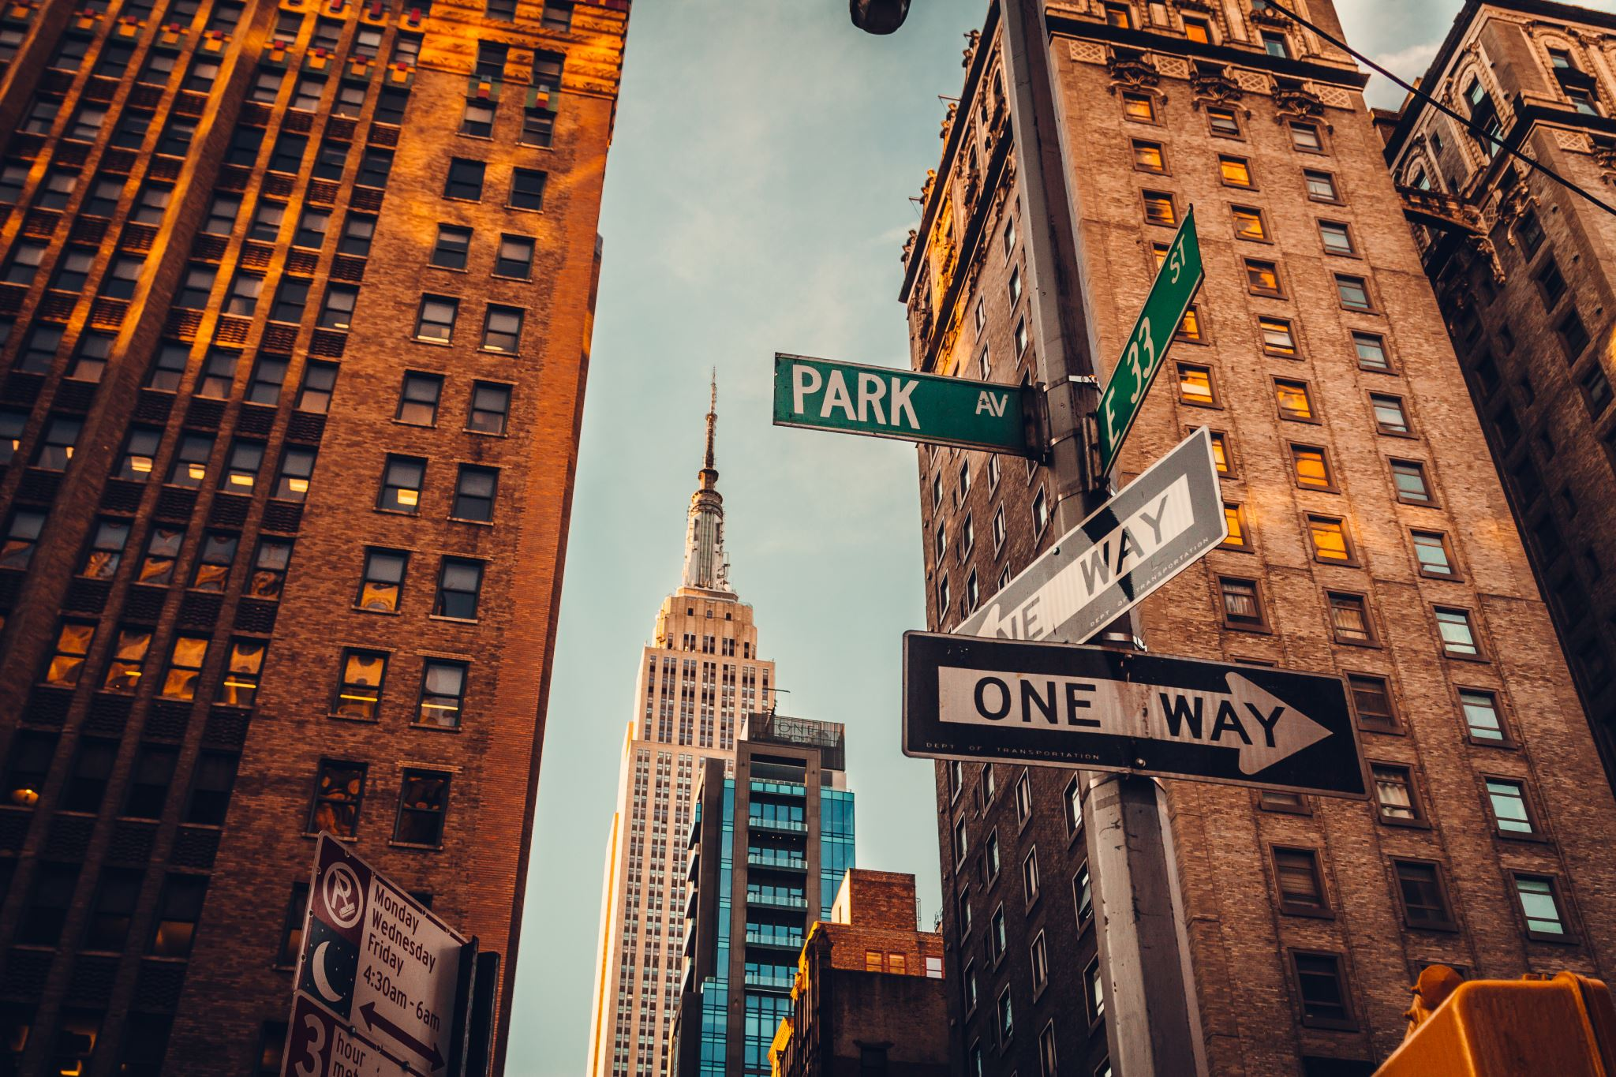
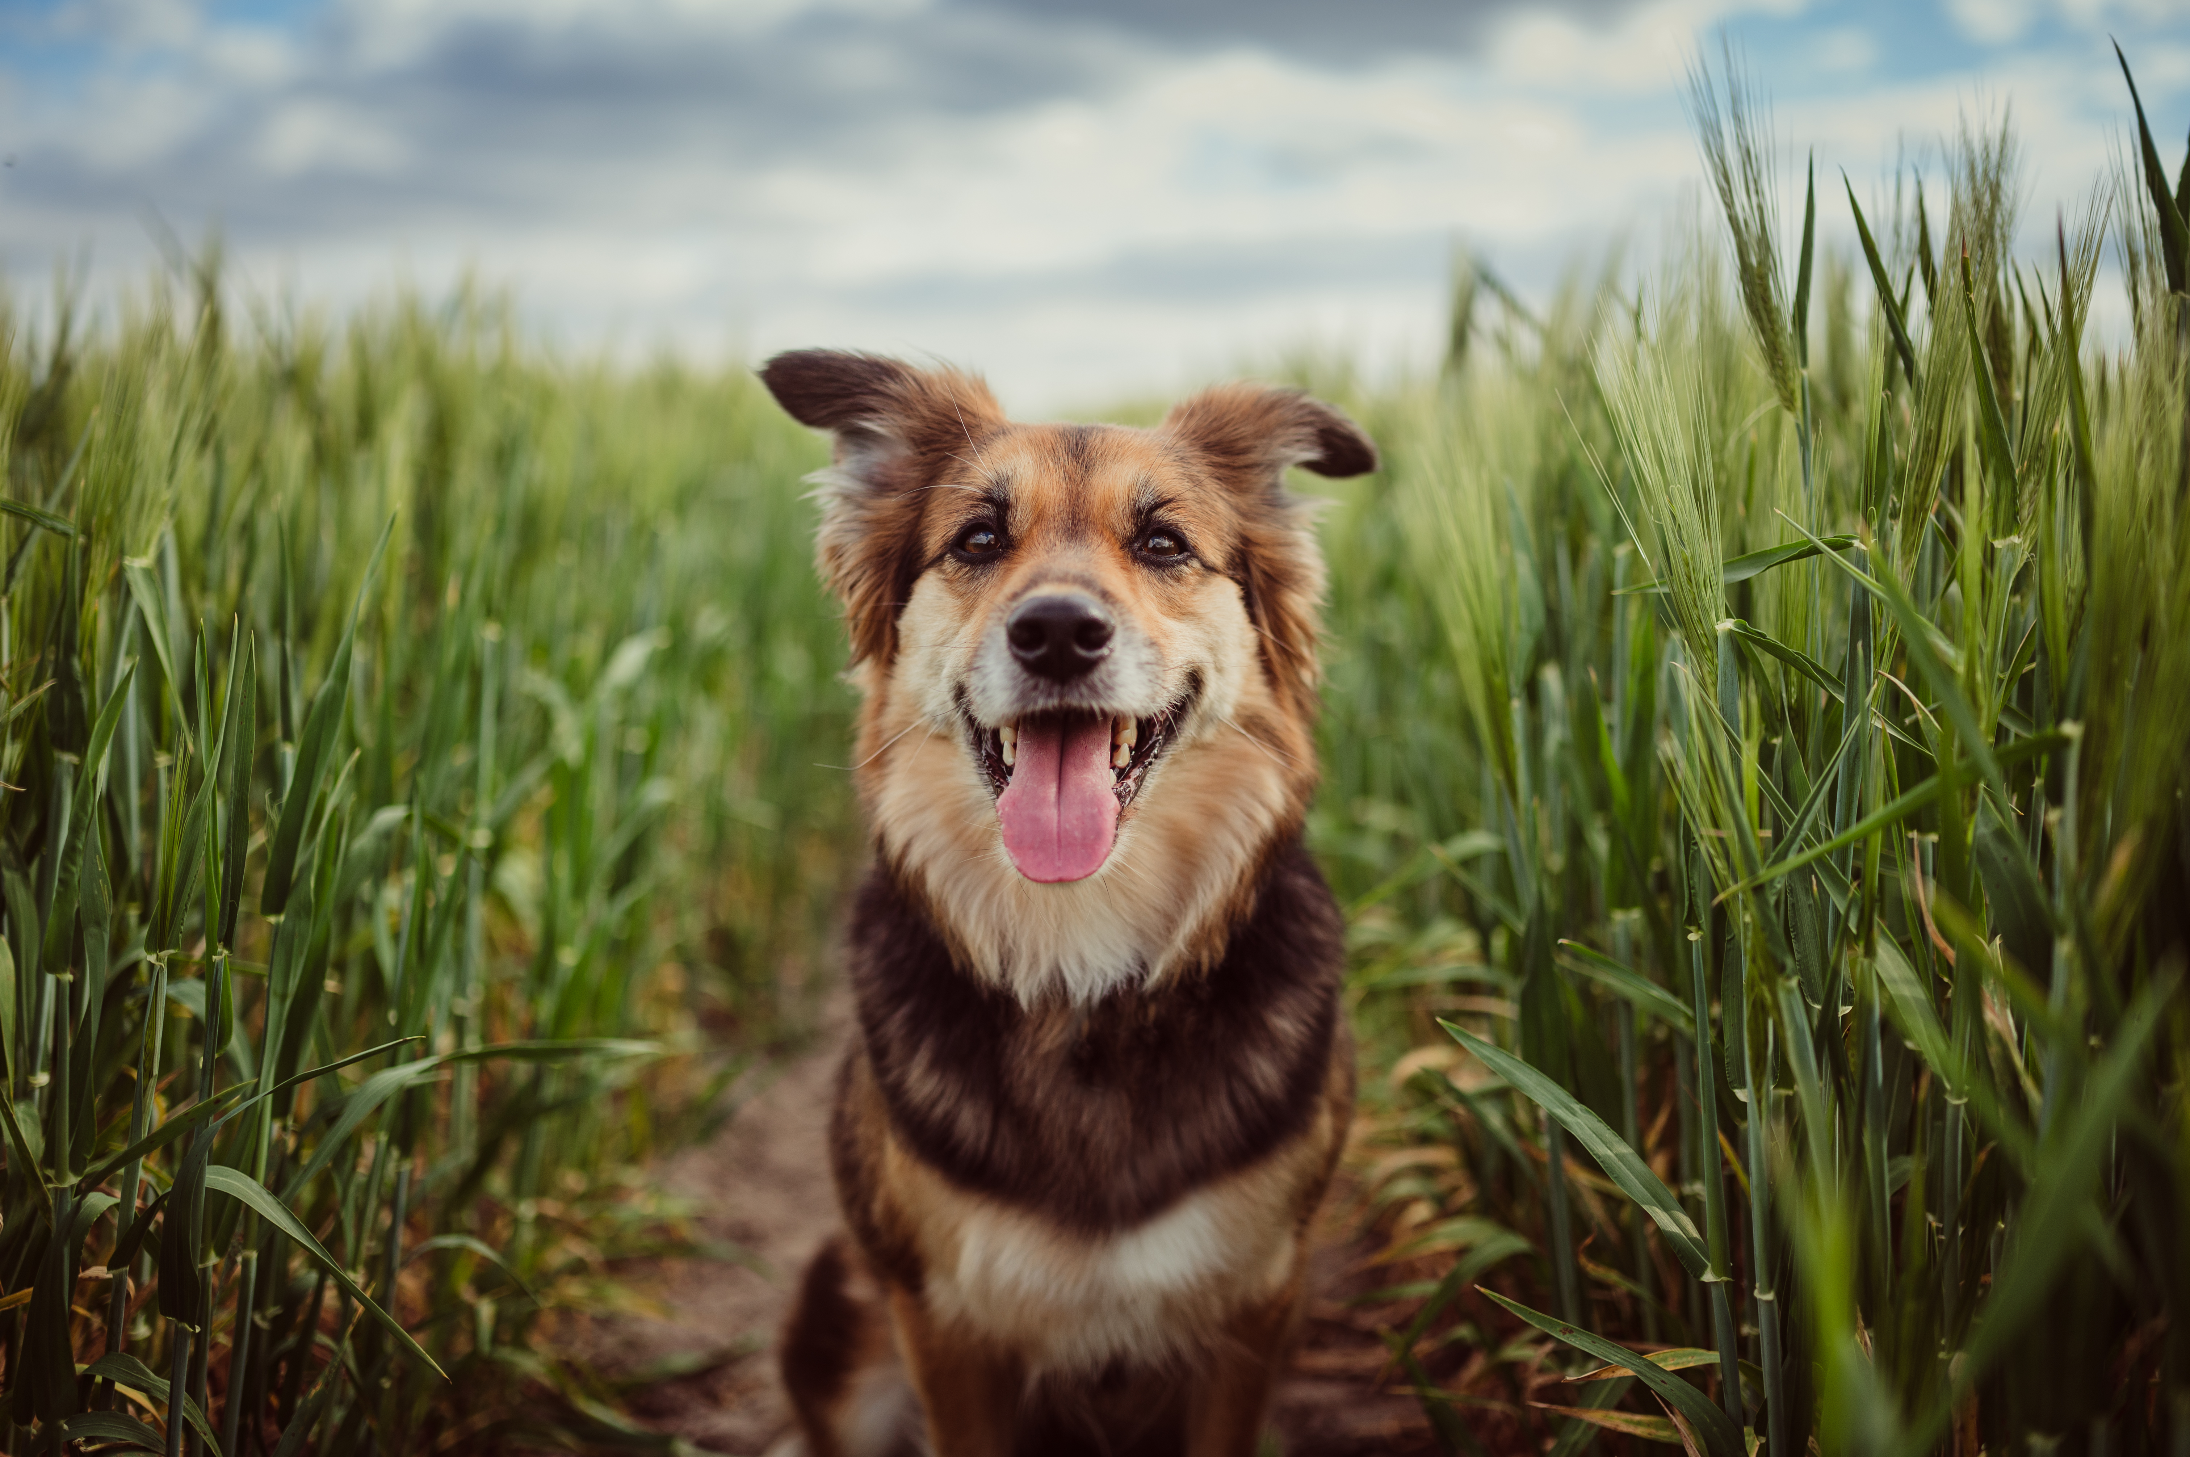
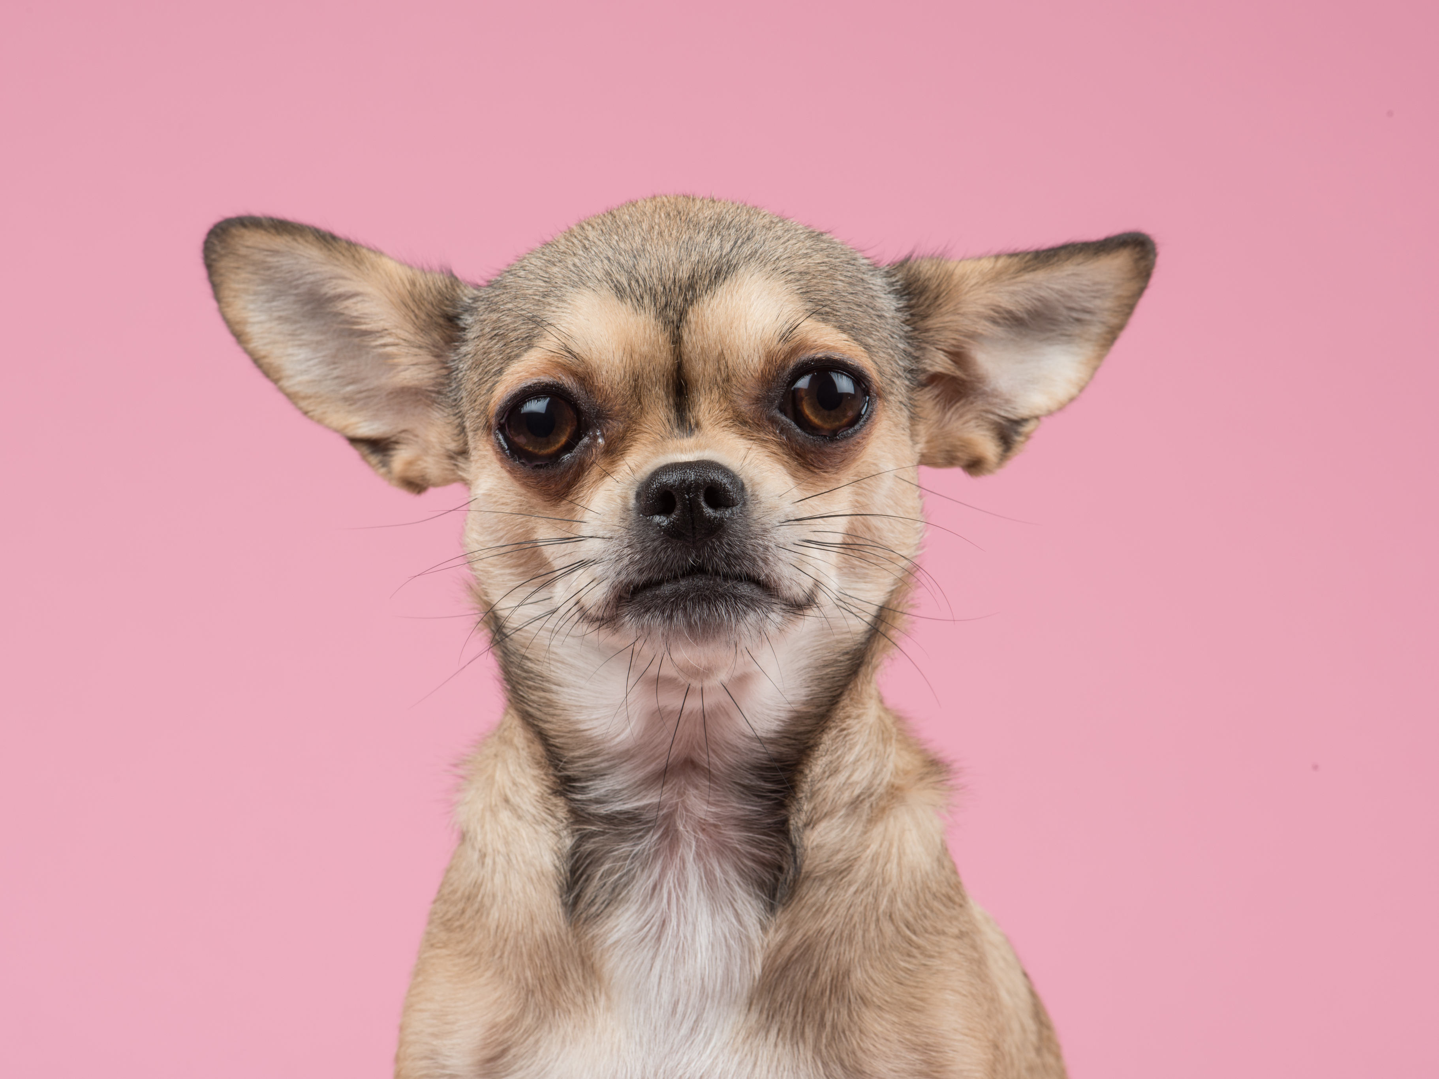
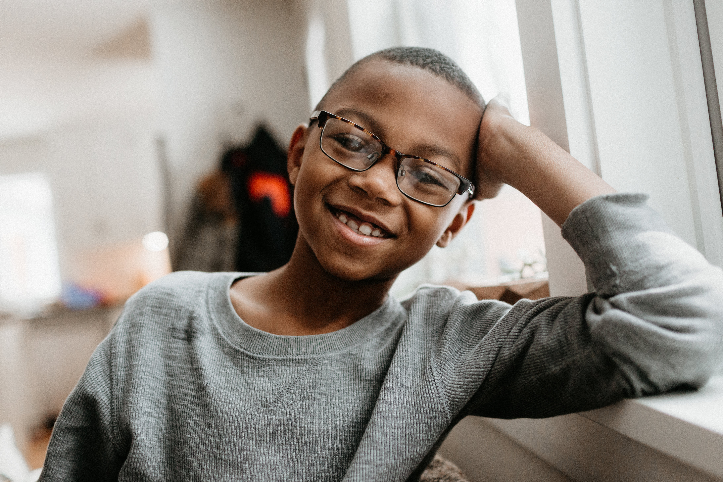
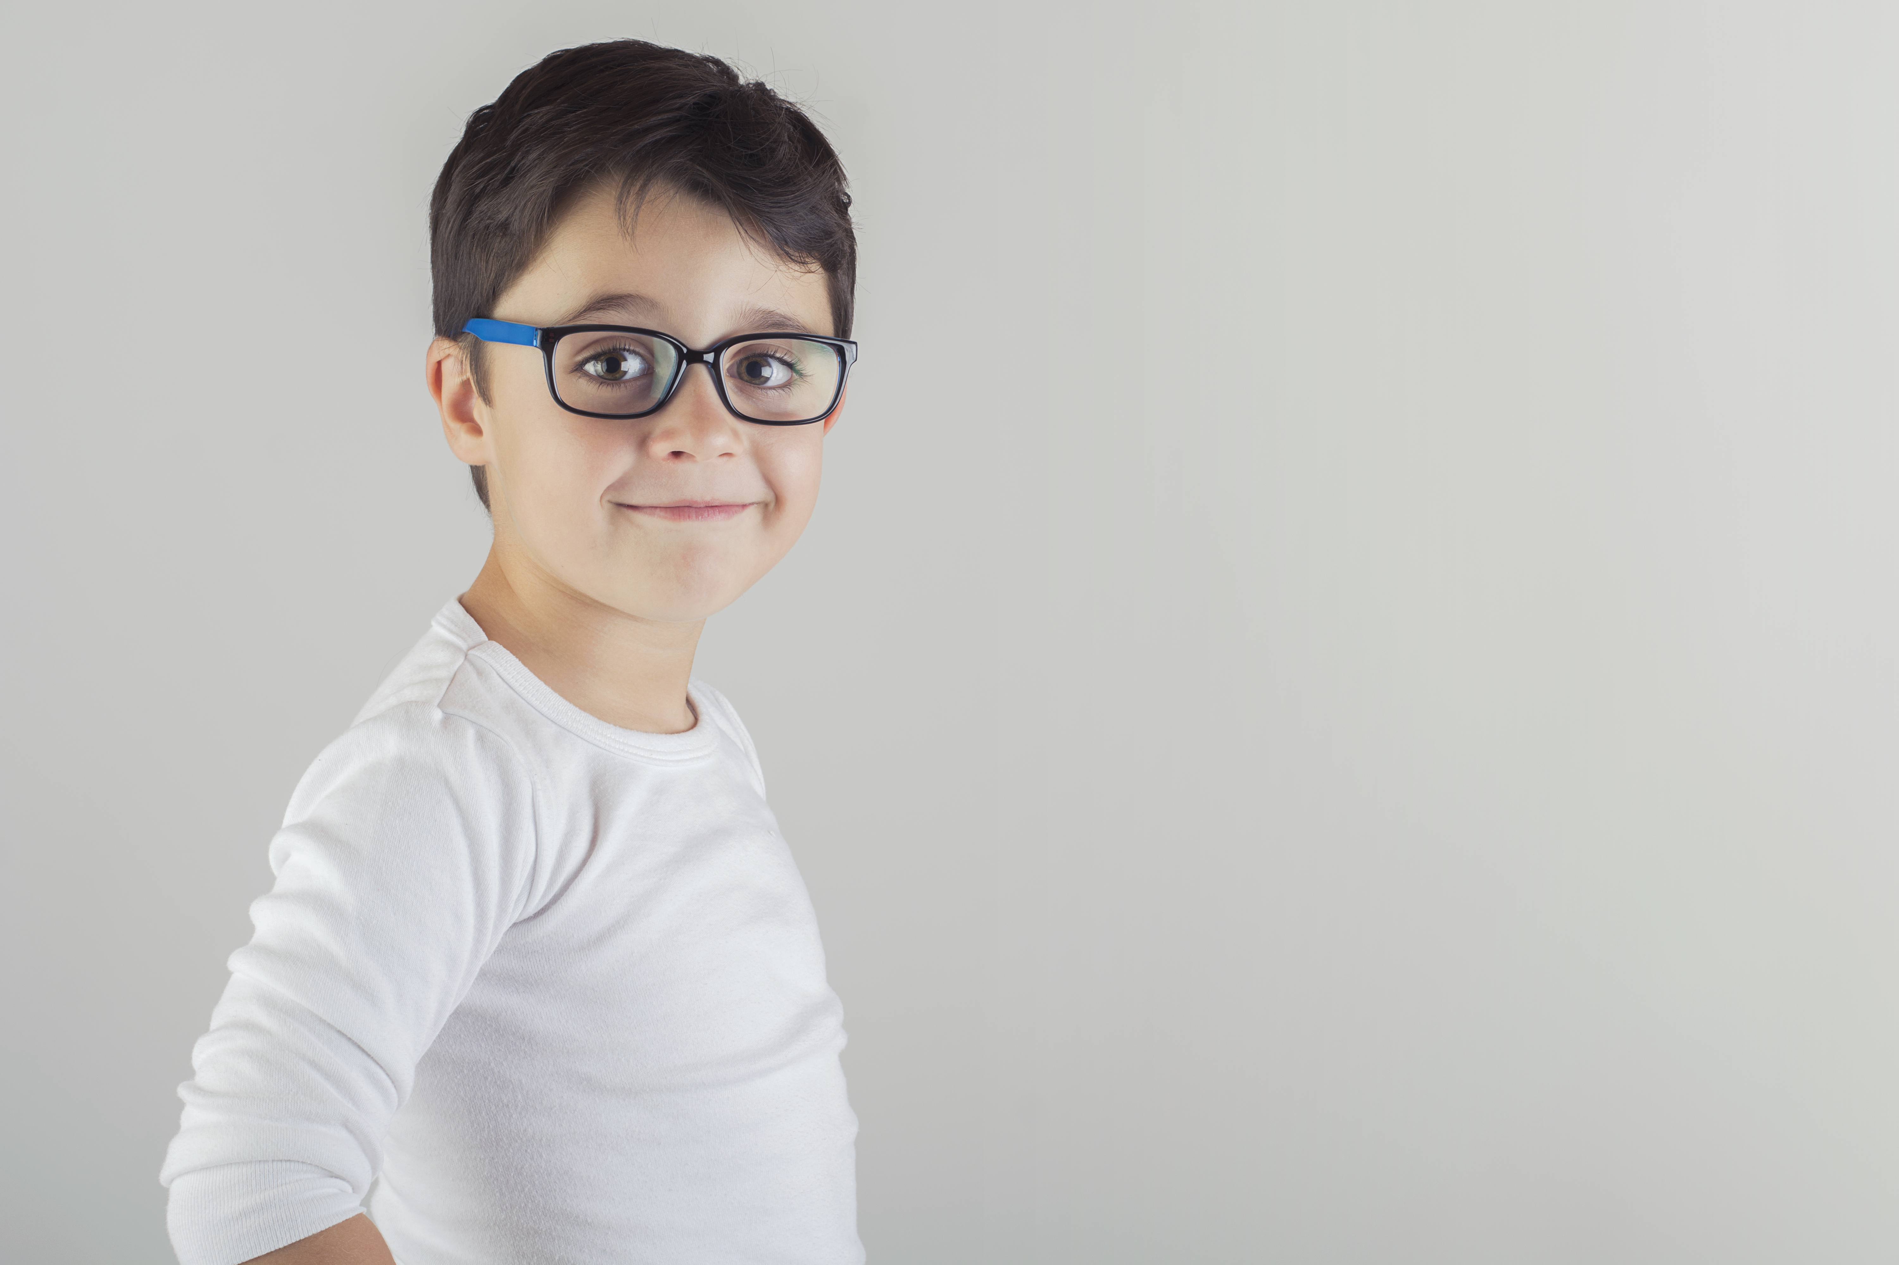
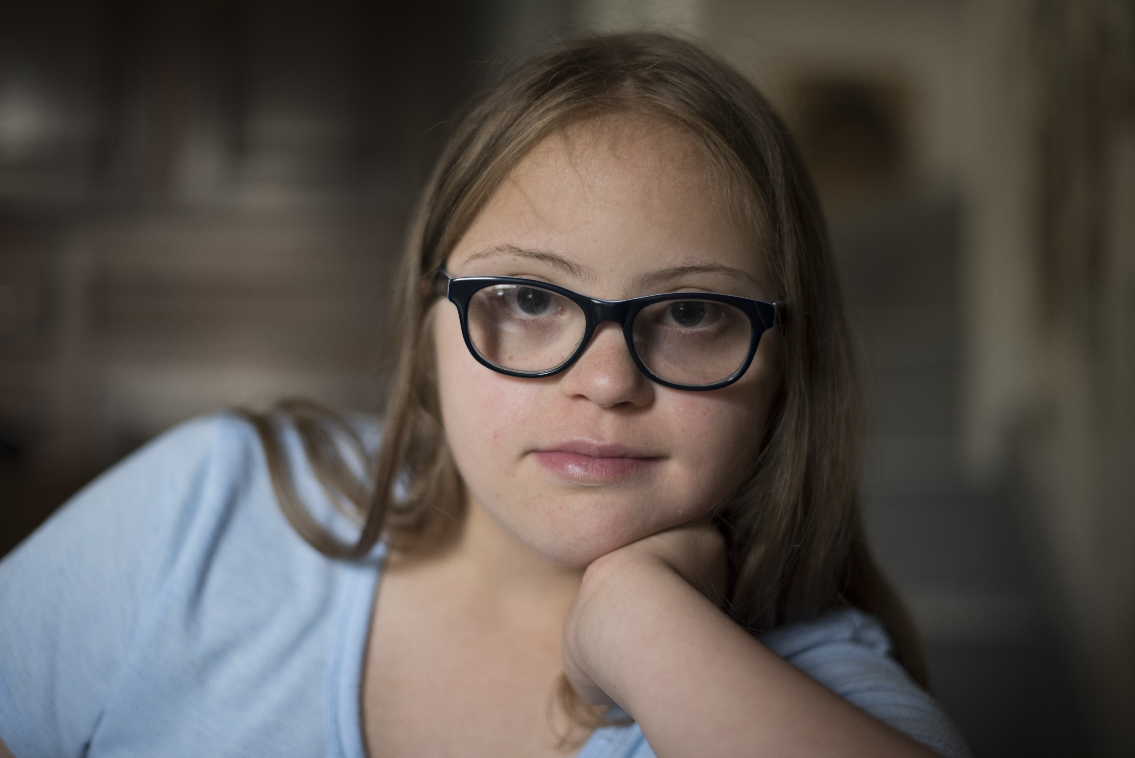
Grammar
Proper Noun
Common Noun
Common Noun
Common Noun
Proper Noun
Common Noun
Proper Noun
Common Noun
Proper Noun
Notes:
Say, “What is a common noun?”
Allow students a chance to answer.
Student Response: A common noun is not specific.
Say, “What is a proper noun? If we know that a common noun is not specific. A proper noun is what?”
Student Response: A proper noun is proper and begins with a capital letter.
Say, “In this activity there will be different pictures, some are going to be common nouns, and some will be proper nouns. It is your job to identify them. Are you ready?”
Student Response: Yes!
Say, “This is a boy. Common or proper?”
Student Response: Common
Click for answer
Click for next picture
Say, “This is a girl. Common or proper?”
Student Response: common
Click for answer
Click for next picture
Say, “This is Kevin. Common or proper?”
Student Response: proper
Click for answer
Click for next picture
Say, “This is a dog. Common or proper?”
Student Response: common
Click for answer
Click for next picture
Say, This is Kane. Common or proper?”
Student Response: Proper
Click for answer
Click for next picture
Say, “This is a city. Common or proper?”
Student Response: common
Click for answer
Click for next picture
Say, “This is Pittsburgh, Pennsylvania. Common or proper?”
Student Response: Proper
Click for answer
Double click for the first picture and noun to appear. Call on one student to answer each.

Slide 8

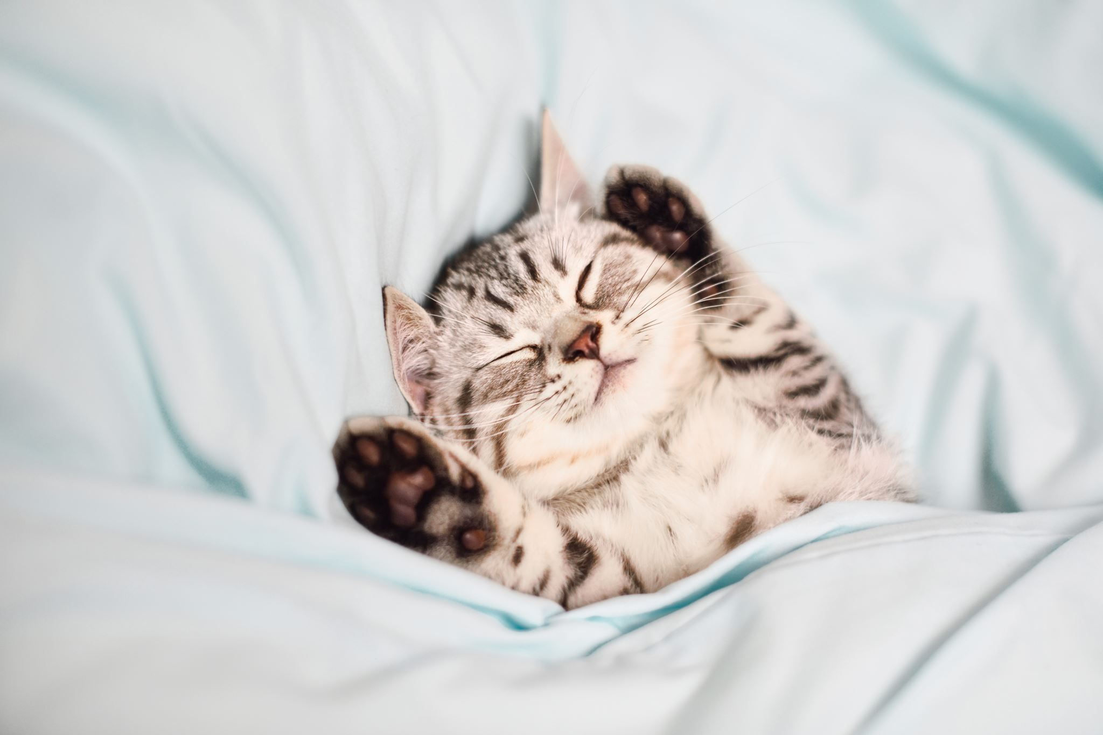
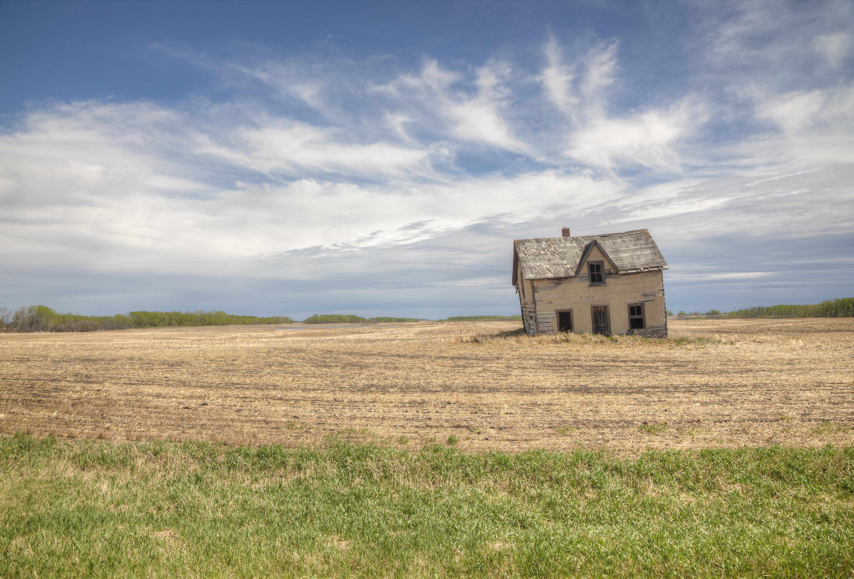
Common Nouns in a Sentence
Notes:
Say, “This is a picture of a cat. Use the common noun “cat” to generate your own sentence.
Student Response: Will vary
Click
Say, “This is a picture of a house. Use the common noun “house” to generate your own sentence.
Student Response: Will vary
Click
Say, “This is a picture of a tree. Use the common noun “tree” to generate your own sentence.

Slide 9

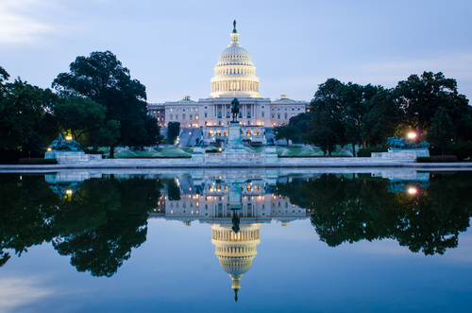
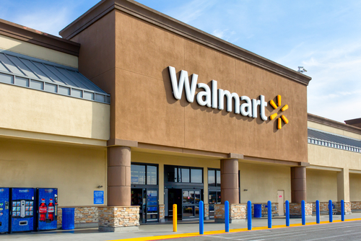
Proper Nouns in a Sentence
Notes:
Say, “This is a picture of Washington DC. Use the proper noun “Washington DC” to generate your own sentence.
Student Response: Will vary
Click
Say, “This is a picture of Mr. Thompson. Use the proper noun “Mr. Thompson” to generate your own sentence.
Student Response: Will vary
Click
Say, “This is a picture of a Walmart. Use the proper noun “Walmart” to generate your own sentence.

Slide 10
Q & A
Any Questions?

