Slide 1
Short -i- Words and Word Meanings
Words and Their Correct Meanings!

Slide 2
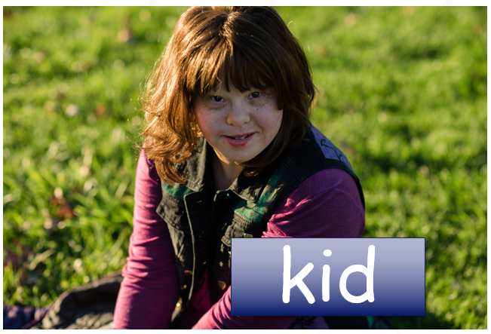

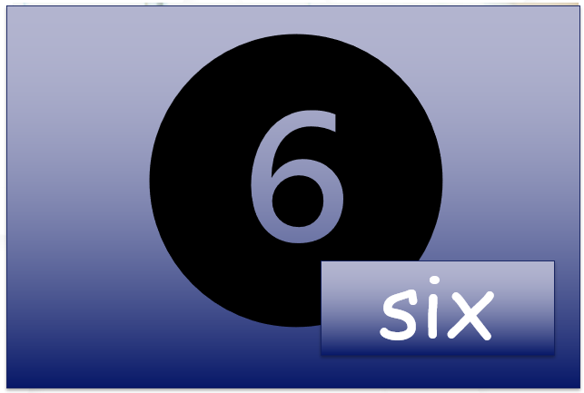
Short –i- Sound
Notes:
Click once: One picture will appear. Allow students to answer what that picture is. You will do this three times.
(Allow students to raise their hands to answer this question)
Once students have said: kid, write, and six. Ask students what two words have a short -i- sound.
Answers should be kid and six. In the word write, the i says its name so that means it is not a short -i- sound.

Slide 3
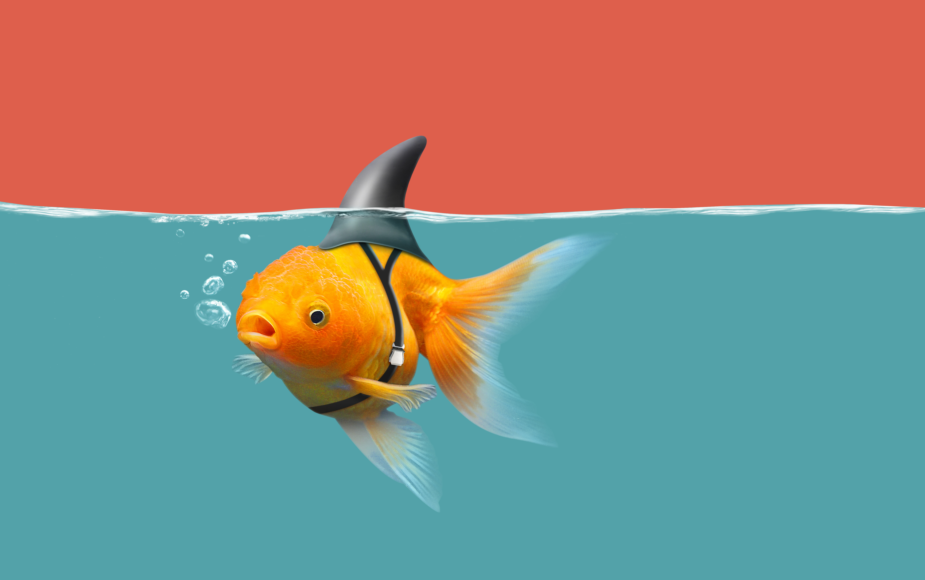

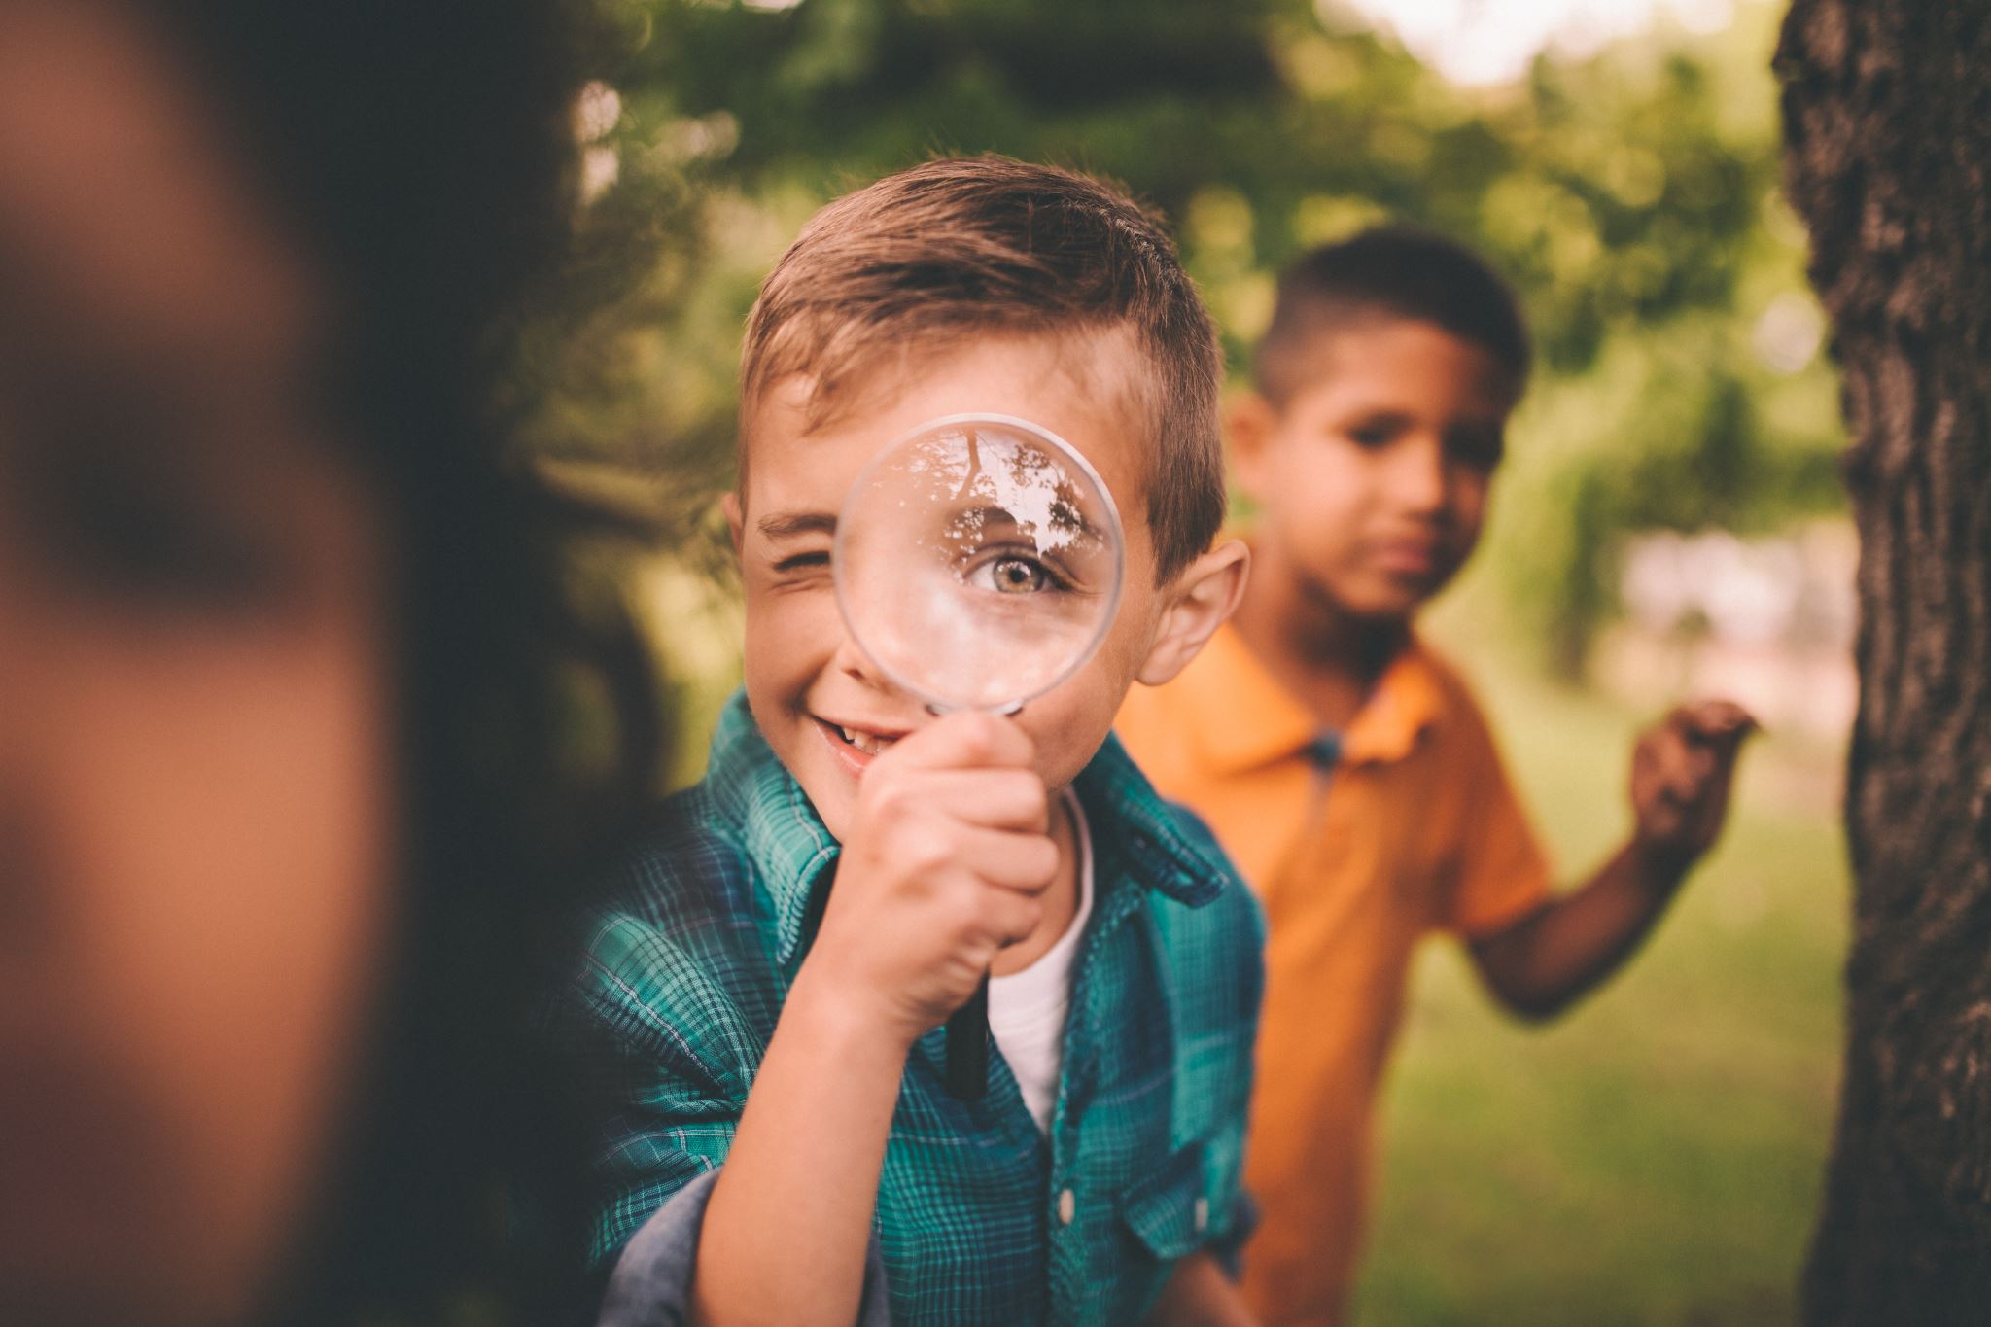


Listen and Spell
fin
lip
win
kit
him
Notes:
The teacher will say a spelling word. I would like for you to listen and then spell the word. (If you are in a one-on-one session have the student spell the words verbally. If this is a large group setting, have the students whisper to themselves the letters they hear and then write them on a piece of paper or a white board.)
There is a total of five words. Make sure to click one at a time after the student spelling the word.

Slide 4
Sight Word Wall
into
pretty
but
at
now
get
ate
like
four
she
came
who
they
was
Notes:
The first 16 words are from module 2 in Buzz. Make sure to still review these words.
IF students were struggling with module 1 sight words make sure to incorporate those into this lesson as well. This will be based off of your specific students.
Module 1 Sight Words: a, can, funny, is, make, play, the, we and, come, go, me, it, red, three, where
Click once, for the Word Wall to appear. Instruct students to raise their hand and wait to be called. Instruct the students to say the sight word, spell the sight word, and use it in a sentence correctly. If in a classroom, please point to the word you want the student to use. If on-line, use your mouse to indicate what word you would like them to use.

Slide 5

The Retelling Hand
Problem: What went wrong in the story?
Setting: The when and where the story took place.
Characters: Who is in the story. List people, animals, or creatures.
BME: Recall details about the beginning, middle, and end of the story.
Solution: Explain about how the problem in the story was resolved.
Notes:
Say, “Let’s go over how to use our retelling hand.”
Say, “Everyone put one hand in front of you. We are going to begin with your thumb. This is the characters.”
Click once to reveal the word characters.
Say, “Here you should talk about who was in the story. The people, animals, or creatures.”
Click once to reveal the word setting.
Say, “Your pointer finger is the setting finger. This is when you will talk about the when and where the story took place.”
Click once to reveal the word problem.
Say, “This next finger, is the problem finger. Here you are going to tell what went wrong in the story.”
Click once to reveal the events in the story.
Say, “Your ring finger is where you talk about what happened in the beginning, middle, and end of the story.”
Click once to reveal the solution.

Slide 6
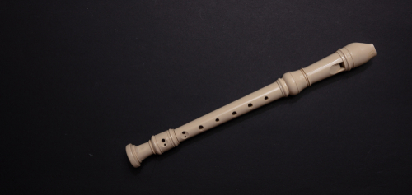
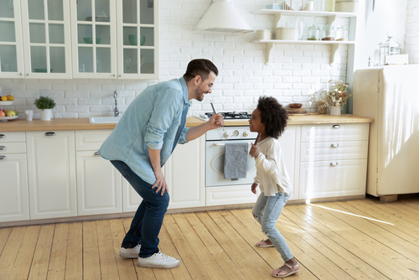
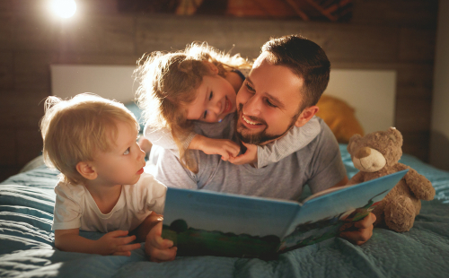
Let’s Practice
Notes:
Say, “Now it’s time to practice with our weekly reading of Bedtime. Use your retelling hand!” ​
Say, “Let’s start with the thumb. Who are the characters?” ​
Student Response: Ben, Meg, Daddy
Say,” Next, is the pointer finger. What is the setting of the story?” ​
Student Response: Right before bedtime in their house.
Say, “Then, the problem finger. What was the problem in the story?” ​
Student Response: Ben wants to learn how to play the recorder like his dad and Meg wants to do something with dad before bed too.
Say, “After, the ring finger asks you to explain the detail in the beginning middle and end of the story.”
Student Response: In the beginning of the story Ben is learning how to play the recorder like his dad. When Ben plays, Chip their dog barks because it hurts his ears. Then it is time for Meg to do something with Daddy before they go to bed. Meg and Daddy take time to sing together. Ben and Meg had to take a bath. After their bath, Dad told them both a story about a Jolly Robin. The kids fell asleep after the story. Dad had to carry Meg to bed.
​
Say, “Finally, the pinky finger. What was the solution to the problem in the story? ​
Student Response: Ben practices with Dad at night and Meg gets to sing with Dad.
​
​

Slide 7
Proper Use of Vocabulary Words
4. I sure hope he ______ to the teacher’s directions.
3. Mom told me to _______ powdered sugar on the cake.
2. Some haunted houses can be very ______.
5. He rocked the baby in hopes that is would ______ her to sleep.
The baby bunny was very _____.
sprinkle
listened
scary
lively
soothe
sprinkle | lively
scary | listened
soothe
Notes:
The teacher will ask students to raise their hands and wait to be called on. That student will read the sentence with the blank and then verbally identify the correct vocabulary word that makes the sentence a complete sentence.

Slide 8
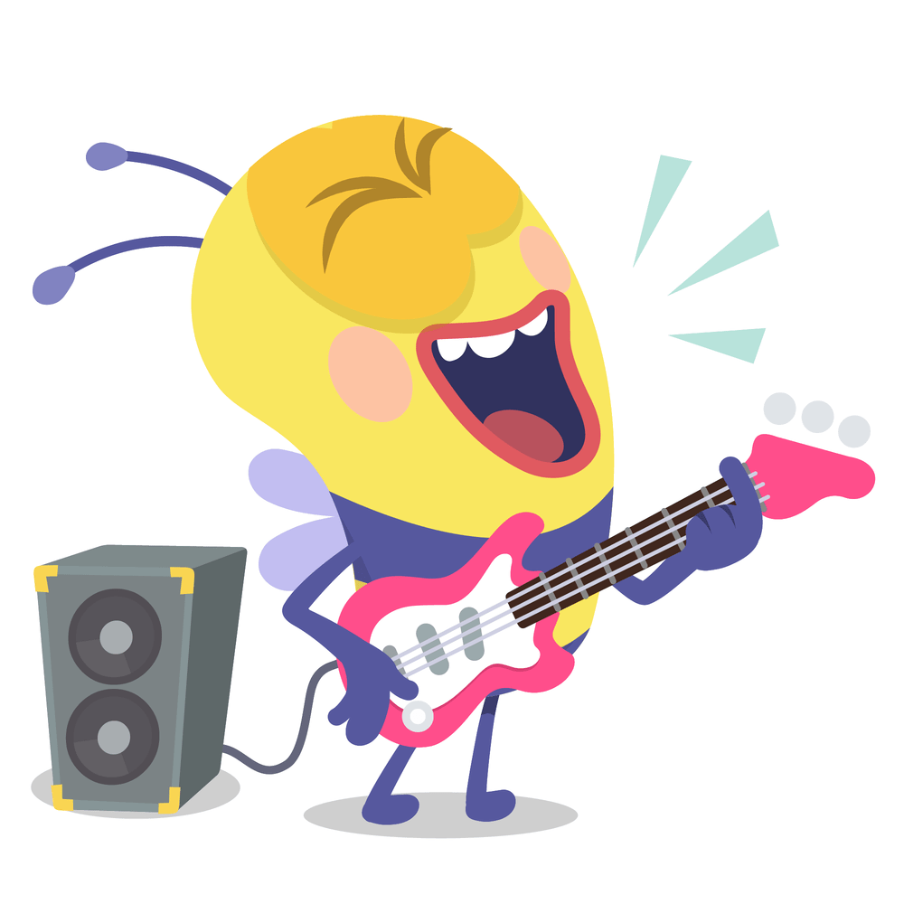
What is a predicate?
The predicate of a sentence tells what the subject is or is doing. The predicate can be one or more words.
Notes:
Say, “Every complete sentence requires a subject and a predicate. Now, who can tell me what a subject is?” ​
Student Response: The subject is the person, place, or thing that is doing or being something. ​
Say, “Yes! Now what about a predicate?” ​
Student Response: The predicate of a sentence tells what the subject is or is doing. The predicate can be one or more words.​
Click to show the meaning of a predicate. ​
Say, “What other items should a complete sentence have?” ​
Student Response: Their responses might be a capital letter and a period to end the sentence. ​
Say, “Good job! Now on the screen you can see a bee rocking out. Can someone construct a sentence that has the subject and the predicate? Then identify it?” ​
Allow multiple students to share their sentences. ​
Click once more for the picture to appear. ​
Say, "Can you construct a sentence that has a subject and a predicate" What is the subject? What is the predicate? ​
Student Example: The bee was rocking out to the music. ​

Slide 9
Let's Practice!
3. The cat looked out the window.
Mr. Taylor opened the door.
2. She wrote a friendly letter.
Notes:
Students will raise their hands and wait to be called on. The student is to read the sentence out loud, identify verbally the subject, and the predicate. There will be three total sentences.
If students need a reminder of what a predicate and a subject are, give them verbal reminders.
The subject is the person, place, or thing that is doing or being something.
The predicate of a sentence tells what the subject is or is doing. The predicate can be one or more words.

Slide 10
Q & A
Any Questions?

