Slide 1
Sounds and Meanings
Short –e- sounds and word meanings.

Slide 2
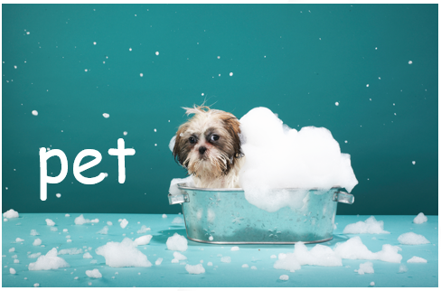
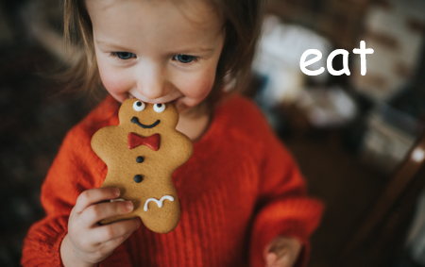
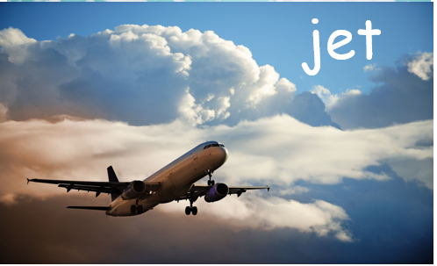
Short –e- Sounds
pet
eat
Notes:
Click once for the first picture to appear. Ask students what this is a picture of. Continue to do this for all three pictures.
Once completed, ask students to correctly identify the two words that have a short -e- sound.
Answers should be pet and jet. In the word eat the e says its name so that means it is not a short -e- sound.

Slide 3



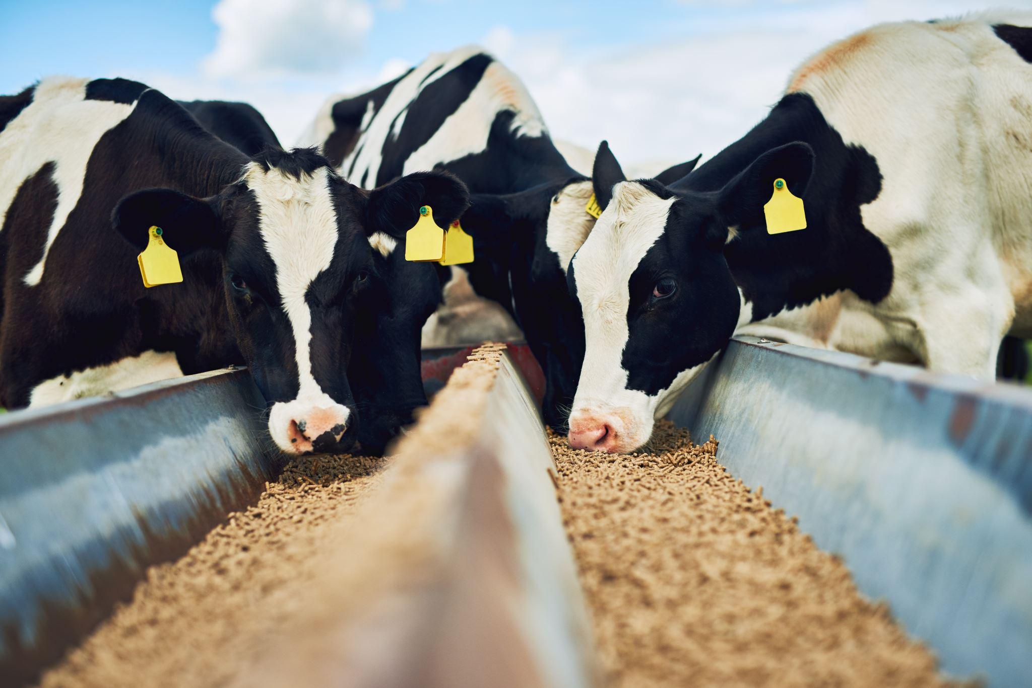

Listen and Spell
fed
met
net
peg
pen
Notes:
The teacher will say a spelling word. “ I would like for you to listen and then spell the word.” (If you are in a one-on-one session have the student spell the words verbally. If this is a large group setting, have the students whisper to themselves the letters they hear and then write them on a piece of paper or a white board.)

Slide 4
Sight Word Wall
did
good
all
do
be
soon
have
new
am
with
must
black
ride
our
went
too
Notes:
Instruct the students to say the sight word, spell the sight word, and use it in a sentence correctly. If in a classroom, please point to the word you want the student to use. If on-line, use your mouse to indicate what word you would like them to use.

Slide 5


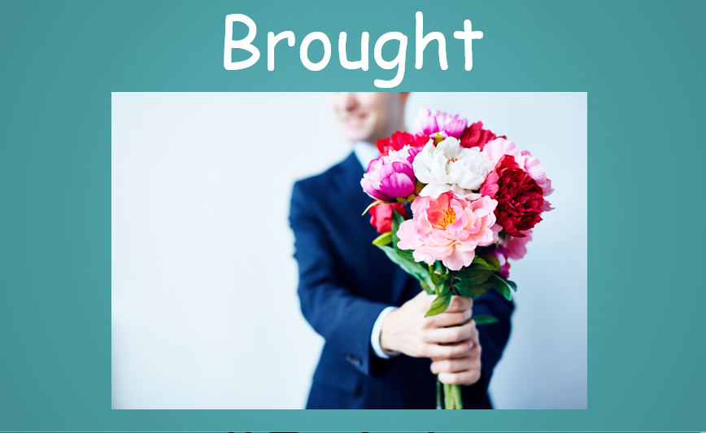




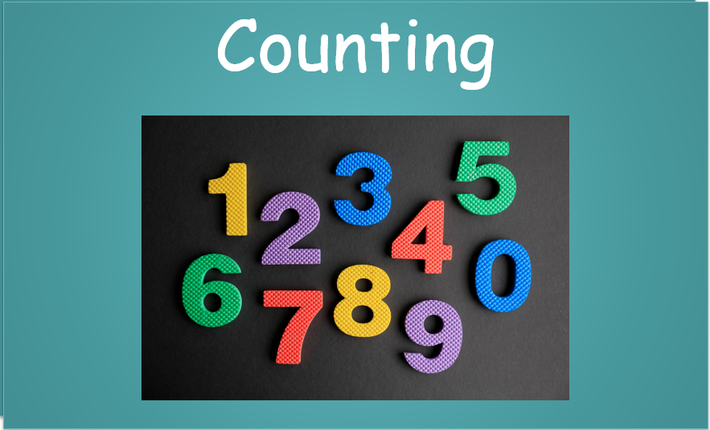

Vocabulary Words
Clothes
Notes:
Students will be shown one word at a time. Ask students to read the word out loud and then define the word. After the student gives their meaning of the word. IF students get the meaning incorrect verbally say the meaning of the word. (List is below.) Make sure to be positive with the student’s responses. If they are not correct, give them hints to help them find the correct meaning. These words are going to be in their module 2 reading, by having them understand the words they will better comprehend the story.
clothes- items worn to cover the body.
counting- taking account of when reaching a total; including.
answers- a thing said, written, or done to deal with or as a reaction to a question, statement, or situation.
pictures- a painting or drawing.
brought- something or someone that has taken something to a place.
beautiful- something or someone that is pretty or handsome.
platforms- a raised level surface on which people or things can stand.
tropical- Explaining the characteristics of an area. Area with warmer weather.
mosquitoes- a type of insect.

Slide 6
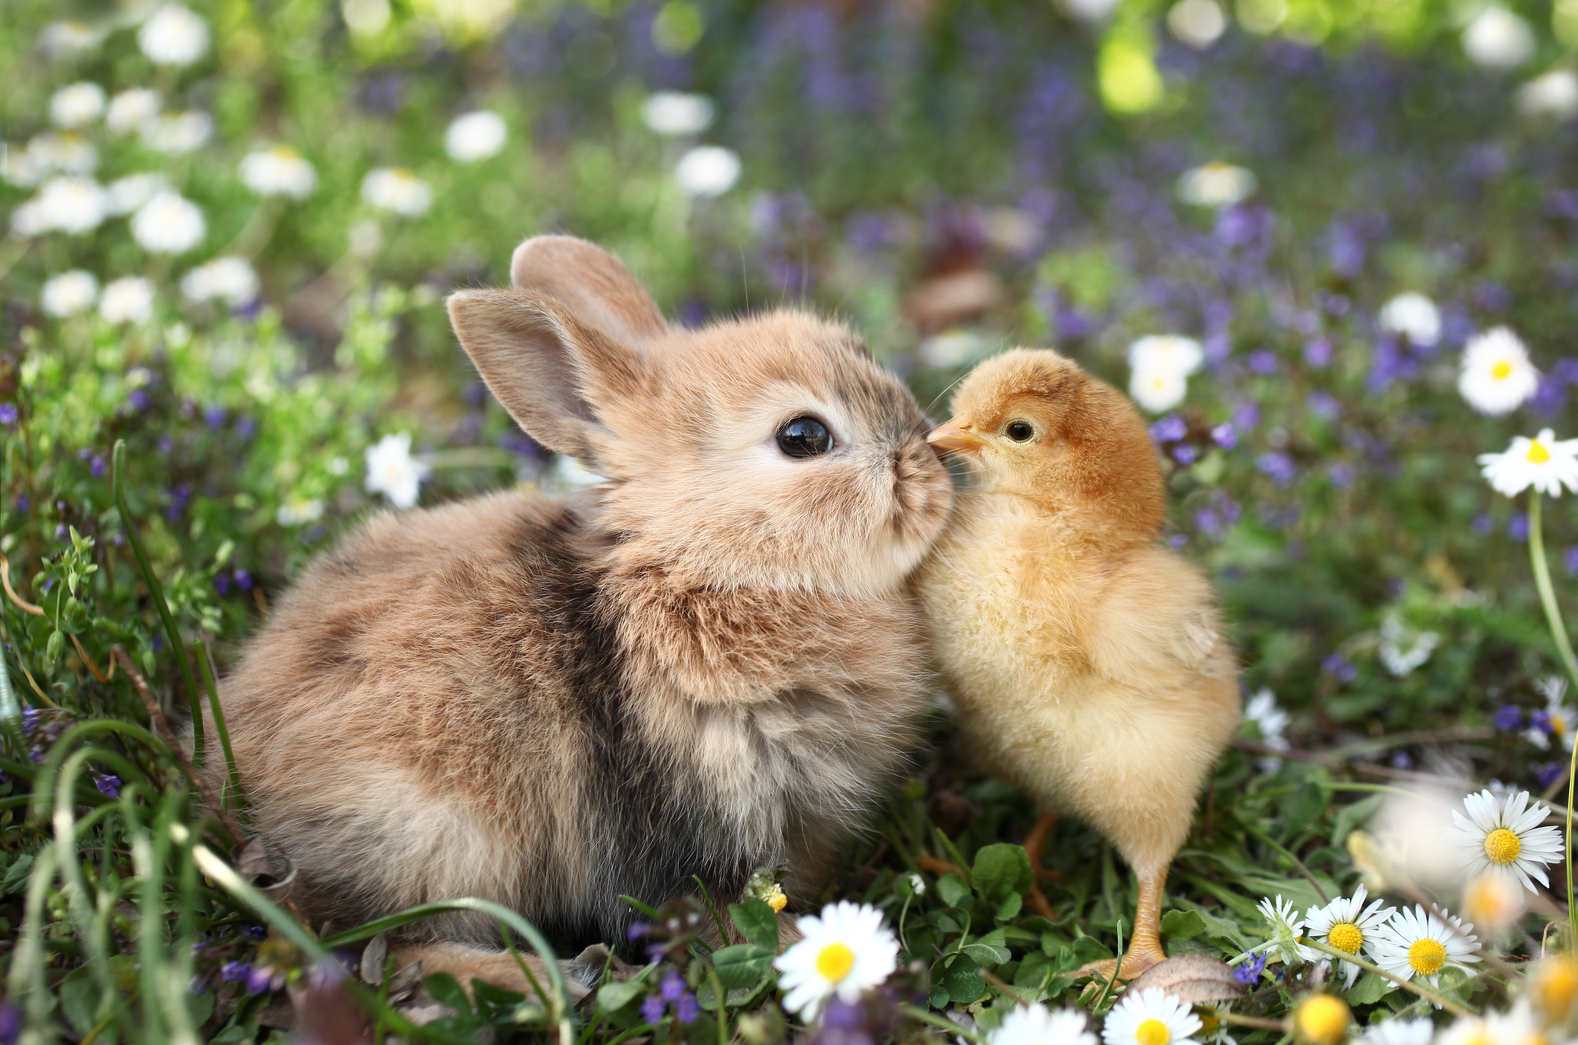
What is a subject?
Notes:
Have students explain to you what a subject is. The subject is the person, place, or thing that is doing or being something. Then, students will be given a picture of a white chicken; students will have to construct a verbal sentence from the picture making sure that there is a subject in their sentence. Then students must correctly identify the subject. Every student will come up with a different sentence. Make sure to allow at least three students to say their sentences. If this is a one-on-one lesson, one sentence is fine as well.

Slide 7

Identify the Subject
dog
The dog barked at the cat.
barked
cat
Notes:
Explain to the students that they are going to have three practice slides. Each slide they will have to read the sentence and then identify subject and explain why. Click once more for the correct answer to move.

Slide 8

Identify the Subject
lazy
The cat is lazy.
cat
is
Notes:
Explain to the students that they are going to have three practice slides. Each slide they will have to read the sentence and then identify subject and explain why. Click once more for the correct answer to move.

Slide 9

Identify the Subject
they
They are drinking coffee.
drinking
coffee
Notes:
Explain to the students that they are going to have three practice slides. Each slide they will have to read the sentence and then identify subject and explain why. Click once more for the correct answer to move.

Slide 10
Q & A
Any Questions?

