Slide 1
Patient of Words
Contraction Surgery
Notes:
Say, “Today you are going to do contraction surgery, review our sight words, and do the 5 finger retell of the I Don’t Want To!

Slide 2

Don’t Miss This Contraction Review
A contraction is a word made by joining two words. An apostrophe shows where the letters are left out.”
do not
don’t
apostrophe
Notes:
Say, “Today we are going to review contractions.”
Click to show the definition of contractions. Say, “A contraction is a word made by joining two words. An apostrophe shows where the letters are left out.” Click for it to disappear
Click to show the apostrophe. Say, “This is an apostrophe, and it will replace the letter or letters we remove.” Click for it to disappear.
Click to show the word do not. Say, “Here are two words, do and not. I am going to join these two words by removing a letter and replacing it with an apostrophe.”
Click to show arrow and word don’t. Say, “When I joined do and not, I removed the o in not and replaced it with the apostrophe.”

Slide 3

Let the Surgery Begin
I
am
Notes:
Say, “Are you ready for contraction surgery ? I am going to show you two words. You will need to tell me which letter/letters needs to be surgically removed. Then we need to quickly put the band aid in its place to close that area and make our contraction.
Click to show the words I am and band aid.
Say, “Which letter(s) do I need to remove to make a contraction?” Wait for the student to say a. Click the band aid to move it over the letter a. (You must click directly on the band aid for it to move) Say, “Good Job, you created the contraction I’m.”

Slide 4
Contraction Surgery
could
not
Notes:
Click to show the words could not and band aid.
Say, “Which letter(s) do I need to remove to make a contraction?” Wait for the student to say o. Click the band aid to move it over the letter o. (You must click directly on the band aid for it to move) . Say, “Good Job, you created the contraction couldn’t.”

Slide 5
Contraction Emergency
she
is
Notes:
Click to show the words I have and the band aid.
Say, “Which letter(s) do I need to remove to make a contraction?” Wait for the student to say i. Click the band aid to move it over the letter i. (You must click directly on the band aid for it to move) Say, “Good Job, you created the contraction she’s.”

Slide 6
Contraction Surgery Center
they
are
Notes:
Click to show the words they are and band aid.
Say, “Which letter(s) do I need to remove to make a contraction?” Wait for the student to say a. Click the band aid to move it over the letter a. (You must click directly on the band aid for it to move) Say, “Good Job, you created the contraction they’re.”

Slide 7
Sight Word Specialist
don’t
pick
seven
warm
sleep
Notes:
Say, “Today we are going to review our sight words. When I say the sight word you tell me which color square to click.”
Only click that square if the student is correct. If the student is wrong. Say, “That is not the correct sight word. Let’s try again and repeat the sight word.
Continue until all the squares have disappeared.

Slide 8
Mixed-up Sight Word Practice
plese
sleep
seven
pick
pick
veesn
icpk
d’not
don’t
warm
arwm
don’t
seven
warm
sleep
Notes:
Say, “Today we are going to practice unscrambling our mixed-up sight words. Do you remember our sight words? Let’s review them one more time.”
Click to show sight words. Say, “Can you read each sight word to me?” Note: Help the student with any sight words they are still struggling with. Click for words to disappear.
Click to show mixed up sight word. Say, “Can you unscramble this mixed-up sight word?” Wait for student to respond. Click for it to disappear.
Click to show sight word warm. Say, “Correct! The mixed-up word is warm.” Click for word to disappear.
Click to show mixed up sight word. Say, “Can you unscramble this mixed-up sight word?” Wait for student to respond. Click for it to disappear.
Click to show sight word don’t. Say, “Correct! The mixed-up word is don’t.” Click for word to disappear.
Click to show mixed up sight word. Say, “Can you unscramble this mixed-up sight word?” Wait for student to respond. Click for it to disappear.
Click to show sight word seven. Say, “Correct! The mixed-up word is seven.” Click for word to disappear.
Click to show mixed up sight word. Say, “Can you unscramble this mixed-up sight word?” Wait for student to respond. Click for it to disappear.
Click to show sight word sleep. Say, “Correct! The mixed-up word is sleep.” Click for word to disappear.
Click to show mixed up sight word. Say, “Can you unscramble this mixed-up sight word?” Wait for student to respond. Click for it to disappear.
Click to show sight word pick. Say, “Correct! The mixed-up word is pick.”

Slide 9
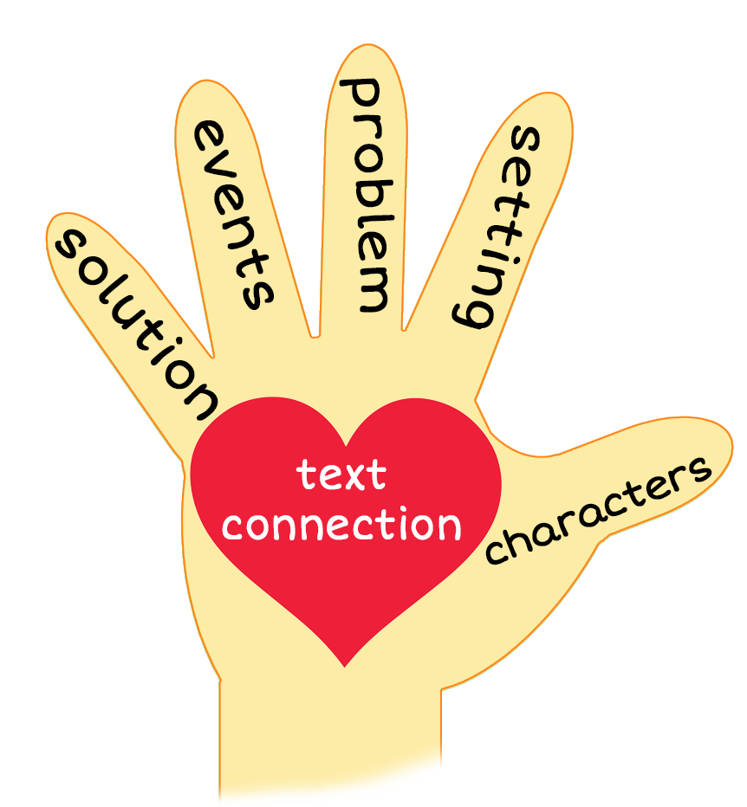
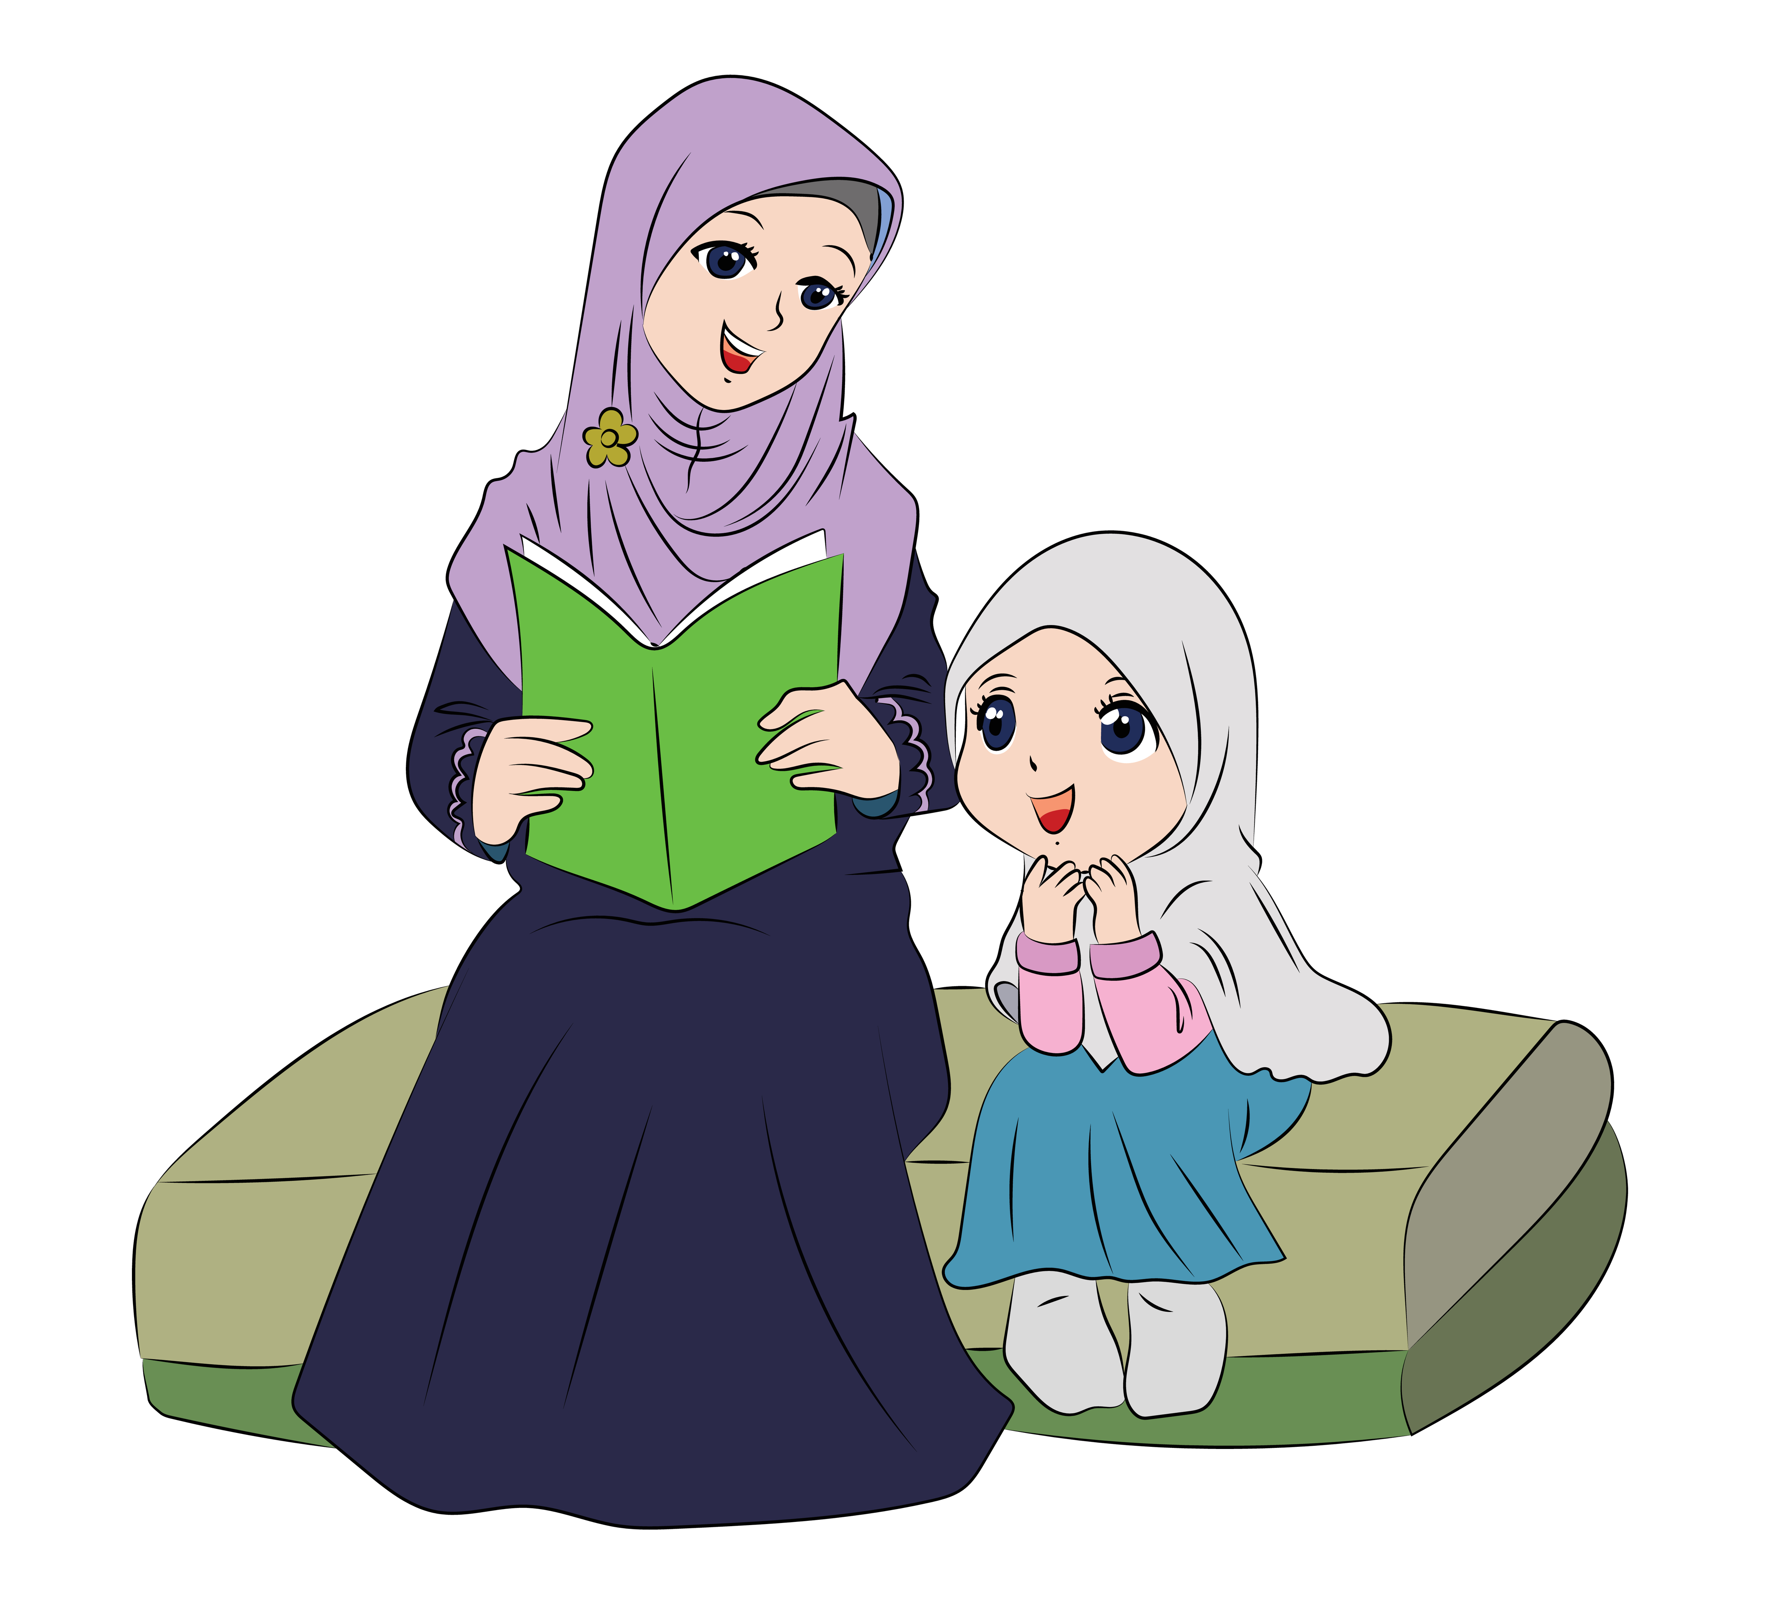
5 Finger Retell
Notes:
Click to show 5 finger retell chart and picture.
Say, “This week you read the story I Don’t Want To!. Using the 5 finger retell strategy, can you tell me about the story.
Say, “Hold up your thumb, tell me the character.” (Jan and Mom)
Say, “Hold up your pointer, tell me the setting.” (Their house)
Say, “Hold up your tall finger, tell me the problem.” (Jan is going to do something fun tomorrow, but she will have to do what her mom asks today.)
Say, “Hold up your ring finger, tell me the events.” (Mom wants Jan to pick up her room, walk the dog, take out the trash, brush her teeth and take a bath, get good sleep, and put a warm coat on but she said she is seven and doesn’t want to)
Say, “Hold up your little finger, tell me the ending/solution.” (Mom said since she doesn’t want to do those things then she doesn’t want to have fun. Jan thinks about it and decides to do those things so she can have fun tomorrow.)
Say, “Make a heart with your fingers, what type of things do you need to do at home before you can have fun?”

Slide 10
Q & A
Any Questions?

