Slide 1
Cascade of Words
Downstream with Compound Words
Notes:
Say, “Today we are going to travel downstream with compound words. We will also review our sight words and the 5 finger retell of the story Bullfrog Goes Downstream.

Slide 2

Waterfall of Compound Word Review
Compound words are words that are formed when two or more words are put together to form a new word with a new meaning.
butter
fly
Notes:
Say, “Today we will review compound words.”
Click to show definition of compound words. Say, “Compound words are words that are formed when two or more words are put together to form a new word with a new meaning!” Click for definition to disappear.
Click for word butter and fly to appear. Say, “What compound word can we make with these two words? Wait for the student to say butterfly.”
Click to show word butterfly and picture. Say, “Yes! Butter and fly make the compound word butterfly.”

Slide 3





Riverbank Compound Word Practice
fishbowl
seashell
newspaper
running
teacher
YES
YES
NO
YES
NO
Notes:
Say, “Remember a compound word is a word made up of two or more words. I will show you a word. If it is a compound word give me a thumbs up. If it is not a compound word give me a thumbs down. Ready?”
Click to show the picture and word newspaper. Say, “Is this a compound word?” Wait for the student to give a thumbs up or down. Click to show the word yes. Say, “You should have your thumb up because newspaper is a compound word.” Click for picture and word to disappear.
Click to show the picture and word teacher. Say, “Is this a compound word?” Wait for the student to give a thumbs up or down. Click to show the word no. Say, “You should have your thumb down because teacher is not a compound word.” Click for picture and word to disappear.
Click to show the picture and word running. Say, “Is this a compound word?” Wait for the student to give a thumbs up or down. Click to show the word no. Say, “You should have your thumb down because running is not a compound word.” Click for picture and word to disappear.
Click to show the picture and word seashell. Say, “Is this a compound word?” Wait for the student to give a thumbs up or down. Click to show the word yes. Say, “You should have your thumb up because seashell is a compound word.” Click for picture and word to disappear.
Click to show the picture and word fishbowl. Say, “Is this a compound word?” Wait for the student to give a thumbs up or down. Click to show the word yes. Say, “You should have your thumb up because fishbowl is a compound word.”

Slide 4
Saltwater Sight Word Review
tell
found
myself
fall
grow
Notes:
Say, “Today we are going to review our sight words. When I say the sight word you tell me which color square to click.”
Only click that square if the student is correct. If the student is wrong. Say, “That is not the correct sight word. Let’s try again and repeat the sight word.
Continue until all the squares have disappeared.

Slide 5
Upstream Sight Word Practice
grow
I want to ____ tomatoes in my garden.
fall
Be careful you don’t ____out of the tree.
Tell
____ me your name.
found
myself
I stayed home by ______.
I _____ my lost toy!
myself
tell
grow
found
fall
Notes:
Say, “We are going to read some sentences that have the sight word missing. You will need to fill in the blank with the correct sight word.”
Click to show word bank. Say, “Can you read each sight word to me?”
NOTE: You must click on the word in the word bank for it to appear in the sentence and you must click on the sentence for it to disappear.
Click to show sentence. Say, “(Blank) me your name. Which sight word makes sense in that sentence?” Once student answers. Click to show sentence with tell in it. Say, “Yes! Tell is the correct word to fill in the blank. “Tell me your name.” Click for sentence to disappear.
Click to show sentence. Say, “I (blank) my lost toy! Which sight word makes sense in that sentence?” Once student answers. Click to show sentence with found in it. Say, “Yes! Found is the correct word to fill in the blank. I found my lost toy!” Click for sentence to disappear.
Click to show sentence. Say, “I stayed home by (blank). Which sight word makes sense in that sentence?” Once student answers. Click to show sentence with myself in it. Say, “Yes! Myself is the correct word to fill in the blank. I stayed home by myself.”
Click to show sentence. Say, “Be careful you don’t (blank) out of the tree. Which sight word makes sense in that sentence?” Once student answers. Click to show sentence with fall in it. Say, “Yes! Fall is the correct word to fill in the blank. Be careful you don’t fall out of the tree.” Click for sentence to disappear.
Click to show sentence. Say, “I want to (blank) tomatoes in my garden. Which sight word makes sense in that sentence?” Once student answers. Click to show sentence with grow in it. Say, “Yes! Grow is the correct word to fill in the blank. I want to grow tomatoes in my garden.”

Slide 6
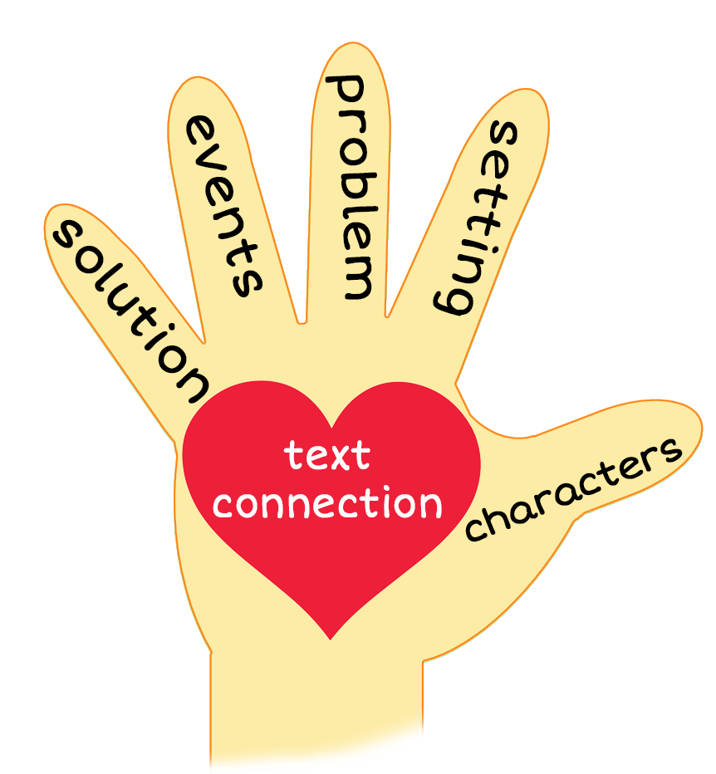
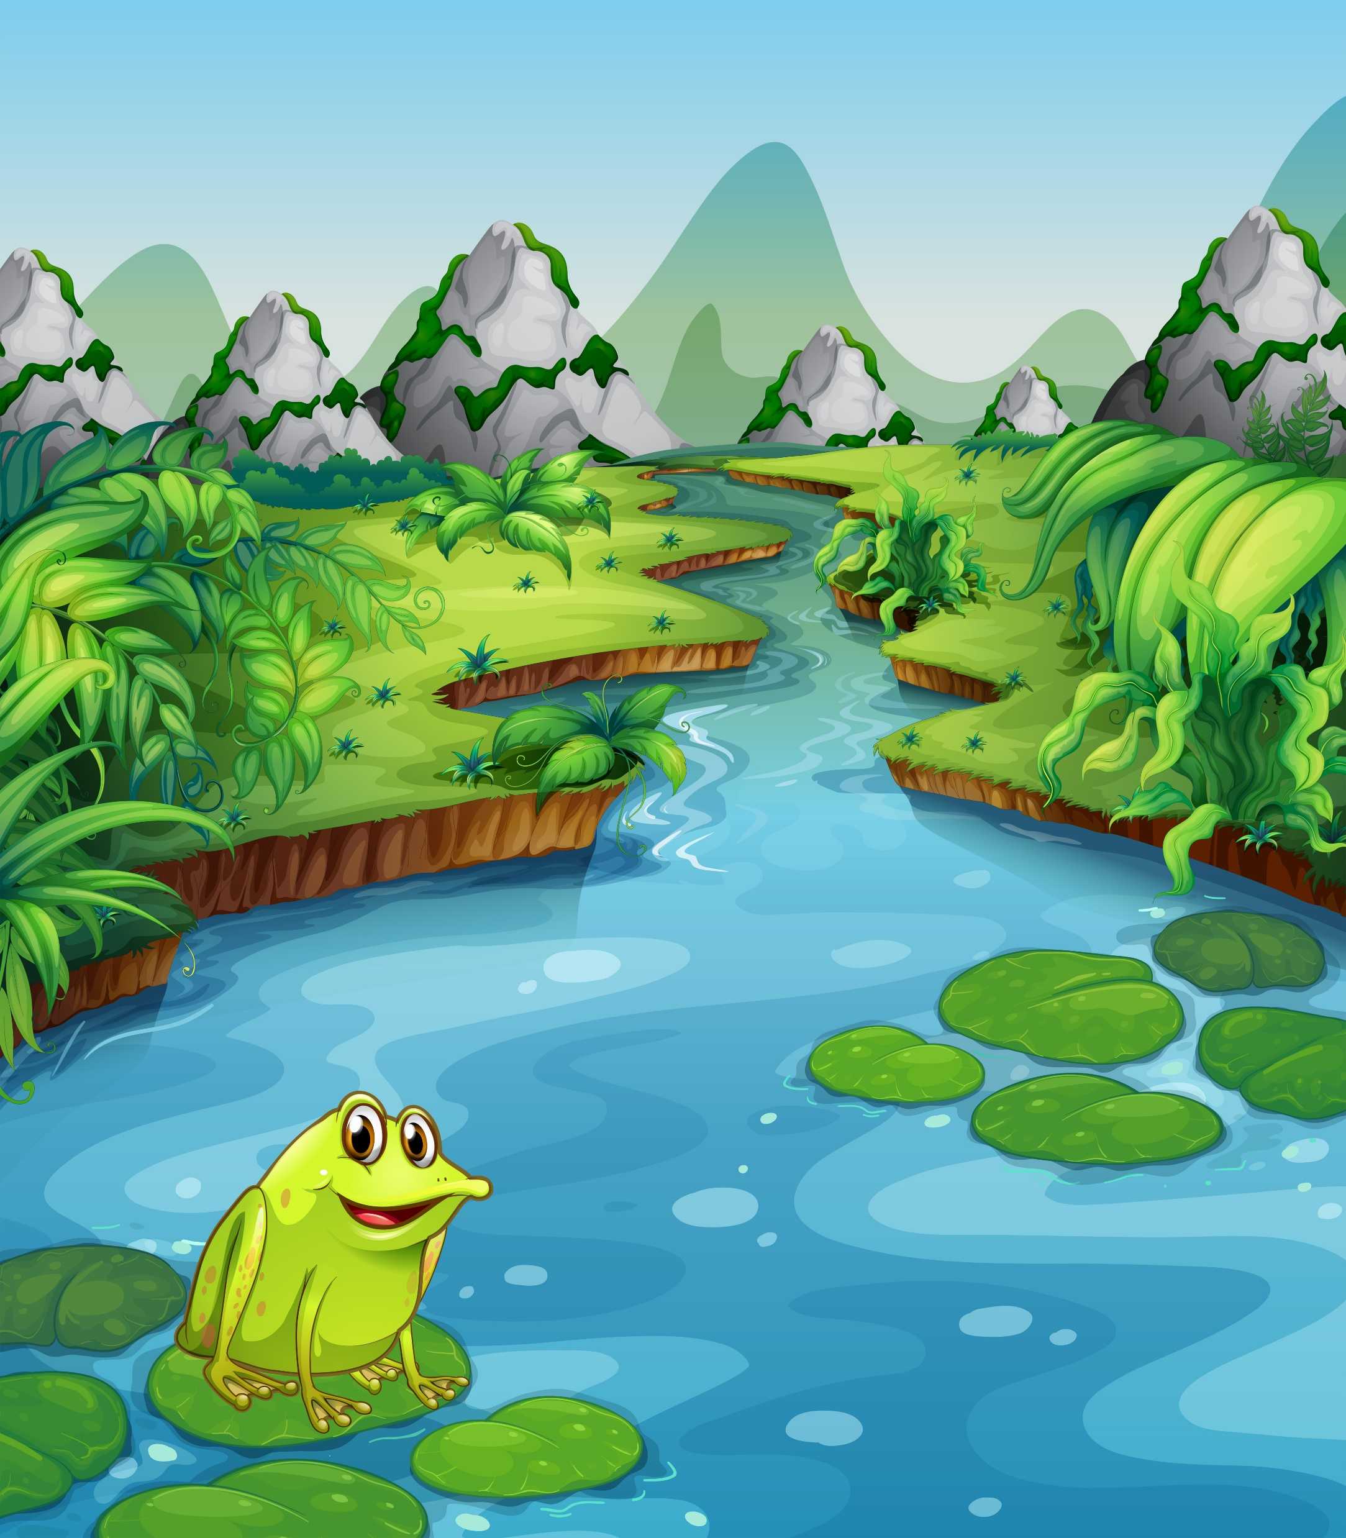
5 Finger Retell
Notes:
Click to show 5 finger retell chart and picture.
Say, “This week you read the story Bullfrog Goes Downstream. Using the 5 finger retell strategy, can you tell me about the story.
Say, “Hold up your thumb, tell me the characters.” (Bullfrog)
Say, “Hold up your pointer, tell me the setting.” (The River and Ocean)
Say, “Hold up your tall finger, tell me the problem.” (Bullfrog went very far downstream)
Say, “Hold up your ring finger, tell me the events.” (Bullfrog found a cowboy, a fisherman, a lumberjack, a grasshopper, a strawberry patch, a swordfish on a surfboard, a jellyfish and stingray, and a humpback whale and starfish) The student does not need to name all of these events. They need to be able to tell at least 3 events from the story.
Say, “Hold up your little finger, tell me the ending/solution.” (Bullfrog swam upstream to go home and had all the friends he found when he went downstream)
Say, “Make a heart with your fingers, does this story remind you of anything from your own life”

Slide 7
Q & A
Any Questions?

