Slide 1
Racing with Words
Fastest er and est
Notes:
Say, “Today we are going to race with words and review er and est endings, sight words, and a main idea and details of the story Fastest Animal.”

Slide 2


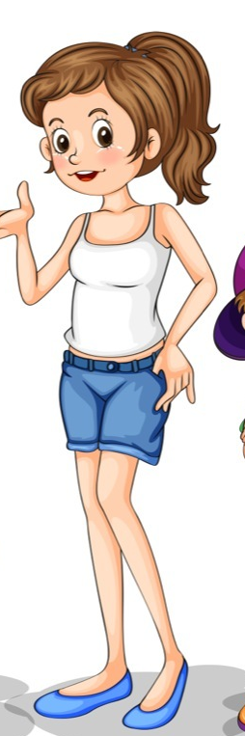


Swifter er and est Review
er
A superlative adjective is an adjective that compares the difference between three or more nouns
A comparative adjective is an adjective that compares the difference between two nouns.
est
Jason is strong.
Mike is stronger.
Dave is the strongest.
Stella is young.
Nora is younger.
Notes:
Click to show er and est. Say, “Today we are going to review er and est.” Click for er and est to disappear.
Click to show the first rule. Say, “A comparative adjective is an adjective that compares the difference between two nouns.” Click for it to disaapear.
Click to show the picture of the girl with the phrase. Say, “Stella is young.”
Click to show the picture of the other girl and phrase. Say, “Nora is younger.”
Click for it to disappear.
Click to show next rule. Say, “A superlative adjective is an adjective that compares the difference between three or more nouns.” Click for it to disappear.
Click to show the picture of the boy with the phrase. Say, “Jason is strong.”
Click to show the picture of another boy with phrase. Say, “Mike is stronger.”
Click to show the picture of last boy and phrase. Say, “Dave is the strongest.”

Slide 3
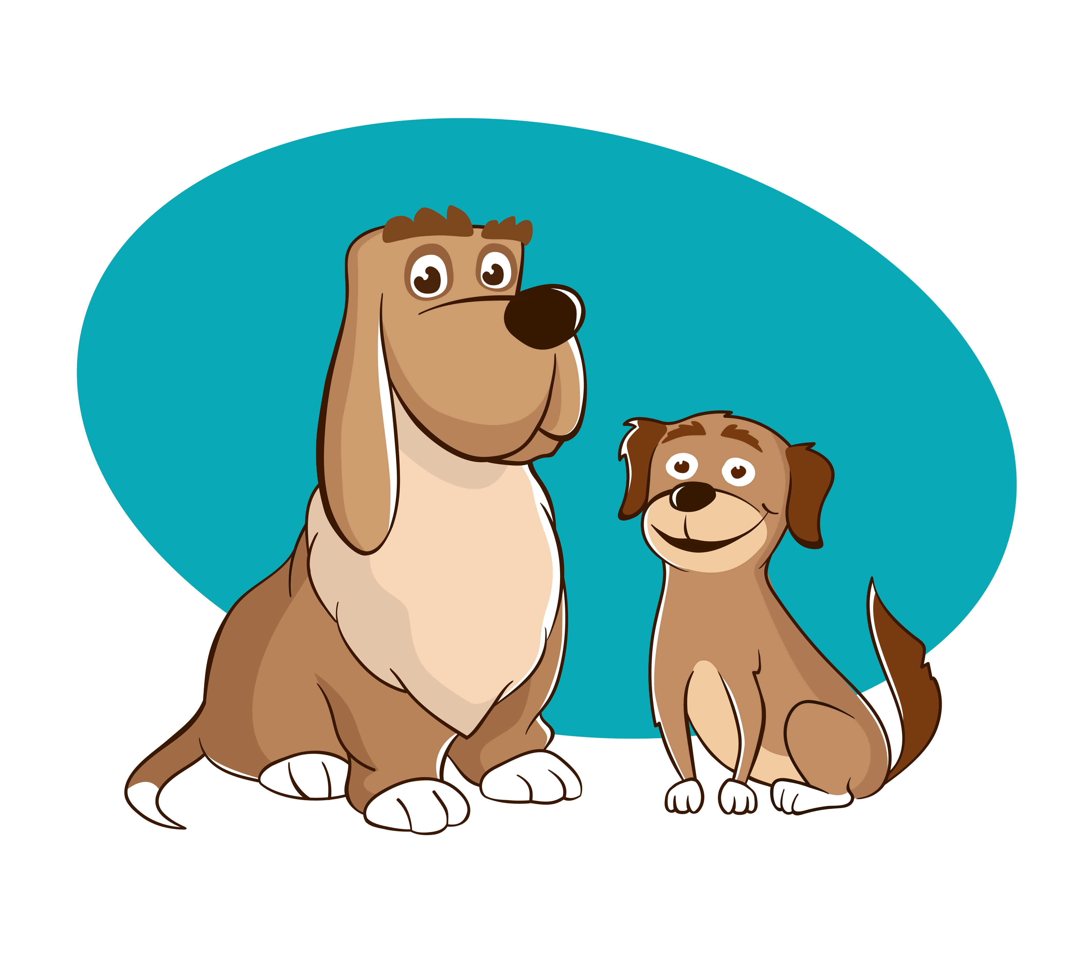
Rapid er and est Practice
bigger
biggest
bigger
My dog is ______ than her dog.
Notes:
Say, “Today we are going to choose which word with er or est completes the sentence.
Remember, er compares two nouns and est compares three or more nouns. I will read the sentence and you need to tell me if the word with er or erst should go in the blank.”
Click to show the picture, sentence with blank and choices. Say, “My dog is (blank) than her dog” Which word would you choose to fill in the blank, bigger or biggest?” Wait for the student to answer correctly and then click to make the correct answer appear in the sentence. Say, “Correct, My dog is bigger than her dog.”

Slide 4

Speedy er and est Practice
faster
fastest
fastest
Lilly is the _______ runner in our class.
Notes:
Click to show the picture, sentence with blank and choices.
Say, “Lilly is the (blank) runner in our class” Which word would you choose to fill in the blank, faster or fastest?” Wait for the student to answer correctly and then click to make the correct answer appear in the sentence. Say, “Correct, Lilly is the fastest runner in our class.”

Slide 5

Rushed er and est Practice
higher
highest
highest
I jumped the _______ in the contest.
Notes:
Click to show the picture, sentence with blank and choices.
Say, “I jumped the (blank) in the contest.” Which word would you choose to fill in the blank, higher or highest?” Wait for the student to answer correctly and then click to make the correct answer appear in the sentence. Say, “Correct, I jumped the highest in the contest.”

Slide 6

Quicker er and est Practice
colder
coldest
colder
Winter is ______ than summer.
Notes:
Click to show the picture, sentence with blank and choices.
Say, “Winter is (blank) than summer” Which word would you choose to fill in the blank, colder or coldest?” Wait for the student to answer correctly and then click to make the correct answer appear in the sentence. Say, “Correct, Winter is colder than summer.”

Slide 7
High Speed Sight Word Review
their
five
own
hold
Notes:
Click to show the sight word. Say, “What is this sight word? That’s right! The sight word is their.”
Click to show the sight word. Say, “What is this sight word? That’s right! The sight word is five.”
Click to show the sight word. Say, “What is this sight word? That’s right! The sight word is own.”
Click to show the sight word. Say, “What is this sight word? That’s right! The sight word is hold.”

Slide 8
Lightening Sight Word Practice
their
five
own
hold
Notes:
Tell the student, “You are going to practice your sight words using actions I am going to tell you the action I want you to do, show you the sight word, and then you say the word 3 times while doing the action. Are you ready?”
Click to show the word their. Say, “Can you read this word 3 times while pretending your flying.”
Click to show the word five. Say, “Can you read this word 3 times while pretending your throwing a football.”
Click to show the word own. Say, “Can you read this word 3 times while you pretend to mix like a chef.”
Click to show the word hold. Say, “Can you read this word 3 times while waddling like a penguin.”

Slide 9
Main Idea and Details
Fastest Animals
Main Idea
Red foxes can run about 30 miles per hour.
Red foxes can run about 30 miles per hour.
Detail
Cheetahs can reach speeds up to 70 miles per hour.
Cheetahs can reach speeds up to 70 miles per hour.
Detail
Quarter horses can run about 50 miles per hour.
Quarter horses can run about 50 miles per hour.
Fastest Animals
Detail
Notes:
Say, “This week you read the story Fastest Animal. This story is a non-fiction story. Do you remember what the main idea and details are of a story?” Wait for the student to answer what the main idea and details of a story are. Say, “Correct, the main idea is what the story is mostly about, and the details support the main idea.”
Say, “Today we are going to move the main idea and details into the correct part of the graphic organizer. You will tell me the answer by telling me the color rectangle the answer is in. First, I’m going to read to you your answer choices.
Red foxes can run about 30 miles per hour.
Cheetahs can reach speeds up to 70 miles per hour.
Quarter horses can run about 50 miles per hour.
Fastest Animals
Say, “What color rectangle is the main idea of the story in? Once the student tells you the color rectangle, click to move it to the graphic organizer. (Main Idea: Fastest Animals)
Say, “What color rectangle is a detail from the story in?” Once the student tells you the color rectangle, click to move it to the graphic organizer. (Details: Can be any of these answers – Red foxes can run about 30 miles per hour, Cheetahs can reach speeds up to 70 miles per hour, Quarter horses can run about 50 miles per hour.)
Say, “What color rectangle is a detail from the story in?” Once the student tells you the color rectangle, click to move it to the graphic organizer. (Details: Can be any of these answers – Red foxes can run about 30 miles per hour, Cheetahs can reach speeds up to 70 miles per hour, Quarter horses can run about 50 miles per hour.)
Say, “What color rectangle is a detail from the story in?” Once the student tells you the color rectangle, click to move it to the graphic organizer. (Details: Can be any of these answers – Red foxes can run about 30 miles per hour, Cheetahs can reach speeds up to 70 miles per hour, Quarter horses can run about 50 miles per hour.)

Slide 10
Q & A
Any Questions?

