Slide 1
Applaud Words
Awesome au and aw
Notes:
Say, “Today we are going to have an awesome review of au and aw, our sight words, and main idea and details of the story Grow Strawberries.

Slide 2
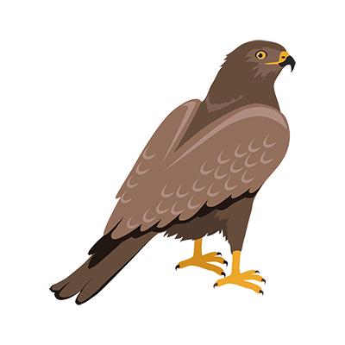
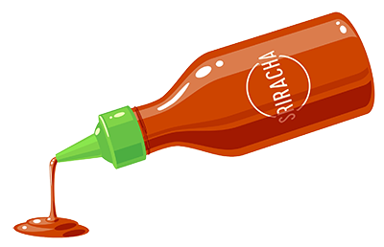
Pause for au and aw Review
aw
au
Notes:
Say, “Listen closely as I say each word with the au and aw sound in it. After I say the word you repeat it”
Click to show au and picture of sauce. Say, “au” sound as in sauce” student repeats au as in sauce.
Click to show aw and picture of a hawk. Say, “aw” sound as in hawk” student repeats aw as in hawk.

Slide 3
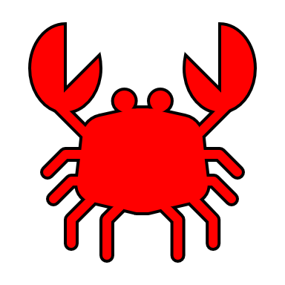
Because We Love au and aw Practice
clau
claw
Notes:
Say, “Today we are going to find the correct spelling of the picture. We will need to figure out if it has an au or aw in it. Are you ready?
Click to show the picture of a claw and the words. Say, “what is this a picture of?” If the student answers incorrectly tell them, it’s a claw.
Say, “Which one of these words is the correct spelling of claw?”
Click so that claw is circled only if the student spells it correctly.
Say, “Correct, c-l-a-w is how you spell claw. Let’s try again!”

Slide 4
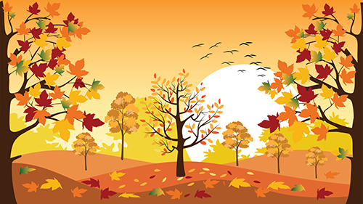
Flawless au and aw Practice
autumn
awtumn
Notes:
Click to show the picture of autumn and the words. Say, “what is this a picture of?” If the student answers incorrectly tell them, it’s autumn.
Say, “Which one of these words is the correct spelling of autumn?”
Click so that autumn is circled only if the student spells it correctly.
Say, “Correct, a-u-t-u-m-n is how you spell autumn. Let’s try again!”

Slide 5

Awfully Fantastic au and aw Practice
pau
paw
Notes:
Click to show the picture of a paw and the words. Say, “what is this a picture of?” If the student answers incorrectly tell them, it’s a paw.
Say, “Which one of these words is the correct spelling of paw?”
Click so that paw is circled only if the student spells it correctly.
Say, “Correct, p-a-w is how you spell paw. Let’s try again!”

Slide 6

I Saw au and aw Practice
vault
vawlt
Notes:
Click to show the picture of a vault and the words. Say, “what is this a picture of?” If the student answers incorrectly tell them, it’s a vault.
Say, “Which one of these words is the correct spelling of vault?”
Click so that vault is circled only if the student spells it correctly.
Say, “Correct, v-a-u-l-t is how you spell vault.”

Slide 7
Launch a Sight Word Review
sing
would
fast
much
only
Notes:
Say, “Today we are going to review our sight words. When I say the sight word you tell me which color square to click.”
Only click that square if the student is correct. If the student is wrong. Say, “That is not the correct sight word. Let’s try again and repeat the sight word.
Continue until all the squares have disappeared.

Slide 8
Sight Word Memory
sing
would
fast
much
fast
only
much
only
would
sing
Notes:
Say, “We are going to play sight word memory. You will tell me a color to click on and then choose another color. If they are a match, then move onto two new boxes. If they are not the same flip them back over so you can try again. Try to remember where they were so you can a match the words the next time!”
Allow the student to continue until all the sight words are matched.

Slide 9
Main Idea and Details
How to grow strawberries
Main Idea
Strawberry plants grow to about 5 inches tall
Strawberry plants grow to about 5 inches tall
Detail
Strawberries need sunlight and water to grow
Strawberries need sunlight and water to grow
Detail
Strawberries have seeds on the outside
Strawberries have seeds on the outside
How to grow strawberries
Detail
Notes:
Say, “This week you read the story Grow Strawberries. This story is a non-fiction story. Do you remember what the main idea and details are of a story?” Wait for the student to answer what the main idea and details of a story are. Say, “Correct, the main idea is what the story is mostly about and the details support the main idea.”
Say, “Today we are going to move the main idea and details into the correct part of the graphic organizer. You will tell me the answer by telling me the color rectangle the answer is in. First, I’m going to read to you your answer choices.
Strawberry plants grow to about 5 inches tall
Strawberries need sunlight and water to grow
Strawberries have seeds on the outside
How to grow strawberries
Say, “What color rectangle is the main idea of the story in? Once the student tells you the color rectangle, click to move it to the graphic organizer. (Main Idea: How to grow strawberries)
Say, “What color rectangle is a detail from the story in?” Once the student tells you the color rectangle, click to move it to the graphic organizer. (Details: Can be any of these answers – Strawberry plants grow to about 5 inches tall, Strawberries need sunlight and water to grow, or Strawberries have seeds on the outside)
Say, “What color rectangle is a detail from the story in?” Once the student tells you the color rectangle, click to move it to the graphic organizer. (Details: Can be any of these answers – Strawberry plants grow to about 5 inches tall, Strawberries need sunlight and water to grow, or Strawberries have seeds on the outside)
Say, “What color rectangle is a detail from the story in?” Once the student tells you the color rectangle, click to move it to the graphic organizer. (Details: Can be any of these answers – Strawberry plants grow to about 5 inches tall, Strawberries need sunlight and water to grow, or Strawberries have seeds on the outside)

Slide 10
Q & A
Any Questions?

