Slide 1
Fun at the Zoo
Wild with es and s
Notes:
Say, “Today we are going to go wild with a review of es and s, our sight words, and go over the beginning, middle, and end of the story “What I Saw at the Zoo”.

Slide 2
Roaring es and s Review
You add the suffix -es if the word ends with s, sh, ch, x, or z
You add the suffix -s if the words ends in any other letter
pens
pen
latches
latch
Notes:
Say, “Today we are going to review adding s and es to words to make them plural. Remember plural means more than one.”
Click to show the first rule. Say, “You add the suffix -es if the word ends with s, sh, ch, x, or z.”
Click to show word latch. Say, “this is the singular noun latch.” Click to show the word latches. Say, “latch ends in ch so we need to add an es to the end to make it plural.”
Click for it to disappear.
Click to show next rule. Say, “You add the suffix -s if the words ends in any other letter.”
Click to show word pen. Say, “this is the singular noun pen.” Click to show the word pens. Say, “pen ends in n so we need to add an s to the end to make it plural.”

Slide 3

Monkeying Around es and s Practice .
es
s
flowers
Notes:
Say, “Today we will need to figure out if the singular noun needs an es or s at the end to make it plural. Are you ready?
Click to show the picture of a flower and es and s. Say, “what is this a picture of?” If the student answers incorrectly tell them, it’s a flower.
Say, “Would you add an es or s to this word to make it plural?” Wait for the student to answer. Click to circle s and have the word flowers appear.
Say, “Correct, you add an s to the end of flower to make it plural. Let’s try again!”

Slide 4

Stampede of es and s Practice
es
s
watches
Notes:
Click to show the picture of a watch and es and s. Say, “what is this a picture of?” If the student answers incorrectly tell them, it’s a watch.
Say, “Would you add an es or s to this word to make it plural?” Wait for the student to answer. Click to circle es and have the word watches appear.
Say, “Correct, you add an es to the end of watch to make it plural. Let’s try again!”

Slide 5
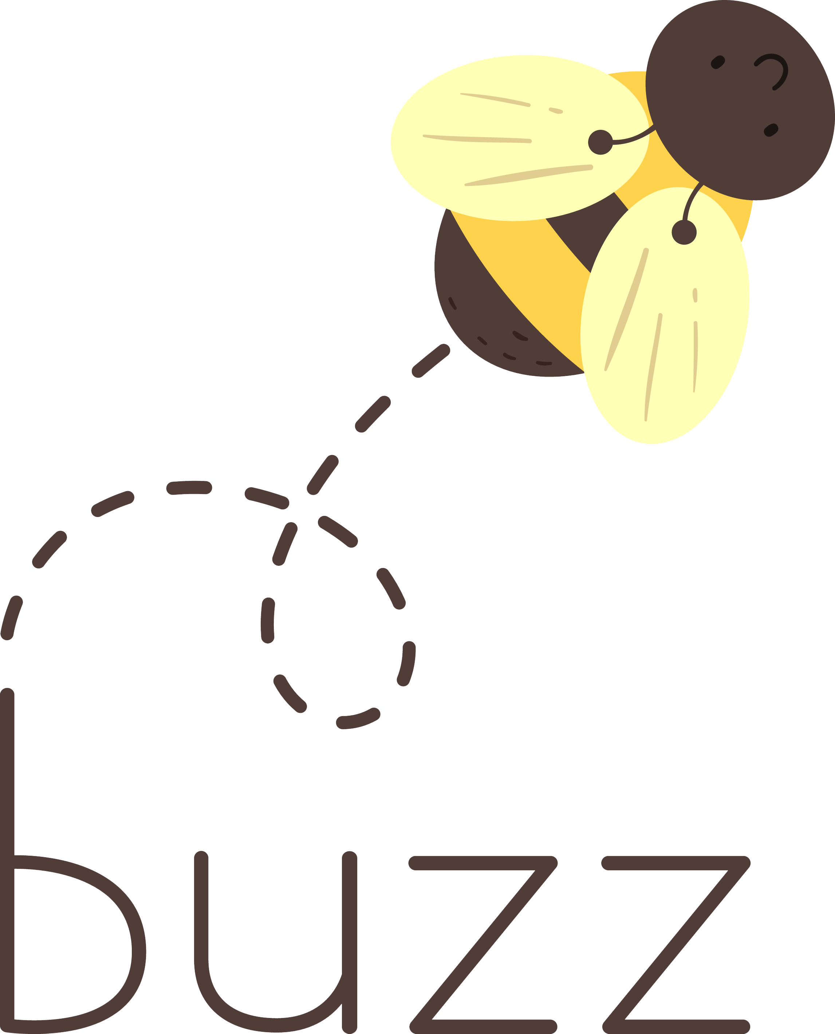
Buzzing Around with es and s Practice
es
s
buzzes
Notes:
Click to show the picture of a bee buzzing and es and s. Say, “what is this a picture of?” If the student answers incorrectly tell them, it’s a bee buzzing.
Say, “Would you add an es or s to this word to make the word buzz plural?” Wait for the student to answer. Click to circle es and have the word buzzes appear.
Say, “Correct, you add an es to the end of buzz to make it plural. Let’s try again!”

Slide 6

Flying with es and s practice
es
s
birds
Notes:
Click to show the picture of a bird and es and s. Say, “what is this a picture of?” If the student answers incorrectly tell them, it’s a bird.
Say, “Would you add an es or s to this word to make it plural?” Wait for the student to answer. Click to circle s and have the word birds appear.
Say, “Correct, you add an s to the end of bird to make it plural.”

Slide 7
Squawking Sight Word Review
off
wash
buy
today
or
which
call
drink
pull
why
long
Notes:
Say, “Today we are going to review our sight words from Module 19-24. When I say the sight word you tell me which color square to click.”
Only click that square if the student is correct. If the student is wrong. Say, “That is not the correct sight word. Let’s try again and repeat the sight word.
Continue until all the squares have disappeared.

Slide 8
Chirping Sight Word Review
cold
far
read
wish
never
does
together
right
work
about
eight
full
Notes:
Say, “Today we are going to review our sight words from Module 19-24. When I say the sight word you tell me which color circle to click.”
Only click that circle if the student is correct. If the student is wrong. Say, “That is not the correct sight word. Let’s try again and repeat the sight word.
Continue until all the circles have disappeared.

Slide 9
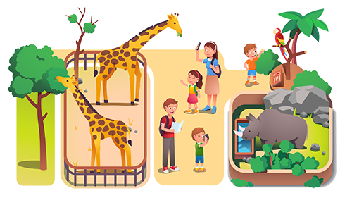
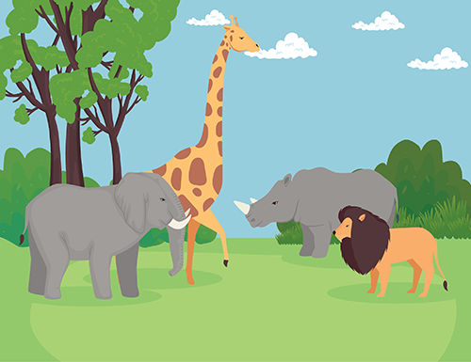
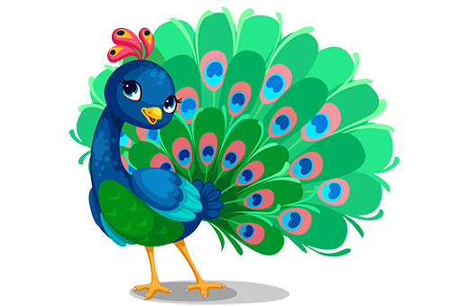
Beginning Middle End
Beginning
Josh saw many different animals
Josh and his parents went to the zoo.
Middle
Josh saw many different animals
The peacock ate their snacks
Ending
Josh and his parents went to the zoo.
The peacock ate their snacks
Notes:
Say, “This week you read the story What I Saw at the Zoo. Today I am going to show you some pictures and you will need to tell me if this happened in the Beginning, Middle or End of the story
Click to show the graphic organizer and the pictures.
Say, “First I will read you each event.”
Josh saw many different animals.
The peacock ate their snacks.
Josh and his parents went to the zoo.
Say, “What happened at the beginning of the story? Correct, Josh and his parents went to the zoo.” Click the picture to move it to beginning.
Say, “What happened in the middle of the story? Correct, Josh saw many different animals.” Click the picture to move it to the middle.
Say, “What happened at the end of the story? Correct, the peacock ate their snacks.” Click the picture to move it to the end.

Slide 10
Q & A
Any Questions?

