Slide 1
Making a Mess of Words
Sloppy Double Consonants
Notes:
Say, “Today we are going to make a mess with words and review double consonants, our sight words, and the 5 finger retell of the story “Tess is a Mess”.

Slide 2


Cluttered Double Consonant Review
Double the middle consonant when a word has two syllables, and the first vowel is short.
Double the consonants f, l, s, and z when they appear after a short vowel in a one syllable word.
ball
muffin
Notes:
Say, “Today we are going to review double consonants.”
Click to show the first rule. Say, “In our first rule, we double the consonants f, l, s, and z when they appear after a short vowel in a one syllable word.”
Click to show the ball and the word ball. Say, “What is this a picture of? Yes, a ball. Ball has the double consonant l and the short a vowel sound in it!
Click for it to disappear.
Click to show next rule. Say, “In the 2nd rule, we double the middle consonant when a word has two syllables, and the first vowel is short.”
Click to show muffin and the word muffin. Say, “What is this a picture of? Yes, it’s a muffin. Muffin has the double consonant f in the middle and a short u vowel sound in it. Let’s Practice!”

Slide 3

Muddled Double Consonant Practice
dre __
ss
ss
ll
ff
zz
Notes:
Say, “I am going to show you a picture and a word with the double consonant missing. You need to tell me which double consonant completes the word.”
Click to show the dress, word with missing letters, and choices.
Say, “What is this a picture of?” Wait for the student to answer. Say, “Correct, it is a dress.” If the student answers incorrectly tell them, it is a picture of a dress.
Say, “Which double consonant goes in the missing boxes?” Wait for the student to answer. Click the ss to disappear and appear in the boxes. Say, “Great job, ss goes in the boxes to make the word dress. Let’s try again!”

Slide 4

Messy Double Consonant Practice
bu __ les
bb
tt
nn
bb
rr
Notes:
Click to show the bubbles, word with missing letters, and choices.
Say, “What is this a picture of?” Wait for the student to answer. Say, “Correct, it is bubbles.” If the student answers incorrectly tell them, it is a picture of bubbles.
Say, “Which double consonant goes in the missing boxes?” Wait for the student to answer. Click the bb to disappear and appear in the boxes. Say, “Great job, bb goes in the boxes to make the word bubbles. Let’s try again!”

Slide 5

Disarray of Double Consonant Practice
cli __
ff
ss
ll
ff
ss
Notes:
Click to show the cliff, word with missing letters, and choices.
Say, “What is this a picture of?” Wait for the student to answer. Say, “Correct, it is a cliff.” If the student answers incorrectly tell them, it is a picture of a cliff.
Say, “Which double consonant goes in the missing boxes?” Wait for the student to answer. Click the ff to disappear and appear in the boxes. Say, “Great job, ff goes in the boxes to make the word cliff. Let’s try again!”

Slide 6

Dirty Double Consonant Practice
ca __ ot
rr
tt
nn
bb
rr
Notes:
Click to show the carrot, word with missing letters, and choices.
Say, “What is this a picture of?” Wait for the student to answer. Say, “Correct, it is a carrot.” If the student answers incorrectly tell them, it is a picture of a carrot.
Say, “Which double consonant goes in the missing boxes?” Wait for the student to answer. Click the rr to disappear and appear in the boxes. Say, “Great job, rr goes in the boxes to make the word carrot.”

Slide 7
Sloppy Sight Word Review
right
work
about
eight
full
Notes:
Say, “Today we are going to review our sight words. When I say the sight word you tell me which color square to click.”
Only click that square if the student is correct. If the student is wrong. Say, “That is not the correct sight word. Let’s try again and repeat the sight word.
Continue until all the squares have disappeared.

Slide 8
Supreme Sight Word Practice
right
work
about
eight
full
Notes:
Tell the student, “You are going to practice your sight words using silly voices. I am going to show you the sight word, tell you the type of silly voice I want hear, and then you say it in that silly voice. Are you ready?”
Click to show the word right. Say, “Can you read this word in a squeaky voice?”
Click to show the word work. Say “Can you read this word in a mad voice?”
Click to show the word about. Say, “Can you read this word in a surprised voice?”
Click to show the word eight. Say, “Can you read this word in a sleepy voice?”
Click to show the word full. Say, “Can you read this word in a whisper voice?”

Slide 9
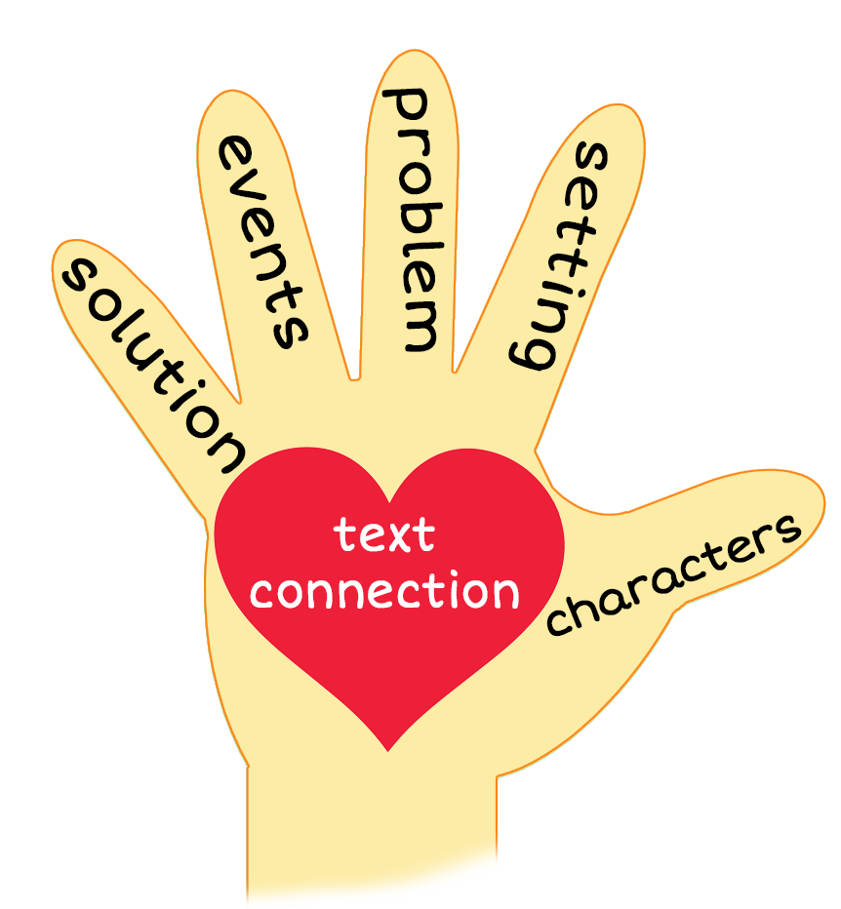
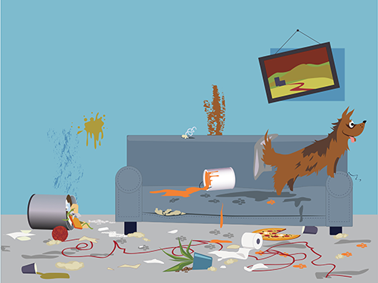
5 Finger Retell
Notes:
Say, “Look at the 5 finger retell chart. Use the chart to help you retell the story Tess is a Mess.”
Say, “Hold up your thumb, tell me the character.” (Tess)
Say, “Hold up your pointer, tell me the setting.” (House)
Say, “Hold up your tall finger, tell me the problem.” (Tess makes a mess)
Say, “Hold up your ring finger, tell me the events.” (She gets into the trash, she howls when she hears the doorbell, brings in grime when its time for dinner, she chews up slippers at night, she loves playing ball, and she will drink your drink and eat your dinner)
Say, “Hold up your little finger, tell me the ending/solution.” (They still love Tess)
Say, “Make a heart with your fingers, do you have a pet? Is your pet messy?

Slide 10
Q & A
Any Questions?

