Slide 1
Wishing on Words
Dreaming of ed and ing
Notes:
Say, “Today we are going to dream of reviewing ed and ing endings, sight words, and a 5 finger retell of the story “The Wish”.”

Slide 2

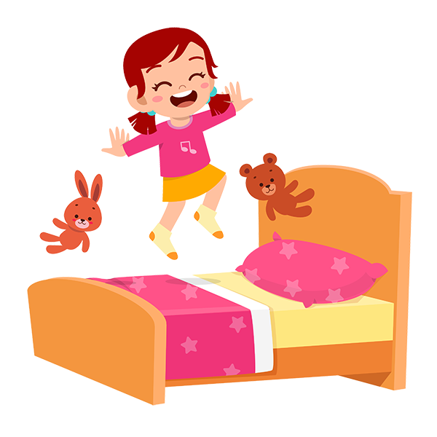
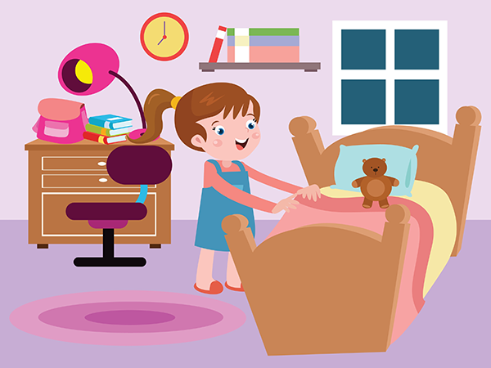
Hoping for an ed and ing Review
ing
ed – when you add ed to the end of a word it means it has already happened.
ing – when you add ing to the end of a word it means it’s happening now.
ed
I jumped on my bed.
I am jumping on my bed.
Notes:
Click to show ing and ed. Say, Today we are going to review the endings ed and ing.” Click for it to disappear.
Click for ing and definition of adding ing. Say, “when you add ing to the end of a word it means it’s happening now.” Click for it to disappear.
Click to show the picture of a girl jumping on a bed and the sentence I am jumping on my bed. Say, “I am jumping on my bed. This means the girl is jumping now. Click for it to disappear.
Click for ed and definition of adding ed. Say, “when you add ed to the end of a word it means it has already happened.” Click for it to disappear.
Click to show the picture of a girl standing next to her bed with a thought bubble of her jumping on the bed and the sentence I jumped on my bed. Say, “I jumped on my bed. This means the girl jumped on her bed in the past.

Slide 3

Imagining ed and ing Practice
helping
helped
helped
Johnny _______ his mom sweep the floor.
Notes:
Say, “Today we are going to choose which word with ed or ing completes the sentence. I will read the sentence and you need to tell me if the word with ing or ed should go in the blank.”
Click to show the picture, sentence with blank and choices. Say, “Johnny ________ his mom sweep the floor.” Which word would you choose to fill in the blank, helping or helped?” Wait for the student to answer correctly and then click to make the correct answer appear in the sentence. Say, “Correct, Johnny helped his mom sweep the floor.”

Slide 4
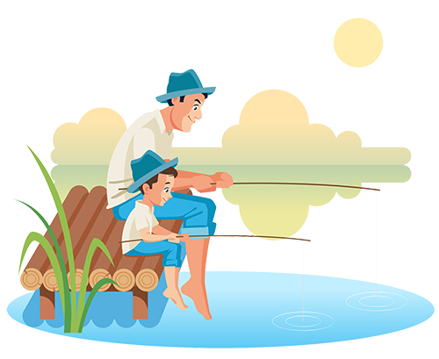
Hoped for ed and ing Practice
fishing
fished
fishing
Jaxon went ______ with his dad.
Notes:
Click to show the picture, sentence with blank and choices. Say, “Jaxon went ________ with his dad.” Which word would you choose to fill in the blank, fishing or fished?” Wait for the student to answer correctly and then click to make the correct answer appear in the sentence. Say, “Correct, Jaxon went fishing with his dad.”

Slide 5
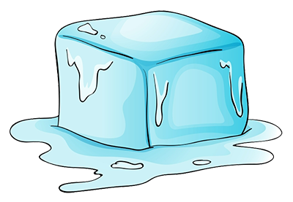
Dreaming of ed and ing Practice
melting
melted
melted
The ice cube ______ down to water.
Notes:
Click to show the picture, sentence with blank and choices. Say, “The ice cube ______ down to water ” Which word would you choose to fill in the blank, melting or melted?” Wait for the student to answer correctly and then click to make the correct answer appear in the sentence. Say, “Correct, The is cube melted down to water.”

Slide 6
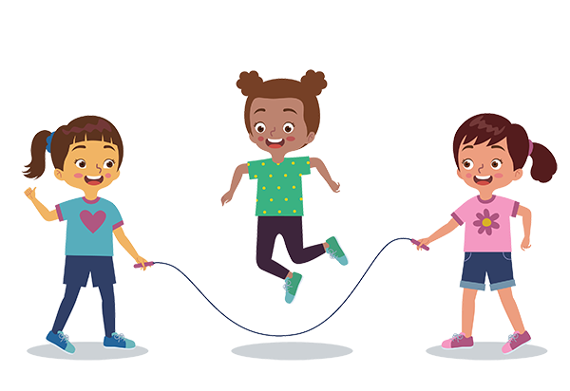
Visualize ed and ing Practice
jumping
jumped
jumping
Luna is _______ rope with her friends.
Notes:
Click to show the picture, sentence with blank and choices. Say, “Luna is ________ rope with her friends.” Which word would you choose to fill in the blank, jumping or jumped?” Wait for the student to answer correctly and then click to make the correct answer appear in the sentence. Say, “Correct, Luna is jumping rope with her friends.”

Slide 7
Surprising Sight Word Review
read
wish
together
does
never
Notes:
Click to show the sight words. Say, “I’ll say the sight word and you repeat it after me.”
Click for the word to emphasize. Say, “read” Student repeats read.
Click for the word to emphasize. Say, “wish” Student repeats wish.
Click for the word to emphasize. Say, “together” Student repeats together.
Click for the word to emphasize. Say, “does” Student repeats does.
Click for the word to emphasize. Say, “never” Student repeats never.
The students will need a piece of paper and pencil for the next activity. They will be asked to write their sight words and then read it.
Say, “Please go get a piece of paper and a pencil for the next activity.”

Slide 8
Celebrating Sight Words Practice
read
wish
together
does
never
Notes:
Say, “I will say a sight word. Then you will write that sight word on a piece of paper and hold it up so I can see it. I will show you the word to check that you spelled it correctly and then you will say the word. Let’s try it!”
Say, “read.”
Say, “Write the word read on your paper.”
Click to show the sight word goes to check their work.
Say, “What is the word?” Correct, the word is read.”
Say, “wish.”
Say, “Write the word wish on your paper.”
Click to show the sight word wish to check their work.
Say, “What is the word?” Correct, the word is wish.”
Say, “together.”
Say, “Write the word together on your paper.”
Click to show the sight word together to check their work.
Say, “What is the word?” Correct, the word is together.”
Say, “does”
Say, “Write the word does on your paper.”
Click to show the sight word does to check their work.
Say, “What is the word?” Correct, the word is does.”
Say, “never”
Say, “Write the word never on your paper.”
Click to show the sight word never to check their work.
Say, “What is the word?” Correct, the word is never.”

Slide 9
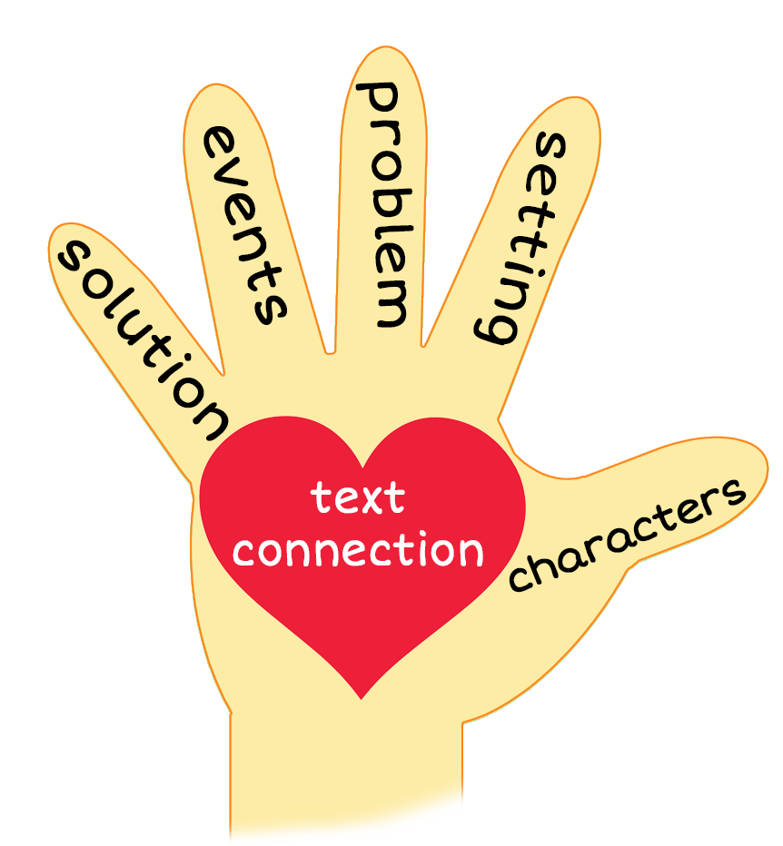
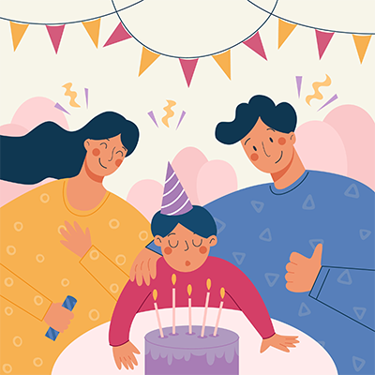
5 Finger Retell
Notes:
Say, “This week you read the story The Wish. Using the 5 finger retell strategy, can you tell me about the story. Click to bring up images on screen.
Say, “Hold up your thumb, tell me the characters.” (Ben and his mom)
Say, “Hold up your pointer, tell me the setting.” (Their house, the park, the movies, the library, and a restaurant)
Say, “Hold up your tall finger, tell me the problem.” (Ben wants his wish to come true)
Say, “Hold up your ring finger, tell me the events.” (Ben goes to the park, the movies, the library. And to dinner at a restaurant)
Say, “Hold up your little finger, tell me the ending/solution.” (Ben’s wish came true. He got to spend time with his mom and dad)
Say, “Make a heart with your fingers, have you ever made a birthday wish that came true?

Slide 10
Q & A
Any Questions?

