Slide 1
Party Time
Celebration of Words
Notes:
Say, “Today we are going to have a celebration of words reviewing ur, er, and ir sound, sight words, and a 5 finger retell of the story “The Birthday Party”. “

Slide 2
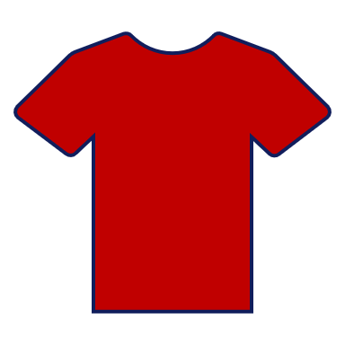

Happy Birthday ur, er, ir Review
ur
ir
er
Notes:
Say, “Listen closely as I say each word with the ur, er, and ir sound in it. After I say the word, you repeat it”
Click to show ur and picture of the color purple. Say, “ur” as in purple” student repeats ur as in purple. Click for it to disappear.
Click to show er and picture of a fern. Say, “er” as in fern” student repeats er as in fern. Click for it to disappear.
Click to show ir and picture of a shirt. Say, “ir” as in shirt” student repeats ir as in shirt.

Slide 3


Surprise ur Practice
fur
her
sir
burn
curve
skirt
Notes:
Say, “What sound does the ur make? Correct! It makes the /er/ sound”. I am going to show you a set of words. You will tell me which words have the ur sound. If you get it correct a check mark will appear. If you get it wrong an “x” will appear and you will need to try again. Ready?
Click to the show set of words. Say, “Which words have the ur sound?” Click until all words are found.

Slide 4
Perfect er Practice
curl
germ
clerk
girl
herd
hurt
Notes:
Say, “What sound does the er make? Correct! It makes the /er/ sound”. I am going to show you a set of words. You will tell me which words have the er sound. If you get it correct a check mark will appear. If you get it wrong an “x” will appear and you will need to try again. Ready?
Click to the show set of words. Say, “Which words have the er sound?” Click until all words are found.

Slide 5
Birthday Party ir Practice
nurse
jersey
bird
stir
turn
skirt
Notes:
Say, “What sound does the ir make? Correct! It makes the /er/ sound”. I am going to show you a set of words. You will tell me which words have the ir sound. If you get it correct a check mark will appear. If you get it wrong an “x” will appear and you will need to try again. Ready?
Click to the show set of words. Say, “Which words have the ir sound?” Click until all words are found.

Slide 6
Burst of Sight Word Review
or
which
call
drink
Notes:
Say, “We are going to review our sight words. I will show you a sight word and you need to read it to me. Ready?”
Click to show the sight word. Say, “What is this sight word? That’s right! The sight word is or.”
Click to show the sight word. Say, “What is this sight word? That’s right! The sight word is which.”
Click to show the sight word. Say, “What is this sight word? That’s right! The sight word is call.”
Click to show the sight word. Say, “What is this sight word? That’s right! The sight word is drink.”

Slide 7
Presents of Sight Word Practice
or
which
call
drink
Notes:
Say, “You are going to practice your sight words using actions I am going to tell you the action I want you to do, show you the sight word, and then you say the word 3 times while doing the action. Are you ready?”
Click to show the word or. Say, “Can you read this word 3 times while doing jumping jacks.”
Click to show the word which. Say, “Can you read this word 3 times while spinning in a circle.”
Click to show the word call. Say, “Can you read this word 3 times while patting your head.”
Click to show the word drink. Say, “Can you read this word 3 times while blinking your eyes.”

Slide 8
Super Sequencing
The girl is having a birthday party with three friends
First
She offers her friends water or purple punch
She offers her friends water or purple punch
Next
They choose chocolate swirl cake for dessert
Then
They choose chocolate swirl cake for dessert
The girl is having a birthday party with three friends
She opens her presents
She opens her presents
Last
Notes:
Say, “This week you read the story The Birthday Party. We are going to put this story in order of how events happened.
Say, “We are going to put the colored rectangles in the correct order of how the events happened in the story. First, I will read you each event.”
She offers her friends water or purple punch to drink.
They choose chocolate swirl cake for dessert.
The girl is having a birthday party with 3 friends.
She opens her presents.
Say, “What colored box tells me what happened first?” (The girl is having a birthday party) Click the rectangle to move it to the 1st sequence box.
Say, “What colored box tells me what happened next?” (She offers her friends water or purple punch) Click the rectangle to move it to the next sequence box.
Say, “What colored box tells me then what happened? (She opens her presents) Click the rectangle to move it to the then sequence box.
Say, “What colored box tells me the last event that happened?” (They choose chocolate swirl cake for dessert) Click the rectangle to move it to the last sequence box.

Slide 9
Q & A
Any Questions?

