Slide 1
Ignite Your Learning
Glowing igh, ie, and y
Notes:
Say, “Today we are going to ignite your learning with a review of igh, ie, and y, our sight words, and main idea and details of the story “Light”.

Slide 2



Sparkling igh, ie, and y Review
y
ie
igh
Notes:
Say, “Listen closely as I say each word with the igh, ie, and y sound in it. After I say the word, you repeat it”
Click to show igh and picture of a knight. Say, “igh” as in knight” student repeats igh as in knight.
Click to show ie and picture of a lie (a person laying down). Say, “ie” as in lie” student repeats ie as in lie.
Click to show y and picture of a fly. Say, “y” as in fly” student repeats y as in fly.

Slide 3





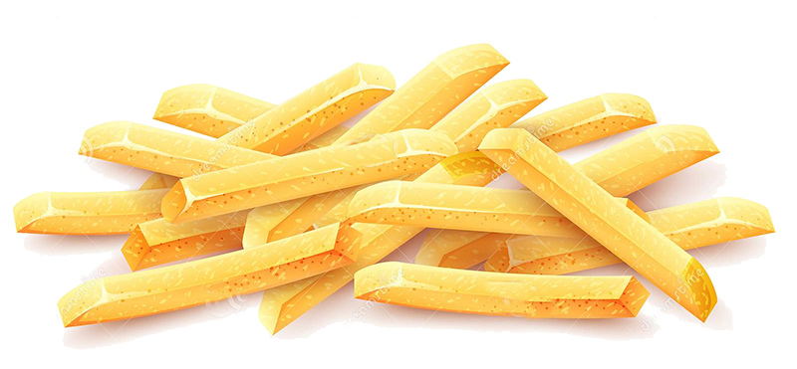
Twinkling Phonics Practice
igh
ie
y
Notes:
Click to show word sort chart and pictures.
Say, “We are going to sort the pictures under the correct column. Can you name each of these pictures?” (pie, right, light, fry, tie, spy) If the student doesn’t name the picture correctly, tell them what it is.
Say, “What column would pie go under? Yes! Pie would go under ie.” Click the pie to move under ie column.
Say, “What column would right go under? Yes! Right would go under igh.” Click right to move under igh column.
Say, “What column would light go under? Yes! Light would go under igh.” Click the light to move under igh column.
Say, “What column would fry go under? Yes! Fry would go under y.” Click the fry to move under y column.
Say, “What column would tie go under? Yes! tie would go under ie.” Click the tie to move under ie column.
Say, “What column would spy go under? Yes! Spy would go under y.” Click the spy to move under y column.

Slide 4
Shimmering Sight Word Review
goes
those
done
been
upon
laugh
because
its
us
Notes:
Say, “Today we are going to review our sight words from Module 19-24. When I say the sight word you tell me which color square to click.”
Only click that square if the student is correct. If the student is wrong. Say, “That is not the correct sight word. Let’s try again and repeat the sight word.
Continue until all the squares have disappeared.

Slide 5
Shining Sight Word Review
before
ten
many
very
made
use
both
best
draw
light
Notes:
Say, “Today we are going to review our sight words from Module 19-24. When I say the sight word you tell me which color circle to click.”
Only click that circle if the student is correct. If the student is wrong. Say, “That is not the correct sight word. Let’s try again and repeat the sight word.
Continue until all the circles have disappeared.

Slide 6
Brighten Up! Main Idea and Details
Main Idea
Light
Plants need light
Plants need light
Detail
Light
A lightbulb gives off light
Detail
A lightbulb gives off light
Light can pass through water, air, and glass
Light can pass through water, air, and glass
Detail
Notes:
Say, “This week you read the story Light. This story is a non-fiction story. Do you remember what the main idea and details are of a story?” Wait for the student to answer what the main idea and details of a story are. Say, “Correct, the main idea is what the story is mostly about, and the details support the main idea.”
Say, “Today we are going to move the main idea and details into the correct part of the graphic organizer. You will tell me the answer by telling me the color rectangle the answer is in. First, I’m going to read to you your answer choices.
Plants Need Light
Light
A lightbulb gives off light
Light can pass through water, air, and glass
Say, “What color rectangle is the main idea of the story in? Once the student tells you the color rectangle, click to move it to the graphic organizer. (Main Idea: Light)
Say, “What color rectangle is a detail from the story in?” Once the student tells you the color rectangle, click to move it to the graphic organizer. (Details: Can be any of these answers – plants need light, a lightbulb gives off light, or light can pass through water, air, and glass)
Say, “What color rectangle is a detail from the story in?” Once the student tells you the color rectangle, click to move it to the graphic organizer. (Details: Can be any of these answers – plants need light, a lightbulb gives off light, or light can pass through water, air, and glass)
Say, “What color rectangle is a detail from the story in?” Once the student tells you the color rectangle, click to move it to the graphic organizer. (Details: Can be any of these answers – plants need light, a lightbulb gives off light, or light can pass through water, air, and glass)

Slide 7
Q & A
Any Questions?

