Slide 1
Words Have Power
Drawing Up oa, oe, and ow
Notes:
Say, “Today we are going to draw up a review of oa, oe, and ow sound, our sight words, and a 5 finger retell of the story “I Love to Draw”.

Slide 2



Sketching a Review of oa, oe, and ow
oe
oa
ow
Notes:
Say, “Listen closely as I say each word with the oa, oe, and ow sound in it. After I say the word you repeat it”
Click to show oa and picture of a boat. Say, “oa” sound as in boat” student repeats oa as in boat.
Click to show oe and picture of a toe. Say, “oe” sound as in toe” student repeats oe as in toe.
Click to show ow and picture of a bow. Say, “ow” sound as in bow” student repeats ow as in bow.

Slide 3
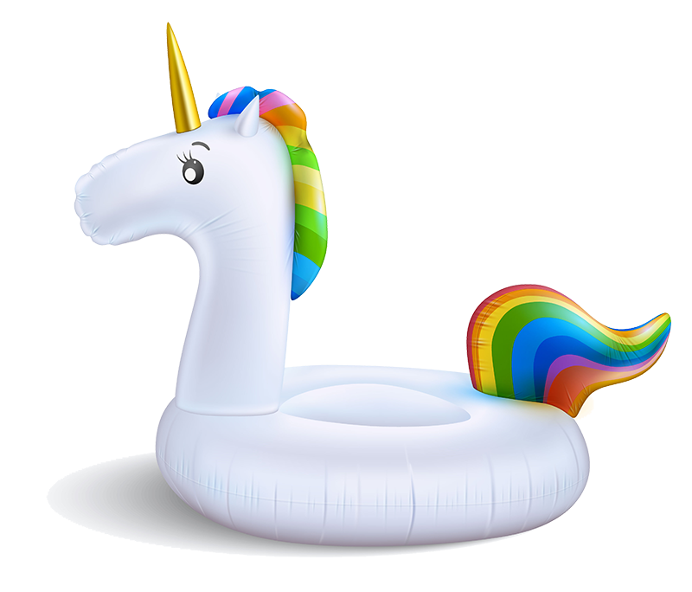
Creating oa, oe, and ow Practice
float
flowt
floet
Notes:
Say, “Today we are going to find the correct spelling of the picture. We will need to figure out if it has an oa, oe, or ow in it. Are you ready?
Click to show the picture of a float and the words. Say, “what is this a picture of?” If the student answers incorrectly tell them, it’s a float.
Say, “Which one of these words is the correct spelling of float?”
Click so that float is circled only if the student spells it correctly.
Say, “Correct, f-l-o-a-t is how you spell float. Let’s try again!”

Slide 4

Animating oa, oe, and ow Practice
hoa
how
hoe
Notes:
Click to show the picture of a hoe and the words. Say, “what is this a picture of?” If the student answers incorrectly tell them, it’s a hoe.
Say, “Which one of these words is the correct spelling of hoe?”
Click so that hoe is circled only if the student spells it correctly.
Say, “Correct, h-o-e is how you spell hoe. Let’s try again!”

Slide 5

Designing oa, oe, and ow Practice
snoa
snow
snoe
Notes:
Click to show the picture of snow and the words. Say, “what is this a picture of?” If the student answers incorrectly tell them, it’s snow.
Say, “Which one of these words is the correct spelling of snow?”
Click so that snow is circled only if the student spells it correctly.
Say, “Correct, s-n-o-w is how you spell snow.”

Slide 6
Scribbling Sight Word Review
best
draw
both
light
Notes:
Say, “Today we are going to review our sight words. When I say the sight word you tell me which color square to click.”
Only click that square if the student is correct. If the student is wrong. Say, “That is not the correct sight word. Let’s try again and repeat the sight word.
Continue until all the squares have disappeared.

Slide 7
Mixed-up Sight Word Practice
iglht
htbo
light
rwda
both
draw
tseb
best
best
both
draw
light
Notes:
Say, “Today we are going to practice unscrambling our mixed-up sight words. Do you remember our sight words? Let’s review them one more time.”
Click to show sight words. Say, “Can you read each sight word to me?” Note: Help the student with any sight words they are still struggling with.
Click to show mixed up sight word. Say, “Can you unscramble this mixed-up sight word?”
Click to show sight word best. Say, “Correct! The mixed-up word is best.” Click for word to disappear.
Click to show mixed up sight word. Say, “Can you unscramble this mixed-up sight word?”
Click to show sight word draw. Say, “Correct! The mixed-up word is draw.” Click for word to disappear.
Click to show mixed up sight word. Say, “Can you unscramble this mixed-up sight word?”
Click to show sight word both. Say, “Correct! The mixed-up word is both.” Click for word to disappear.
Click to show mixed up sight word. Say, “Can you unscramble this mixed-up sight word?”
Click to show sight word light. Say, “Correct! The mixed-up word is light.” Click for word to disappear.

Slide 8
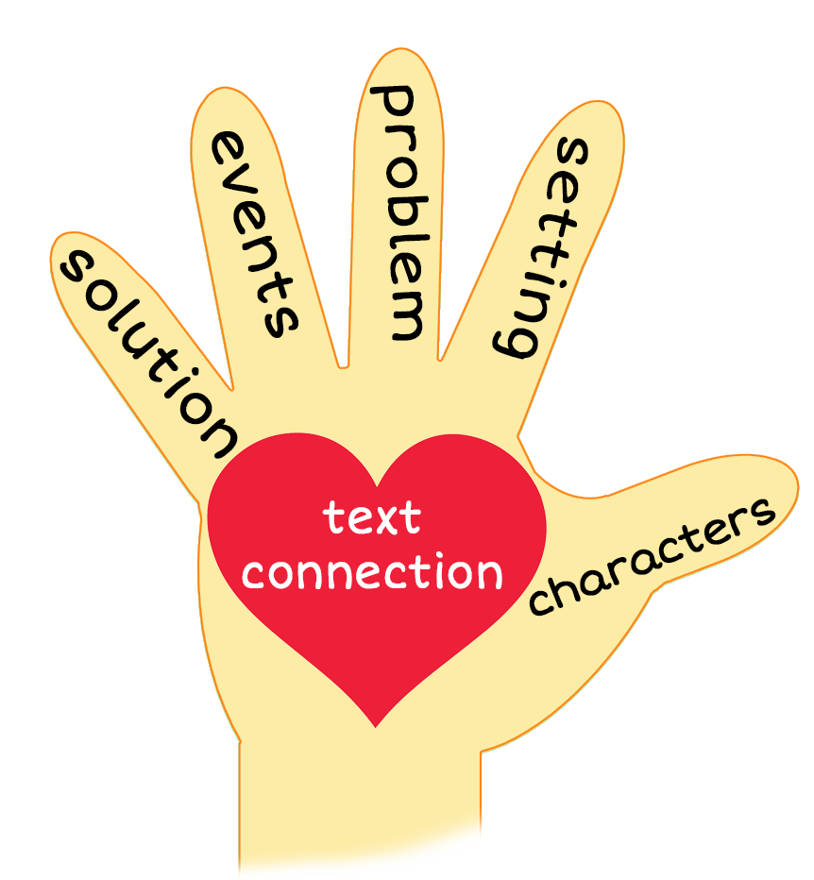
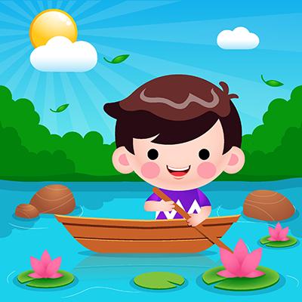
5 Finger Retell
Notes:
Click and say, “This week you read the story I Love to Draw. Using the 5 finger retell strategy, can you tell me about the story.
Say, “Hold up your thumb, tell me the characters.” (boy)
Say, “Hold up your pointer, tell me the setting.” (In a boat on the water)
Say, “Hold up your tall finger, tell me the problem.” (Because he likes to float and draw, he cannot reach the coast)
Say, “Hold up your ring finger, tell me the events.” (He floats on his boat and draws - toads, bows, arrows, crows, snow, shadows, and rainbows)
Say, “Hold up your little finger, tell me the ending/solution.” (He gets a tow and the drawings are his best yet)
Say, “Make a heart with your fingers, do you like to draw? What are some things you like to draw?”

Slide 9
Q & A
Any Questions?

