Slide 1
Library of Learning
Become a Word Wizard
Notes:
Say, “Today we are going to become a word wizard and review the ey and y sounds, sight words, and a 5 finger retell of the story “Study Daisy, Study”.

Slide 2


Word Study ey and y
y
ey
Notes:
Say, “Listen closely as I say each word with the ey or y in it. After I say the word you repeat it”
Click to show ey and picture of a monkey. Say, “ey” sound as in monkey” student repeats ey as in monkey.
Click to show y and picture of a puppy. Say, “y” sound as in puppy” student repeats y as in puppy.

Slide 3
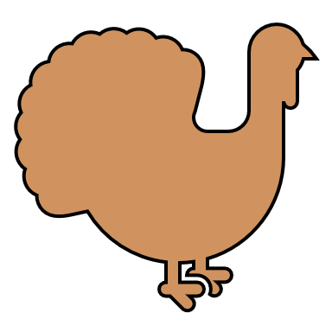
Knowledge of ey and y Practice
turk
ey
ey
y
Notes:
Click to show the picture of the turkey and the word with missing letters ey.
Say, “Look at the picture. What is this a picture of? Yes, it’s a turkey.
Do you need to add a y or an ey to the end of turkey? Correct, you add ey.” Click on the ey for it to disappear and appear in the box.

Slide 4

Scholar of ey and y Practice
stor
y
ey
y
Notes:
Click to show the picture of the storybook and the word with missing letter y.
Say, “Look at the picture. What is this a picture of? Yes, it’s a story.
Do you need to add a y or an ey to the end of story? Correct, you add y.” Click on the y for it to disappear and appear in the box.

Slide 5

School of ey and y Practice
sunn
y
ey
y
Notes:
Click to show the picture of the sun and the word with missing letter y.
Say, “Look at the picture. What is this a picture of? Yes, it’s sunny.
Do you need to add a y or an ey to the end of sunny? Correct, you add y.” Click on the y for it to disappear and appear in the box.

Slide 6

Academics of ey and y Practice
mon
ey
ey
y
Notes:
Click to show the picture of money and the word with missing letters ey.
Say, “Look at the picture. What is this a picture of? Yes, it’s money.
Do you need to add a y or an ey to the end of money? Correct, you add ey.” Click on the ey for it to disappear and appear in the box.

Slide 7
Student of Sight Words
many
very
made
use
Notes:
Say, “I’ll say the sight word and you repeat it after me.”
Click to show sight word. Say, “many” Student repeats many.
Click to show sight word. Say, “very” Student repeats very.
Click to show sight word. Say, “made” Student repeats made.
Click to show sight word. Say, “use” Student repeats use.

Slide 8
Sight Word Memory
many
very
made
use
very
use
many
made
Notes:
Say, “We are going to play sight word memory. You will tell me a color to click on and then choose another color. If they are a match, then move onto two new boxes. If they are not the same flip them back over so you can try again. Try to remember where they were so you can a match the words the next time!”
Allow the student to continue until all the sight words are matched.

Slide 9
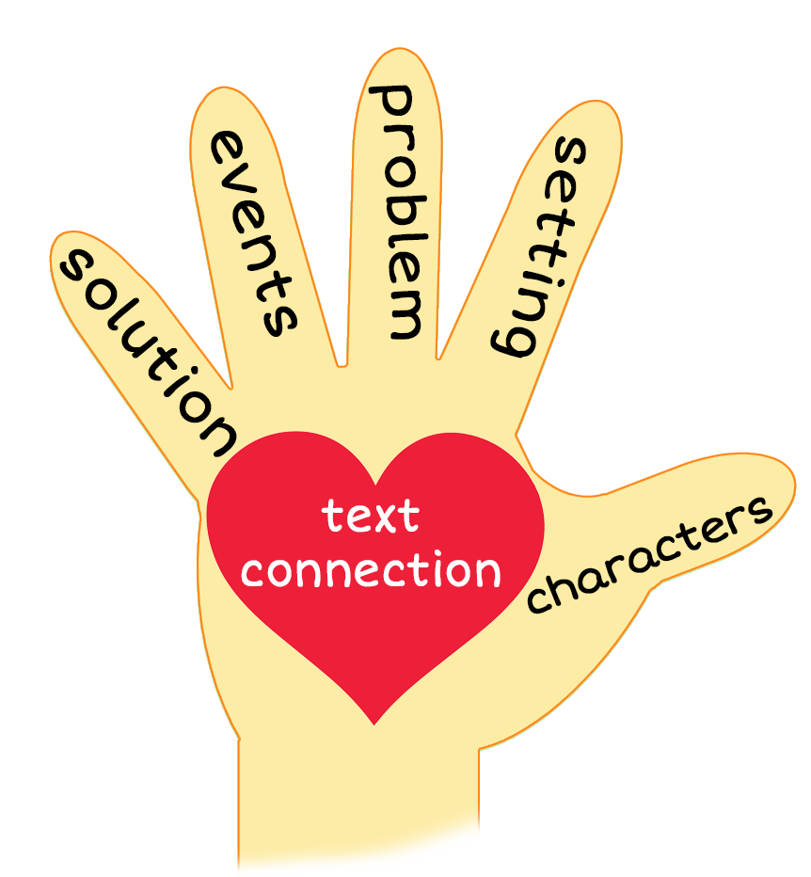
5 Finger Retell
Notes:
Say, “Look at the 5 finger retell chart. Use the chart to help you retell the story Study Daisy, Study.”
Say, “Hold up your thumb, tell me the characters.” (Daisy and her friends)
Say, “Hold up your pointer, tell me the setting.” (Outside)
Say, “Hold up your tall finger, tell me the problem.” (Daisy has a tricky test to study for.)
Say, “Hold up your ring finger, tell me the events.” (Daisy’s mom keeps making Daisy study for the test but Daisy keeps forgetting and starts playing with her friends.)
Say, “Hold up your little finger, tell me the ending/solution.” (Daisy’s friends help her study for the test.)
Say, “Make a heart with your fingers, have you ever had a tricky test to study for? Who helped you study?” (Answers will vary)

Slide 10
Q & A
Any Questions?

