Slide 1
Animal Adventures
Wild with Words
Notes:
Say, “Let’s take an animal adventure and go wild with words. We will review nk and ng sounds, our sight words, and the 5 finger retell of the story “Skunks in a Trunk”.

Slide 2


Hang Around for nk and ng Review
ng
nk
Notes:
Say, “Listen closely as I say each word with the nk or ng ending blend in it. After I say the word you repeat it”
Click to show nk and picture of a sink. Say, “nk” sound as in sink” student repeats nk as in sink.
Click to show ng and picture of a ring. Say, “ng” sound as in ring” student repeats ng as in ring.

Slide 3

What am I? nk and ng
I am black and white.
I have a stripe.
I might spray you.
skunk
Notes:
Say, “We are going to play the game, What am I? I will give you 3 clues about the object and you have to guess what it is. Remember the object will have the nk or ng ending blend in it. Are you Ready?
Click to show the first clue. Say, “I am black and white”.
Click to show the second clue. Say, “I have a stripe”.
Click to show the third clue. Say, “I might spray you”.
Say, “What am I?” Wait for student to answer. Click to show the picture and word skunk. Say, “I am a skunk!”
Let’s try again!

Slide 4
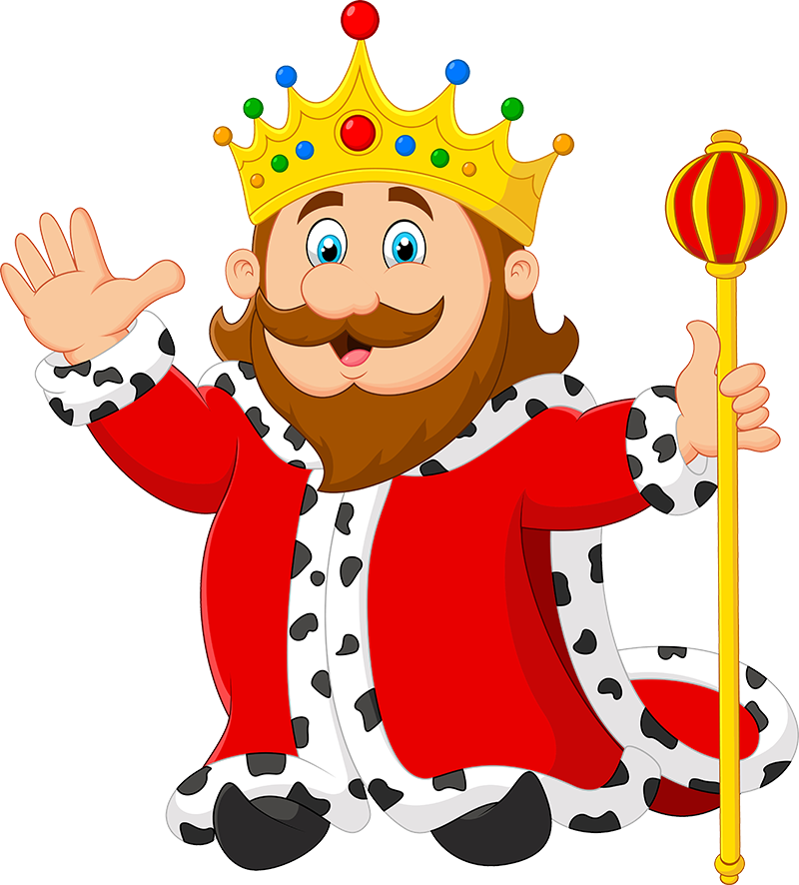
nk and ng What am I?
I wear a crown.
I rule a land.
I live in a castle.
king
Notes:
Click to show the first clue. Say, “I wear a crown”.
Click to show the second clue. Say, “I rule a land”.
Click to show the third clue. Say, “I live in a castle”.
Say, “What am I?” Wait for student to answer. Click to show the picture and word king. Say, “I am a king!”
Let’s try again!

Slide 5

What Am I? Final Try
I am at a playground.
You can sit on me.
I like to go back and forth.
swing
Notes:
Click to show the first clue. Say, “I am at a playground”.
Click to show the second clue. Say, “You can sit on me”.
Click to show the third clue. Say, “I like to go back and forth”.
Say, “What am I?” Wait for student to answer. Click to show the picture and word swing. Say, “I am a swing!”

Slide 6
Roaring Sight Word Review
its
before
ten
us
Notes:
Say, “Today we are going to review our sight words. When I say the sight word you tell me which color square to click.”
Only click that square if the student is correct. If the student is wrong. Say, “That is not the correct sight word. Let’s try again and repeat the sight word.
Continue until all the squares have disappeared.

Slide 7

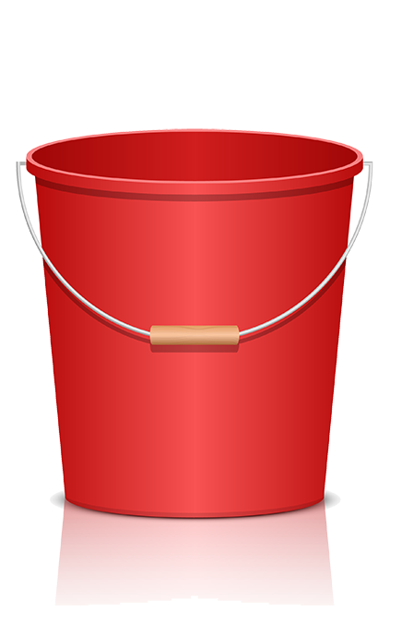
Vicious Vowels and Clever Consonants Practice
i
s
t
consonants
vowels
Notes:
Click to show the sight word and buckets.
Say, “Today we are going to practice our vowels and consonants. I will show you a sight word. Then you tell me which letters are vowels and which letters are consonants.
Say, “What sight word is this? Correct, the sight word is its.”
Say, “Is i a consonant or a vowel? Yes it is a vowel.” Click directly on the i to move it to the vowel bucket.
Say, “Is t a consonant or a vowel? Yes it is a consonant.” Click directly on the t to move it to the consonant bucket.
Say, “Is s a consonant or a vowel? Yes it is a consonant.” Click directly on the s to move it to the consonant bucket.

Slide 8
Chasing Consonants and Vowels
b
f
o
r
e
e
consonants
vowels
Notes:
Click to show the sight word and buckets.
Say, “Let’s try this word.”
Say, “What sight word is this? Correct, the sight word is before.”
Say, “Is b a consonant or a vowel? Yes it is a consonant.” Click the b to move it to the consonant bucket.
Say, “Is e a consonant or a vowel? Yes it is a vowel.” Click the e to move it to the vowel bucket.
Say, “Is f a consonant or a vowel? Yes it is a consonant.” Click the f to move it to the consonant bucket.
Say, “Is o a consonant or a vowel? Yes it is a vowel.” Click the o to move it to the vowel bucket.
Say, “Is r a consonant or a vowel? Yes it is a consonant.” Click the r to move it to the consonant bucket.
Say, “Is e a consonant or a vowel? Yes it is a vowel.” Click the e to move it to the vowel bucket.

Slide 9
Flying High with Consonants and Vowels
e
n
t
consonants
vowels
Notes:
Click to show the sight word and buckets.
Say, “Let’s try this word.”
Say, “What sight word is this? Correct, the sight word is ten.”
Say, “Is t a consonant or a vowel? Yes it is a consonant.” Click the t to move it to the consonant bucket.
Say, “Is e a consonant or a vowel? Yes it is a vowel.” Click the e to move it to the vowel bucket.
Say, “Is n a consonant or a vowel? Yes it is a consonant.” Click the n to move it to the consonant bucket.

Slide 10
Galloping with Consonants and Vowels
u
s
consonants
vowels
Notes:
Click to show the sight word and buckets.
Say, “Let’s try this word.”
Say, “What sight word is this? Correct, the sight word is its.”
Say, “Is i a consonant or a vowel? Yes it is a vowel.” Click the i to move it to the vowel bucket.
Say, “Is t a consonant or a vowel? Yes it is a consonant.” Click the t to move it to the consonant bucket.
Say, “Is s a consonant or a vowel? Yes it is a consonant.” Click the s to move it to the consonant bucket.

Slide 11
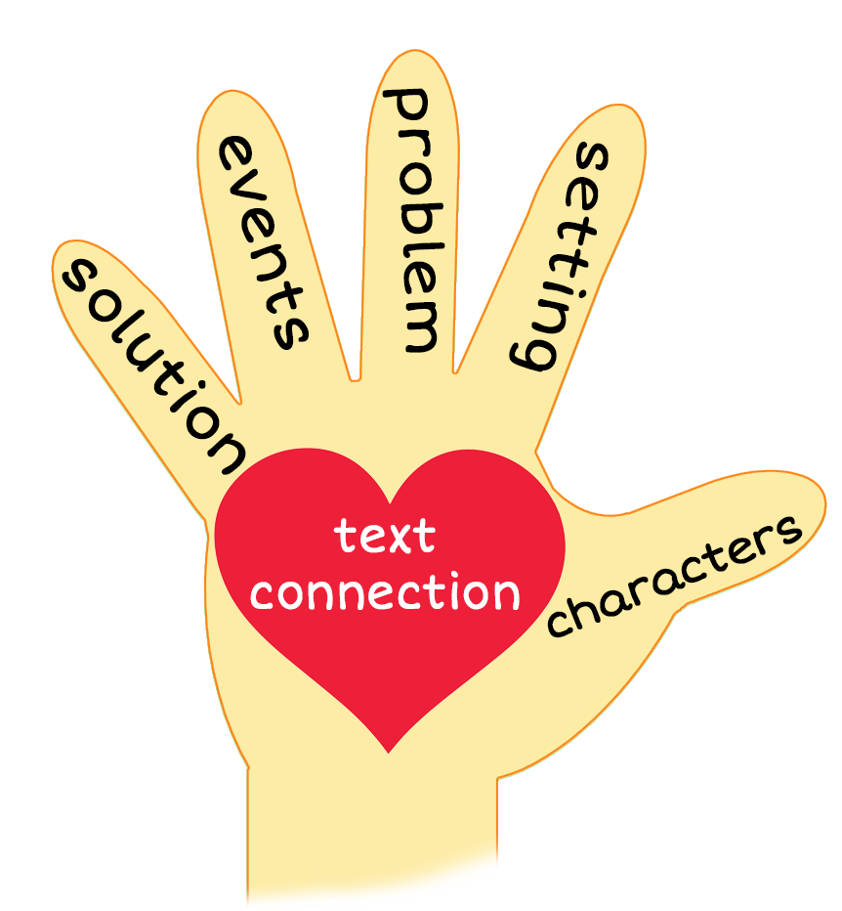


5 Finger Retell
Notes:
Click and say, “Look at the 5 finger retell chart. Use the chart to help you retell the story Skunks in a Trunk.”
Say, “Hold up your thumb, tell me the characters.” (Frank and Hank)
Say, “Hold up your pointer, tell me the setting.” (Frank’s house)
Say, “Hold up your tall finger, tell me the problem.” (Found a trunk filled with ten skunks that they hope won’t spray them)
Say, “Hold up your ring finger, tell me the events.” (One skunk winked at them, another did a swing by its tail, another played ping pong with them, and another dunked a basketball)
Say, “Hold up your little finger, tell me the ending/solution.” (None of the skunks sprayed them but all of them sang to them)
Say, “Make a heart with your fingers, does this story remind you of anything from your own life?” (Answers will vary)

Slide 12
Q & A
Any Questions?

